Slide 1
A Focus on Functional Child Outcomes
Kathi Gillaspy, NECTAC

Slide 2
Functional
IFSP Outcomes and
IEP Goals

Slide 3
Using information to Develop Outcomes/Goals
Start with parent’s/caregiver’s priorities about child’s learning/development and/or family’s needs (hopes for their child and/or family’s participation), not the interventionists’/teachers’ priorities
Consider what’s working in everyday routines and activities
Notes:
Steps to writing a good functional outcome:
Read the slide ☺

Slide 4
IFSP Outcomes
IFSP outcomes: What would your family like to see happen for your child/family?
2 types of outcomes
Child Outcomes
Family Outcomes (participation-based or resource based)
Notes:
Child Outcomes should:
Enhance child’s learning through functional participation in everyday activities (child is learner/actor)
Be important and meaningful to family/caregiver (priorities)
Expand activity settings in which child can be competent
Be based on child’s interests
Often, child-focused, participation-based IFSP outcome statements focus on child interests and assets that provide opportunities for learning and development within context. Other times, IFSP outcome statements focus on routines and activities that parents want or need to go more smoothly, such as mealtimes or bedtime routines.
Family Outcomes should:
Enhance the capacity of the family to meet the needs of their child (family is learner/actor)
Support accessing community resources and supports (FRC supported)
Be important and meaningful to family/caregiver (priorities)
Be based on family’s interests
Two types of family outcomes – participation-based or resource based outcomes
An example of a participation-based, family-focused outcome is: Frank and Tamara will use signs to offer Dawn snack choices from within her favorite foods by the end of the month
What are resource-based, family-focused outcomes that can be written on an IFSP? Anything that the family identifies can qualify as a resource-based outcome. Here are some examples: Jeri will find child care for her son within 25 miles of her new job.

Slide 5
Developing Outcomes
Step 1: Determine the functional area(s) | Eating and chewing
Step 2: What routine(s) does this affect? | Meal time (e.g., lunch, dinner, restaurant )
Step 3: Child will participate in (routines in question)” | “Alicia will participate in lunch, dinner, and restaurant . . .”
Step 4: “ by ---ing” (address specific behaviors) | “ . . . chewing her food”
Notes:
Consider these 4 steps.
Robin McW model – reference at the end.

Slide 6
Child Outcomes
What Parent States:
“We want to Romeo to be able to sit up by himself – it’s so hard to play on the floor and to help him when he eats!”

Slide 7
Child Outcomes: Examples
This
"Romeo will play with toys and eat meals with his family by sitting without much support”
Not This
“Romeo will improve muscle tone for sitting"
Notes:
Using Robin’s mechanism, here’s an example of a child outcome.

Slide 8
Family Outcomes
What Parent States:
“We want to be able to take
Romeo with us in the car; we need a
travel car seat ”

Slide 9
Family Outcomes: Examples
This
“Karen and Mark will learn about resources and low cost options so they can obtain a car seat.”
Not This
“Staff will explore options for financial assistance for travel chairs”

Slide 10
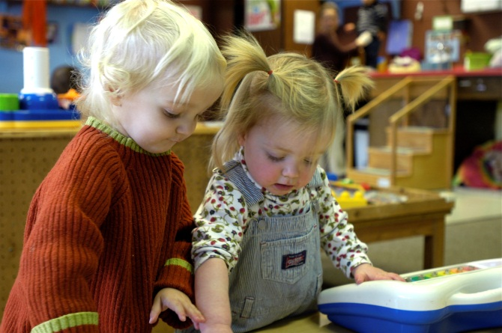
Meaningful
IFSP outcomes & IEP goals
3 global child outcomes
Functional Assessment
Activity:
Rating IFSP Outcomes

Slide 11
Criteria for Rating IFSP Outcomes
The outcome statement is necessary and functional for the child’s and family’s life.
The wording of the statement is jargon-free, clear and simple.
The statement reflects real-life contextualized settings (e.g., not test items).
The statement avoids the use of passive words (e.g., tolerate, receive, improve, maintain).
The outcome is discipline-free.
The wording emphasizes the positive.
When the child’s contextual information is available, the following IFSP outcome criteria can also be evaluated:
The outcome is based on the family’s priorities and concerns.
The outcome describes both the child’s strengths and needs based on information from the initial evaluation or ongoing assessment.
Notes:
Through literature review of what makes for a good IFSP goal, these six criteria indicate what constitutes a good IFSP outcome.
Review each criteria and make note of the ones on the bottom.

Slide 12
Criteria for Rating IFSP Outcomes
The outcome statement is necessary and functional for the child’s and family’s life.
The wording of the statement is jargon-free, clear and simple.
Nolan will play with
toys with his sister
during bath time
The statement reflects real-life contextualized settings (e.g., not test items).
+ YES!
The statement avoids the use of passive words (e.g., tolerate, receive, improve, maintain).
The wording emphasizes the positive.
The outcome is discipline-free.
When the child’s contextual information is available, the following IFSP outcome criteria can also be evaluated:
The outcome is based on the family’s priorities and concerns.
The outcome describes both the child’s strengths and needs based on information from the initial evaluation or ongoing assessment.
Notes:
Let’s look at how we can rate the outcome that we developed for Nolan earlier.
Introduce the activity. Will have a set of cards and a placemat.
Put card in the middle and draw a grid on it like this example. Go through each criteria and mark (use example).
Go through all the outcome statements and talk as a team (split up somehow). Separate into “good” and “bad” outcome statements; any that have questions about, set aside.
Debrief: Are there any that stumped you? What was the sticking point? What do others think?
Was this helpful?

Slide 13
Resources for Writing Outcomes and Goals
Rush and Shelden. Tips and Techniques for Developing Participation-Based IFSP Outcomes Statements, BriefCASE, Vol 2, No. 1 http://www.fippcase.org/briefcase/briefcase_vol2_no1.pdf

Slide 14
Making the Connection
Functional child outcomes are written to support the child’s successful participation in everyday experiences and activities.
The 3 global child outcomes reflect functional, meaningful behaviors and skills of young children.
Notes:
It should be easy to see the connection between what we measure for all children to see if we are meeting our mission for early intervention (successful participation) and what we do for each child individually (successful participation).
Child outcomes, while they do not specifically need to relate to one or more of the global child outcomes, will likely relate back to the functional child outcomes.
Nolan – social, language, skill development (playing with toys)
Romeo – eating – getting needs met; playing – skill development.
If think about it, if cannot connect the outcome you’ve written back to one of the 3 outcomes, chances are it is not functional for the child.
Go back to the “good goals” and connect with the 3 outcomes. Look at “bad” outcomes – do they see the disconnect?

Slide 15
Putting it All Together
There is a connection between quality practices and the global child and family outcomes.
The key to making the connection is focusing on the functionality of the information
Notes:
There is a connection between the quality practices, the outcomes AND the overall mission and principles.
The gathering and using of functional, meaningful information is the key to making the connection.

Slide 16
Contact Information
Kathi Gillaspy, NECTAC
kathi.gillaspy@unc.edu
919.843.5950

