Slide 1
Understanding Age Expectations
Kathi Gillaspy, NECTAC
Sharon Ringwalt, NECTAC/MSRRC

Slide 2
Session Agenda
Remembering your knowledge of typical child development
Using your knowledge of typical child development
Organizing your knowledge of typical child development
Putting it in action - Kim’s case study
Putting it all together
Notes:
The objectives of this session are to help you make the connection between what you know about the typical child development and putting to use to help you in the process of completing the child outcomes measurement process. Already today you have attended a session that gave you an overview of the 7 point scale, which is anchored in the concepts of age-expected development. In order to make that a truly effective process, it is essential to be able to apply what we know about child development to what we are seeing in individual children. Today’s session will:
Review resources that are available to help you anchor your thinking in typical child development
Help you use that knowledge by thinking about what happens when, and in what order – essentially defining skills that are age-expected, those that come immediately before age expected, and those that are foundational.
Help you organize the information you know so that you can apply it in observation, and
Help you apply the information to a child from various sources, identifying her skills that fall in each category

Slide 3
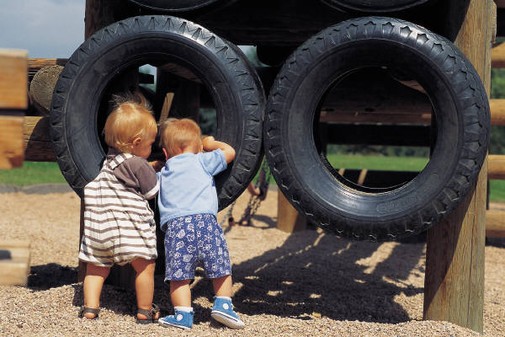
Remembering Your Knowledge of Typical Child Development

Slide 4
Know and use your resources!
Maryland Healthy Beginnings & Crosswalk
Notes:
The first resource you have in your packet is your full crosswalk between the Healthy Beginnings document and the three outcome areas.
[Flip through a few pages, describe how the document can be used as a resource]

Slide 5
Know and use your resources!
Virginia Infant/Toddler Development by Age and Early Childhood Outcomes
Notes:
This document in your packet can also be helpful – many states are creating this kind of document in which their resources about typical child development are organized by the three outcomes.

Slide 6
Resources for understanding age-expected child development
Website list: http://www.fpg.unc.edu/~eco/assets/pdfs/Age-expected_Resources.pdf
CDC milestone lists by age: http://www.cdc.gov/ncbddd/actearly/milestones/index.html
MEISR-COSF – routines by outcomes with approximate age levels
ND state compiled milestone lists in each outcome area by age
Notes:
Several other resources for child development
On ECO Website
CDC lists on website
MEISER-COSF – created by Naomi
Other state examples – ND (can be found on the ECO website as well)

Slide 7
Using Age-Expected Resources
Look for items that are similar to the skills the child has demonstrated – they won’t be exact
Use more than one resource
If in doubt, get information about the child’s functioning that is more descriptive
He’s happy.
What is he doing that makes you say he’s happy?
She plays well with toys.
What does she do with toys?
Notes:
Be aware that there are challenges with using age expected resources
They usually provide age ranges
They don’t all agree
Even children developing according to age expectation show variations in development.
Ideas for addressing the challenges (slide)

Slide 8
Before, During and After
Use the resources to refresh your understanding of child development for the age of each child you see at each step in the IFSP process, including:
Intake
Evaluation and Assessment
COS Rating
Intervention
Exit
Notes:
Use the resources to refresh your understanding of child development at that age. IF going to see a 18 month old child, review the skills expected at 18 months, as well as the range (15- 21 months) before you see the child, keep it in mind when you are with the child, and reflect on it afterwards. If you go in with that anchor, you will have begun to develop the frame of thinking of child development in terms of age-expected, immediate foundational and foundational skills.

Slide 9
At what age does a child…?
At wake up, child raises arms to be picked up
At breakfast child holds own bottle propped
At dressing child helps by extending arms/legs for shirt/pants
In play child entertains self with a single toy for a bit longer (2-3 minutes)
In play child names familiar objects (car, ball…)
At home child walks about without support to play and explore
In play child combines related objects in play (spoon-cup, stick-drum)
Child has a vocabulary of 1-3 words
At child care, child interacts with peers using gestures (e.g. push, pull, grab, aggressive with an occasional pat or toy offering)
Notes:
5-6 months
4-6 months
10-12 months
6-9 months
13-19 months
13-15 months
9-12 months
12-15 months
18-24 months
Just an exercise – as you went through, I’m sure that you’ll be validated that you already know a lot about child development – you may also find that it’s good to check with others and check resources.
It is not expected that everyone be able to say exactly when each skill a child demonstrates comes in developmentally; we will all have our own knowledge base especially in our area of focus. But we do need to all know the resources available for anchoring children’s skills by age. It’s important to not guess, but use the resources available, including each other.

Slide 10
Developmental Progression
Children typically follow a predictable developmental pattern
Think about development in terms of the progression of skills: Head control – sitting – crawling – standing – walking
Remember that not all children follow the same pattern – and that’s ok!
Notes:
We know what the typical pattern is so that alerts us to when the pattern IS NOT typical. Some skills are atypcial and don’t have an age anchor because they are not a part of the typical child development pattern.
It’s important for us to be able to put development into a progression, knowing what skills must come before others in the pattern. Some may get skipped (i.e. crawling) but there are others that we don’t want to see skipped because they are foundational to the ability to develop future skills.
Remember too that some foundational skills stay once the children develop them (i.e. eye contact) while others fade in favor of more sophisticated skills (i.e. crawling)

Slide 11
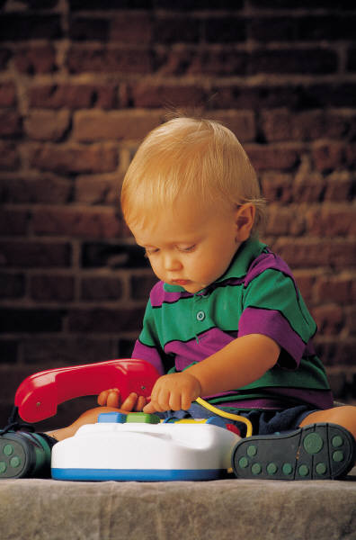
Developmental Progression
Looking at skills in this progression is KEY to understanding where a child is on the continuum of age-expected (AE), to immediate foundational (IF), to foundational (F) skills.

Slide 12
Developmental Progression
Outcome 1 – Play with others
Participates in coordinated play with others
Reaches out to other children – touches, pats, may hit or pull hair
Participates in play with other children doing similar activities for a short time
Looks at other children play
Imitates other children pretending
5
2
4
1
3
Notes:
Look at this sample progression associated with Outcome 1 – positive social and emotional skills (playing with others).
Use the numbers 1-5 to order these steps from the first to the last skill developed.
[Mouse click will bring right hand column up]
= 5, 30-36 months
=2, 12 -18
=4, 24 – 30
=1, 4-8 and builds through 8-12 with increased interest
=3, 18-24 months

Slide 13
Developmental Progression
Outcome 2 – Learning about toys in play
Engaging in pretend play with toys and materials
Shows understanding of the aspects of toys – color awareness, matching
Experiments with banging, dropping and repeating actions on toys
Using a variety of toys in intended manner
Mouthing toys in exploration
5
4
2
3
1
Notes:
Look at this sample progression associated with Outcome 2 – Acquiring and using knowledge and skills.
Use the numbers 1-5 to order these steps from the first to the last skill developed.
[Mouse click will bring right hand column up]
= 5, 24-30 months
=4, 18 – 24
=2, 8-12 months early
=3, 12-18
=1, 0-4, 4-8

Slide 14
Developmental Progression
Outcome 3 – Self-care (dressing, undressing, eating, toileting)
Eat thick food with spoon, spilling often
Feed self with spoon all the time with limited spilling
Pick up spoon by handle
Use spoon successfully most of the time, still spills some
Use fork one handed
2
4
1
3
5
Notes:
Look at this sample progression associated with Outcome 3 – self-care (feeding)
Use the numbers 1-5 to order these steps from the first to the last skill developed.
[Mouse click will bring right hand column up]
= 2, 12-18
4, 24-30
1, 8-12
3, 18-24
5, 30-36

Slide 15
Defining Age-Expected (AE), Immediate Foundational (IF) and Foundational (F)
Age-Expected (AE):
Immediate Foundational (IF):
Foundational (F):
The skills and behaviors demonstrated when one would expect for a child his/her age
The skills and behaviors that come just before the age-expected skills and behaviors
The skills that are farther away from age-expected skills and behaviors (either much earlier or atypical skills and behaviors)
Notes:
Read through definitions – refer back to developmental progression.
Look deeper into IF and F: next slide

Slide 16
Immediate foundational skills
The set of skills and behavior that occur developmentally just prior to age-expected functioning
Are the basis on which to build age-expected functioning
Functioning looks like a younger child
Notes:
Key concepts with IF:
Just before what is age expected
Children demonstrating IF skills will look like a child younger than their chronological age.

Slide 17
What are foundational skills?
Foundational skills are….
Skills and behaviors that occur earlier in development and serve as the foundation for later skill development
Functioning like a MUCH younger child
Notes:
Key concepts with F:
Foundation for later skill development
Children demonstrating F skills will look like a child MUCH younger than their chronological age.
Consider this example: Justin is 24 months old. He uses a spoon, but often spills the food before it gets to his mouth. Without his mom’s help, he wouldn’t get much to eat at meal time.
Think about developmental progression and skills expected of a 2 year old.
A child who is 2 should be able to meet his feeding needs without much help, using various kinds of tools, including his fingers.
The younger child experiments with tool use, but with limited success.
The much younger child participates in feeding by opening his mouth, but doesn't not attempt to feed himself.
Do you think the description of Justin is AE, IF or F? Answer: IF

Slide 18
Activity
Notes:
In your packets you’ll find this activity.
30 month old child
Remember developmental progression!
Take about 5-7 minutes to do this. Each set of three has a set of skills, one of which is AE, one is IF and the other F. Mark which one is which, then move on to the next section.
Review as a group, pass out answer key after activity.
Debrief – was this hard? Why? What will you need to get more efficient at looking at skills this way?

Slide 19
Honing in on what’s age-expected
What is expected for a 12 month old child?
Interacting with adults
Playing and talking
Getting around
Notes:
Hopefully the previous exercise highlighted the importance of knowing typical child development.
Take a moment to really hone in on what is age expected – if know that, can determine the others.
12 months old – group brainstorm – write on flip charts for each area. Have participants call out skills in each area. Use the following to prompt:
Interacting with Adults
Ventures out when trusted adult is nearby
Enjoys imitating people in play
Repeats sounds and gestures for attention
Playing and talking
Learns some simple words and phrases
Uses inflection when babbling
Says mama/dada
Holds object in one hand to something to it with the other hand
Explores objects in many different ways, begins to use objects correctly
Getting around
Walks more than crawls
Goes from sitting to standing more easily
Carries toys while walking

Slide 20
Tyler at 12 months old
Notes:
What do we think of Tyler’s skills? AE?? (YES)

Slide 21
Putting it into Action - Kim
Notes:
Kim case study – information from different sources (medical, eval/assessment, parent report)
Small groups
Read the information – use highlighters to mark information
Green – AE
Yellow – IF
Pink – F
Use the resources!
Report out – write on flips (one for each outcome, marked AE/IF/F)
Consensus?
Did you have enough information to get a sense of where Kim’s skills are falling
What else would you want to know or observe in order to feel like you have a good picture of Kim’s skills?

Slide 22
Putting it all together
Keep a focus on functionality and the quality of skills
Remember that children’s skills don’t come at exact ages
Give credit for accommodations, but don’t adjust for prematurity
Remember that culture plays a part in what is age-expected
Notes:
Functionality and quality: don’t get overly focused so that miss functionality of skills.
Pay attention to the quality of a skill and how the child uses it functionally
Consultation is key for dealing with variations in development – team discussions, use resources! Observe typical children – many of us have forgotten b/c of many years of working with children with special needs!
If children use AT to be demonstrate age expected skills, that is ok and can be accounted for. Prematurity does not.
As you know from working with families of different cultures, expectations for development may vary -- especially with regard to independence and self care skills. It’s important for the team to learn from the family about their culture’s expectations for their child’s development and learning. If a child’s skills are not at the same level as same age peers of our mainstream culture, it may be that there is a different expectation within that child’s culture. Teams must be aware and sensitive to these differences. The rating is to reflect age expected functioning within the child’s culture-- so the team needs to understand those expectations.

Slide 23
Questions?

Slide 24
Contact Information
Kathi Gillaspy, NECTAC
kathi.gillaspy@unc.edu
919.843.5950
Sharon Ringwalt, NECTAC/MSRRC
sharon.ringwalt@unc.edu
919.843.2275

