Slide 1
Early Childhood Outcomes
ECO Institute – Day 2: Data Workshop
Kathy Hebbeler, ECO at SRI
Robin Rooney ECO at FPG
Prepared for the Office of Early Learning and School Readiness
Ohio Department of Education
May 2010

Slide 2
Day 2 Agenda
Killer questions
Preparing data analysis
    Going from the questions to the analysis
Practice working with the data
Understanding the numbers
Messaging: Talking about your data

Slide 3
Finding the Killer Questions

Slide 4
Continuous Program Improvement
Reflect
Are we where we want to be?
Check
(Collect and analyze data)
Plan (vision)
Program characteristics
Child and family outcomes
Implement
Notes:
Vision – so important. Logically impossible to check to see if the system is where it should be if the leadership has no sense of where it should be.
Start with a plan or vision of what the service system should be and what it should accomplish.
Vision can be expansive – what we want for all children and families in our state
Vision can be more constrained – what we want for children and families in early intervention
Vision can be driven by outside forces – extent of our vision for early intervention is to be in compliance.
All of you entered systems that were already implemented which means some articulated or unarticulated vision (not yours) was in place.
This is a cycle – means it was already operating but it also means it is never too late to articulate the vision is in place or expand it.
You will find it very difficult to analyze data for program improvement if there is not a sense of what the programs are supposed to look like and what they are supposed to be achieving.

Slide 5
Continuous Program Improvement
Reflect
Are we where we want to be?
Is there a problem?
Is it working?
Why is it happening?
Check
(Collect and analyze data)
What should be done?
Plan (vision)
Program characteristics
Child and family outcomes
Implement
Is it being done?
Notes:
Vision – so important. Logically impossible to check to see if the system is where it should be if the leadership has no sense of where it should be.
Start with a plan or vision of what the service system should be and what it should accomplish.
Vision can be expansive – what we want for all children and families in our state
Vision can be more constrained – what we want for children and families in early intervention
Vision can be driven by outside forces – extent of our vision for early intervention is to be in compliance.
All of you entered systems that were already implemented which means some articulated or unarticulated vision (not yours) was in place.
This is a cycle – means it was already operating but it also means it is never too late to articulate the vision is in place or expand it.
You will find it very difficult to analyze data for program improvement if there is not a sense of what the programs are supposed to look like and what they are supposed to be achieving.

Slide 6
Starting with a question (or two..)
All analyses are driven by questions
Several ways to word the same question
Some ways are more “precise” than others
Questions come from different sources
Different versions of the same question are necessary and appropriate for different audiences.

Slide 7
Question sources
Internal – Program directors, principal
External –
  The school board
  The governor, the legislature
  Advocates
  Families of children with disabilities
  General public
  OSEP
External sources may not have a clear sense of what they want to know

Slide 8
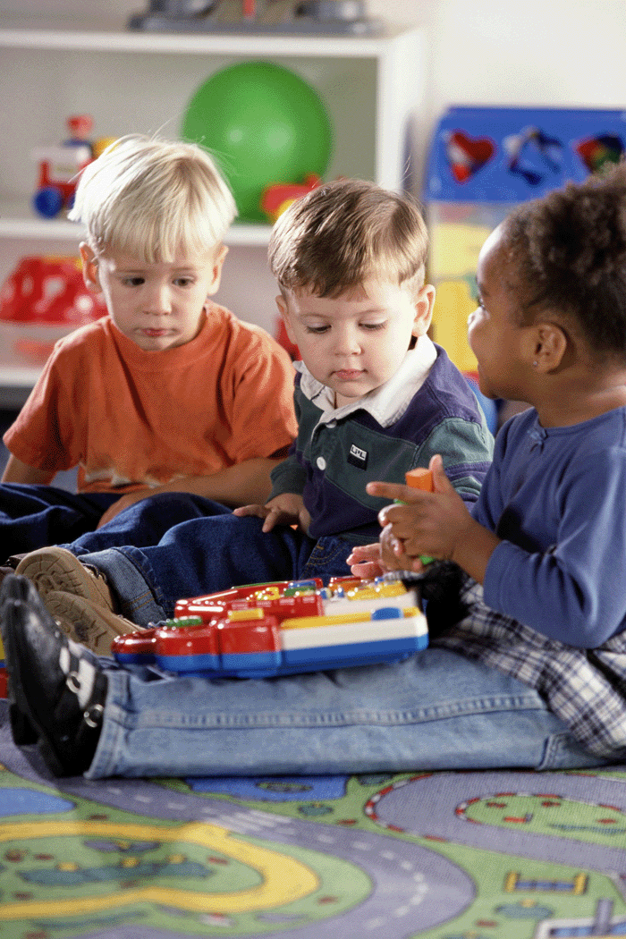
A possible question
Is our early childhood special education program effective?
Notes:
Now the program improvement implications are embedded in the question – note if the answer is an unequivocal yes, then you don’t need to improve effectiveness.
If the answer is yes, is there no room for improvement in your system. (what about child find – effective for the children you are serving but what about the ones not getting in? Are programs efficient? Is the state spending a lot more money than it needs to obtain good results?)

Slide 9
Areas for Program Improvement
WHO
SERVICES
OUTCOMES
QUALITY
COST
9
Notes:
9

Slide 10
Possible basic questions
Who is being served?
What services are provided?
How much services is provided?
Which professionals provide services?
What is the quality of the services provided?
What outcomes do children achieve?

Slide 11
Sample questions that cut across components
How do outcomes relate to services?
Who receives which services?
Who receives the most services?
Which services are high quality?
Which children receive high cost services?
Notes:
These are questions about relationships

Slide 12
Making comparisons
How do outcomes for 2008 compare to outcomes for 2009?
In which classrooms are children experiencing the best outcomes?
Which children have the best outcomes?
How do children who receive speech therapy compare to those who do not?

Slide 13
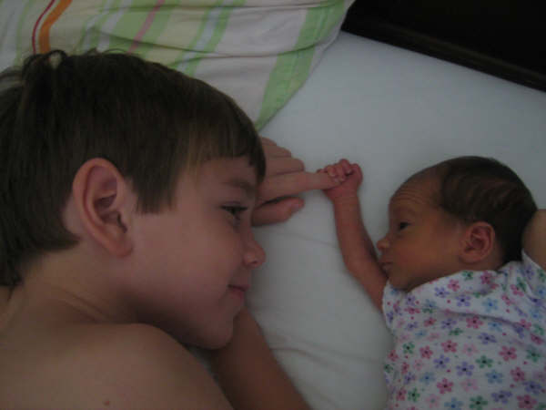
Making comparisons
Disability groups
Schools
Program type
Household income
Age
Length of time in program
Comparing Group 1 to Group 2
to Group 3, etc.

Slide 14
Question Clarification
External sources may not have a clear sense of what they want to know
  You need to clarify with them or for them
More liberty to pursue alternative questions when the questions are completely internal

Slide 15
Activity 1: Killer Questions
Imagine you are a local coordinator for ECSE. A major foundation in your state has announced they will be giving your district a large grant to improve services in the district. What are the 5 top questions you want answered to be able to plan this new program improvement effort?

Slide 16
Conclusion
Data analysis is always driven by questions.
What do you want to know?
What are others likely to want to know?
Write down your questions.

Slide 17
Talking to Your [Data] Analyst

Slide 19
General Research (aka the Superintendent’s) Question
    Versus
Analytic Question
  Well specified

Slide 20
Question precision
A research question is completely precise when the data elements and the analyses have been specified.
Are programs serving young children with disabilities effective?
(version 1)
Notes:
Is this a precise question? Does the fact that it is not precise mean it is a bad question? No, it is a great question. But you can’t handle this question to your programmer and say give me the data. There is a fair amount of specification that needs to be done to be able to answer this question.

Slide 21
Question precision
Of the children who exited the program between July 1, 2008 and June 30, 2009 and had been in program at least 6 months and were not typically developing in outcome 1, what percent gained at least one score point between entry and exit score on outcome 1?
(version 2)
Notes:
Does anybody recognize this question?

Slide 22
Finding the right level of precision
Who is the audience?
What is the purpose?
Different levels of precision for different purposes
BUT THEY CAN BE VERSIONS OF THE SAME QUESTION

Slide 23
Identifying Data Elements
Who is to be included in the analysis?
  Exit between July 1, 2008 and June 30, 2009
  In program at least 6 months (exit date minus entry date)
  Not typically developing at entry (hmm….)
What about them?
  Entry score outcome 1
  Exit score outcome 1
Do we need to manipulate the data?
  Gain = Exit score minus entry score
Notes:
Need to define effectiveness. This is your call. Make it reasonable. What about all children who made progress as a definition of effectiveness?

Slide 24

Variables/Data Elements
ID
Year of Birth
Date of entry
Gender
Score on Outcome 2 at entry

Slide 25
Outcomes Questions
Status
  Where are children at a point in time?
    Need a standard to make this meaningful
    OSEP indicators use compared to same aged peers / age expectations
  Usually the way we think about kindergarten readiness
Progress
  Change over time
  Requires two measurements (e.g., fall, spring)

Slide 26
Many options…
How do exit scores compare to entry scores?
  Compare average score at entry and exit
  Compare two frequency distributions of scores
  Compare % who were rated typical
Need to decide what you want
May need to be able to communicate it to someone else.

Slide 27
Activity 2: Data Elements
How many children are male?
How many children ever received speech therapy?
How many children were given a 6 or 7 on the COSF at entry?
How many children received a 6 or 7 on outcome 1 at entry and a 6 or 7 on outcome 1 at exit?
How many children were in the program at least 6 months?
Did children who received occupational therapy have higher Outcome 3 COSF ratings at exit than children who did not?
Did children who received speech therapy make greater gains on Outcome 2 COSF ratings than children who did not?

Slide 28
Discussion
Do children make greater gains when they are served in inclusive programs?
  What data elements do you need to answer this question?
Notes:
Gains in what – COSF ratings, GGG, Ages and Stages

Slide 29
Working with Table Shells

Slide 30
Terminology
Frequency (count, percentage)
  16 boys, 62%
  10 girls, 38%
Cross-tabulation (data element by data element)
  12 boys with Communication Delays, 4 Other
  5 girls with Communication Delays, 5 Other
Average or Mean
  Average age at entry = 17 months
Notes:
Do you need a frequency, an average,

Slide 31

Next decisions
Tables and Graphs - How do you want your data displayed?
What is the display that will address your question?

Slide 32
Frequency Table
Used for data with categories (e.g., disability, primary language, school)
Show the number and percent of each category.
May or may not want to show missing data depending on amount and intended use.
If there is a lot of missing data, your frequencies might be mis-leading (i.e., not representative).
Notes:
Not numerical data like days in program.

Slide 33
Example of a Frequency Table
Ages of Children Enrolled at Happy Valley Preschool
Age | Number | Percent
Three | 34 | 43
Four | 45 | 57
Total | 79 | 100

Slide 34
Frequencies and Missing Data
Education Level of Mothers of Children
at Happy Valley Preschool
Education Level | Number | Percent
Less than high school | 12 | 15
High school | 16 | 20
Some College | 15 | 19
Missing | 36 | 46
Total | 79 | 100
Notes:
When to show missing data. Should you even present this table?

Slide 35
One More Example of a
Frequency Table
See Day 1, Handout 8

Slide 36
Cross-tabulations
Tables that show two variables crossed with one another
  Gender and race/ethnicity
  Disability and age
  Program and disability
Number of cells determined by number of values
  Gender (2) by race/ethnicity (5) = 10

Slide 37
Example: Categorical Data
Preschool Program by OSEP Category
5 Preschool Programs by 5 OSEP Categories = 25 cells (not counting cells for totals)

Slide 38
 | OSEP Progress Categories for Outcome 1
Program | a | b | c | d | e | Row total
Children’s Corner | 1 | 1 | 3 | 1 | 8 | 14
Elite Care | 1 | 6 | 2 | 2 | 6 | 17
Ms Mary’s | 1 | 3 | 3 | 11 | 13 | 31
New Horizons | 0 | 1 | 4 | 2 | 3 | 10
Oglethorpe | 0 | 2 | 3 | 2 | 10 | 17
Column total | 3 | 13 | 15 | 18 | 40 | 89

Slide 39
Analyzing categorical data
Row percentages –percentages computed with the Row total as the denominator
# of children in Elite Care in Category “b”
Total number of children in Elite Care
What does this tell us?
Notes:
6/17 = 35% of the children in Elite Care were in category b
39

Slide 40
Analyzing categorical data
Column percentages –percentages computed with the Column total as the denominator
# of children in Elite Care in Category “b”
Total number of children in Category “b”
What does this tell us?
Which percents (row or column) would you display for this table?
Notes:
6/13 = 46%
Row percents…note lots of the kids in category e are from Ms. Mary’s but Ms. Mary’s has more kids than the other programs.

Slide 41
Discussion
Three years ago, Ms Mary implemented a state of the art social skills intervention for all the classrooms in her program. She wants to see if this intervention was effective. As a preliminary analysis she wants to compare the percent of children in category D for OSEP outcome 1 between her program and other similar programs. Using the data we just saw, should she use row or column percents?

Slide 42
 | OSEP Progress Categories for Outcome 1
Program | a | b | c | d | e | Row total
Children’s Corner | 1 | 1 | 3 | 1 | 8 | 14
Elite Care | 1 | 6 | 2 | 2 | 6 | 17
Ms Mary’s | 1 | 3 | 3 | 11 | 13 | 31
New Horizons | 0 | 1 | 4 | 2 | 3 | 10
Oglethorpe | 0 | 2 | 3 | 2 | 10 | 17
Column total | 3 | 13 | 15 | 18 | 40 | 89

Slide 43
 | Progress Categories OSEP 1
Program | a | b | c | d | e | Row percent totals
Children’s Corner | 33% | 8% | 20% | 6% | 20% | 16%
Elite Care | 33% | 46% | 13% | 11% | 15% | 19%
Ms Mary’s | 33% | 23% | 20% | 61% | 33% | 35%
New Horizons | 0% | 8% | 27% | 11% | 8% | 11%
Oglethorpe | 0% | 15% | 20% | 11% | 25% | 19%
Column percent totals | 100% | 100% | 100% | 100% | 100% | 100%

Slide 44
 | Progress Categories OSEP 1
Program | a | b | c | d | e | Row percent totals
Children’s Corner | 7% | 7% | 21% | 7% | 57% | 100%
Elite Care | 6% | 35% | 12% | 12% | 35% | 100%
Ms Mary’s | 3% | 10% | 10% | 35% | 42% | 100%
New Horizons | 0% | 10% | 40% | 20% | 30% | 100%
Oglethorpe | 0% | 12% | 18% | 12% | 59% | 100%
Column percent totals | 3% | 15% | 17% | 20% | 45% | 100%

Slide 45
Final results
Using the row percents we know that 35% of children in Ms Mary’s programs closed the gap in Outcome 1.
As a reference, we can compare this to the 20% of children across all programs that closed the gap in Outcome 1.
Is this an important difference?
  To answer that question we could do a nonparametric statistical test like a chi-square with the appropriate follow up tests.

Slide 46
Activity 3: Building a table shell
You are interested in how the entry COSF ratings for Outcome 2 for children with communications delays compare to the entry ratings for all children with all other disabilities.
Draw the table shell and write in the category names.
Do you want to compute row or columns percentages?

Slide 47
Working with Data

Slide 48

Excel online training
http://office.microsoft.com/en-us/training/CR100479681033.aspx

Slide 49
Data Explorations
Computing with pivot tables
  Frequencies
  Cross-tabulations
Learning to use the COSF Calculator

Slide 50

Creating a Frequency Table: Primary Disability

Slide 51
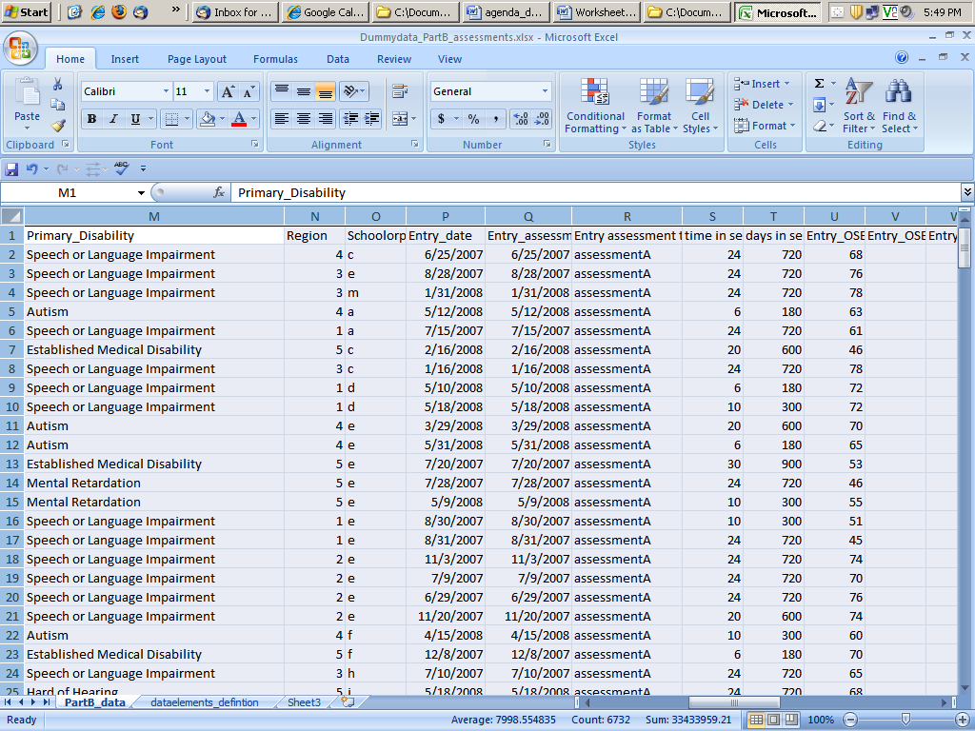
Step 1: Open either your own data or the “dummy data” provided. Click on the top left hand corner to select the entire workbook.

Slide 52
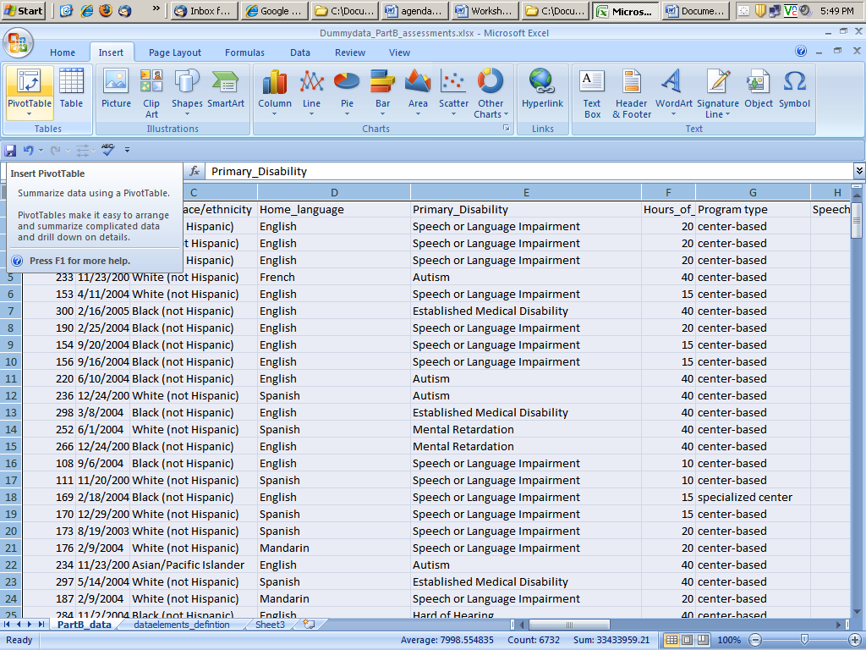
Step 2: Under the “Insert” ribbon, click on the icon labeled “PivotTable”

Slide 53
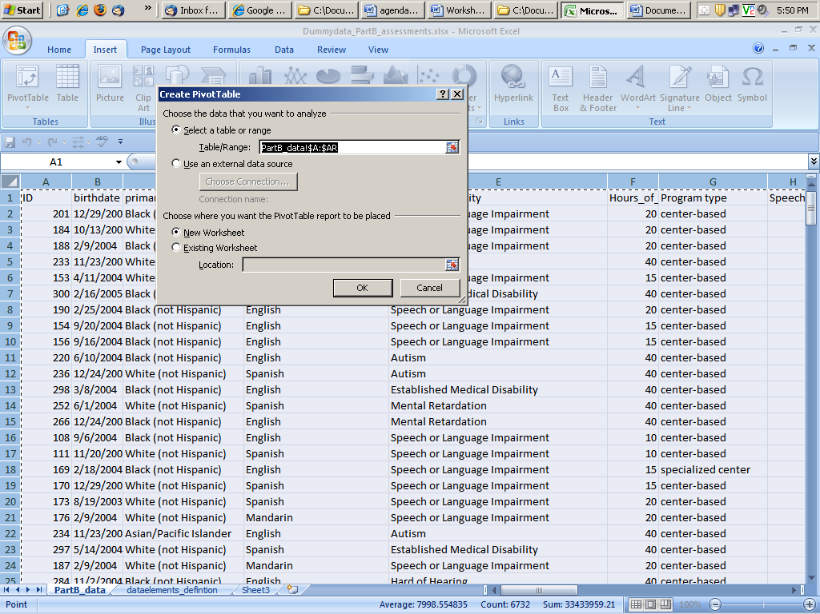
Step 3: Click “OK.” We will be using the default options.

Slide 54
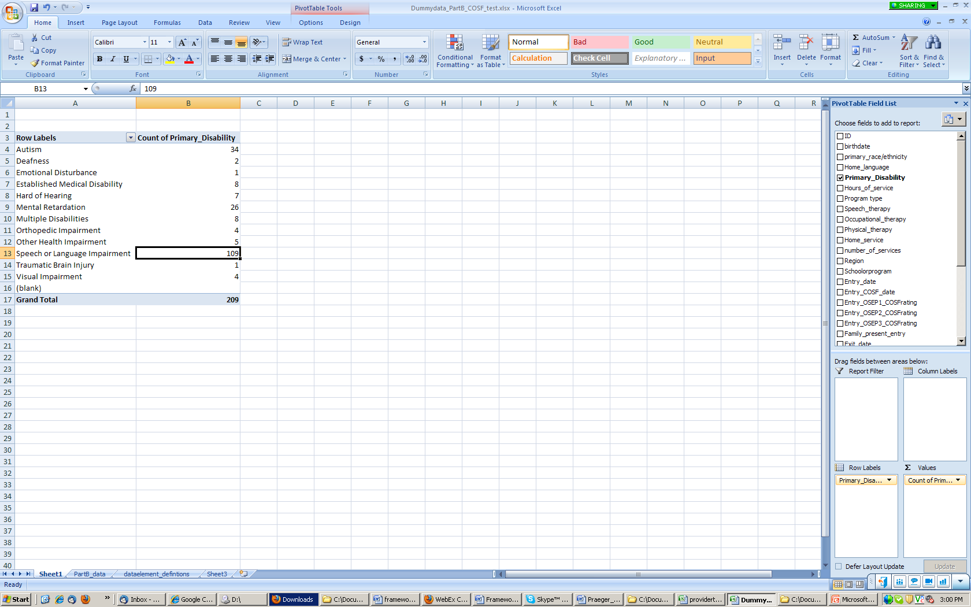
Step 4: Drag the variable “Primary Disability” into the area “Row Labels” and “Values”
Primary Disability
Primary Disability

Slide 55
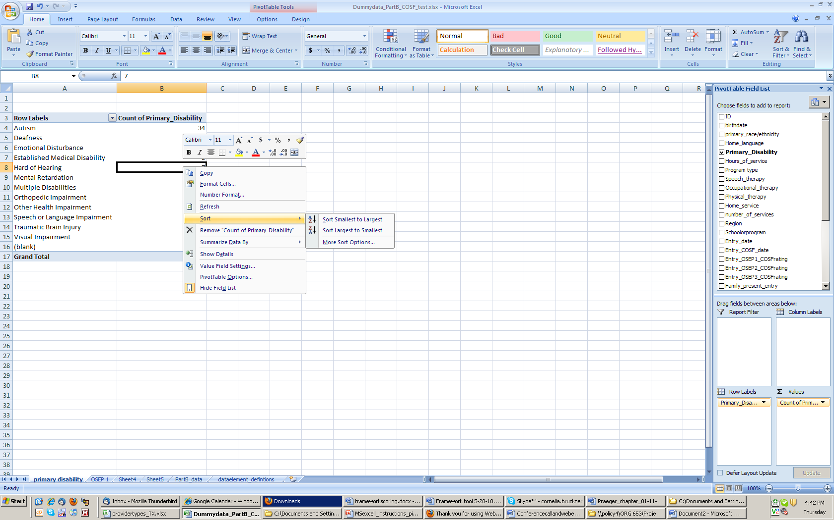
Step 5: Sort the rows from largest to smallest. Right click in a cell under “Count of Primary_Disability.” Select “Sort”. Select “Sort Largest to Smallest.

Slide 56
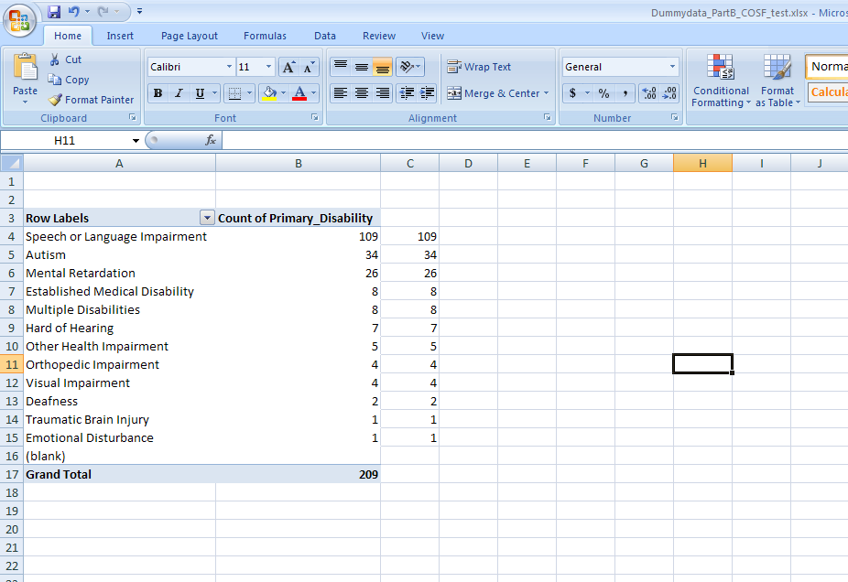
Step 6: Copy the numbers in the column “Count of Primary_Disability” and paste them into the adjacent column

Slide 57
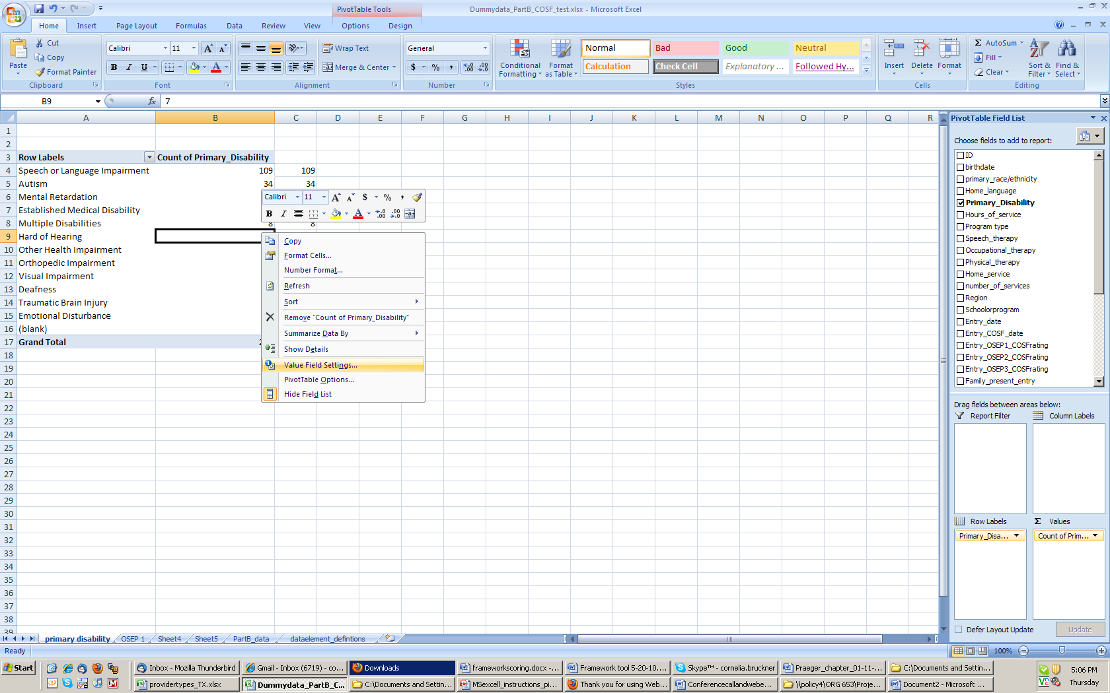
Step 7: Right click in one of the cells with data. From the drop down menu that appears, select “Value Field Settings”

Slide 58
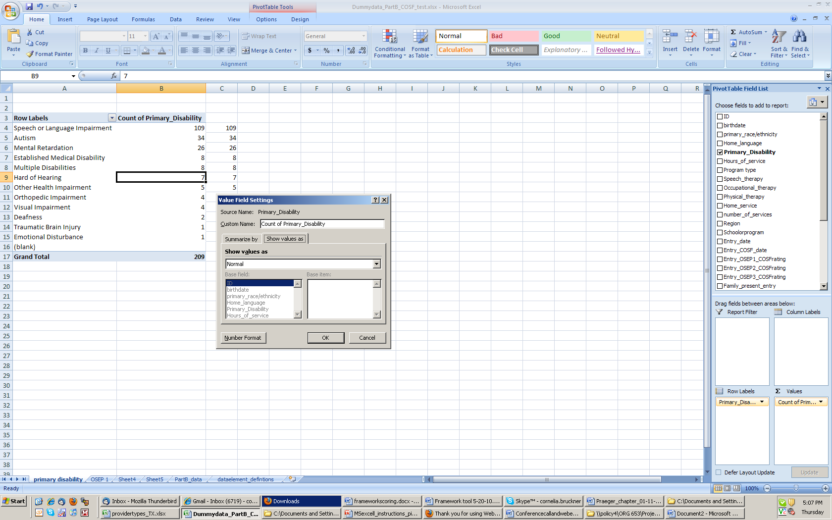
Step 8: In the “Value Field Setting” dialogue box, click on the “Show values as” tab.

Slide 59
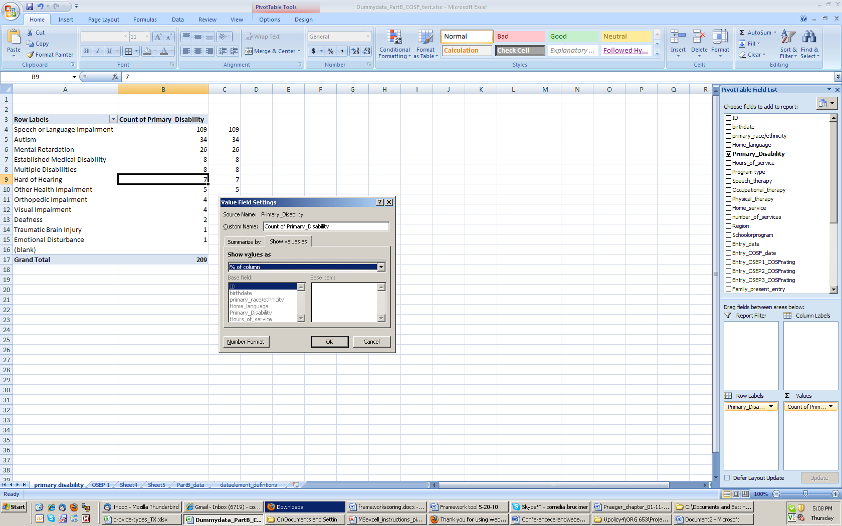
Step 9: In the “Show value as” drop down menu select “% of column.” and click “OK”

Slide 60
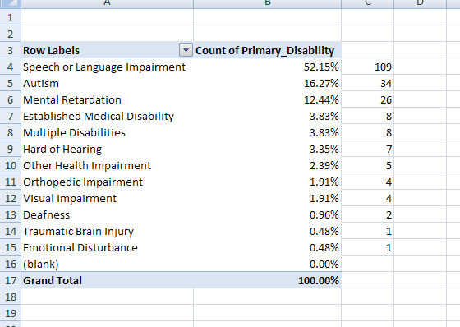
Final Table

Slide 61

Creating a table with percent of children in each progress category

Slide 62
Step 1: Open either your own data or the “dummy data” provided. Click on the top left hand corner to select the entire workbook.

Slide 63
Step 2: Under the “Insert” ribbon, click on the icon labeled “PivotTable”

Slide 64
Step 3: Click “OK.” We will be using the default options.

Slide 65
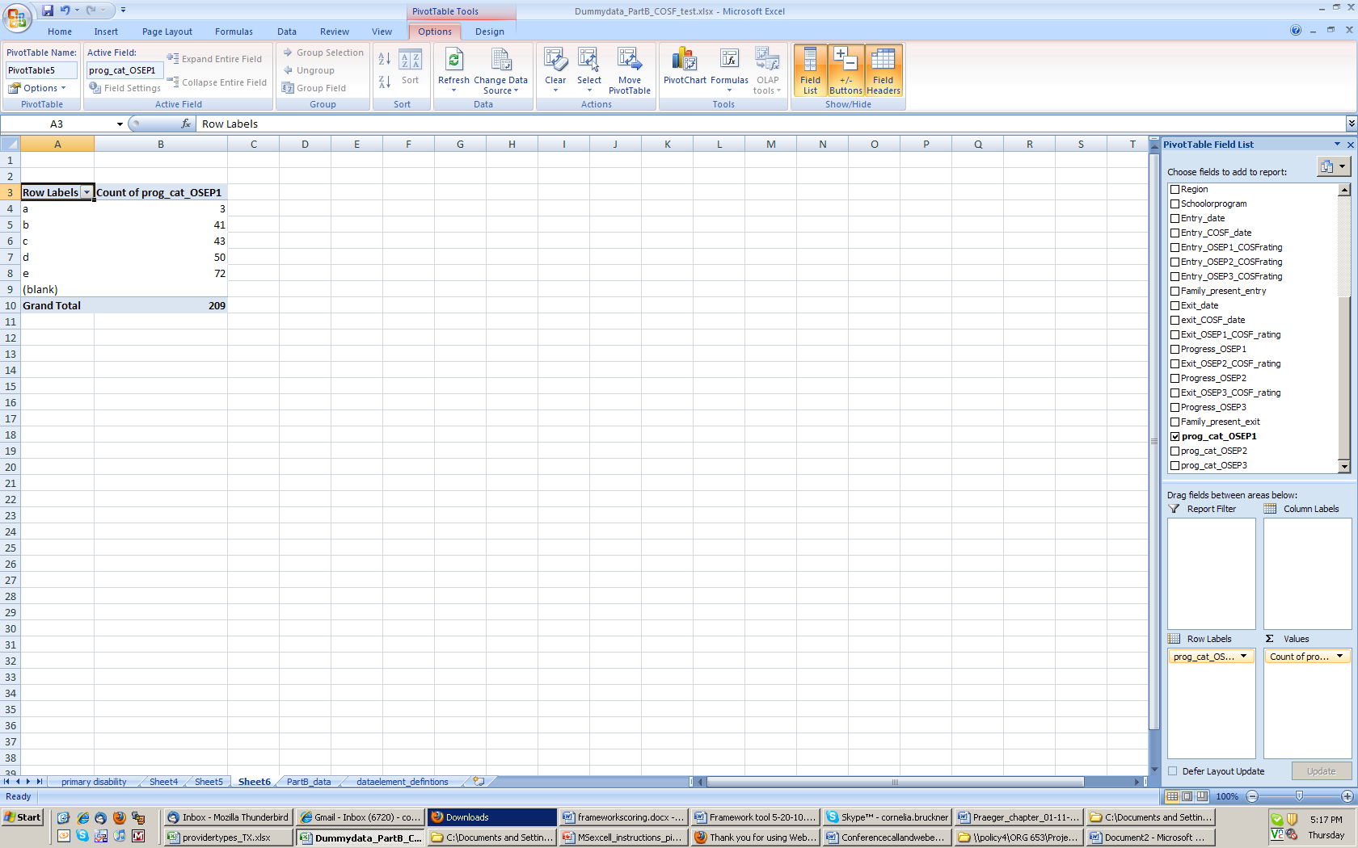
Step 4: Drag the variable “prog_cat_OSEP1” into the area “Row Labels” and “Values”

Slide 66
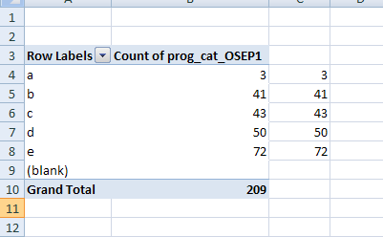
Step 6: Copy the numbers in the column “Count of Primary_Disability” and paste them into the adjacent column

Slide 67
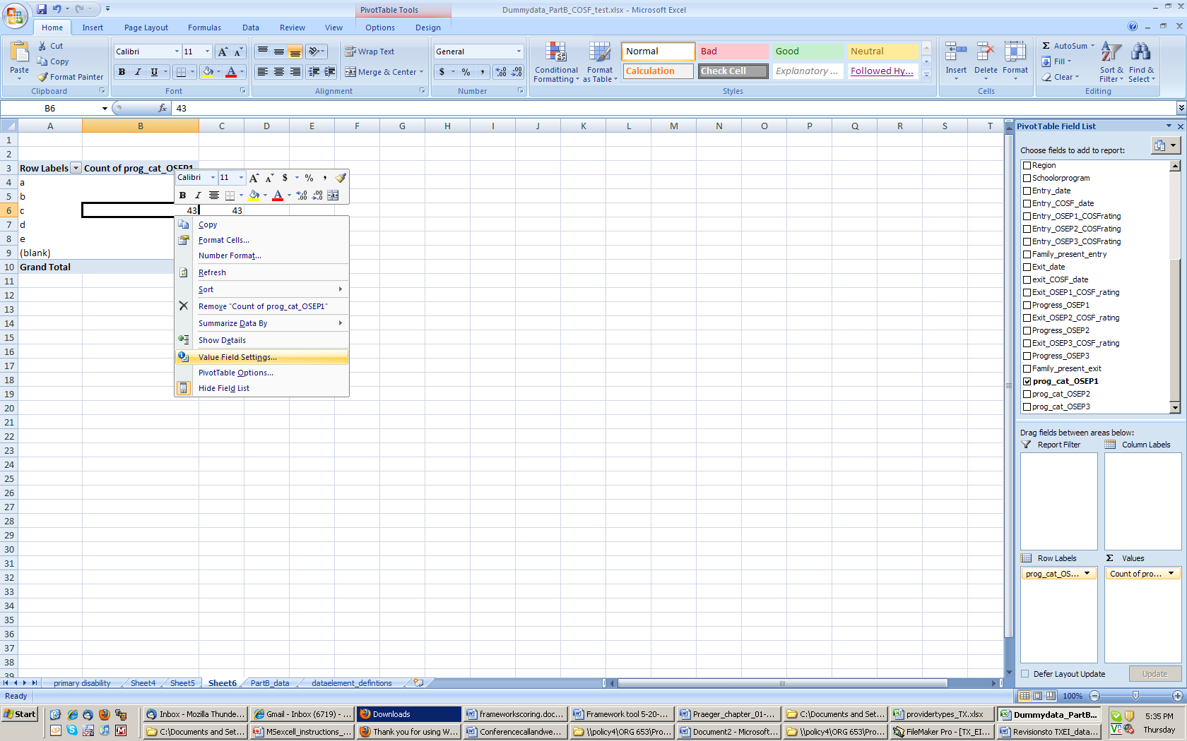
Step 7: Right click in one of the cells under “Count of prog_cat_OSEP1.” From the drop down menu that appears, select “Value Field Settings”

Slide 68
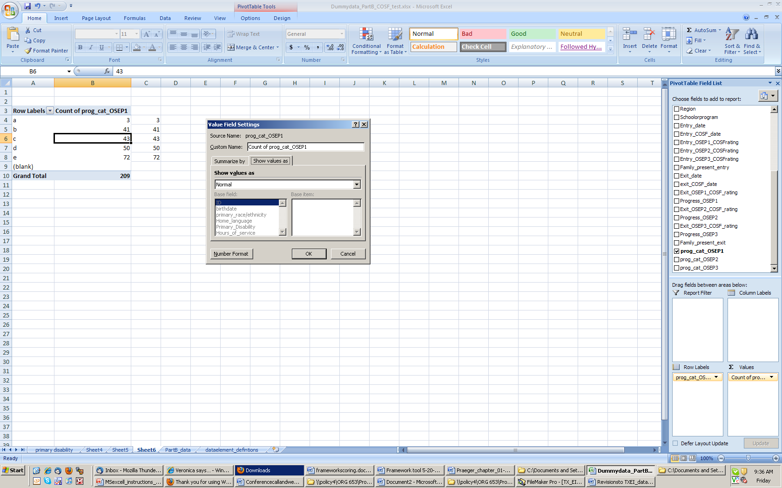
Step 8: In the “Value Field Setting” dialogue box, click on the “Show values as” tab.

Slide 69
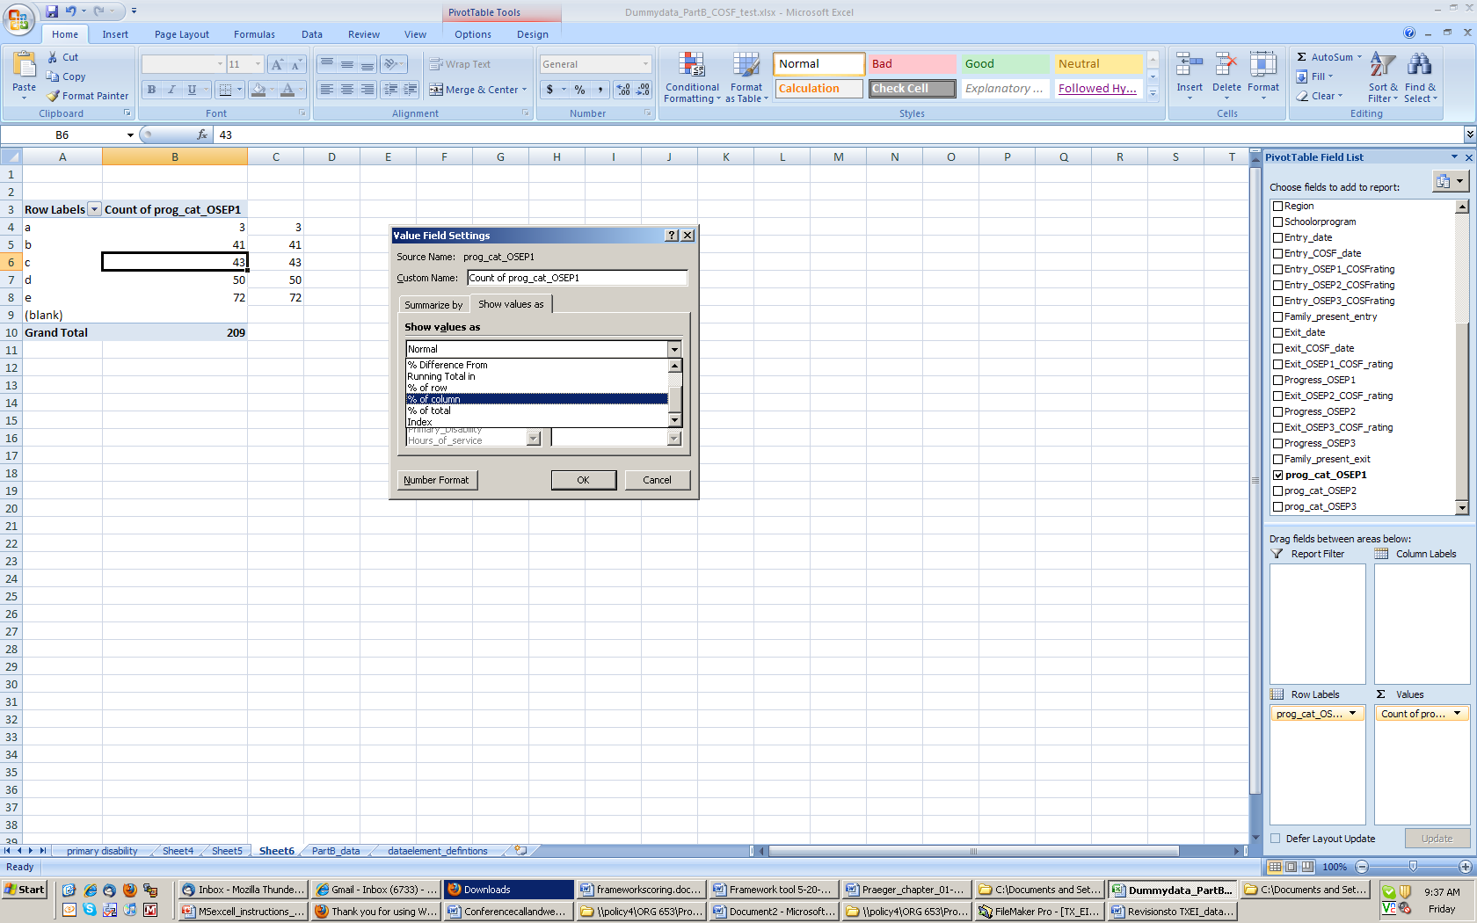
Step 9: In the “Show value as” drop down menu select “% of column.” and click “OK”

Slide 70
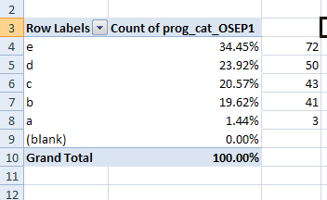
Final Table for OSEP 1

Slide 71
Creating a crosstab report of Primary Disability by Progress Categories

Slide 72
Step 1: Open either your own data or the “dummy data” provided. Click on the top left hand corner to select the entire workbook.

Slide 73
Step 2: Under the “Insert” ribbon, click on the icon labeled “PivotTable”

Slide 74
Step 3: Click “OK.” We will be using the default options.

Slide 75
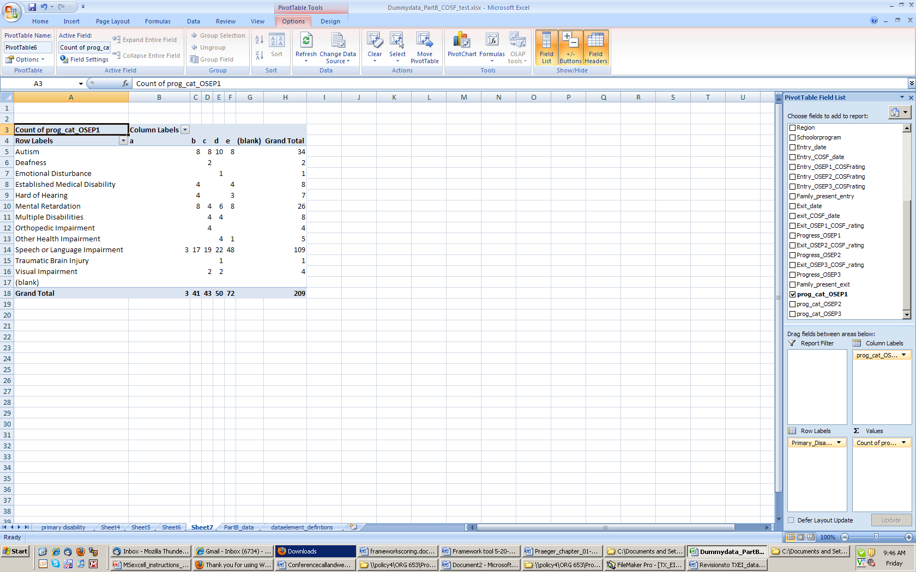
Step 4: Drag “prog_cat_OSEP1” into “Column Labels” Drag “Primary_Disability” into “Row Labels” and drag “prog_cat_OSEP1” into “Values”.

Slide 76
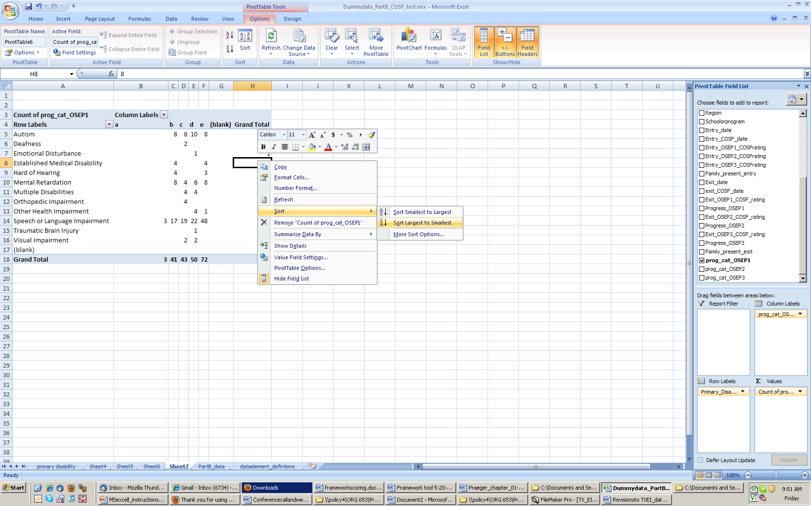
Step 5: Sort the rows from largest to smallest. Right click in a cell under “Grand Total.” Select “Sort”. Select “Sort Largest to Smallest.

Slide 77
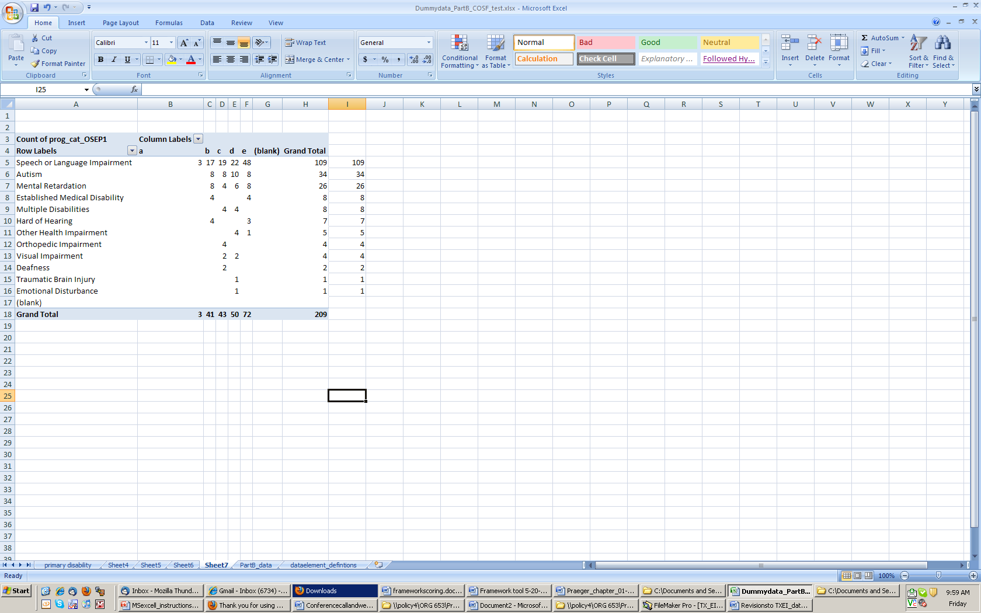
Step 6: Copy the numbers in the column “Grand Total” and paste them into the adjacent column

Slide 78
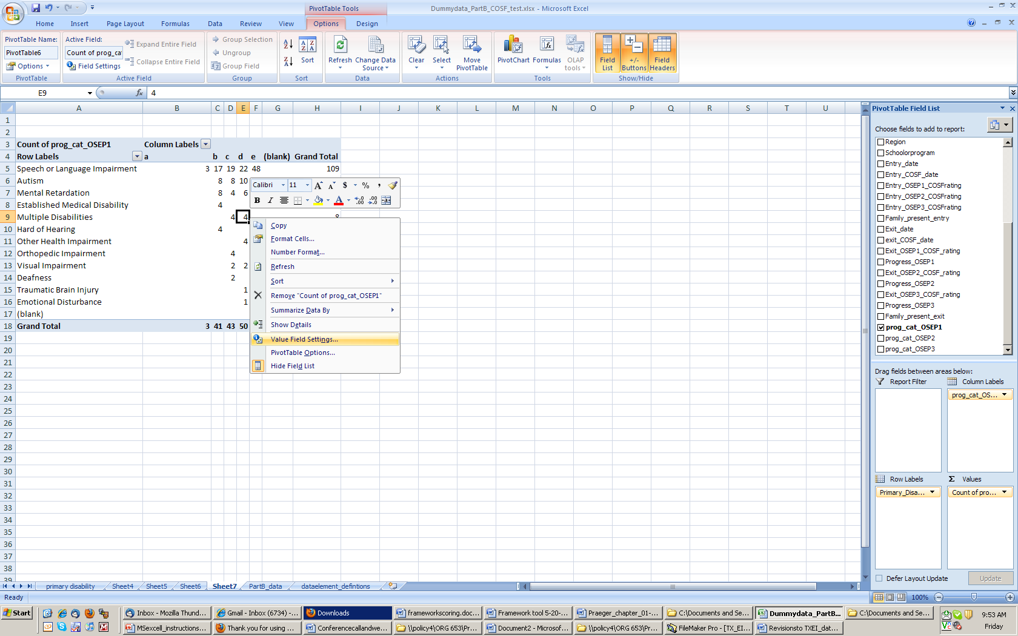
Step 7: Right click in one of the cells under “c.” From the drop down menu that appears, select “Value Field Settings”

Slide 79
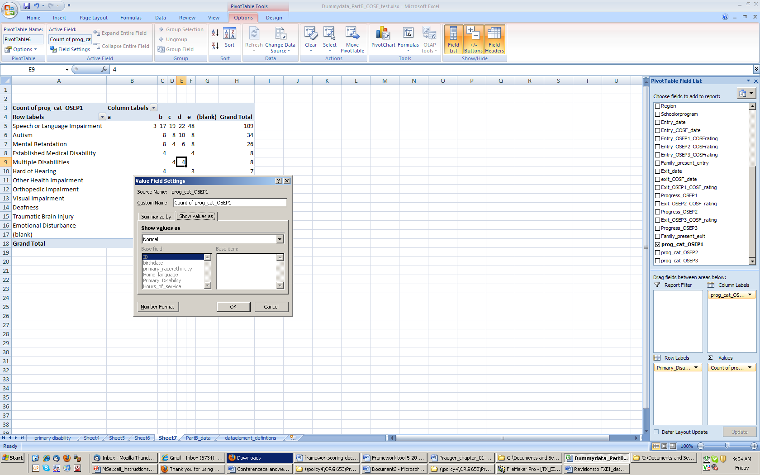
Step 8: In the “Value Field Setting” dialogue box, click on the “Show values as” tab.

Slide 80
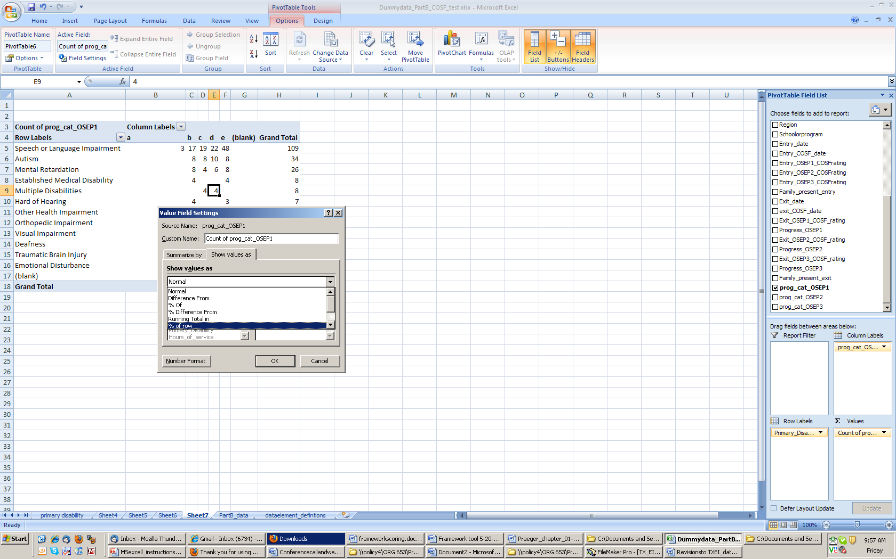
Step 9: In the “Show value as” drop down menu select “% of row.” and click “OK”

Slide 81
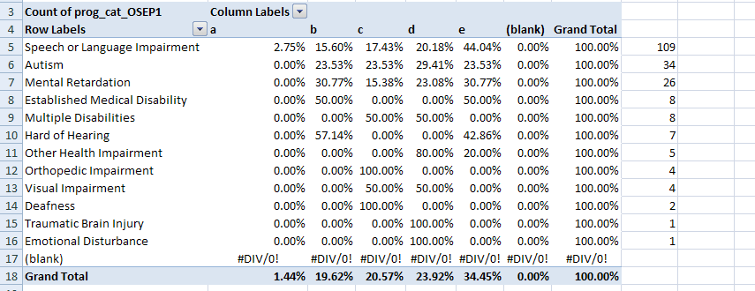
Final Table for Crosstab

Slide 82
Activity 4: Creating a Table with Data
Using your own data or the dummy data create a table to give you information on children with speech and language impairments who were rated a 7 at entry on Outcome 3.
What is the number?
What percentage of children with speech and language impairments were rated a 7?
What percent of 7s were given to children with speech and language impairments?

Slide 83
COSF Calculator
http://www.fpg.unc.edu/~eco/pages/outcomes.cfm#CalculatingProgress

Slide 84
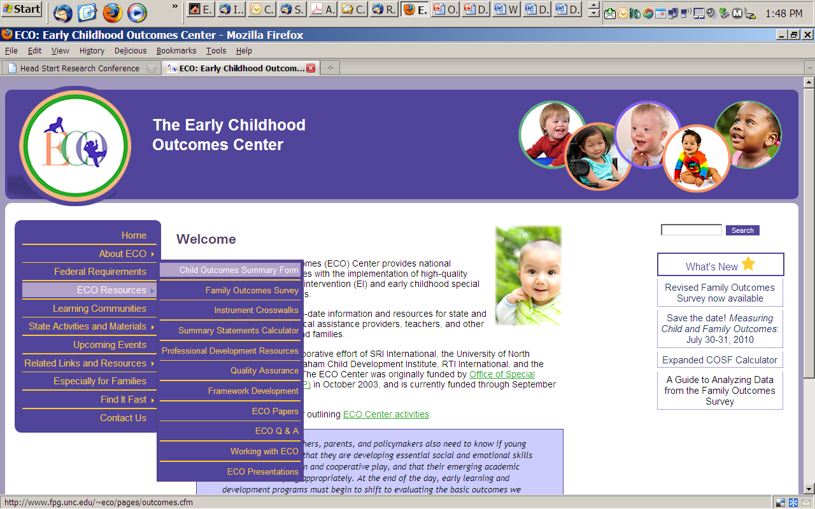

Slide 85
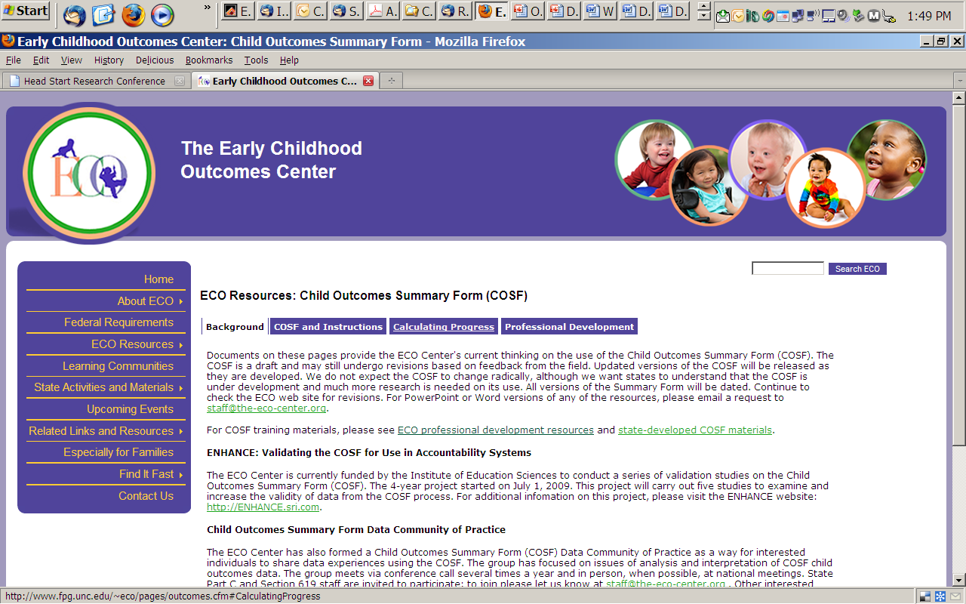

Slide 86
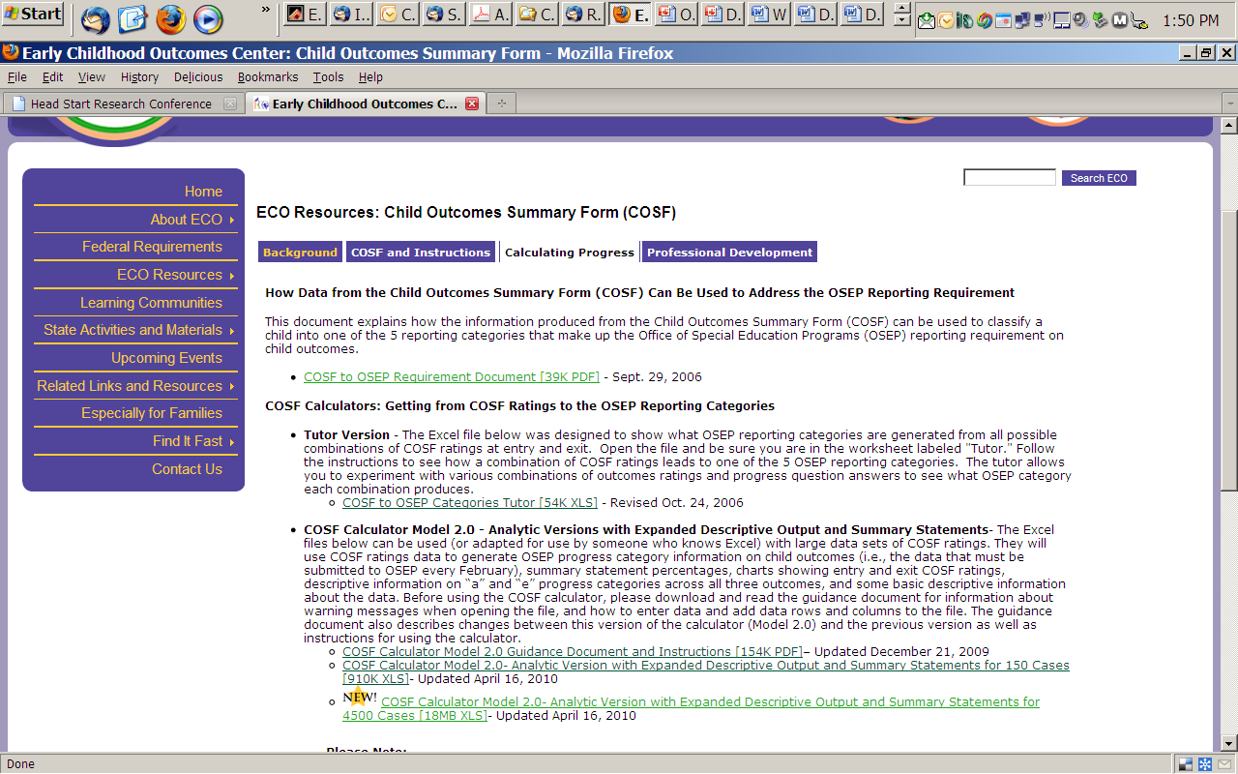

Slide 87
Open the Calculator on your CD and follow along
ECO_COSF_OSEP_Model2_150_no data.xls
ECO_COSF_OSEP_Model2_150_data.xls

Slide 88
Activity 5: Using the calculator
Enter exit and entry data into the calculator for a few children for one outcome. Watch how the OSEP categories appear.
Can you find the combination that will give you an “impossible” for the OSEP outcome?
Why is this combination impossible?

Slide 89

Finding Meaning in the Findings

Slide 90
Using data for program improvement = EIA
Evidence
Inference
Action

Slide 91

Evidence
Evidence refers to the numbers, such as
  “45% of children in category b”
The numbers are not debatable

Slide 92
Inference
How do you interpret the #s?
What can you conclude from the #s?
Does evidence mean good news? Bad news? News we can’t interpret?
To reach an inference, sometimes we analyze data in other ways (ask for more evidence)

Slide 93

Inference
Inference is debatable -- even reasonable people can reach different conclusions
Stakeholders can help with putting meaning on the numbers
Early on, the inference may be more a question of the quality of the data

Slide 94
Action
Given the inference from the numbers, what should be done?
Recommendations or action steps
Action can be debatable – and often is
Another role for stakeholders
Again, early on the action might have to do with improving the quality of the data
Notes:
Action steps = training and TA, for example – first to improve the quality of the data, then to improve programs when the inference is that improvement is needed

Slide 95
Talking to the Public: Summary Statements

Slide 96
Summary Statements
Of those children who entered the program below age expectations in each Outcome, the percent who substantially increased their rate of growth by the time they turned 6 years of age or exited the program.
The percent of children who were functioning within age expectations in each Outcome by the time they turned 6 years of age or exited the program.

Slide 97
The Point of EIA (Remember this!!)
Evidence (i.e., the summary statement numbers) by themselves are meaningless.
Inference is attached by those who read the numbers.
You have the opportunity and obligation to attach meaning. Seize it!
Notes:
You cannot prevent the misuse of data but you can set up conditions to make it less likely.

Slide 98

Being prepared……….
When the child outcomes data become available, how will we talk about the data with:
  The media
  School boards
  Families
  Teachers and therapists
  Other key stakeholders in your community

Slide 99
Being prepared means……….
Think ahead about how to talk with the public about the data.
Write out the specific messages you want to make (an internal ‘talking points’ memo).
Being thoroughly familiar with your district and state data.
Use public dissemination opportunities to get out key messages that will educate the public about your program, its benefits.

Slide 100
Heading off the misuse of outcome data: Be prepared
Think through possible scenarios
  Good news would be….
  Bad news would be…
Think through how you will make sense of your data
  Will you need other information?
  What would that be?
Anticipate how others might use or interpret the data

Slide 101
Crafting the messages………
Refer to the Talking Points document (Day 1, Handout 1, Day 1)Use thProderal reporting).
See also the ECO Center Q&A document** to explain:
  What are the child outcomes
  Why we are measuring and reporting outcomes
  The overarching goal of children being active and successful participants
  ** Q&A is on Web site under ECO Resources - http://www.fpg.unc.edu/~eco/pages/faqs.cfm)

Slide 102
Preparing a news release…..
Find the main message you want to communicate
Translate the main message into a simple statement about the data
Use the quotes to explain the meaning of the data; give an interpretation
  Include quote by local official.
  Include quote by program or provider.
  Include quote(s) from parent(s).

Slide 103
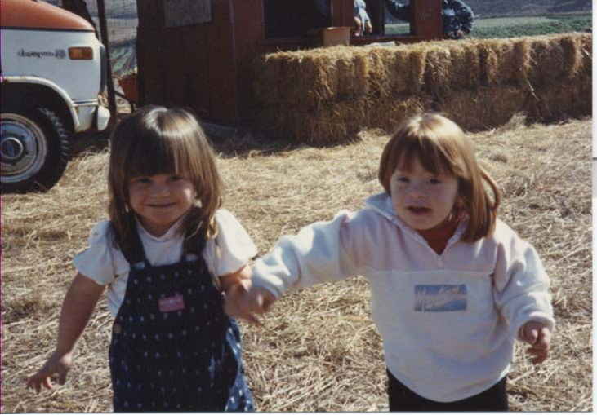
Describe the numbers in simple ways ….
  “Nearly half the children showed made greater than expected progress while they were in the program.
  “About two thirds of the children were performing like same age peers when they left the program.”
You can talk about more than the two Summary Statements

Slide 104
Put YOUR interpretation on the numbers…..
  “We see these data as good news….”
  “We are pleased that the data shows that children in these programs are making progress between the time they enter and leave these programs…”
  “Many children are catching up with peers in the same age group…”

Slide 105

Link messages to broader EC issues…
Point out how the program is helping get children ready for school.
Note that there is lots of policy attention and research about the cost effectiveness of early programs.

Slide 106
If the data show possible problems….
Get out in front of the data, and note the problem areas:
  “We see large differences in the data in different regions………..”
Then, offer interpretations and note that you are trying to understand such differences:
  “We are trying to understand these variations. They may have to do with differences in the children being served or in ways the data are being collected…..”
Remind that these are very early data and that we expect better data in the coming years.

Slide 107

This is an OPPORTUNITY to educate about ECSE….
“These programs serve many different children….”
“Some children have mild delays or problems in one area only. These are children who can ‘catch up’”.
“Other children have more significant disabilities; some make substantial progress and others make slower progress”.

Slide 108
Messaging
How do you make the message easily understandable for the public?
  “Plain Speak”
  Don’t be repetitive
  Explain how your data relates to the average person in your state
    Don’t ever use the analytic questions – they are for analysis purposes

Slide 109
Activity 6: Being Prepared
Write 3 to 5 questions that [your superintendent] [local media] [advocates] [??] might ask you about your child outcomes data.

Slide 110
Activity 7: Talking Points
You have been asked to speak to a parent organization in your community about the Summary Statement data. Write out your talking points.

Slide 111
Resources
Resources about communicating and messaging by Zero to Three’s The Baby Monitor (4/6/09):
http://www.zerotothree.org/site/PageServer?pagename=BM_04_06_09

Slide 112



Find more resources at: www. the-eco-center-org

