Slide 1
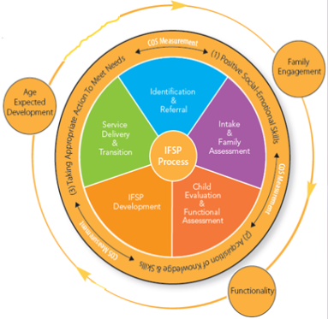
Together with Families
COS
Mini Conference
November
2011
Hearing Family Stories
Gaining Family Insight
Involving Family
Naomi Younggren, Ph.D.

Slide 2
Hearing Family Stories
Mass. Health & Human Services

Slide 3
Gaining Family Insight
Listening
Asking good questions

Slide 4
How good are you as a listener?

Slide 5
Good Listener?
Zachary’s mom talks with Spec. Ed. Director

Slide 6
Listening Prof. Jeffrey Berman, Salem State College
Don’t confuse hearing with listening
Listen with intensity
Listen with empathy
Practice acceptance
Take responsibility for completeness

Slide 7
Seek Clarification I understand

Slide 8
Interviewing Pointers Westby, Burda, & Metha, 2003
Use open-ended questions
Use restating – repeating the exact words
Summarize and invite opportunities to correct
Avoid back-to-back and compound questions
Avoid leading questions
Cautiously use "why" questions
Listen more than talk

Slide 9
L – I - S - T – E - N
L Look attend
I Inquire - show interest ask questions
S Summarize what you hear - seek clarification
T Take notes to remember
E Encourage smile, nod, respond
N Neutralize your biases

Slide 10
Involving Family in the COS Process
Remember Parent Roles
Share EC Outcome Information Early & Often
Include Parents in the COS Rating Discussion

Slide 11
Parent Roles
Team Member
Information Provider & Receiver
Participant in the COS rating discussion
Consumer

Slide 12
Listening
CO Results Matters

Slide 13
Information Sharing
Brazelton

Slide 14
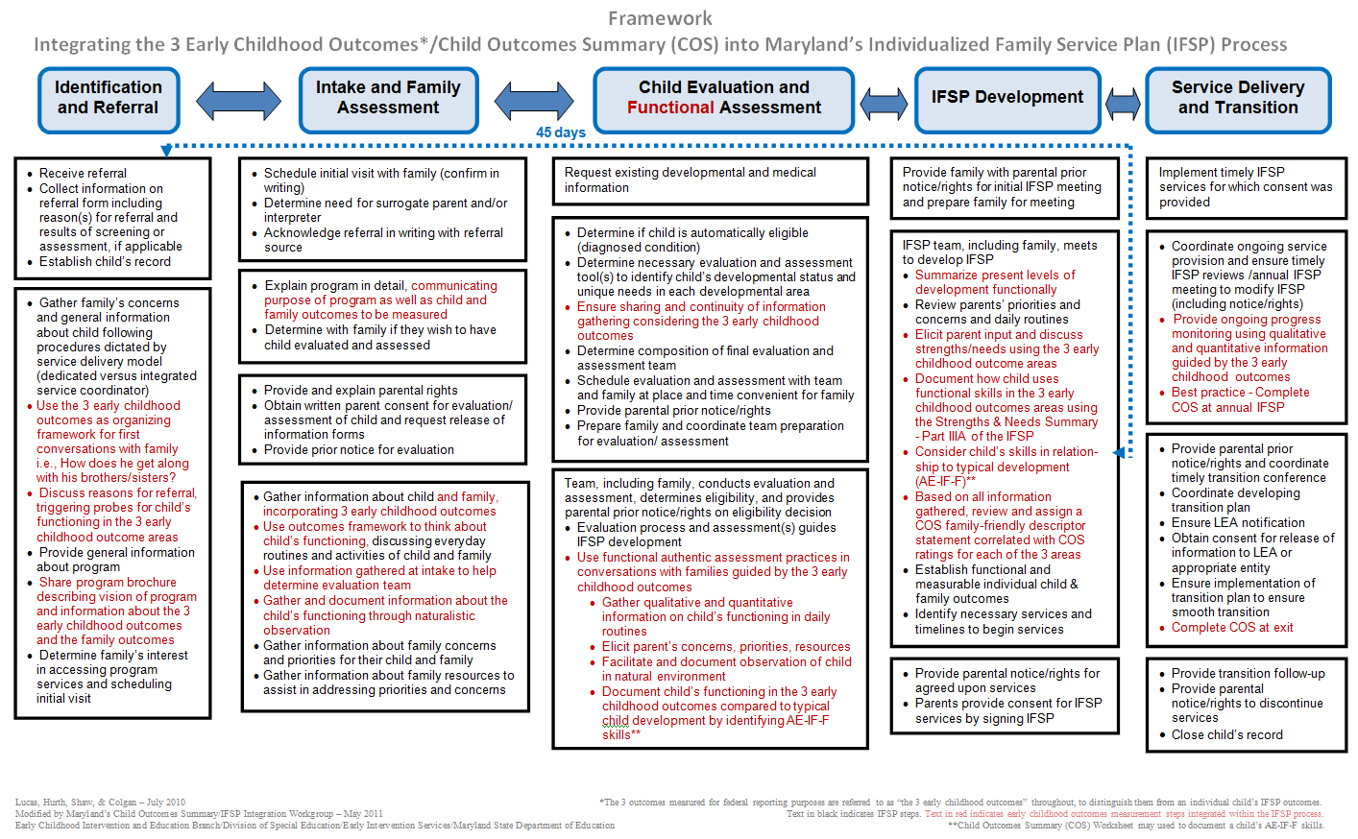
Share Information Early & Often

Slide 15
Prepare Families

Slide 16
Prepare Families for the COS Process
Washington

Slide 17
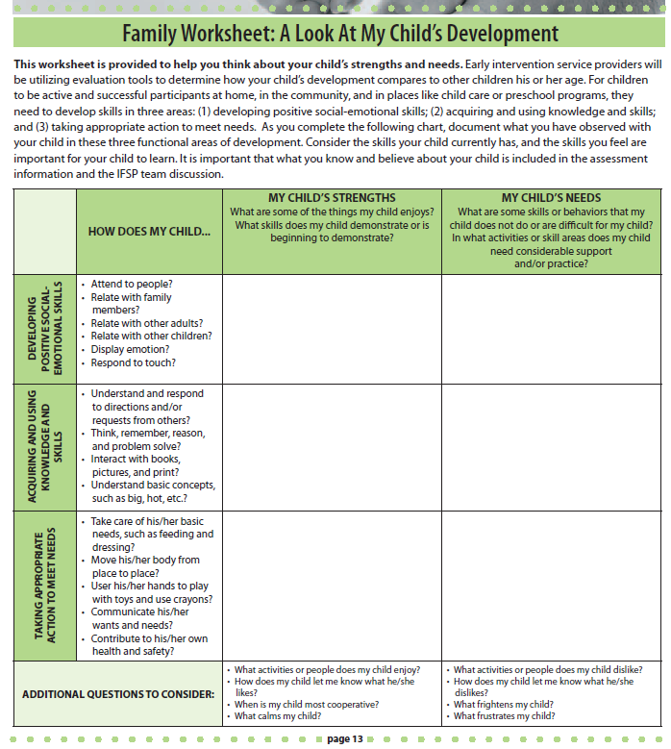

Slide 18
What We Should Expect from Family Involvement in the COS Rating?
Yes!
They can provide rich information about their child’s functioning across settings and situation.
Maybe…but not necessarily!
They will know whether their child is showing age expected skills.

Slide 19
Discussing Strengths & Needs
CO Results Matters

Slide 20
Rating Decision

Slide 21
Decision Making Models
Model | Provider | Parent | Knowledge flow | Objective
Paternalistic | Directive | Passive | One-way knowledge transfer provider to parent | Compliance of parent
Autonomous | Receptive | Directive | One-way knowledge transfer parent to provider | Compliance of provider
Shared Decision Making | Informative | Informative | Two-way knowledge exchange | Equity in the decision making process
Collaborative Decision Making | Supportive | Proactive | Knowledge builds through shared learning | Optimal action

Slide 22
Genuinely engage families
in the entire process,
appreciate their strengths, and
reach agreement with them
about their child.

Slide 23
Naomi Younggren, Ph.D.
naomi.younggren@gmail.com

