Slide 1

Christina Kasprzak
ECTA/ECO/DaSy
Lauren Barton
ECO/DaSy
Ruth Chvojicek
WI Statewide Part B Indicator 7 Child Outcomes Coordinator
March 17, 2014
Encore Webinar: Improving Data, Improving Outcomes Conference
Where the Rubber Hits the Road:
Tools and Strategies for Using
Child Outcomes Data for
Program Improvement

Slide 2

Purposes
To describe national resources for promoting data quality and supporting program improvement
To share Wisconsin 619 experience and strategies to promote data quality and program improvement
2

Slide 3
Available Resources
Question | Resource
Can I trust the quality of my data? Where are there red flags? | Pattern Checking Table
See the “using data” page under Outcomes Measurement
on the ECTA website:
http://www.ectacenter.org/eco/pages/usingdata.asp

Slide 4
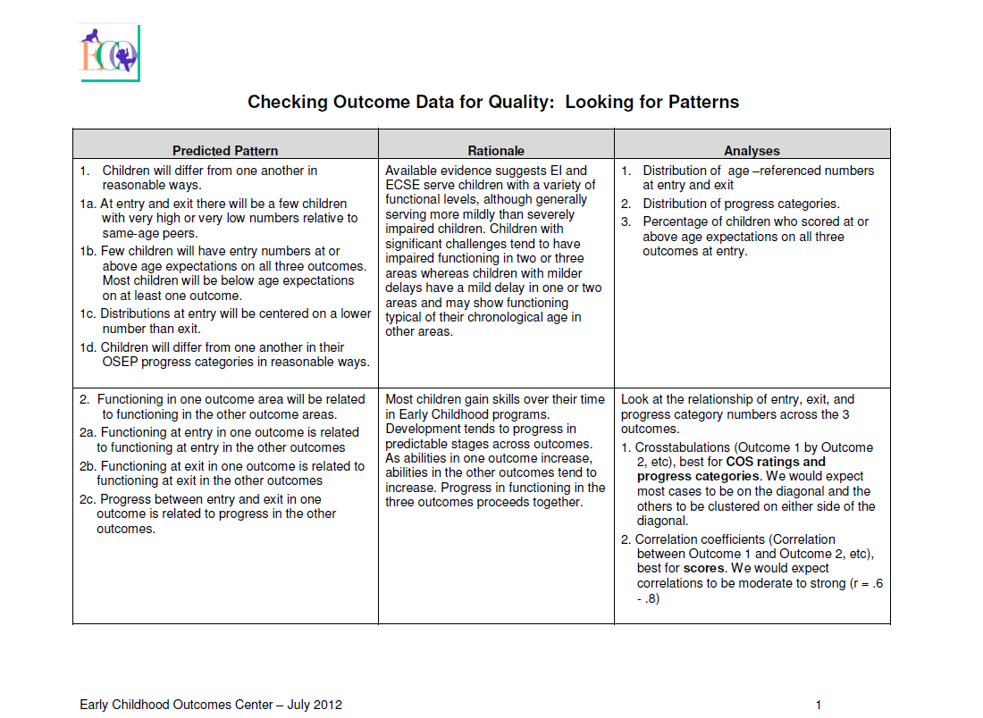
Pattern Checking for Data Quality
Strategies for using data analysis to improve the quality of state data by looking for patterns that indicate potential issues for further investigation.
http://www.ectacenter.org/eco/assets/pdfs/Pattern_Checking_Table.pdf

Slide 5
Questions to Ask
Do the data make sense?
  Am I surprised? Do I believe the data? Believe some of the data? All of the data?
If the data are reasonable (or when they become reasonable), what might they tell us?

Slide 6
Available Resources
Question | Resource
Can I trust the quality of my data? Where are there red flags? | Pattern Checking Table
What are your internal systems that support quality data? | Local Contributing Factors Tool

Slide 7
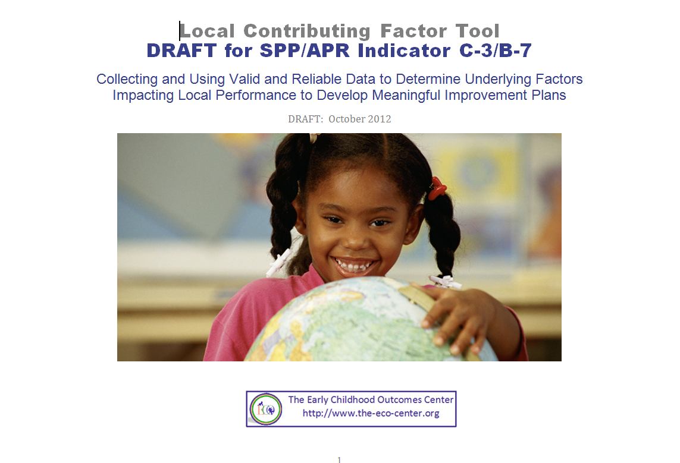
Local Contributing Factors Tool
Provides ideas about questions a local team would consider in identifying factors impacting performance.
Introductory video and document at:
http://www.ectacenter.org/eco/pages/usingdata.asp

Slide 8
Available Resources
Question | Resource
Can I trust the quality of my data? Where are there red flags? | Pattern Checking Table
What are your internal systems that support quality data? | Local Contributing Factors Tool
What strategies might support improvement in different outcomes for Part C? | Relationship of Quality Practices to Child and Family Outcome Measurement Results

Slide 9
Relationship of Quality Practices to Child and Family Outcome Measurement Results
Designed to assist states in identifying ways to improve results for children and families through implementation of quality practices.
http://www.ectacenter.org/~pdfs/QualityPracticesOutcomes_2012-04-17.pdf
9

Slide 10
Available Resources
Question | Resource
Can I trust the quality of my data? Where are there red flags? | Pattern Checking Table
What are your internal systems that support quality data? | Local Contributing Factors Tool
What strategies might support improvement in different outcomes for Part C? | Relationship of Quality Practices to Child and Family Outcome Measurement Results
How can I use my data to analyze and improve program practices? | Analyzing Child Outcomes Data for Program Improvement: A Guidance Table

Slide 11

Analyzing Child Outcomes Data for Program Improvement
Quick reference tool
Consider key issues, questions, and approaches for analyzing and interpreting child outcomes data.
http://www.ectacenter.org/eco/assets/pdfs/AnalyzingChildOutcomesData-GuidanceTable.pdf

Slide 12
Describes Steps in Process of Using Data for Program Improvement
Defining analysis questions
Clarifying expectations
Analyzing data
Testing inferences
Data-based program improvement planning

Slide 13
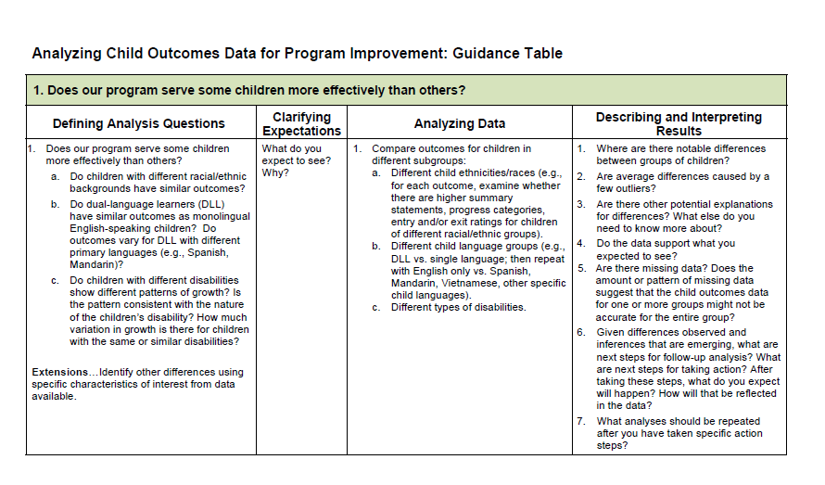
Guidance Table

Slide 14





Slide 15



Using Data for State &
Local Improvement
Wisconsin’s Part B
Ruth Chvojicek – WI Statewide Part B Indicator 7 Child Outcomes Coordinator

Slide 16
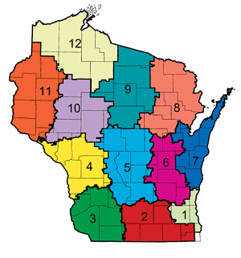
Wisconsin T/TA System
CESA Program Support Teacher
Indicator 6/7/12 Coordinators
Department of Public Instruction

Slide 18
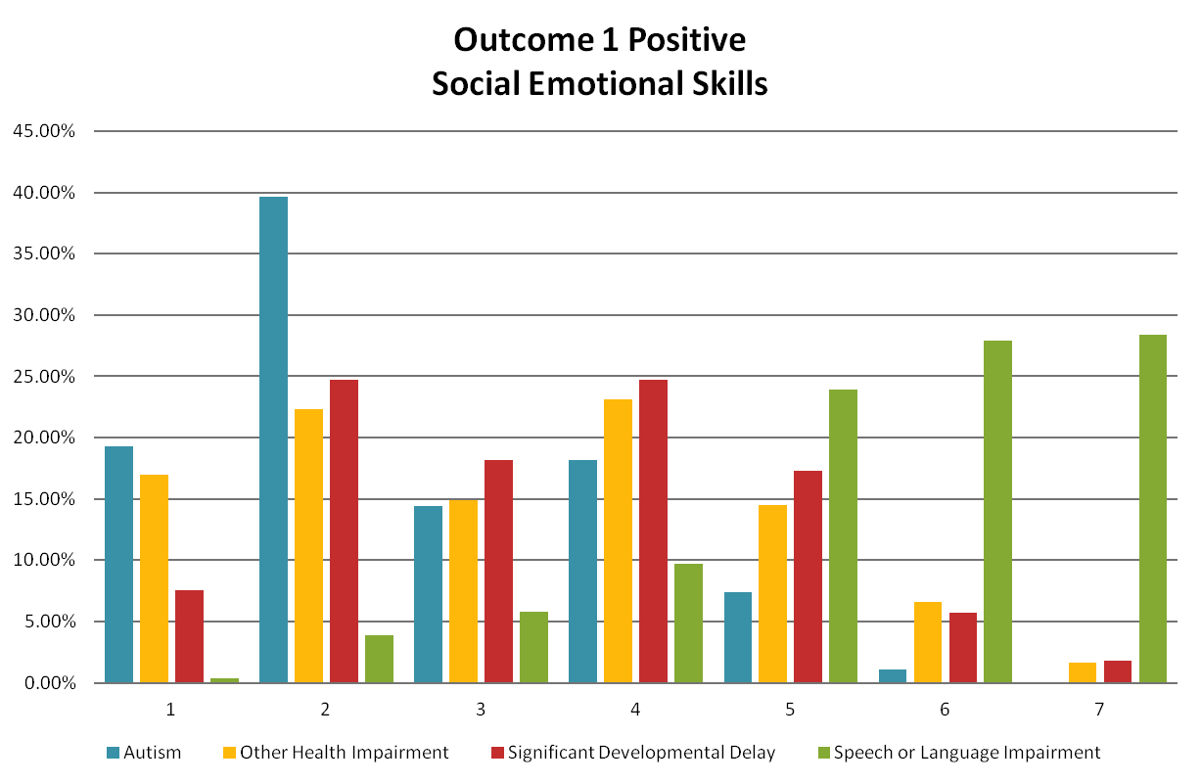
Examples from 2011-2012

Slide 19
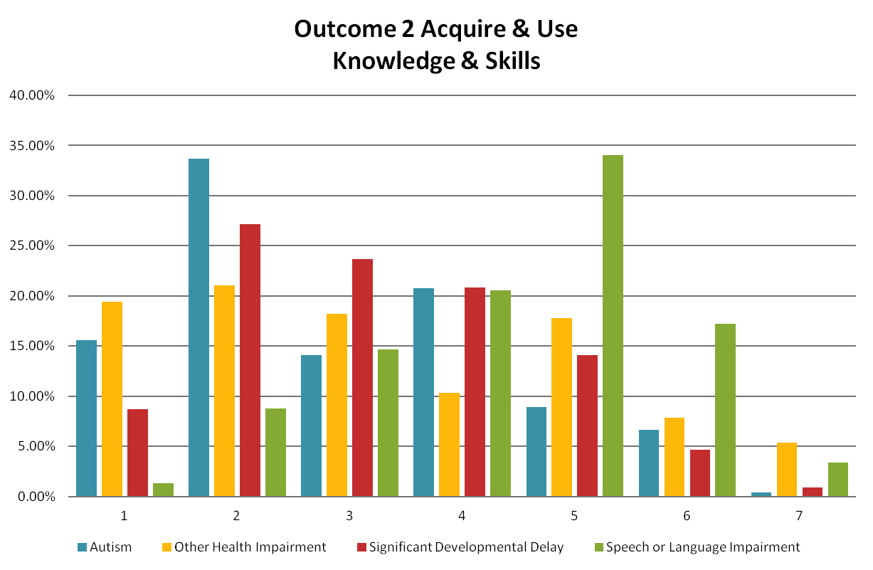

Slide 20
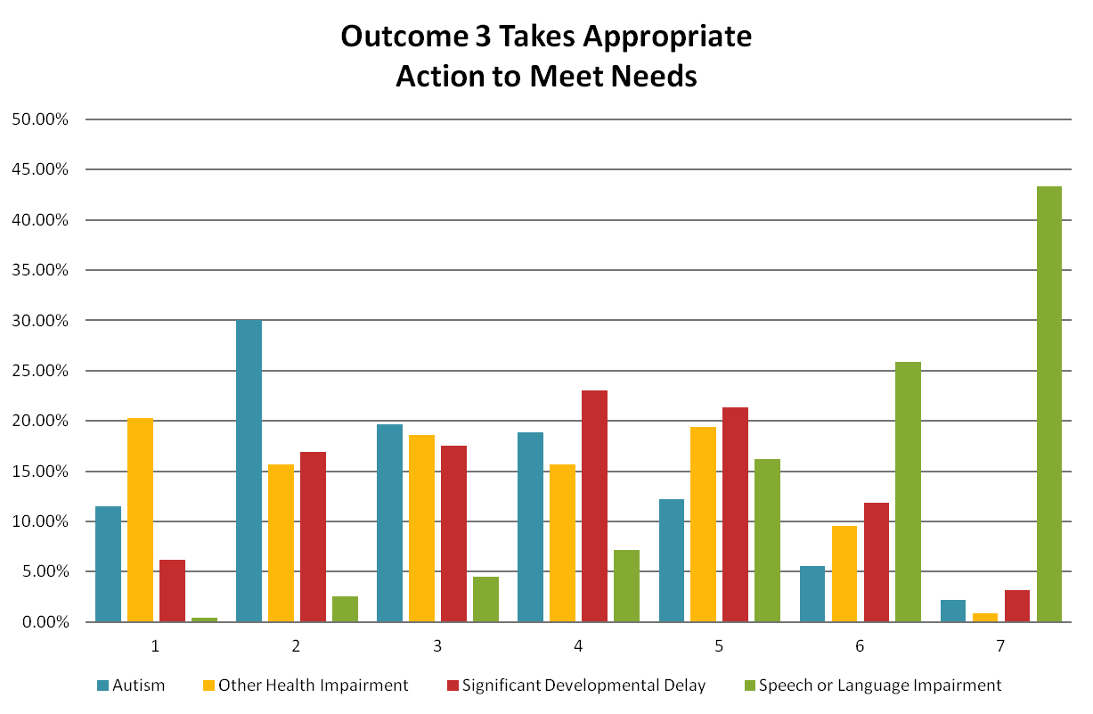

Slide 21
Wisconsin Data Review Progression
2011-2012
Pilot – 20 LEAs
2012-2013
Offered group data reviews within each CESA region and several large LEA’s
Focus on enhancing data quality (accuracy of rating)
Delivery via technology
Pattern common discussion points informed 12-13 statewide PD
Individual District Data Reports
Process for development of reports
District action steps: Assessment process, rating practice +

Slide 22
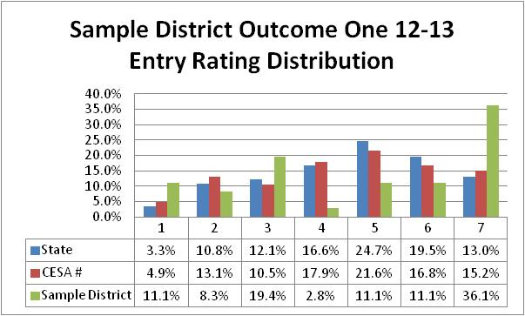
Sample Graphs – Entry or Exit Rating Distribution

Slide 23
Sample – Entry Rating By Eligibility

Slide 24
Sample – Entry Rating Comparison

Slide 25
EXAMPLE Race/Ethnicity

Slide 32
BUT … Outcome One Exit Rating

Slide 33
Outcome Three

Slide 34
Wisconsin Data Review Progression
2011-2012
Pilot – 20 LEAs
2012-2013
Offered group data reviews within each CESA region and several large LEA’s
Focus on enhancing data quality (accuracy of rating)
Via technology
Pattern common discussion points informed 12-13 statewide PD
Individual District Data Reports
Process for development of reports
District action steps: Assessment process, rating practice +
2013-2014
Continue group data reviews all CESA regions
Continue working on data quality – plus…
Statewide Stakeholder Workgroup – Discussion using Analyzing Child Outcomes Data tool
Piloting conversation around settings and Indicator 7 progress

Slide 35
Next Steps?
Try out using these resources
Send feedback to ECO Center about the new Analysis tool
What are your ‘take aways’ and next steps related to analyzing your data for data quality and/or program improvement? (notes for State Team time)
35

Slide 36

Find more resources at: http://www.ectacenter.org

Slide 37



Questions? Comments?
#6 to un-mute

