Slide 1
Measuring Child Outcomes:
State of the Nation

Slide 2
Learning objective:
To gain new information about the national picture regarding measuring child outcomes

Slide 3
Why we are collecting child outcomes data

Slide 4
Keeping our eyes on the prize:
High quality services for children and families that will lead to good outcomes.

Slide 5
Goal of early childhood special education
“…To enable young children to be active and successful participants during the early childhood years and in the future in a variety of settings – in their homes with their families, in child care, in preschool or school programs, and in the community.”
(from the Early Childhood Outcomes (ECO) Center
http://www.fpg.unc.edu/~eco/pdfs/eco_outcomes_4-13-05.pdf)

Slide 6
High quality data on outcomes
Data are one piece of the early intervention system
Data yield:
  Evidence that allows you to make an
  inference that should lead to specific
  actions to improve the system.

Slide 7
System for Producing Good Child and Family Outcomes
Adequate funding
Good Federal policies and programs
High quality services and supports for children 0-5 and their families
Good outcomes for children and families
Good State policies and programs
Good Local policies and programs
Strong Leadership
Prof’l Development
Preservice
Inservice
Notes:
Accurate, quality data feed the system for producing good outcomes for children and families.

Slide 8
The vision: Using data as a tool for program improvement
Early intervention and early childhood programs will have quality data available on an ongoing basis about multiple components of the system
  Outcomes for children and families
  Programs and services provided
  Personnel (types, qualifications, etc.)
  Etc.
Notes:
Outcomes data can be linked to child and program characteristics to answer questions about which characteristics produce better outcomes. With this information, we can make decisions about how to improve programs.

Slide 9
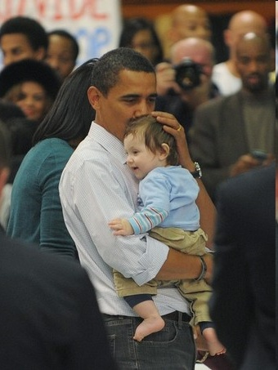
Driving force for data comes from the federal level
Government Performance and Results Act (GPRA)
Program Assessment Rating Tool (PART)
Individuals with Disabilities Education Act (IDEA)
Notes:
These are the federal initiatives/laws that require outcomes data. Although the ‘PART’ may change with the new administration, GPRA is in regulations and IDEA is law.

Slide 10
State of the nation:
Federal reporting requirements

Slide 11
OSEP reporting requirements:
Child outcomes
Positive social emotional skills (including positive social relationships)
Acquisition and use of knowledge and skills (including early language/ communication [and early literacy])
Use of appropriate behaviors to meet their needs

Slide 12
OSEP reporting categories
Percentage of children who:
Did not improve functioning
Improved functioning, but not sufficient to move nearer to functioning comparable to same-aged peers
Improved functioning to a level nearer to same-aged peers but did not reach it
Improved functioning to reach a level comparable to same-aged peers
Maintained functioning at a level comparable to same-aged peers
3 outcomes x 5 “measures” = 15 numbers

Slide 13
Summary statements for target setting
States set targets for two sets of progress data
These sets of progress data are referred to as ‘summary statements’
Summary statements were developed so that states would not have to set 15 targets for child outcomes!
For additional information on target setting, see the ECO “Target Setting” page under “Federal Requirements”: (http://www.fpg.unc.edu/~eco/pages/fed_req.cfm#TargetSetting)
Notes:
OSEP decided not to have states set goals (or ‘targets’) for each of the 5 progress categories. Because there are 3 outcomes, setting goals for each category would mean 15 targets just for this indicator on each state’s Annual Performance Report! Instead, OSEP collected several rounds of input and feedback from stakeholders and worked with ECO to define two ‘summary statements’ for setting targets. The next two slides describe the summary statements.

Slide 14
Summary Statement 1
Of those children who entered the program below age expectations in the outcome area, the percent who substantially increased their rate of growth by the time they exit the program.
Progress categories c + d
Notes:
The first summary statement is about children who made ‘more than expected’ progress while they were in the program. Children who make ‘more than expected’ progress are those who move up on the COSF 7-point rating scale. They include children who ‘catch up’ to age level (which is progress category d) and also children who do not catch up, but move closer to age level by the time they leave the program (which is progress category c). For this summary statement, states will set targets for the percentage of children who leave the program having caught up, or having moved closer, to age level.

Slide 15
Summary Statement 2
The percent of children who are functioning within age expectations in the outcome area by the time they exit the program.
Progress categories d + e
Notes:
The second summary statement is about children who leave the program at age level. Children who leave the program at age level are those who move up to a 6 or 7 on the COSF 7-point rating scale (which is progress category d) or who maintain a level of 6 or 7 for entry and exit COSF ratings (which is progress category e). For this summary statement, states will set targets for the percentage of children who leave the program having caught up to or maintained age level.

Slide 16
Reporting Schedule
Feb 2011 SPP/APR (4th time to report progress data)
First time to use APR format
First time to report on LEA/EIS program performance.
Revised SPP to include targets for 2011 and 2012 and additional improvement activities.
Report on children who exited in 2009-2010, have entry and exit data, and have been in the program for at least 6 months.
Report on the 5 categories and two summary statements for the 3 outcomes, and comparison to targets.
Feb 2012 SPP/APR (5th time to report progress data)
Report on children who exited in 2010-2011, have entry and exit data, and have been in the program for at least 6 months
Continue reporting on the 5 categories and summary statements across 3 outcome areas, and comparisons to targets.
Continue to use APR format and report on LEA/EIS program performance
For more details on the reporting schedule, see: http://www.fpg.unc.edu/~eco/assets/pdfs/TimelineforReportingEarlyChildhoodOutcomesJan2011.pdf

Slide 17
State decisions and activities

Slide 18
WHY collect outcomes data?
(state version)
Purpose
To have data for program improvement
and
to respond to federal reporting requirements
To respond to federal reporting requirements
Notes:
States are developing outcomes data systems not just for reporting to OSEP, but also to have data for program improvement.

Slide 19
WHY collect outcomes data?
(local version)
Purpose
To have data for program improvement
and
to respond to state reporting requirements
To respond to state reporting requirements
Notes:
Likewise, local programs can develop data systems to report to the state, but also to inform their own decisions.

Slide 20
State approaches
Most states have embraced outcomes measurement and are collecting outcomes data for their own purposes
Many states are building bigger systems than needed to produce the federal data
For more information about what other states are doing, see: http://www.fpg.unc.edu/~eco/pages/states_approaches.cfm

Slide 21
How are states collecting child outcomes data?
State approaches to data collection
  Child Outcomes Summary Form (COSF)
    State Part C programs: 41 states (73%)
    State 619 programs: 36 states (61%)
  Single assessment statewide (13% Part C; 15% of 619)
  Publishers’ online assessment systems (4% Part C; 10% of 619)
  Other approaches (11% Part C; 14% of 619)
Notes:
According to the Annual Performance Reports submitted to OSEP in February 2011, most states were using the COSF. Some states have mandated that all local programs use the same tool for outcomes measurement, and some allow programs to choose from among several “approved” tools. Some require everyone to use the BDI, others the AEPS, etc. A few states are working with the publishers of assessment tools to develop electronic systems so that local providers enter data into the system and the computer generates a report.

Slide 22
Assessment tool trends
Part C
  HELP
  BDI-2
  AEPS
  Carolina
  ELAP
Preschool
  Creative Curriculum
  BDI-2
  Brigance
  AEPS
  High Scope
  Work Sampling

Slide 23
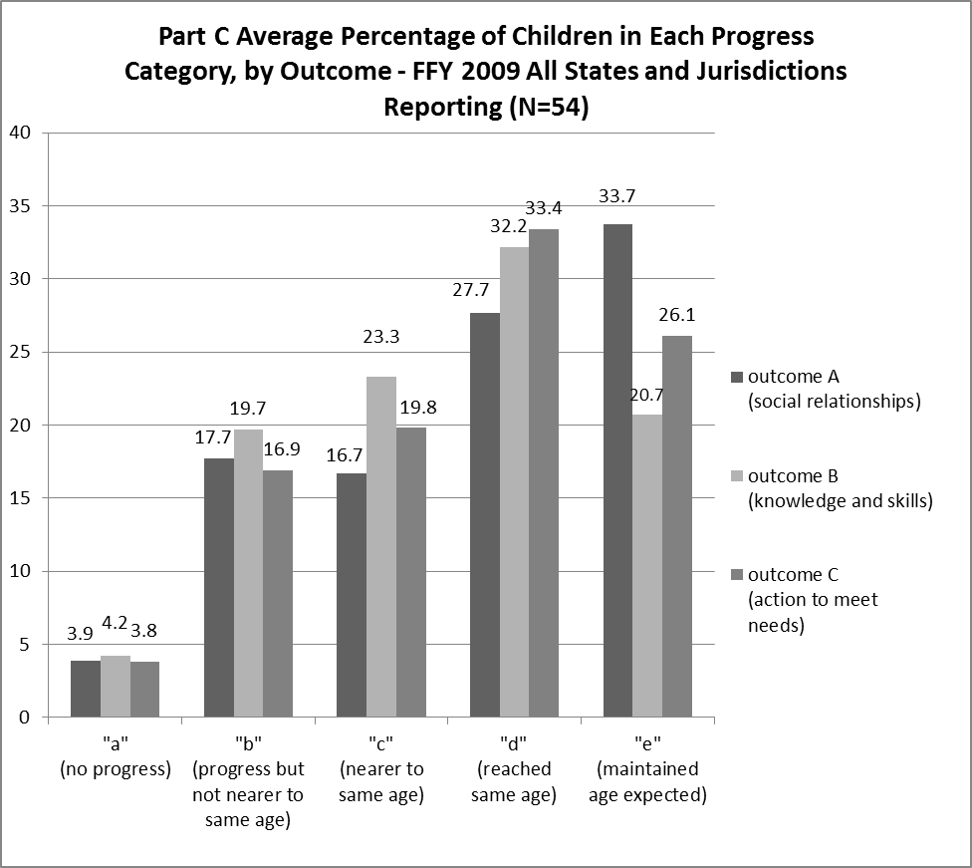
Part C Progress Categories
Notes:
Part C results from data submitted in February 2011.

Slide 24
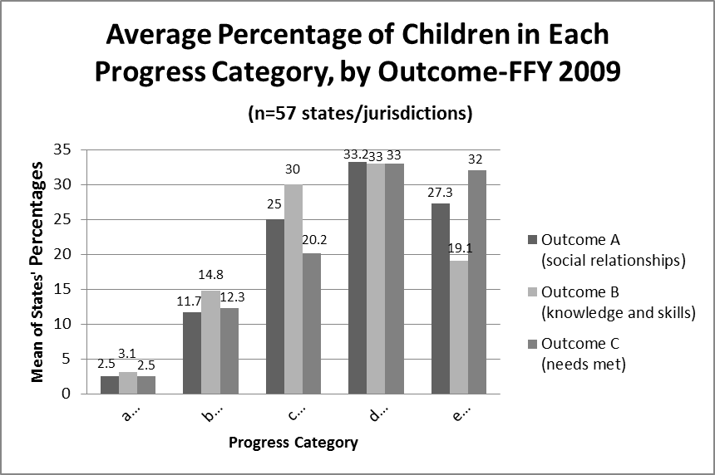
Preschool/ 619 Progress categories
Notes:
Part B/ Section 619 results from data submitted in February 2011.

Slide 25
Should your state data look like the national data?
Not necessarily
More important that each state continue to focus on the quality of its own data
  Getting outcomes data on all children who exit
  Working with programs whose data look unusual to address possible data quality issues
Notes:
Slides with local data may be used to

Slide 26
North Carolina Progress Data Part C: February 2011 APR

