Slide 1
Using outcomes data for program improvement
Kathy Hebbeler and Cornelia Taylor
Early Childhood Outcome Center, SRI International

Slide 2
Topics to be covered on today’s call
Basic steps in using data for program improvement process
Key concepts in using outcomes data for program improvement at the state or local level
Additional resources for you
Notes:
Topics to be covered on today’s call include
Basic steps in using data for program improvement process
Key concepts in using outcomes data for program improvement at the state or local level
Additional resources for you

Slide 3
Question 1
Which of the following best describes the hat you are wearing on this call
State administrator
Program administrator
Teacher/provider
Family member
TA provider
Other

Slide 4
Question 2
How would you describe your current use of child outcomes data for program improvement?
Not using – data are not good enough yet
Not using but the data are credible
Just beginning to use the data
Have some experience using the data
Well on our way in using the data
My position does not involve using data

Slide 5
Working Assumptions for Program Improvement
There are high quality services and programs in your _____[state, region, district, etc.] .
There are [a few/some/many] children who are not getting the most appropriate services and programs for their needs.
If we can identify weak points and find ways to improve their services/programs, these children will experience better outcomes.
Notes:
Before we begin discussing using data for program improvement we want to state that there are several working assumptions to this use of data. First, we assume that the data are of high quality. All levels of data that are being used must be of high quality. For example, If you are using data from a local program, ensuring that data from that program is of high quality is sufficient for the analysis, however, if you want to look at data on a state level, you must ensure that the data from all programs is of high quality
Another working assumption is that there are programs that need to be improved, that is, within programs there are groups/types of children that are not receiving the appropriate services to meet their needs. This could mean that there are children receiving the wrong types of service for example, general services when they need specialized speech services. This could also include children that are getting the wrong amount of services for example 10 hours a month when they would make better progress with 40 hours a month. This could also include children that are receiving poor quality services for example services that are not appropriately adapted to meet the child’s needs.
If we can identify these programmatic weak points, we can use this information to provide targeted resources for program improvement and improve outcomes for these children.

Slide 6
Child Outcome Measurement System Framework Components
Purpose
Data Collection and Trans-mission
Analysis
Reporting
Using Data
Cross-system Coordination
Evaluation
Notes:
This slide shows the Child outcomes measurement system (COMS) framework. As you can see, many things contribute to a good COMS including a clear purpose, high quality data collection, analysis and reporting and good use of data. For this call we will be focused on the use of data for program improvement.

Slide 7
COMS Quality Indicators: Using Data
12. State agency makes regular use of information on child outcomes to improve programs.
13. Local programs make regular use of information on child outcomes to improve programs.
Notes:
The two quality indicators from the COMS that address the use of data for program improvement are Quality Indicators 12 and 13. Quality Indicator 12 focuses on the state agencies regular use of information on child outcomes to improve programs. Quality Indicator 13 focuses on the same topic but related to local programs. The purpose of today’s call is to talk more about how states go about using data to improve programs.

Slide 8
Steps in Using Data for Program Improvement
Formulate your questions
Analyze your data
Interpret your data – generate hypotheses
Do you need more information (maybe analyze more data) to understand what you have found?
Identify a course of action based on findings.
Implement the action to address the findings.
Repeat process.
***PROGRAM IMPROVEMENT IS A CYCLE***
Notes:
Program improvement involves a cycle of activities. The first step is always to formulate your questions. This is critical because without good questions, you can never make good use of data. After you have a set of useful questions you need to determine how you can analyze your data to address those questions. This step is often completed by a data analyst. The data analyst will produce a set of numerical results which will need to have meaning attached to them. This step of interpretation is difficult and often produces more questions that answers. To optimize this process, be ready to identify a set of follow up analyses that answer the additional questions that result. Once you have an agreed upon interpretation of the data, you can identify a course of action based on this interpretation. You will need to implement these actions and then repeat the process to determine if the actions were successful in improving outcomes.

Slide 9
Continuous Program Improvement
Reflect
Are we where we want to be?
Is there a problem?
Why is it happening?
Is it working?
What should be done about it?
Check
(Collect and analyze data)
Plan (vision)
What should be?
Implement
Is it being done?
Notes:
This diagram describes the cycle of continuous program improvement. We often start at three-o-clock where we design the vision for program improvement in the state. Without a vision, program improvement activities are likely to be piece meal and not lead to statewide improvements in child outcomes. The next step is to implement your plan, and the collect data on how you plan is being implemented. The data will then be analyzed and interpreted to determine if the plan that was implemented is working. Then you reflect on your findings and revise your program improvement plan accordingly.

Slide 10
Different hypotheses lead to different solutions
Possible hypotheses
Possible solutions
Working assumption: There is something that can be changed and we need to identify what it is and make the changes.
Notes:
It is important to keep in mind that different hypotheses lead to different solutions. This is one reason why it is critical to have stakeholders involved in the development of hypotheses. Keep in mind that with all data analysis and interpretation for program improvement there is a working assumption that a) changes are possible and b) we can identify what needs to be changed.

Slide 11
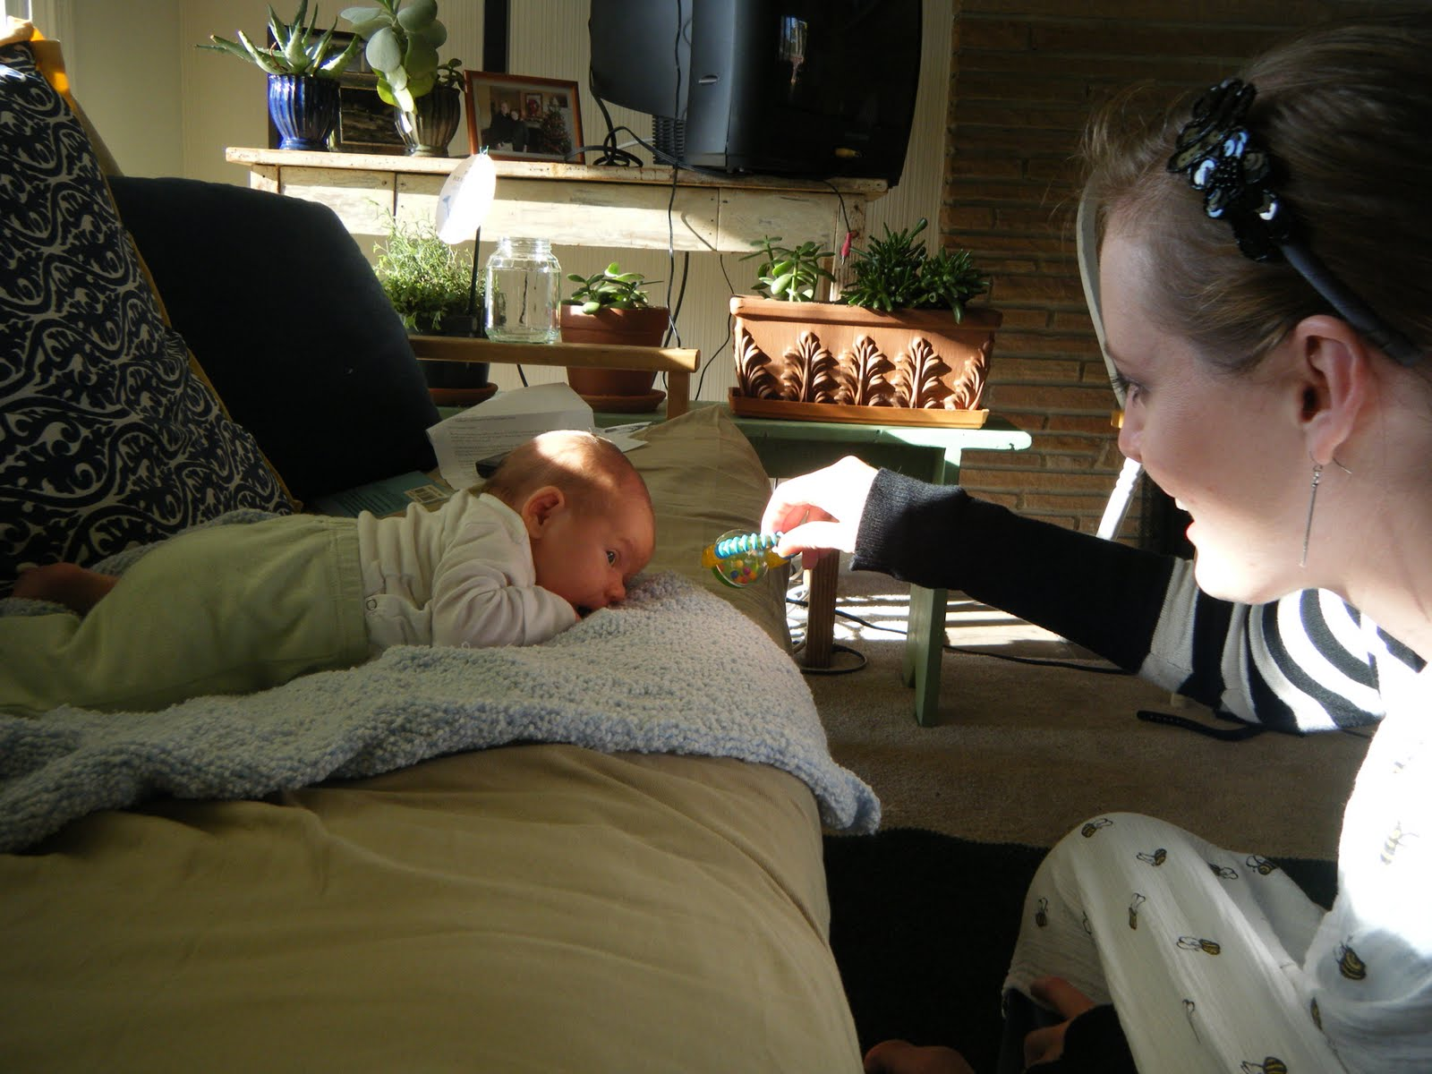
EIA*
Evidence
Inference
Action
*also known as FMA (Findings, Meaning, Action)
Notes:
For the next section of this presentation we will discuss the concept of evidence inference and action. This process is also known as finding meaning action.

Slide 12
Evidence
Findings are the numbers
10% of children scored……
45% of children made progress
The numbers are not debatable (assuming the numbers are correct…)
Notes:
Evidence refers to the numbers that are produced through data analysis. If the numbers are computed from high quality datasets, they are not debatable.

Slide 13
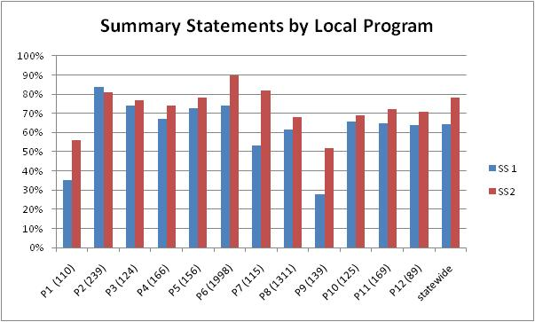
Outcome C: Takes Actions to Meet Needs
Notes:
This is an example of a distribution of percentages for summary statements by program for outcome C: takes actions to meet needs. Summary statement 1 is the percent of children that entered the program below age expectations in outcome C and substantially increased their rate of growth. Summary statement 2 is the percent of children who were functioning within age expectations in each of the outcomes by the time they exited the program.
When you look at this data, the first step is to take in the big picture. Which program has the highest value on SS1? The lowest? Which program has the highest value on SS2? The lowest? Which program has the largest difference between SS1 and SS2? The smallest? How many programs are above the state average?
The previous questions are all answered with evidence but the answer will not tell you why.

Slide 14
Question 3
Which of the following is not an evidence statement?
Program 3 is the highest in SS1
Program 6 is the highest in SS2
Program 9 has lower scores because it serves children with more severe needs
For Program 11, both Summary Statements were over 60%.
Notes:
Answer
C – This response includes inference about the evidence in the statement “because it serves children with more severe needs”

Slide 15
Inference
The interpretation put on the numbers
Is this evidence:
Credible? (Based on valid data?)
Good news? Bad news?
News we can’t interpret?
Does it raise more questions?
Notes:
Inference is the act of putting meaning to evidence. Some common inferences are about the credibility of the data, the “spin” of the data (good news /bad news) and the interpretability of the information. Often evidence presents us with more questions that it answers and we have to dig into the data to find out what is really happening.

Slide 16
Inference
Inference is debatable and reasonable people can reach different conclusions from the same set of numbers
Stakeholder involvement can be helpful in making sense of findings
To interpret meaning, sometimes we analyze data in other ways (ask for more findings)
Notes:
Unlike evidence, inference is debatable. Different people can interpret the same set of numbers in different ways based on their experiences with the system that the data describe. For this reason, stakeholder involvement is critical for correct inference of data. In addition to stakeholder involvement we often conduct additional analysis of the data to determine what the evidence means

Slide 17
Question 4
What else would you like to know about the five programs in your state with the lowest percentages for SS 1 or SS 2?
The disabilities of the children served by the different programs
The progress category distribution
The racial and ethnic makeup of the children served.
Other targeted follow up questions
Notes:
Answer – there is no right answer! all of these would contribute useful information
When we asked this question on the webinar people contributed so other ideas for follow up analysis including looking at the number of children reported by each program and looking at the programs performance on other indicators.

Slide 18
Question and answer/evidence from these data
Which program has the lowest SSs?
Answer:
Program 9 has the lowest percentage for SS1 and the second lowest for SS2.
This is not debatable – but what is the inference that follows from the evidence?
Notes:
The following section of the power point is an example of how we might drill down into the summary statement data presented earlier to aid us in making inferences about the data. The question we asked was “which program has the lowest SSs?” The answer based on the SS data presented earlier is Program 9 which has the lowest value for SS1 and the second lowest for SS2. This is evidence and is not debatable but now we want to make inferences about the data and we need to know more about program 9. Does the evidence show that they are not providing quality services to children or is there some characteristic of the children served by program 9 that leads to lower SS values.

Slide 19
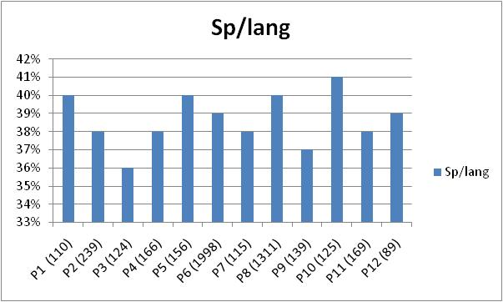
Notes:
The first variable that we look at across programs to learn more about how Program 9 compares to the other programs is the primary disability of the children served by program 9.
This chart shows the percent of children served by each program that have a primary disability of speech language impairment. Children with this primary disability are typically less severely impaired than many of the other children that receive services. We expect programs serving a high percentage of children with speech language impairment to have high values on SS2 in Outcome c Takes actions to meet needs.
When we look at this chart we see that program 9 serves fewer children with speech language impairments than many of the other programs in the state but it does not serve the fewest. There is some variation across programs but all are between 36 – 41% not a very wide range.

Slide 20
Notes:
Outcome C: Actions to meet needs is an outcome that often has a strong motor component. We know that children with orthopedic impairments often score lower than their peers without motor impairments on items related to outcome C that are not administered with the appropriate adaptations. For this reason we would want to look at how the percent of children with orthopedic impairments served by program 9 compares to other programs in the state.
Looking at this chart we see that the percent of children with orthopedic impairments served by different programs varies between 2 – 7%. Program 9 serves the most children with orthopedic impairments in the state (tied with program 3).

Slide 21
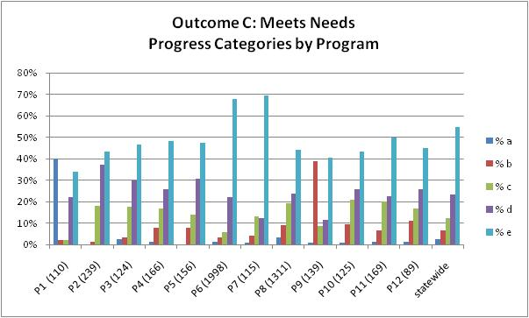
Notes:
The summary statements are based on the progress categories. Looking more closely at the distributions across the progress categories can sometimes help you to understand why the summary statements are low or high.
When we look at the data above are there outliers that jump out are? P1, P6, P7, P9, Note how much P6 is influencing the statewide number because it is a big districts. The big districts are likely to track much closer to the state number because they contribute so much to it. When we look at Program 9 we see that they have the highest percentage of children in category b in the state. Category b includes children that made some progress but not enough to move closer to their typically developing peers.

Slide 22
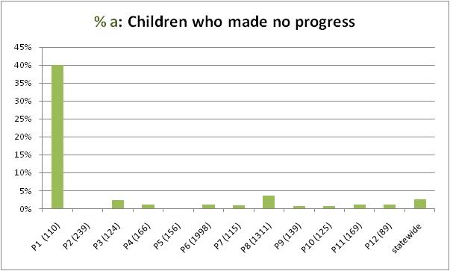
Notes:
As a helpful hint, it is often easier to look at the progress category data by pulling the progress categories apart. Remember that the progress categories sum to 100% so programs that are outliers for one progress category are often outliers for another. Looking at the percent in category a is a good way to detect data quality issues. Programs that have a high (above 10%) percentage of children in category a may not be completing assessments correctly.
We see in this chart that Program 9 has a very low percentage of children in category a. This is evidence that what we are seeing in the summary statements is not due to a data quality issue or a high number of children with disabilities where they are losing skills.

Slide 23
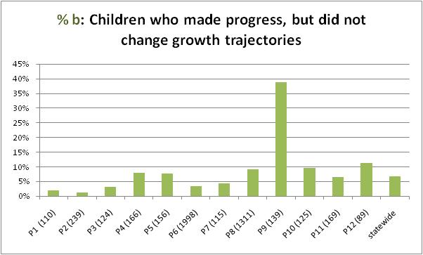
Notes:
Because we saw that Program 9 was the highest in progress category b. We pulled out the data on progress category b across programs. We see when we look at this data that Program 9 really is an outlier for this progress category. Program 9 shows almost 40 percent of children in category b. and the next highest program is about 10%. This is effecting the summary statements because category b includes children that did not move closer to their typically developing peers and do not exit looking like their typically developing peers.

Slide 24
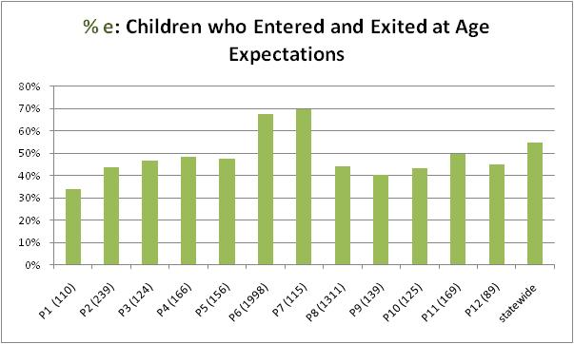
Notes:
Category e contributes to summary statement 2 because it described the number of children that entered and exited at age expectations. This progress category is an indicator of the initial status of the children entering the program (performing like their typical peers). Programs with high percentages in category e typically serve less severe populations.
We can see from the graph above that Program 9 is among the programs that serve the lowest percentage of children in category e but they are not the lowest

Slide 25
Notes:
The next piece of evidence that we looked at was the race/ethnicity distribution of the programs. When we look at this distribution it is important to look at the big picture first. We see here that most of the programs are majority white (not Hispanic). But program 9 looks very different because it is majority Hispanic.
After digging down into your existing data to make inferences about you programs you may find that you need additional information that you have not already collected to determine what is going on.

Slide 26
Targeted follow up Questions for Program 9
Review of a sample of entry and exit data and staff interviews found:
About half of the children enrolled in the program are from families whose home language is Spanish
There is a shortage of Spanish speaking providers
Data collection procedures were followed, but assessments did not include family input for many Spanish speaking families
Providers reported heavy workloads and frustration with language challenges
Notes:
Some techniques for collecting this additional information include detailed record review of the cases, review of assessment data and interviews with staff. For the follow up with Program 9 we reviewed a sample of the entry and exit data and conducted some staff interviews. From this additional data collection we found that Program 9 is struggling to appropriately serve family whose home language is Spanish.

Slide 27
Possible inferences based on the available data for Program 9
SS data are not credible.
Children are not making gains comparable to those seen in other programs because they have more support needs around language. The SS results are what we would expect.
Children are not making gains comparable to those seen in other programs because of the lack of Spanish speaking providers. This needs to be addressed and we would expect the SS results to improve when we do.
Another inference (Describe:_____).
Notes:
This slide shows some of the inference you could make related to the evidence that Program 9 is the lowest in SS1 and the second lowest in SS2. These inference include
The data are not credible
The children are making less gains because they have more support needs around language and these SS results are what we would expect from a high quality program
Children are not making gains because of the lack of Spanish speaking providers and we would expect the results to improve if this was resolved.
In addition to these inferences there are many more that could be made based on the available data. Think about what we have learned and what else might be causing children in Program 9 not to make enough progress to get closer the performance of their typically developing peers.

Slide 28
Action
Given the inference attached to the evidence, what should be done?
Possible actions:
Continue to work to improve the quality of the data
Accept the data as credible and develop recommendations to address what was learned
Action is always debatable – and often is
Another role for stakeholders
Notes:
Action is the third piece of the evidence inference action cycle describing the process of making changes as a result of inference. States are in different places with regards to data quality. One possible action for some states is to improve the quality of their data so they can make inferences from their evidence. If the data are credible, actions can be implemented based on the evidence and inference.
Keep in mind that action is always debatable (one of the reasons why we follow up to make sure the action is working to correct the identified problem) and developing actions is another important place to involve stakeholders.

Slide 29
Possible inferences based on the available data for Program 9
SS data are not credible.
Children are not making gains comparable to those seen in other programs because they have more support needs around language. The SS results are what we would expect.
Children are not making gains comparable to those seen in other programs because of the lack of Spanish speaking providers. This needs to be addressed and we would expect the SS results to improve when we do.
Another inference (Describe:_____).
Notes:
Let’s return to our earlier example and the inference – What is the action that follows from each inference?
Improve the data.
Do nothing (that is an action when intentionally chosen).
Work to increase the number of Spanish speaking providers.

Slide 30
Steps in Using Data for Program Improvement
Formulate your questions
Analyze your data
Interpret your data – generate hypotheses
Do you need more information (maybe analyze more data) to understand what you have found?
Identify a course of action based on findings.
Implement the action to address the findings.
Repeat process.
***PROGRAM IMPROVEMENT IS A CYCLE***
Notes:
Let’s review the steps in the process for the Summary Statement example we just went through.
What was the question? Which program had the lowest SS percentages?
What did the data show? P9
[Note that sometime you already have analyzed data which is the case with the Summary Statements and the Progress Categories – and then you need to work backwards and figure out what questions the evidence can answer.]
What was done to interpret the data? Look at some other information. Why? Because we wanted to understand more about the program to make reasonable hypotheses as to why the SS percentages were low.
And then based on the additional data, we made a hypothesis as to why the data were low which suggested a course of action.
Next step implement a solution --- and then watch the data for next year to see if things change.

Slide 31
QI 12. State agency makes regular use of information on child outcomes to improve programs.
State regularly implements a stakeholder process that includes families for considering the implications of child outcomes and other data.
As appropriate, state identifies some local programs for targeted support and then works with these programs to jointly develop action plans.
State identifies statewide systemic goals for improvement.
State develops a comprehensive plan for program improvement.
Notes:
The self assessment identifies 7 elements that a state has to have in place to fully implement the Quality Indicator on use of data. These are
a- can you see the importance of the stakeholder process in coming up with hypotheses and deciding on a course of action.
b – a recurring theme is going to be identifying those programs that need additional support.
C – state overall goals.
D – the state develops a comprehensive plan for program improvement.

Slide 32
QI 12. State agency makes regular use of information on child outcomes to improve programs.
State implements and evaluates program improvement activities on a regular cycle.
State provides support to local programs related to use of child outcomes data.
State has policy or guidance that addresses local program responsibilities with regard to use of data for program improvement.
Notes:
E – the state implements and evaluates the program improvement activities on a regular cycle.
F – state provides support to local programs
G – state has policy or guidance to address responsibilities with regards to the use of data for program improvement.

Slide 33
Notes:
This is what the Quality Indicator in the COMS framework looks like. The state can rate their performance on each of the 7 elements listed below the Quality Indicator and then combine the information to give themselves a rating on the Quality Indicator.

Slide 34
QI13. Local programs make regular use of information on child outcomes to improve programs.
All local programs regularly implement a stakeholder process that includes families for considering the implications of child outcomes data and other data.
Local programs use data to develop a comprehensive plan for program improvement.
All local programs implement and evaluate program improvement activities on a regular cycle.
Notes:
In addition to the state level Quality Indicator there is also a Quality Indicator for use of data for program improvement for local programs. It includes three elements.
A – local programs implement a stakeholder process for understanding and using data
B – local program develop a comprehensive plan for program improvement
C – implementation and evaluation of program improvement activities continue in a regular cycle.

Slide 35
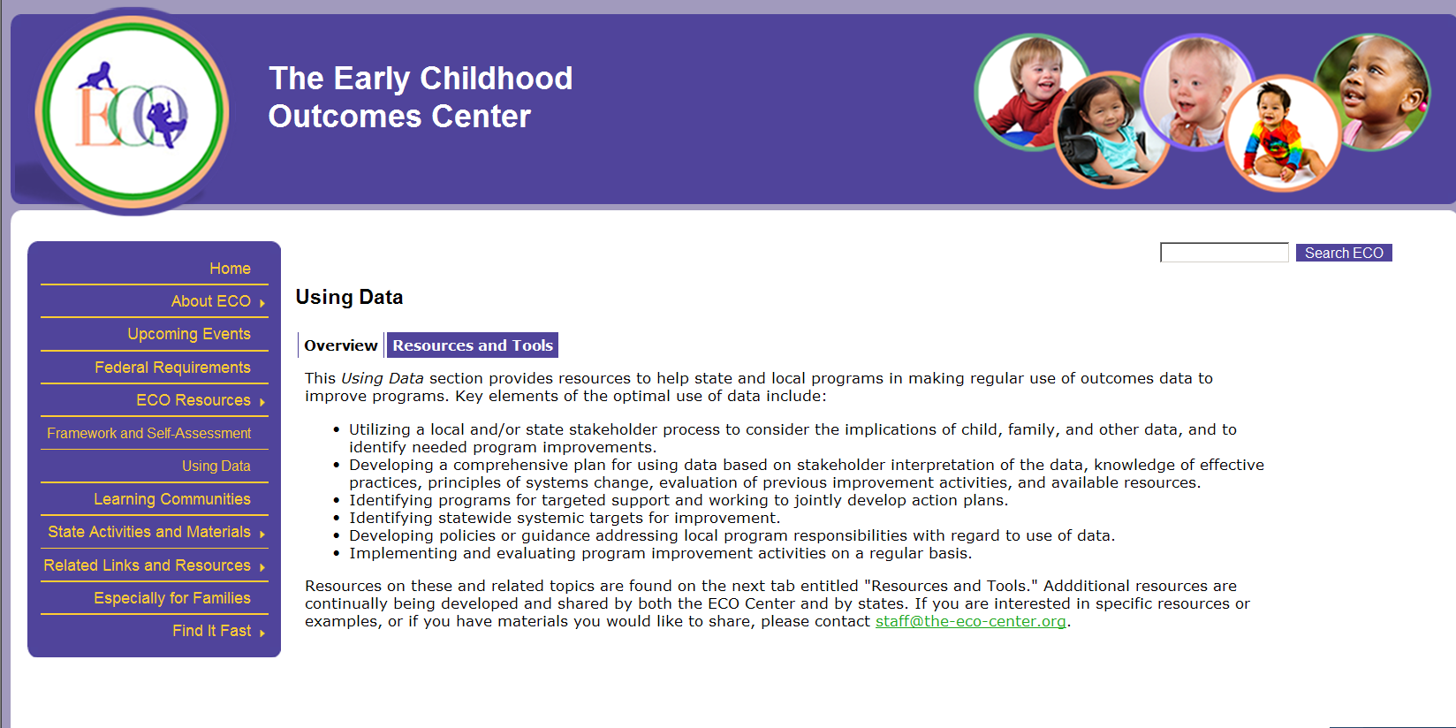
Notes:
More information on using data is available on the using data section of the ECO website

Slide 36
Resources on the ECO website
Slides and materials from the Using Data Call Series
Evaluating SPP/APR Improvement Activities document
Slides and materials from workshops on using child outcomes data for program improvement
COMS framework
Notes:
Resources include
Slides and materials from the using data call series
A document describing the process of evaluating SPP/APR Improvement activities
Slides and materials from workshops on using data
And the COMS framework

Slide 37
Find more resources at: www. the-eco-center-org
Thank you!!

