Slide 1
Webinar Series 1 Supporting the Inclusion of Young Children with Disabilities Session 2: State Strategies to Promote Inclusive Practices February 17th, 2015
Jim Coyle
Patti Wirick
Vivian James
Robin Rooney
Notes:
Katy McCullough
This webinar is the second in a series of three webinars planned for 2014 and 2015, jointly sponsored between ECTA and ELC-TA. The presenters for this webinar are:
Dr. Jim Coyle – Is both the Part C and 619 Coordinator for PA, official title is Director, PA Bureau of Early Intervention Services
Patti Wirick - Project Manager for EITA
Vivian James - 619 Preschool Coordinator. For NC, State Dept. of Public Instruction and Exceptional Children's Program
Robin Rooney – Director, NC Early Learning Network
We will be muting all phone lines. To speak, please press *6 to unmute. Then *6 to mute again.

Slide 2
Objectives
Participants will:
Understand how two states (PA & NC) are implementing strategies to support local early childhood special education programs to promote the use of inclusive practices.
Have opportunities to pose questions and generate ideas with colleagues.
Notes:
Katy
The objectives of this webinar are for participants to:
Understand how two states (PA & NC) are implementing strategies to support local early childhood special education programs to promote the use of inclusive practices.
Have opportunities to pose questions and generate ideas with colleagues. Encourage participants to use the chat to pose questions.
Poll Q: Who is on the call? By role, by system.

Slide 3
Pennsylvania’s Inclusion Support
Notes:
Jim will do this slide
Thanks to ECTA for allowing Pennsylvania to talk about our efforts at improving inclusive opportunities for young children with disabilities in typical early childhood settings.
Introduce self -- Dr. Jim Coyle, Director, PA Bureau of Early Intervention Services and Deb Daulton, Director, Early Intervention Technical Assistance, and Patti Wirick, Project Manager for EITA which is the statewide birth to five training and TA network supporting the Bureau of Early Intervention Services—in our state we use the term early intervention for both Part C and Section 619 but for this webinar we will try to use preschool special education for the section 619 program.

Slide 4
Inclusion Supports
Successful Inclusion
Intentional collaboration
State funded Pre K
Joint Professional Development
Inclusion Guidelines
Incentive Grants
Quality Enhancement Plans
TQRIS incentives
Notes:
Jim will do this one.
Pennsylvania, through the Office Of Child Development and Early Learning (OCDEL) has a tradition of providing many supports for inclusion.
These supports include:
Intentional collaboration between state supported early childhood programs (including RTTELC) and Part C/Section 619 because they are in the same Office of Child Development and Early Learning (OCDEL)
The number of children with IFSP/IEPs in child care combined with the number of children who receive subsidy qualifies an early childhood program to receive TQRIS incentives
The TQRIS already includes some requirements around inclusion and is being revised to add more.
State funded PreK has requirements for including children with IEPs as well as a requirement for screening and referral to EI/preschool special education.
Joint PD on Early Learning Standards with EC, Part C and Section 619
OCDEL Inclusion Guidelines developed for all early childhood programs including Part C and Section 619
All preschool special education programs must set inclusion targets as part of their Quality Enhancement Plan
Incentive grants for preschool special education programs to promote use of assistive technolgy with children with IEPs in child care/Head Start/Prek
Incentive grants for preschool special education programs to promote use of positive behavior supports in child care/Head Start/Prek
Incentive grants for preschool special education programs to increase the numbers of children with IEPS in child care/Head Start (which is the focus for this webinar)
TURN IT OVER TO PATTI

Slide 5
Inclusion Performance Grants
Offered to low performing early intervention preschool programs since 2008
BEIS and EITA review LRE data for all preschool early intervention programs
Selected programs whose data fell significantly below the state average
Utilized LRE categories of % of children served in Head Start and/or Early Childhood as well as Early Childhood Special Education settings
Notes:
Since 2008, the Bureau of Early Intervention Services (BEIS) has offered incentive grants to low performing local preschool special education programs. Programs are selected based on data that indicates the percentage of children served in early childhood and/or Head Start settings is significantly below the state average. And beginning in 2011, we also looked at preschool special education programs whose data indicated they served significantly more children in early childhood special education programs (ECSE) than the state average.
Pennsylvania used the “old” LRE categories to allow us to be more intentionally specific in addressing inclusion in early childhood/Head Start settings.
The Bureau and Early Intervention Technical Assistance review the data and make selections.

Slide 6
Inclusion Performance Grant Application Requirements
Targets for increasing % of children served in EC/HS settings
Targets for decreasing % of children served in ECSS settings
Increase community program partnerships
Designate internal and external coaches
Professional Development
Sustainability
Notes:
Once programs have been identified, they complete an application to receive the grant. The requirements in the application are:
Programs must set annual targets for increasing the % of children served in EC/HS settings and beginning in 2011, they must also set targets for decreasing the % of children served in ECSE settings. These targets must be approved by the BEIS.
Programs must also indicate an increase in community program partnerships where children with disabilities are included. These community programs must be included in our state-operated Keystone STARS, the quality rating system for child care programs in Pennsylvania.
Increasing the number of children with disabilities included in typical early childhood settings requires a collaboration of preschool special education and Early Childhood staff. This grant requires that expertise be developed in both programs to sustain progress, to plan, carry out, and review the impact of grant activities therefore each grantee must designate an Internal and External coaches.
One or more staff should be identified from the preschool special education program to provide support and consultation to the early childhood program. The staff can be itinerant teachers or therapists, inclusion specialist or other staff who function as external coaches to the early childhood programs.
Each early childhood program must identify an internal coach to provide support for inclusion across their own early childhood program. This person should be an employee of the EC program. This individual must be given the flexibility of schedule to be able to observe and coach all other personnel in the building. He/she should be respected by fellow colleagues, be enthusiastic about inclusion, and be able to provide training and feedback in group and individual situations.
Professional development to support both the preschool special education staff and early childhood partners to build the capacity for inclusive services by the end of this grant. Key components of professional development should include:
Characteristics and contexts of the learners (i.e., “who are they and where do they work”)
Content (i.e., “what do you want them to know and be able to do”); and
Organization and facilitation of learning experiences (i.e., “how will you accomplish these changes”)
Preschool special education programs need to demonstrate change that will sustain the increases in inclusive opportunities after the grant period.

Slide 7
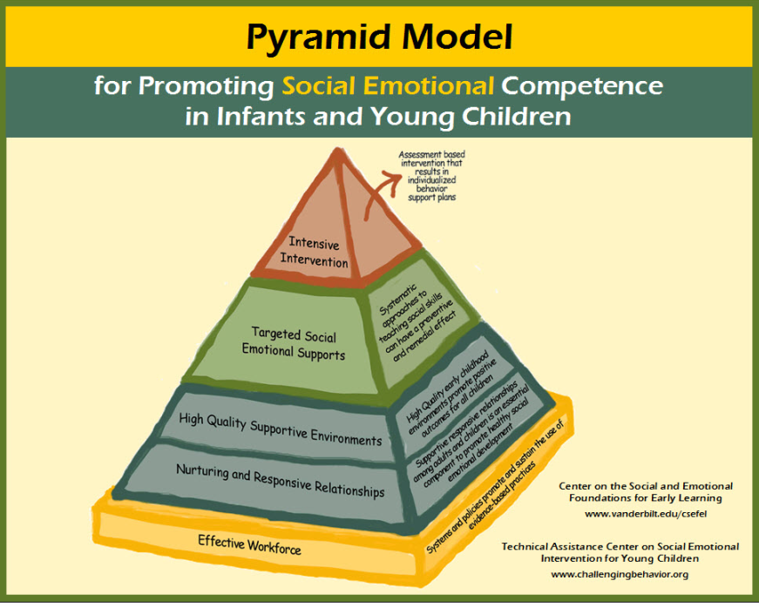
Inclusion Performance Grant PBIS Option
Beginning in 2014, programs could elect to implement PBIS as a strategy to support inclusion
Notes:
In 2014 we added an option to the performance grant application for programs to implement Positive Behavior Interventions and Supports (PBIS) as a strategy to support inclusion.

Slide 8
Inclusion Performance Grant PBIS Option Requirements
Identify at least one EC partner for implementation
Commit to multi-year process
Complete “Commitment to Fidelity Implementation”
Identify a PBIS Facilitator
Participate in on-going trainings
Notes:
The PBIS option required that preschool special education programs:
Identify at least 1 early childhood partner for implementation
Commit to a multi-year process.
Complete the “Commitment to Fidelity Implementation” designed to determine current status and develop goals to address over time.
Identify a PBIS Facilitator who has been, or is in the process of being trained by the PA PBS Network. This person must be available for sustainable support to the process.
Participate in on-going trainings related to PBIS.

Slide 9
Inclusion Performance Grant Self Evaluation
Access
Identification of strengths and needs related to:
Participation
Supports
Aligned with DEC/NAEYC Position Statement on Inclusion
Aligned with DEC Recommended Practices
Notes:
Another requirement of the Inclusion grant application is for each grantee to complete a self-evaluation in order to identify strengths and needs related to inclusion. The purpose of the self-evaluation tool is to provide a framework for discussion that promotes partnerships to benefit young children with special needs and their families.
Each program is encouraged to convene a team of stakeholders that may include:
Preschool special education Program Administrator
Early Childhood Partner program Administrator
External Coach(s)
Internal Coach(s)
BEIS Advisor
EITA Consultant
IMFS Consultant (from the PA Arc)
Family Members

Slide 10
Inclusion Performance Grant Self Evaluation
Notes:
The Pennsylvania Preschool Inclusion Self Evaluation Tool was adapted from New Hampshire and is aligned with the NAEYC/DEC Position Statement on Inclusion and has recently been cross walked with the revised DEC Recommended Practices. This self evaluation tool is divided into sections on:
Access to Services
Access to Information
Planning for Full Participation
Supports for Inclusion
Once the self evaluation is complete, teams develop an Action Plan based on the results.

Slide 11
Inclusion Performance Grant Action Plan
Based on results of self assessment
Resources needed
Evaluation/data
Activities for implementation
Team member’s responsibilities
Timelines
Notes:
The Inclusion Grant Action Plan format is designed to address results of the self evaluation and is based on the principles of Implementation Science. Grantees identify activities/strategies for implementation and who will be responsible for each part of the step/activity. We also ask that administrator’s roles be identified in each step. Timelines are developed and resources needed are identified. In addition, we ask that evaluation measures be identified for each activity to insure that programs are using data informed decision making.

Slide 12
Inclusion Performance Grant Action Plan
Notes:
The Action Plan “mirrors” the general sections of the PA Self Evaluation tool. There are sections on:
Access to Services
Access to Information
Planning for Full Participation
Supports for Inclusion

Slide 13
Inclusion Performance Grant Support
Program
PA Arc Consultant
EITA Consultant
Local technical assistance and support
Parent training and support
Notes:
Each grantee is provided with on-going support. An Early Intervention Technical Assistance (EITA) consultant(s) is assigned to each program. The consultants are required to have at least monthly contact with each grantee to provide on-going training and TA related to inclusion. In addition, those preschool programs who elect to implement PBIS are assigned an additional consultant with expertise in PBIS to provide on-going support related to behavior.
Each grantee is also assigned a PA Arc Consultant to provide on-going support and training for families.

Slide 14
Inclusion Performance Grant Ongoing Support
Quarterly meetings
Quarterly reports
Monthly data reports
Monthly EITA Consultant contacts
Notes:
At the beginning of the year, we bring all grantees together for a special “Kick Off” of the grant. During this event, grantees have an opportunity to network with other grantees and to understand the full requirements of their participation in the incentive grant. We have regularly scheduled virtual quarterly meetings with all grantee teams. Each grantee is also required to submit a quarterly narrative report on grant activities based on their Action Plan. We also provide monthly data reports which allow programs to see and measure their progress related to their targets in EC/HS and ECSE. In addition, there are at least monthly contacts with their assigned EITA Consultants. We also have the support of parent training/support consultants through Arc of PA. These consultants work under the direction of the preschool special education program to offer training/resources and support to families of children with disabilities in or considering placement in inclusive settings. These IMFS Consultants have been a great support to community preschool programs as well, as they have conducted trainings and developed resources to support inclusion.
Another way of providing ongoing support to our grantees is through the EITA Online Learning Portal.

Slide 15
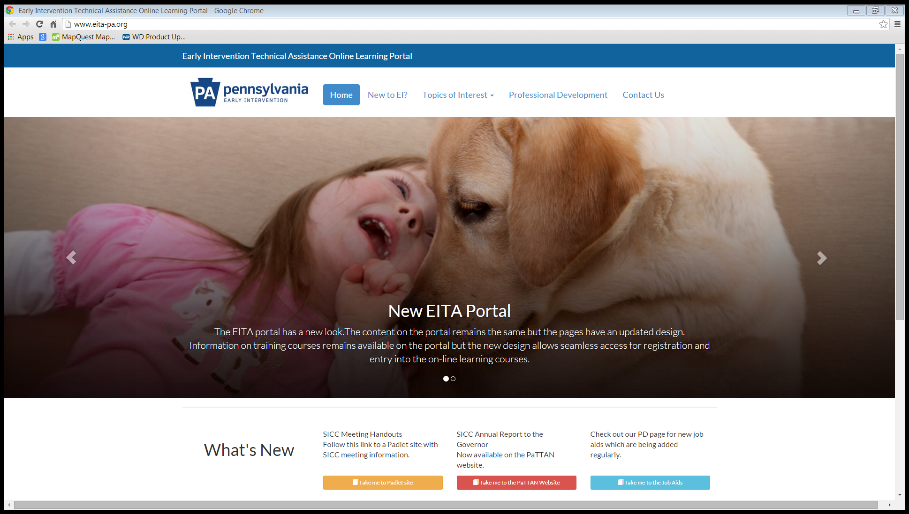
http://www.eita-pa.org/
Notes:
The EITA Online Learning Portal serves as a repository of resources and materials to support grantees. Under “Professional Development” there is a place labeled Inclusion Grantees. If you click on that tab you will see:
Resources for Inclusion
Tools for Inclusion
Cultural Diversity Resources
Family Engagement Resources
Curriculum Resources
Social Emotional Resources
National Inclusion Initiative Web Sites
Pennsylvania Inclusion Web Links
Current Year Grantees Information
New information is being added constantly, so programs are encouraged to check the portal often.

Slide 16
Inclusion Performance Grant Results
Majority of programs met targets
Sharing of strategies across programs helps sustainability
Programs strengthened PBIS
Partnering with PA Arc strengthened family engagement
Notes:
Results of our efforts with the Inclusion Performance Incentive grants have been positive. A majority of programs have met their targets. Sharing of resources across programs helps with sustainability. Programs have strengthened their implementation of PBIS which has allowed for more inclusion opportunities for children with disabilities. Partnering with the PA Arc has strengthened family engagement.

Slide 17
Inclusion Performance Grant Data
Notes:
Here is some data from our grantees over the years. You will see that most programs have met at least 84% to 100% of their targets in increasing numbers/percent of children served in EC/HS programs. You also see that as we move from 2009 to this year, the percentages have increased. More programs are reaching their targets now then in 2009.

Slide 18
Inclusion Performance Grant Data
Notes:
The graph represents our data from grantees when we began to include a decrease in the number/percent of children served in early childhood special education settings (segregated classrooms). We started that in 2012 and it looked like we were being successful until last year. We had a pretty significant drop off in the data, so we decided that we needed to do something different with our grantees. That is why we offered the PBIS option this year to grantees, and already we’ve seen an improvement in the data.

Slide 19
Inclusion Performance Grant Data
Notes:
And finally, we’d like to show you data for the only grantee that has been a recipient of the incentive grants since the beginning. This is a very rural high risk, low reach area of the state, but as the data shows, the opportunities for inclusion have steadily grown over the 7 years this program has been participating in the grant. Without the fiscal support of the grant, and the resources/materials and human support, we may not have seen this growth in children with disabilities being served in typical early childhood settings.

Slide 20
Questions?
Notes:
Katy
Please *6 to unmute to ask a question. Can also type your question in the chat.
5 minutes

Slide 21
Resources to Promote Inclusion
North Carolina Preschool
Exceptional Children Program

Slide 22
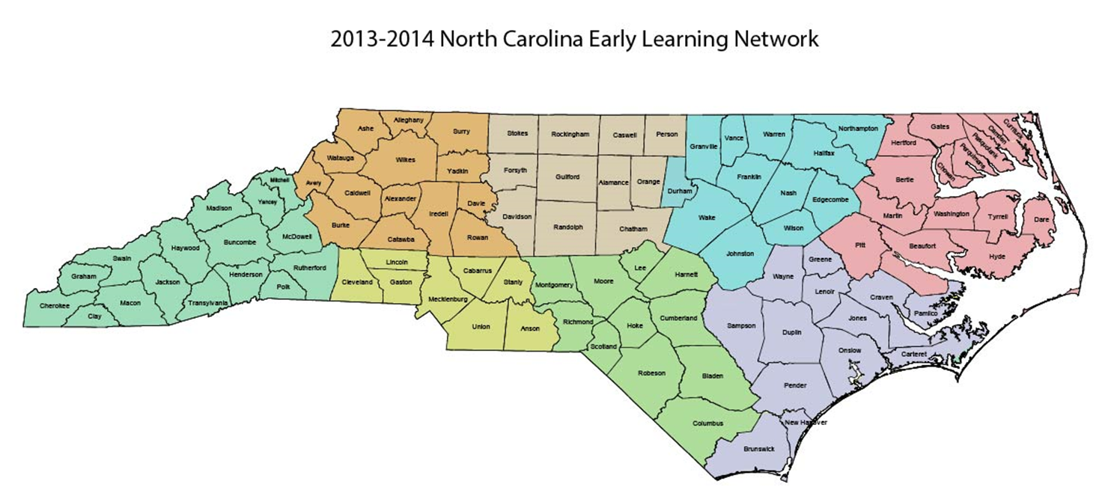
NC Least Restrictive Environment (LRE) Data

Slide 23
Reporting Indicator 6
Summary Statements | Actual FFY 2012 Total Headcount N= 18,665 (% and # of children) | Actual FFY 2013 Total Headcount N= 18, 801 (% and # of children) | Target FFY 2012
6A. Regular early childhood program and receiving the majority of special education and related services in the regular early childhood program | 49.9% (N=9.322) | 50.26% (N=9.450) | 51.5%
6B. Separate special education class, separate school or residential facility | 21.2% (N=3,962) | 21.98% (N=4,132) | 20.5%

Slide 24
Notes:
Last year’s RECP was 49.88
Last year’s SC was 21.20
Next, do the same thing for your LEA data

Slide 25
Notes:
Last year’s RECP was 37.84
Last year’s SC was 23.53

Slide 26
M
T
S
S
in
N
C
Intensive Support
Inclusion Initiative
PreK IEP Training (TOT),
Early Learning & Development
Standard Training (TOT),
NC SEFEL Initiative
Supplemental Support
Preschool Coordinator Orientation, Regional Meetings and/or Webinars, Representatives/Mentors , Annual Institute, National Inclusion Institute, Listserv, Guiding Practice Documents, Questions & Answers Document
Differentiated Core

Slide 27
Differentiated Core- Understanding the Data

Slide 28
Indicator 6 questions
In general…
What do you notice about the data?
Are there patterns? Trends?
Did your data show improvement from the previous year?
What kinds of questions do you have about these data?
What are the data telling you?
What is the ‘story’ behind the data?

Slide 29
Indicator 6 questions
Specifically…
Did the State meet targets for Indicator 6?
Did your LEA meet targets for Indicator 6?
What is the difference in LRE for PreK and Kindergarten?
If your LEA did not meet the state targets, what should be the plan for improvement?
If you are performing above the state target, have you set improvement targets for your LEA?

Slide 30
Results Driven Accountability
When selecting LEAs for intensive support, we considered:
LRE data
Impact the size of the district had on the state data and the number of children they serve
The LEA’s buy-in

Slide 31
Inclusion Initiative-
Intensive Support
SEA and LEA
Agreement
(Assurances)

Slide 32
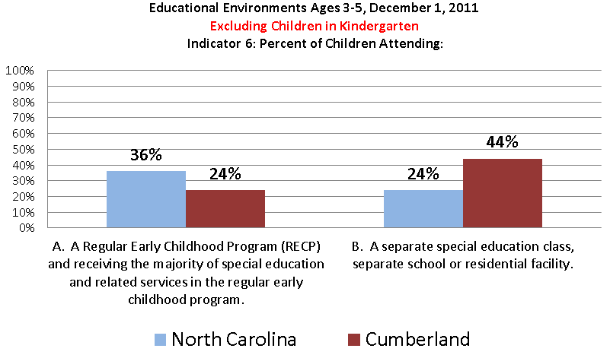

Slide 33
DRAFT

Slide 34
http://nceln.fpg.unc.edu
Notes:
Go to website to show self-directed online training modules for preK IEPs.

Slide 35
Questions?
Notes:
5 min.
Katy
Please *6 to unmute to ask a question. Can also type your question in the chat.

Slide 36
New Resources! http://ectacenter.org/topics/inclusion/default.asp 1. TA Project and National Association Professional Development Resources to Support Inclusion 2. State Professional Development Resources to Support Inclusion 3. Supporting Inclusive Practices: Professional Development Resources
Notes:
Shelley
This are posted. Will be interactive. More on these once that’s done.

Slide 37
Have you come up with one new idea from today’s call that you would like to explore further? If so, what is it?
Notes:
Megan
Either share on the line (press *6 to unmute) or via the chat.
Q: Do you have strategies you use in your state? List in chat.

Slide 38
Contact Information James Coyle: jecoyle@pa.gov Patti Wirick: pwirick@atlanticbb.net Vivian James: vivian.James@dpi.nc.gov Robin Rooney: robin.rooney@unc.edu Shelley de Fosset: shelley.defosset@elcta.org Megan Vihn: megan.vinh@unc.edu Katy McCullough: katy.mccullough@unc.edu
Notes:
Megan

Slide 39
Thank you for your attention!
Resources related to this webinar and other presentations are available at the following URL:
http://ectacenter.org/webinars.asp
Notes:
Megan
Resources related to this webinar and other presentations are available at the following URL: http://ectacenter.org/webinars.asp

