Slide 1
Enhancing Trusting Partnerships at the Systems and Practice Levels: Reciprocal Opportunities for Professionals and Families
Engaging Families and Creating Trusting Partnerships to Improve Child and Family Outcomes
April 20, 2017

Slide 2
Today’s Presenters/Facilitators
Sherry Franklin, TA Specialist, ECTA/DaSy Centers
Ann and Rud Turnbull, Faculty Fellows, UNC/FPG
Dee Gethmann, Part B 619 Coordinator, Iowa Dept. of Education
Alicia Karwal, Family Leader, Iowa’s SPDG Family-Professional Partnership Strand Team
Karen Thompson, Executive Director, ASK Resource Center (Iowa PTI Center)
Brandi Thacker, Director of Training, Technical Assistance, and Collaboration, NCPFCE

Slide 3
Today’s Discussion
Principles of trusting partnership
Using national resources to inform and guide program improvement work
Thinking about and planning for measuring family-professional partnerships and related practices

Slide 4
Facilitator: We focused on the foundation of family engagement in our first webinar. Rud, would you give us a brief re-cap?

Slide 5
Bringing it All Together: Bottom Line
The bottom line of family engagement is the development of a respectful and trusting partnership.

Slide 6
Facilitator: Ann, remind us of your “solar power” characterization of trusting partnerships.

Slide 7
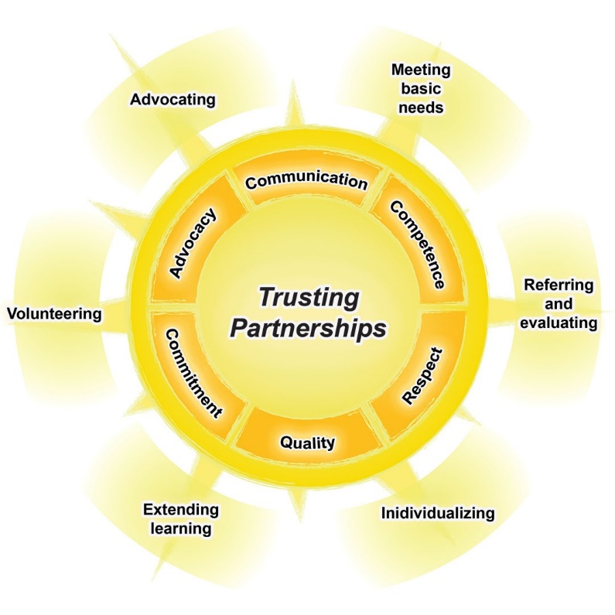

Slide 8
Facilitator: Ann, I am resonating with your six principles of trusting partnerships. How did you come to the formulation of these six?

Slide 9
The Beach Center’s Research on Partnerships
Qualitative research – 33 focus groups and 32 individual interviews
Participants included parents of children with and without disabilities, service providers, administrators
Broad representation of cultural diversity

Slide 10
Trusted Research Partners
Ursula and DJ Markey Louisiana Community Parent Resource Center

Slide 11
Trusting Partnerships: Six Components
Communication
Competence
Respect
Commitment
Equality
Advocacy

Slide 12
Facilitator: What were highlights from your research of what families and practitioners shared about the essence of each of these six themes?

Slide 13
Communication
Being friendly
Being clear
Highlighting strengths and good news
Being honest, even with bad news
Responding to feelings
Listening

Slide 14
Competence
Knowing and implementing evidence-based practices
Setting high expectations and working hard to meet them
Continuing to learn when faced with new challenges

Slide 15
Respect
Honoring cultural diversity
Building on strengths
Valuing each other’s perspectives and recommendations
Seeking to “walk a mile” in the others’ shoes

Slide 16
Commitment
Being available for communication
Being flexible with using innovative ways to solve challenges
Being sensitive to emotional needs
Going above and beyond

Slide 17
Equality
Fostering each other’s confidence
Seeking each other’s input
Creating conditions that lead to a level playing field

Slide 18
Advocacy
Expressing viewpoints
Thinking creatively “outside of the box”
Working toward win-win solutions
Speaking up for children, families, practitioners, and system leaders

Slide 19
Research on Partnerships
Families from three age groups of children (birth-3, 3-5, 6-12) place equal importance on partnerships. Parents of children ages 6-12 are less satisfied than parents of children 3-5, who are also less satisfied than parents of children birth-3 (Summers et al., 2005b).
Families with low-income rate all the items related to partnership as equally important as compared to middle- and high-income families; but families with low income are significantly less satisfied (Summers et al., 2005b).

Slide 20
Research on Partnerships (cont.)
Parents’ satisfaction with partnership significantly predicts parent involvement and parent-teacher communication for families of kindergarten children with and without disabilities (Zuna, 2007).
Families who experience stronger partnerships with educators experience less family stress (Burke & Hodapp, 2014).

Slide 21
Research on Partnerships (cont.)
For families of children (ages birth-21) with deaf-blindness, both high quality partnership and high quality educational services are needed for family quality of life. The high quality effects of one (partnership or education services) do not buffer the low quality effects of the other (Kyzar et al., 2015).
Parents of children birth-21 with various types of disabilities, who have higher satisfaction with partnerships, report having higher family quality of life (Kyzar, Brady, Summers, & Turnbull, submitted; Summers et al., 2007).

Slide 22
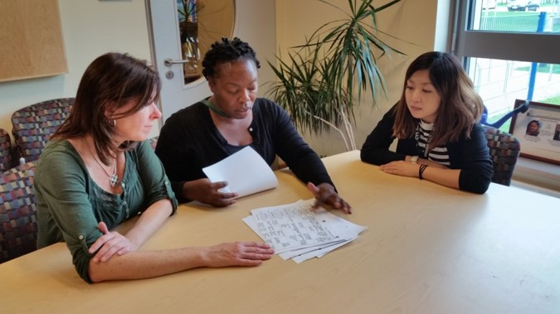
What’s Missing from the Research?
We need research on the impact of partnerships on professional quality of life.

Slide 23
“I’ve learned that people will forget what you said, people will forget what you did, but people will never forget how you made them feel.”
-Maya Angelou, American poet

Slide 24
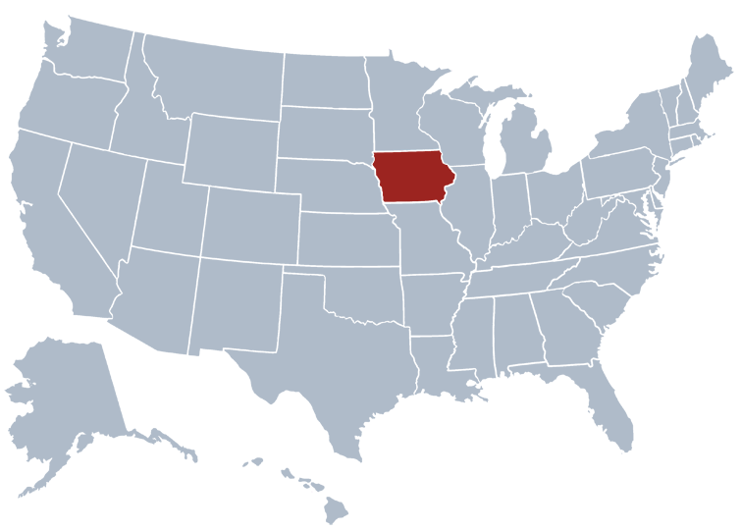
Iowa’s Early Childhood Partnership Team

Slide 25
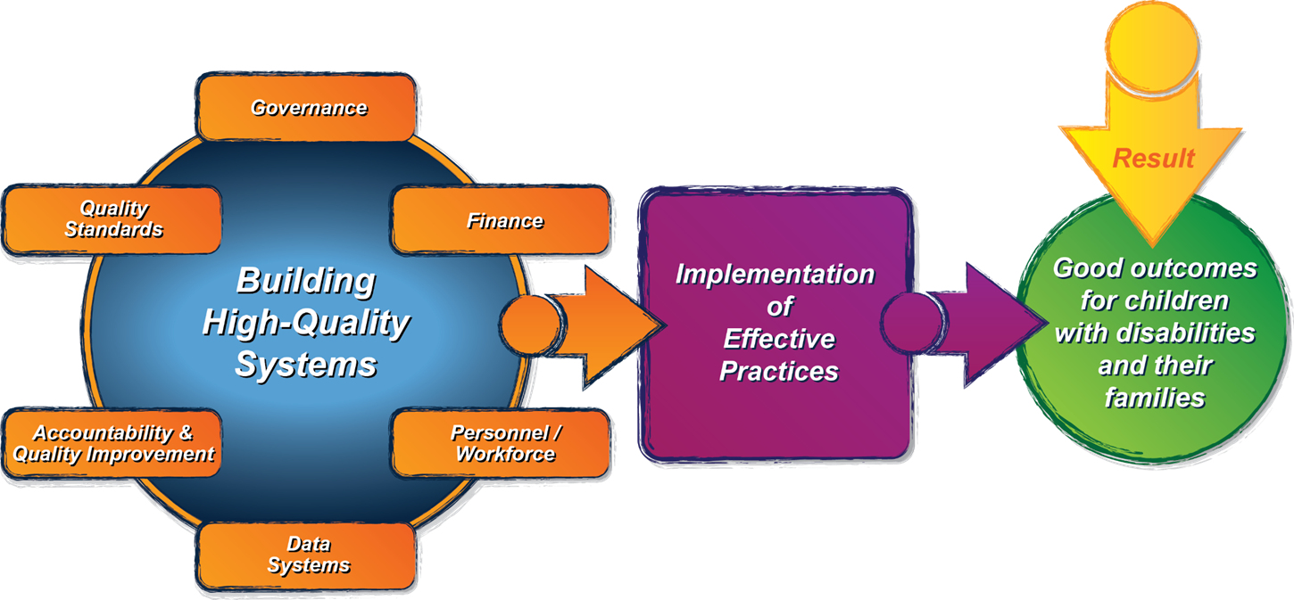
Iowa’s Journey
ECTA System Framework: What does Iowa need to put into place to support implementation of effective practices?
ECTA System Framework Self-Assessment
Governance Quality Indicator GV5: State and regional and/or local system entities are designed to maximize meaningful family engagement in the development and implementation of the system.
Personnel/Workforce Quality Indicator PN1a: The composition of the leadership team represents key partners from cross-sector early childhood systems, technical assistance programs, institutions of higher education, parent organizations as well as any other relevant stakeholders across disciplines.

Slide 26
Iowa’s Journey
Areas of improvement:
Articulate vision, mission, and guiding principles of system of services for young children with developmental delays and disabilities and their families
Re-establish commitment to family leadership, family engagement, and parent-professional partnerships
Partner to promote an inclusive, integrated early childhood system of services
This takes implementing the principles of trusting partnership!

Slide 27
Iowa’s Inclusion Cohort State Team
Vision: Every child, beginning at birth, will be healthy and successful.
Mission: Design and implement cross-sector system supports, including policies and practices, to ensure young children of all abilities, and their families, experience inclusion across all early childhood settings and services that result in a sense of belonging, partnerships, positive social relationships, friendships, development, and learning to meet the full potential of each and every child. (Adopted from DE/HHS Inclusion Policy Statement, 2014)

Slide 28
Iowa’s Inclusion Cohort State Team
Parent Training and Information (PTI) Center
Head Start Collaboration Office
Child Care Administration – Dept. of Human Services
Early Childhood Administration – Dept. of Education
IDEA Part C – Early Intervention
IDEA Part B - Early Childhood Special Education (619)
State Prekindergarten/Preschool for 4-year-olds
State At-Risk Preschool
Early Childhood Iowa – early care, health, and education system

Slide 29
Inclusion Cohort State Team Goals
Goal 1: Gather, analyze, and use data from key stakeholders, including practitioners, families, and leadership, to identify current challenges and solutions related to inclusion of children, birth to five years of age.
Goal 2: Develop and disseminate a cross-sector policy statement that provides guidance for practitioners, families, and leadership on implementing high-quality inclusive practices across early childhood settings and services.
Communication Plan and Stakeholder Engagement: Ensure effective communication and stakeholder engagement.
Resources: US Dept. of HHS DE Policy Statement Inclusion of Children with Disabilities in Early Childhood Programs (2015). Barton & Smith, Preschool Inclusion Toolbox (2015).

Slide 30
Iowa’s State Personnel Development Grant (SPDG)
Competitive funding opportunity provided by the U.S. Department of Education
Focused on personnel development within project areas
Focused on a particular topic of set of topics:
Literacy
Specially Designed Instruction (SDI)
PTI Centers are required partners on SPDGs.

Slide 31
SPDG Strands
Early Childhood Special Education
K-6
Significant Disabilities
Assistive Technology
Family/Professional Partnerships
Family-School Partnerships
Family-School-Community Partnerships
“School” or “Educator” or “Professional”

Slide 32
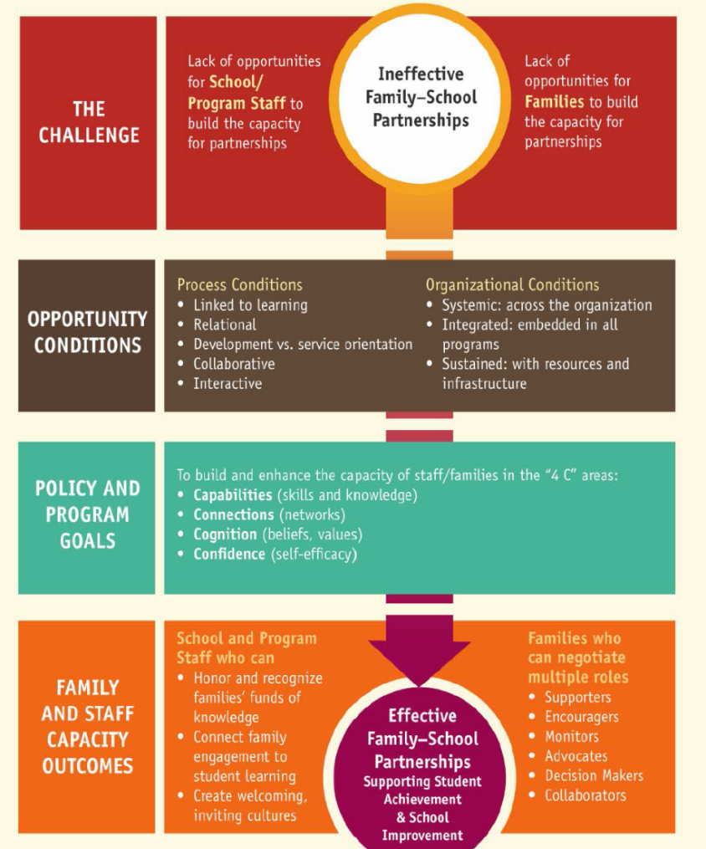
Informing Our Work
U.S. Department of Education’s Dual Capacity Framework for Family-School Partnerships
Epstein’s Framework on Parent Involvement
Six Types of Parent Involvement:
Parenting
Communicating
Volunteering
Learning at Home
Decision Making
Collaborating with Community
Framework Categories:
Practices
Challenges
Redefinitions
Expected Results

Slide 33
Depth to working with families
Involve
Engage
Partner
RECIPROCAL ● MUTUAL ● EQUAL ● SHARED
TO FAMILIES ≠ FOR FAMILIES ≠ WITH FAMILIES

Slide 35
Resources on Trusting Partnerships

Slide 36
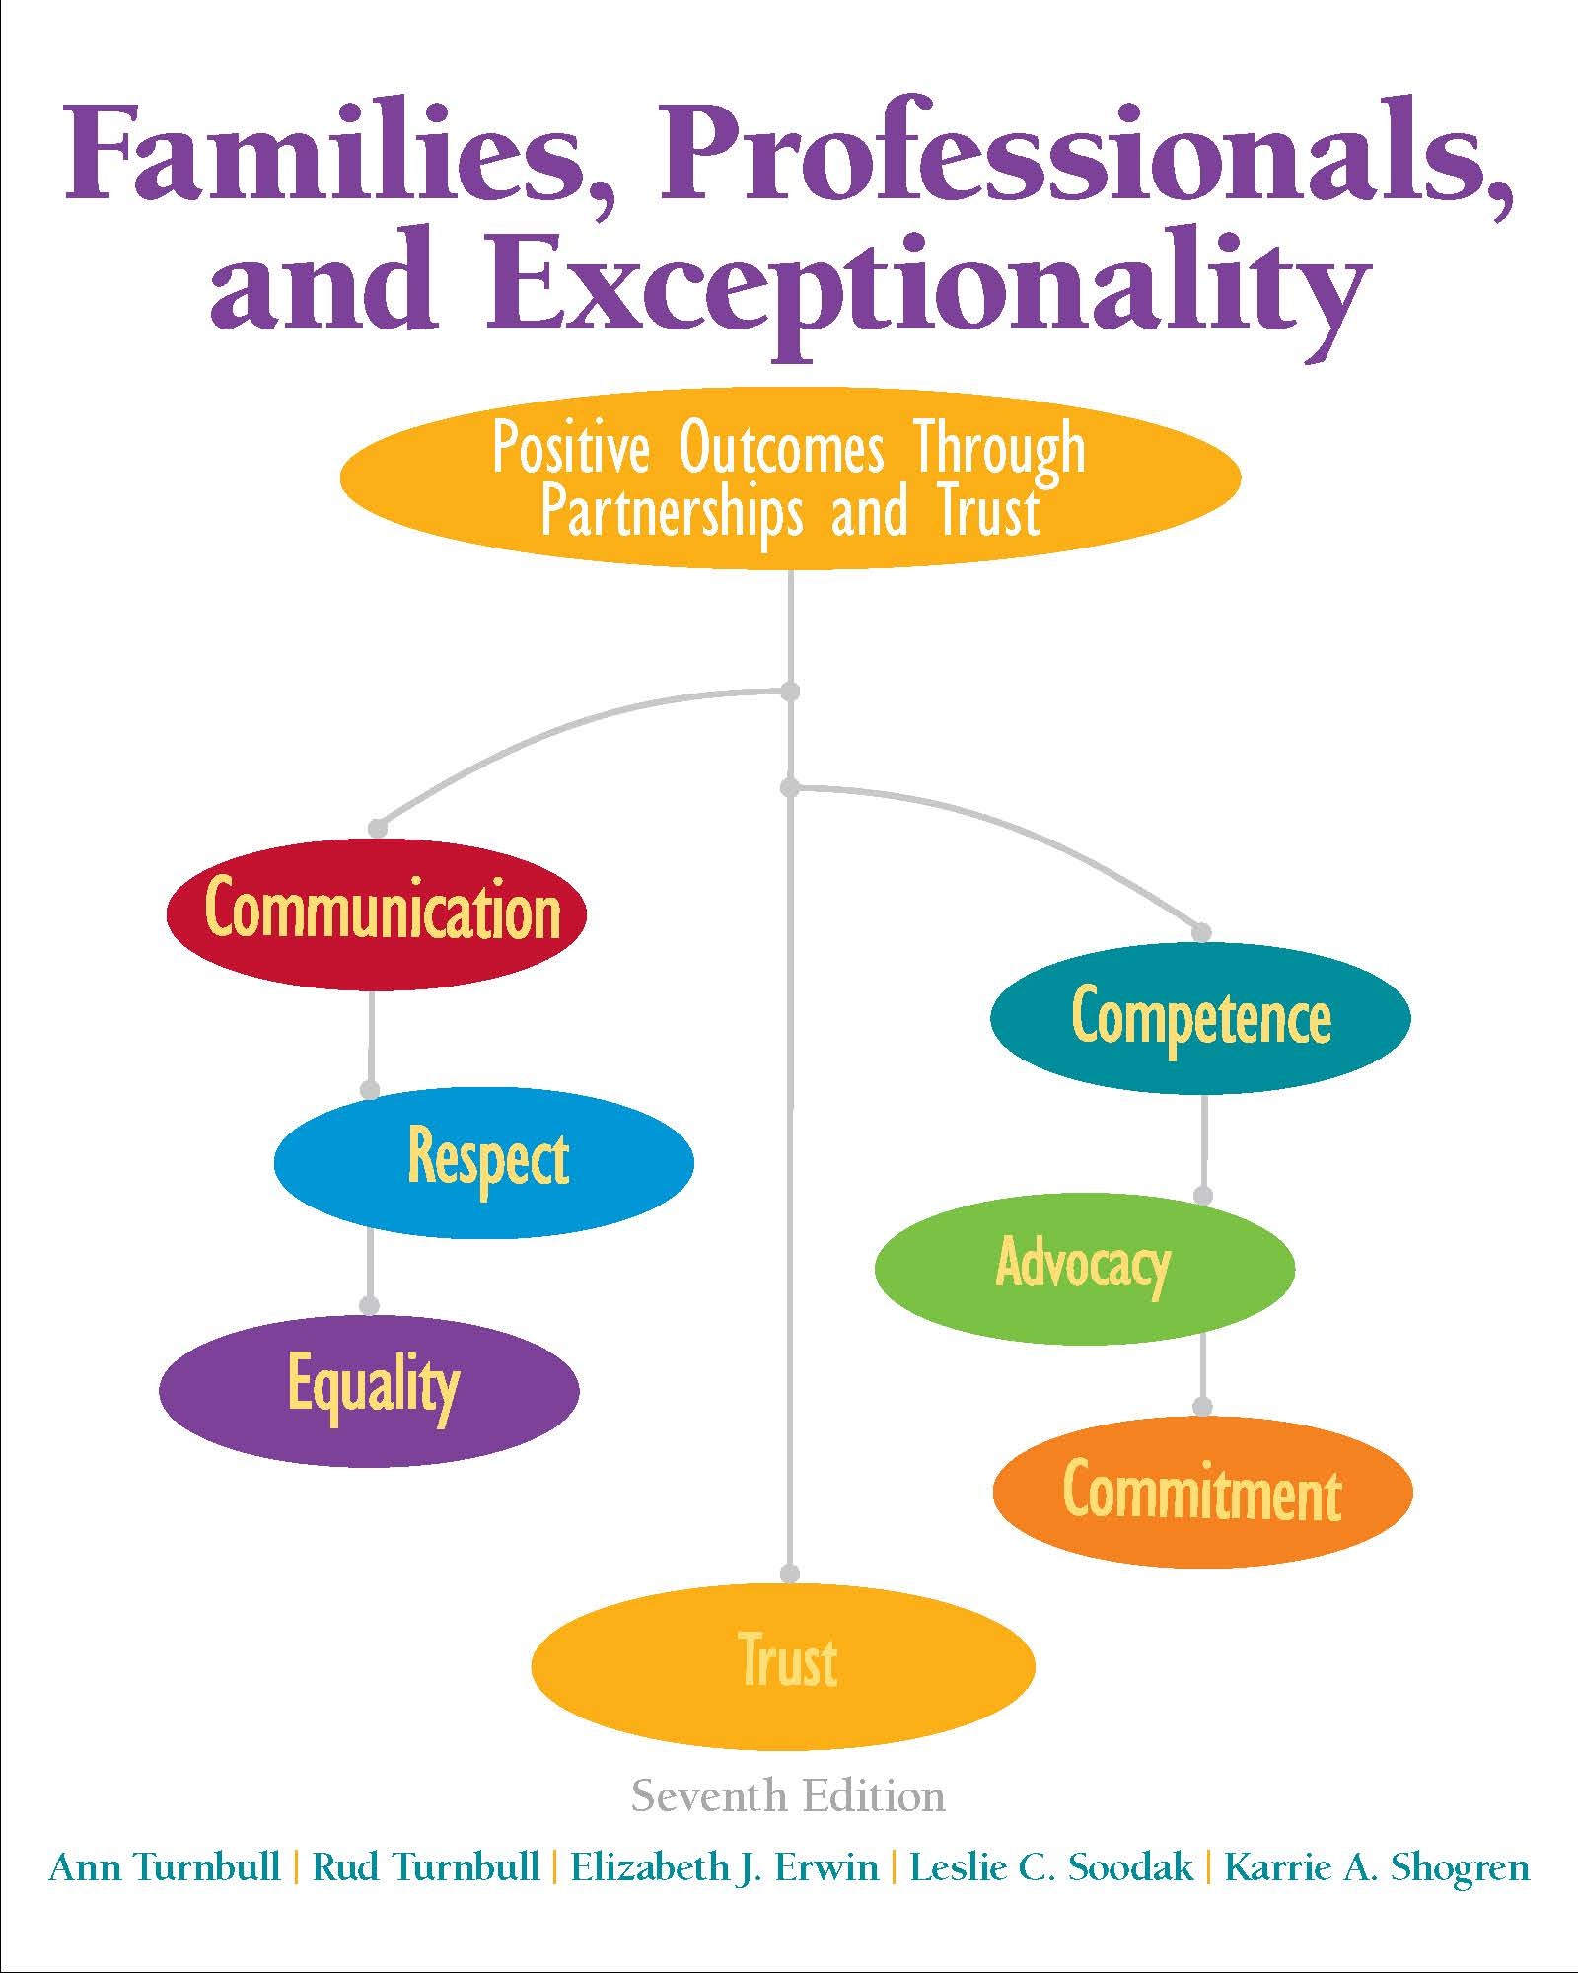
Available at:
https://www.amazon.com/Families-Professionals-Exceptionality-Partnerships-Loose-Leaf/dp/0133833682/ref=sr_1_1?ie=UTF8&qid=1473348717&sr=8-1&keywords=family+professionals+and+exceptionality

Slide 37
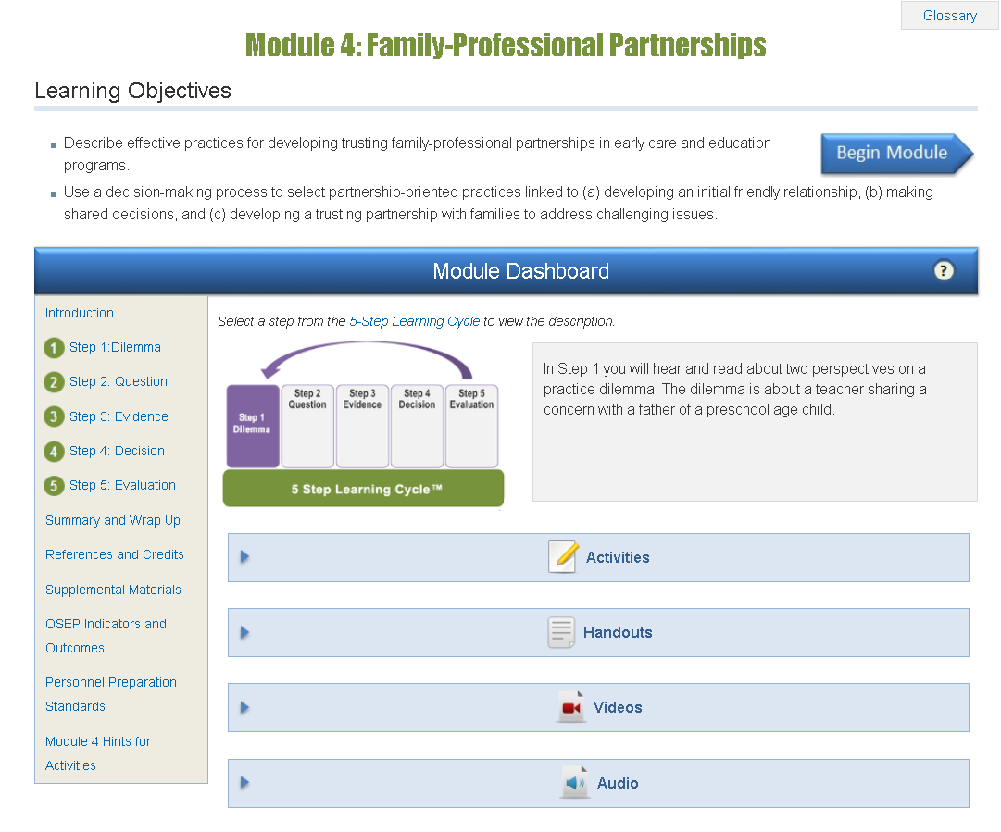
CONNECT Online Module on Family-Professional Partnerships

Slide 38
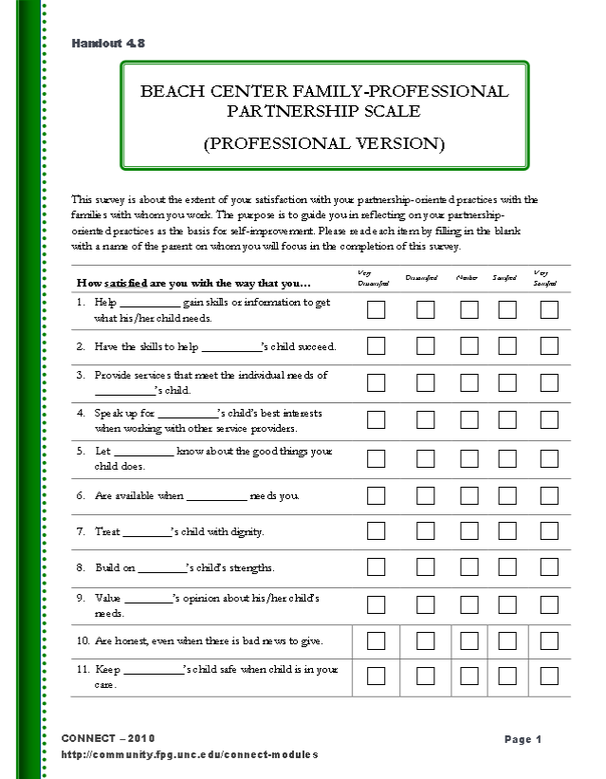
Beach Center Family-Professional Partnership Scale
2 domains
Enhancing Connection
Enhancing Capacity
18 items

Slide 39
Sample Excerpt: Beach Center Family-Professional Partnership Scale

Slide 40
PFCE Framework Resources

Slide 41
Parent, Family, and Community Engagement (PFCE) Framework
Positive & Goal-Oriented Relationships
Family Well-being
Positive Parent-Child
Relationships
Families as Lifelong Educators
Families as Learners
Family Engagement in Transitions
Family Connections to Peers and Community
Families as Advocates and Leaders
Children are ready for school and sustain
Development and learning gains through third grade
Program Environment
Family Partnerships
Teaching and Learning
Community Partnerships
Program Leadership
Continuous Program Improvement
Professional Development
Program Foundations
Program Impact Areas
Family Outcomes
Child Outcomes

Slide 42
Available at:
https://eclkc.ohs.acf.hhs.gov/hslc/tta-system/family/docs/building-partnerships-developing-relationships-families.pdf

Slide 43
Available at:
https://eclkc.ohs.acf.hhs.gov/hslc/tta-system/family/docs/tracking-progress-early-care-education-long-version.pdf

Slide 44
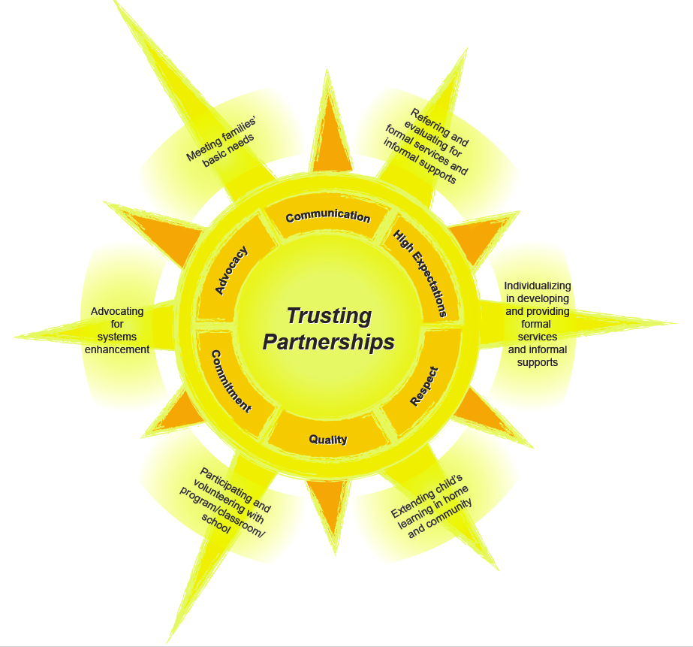

Slide 45
Where do we go from here?
March 29th (3-4 p.m. ET)
Today’s Webinar: April 20th (3-4 p.m. ET)
Getting to the Bottom Line of Family Engagement
Enhancing Trusting Partnerships at the Systems and Practice Levels: Reciprocal Opportunities for Professionals and Families
Next Webinar: May 24th (3-4 p.m. ET)
Infusing Partnership Principles and Practices into Family Engagement Activities

Slide 46
The WHAT of Family Engagement: Types of Activities
Meeting families’ basic needs
Referring and evaluating for services and supports
Individualizing in developing and providing services and supports
Extending child’s learning in home and community
Participating and volunteering with program/school
Advocating for systems improvement

Slide 47
Online Webinar Resources
http://ectacenter.org/~calls/2017/familyengagement.asp
PowerPoint
Handouts
Suggestions for Follow-up Reflection/Discussion
Resources and References

Slide 48
Register for the Next Webinar!
Infusing Partnership Principles and Practices into Family Engagement Activities
May 24th, 3-4 p.m. ET
Register at:
http://ectacenter.org/webinars.asp

Slide 49
The contents of this tool and guidance were developed under grants from the U.S. Department of Education, #H326P120002 and #H373Z120002. However, those contents do not necessarily represent the policy of the U.S. Department of Education, and you should not assume endorsement by the Federal Government. Project Officers: Meredith Miceli, Richelle Davis, and Julia Martin Eile.

