Slide 1
State Leadership: Implementing and Influencing Policy
Deborah Ziegler, ECPC
Sharon Walsh, ECTA
December 14, 2020

Slide 2
Who is here today?

Slide 3
Objectives
As a result of the session participants will be able to:
Describe the public policy life cycle, the types of policy, and how to engage in the public policy process
Describe the evolution of IDEA policy from federal to state to local levels and identify influences on state policy implementation and strategies to change them
Identify relevant federal laws that impact early childhood policy and statewide systems of services
Analyze components of a framework for developing new or revised policy for specific IDEA topics

Slide 4
Quote
“The law never is. The law is always about to be.”
- Benjamin Cardozo
U.S. Supreme Court Justice

Slide 5
Word Cloud
Identify one word that characterizes your leadership approach to policy.
Notes:
Can be change? Influence? Implementation?

Slide 6
Public Policy Working Definition
The way policy reforms are planned, designed, implemented and evaluated.

Slide 7
Reality of Policy Processes
In practice policy processes are complex

Slide 8
Policy Processes Often Look Like an Amoeba!
External Pressures
Interest Group
STATE
Time
Interest Group
Policy Spaces

Slide 9
Chat Box – Fingers to the Keys!
Add one “messy” internal or external influence on the policy process you have encountered in your work.

Slide 10
Why are Policy Processes Complex & Messy?
Involve different types of actors
Are influenced by practice/experimentation, events, learning from mistakes, actor’s networks, etc.
Are shaped by discourses and narratives
Have a highly political character

Slide 11
How a Bill Becomes Law

Slide 12
How a Bill Becomes Law 2

Slide 13
How a Bill Becomes Law 3

Slide 14
Public Policy Engagement
Definition of Public Policy
Phases of the Public Policy Life Cycle
How to Engage in Public Policy
Types of Public Policy

Slide 15
Definition of Public Policy
A decision of action of government that addresses problems and issues

Slide 16
Phases of the Public Policy Life Cycle
Problem Definition
Agenda
setting
Policy adoption
Implementation
Evaluation
This life cycle is only a framework – not all policy is formed according to this linear model. However, all policy creation is incremental and builds upon prior developments and activities

Slide 17
Poll
What phase of the Public Policy Life Cycle do you have the most experience with?
Problem Definition
Agenda Setting
Policy Adoption
Implementation
Evaluation

Slide 18
Phases of the Public Policy Life Cycle 2
Problem definition: a problem is identified and examined, and possible solutions are explored through research and analysis

Slide 19
Phases of the Public Policy Life Cycle 3
Agenda setting: Efforts used to raise the profile of the problem and possible solutions among the public and decision makers
Agenda setting strategies may include:
Community organizing
Public education
Media and communications
Convening stakeholders
Building coalitions

Slide 20
Phases of the Public Policy Life Cycle 4
Policy adoption: Discussion of options and possible solutions, which leads to the either new policy or amend existing policy.
Common strategies used to impact policy adoption include:
Issue advocacy
Regulatory advocacy
Community organizing
Public/private partnership creation

Slide 21
Phases of the Public Policy Life Cycle 5
Implementation: Implementation is an essential phase during which critical decisions are made which ultimately determine the policy’s effectiveness
Approaches used include:
Issue advocacy
Regulatory advocacy
Litigation
Public/private partnership creation

Slide 22
Phases of the Public Policy Life Cycle 6
Evaluation: Policy research and analysis are strategies to evaluate whether the policy meets its original intents and if there are any unintended outcomes. If the policy is not successful on any level, evaluation findings can be used during a new phase of problem definition. The policy life cycle begins again and continues until an effective policy is created and successfully implemented

Slide 23
How to Engage in Public Policy
How should one determine which strategy(-ies) to use?
Which phase of the policy life cycle (problem definition, agenda setting, policy adoption, implementation, evaluation) is the policy currently in? Different strategies are more effective at different stages of the policy formation process
What is the current political climate, including any changes in executive and/or legislative leadership?
Which jurisdiction (local, state, national) does the funder wish to impact?

Slide 24
How to Engage in Public Policy 2
Building Coalitions
Community Organizing
Convening Stakeholders
Funding Demonstration Projects
Issue Advocacy –Lobbying and Non-Lobbying
Leadership Development
Litigation
Media and Communications
Policy Research and Analysis
Public Education
Public/Private Partnerships
Regulatory Advocacy
Voter Engagement

Slide 25
Types of Public Policy

Slide 26
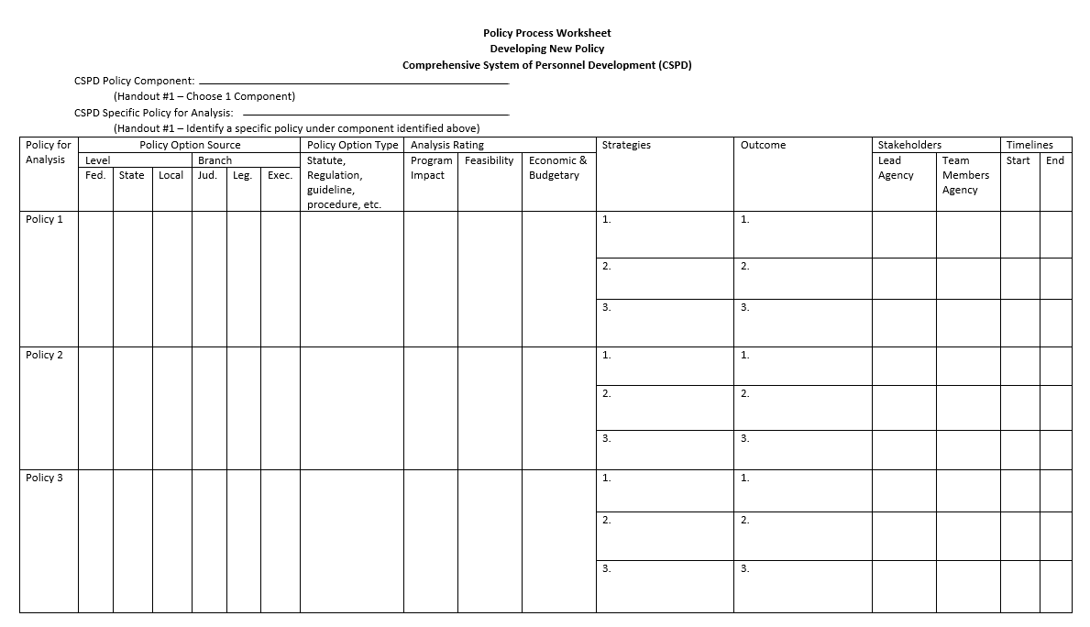
Interactive Activity: New Policy Process Worksheet - CSPD

Slide 27
Policy Evolution
Federal
Statute
Regulations
Policy Letters
Court Decisions
State
Laws/Code
Regulations
Policies
Procedures
Guidance
Hearing or court Decisions
Local
County/City rules
Provider Agency policies and procedures
School Board policies and procedures

Slide 28
Influences on Policies
Reauthorization or other Statutory Changes
Supreme and other Federal Courts
Part B - Endrew
Part C - Marie O (Illinois)
State Courts
Funding and Budget Changes
Pandemics and other public health issues
Advocacy Efforts
Federal Election Results – Changes to President, Cabinet and Congress
State Election Results – Chances to Governors, Cabinet and State Legislature
This Photo by Unknown Author is licensed under CC BY

Slide 29
Influences
What influences have recently affected Part C or Preschool 619 policy in your state?
Please respond in the chat box.

Slide 30
Approaches and Strategies when Considering Policy Change: Strategy and Timing Are Everything!!
Get support from leadership considering your role and your agency’s culture
Determine whether changes are statutory, regulatory, SEA/lead agency policy change
Prepare side by side for analysis of current and possible revisions
Identify givens to identify things that are not “on the table”
Convene a task force of stakeholders
Prepare data (including trend data) relevant to the implementation of the policy
Notes:
Add to chat which have been most important for you in your state work or what you have observed….

Slide 31
Approaches and Strategies when Considering Policy Change: Strategy and Timing Are Everything!!2
Develop list of challenges and possible solutions
Throughout process, gather input from consumers and other stakeholders
Consider policy options; think through positive outcomes and unintended consequences
Prepare recommendations including rationales
Strategize approach to leadership for next steps – consider politics and authority
Notes:
Add to chat which have been most important for you in your state work or what you have observed….

Slide 32
Policy Development and Implementation Across Agencies and Programs
Building and Sustaining High Quality Equitable Inclusive Systems of Services for All Young Children Statewide

Slide 33
ED/HHS Federal Policy Statement on Inclusion of Children with Disabilities in EC Programs
It is the Departments’ position that all young children with disabilities should have access to inclusive high-quality early childhood programs where they are provided with appropriate support in meeting high expectations

Slide 34
Across Agencies
State Pre-K Programs
B-5 Preschool Development Grant
CAPTA
Home Visiting
ESSA Title 1
Head Start Program
IDEA
Section 504
Civil Rights
ADA
Civil Rights
Child Care CCBDG
Other Public Health Programs

Slide 35
Preschool Development B-5 Grants
Enacted under ESSA & administered by HHS/ACF with collaboration of U.S. Department of Education
Designed to fund states to conduct a comprehensive statewide birth through five needs assessment followed by in-depth strategic planning
In FY2019, 46 States/Territories received a PDG B-5 Initial Grant Award.
In FY2020, 6 additional States/Territories received a PDG B-5 Initial Grant Award and 23 states were awarded 3-year PDG B-5 Renewal Grants.
https://www.acf.hhs.gov/ecd/early-learning/preschool-development-grants

Slide 36
Title I LEA Requirements
Using Title I funds for preschool is a local decision down to birth.
LEAs/schools who provide early childhood programming in schoolwide model, are required to create interagency agreements with Head Start agencies.
State Plans must reflect how the state will provide:
Assistance to LEAs/schools using Title I funds for early childhood education
Information on family engagement and child development to early childhood and K-12 teachers and principals

Slide 37
State and LEA Plans
State report cards include number and percentage of children enrolled in preschool programs
LEAs describe if and how the LEA will use Title I funds to provide early childhood education.
Must describe how they will support, coordinate, and integrate services with early childhood education programs, including transition to kindergarten.

Slide 38
Applicable Head Start Program Performance Standards (HSPPS)
Ensure full participation in program services and activities for children with IFSPs and IEPs§1302.60
Provide additional services for children §1302.61
Additional services for children with disabilities.
Services during IDEA eligibility determination.

Slide 39
Head Start Program
Provide supports for children with significant delays who are not eligible for IDEA (1302 Subpart C)
Recognizing the parents’ role in the IFSP or IEP process, and preparing parents to advocate for their children (1302 Subpart C)
Provide transition services to support children with disabilities and their families as they prepare to leave the program. (1302 Subpart G)

Slide 40
Head Start Program 2
Coordination and collaboration with local agencies responsible for implementing IDEA, Part B (preschool) and Part C (infant and toddler) services to ensure appropriate referral, evaluation, service delivery and transition. (1302 Subpart J)
Make Referrals to IDEA for Full Evaluations
Coordinate on Evaluations
Service Delivery

Slide 41
Child Care Block Grant Federal Law
The CCDBG Act of 2014 requires that States:
Develop strategies for increasing the supply and quality of childcare services for children with disabilities;
Provide information about the availability of the full diversity of child services that will promote informed child care choices and that concerns programs carried out under Part B section 619 and part C of the IDEA;
Provide information on developmental screenings including Part B section 619 and part C of the IDEA; and

Slide 42
Child Care Block Grant Federal Law 2
Provide training and professional development appropriate for a population of children that includes children with disabilities
Promote and expand childcare providers’ ability to provide developmentally appropriate services for infants and toddlers through training and professional development; coaching and technical assistance and improved coordination with early intervention specialists who provide services for infants and toddlers with disabilities

Slide 43
504 Statute Civil Rights
“No otherwise qualified individual with a disability in the United States…shall, solely by reason of her or his disability, be excluded from the participation in, be denied the benefits of, or be subjected to discrimination under any program or activity receiving Federal financial assistance…”

Slide 44
ADA Applies to Public and Private Entities
Can’t exclude children unless they pose a “direct threat” to health or safety of others or require “fundamental alteration” of the program
Must make reasonable accommodations to policies and practices unless doing so would result in “fundamental alteration”
Must provide aids and services for effective communication unless “undue burden”

Slide 45
Add Some Thoughts to the Chat
Put in the chat:
With which of these programs/policies is your state currently having the most collaboration success?

Slide 46
Policies to Consider for State Change Small Group Discussion
Part C or Preschool Child Outcomes Measurement
Transition from Part C to Preschool
Part C or Preschool Eligibility Criteria

Slide 47
Interactive Activity: New Policy Process Worksheet – CSPD 2

Slide 48
Small Group Discussion
First: from the 3 options, select one for policy analysis
Next discuss:
What is the policy source – federal, state, local?
What is the policy branch – judicial, legislative, executive?
What is the policy type – statute, regulation, guidance, procedure?
What is the new intended policy outcome(s) for your state?
Identify 2-3 strategies for developing new or revised state policy in this area (who is involved, stakeholders, data to prepare, information to consider, etc.)

Slide 49
Takeaways
What is your biggest “take away” from the discussion?
Please put it in the chat!

Slide 50
Find Your People
Parent to Parent
DX Specific
Childcare
Head Start
Title V
Community Based
Faith Based
WIC
Education
Adult Disability Systems
Working for you
Policy Makers
Your friends and family
Healthcare System Leaders

Slide 51
Stay in Your Lane

Slide 52
video
(Music playing: Gloria Gaynor’s “I Will Survive”)

Slide 53
Questions?
Thank you!
Please complete the evaluation:
You will receive an email with a link to the survey
We appreciate your input for our planning future Leadership opportunities
Notes:
Thank you and evaluation

