Slide 1
Critical Questions to Improve Equitable Access, Experiences and Outcomes
Kathy Hebbeler, DaSy
Ginger Elliott-Teague, DaSy
Catasha Williams, ECTA
Leadership with an Equity Mindset: Using Preschool Special Education Data Series
May 24, 2023

Slide 2
Purpose & Agenda
Use the critical questions to inform how you collect, analyze and interpret your data
Recap of session 1
Using critical questions
Activity
Discussion
Session 3 preparation

Slide 3
Introductions
Poll Questions

Slide 4
Session 1: Recap
Equity in the Data Life Cycle

Slide 5
Engage in a Cycle of Inquiry
Inquiry is a cyclical process that takes time, and it’s important for data teams and communities to work together throughout.
Applying an equity-focused approach to inquiry prompts data teams to reexamine and assess power dynamics, policies, practices, mental models, and beliefs, that perpetuate systemic barriers and inequalities.
Draft representation of Embedding Equity in the Data Lifecycle. Will be available from dasycenter.org

Slide 6
Ask the Right Questions
Plan & Design
Understand who is privileged by the data to be collected
Ensure the people defining the questions represent the people who will answer the question​s
​Engage those who are impacted by the data to define the questions that get asked.​
Design questions that reflect the lived experiences for those impacted by the data
Consider questions about how the system/program addresses the needs of children and families​

Slide 7
Engage Partners & Collect Data
Collect Data
Collect the data​ needed to:
Operate the program
Report to the federal government and the public
Examine critical questions about the program
Show respect in the data collection:
Engage critical partners
Explain how the data will be used
Do not ask for the same information more than once
Provide options choices that are meaningful to the respondent
Do not collect data that are not needed/will not be used

Slide 8
Analyze Data Thoughtfully
Analyze Data
Disaggregate your data to show who is represented and who is missing
Use data visualization techniques to make the data meaningful and interesting
Provide training to ensure that partners are comfortable reading tables and graphs​
Include partners in discussions about what the data mean to them

Slide 9
Find Meaning in Your Data
Interpret Data
Value the different perspectives and contributions of all participants
lived experiences and qualitative data help bring meaning to quantitative data
Avoid deficit interpretations that blame families for shortcomings of the system​
Encourage divergent ideas and take all interpretations seriously ​
Recognize what the data can realistically tell you
Involve a diverse set of perspectives during the interpretation and meaning-making

Slide 10
Share and Apply Data Findings
Share and Apply Findings
Highlight and share achievements, big and small
Engage partners in how to share and apply the findings
Provide information on how partners can use the findings to improve outcomes
Ensure that those who provided the data receive the findings​ in an understandable format
Accessible
Plain language
Respectful terminology
Easy to understand visualizations

Slide 11
Act on What Was Learned
Take Action
Identify which actions are within the authority of the program and which require those outside the program
Develop a plan for how to act on what was learned
AND THEN START THE CYCLE ALL OVER AGAIN!

Slide 12
Prior Homework
Review critical questions: https://dasycenter.org/resources/critical-questions/
Identify 1-2 that you think would have an important impact on your program?
Identify what quantitative data do you have that may answer the questions.
How would you enhance the story using other data sources, including qualitative data?

Slide 13
Asking Critical Questions

Slide 14
Data Systems (Can) Serve Multiple Purposes
Provide information needed for federal reporting
Provide information for program monitoring
Provide information for program operation
Provide information for improving the program
By answering critical questions about the program

Slide 15
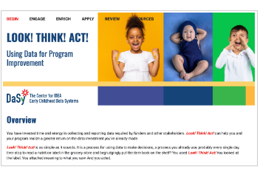
Using data to identify and address equity is a cycle
Do the data indicate there is a problem?
What is causing the problem? (more data needed)
What action(s) should be taken to address the problem? (not likely to have data on this one; maybe some research)
Implement action(s)
Did the action(s) address the problem? (data)
https://dasycenter.org/look-think-act/

Slide 16
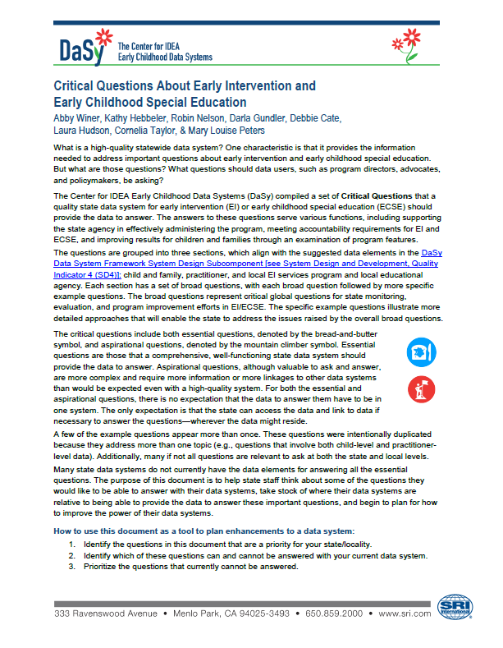
How does a focus on equity change how we ask questions?
Coming Soon!
https://dasycenter.org/resources/critical-questions/

Slide 17
Questions can be asked at different levels
Are the programs serving families of different races and ethnicities equally well?
This is the big, broad 100,000 foot question

Slide 18
Questions are more useful when they focus in on one or more program areas
10,000 foot questions
We will call them Overarching Questions
Examples:
Is child find working equally well for children of all races and ethnicities?
Are programs providing appropriate services and supports to children of all races and ethnicities?
Are programs providing children of all races and ethnicities an equal opportunity to receive IDEA services in settings that are for all children?
Overarching questions are valuable for policy-makers, partner and community discussions.

Slide 19
Answering an Overarching question often requires Sub-questions
Overarching questions (usually) don’t pinpoint the data needed.
Example: Is child find working equally well for children of all races and ethnicities?
To answer this question, you might want to look at:
Are there differences by race/ethnicity in referral sources?
Are there differences in the percent of children referred from each racial/ethnic group?
Are there differences in the percent of children from each racial/ethnic group who complete the eligibility process?
Etc.
Sub-questions
Point to the data needed to answer the question
Taken as a group, they address an over-arching question
Sub-questions

Slide 20
Answering an Overarching question often requires Sub-questions continued
Overarching questions (usually) don’t point to the data table.
Example: Is child find working equally well for children of all races and ethnicities?
To answer this question, you might want to look at:
Are there differences by race/ethnicity in referral sources?
Are there differences in the percent of children referred from each racial/ethnic group?
Are there differences in the percentage of children from each racial/ethnic group who complete the eligibility process?
Etc.
Sub-questions
Point to the data needed to answer the question
Taken as a group, they address an over-arching question
Sub-questions

Slide 21
All levels can be meaningful for program improvement. Use them appropriately.
Big Broad Questions
Overarching Questions
Sub-Questions

Slide 22
There are multiple ways to ask the same question
Who receives preschool special education?
Are there differences by race/ethnicity in who receives preschool special education?
Are programs processes and procedures resulting in equal opportunity for receipt of preschool special education for children and families of all races and ethnicities?
The exact same data tables answer all three questions

Slide 23
Word overarching questions to focus on the program
“Neutral” questions leave the door open for biases to enter in at the data interpretation step.
Use question wording that focuses on the program and what it can control for the over-arching questions – program policies, procedure, activities
This is about program improvement, not blaming children or families
Alternate ways to write overarching questions:
Do our child find processes result in inequitable access to preschool special education services?
Do our child find processes work equally well for all children and families?

Slide 24
Categories of Critical Questions for Addressing Racial Equity
Child and family
Practitioner
Local Programs (LEAs)

Slide 25
Child and Family
Topics | Examples of Sub-topics
Characteristics | demographics, disability
IDEA services and setting --Services --Entry and exit process --Setting | --planned and received, type, amount, duration, cost --referral sources, complete evaluation, found eligible, time between milestones, length of time in program --Type of setting, quality
Non-IDEA programs and services --General early care and education programs --Public benefits | --Use of, quality --Insurance, nutrition
Child and Family Outcomes --During and at exit from program --Long term outcomes | --subsequent receipt of special education, achievement

Slide 26
Practitioner
Topics | Examples of Sub-topics
Diverse workforce --Racial/ethnic characteristics --Credentials --Preparation --Professional development | Racial/ethnic characteristics overall, compared to children served, change over time
Working conditions --Wages --Turnover | Turnover overall by race/ethnicity, turnover within roles by race/ethnicity

Slide 27
LEA
Topics | Examples of Sub-topics
Characteristics and Features --Differences between LEAs serving higher and lower percentages of children from historically underserved racial and ethnic groups? | --number and percent of children served --number of practitioners --practitioner to child ratio --average funding per child
Performance --Child Outcomes | --% of children showing greater than expected growth
Funding and Expenditures --Funding stream --Cost per child --Full cost for IDEA services --Revenue gap

Slide 28
Difference and Disparity
A point or way in which people or things are not the same
A difference in level or treatment, especially one that is seen as unfair
Difference
Disparity

Slide 29
When is a difference a disparity?
Some questions are about differences.
Some lend themselves better than others to identifying disparities. Some require more data to determine a disparity.
Nearly all questions will require more questioning and more data to understand why there is disparity – and understanding the root cause is critical to designing effective solutions.
A difference does not automatically mean a disparity. It is disparities that need to be identified and addressed.
Sometimes numbers that are not different could indicate a “disparity.”

Slide 30
How many 3 to 5-year-old Black or African American children received IDEA early childhood services in each state FFY 2021?

Slide 31
Difference or disparity?
Source: IDEA Section 618 Data Products

Slide 32
Of all the children who received IDEA early childhood services in 2021-22, what percent in each state were Black or African American?

Slide 33
Difference or disparity? 2
Source: IDEA Section 618 Data Products

Slide 34
Of all the 3 to 5-year-old children who received IDEA early childhood services in 2021-22, what percent in each state were boys?

Slide 35
Difference or disparity? 3
Source: IDEA Section 618 Data Products

Slide 36
Difference or disparity? 4
“We can’t understand whether there is an equity issue (i.e., a disparity) without knowing….”

Slide 37
What percent of the population of each racial/ethnic group received preschool special education services in the U.S. in 2021-22?

Slide 38
Difference or disparity? 5
Data from 44th Annual Report to Congress on the Implementation of IDEA

Slide 39
Difference or disparity? 6
“We can’t understand whether there is an equity issue (i.e., a disparity) without knowing…”

Slide 40
What percent of families of children who were found eligible in each racial/ethnic group declined preschool special education services?

Slide 41
What percent of families of children who were found eligible in each racial/ethnic group declined preschool special education services? continued
In 2021-22, African American and Hispanic families were far more likely to decline preschool special education services compared to White and Asian families.
Note: This is not real data!

Slide 42
Take-Aways about Critical Questions
Questions can be asked at different levels. Each is appropriate and useful but you need to know what level is appropriate for your purpose and audience.
Question wording matters. Avoid deficit thinking by wording overarching questions to focus on what the program is doing.
Questions can be asked (and therefore data analyzed) about children and families, practitioners, or LEAs.
Questions can generate data that show differences, possible disparities, or likely disparities. To examine (and ultimately achieve) equity, ask the questions that will allow identification of disparities.
And then look for the root causes, design and implement solutions, examine effectiveness….

Slide 43
Activity

Slide 44
Activity continued
With input from partner agencies, families, and other community members, a decision has been made to begin address equity by looking at child outcomes. Write an overarching child outcomes question that focuses on program processes and addresses equity.
What are the sub-questions that lead to these data tables/graphs that will answer the overarching question(s)?
Look at the data provided. Given the data, are there additional questions you need to ask and data you need to determine whether there is disparity across racial and ethnic groups? Can you and your data team conclude there is a disparity, i.e., a problem with the program based on these data?

Slide 45
Homework
Preparing for Session 3: Analyzing Your Data

Slide 46
Part 1: Review
https://dasycenter.org/look-think-act/

Slide 47
Part 2: Consider
Now that you have reviewed the critical questions and have highlighted one or two you want to address:
Seek out the data, and
Be prepared to use or consult on how to analyze.
Come with analysis questions… what do you need to know to be able to answer your program’s critical questions?

Slide 48
Thank you
https://dasycenter.org/ Follow DaSy on Twitter: @DaSyCenter | ectacenter.org Follow ECTA on Twitter: @ECTACenter | https://ideadata.org/ Follow IDC on Twitter: @IDEAdatacenter
The contents of this presentation were developed under grants from the U.S. Department of Education, #H373Z190002 and #H326P170001. However, those contents do not necessarily represent the policy of the U.S. Department of Education, and you should not assume endorsement by the Federal Government. Project Officers: Meredith Miceli, Amy Bae, and Julia Martin Eile.

