Slide 1
Session 3: Analyzing Data to Improve Equitable Access, Experiences and Outcomes June 28, 2023
Christina MacDonald, IDC
Ginger Elliott-Teague, DaSy
Leadership with an Equity Mindset: Using Preschool Special Education Data Series
Notes:
Ginger

Slide 2
Purpose & Agenda
To share tools and strategies to understand root causes of data trends and patterns, with a particular focus on equity.
Recap of Session 2
Key Concepts
Brainstorming Discussion
Session 4 preparation
Optional: Question and answer time
Notes:
Ginger

Slide 3
Introductions & Polls
Please change your name to include your role and group (619, data, TA, other)
Polls
Have you:
participated in previous sessions?
identified a critical question?
begun pulling data together to analyze?
Christina Macdonald
WESTAT
Ginger Elliott Teague
SRI
Notes:
Ginger
Were you able to participate or watch session 1? Session 2? Did you identify a critical question? Have you begun pulling data together to analyze? Use “what is your critical question?” and maybe are you seeing a trend in your analyses or anything surprising, etc. to keep the energy/interest going while others finish the poll.

Slide 4
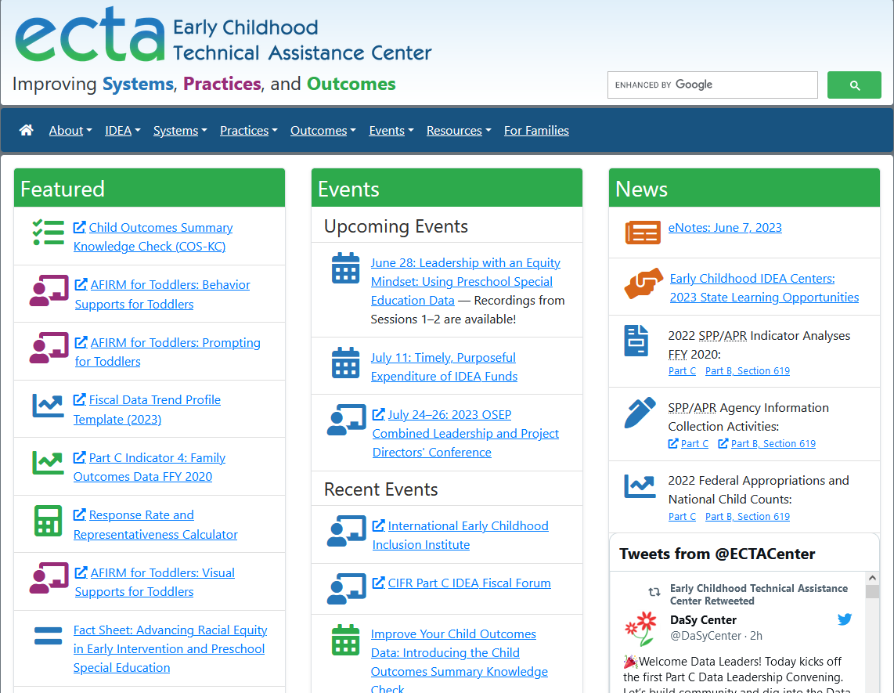
Session 2: Recap
Equity in the Data Life Cycle
https://ectacenter.org/events/webinars.asp#y2023dataequityseries
Notes:
Ginger
Mention recordings of sessions 1 and 2 (and 3 and 4 when available) on ECTA website under Events

Slide 5
Engage in a Cycle of Inquiry
Inquiry is a cyclical process that takes time, and it’s important for data teams and communities to work together throughout.
Applying an equity-focused approach to inquiry prompts data teams to reexamine and assess power dynamics, policies, practices, mental models, and beliefs, that perpetuate systemic barriers and inequalities.
Draft representation of Embedding Equity in the Data Lifecycle. Will be available from dasycenter.org
Notes:
Ginger

Slide 6
Session 2 Main Topics
Asking the right questions: select the critical question(s) you want to answer
Seeking out the data you need to answer those questions: considering differences versus disparities across categories
Centering equity in the review and the analysis
Notes:
Ginger
Once you have the data, what next? Today we will touch on one component of the analysis process: root cause analysis. Because of time constraints, we cannot cover all analytical topics we would like, unfortunately! So, we are focusing on one technique you can use to begin to understand why your data trends exist. We are simplifying the process of course, because root cause analysis can be a complex undertaking depending on the nature of your question and the data you will use. But it is a place to begin.

Slide 7
Root Cause Analysis
Notes:
Christina
Based on Session 2, you have identified your question and used data to answer it. In that process, you discover a difference – either between subgroups, over time, or with what you would expect to see. The question is: “Is that difference representative of a disparity?” When using an equity lens, it’s important to not jump to conclusions. You want to be careful not to assume that there is an issue with equity or that there is not an issue with equity. It’s like mindfulness. You question rather than pass judgement on the data. The goal is to approach the data with curiosity. When you notice something different in your data, either a subgroup in more segregated settings or an atypically high inclusion rate, be curious. “I wonder if…” or “why is that…?”.

Slide 8
Root Cause Analysis…
Is a problem-solving method for uncovering the factors that, if addressed appropriately, will prevent the problem from recurring. In order to identify appropriate solutions, it is necessary to identify root causes first.
Encourages reflection on current practices
Helps identify the underlying sources of problems
Can eliminate wasted effort on initiatives that will not solve the actual source of the problem
Provides justification for interventions
Notes:
This curiosity is what sparks a root cause process. Root cause is a process for understanding at its ROOT, why something is occurring. When you understand the factors that are causing or leading to a result, you are better able to identify the strategies that will lead to the outcomes you want. I know we are talking about finding and addressing issues of inequity in this conversation, but I want to mention that root cause isn’t simply to get to the root of a problem. It can be used to explore what is going on with any data set you are looking at., whether the data appears concerning or it suggests something exciting that you may want to replicate or scale across settings. Root cause analysis can help you get to the root of any type of data that you want to look at.
Once you get to the causes that lead to the observed data, then you can make a determination of whether or not there is an issue of equity.
For example, a colleague of mine was examining state data and noticed that a particular LEA had substantially higher rates of students identified with Other Health Impairments than other LEAs across the state. She could have assumed inequity, but she went through a root cause process to look at what was underlying the data. She discovered that the LEA was situated near a prominent hospital with a strong children’s medical unit. Families of children with OHI had relocated to this area, and consequently this LEA, in order to be closer to high quality medical services for their children. So what she had was a difference, yes, but not disparity. If she had looked at the original data and assumed inequity, she would have invested a lot of resources into addressing a problem that didn’t exist.
The opposite is also true. You don’t want to presume inequity, but neither do you want to presume equity. If you see an LEA with 100% inclusion, that’s awesome, right? We want children in the classroom with their typically developing peers, but it’s not about location. Children also need to have services they need to succeed in those environments. So when I look at this data, I wonder: ”Are children provided equitable access to the curriculum?”

Slide 9
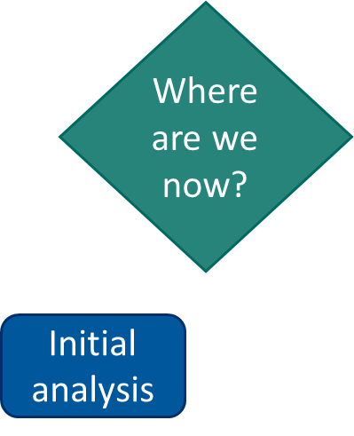
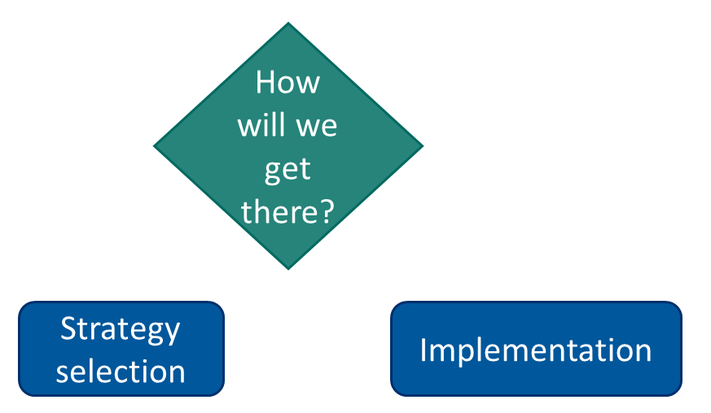
Typical Planning Process
Notes:
So what does this look like? Let’s start by examining how we typically use data in planning. When we use data for planning, we typically engage in a process referred to as Look, Think, Act.
We begin by looking at our goal and what we want the outcome of our efforts to be. We have to define where we are going in order to determine a path to get there. As we know, a path requires two points.
We need to know the end, but we also need to Think about where we are beginning, where we are in this moment. We do this by looking at data. How are we currently performing? What are our current outcomes? And what data do we have from interim measures or progress monitoring?
Based on this data, we decide which direction to go to get to our destination. We select a strategy to get us there and we begin implementing it. And while this looks like a straight line, if you think back to the inquiry diagram, it really is a circle. After we start implementing, we continue to revisit where the data says we are going, where we currently are and make any course corrections or strategy adjustments to keep us on course.

Slide 10
Example of a Dying Plant
Fertilizer
Notes:
Let’s use a simple example of how this plays out in everyday life.
Here is a picture of my office. It was feeling pretty bland and dull, so I got a plant to spruce things up.
About a week after I got the plant, some leaves started turning brown. I wanted it my plant to be healthy. Without being consciously aware of what I was doing, I identified my desired outcome as part of a planning process to improve my plant’s health. My initial analysis of my observations of the brown leaves told me my plant wasn’t getting what it needed to survive.
So based on my knowledge of plants and their need for water, my strategy was to give my plant more water.
A few days later, though, more leaves were turning brown and start falling off the plant. So what else does the plant need? I know my mom used to talk a lot about how well fertilizer worked for her plants.
I went out and get a big bucket of fertilizer and dump it on the plant, but more leaves start turning brown and falling off! What was going on? I was using Look , Think Act and using data to plan, but something about my approach was not working.

Slide 11
Embedding a Root Cause Analysis
Where are we going?
Where are we now?
What factors must change?
How will we get there?
Desired outcome
Initial analysis
In-depth root cause analysis
Strategy selection
Implementation
Notes:
If I keep stabbing in the dark to select strategies to improve my plant’s health, I might very well-end up killing it. So before jumping to other strategies, I’m going to revise the typical planning process I’ve been using to include root cause analysis. This occurs between initial analysis and strategy selection, and it tells me what factors need to change, based on my initial analysis of where we are now, to ultimately achieve my desired outcome. Knowing these factors helps me make more informed decisions about strategies to have confidence that what I’m doing will actually address and resolve the problem I’ve identified. My initial analysis of the plant was that its leaves were brown. But I never considered actually learning more about my plant to see what could cause its leaves to start dying. So I need to do more in-depth root cause analysis and get familiar with the plant.

Slide 12
Example of Dying Plant’s Solution
Notes:
So lets go back to my poor plant. There is a difference between my plants current growth and the growth I would like to see. I wonder why that is. I think about the potential factors that impact plant growth and I come up with three central ones – water, food, and light. Using a gardening book, I determined my plant needs 1 cup of water per week. Based on my data, I’m giving it enough water. I may even be watering it a little too much where I increased the frequency. I measured the fertilizer according to the package so my plant is getting the correct amount. I look at the label that came on my plant. It says my plant is a full sun plant and needs at least 6 hours per day of direct sunlight. Where it is located, my plant is currently only getting two.
I move the plant closer to the window and lo and behold, my plant begins to thrive again.
Water and fertilizer are perfectly good strategies. They have been well researched and demonstrated to show positive results. However, they didn’t address the underlying reason why my plant was dying. I was investing a lot of time and resources into some great strategies that were never going to work. By engaging in root cause analysis, I was able to more efficiently and effectively address what was underlying the data I was observing and get the result I wanted.

Slide 13
Root Cause Tools
Root cause tools guide the process
Especially valuable for teams new to the process
Designed to surface and evaluate potential causes
Encourage deeper analysis of the data
Different tools may work better for different problems or different teams
Tool examples include:
5 Why's
Fishbone
Diagnostic Tree
Resources:
Look! Think! Act! Success Gaps Toolkit
Notes:
We’ve talked a little about what root cause looks like, but how do we get started?
To begin, I strongly recommend using a root cause tool. While it is possible to engage in root cause analysis without a tool, the tools are very helpful. They are designed to encourage deeper discussion and keep the process on track and as efficient as possible. It is easy to lose your focus when analyzing data. As you begin looking at data, you find something that looks interesting and before you know it you are 5 miles down a road that has nothing to do with what you started out trying to accomplish. Beware the bright shiny object!
When it comes to root cause tools, there are a variety of them and some may work better for different problems, but I find more often it’s the nature of the team that drives the “right” tool. Teams often naturally gravitate toward one tool or another based on how they communicate and process information. Some of the more popular tools include the 5 Why’s, Fishbone, and Diagnostic Tree. There is more information about these and other tools on the Look! Think! Act! website as well as IDC’s Success Gaps Toolkit.
Put links in chat:
https://dasycenter.org/look-think-act/ https://ideadata.org/resources/resource/1538/success-gaps-toolkit-addressing-equity-inclusion-and-opportunity

Slide 14
Root Cause Tools continued
Root cause tools guide the process
Especially valuable for teams new to the process
Designed to surface and evaluate potential causes
Encourage deeper analysis of the data
Different tools may work better for different problems or different teams
Tool examples include:
5 Why's
Fishbone
Diagnostic Tree
Resources available at https://dasycenter.org/look-think-act/ and https://ideadata.org/resources/resource/1538/success-gaps-toolkit-addressing-equity-inclusion-and-opportunity
Resources:
Look! Think! Act! Success Gaps Toolkit
Notes:
We’ve talked a little about what root cause looks like, but how do we get started?
To begin, I strongly recommend using a root cause tool. While it is possible to engage in root cause analysis without a tool, the tools are very helpful. They are designed to encourage deeper discussion and keep the process on track and as efficient as possible. It is easy to lose your focus when analyzing data. As you begin looking at data, you find something that looks interesting and before you know it you are 5 miles down a road that has nothing to do with what you started out trying to accomplish. Beware the bright shiny object!
When it comes to root cause tools, there are a variety of them and some may work better for different problems, but I find more often it’s the nature of the team that drives the “right” tool. Teams often naturally gravitate toward one tool or another based on how they communicate and process information. Some of the more popular tools include the 5 Why’s, Fishbone, and Diagnostic Tree. There is more information about these and other tools on the Look! Think! Act! website as well as IDC’s Success Gaps Toolkit.
Put links in chat:
https://dasycenter.org/look-think-act/ https://ideadata.org/resources/resource/1538/success-gaps-toolkit-addressing-equity-inclusion-and-opportunity

Slide 15
The “5 Whys” Technique
Simple, straightforward and memorable method to dig deeper into the factors that cause a particular problem:
Define the problem with a why statement
Investigate the possible reasons
The answer becomes the basis for the next "Why?"
Continue answering the “Whys” with evidence until you get to the root cause
Notes:
For today, we are going to focus in on the 5 Whys, and the 5 Whys is a tool that works exactly as it sounds. You begin by defining your problem or whatever you are looking into as a question beginning with Why? Then you examine the possible reasons and keep asking why until you get to the root cause. Usually this takes about 5 iterations, hence the 5 Whys. Stopping before 4 or 5 usually means you haven’t gotten to the real root of the issue.

Slide 16
Basic Steps: Analyzing Your Data
Identify the problem and write out the first “Why” question
Commence the 5 Whys process by hypothesizing the causes
Collect data that will help you answer your questions
Analyze your data and determine the strength of your proposed causes
Repeat by digging deeper or changing the question
Pinpoint what else you need to know
Notes:
Pinpoint what else you need to know:
Missing and necessary data
People and perspectives
Basic steps – first frame your question as a why? Brainstorm potential factors and use data to eliminate those that don’t hold up. Once you find one (or more) that continue to be possible factors, ask another why question about that factor and repeat the process.
You may find going through this process, that you might need to pull in data or perspectives that you weren’t necessarily expecting. Be open to the process and follow where it leads. Also, be sure to test your assumptions whether you think they are a factor or not. You want to be sure you are following the data or you could miss something critical.

Slide 17
Example
WHY 1?
Children with AUT receive ISS 3x more often than prior years
WHY 2?
Children with AUT are in more segregated settings than prior years
Why are children with AUT receiving more ISS?
Why are they in more segregated settings?
Why are LEAs placing them in in-house programs?
Why is there limited staff?
Why have eligibility determinations increased?
WHY 3?
LEAs serving children with AUT at in-house programs for AUT
WHY 4?
Lack of qualified staff to provide services and consultation
WHY 5?
Increase in eligibility determinations for AUT
Increased in children presenting with social, communicative, and adaptive deficits following COVID
Notes:
So what does the 5 Whys look like in practice. Let’s use an example.
Before we get started, I want to preface this by that what we see in our fictitious data here may not be what you would find when examining your own data. We could all start be observing the same data pattern outset and find ourselves with completely different root causes at the end. This is why it is so important to follow your data and not your assumptions based on what you’ve seen in other places. The process may, and with challenging issues, often does lead you somewhere you did not expect. Hence the reason the strategies you have been using are not working; the root cause is not what you would have expected it to be.
In this example, my pretend data team and I were looking at our and found that children with Autism are receiving ISS 3x more often than in prior years. This was a difference that we were not expecting and that represented a change from prior years. So we asked why. Why are children with AUT receiving more ISS?
We explored our data in a variety of ways to consider whether there might be a particular LEA or region driving the change, whether there was a corresponding drop in OSS, and other patterns. What we found was there was a similar spike in children with AUT being served in segregated settings. So, we asked Why. Why are children with AUT being served in more segregated settings? We considered and based on data eliminated a variety of different factors. We found that LEAs …
Remember this is a no judgement process. We are approaching from a place of curiosity.
So, thinking about the data we started with. what strategies might we have selected if we had not engaged in this process or even if we had gone a level or so in? What strategies might we consider based on the identified root cause?
That said, there are some other things that surfaced along the way that we may also want to address for various reasons (e.g. placement not being determined by staffing), ultimately it is the root cause that will guide the selection of strategies that will have the most impact on the original data observations

Slide 18
Tips
Consider several hypotheses
Disaggregate the data to look for patterns
Identify competing factors
Produce supporting evidence in context
Justify conclusion
Rule out other reasons
Bring together a diverse team for multiple perspectives on the problem of interest
Don’t rely on your own opinions
Be aware of assumptions and preconceptions
Notes:
Some tips and tricks –
Consider a variety of factors. Look at it from different angles. Consider all of the aspects of systemic conditions from policy and procedures, personnel and training, data integrity and data systems, fiscal considerations, etc. as well as contextual factors such as location, region/LEA, what you know about learning and disabilities. Put everything on the table, including your assumptions and what you “know.”
Then, test them with data. Does the data support or negate each factor? Recognize you may need to pause the process to collect additional data or to represent/render data in a different way. Or you may find you need data that isn’t available. If that is the case, you can problem solve proxy data and/or put a pin in it and pursue other potential factors that could be additional causes. Also, recognize that our world is complex, and you will often find multiple root causes which you and your team will have to figure out how to address.
The final tip is to bring together a diverse team – Don’t do this process alone. It’s so easy for us to get busy in our offices and assume that we can discover and know the answers by ourselves. And yes, while the process itself is inherently valuable and will push you to engage in deeper analysis, it is the engagement of multiple perspectives and teaming that gets us to where we really want to be.

Slide 19
High Quality Teaming
Notes:
Ginger

Slide 20
Making Meaning
Purpose: to set a team in place whose members can provide multiple perspectives on the problem so the root cause can be determined accurately
Program personnel related to the question at hand
Outside representatives who have contributed to the data you have
Data analysis experts
Representatives of the groups differentially affected in the dataset
Need a variety of perspectives, but maintain efficiency
Empower all to participate fully and ensure equal opportunity to make meaning
Notes:
Ginger
WHO all depends on the question of interest and the problem at hand. A lot of what was discussed in session 1 applies here: do you have the right people at the table to help you understand what is going on?
Program personnel: EC teachers, discipline experts, personnel support and hiring leads at your agency, literacy coaches, etc.
Outside representatives: school psychs doing evaluations, teachers, principals, parents (if looking at family outcomes)
Data analysis experts: may include IT folks if the data system features may be pulled in as a potential explanatory factor
Representatives of groups: if you are looking at differences across race groups, include them; if looking at differences by disability, include their parents; if looking at differences by region or site, include them.

Slide 21
Data Meetings
Notes:
Ginger

Slide 22
Facilitating Conversations about Data
Advantages
Common Challenges
Multiple perspectives and voices
Deeper understanding of data
Deeper understanding of what is happening in practice
Shared goals and ownership (distributive leadership and buy-in)
Confusion/apprehension about data
Insufficient data
Assumptions and preconceptions
Individual agendas
Power imbalances

Slide 23
Using Data Meeting Protocols
Build understanding of the data
Create a shared understanding of discussion format and expectations
Equalize voice
Provide strategies for addressing assumptions and preconceptions

Slide 24
IDC Data Meeting Toolkit
Description of meeting roles and responsibilities
Data Meeting Protocol
Examples of how to use the toolkit to address a range of data meeting needs
Guidelines and editable templates for planning, facilitating, and documenting data meetings
Additional resources to support data use
Data Meeting Toolkit | IDC - IDEA Data Center Available from https://ideadata.org/resources/resource/2035/data-meeting-toolkit
Notes:
Upcoming discussions to help frame approach to talking about data and conducting a meaningful root cause analysis.
Brainstorm how to plan well and consider teaming to promote equity. The questions we will consider come straight from the toolkit, to give you a flavor of the content and structure of it.

Slide 25
Brainstorming Discussions
Notes:
Ginger
We are going to break out into groups for discussion. In these groups, we are going to provide you with an issue and pretend that you are preparing to engage in a root cause analysis process. As a group, you will be able to discuss some of the foundational elements to prepare to engage in root cause analysis.

Slide 26
Early Childhood Environments
There was a significant difference in the FFY2020 early childhood environments from previous years. We suspect recent events may be uncovering systems issues related to equity and want to engage in root cause analysis to find out why the data changed so significantly.
How can we build our team so that it can promote equity in the analysis and meaning making from our data?
Who can help us identify what data we may need? What data do we have? What data might we need to get? What data will we not be able to share?
Who should be part of the analysis team? Why?
What will participants need to understand the data and be able to fully participate?
Notes:
Additional probing questions for facilitators:
What questions or concerns might arise during the process? What might we need to explain?
Will the group of participants being assembled serve in an advisory capacity, or will it have responsibility for decision-making?
Will we be able to access additional, unanticipated, data elements during the meeting? If so, who will be able to access and how?
Who needs to be at the table to provide context to data being analyzed? What voices need to be represented? Will participants include individuals with data literacy skills that can support the data discussion? How might you address concerns regarding data privacy?
How will the nature of the group – advisory vs. decision makers – impact the focus of the group?
What questions might different stakeholder groups have? What would you address before the meeting? What would you address during?
What level of commitment are you asking for participants?
How much time do you anticipate the group will need? Will this be one meeting or a series of meetings? Why? How long should the meetings be?
Would you want to conduct the meetings virtually, in-person, or hybrid? Why?
Will there be work before or between meetings (e.g. reviewing data)?

Slide 27
Preparing for Session 4: Continuing the Work and Taking Action
July 12, 2023 3-4:30 pm EDT
Notes:
Christina

Slide 28
Reflection Activity
What is your and your team’s most important takeaway from the series so far?
What questions has the series raised for you and your team?
Notes:
Christina
Remind about opportunity to stay on for ½ to ask questions and have further discussion

Slide 29
Thank you for joining us!
https://dasycenter.org/ Follow DaSy on Twitter: @DaSyCenter | ectacenter.org Follow ECTA on Twitter: @ECTACenter | https://ideadata.org/ Follow IDC on Twitter: @IDEAdatacenter
The contents of this presentation were developed under grants from the U.S. Department of Education, #H373Z190002 and #H326P170001. However, those contents do not necessarily represent the policy of the U.S. Department of Education, and you should not assume endorsement by the Federal Government. Project Officers: Meredith Miceli, Amy Bae, and Julia Martin Eile.
Notes:
Christina

