Slide 1
Session 4: Continuing the Work and Taking Action July 12, 2023
Alyson Cavanaugh & Christine Wagner, ECTA
Christina MacDonald, IDC
Grace Kelley & Howard Morrison, DaSy
Leadership with an Equity Mindset: Using Preschool Special Education Data Series
Notes:
Hello Everybody! Welcome to Session 4 of the Series – Continuing the Work and Taking Action
We are so glad to be with you today.
Our collective work of ensuring equitable access, experiences, and outcomes for children and families in Preschool Special Education and beyond is grounded in relationships.
We all have an important role and responsibility in this work, and areas of influence or authority in decision making.
Continuing the work includes developing a shared language. Taking time to build trust in our relationships. Creating space to understand and learn about shared goals and meaning in the data process.
As we spend this hour together there will be space to listen and learn, to pause and reflect, and to brainstorm together – all important actions in our equity journey.

Slide 2
Purpose & Agenda
To continue sharing steps in the cycle of inquiry and inform your action plan to use your data with an equity mindset.
Key Takeaways of the Series
Taking Action: Look! Think! Act!
Brainstorming Session
Closing: Key Actions
Optional: Question and Answer time
Notes:
As we begin we will review key takeaways from the series leaving space for you to identify what resonated most with you. Then move onto what taking action might look like and allow for time to reflect individually and brainstorm with peers.

Slide 3
Welcome!
TA Team:
Alyson Cavanaugh, TA Specialist, ECTA
Christina MacDonald, TA Specialist, IDC
Christine Wagner, Design & Accessibility Consultant, ECTA
Grace Kelley, Director, DaSy
Howard Morrison, TA Specialist, DaSY
Help us learn who is here by updating your name to include your role and location

Slide 4
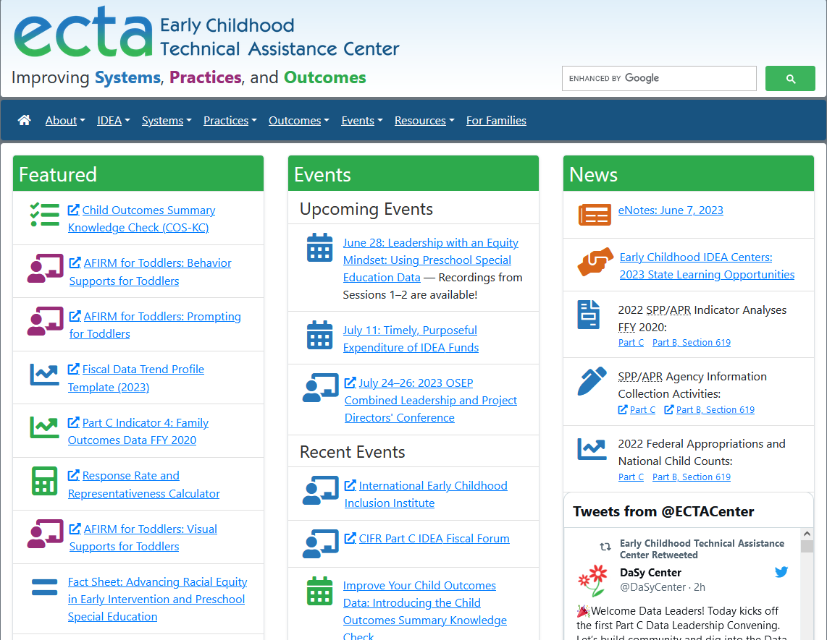
Series Recap
Session 1: Using an Equity Mindset in the Data Life Cycle
Session 2: Critical Questions to Improve Equitable Access, Experiences, and Outcomes
Session 3: Analyzing Data to Improve Equitable Access, Experiences and Outcomes
https://ectacenter.org/events/webinars.asp#y2023dataequityseries
Notes:
All recordings and slide decks can be accessed on ECTA website under Events using the link in the chat or on the screen. Session 4 will be posted as well.
https://ectacenter.org/events/webinars.asp#y2023dataequityseries

Slide 5
What does equity mean in early care and education systems?
“The state that would be achieved if individuals fared the same way in society regardless of race, gender, class, language, disability, or any other social or cultural characteristic. In practice, equity means all children and families receive necessary supports in a timely fashion so they can develop their full intellectual, social, and physical potential.”
Access
Experiences
Outcomes
https://www.naeyc.org/resources/position-statements/equity/definitions; Children’s Equity Project

Slide 6
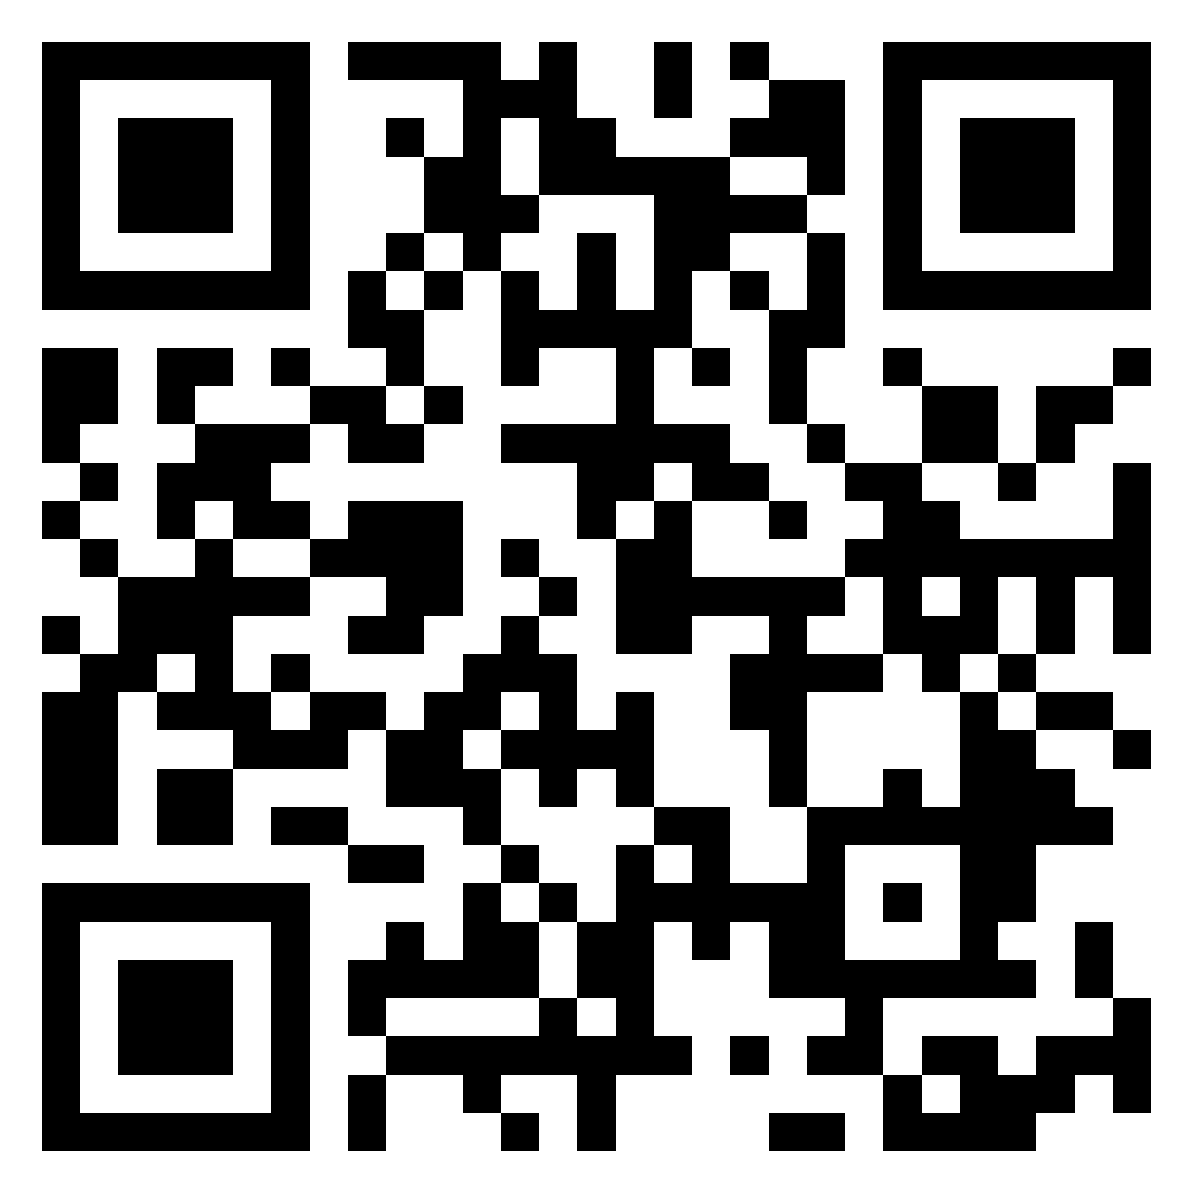
Barriers
Question: What is the biggest barrier your team experiences to using state-level preschool special education data with an equity mindset?
Use the Link in the Chat or QR Code to share your answer and view results: https://padlet.com/scheduleecta/what-is-the-biggest-barrier-your-team-experiences-to-using-s-yql7kjovo5439i74
Notes:
Opening Question: What is the biggest barrier your team experiences to using state-level preschool special education data with an equity mindset?
Link to the Barriers Question: https://padlet.com/scheduleecta/what-is-the-biggest-barrier-your-team-experiences-to-using-s-yql7kjovo5439i74

Slide 7
Session 1: Using an Equity Mindset in the Data Life Cycle Key Takeaways
Advancing equity takes focus and commitment from leadership and all staff.
Establishing shared language and values creates a strong foundation to use data to align policy and practice.
Listening to those who have been most impacted by the problem helps build the “data” story and uncover root causes of inequities and opportunities to course correct.
Reframing questions to challenge assumptions of the problem invites new data stories.
Notes:
Advancing equity takes focus and commitment
It requires us to ask the right questions…….
Reflective, probing questions help build the “data” story that identifies gaps in outcomes for children and explores adult capacity around equity
Establish a shared language to present data, describe conditions and outcomes and identify root causes of inequities.
Our question should not put the onus on children and families to change but for the system to change.
We have to reframe our questions to challenge deficit assumptions of children and families
Our question should not put the onus on children and families to change but for the system to change.
Our questions should be defined and detailed.
We should include partners in all aspect of our program evaluations, research projects and quality improvement activities.

Slide 8
Engage in a Cycle of Inquiry
Inquiry is a cyclical process that takes time, and it’s important for data teams and communities to work together throughout.
Applying an equity-focused approach to inquiry prompts data teams to reexamine and assess power dynamics, policies, practices, mental models, and beliefs, that perpetuate systemic barriers and inequalities.
Draft representation of Embedding Equity in the Data Lifecycle. Will be available from dasycenter.org.
Notes:
Leaders follow four principles to use data for good
Expand opportunity – open doors to greater opportunity for families and children
Provide transparency and evidence – provide information to stakeholder on how data has informed policy or practices
Empower communities – empower stakeholder to hold systems accountable
Promote equitable outcomes – achieve equitable outcomes for all
Source (2020) Four Principles to make Advance Data Analytics Work for Children and Families. Annie E. Case Foundation

Slide 9
Session 2: Critical Questions to Improve Equitable Access, Experiences, and Outcomes Key Takeaways
Program and system improvement questions require a focus on how the programs, policies, and procedures are experienced differently by children, families, and personnel.
Questioning "why" patterns in data are emerging is critical for getting to the root cause of the issue.
Feedback loops with those most impacted by the issue are critical for continuous improvement efforts.
Receiving data is a privilege. Have respect in the data process.
Notes:
Understanding the "why" requires listening with those most impacted by the problem

Slide 10
Session 3: Analyzing Data to Improve Equitable Access, Experiences, and Outcomes Key Takeaways
Engaging in Root Cause Analysis increases understanding of key factors that impact the data and identifies strategies to meet intended outcomes.
Building strong teams that leverage multiple perspectives provides insight into system and contextual factors impacting data.
Prepare for and facilitate data discussions that support each voice and challenge participants to think deeply about data.
Notes:
a note in speaking around power differential … authority creates a brave space to listen and understand …
That each individual understands how they contribute, what is being discussed, how they can offer feedback
Annonymous ways of submitting information or group process

Slide 11
Root Cause Analysis…
Is a problem-solving method for uncovering the factors that, if addressed appropriately, will prevent the problem from recurring. In order to identify appropriate solutions, it is necessary to identify root causes first.
Encourages reflection on current practices
Helps identify the underlying sources of problems
Can eliminate wasted effort on initiatives that will not solve the actual source of the problem
Provides justification for interventions
Notes:
This curiosity is what sparks a root cause process. Root cause is a process for understanding at its ROOT, why something is occurring. When you understand the factors that are causing or leading to a result, you are better able to identify the strategies that will lead to the outcomes you want. I know we are talking about finding and addressing issues of inequity in this conversation, but I want to mention that root cause isn’t simply to get to the root of a problem. It can be used to explore what is going on with any data set you are looking at., whether the data appears concerning or it suggests something exciting that you may want to replicate or scale across settings. Root cause analysis can help you get to the root of any type of data that you want to look at.
Once you get to the causes that lead to the observed data, then you can make a determination of whether or not there is an issue of equity.
For example, a colleague of mine was examining state data and noticed that a particular LEA had substantially higher rates of students identified with Other Health Impairments than other LEAs across the state. She could have assumed inequity, but she went through a root cause process to look at what was underlying the data. She discovered that the LEA was situated near a prominent hospital with a strong children’s medical unit. Families of children with OHI had relocated to this area, and consequently this LEA, in order to be closer to high quality medical services for their children. So what she had was a difference, yes, but not disparity. If she had looked at the original data and assumed inequity, she would have invested a lot of resources into addressing a problem that didn’t exist.
The opposite is also true. You don’t want to presume inequity, but neither do you want to presume equity. If you see an LEA with 100% inclusion, that’s awesome, right? We want children in the classroom with their typically developing peers, but it’s not about location. Children also need to have services they need to succeed in those environments. So when I look at this data, I wonder: ”Are children provided equitable access to the curriculum?”

Slide 12
Root Cause Process
Bring together a diverse team for multiple perspectives on the data of interest:
Don’t rely on your own opinions
Address assumptions and preconceptions
Elevate each voice, especially those most impacted by the process
Consider several hypotheses:
Include system and contextual factors
Disaggregate the data to look for patterns
Identify competing factors
Use data to support or negate potential factors.

Slide 13
Taking Action
Notes:
The effective use of Part C and Part B 619 data is fundamental to the achievement of positive outcomes for children with disabilities and families.

Slide 14
How are You Using Your Data?
To meet state and federal reporting requirement
To include family, partner, or community constituents in determining what action(s) should be taken to address the issues​
To ensure equitable access, supports and services, and outcomes
To inform decisions that will lead to impactful sustainable change in your systems
Notes:
Let’s start by talking about how you are using your data. This may be to improve programs and services at the state, regional, local, and program level

Slide 15
Key Considerations for Data Use
Consider critical questions about how the system and program addresses the needs of children and families​
Expand the group of people who get to make meaningful choices about data
Disaggregate your data to show who is represented and who is missing
Ensure that those who provided the data receive the findings​ in an understandable format
Decide if the data indicates barriers or obstacles to equity that need to be addressed
Recognize that we are making subjective human choices in our data work

Slide 16
What Does Taking Action Mean?
Using data for program improvement involves more than making decisions based on data—it involves identifying concrete actions that will lead to meaningful improvement and address the root causes of any institutional or systemic inequities.
Notes:
Focus: this goes beyond data use. How are you taking action that impacts the state, regional, or local level.

Slide 17
Leverage a Simple Process
Notes:
You may have developed some approaches to taking action within your organization, however, the DaSy center has created a simple process called Look! Think! Act!.
Share link, https://www.dasylearning.org/learn/article/look-think-act
Look! Think! Act! (LTA) was developed by a DaSy team to promote using data for program improvement.
Goals of LTA:
Support data use/data culture among state teams
Provide a resource that can be used by state teams to build local capacity to use data
Spotlight existing resources within a context of use
The module can be used in a group setting or as self-paced learning by individuals

Slide 18
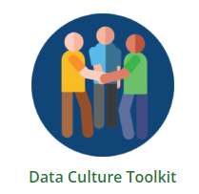
Setting the Stage
Create essential conditions and a supportive environment for using data for program improvement:
Culture of data use
Data leadership
Data infrastructure
Systems components
Family, partners, and community engagement
Intentional implementation
Notes:
When implementing LTA, creating essential conditions and a supportive environment for using data for program improvement is critical. Some examples are:
a culture of data use where staff and stakeholders across the program value and use data to improve the program
Data leadership - building one’s own capacity and the capacity of staff and other stakeholders to use data
a strong data infrastructure that provides accessible, timely, relevant, and accurate data that program staff and stakeholders can use to make decisions
a team open to addressing systems components so that state and local policies, resources, and structures are in place to support high-quality service delivery at the local level
Engaging families, partners, and communities leads to richer discussions and more informed decision-making
intentional implementation that pays attention to building staff competencies to implement change and to the leadership and organizational resources and capabilities that support implementation
DaSy has developed two resources so support this:
DaSy Data Culture Toolkit – https://dasycenter.org/data-culture-toolkit/
Data Leadership Competencies, https://dasycenter.org/data-leadership-competencies-for-part-c-and-part-b-619/

Slide 19
Before You Look at Your Data
What steps can you take?
Determine your critical questions
Clarify your purpose
Identify participants
Prepare your data
Plan for your data discussion
Notes:
There area a few standards steps to take before you look at your data that you should consider before you take action or Act.
This is somewhat of a review of the earlier webinars, but a critical piece of the LTA process, specifically, to identify the participants or your “team”.

Slide 20
Sections of Look! Think! Act!
Prepare to successfully use process with staff and other stakeholders, including families.
Look at your data objectively and state the facts the data provide.
Think about what you observed.
Act based on the data and conclusions made.
Enrich the process by creating a supportive environment to ensure that the actions you take are effective in helping you reach your goals.

Slide 21
Time to Act!
Create and review discussion questions for your team to consider
Identify actions that are directly linked to the data from the Look stage and conclusions from the Think stage.
Develop a written plan of the improvement actions to help your team
Notes:
During the Act or Taking action stage, create and view discussion questions for your team to consider. This could be:
Discussion Questions:
What do the results mean for our work? Why do they matter?
What additional data do we need to determine actions?
What actions should be considered based on these results?
How will these actions lead to improvement?
When, how, and by whom will the actions be implemented?
What resources do we need to implement the actions?
How will we monitor progress on these actions?
What are the next steps?
Then Identify actions that are directly linked to the data from the Look stage and conclusions from the Think stage. These actions may be small and short-term such as making an immediate procedural change, or they may involve large changes in your program or system
Develop a written plan of the improvement actions will help hold your team accountable for implementation and provide benchmarks of success along the way so you know the change is taking place. The plan should include:
key or concrete actions
person(s) responsible
timeline
expected outcome or goal
benchmarks to assess progress
As you reach your first benchmark or check-in point, use Look! Think! Act! to assess progress.
If you are on track, keep doing what you are doing.
If the data show a need for a course correction, revisit your plan, and adjust based on the data.
Repeat this cycle until you reach your desired goals.
The more you use the Look! Think! Act! process, the sooner it becomes the natural way of doing work. You will be using the process routinely whether you are holding a meeting for a small group of people or a full council of stakeholders. Look! Think! Act! will become a cornerstone in building your data culture and using data for program improvement.

Slide 22
Quote from the Annie Casey Foundation
“The point of collecting and analyzing disaggregated data is to use data as a mirror and tool to uncover the drivers of disparity and inequity and increased opportunities and outcomes for all children.”
– Annie E. Casey Foundation, 2016

Slide 23
Quiet Reflection
Notes:
Take a few moments to pause …. Quiet moment to reflect and share ONE action as an individual in your role and one action with your team
Link for Reflection Notes: https://padlet.com/scheduleecta/what-is-one-action-you-can-take-bmab2i06pufh7g3h

Slide 24
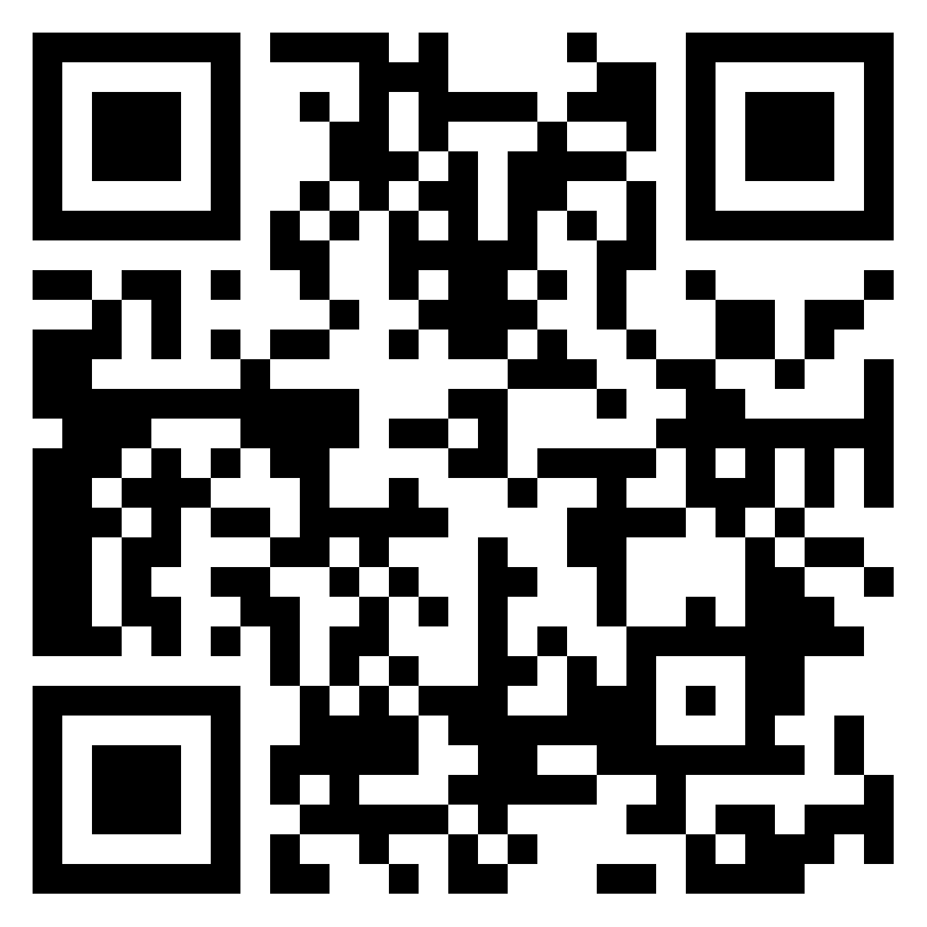
Actions
Questions: What is one action you can take individually? One action you can take as a team?
Use the Link in the Chat or QR Code to share your answer and view results:
https://padlet.com/scheduleecta/what-is-one-action-you-can-take-bmab2i06pufh7g3h

Slide 25
Brainstorming Discussions

Slide 26
Brainstorming Questions
Discuss and describe your most important takeaway from the series.
What questions has the series raised for you related to using data with an equity mindset?
What support do you need to make progress on the action individually and as a team?
How can TA centers help your team?
Notes:
https://padlet.com/scheduleecta/brainstorming-questions-oj3566s2lxz667xp

Slide 27
Closing: Key Actions

Slide 28
Resources
Reflection Worksheet for Leadership with an Equity Mindset Series will be available online for Session 4 at https://ectacenter.org/events/webinars.asp#y2023dataequityseries
Look! Think! Act! Using Data for Program Improvement Resources available online at https://dasycenter.org/look-think-act/
Preparation Checklist
Facilitator’s Guide
Discussion Guide
Documentation Template

Slide 29
Evaluation
You will receive a link to the evaluation survey in your email.
Thank you for sharing your feedback!

Slide 30
Thank you for joining the series! We will transition to the Q&A.
https://dasycenter.org/ Follow DaSy on Twitter: @DaSyCenter | ectacenter.org Follow ECTA on Twitter: @ECTACenter | https://ideadata.org/ Follow IDC on Twitter: @IDEAdatacenter
The contents of this presentation were developed under grants from the U.S. Department of Education, #H373Z190002 and #H326P170001. However, those contents do not necessarily represent the policy of the U.S. Department of Education, and you should not assume endorsement by the Federal Government. Project Officers: Meredith Miceli, Amy Bae, and Julia Martin Eile.

