Slide 1
Preparing for DMS 2.0
February 22, 2024

Slide 2
Preparing for DMS 2.0: Outcomes
Participants will:
Improve understanding of steps to prepare for and participate in the DMS process
Gain an understanding of the new DMS web-based resources and how to access them
Increase awareness of available DMS TA and how to access it

Slide 3
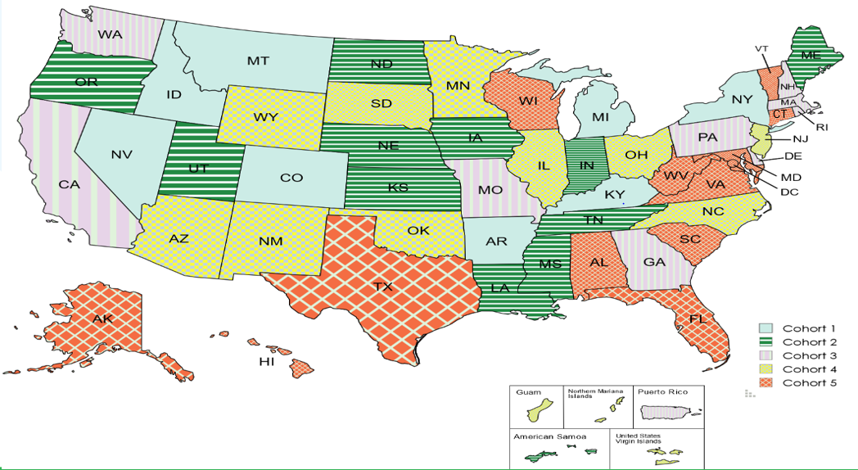
States Participating

Slide 4
Poll
Select the item that best describes where your state is in preparing for DMS activities with OSEP:
We have already had our DMS engagement visit from OSEP
We have completed a gap analysis and planning for one or more of the topical areas
We are actively involved in planning activities for the DMS process
We are ready to begin planning for the DMS process

Slide 5
Preparing for DMS 2.0 Webpage: Purpose
Helping your state have a “successful” DMS process by:
By completing all planned DMS preparation activities
Getting your state team grounded in how your systems are implemented: monitoring, dispute resolution, data and fiscal management
Identifying your systems’ strengths and gaps
Planning/making systems improvements and implementing changes as feasible
Being prepared to clearly describe your systems and showcase your strengths to OSEP

Slide 6
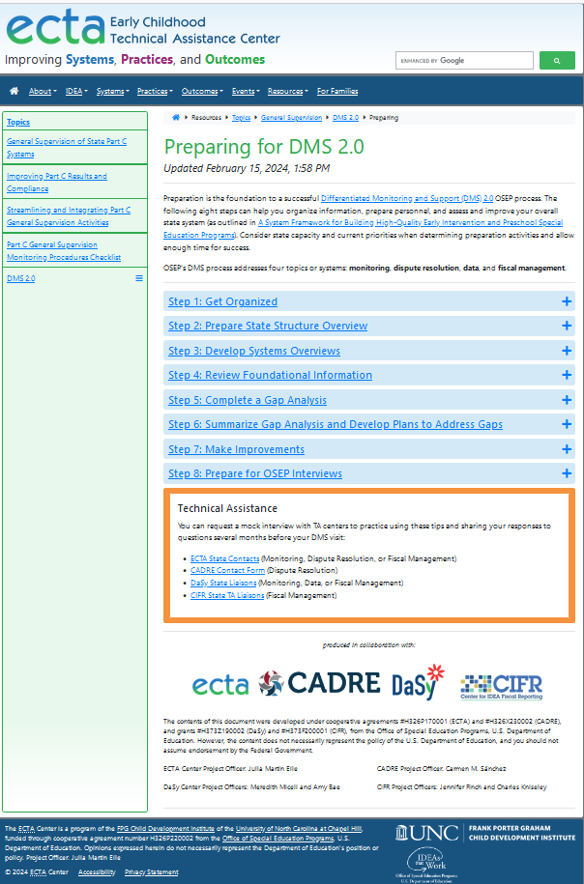
8 Steps to Prepare for DMS
Step 1: Get Organized
Step 2: Prepare State Structure Overview
Step 3: Develop Systems Overviews
Step 4: Review Foundational Information
Step 5: Complete Gap Analysis
Step 6: Summarize Gap Analysis and Develop Plans to Address Gaps
Step 7: Make Needed Improvements
Step 8: Prepare for OSEP Interviews
https://ectacenter.org/topics/gensup/dms-preparing.asp

Slide 7
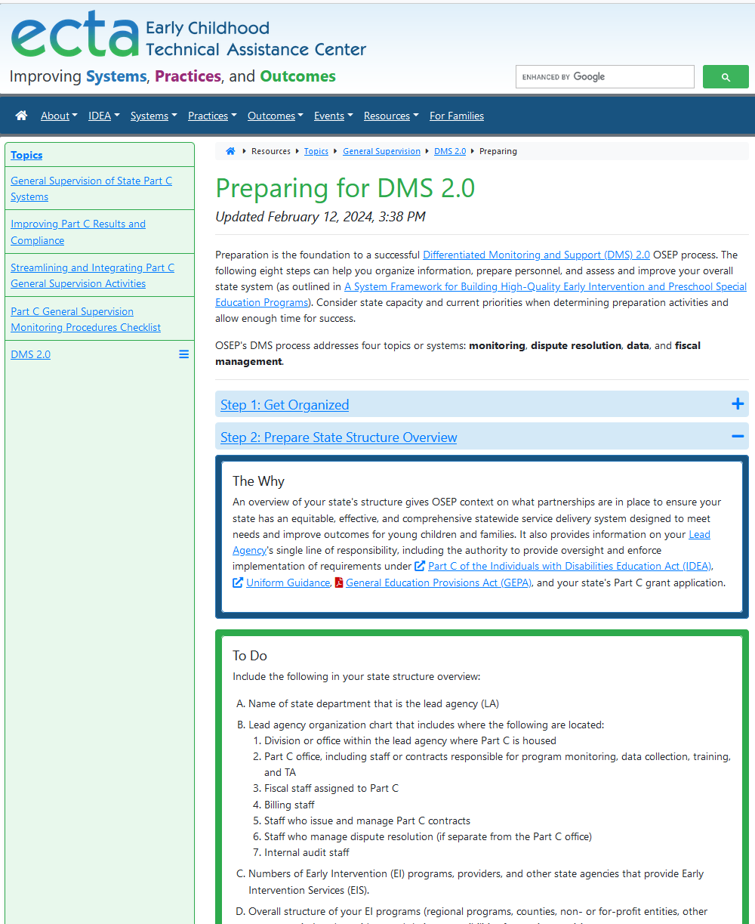
Webpage Content Structure
Content Structure for Steps
The Why
To Do - some Steps include:
Monitoring
Dispute Resolution
Data
Fiscal Management
Tips
Resources/Examples

Slide 8
Exploring the Webpage
Take 90 seconds to explore the webpage
In the chat, share one thing that you think might be helpful for your state
Time’s
Up!
https://ectacenter.org/topics/gensup/dms-preparing.asp

Slide 9
Step 1: Get Organized
What: Ways to organize and what to include in overall plan for DMS
Why: Comprehensive planning helps team members know what needs to be done when and by whom to ensure all DMS preparation activities are completed

Slide 10
Step 1: To Do
Review resources & guidance
Create state team for all DMS work
Form workgroups for data, fiscal, monitoring, & dispute resolution
Develop detailed plans for all DMS activities
Create a communication plan
Document all planned & completed DMS activities
Develop a glossary of terms

Slide 11
Step 2: Prepare State Structure Overview
What: Content for developing high-level state structure overview to share with OSEP
Why: Provides OSEP context on your statewide system of early intervention services including:
Partnerships
EI programs and providers
Oversight

Slide 12
Step 2: To Do
Describe and/or create visual(s):
Where Lead Agency is housed
Detailed Lead Agency organizational chart
Number of EI programs, providers, and state agencies providing services
Overall structure and responsibilities of EI programs and providers

Slide 13
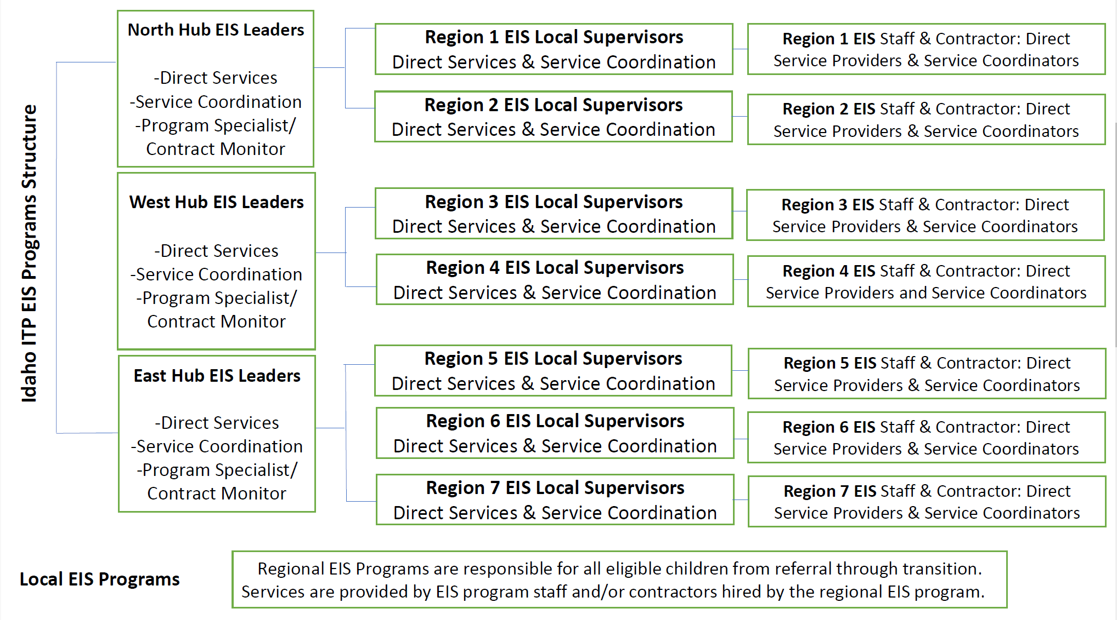
Example: Idaho State Structure Overview

Slide 14
Step 3: Develop Systems Overviews
What:
Content for developing systems overviews to share with OSEP:
Monitoring
Dispute resolution
Data
Fiscal management
Why:
Helps OSEP understand how each system is implemented
Helps your state team:
Get grounded in how each system functions
Conduct a gap analysis for each system (Step 5)
Respond to OSEP’s interview questions

Slide 15
Scavenger Hunt: Steps 1, 2, and 3
Look in Step 3 and open “Fiscal Management” and let us know in the chat which letter addresses “methods of monitoring the use of federal funds”?

Slide 16
Step 4: Review Foundational Information
What: Foundational information for each of the 4 DMS systems:
Basic requirements
Considerations
Resources
Why: Helps state teams understand critical information to:
Effectively identify gaps (Step 5)
Develop plans to address gaps (Step 6)
Make systems improvements (Step 7)

Slide 17
Step 4: To Do
Compare foundational information for each topic to:
Written public-facing policies and procedures
Operating procedures
Current implementation practices
Document consistencies/ inconsistencies:
Not using correct timeline for prefinding correction/issuing written findings
List of hearing officers and process to assign them in place, but have not trained in 5 years

Slide 18
Step 5: Complete Gap Analysis
What: Tools to identify areas needing improvement in each of your 4 systems
Why: Helps your state:
Identify your strengths and gaps
Prioritize areas for improvement

Slide 19
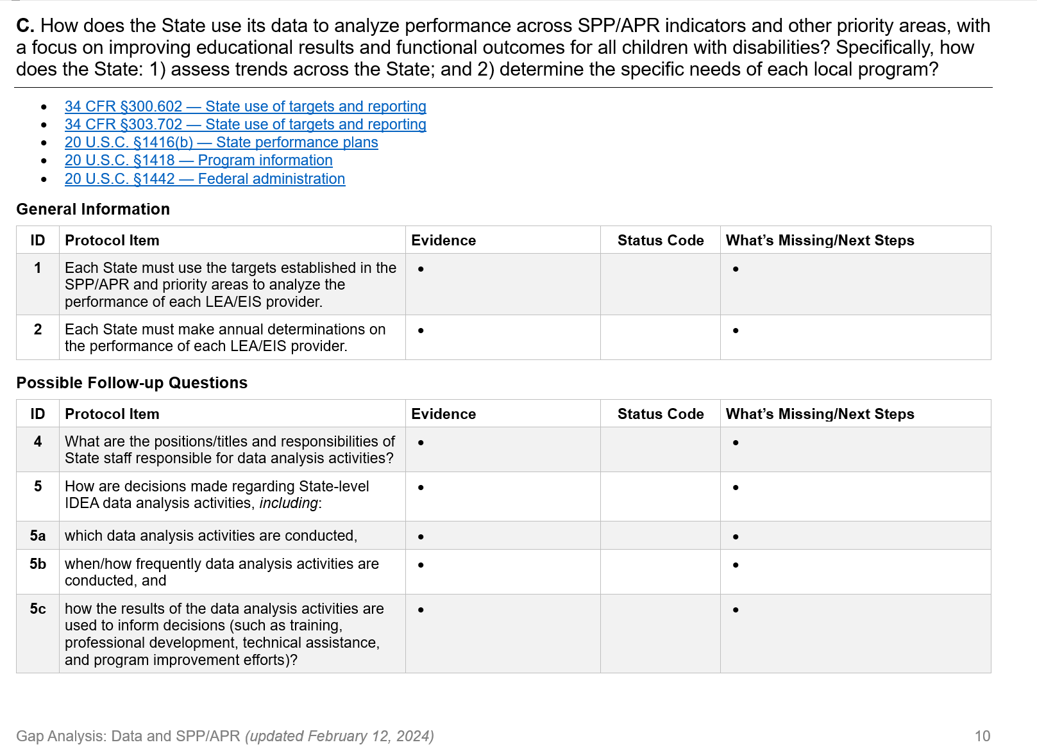
Step 5: To Do
For each worksheet Protocol Item:
Use information from prior steps and assign a rating (1, 2, 3, 4)
Doing it correctly and it is documented
Doing it correctly, but it needs to be documented
Doing some but not all, and documentation needs to be developed or modified
Need to give this a lot of attention

Slide 20
Engagement
Download the State Complaints Gap Analysis Worksheet located in Step 5 and put in the chat why Overarching Question A is not included in the worksheet.

Slide 21
Step 6: Summarize Analysis and Develop Plans
What: Process and tools for developing:
Summary of identified gaps, with actions/next steps, for each topic
Detailed plans for complex gaps requiring system change
Why: Summarizing needs identified in gap analysis and developing plans for improvement help ensure gaps are addressed and systems are improved

Slide 22
Step 6: To Do
Summarize and prioritize gaps
Describe issues
Determine actions to address issues
Identify resources
Develop plan for complex gaps including:
Activities
Due dates
Staff responsible
Resources to assist in completing the activity

Slide 23
Step 7: Make Improvements
What: Information and tips on implementing improvement plans, monitoring progress, and updating plans as needed.
Why: Making systems improvements is critical to:
Meet IDEA requirements
Ensure the state's overall system is high-quality
Improve child and family outcomes

Slide 24
Step 7: To Do
Use foundational information (Step 4) to make improvements and address gaps
Develop/modify public-facing policies and internal operating procedures to reflect improvements
Compile evidences when implementing the changes

Slide 25
Step 8: Prepare for OSEP Interviews
What: Guidance on activities to do before OSEP interviews and tips to use during the interviews
Why: Preparing for OSEP interviews helps your state team:
Know what information will be shared to effectively communicate the implementation of your systems
Identify who will share specific information
Determine how information shared by various team members connects to ensure consistency

Slide 26
Step 8: To Do
Before OSEP Interviews:
Decide who needs to be involved
Assign staff to share content
Complete a walk-through for each of the 4 systems
Review your notes
During Interviews:
Take your time
Ask for clarification
Answer carefully and concisely
Stick to the facts
Be confident and consistent
Acknowledge when you don’t know
Consider requesting a TA Center mock interview 4-6 mos. before your OSEP interviews!

Slide 27
What States Say About Mock Interviews
Gave context on what OSEP interviews would be like
Provided practical experience in answering questions in a more formal setting
Helped us learn where we needed more practice and what areas were our strengths
Tips were particularly helpful
Highly encourage the mock interview process for others who are preparing to go to DMS
Assisted our team to better prepare for the type of questions we would possibly be asked during the DMS process
Discussion and feedback provided was very helpful

Slide 28
Questions? What are you thinking about?

Slide 29
Knowing I have these resources, preparing for DMS makes me feel like…
1
4
3
2
5

Slide 30
TA Support
Individualized TA
ECTA State Contacts (Monitoring, Dispute Resolution, or Fiscal Management)
CADRE Contact Form (Dispute Resolution)
DaSy State Liaisons (Monitoring, Data, or Fiscal Management)
CIFR State TA Liaisons (Fiscal Management)
Cross-State Quarterly DMS Calls for All States
Webinar Evaluation

Slide 31
Find out more at ectacenter.org
The ECTA Center is a program of the FPG Child Development Institute of the University of North Carolina at Chapel Hill, funded through cooperative agreement number H326P220002 from the Office of Special Education Programs, U.S. Department of Education. Opinions expressed herein do not necessarily represent the Department of Education's position or policy.

