Slide 1
Notes:
This online module introduces family capacity building to practitioners and service providers. The module walks the online learner through the steps of introducing a practice to a parent and ensuring that they understand the important components of the practice.

Slide 2
The approach is called
Family Capacity-Building practices
Notes:
This online module is written for practitioners who are unfamiliar with family-capacity building practices. These practices help to build parents’ confidence in their ability to provide learning opportunities for their child and their feelings of competence as well!

Slide 3
Introduce & Illustrate
Engage & Support
Review & Next Steps
Notes:
When sharing the family capacity building model with caregivers we use six components or elements. First, Introducing and illustrating the practice. Next engaging in the practice with the parent and supporting their use of the practice, and finally, reviewing their use of the practice and discussing next steps of how they use the practice with their child on their own in new and different ways.
There are four lessons in this module but here are a few slides that show you the highlights of the module and examples of the six components

Slide 4
Notes:
Introducing an activity to a parent, in the first phase of family capacity-building includes explaining the key characteristics and what the intended benefits to the child are.
It’s important when teaching a parent a practice that they understand the key characteristics of the practice. These are the behaviors that research tells us lead to the positive intended benefits for children.
This lesson uses the game of “peek-a-boo” to illustrate the use of Family Capacity-Building practices.
This slide illustrates for the parent “How-to-do” the game of “peek-a-boo” and the intended benefits our expected outcomes for their child.

Slide 5
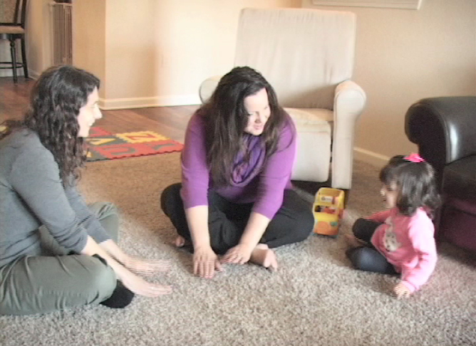
Notes:
The next phase is Engage and Support. The more engaged a child and parent are in recommended practices, the more a child is learning. It’s important to help parents increase engagement. It’s also important to provide support and encouragement to families when they are using the practice.
In this video the practitioner engages in songs with the family. This is an example for the practitioner of what it might look like to support the parent in supporting their child in an activity.

Slide 6
Notes:
The modules also include knowledge checks in a variety of interactive formats so the learner can actively participate and see if they understand the concepts. This knowledge check discusses using the practice during everyday activities as the context for using the practice of early learning games.

Slide 7
Notes:
This is another example for the practitioner to see what supporting the parents use of the practice might look like.

Slide 8
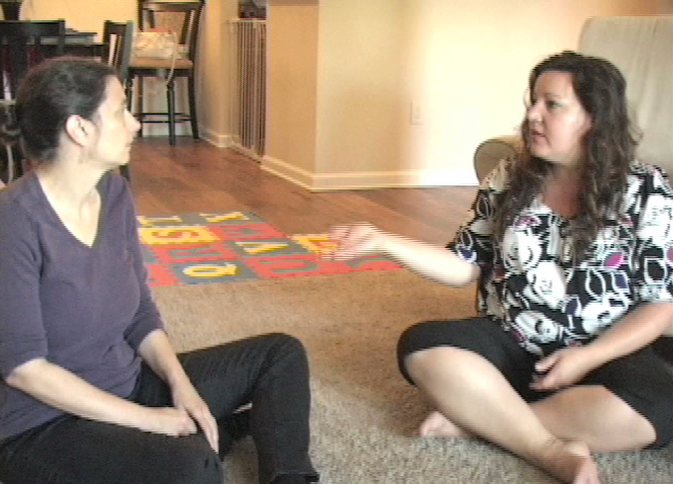
Notes:
In this video the parent and practitioner discuss how the parents has used the practice with the child. They discuss how using the practice has led to seeing benefits for the child.

Slide 9
Notes:
Next steps involves discussing with the caregiver how they may want to use the practice in the future. Parents are encouraged to think of new activities, such as learning new songs or lap games the child didn’t know before. Next steps also involves discussing with the parent new places they might use the practice, such as car rides, bath time, or during outings like visits to the park.

Slide 10
Notes:
Lesson 4 of the module gives the learner more examples and activities to test their knowledge

Slide 11
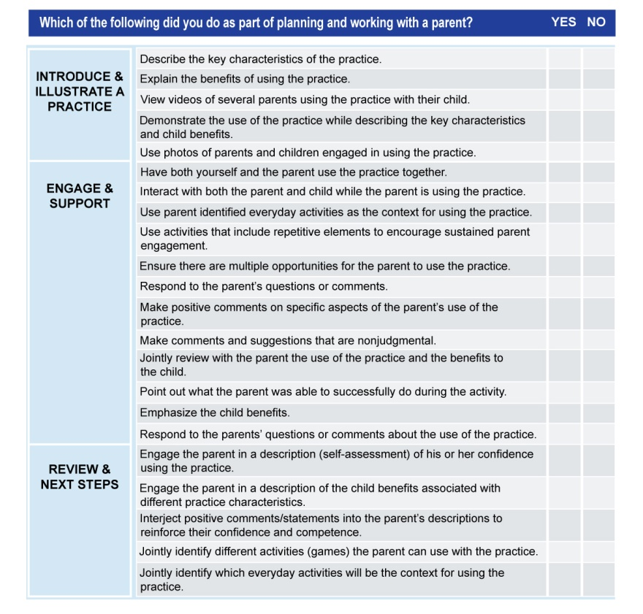
Notes:
The learner has access to a checklist that service providers can use for self-assessment and planning their visits.

