Slide 1


Welcome to the Webinar Series: Recommended Practices for Engaging Families
Webinar 3: Resources and Supports for Parent Centers
Wednesday, August 7, 2019, 3:00 - 4:00 PM EDT

Slide 2
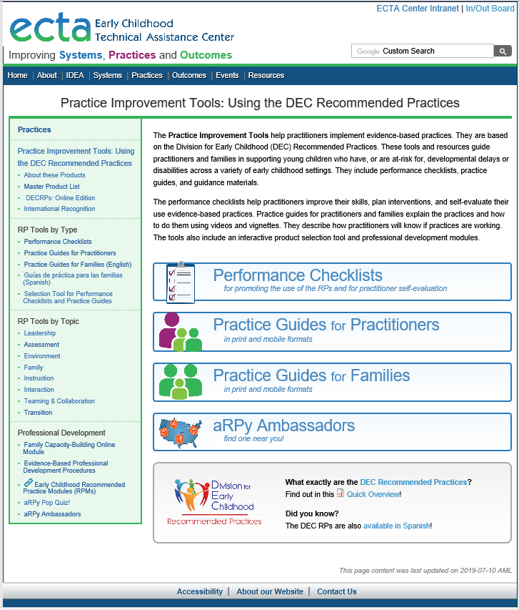
Recap From Webinar 2

Slide 3
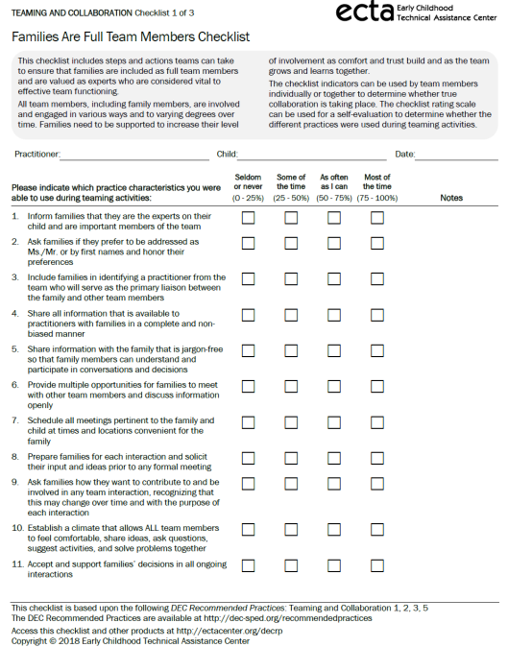

Example of a
Performance Checklist
Each checklist is formatted in the same way for consistency across topic areas

Slide 4
Practice Guide
Description of the Practice
Video example of the Practice
Performing the Practice
Illustrative vignette
Recognizing success

Slide 5
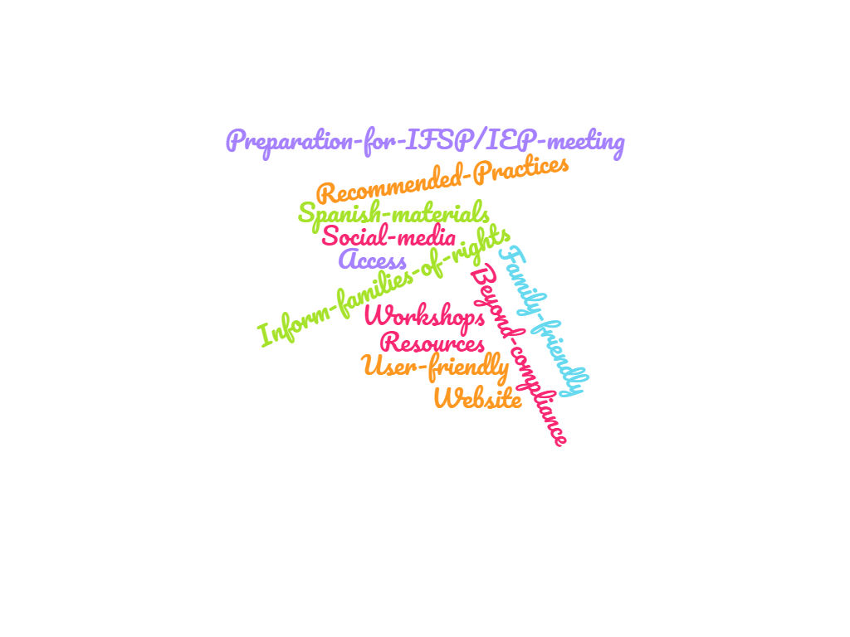

Slide 6
Session Objectives
Participants will become familiar with the ECTA Center suite of resources that support the work of Parent Centers
Participants will become familiar with how to access and use the resources

Slide 7

Notes:
Transition Slide:
Today our goal is to help you connect the dots, to help you take the information that we’ve shared in the first 2 webinars and help you think about how you, Parent Center staff, can use the information, the tools and the resources in your work. We are going to share some scenarios that we hope will make it clearer how all of this can be used to enhance your typical interactions with families. So, let’s take a look at the first scenario.

Slide 8
Let’s See It:
Scenario #1: Teaming & Collaboration
Maya provides group trainings for families as part of her work at her state’s Parent Center. One of the trainings that is often requested addresses effective communication and working together as a part of a team (such as an IEP or IFSP team). The training curricula hasn’t been updated in a few years and Maya has been charged with updating the materials. Where should she begin?

Slide 9
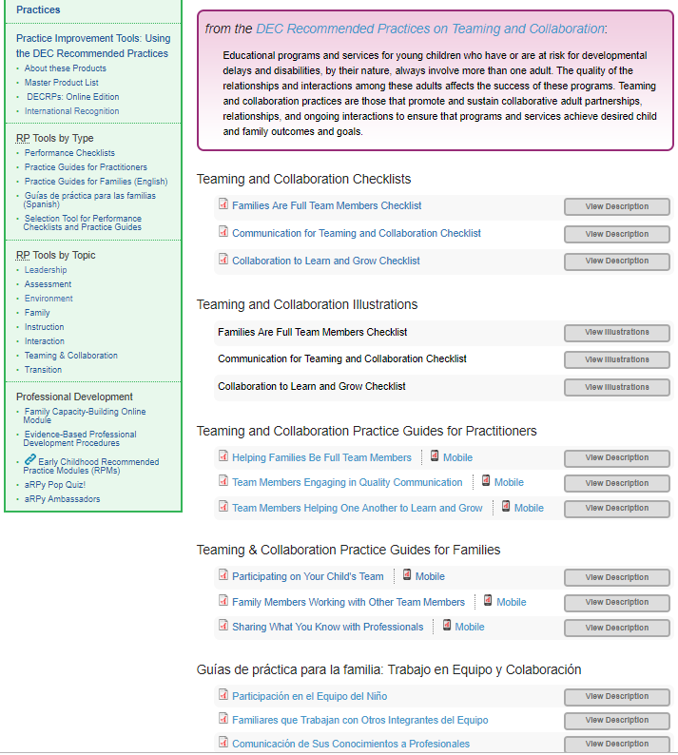
Resources that support this scenario

Slide 10
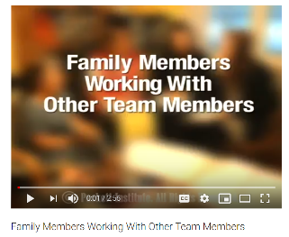
Resources that support this scenario
https://youtu.be/oickxJKapvA

Slide 11
Let’s See It:
Scenario #2: Assessment
Steve works for the Parent Center in his state and is responsible for the Center’s website and social media presence. He is preparing a calendar of information and material that will be shared using various forms of technology for the next 6 months and notices that he’s lacking good content that focuses on early childhood. How could he use the RPs and the various resources and tools as he continues planning?

Slide 12
Resources to Support Scenario
Schedule an RP topic to highlight each month – for example, April is “Assessment” month – Tips for Families to Prepare for Your Child’s Assessment:
  Week 1 - Identify ways to share information about your child with team members. Share photos or videos of your child participating in activities.
  Week 2 - Describe how your child participates in different activities, including things your child does easily and things your child has difficulty doing. Describe your child’s favorite activities and the toys, materials, people, and actions that hold your child’s interest.
  Week 3 - Notice how your child interacts with objects, materials, and his or her surroundings. What does your child do to stay involved in activities? Pay attention to what your child can do without help from others, is good at doing, and is just beginning to do.
  Week 4 – Make a list of your child’s strengths. Note how your child interact with you and other people and how your child interacts with toys and other objects. In the same way, make a list of your child’s interests. Write down the things that excite your child, things your child likes to do, and things that your child prefers to do.

Slide 13
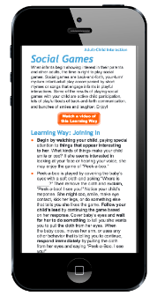
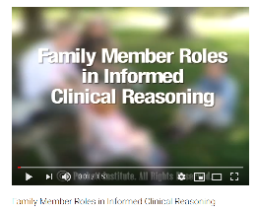
Resources to Support Scenario
Embed video clips from the Practice Guides for Families in social media posts.
Link to the Recommended Practices and the Practice Improvement Tools from your website.
Use text messaging to text a Tip of the Day to Parents/Families, based upon the RPs and Practice Guides for Families.
Highlight one RP per month in your email newsletter to family in a special section focused just on early childhood.

Slide 14
Let’s See It:
Scenario #3: Assessment
Bryce’s mother, Sharon, called the Parent Center in her state asking for assistance preparing for Bryce’s upcoming evaluation for Part C/early intervention eligibility. She stated “I just received a call from the health department in regard to my son’s hearing loss. The early intervention program staff are coming to our house Monday, but I’m not sure what to expect. My son is 14 months old.” She explained that Bryce also has a cleft palate and went on to describe how Bryce is currently making sounds and communicating. She asked how she should prepare for the evaluation and what information she should share.

Slide 15
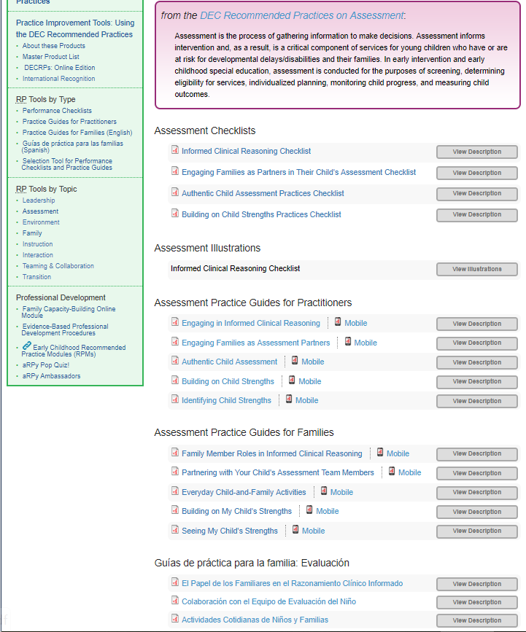
Resources to Support Scenario

Slide 16
Resources that support this scenario

Slide 17
Let’s See It:
Scenario #4: Instruction
Malcolm’s grandmother, Betty, recently contacted her Parent Center for assistance. She explained that mealtimes, both at home and in childcare, are a huge struggle for her grandson. He has many food allergies as well as some oral motor and fine motor delays. Betty wants for him to become more independent with feeding skills. She asked how to get this added to his IFSP and what else she should be asking the IFSP team to do.

Slide 18
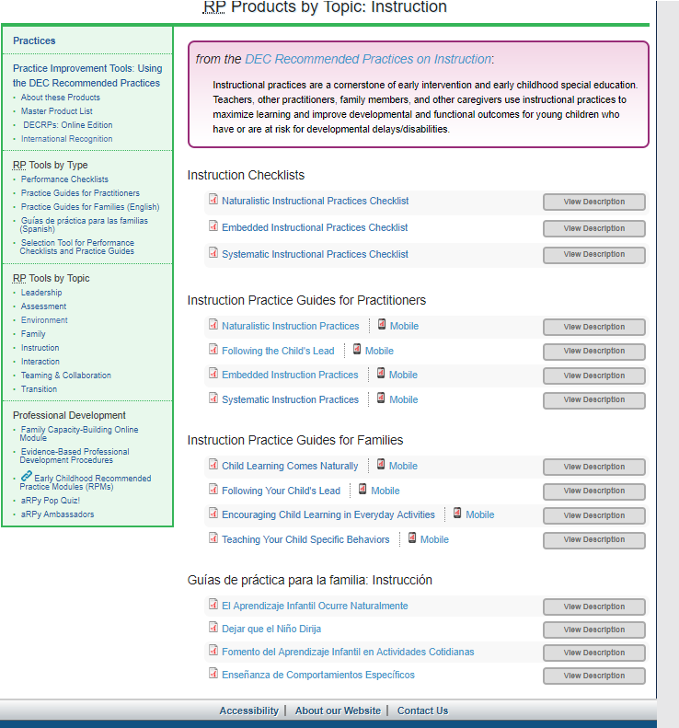
Resources to Support Scenario

Slide 19
Resources to Support Scenario

Slide 20
Let’s See It:
Scenario #5: Transition
Zayden has an IEP and is currently receiving preschool special education services. Next year, he will be ready to transition to kindergarten. His parents and the rest of the IEP team feel he will continue to need an IEP. His parents want to check out all of their options before the IEP Team meets to begin discussing this transition. But they don’t know where to begin, what questions to ask and what they should be considering. They contact the Parent Center in their area to ask for assistance.

Slide 21
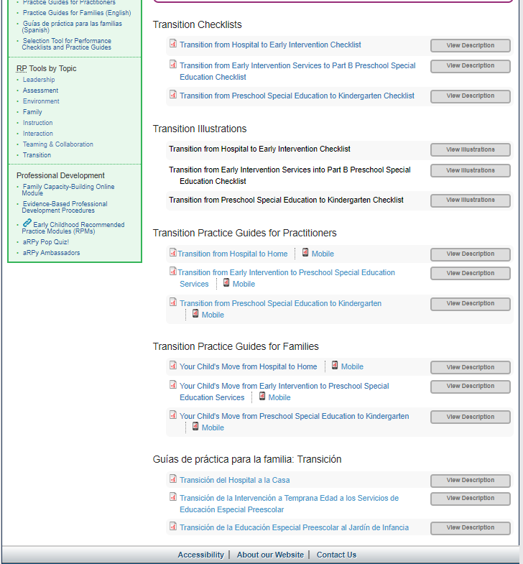
Resources that support this scenario

Slide 22
Resources that support this scenario

Slide 23
Resource List
Webinar 1 & Webinar 2 Recordings
http://ectacenter.org/events/webinars.asp
Practice Improvement Tools - http://ectacenter.org/decrp/
Performance Checklists - http://ectacenter.org/decrp/type-checklists.asp
Practice Guides for Practitioners - http://ectacenter.org/decrp/type-pgpractitioner.asp
Practice Guides for Families (English) - http://ectacenter.org/decrp/type-pgfamily.asp
Practice Guides for Families (Spanish) - http://ectacenter.org/decrp/type-pgfamily-sp.asp

Slide 24
Questions and Comments
Comments or questions…
Now that you’ve seen some example illustrations of how the RPs and resources could be used by a Parent Center, what are your thoughts? Do you have plans for using the resources that you’d be willing to share?
Are there people who come to mind that you plan to share these resources with in the near future?
Is there anything else you need to begin using the DEC RPs and related resources?

Slide 25
What’s Next?
Evaluation Survey from this email:
Webinar 4 Wednesday, September 11, 2019 from 3:00-4:00pm EDT
Objectives:
  Participants will become familiar with the purpose and intended benefits of the aRPy Ambassador Initiative
  Participants will become familiar with the role of the aRPy Family Ambassador
  Participants will become familiar with the qualifications and process for applying to be an aRPy Family Ambassador

Slide 26
Thank You for Your Time and Participation
Contact Information
Betsy Ayankoya, ECTA Center: betsy.ayankoya@unc.edu
Peggy Kemp, Executive Director, Division for Early Childhood: peggy@dec-sped.org
Stephanie Moss, Region B PTAC and ECTA Center stephanie@p2pga.org
DEC: http://www.dec-sped.org/
The Early Childhood Technical Assistance Center: http://ectacenter.org
Region B Parent Technical Assistance Center at Parent to Parent of Georgia: www.p2pga.org

