Slide 1
National Webinar
Presented by: Amy Nicholas
Cathy Smyth
Naomi Younggren
October 18, 2017

Slide 2
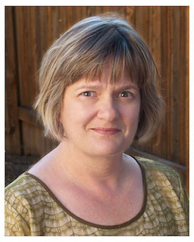
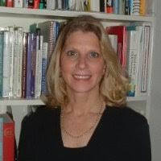
Presenters
Amy Nicholas DaSy Center
Cathy Smyth DaSy Center
Naomi Younggren U.S. Dept. of Defense, EDIS

Slide 3
Intended Outcomes
As a result of this webinar, participants will have increased:
Awareness of the Child Outcomes Summary Team Collaboration (COS-TC) tool and related resources; and
Understanding of the potential uses of the COS-TC at the state and local level.

Slide 4
Agenda
Background & Purpose
Resource Collection
Potential Uses
Next Steps

Slide 5
Child Outcomes Summary (COS) Online Learning Module
For more information about the module and to register to use it, visit: http://dasycenter.org/child-outcomes-summary-cos-process-module-collecting-using-data-to-improve-programs/

Slide 6
Teaming for the COS Process
The COS process is a team-based process for synthesizing multiple sources of information about a child’s functioning across settings and situations for each of three child outcomes.
Families are essential members of COS teams!

Slide 7
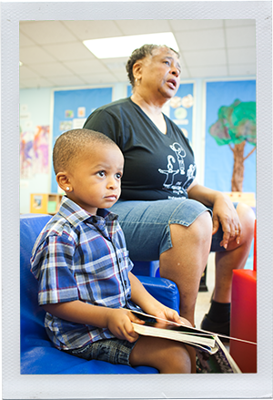
ENHANCE Study
There is wide variety in who comprises the COS team.
Families are frequently not included.
There is not a standard way that teams complete the COS process.
Length
Structure
Content
For more information, visit http://ectacenter.org/eco/pages/enhance.asp

Slide 8
What have we heard from providers?
Good teaming and collaboration takes time (that we don’t have).
Involving families is too difficult.
Providers perceive that families don’t want to hear that their children are functioning below age expectations.
Providers worry that families will think we’re emphasizing their children’s delays.
It’s a tough conversation to have!

Slide 9
What do COS teams need?
Practitioners need strategies for meaningfully engaging families in the COS process.
COS teams need help with having good discussions about children’s functioning (e.g., what to talk about, how to gather input from families).
COS teaming and collaboration practices need to be described and operationalized.

Slide 10
The COS-TC and Its Purpose
The COS-TC is a checklist that serves as a mechanism for those who implement, supervise, or train on the COS process to identify, observe, and assess quality team collaboration practices in COS implementation.

Slide 11
COS-TC Quality Practices
Planning for the COS
Explaining the COS Process to Families
Understanding Child Functioning
Building Consensus for a High-Quality COS Rating
Interactive Practices

Slide 13
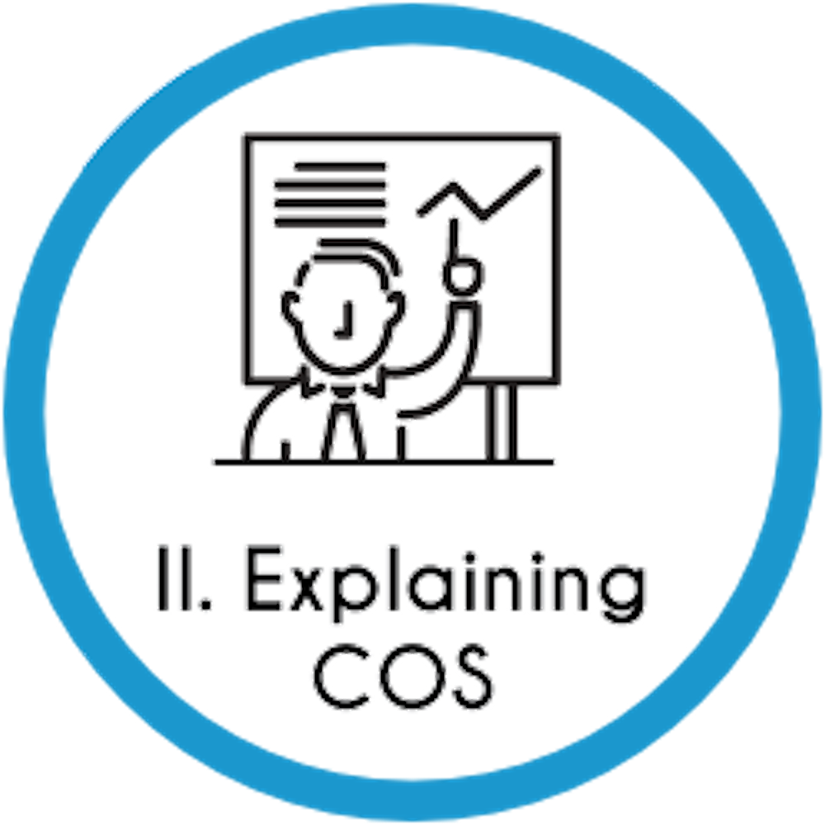
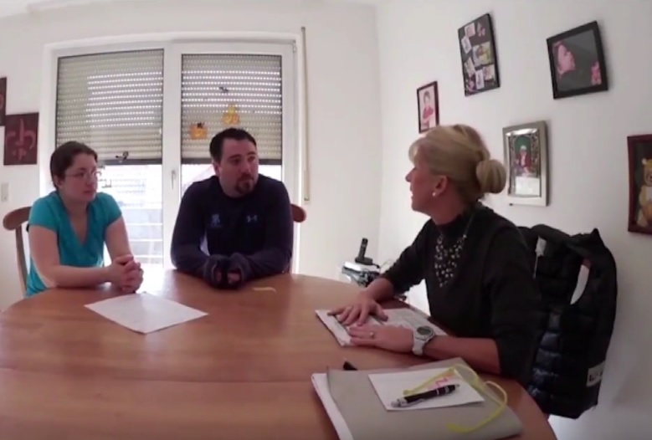

Slide 16
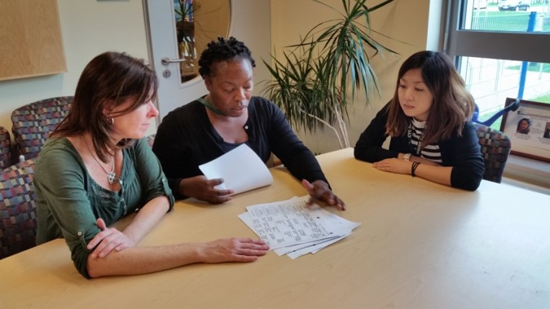

Slide 17
COS-TC Resource Collection
Checklist and Descriptions
Full set of checklists
Online Practice Site
Extend learning by watching video clips of COS team meetings
Practice using COS-TC Checklist to rate the providers in the videos use quality practices.
Contains training agendas and instructions for training activities
Descriptions and other information about each quality practice
Examples of team discussion points related to each practice
Video Library
Trainer's Guide & Presentation
Accompanying PowerPoint presentation provided
Collection of videos to be used for training purposes
Closed captioning provided

Slide 18
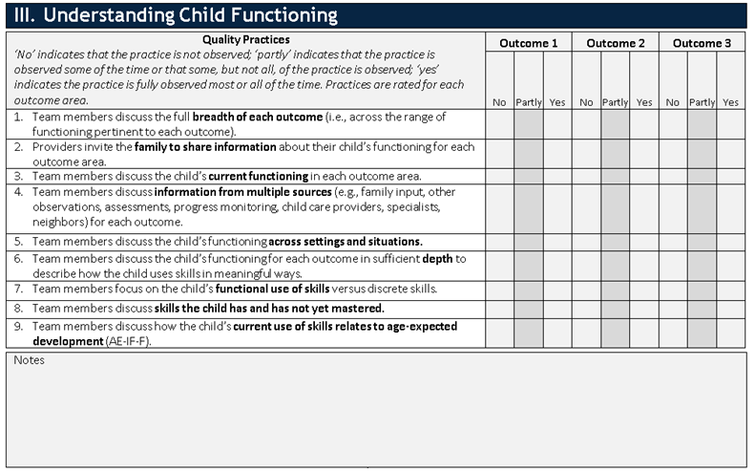
COS-TC Checklist

Slide 19
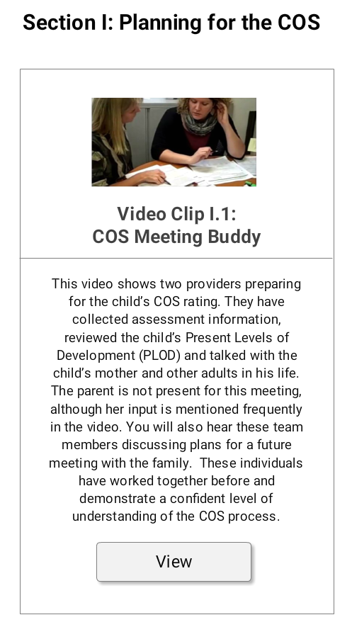

Slide 20
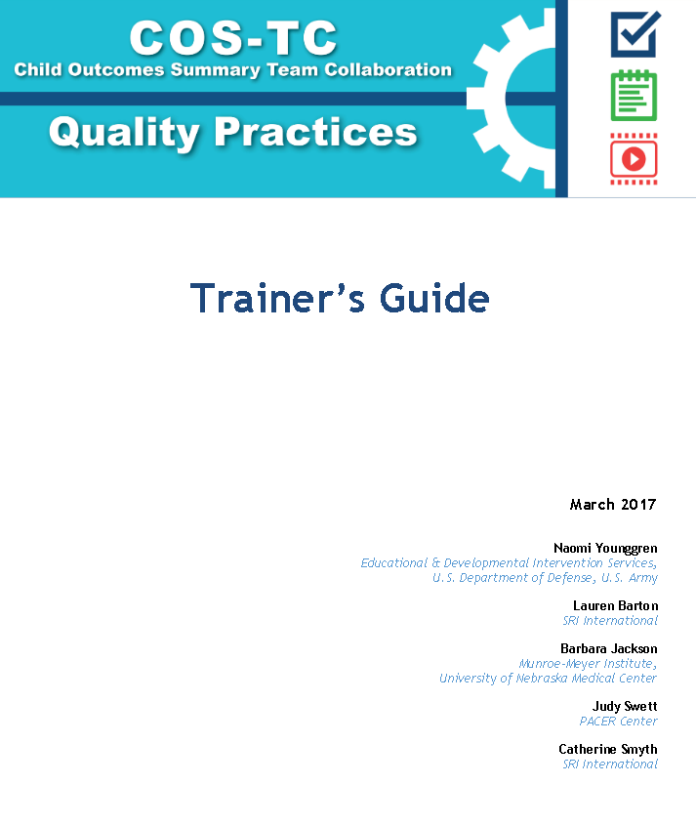
Trainer’s Guide
PPT Presentation
Video Library

Slide 21
How should the resources in the collection be used?
Learn about COS-TC Quality Practices
Reflect on COS Teaming Practices
Plan for Improving COS Teaming Practices
Download, print, and read the 2-page guidance document to learn more: http://ectacenter.org/eco/pages/costeam.asp.

Slide 22
COS-TC Webpage
http://ectacenter.org/eco/pages/costeam.asp

Slide 23
Program Use: Example from the Field
Educational and Developmental Intervention Services (EDIS), U.S. Department of Defense
Having families at the table for COS rating determinations evolved over time
Engaging families improved with COS-TC
COS-TC training and self-reflection will be part of EDIS Provider Training/Certification

Slide 24
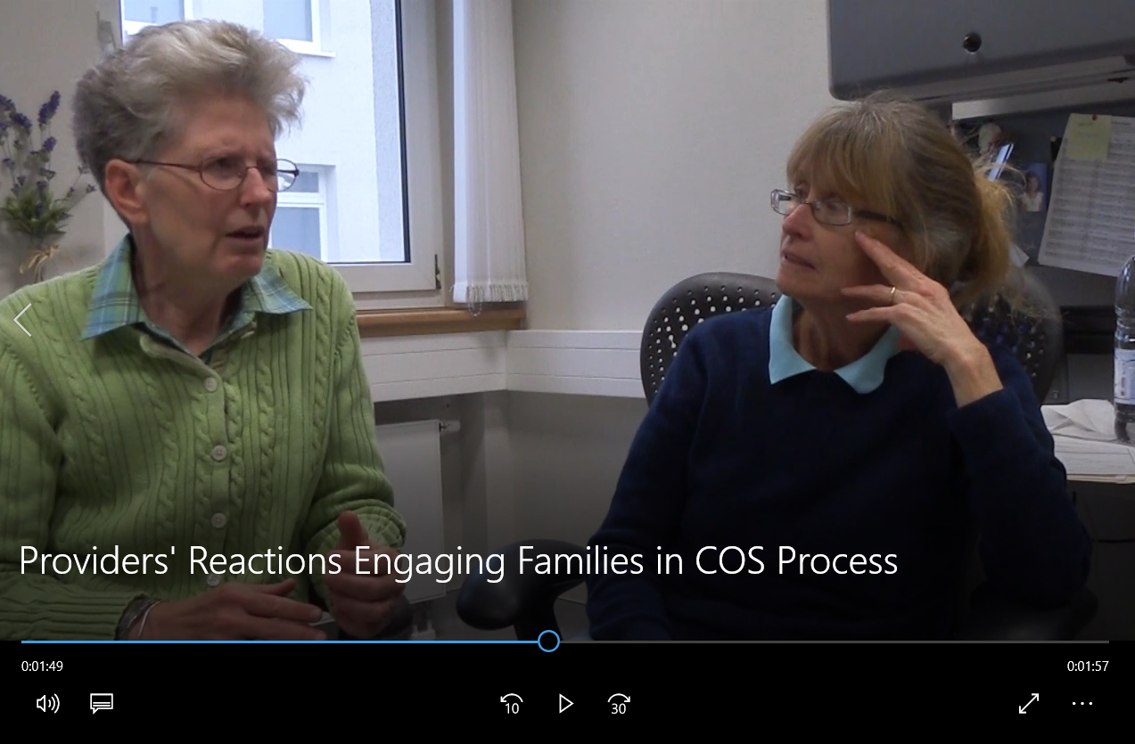
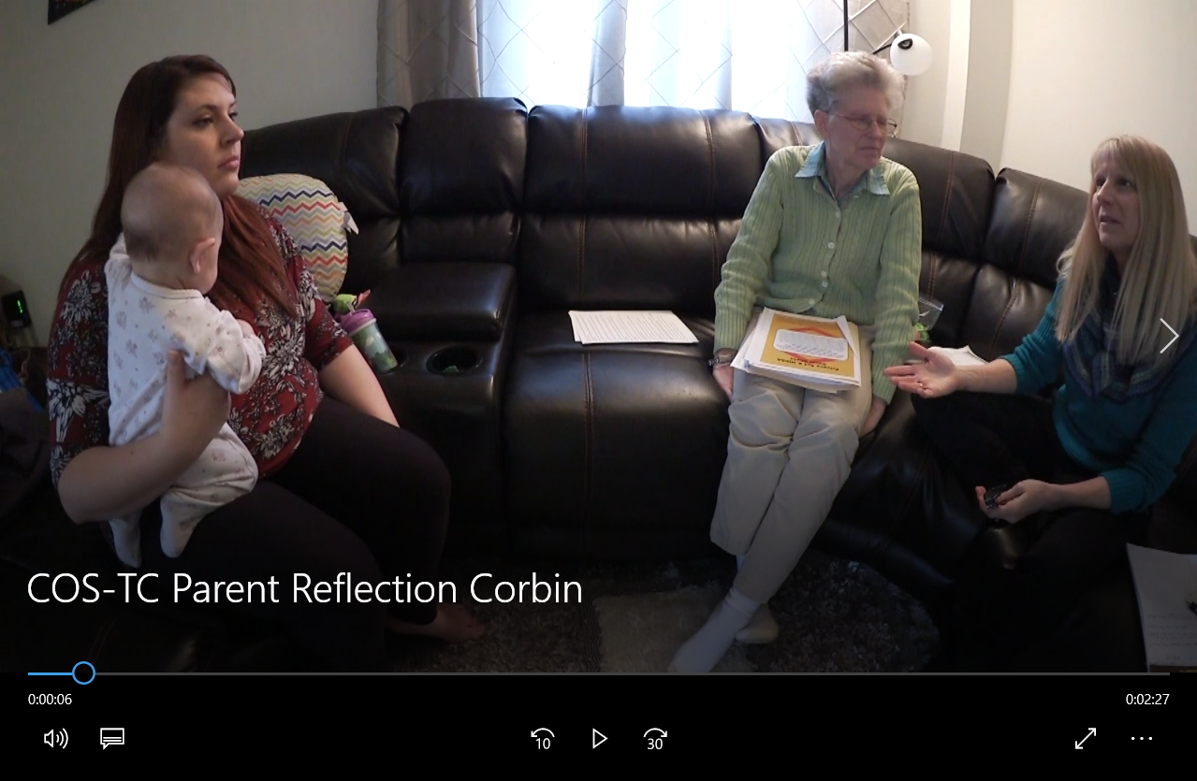
Outcomes and Impact: Team Member Reflections

Slide 25
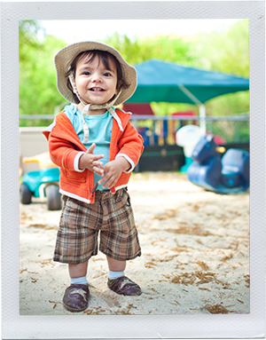
Next Steps
Use with a purpose
Integrate with use of other tools and resources
Provide individualized support

Slide 26
Follow-up Questions or TA Requests
Amy Nicholas
amy.nicholas@unc.edu
Cathy Smyth
cathysmyth@yahoo.com
Naomi Younggren
naomi.younggren@gmail.com

Slide 27
The contents of this presentation were developed under grants from the U.S. Department of Education, #H373Z120002 (Project Officers: Meredith Miceli and Richelle Davis) and #H326P120002 (Project Officer: Julia Martin Eile). However, contents of the presentation do not necessarily represent the policy of the U.S. Department of Education, and you should not assume endorsement by the Federal Government.

