Slide 1
Training Presentation

Slide 2
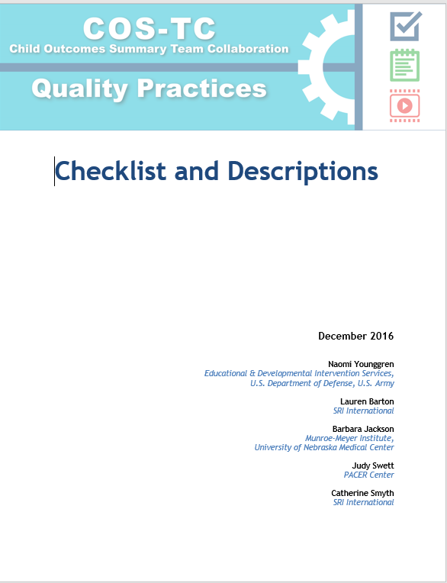
Child Outcomes Summary - Team Collaboration Quality Practice Checklist and Descriptions
Online Practice available soon!
Paper version at:
http://ectacenter.org/eco/pages/costeam.asp

Slide 3
By the end of the day, participants will be able to…
Describe quality practices related to team collaboration in the COS process
Recognize how to engage all IFSP or IEP team members including families in the COS decision-making process
Analyze the presence or absence of quality team collaboration practices in video clip excerpts from COS team meetings
Appraise the extent to which quality practices have been implemented in recent COS team meetings
Identify practices to improve upon for optimal COS team collaboration and design a plan for implementation
Objectives for the Day

Slide 4
Purpose of COS-Team Collaboration Quality Practices
Regular use of COS-TC quality practices to:
Actively engage all COS team members, especially families, in the COS process, however, also broadly applicable to COS teams of all compositions
Help those who implement, supervise, or train on the COS process to identify, observe, and assess recommended team collaboration practices in COS implementation.
Celebrate progress and identify opportunities for further improvement in COS team collaboration
Improve the quality of COS ratings
Background

Slide 5
How COS-TC Quality Practices Came About….
Observed different approaches to teaming during the COS process
Identified a need for greater guidance about what quality practices in the COS process look like and how to partner with families effectively when implementing the COS process
Developed with broad input from many involved in the COS process and built on findings from ENHANCE about the COS process (http://ectacenter.org/eco/pages/enhance.asp)
Background

Slide 6
Let’s share out!
What happens in your COS meetings?
What are your reactions to the COS-TC Quality Practices?
Group Share

Slide 7
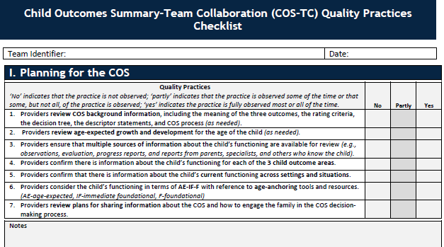
I. Planning for the COS

Slide 8
I. Planning for the COS

Slide 9
I. Planning for the COS

Slide 10
Look at section I. Planning for the COS
Identify how or if you are accomplishing the identified quality practices (1-7)
What parts are going well?
Where are there opportunities for enhancement?
What do you want to try?
Reflect
I. Planning for the COS

Slide 11
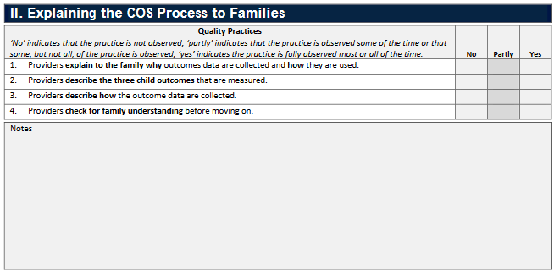
II. Explaining the
COS Process to Families

Slide 12
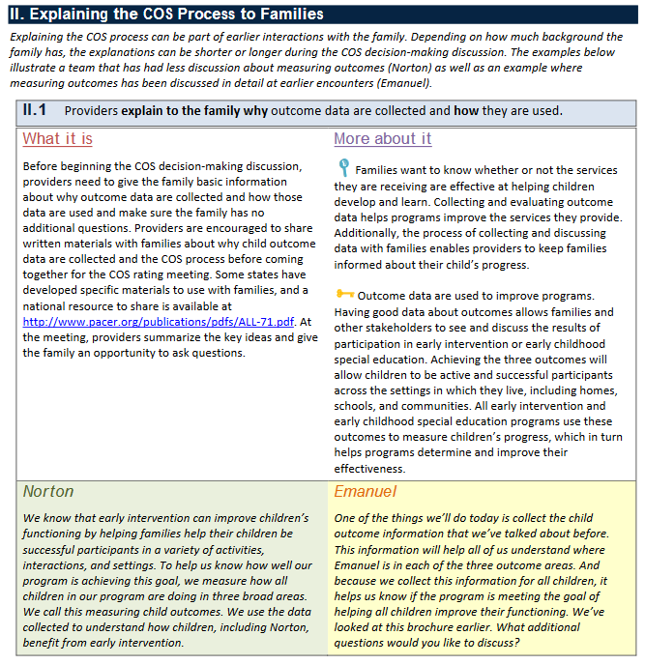
II. Explaining the
COS Process to Families

Slide 13
II. Explaining the
COS Process to Families

Slide 14
Look at section
II. Explaining the COS to Families
Identify how or if you are accomplishing the identified quality practices (1-4).
What parts are going well?
Where are there opportunities for enhancement?
What do you want to try?
II. Explaining the
COS Process to Families
Reflect

Slide 15
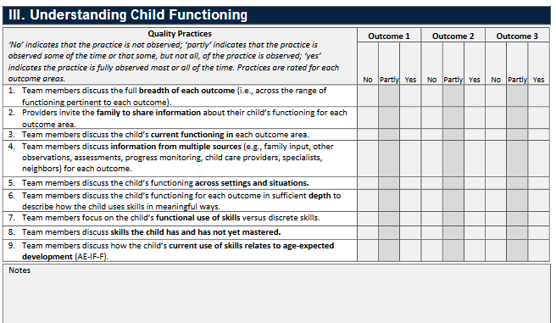
III. Understanding Child Functioning

Slide 16
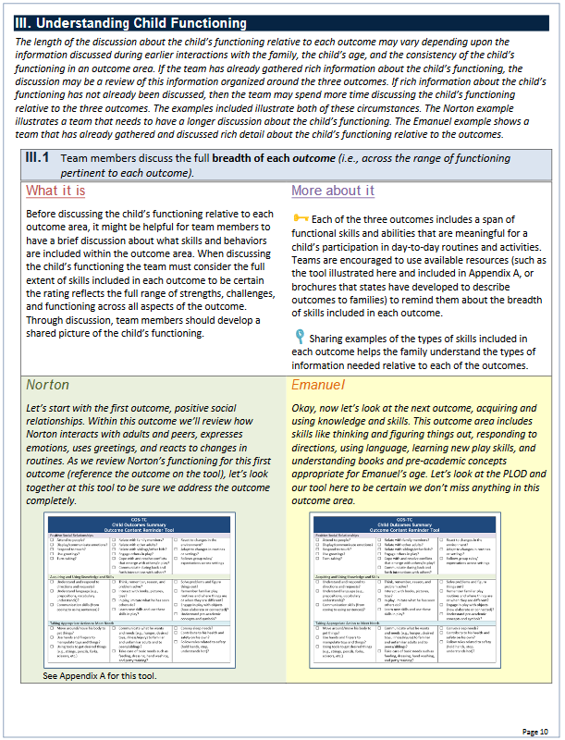
III. Understanding Child Functioning

Slide 17
III. Understanding Child Functioning

Slide 18
Reflect
III. Understanding Child Functioning
Look at section
III. Understanding Child Functioning
Identify how or if you are accomplishing the identified quality practices (1-9).
What parts are going well?
Where are there opportunities for enhancement?
What do you want to try?

Slide 19
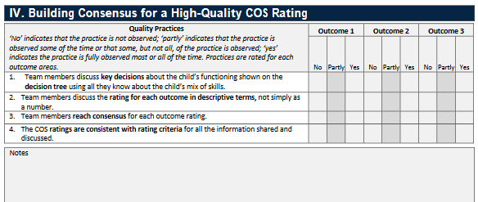
IV. Building Consensus for a High-Quality COS Rating

Slide 20
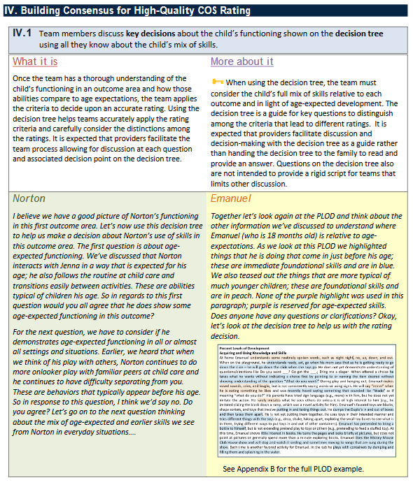
IV. Building Consensus for a High-Quality COS Rating

Slide 21
IV. Building Consensus for a High-Quality COS Rating

Slide 22
Look at section
IV. Building Consensus for High Quality COS Rating
Identify how or if you are accomplishing the identified quality practices (1-4).
What parts are going well?
Where are there opportunities for enhancement?
What do you want to try?
IV. Building Consensus for a High-Quality COS Rating
Reflect

Slide 23
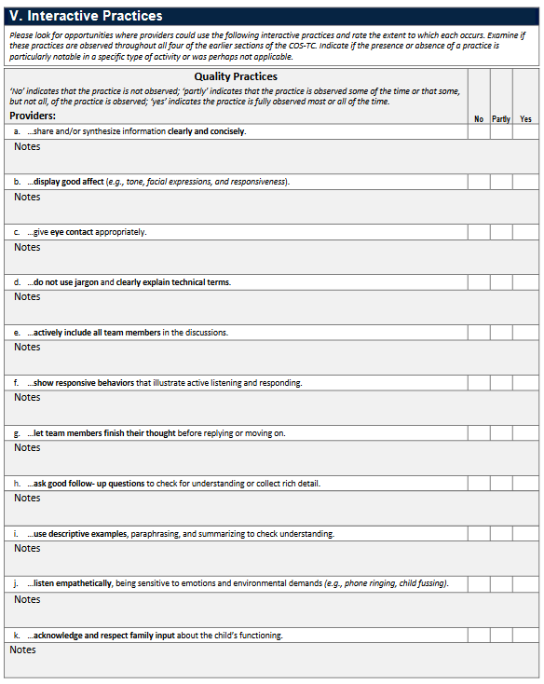
V. Interactive Practices

Slide 24
V. Interactive Practices

Slide 25
Look at section
V. Interactive Practices
Identify how or if you are accomplishing the identified quality practices (a –k).
What parts are going well?
Where are there opportunities for enhancement?
What do you want to try?
V. Interactive Practices
Reflect

Slide 26
Wrap up activity
1. Get into small groups or partners.
2. Identify one to three quality practices.
3. Explore how you will apply that quality practice in your role.
4. Share out with the whole group.
Put it all Together
Reflect

Slide 27
Questions

Slide 28
Child Outcomes Summary – Team Collaboration Thank you!

