Slide 1
IDEA Part C and Part B Section 619 National Child Outcomes Results for 2016-17
Webinar
October 9, 2018
Presenters: Christina Kasprzak and Cornelia Taylor

Slide 2
Webinar Intended Outcomes
Learn about the latest national child outcomes data and patterns
Identify where to find more information about the national analysis and resources to support state and local child outcomes data use
Poll questions about your role and familiarity with child outcomes requirements

Slide 3
General Background
The emphasis has shifted from getting children access to services (compliance) to focusing on results.
All federal agencies are required to report on the outcomes achieved by their programs.
The Office of Special Education Programs (OSEP) uses child outcomes data to:
Justify the funding for Part C and Part B Preschool.
Monitor state results through Results Driven Accountability processes (Part C only).

Slide 4
Three Child Outcomes
In 2005, OSEP required states to report data on 3 child outcomes.
Children have positive social emotional skills (including social relationships)
Children acquire and use knowledge and skills (including early language/ communication [and early literacy])
Children use appropriate behaviors to meet their needs

Slide 5
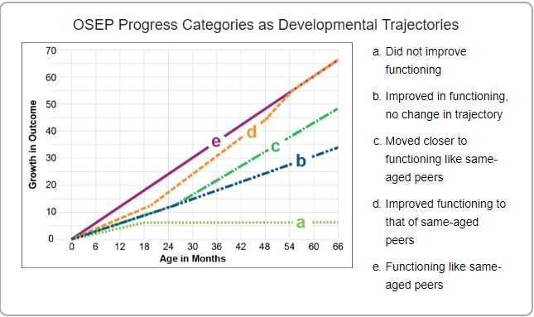

Slide 6
The Summary Statements
Of those children who entered or exited the program below age expectations in each outcome, the percent who substantially increased their rate of growth by program exit.
The percent of children who were functioning within age expectations in each outcome by program exit.

Slide 7
State Approaches to Measuring Child Outcomes: FFY 2016-17
Approach | Part C (N=56) | Part B/619 (N=59)
COS | 42 (75%) | 41 (69%) (decrease -2)
One tool statewide | 8 (14%) | 10 (17%) (increase +2)
Publisher's online system | 3 (5%) | 6 (10%)
Other | 3 (5%) | 2 (3%)
TOTAL | 56 | 59
7

Slide 8
Method for Calculating National Estimates & Criteria
Weighted average of states that met minimum quality criteria
Minimum quality criteria for inclusion in national analysis:
Reporting data on enough children
Part C – 28% or more of exiters
Part B Preschool – 12% or more of child count
Within expected patterns in the data
category ‘a’ not greater than 10%
category ‘e’ not greater than 65%

Slide 10
Table 1. Reasons for excluding Part C states
Reason | # excluded
Sampling | 2
Missing data (Reported outcomes data on less than 28% of exiters) | 1
"a" and "e" patterning (Had at least one outcome with category "a" greater than 10% or category "e" greater than 65%) | 2
States included in the analysis | 46
Table 2. Reasons for excluding Part B 619 states
Reason | # excluded
Sampling | 3
Missing data (Reported outcomes data on less than 12% of child count) | 1
"a" and "e" patterning (Had at least one outcome with category "a" greater than 10% or category "e" greater than 65%) | 2
No 3-5 Child Count data available for 2016-2017 | 2
States included in the analysis | 43

Slide 11
National Child Outcomes Data for Children Exiting in 2016-17
Outcome | Part C Early Intervention |  | Part B Preschool
 | Summary Statement 1 | Summary Statement 2 | Summary Statement 1 | Summary Statement 2
Social Relationships | 67 | 58 | 80 | 60
Knowledge and Skills | 73 | 49 | 81 | 56
Action to Meet Needs | 75 | 57 | 80 | 65
Note: Data are based on 46 Part C states and 43 Part B Preschool states. Only states with high-quality data were included.

Slide 12
Part C: Completeness* of Child Outcomes Data (n=50)
* Completeness = total with outcomes data/total exiters

Slide 13
Part B Preschool: Completeness* of Child Outcomes Data (n=49)
* Completeness = (total with outcomes data/child count)

Slide 14
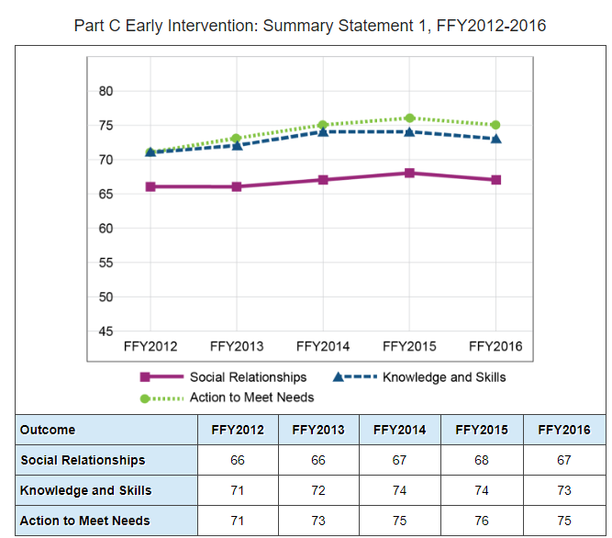
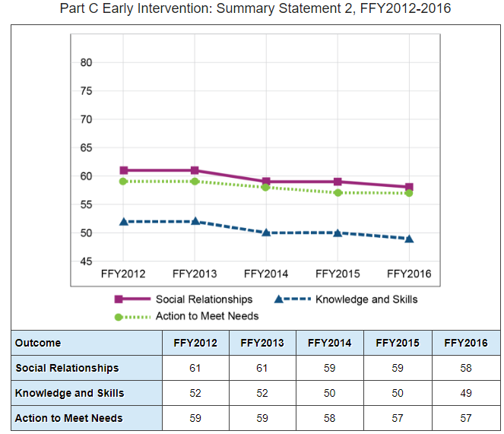
Part C Child Outcomes Data Trends

Slide 15
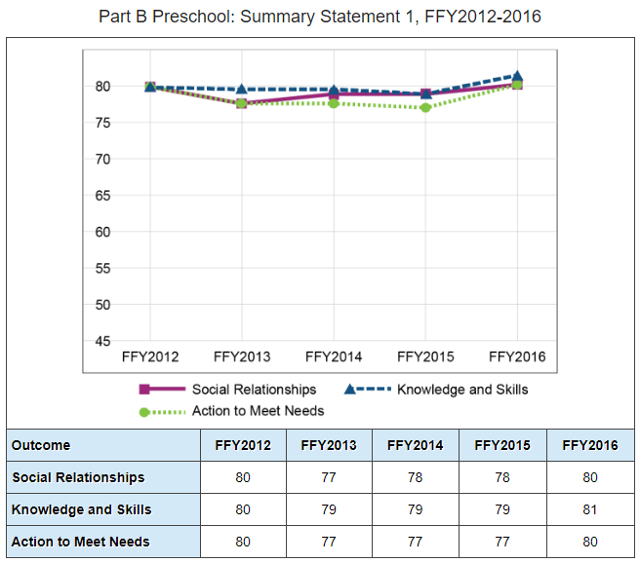
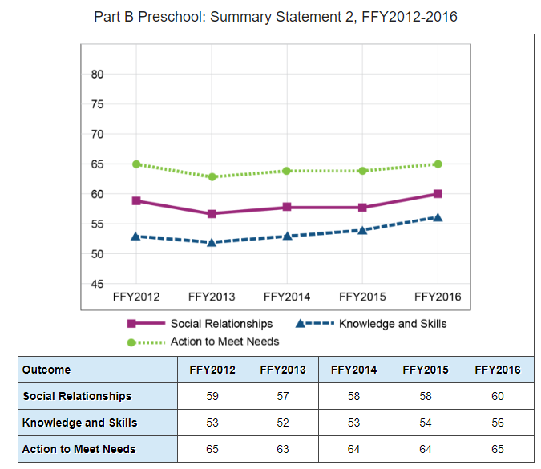
Preschool 619 Child Outcomes Data Trends

Slide 16
State-Level Variation and Patterns
16

Slide 17
Part C State Variation: Exited within Age Expectations – Knowledge and Skills, 2016-17 (n=51)
National Estimate 49%

Slide 18
Part B State Variation: Exited within Age Expectations – Knowledge and Skills, 2016-2017 (n= 51)
National Estimate 56%

Slide 19
Part C: Average Percentage Who Exited within Age Expectations by State Percent Served*, 2016-17 (n=51)
19
* Link to Percent Served Data

Slide 20
Part B Preschool: Average Percentage Who Exited within Age Expectations by State 3-5 Percent Served*, 2016-17 (N=49)
*Link to Percent Served Data

Slide 21
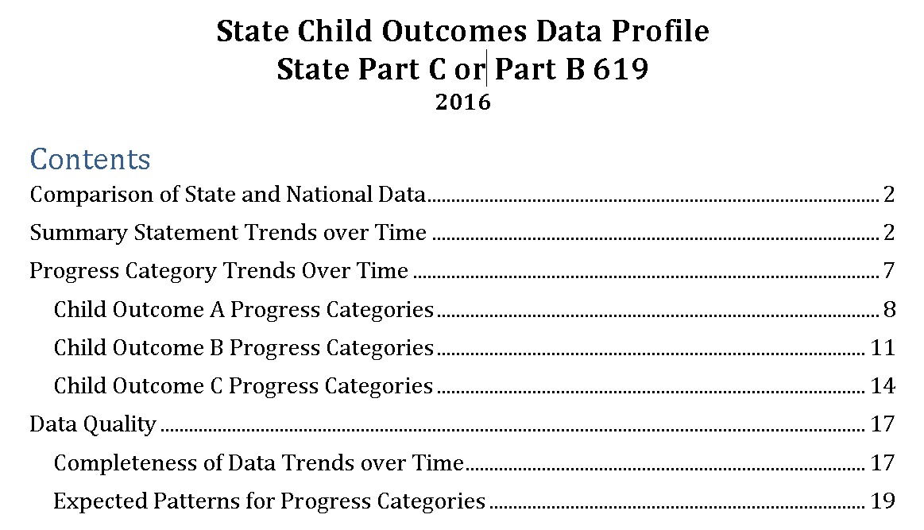
2016-17 State Data Quality Profiles

Slide 22
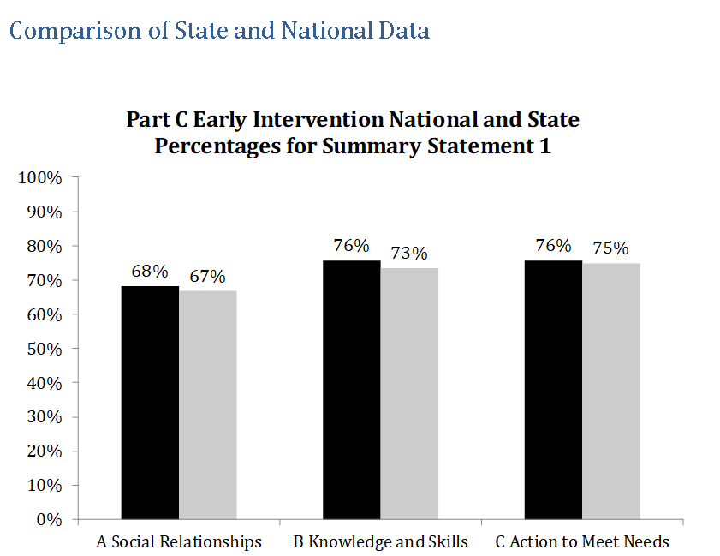
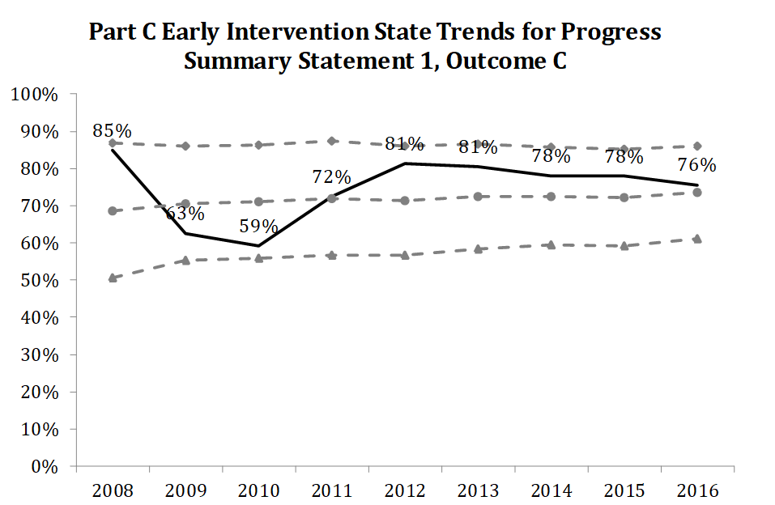
2016-17 State Data Quality Profiles

Slide 23
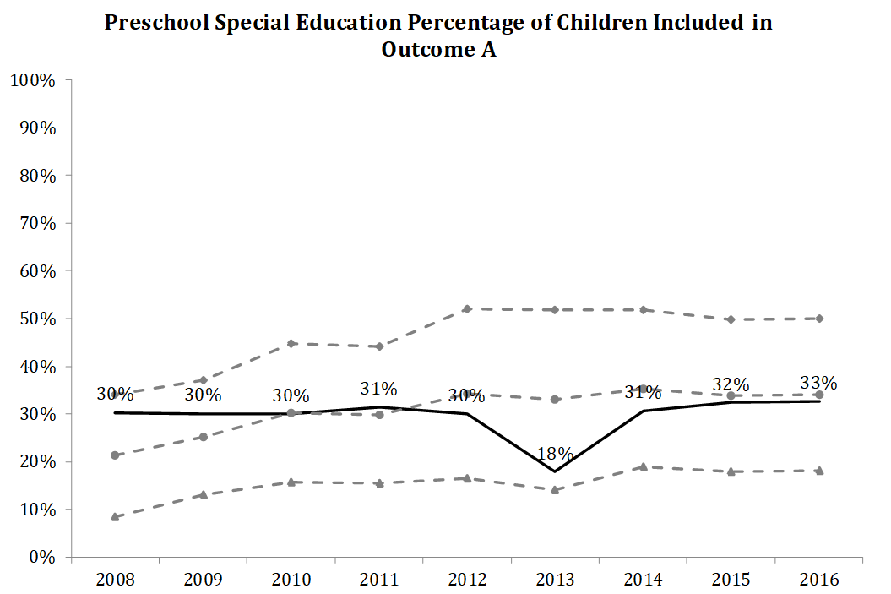
2016-17 State Data Quality Profiles
Poll questions about your receipt and use of the state data profiles

Slide 24
Other Child Outcomes Resources
Child Outcomes Highlights for FFY16
A 2-page summary of the national results.
Special Collection of Outcomes Reports
An online collection of child outcomes data reports that states have produced for their local programs.
Year-to-Year Changes in State Child Outcomes Data: What Do They Mean?
A 4-page brief designed to help stakeholders learn what questions to ask to understand year-to-year changes in child outcomes data.
Child Outcomes Summary (COS) Process Professional Development Resources
Collection of national resources to support training and TA on the COS process.

Slide 25
Find out more at ectacenter.org and dasycenter.org
The ECTA Center is a program of the FPG Child Development Institute of the University of North Carolina at Chapel Hill, funded through cooperative agreement number H326P170001 from the Office of Special Education Programs, U.S. Department of Education. Opinions expressed herein do not necessarily represent the Department of Education's position or policy. Project Officers: Julia Martin-Eile
The DaSy Center is a program of SRI International, funded through cooperative agreement number H326P120002 from the Office of Special Education Programs, U.S. Department of Education. Opinions expressed herein do not necessarily represent the Department of Education's position or policy. Project Officers: Meredith Miceli & Richelle Davis
25

