Slide 1
Supporting Social-Emotional and Mental Health Needs of Young Children Through Part C Early Intervention: Results of a 50-State Survey

Slide 2
Presenters
Sheila Smith & Dan Ferguson – National Center for Children in Poverty
Andy Gomm – University of NC, Early Childhood TA Center
Elisabeth Burak – Georgetown University, Center for Children & Families
Sharon Loza – North Carolina Part C Early Intervention/Infant-Toddler Program

Slide 3
Agenda
Overview/Background
Early Intervention Part C Survey Findings
North Carolina’s Part C Experience
National Technical Assistance
Resources and Contacts
Questions and Discussion

Slide 4
Overview: Early Intervention (Part C) & Infant & Early Childhood Mental Health (IECMH)
EI Part C
IECMH
social and emotional development
Promotion, prevention, treatment child’s mental health
Focus on the parent-child dyadic relationship
Focus on coaching parents to promote their child’s development
Parent – child relationship

Slide 5
50-state Part C survey background
Goal: to learn how states’ Part C programs are identifying and meeting the mental health needs of infants and toddlers
Follow-up of 2009 NCCP survey on the same topic
Part of NCCP’s PRiSM project, which highlights exemplary IECMH state policies and scaled initiatives
Full results, along with state snapshots, are in a newly published report: https://www.nccp.org/publication/part-c-report/

Slide 6
50-state Part C survey methods
Online survey sent to Part C coordinators in 50 states and DC
Data collected from October 2019-June 2020
Received 51 responses
Topics: Screening, referral, and evaluation; eligibility; services for eligible and ineligible children; collaboration, including referrals under CAPTA and Medicaid funding

Slide 7
Screening, evaluation, and eligibility
Most states (42) recommend the use of an SE-specific screening tool; only 8 require one (in all cases the ASQ:SE).
State policy highlight: Illinois

Slide 8
Many states not using tools/strategies to promote identification of infants and toddlers with mental health needs in EI
Most states (30) recommend or require the use of an SE-focused tool for evaluation and assessment
3 states require and 5 states recommend the use of the DC:0-3/DC:0-5 to determine eligibility on the basis of a diagnosed condition
13 states require that evaluation teams include professionals with expertise in IECMH and SE development
State policy highlight: Colorado

Slide 9
Few states use tools to identify family risk factors
1 state requires and 14 states recommend the use of additional tools to identify family risk factors and/or trauma
30 states do not provide screening, referrals, or treatment for maternal depression. The remaining states provide either screening or referrals for screening/evaluation/treatment

Slide 10
Programs vary in supports for infants & toddlers found not eligible for Part C
31 states refer family to services, e.g., home visiting (28 states), ECE (27 states), parenting programs (22 states)
State policy highlights: Oklahoma and Alabama
29 states tell parents they can ask for another screen in future
5 states contact parents and offer another SE screen
11 states have no written policies

Slide 11
Use of a SE screening or assessment tool not always required for children referred from CPS
For children referred from child welfare in cases of substantiated abuse and neglect:
20 states reported that the child is referred to Part C for screening
12 states reported that the child is referred for evaluation.
9 states require and 24 states recommend the use of a social-emotional tool in the screening or evaluation for CPS-referred children

Slide 12
IECMH services for eligible children
29 states provide IECMH consultation
34 states provide parenting programs designed to address infant/toddler mental health needs
10 recommend and 4 require evidence-based parenting programs (e.g., Triple P, Incredible Years, Circle of Security-Parenting (COS-P))
State policy highlight: Nebraska

Slide 13
Dyadic treatment
24 states provide parent-child dyadic treatment (DT)
6 states require and 6 states recommend evidenced-based treatment models
Three states (GA, AL, SC) collaborating on DT training
Evidence-based dyadic treatment models | Requires EB models | Recommends EB models
Child Parent Psychotherapy/Infant Parent Psychotherapy/Toddler Parent Psychotherapy | KY, MT | AK
Parent-Child Interaction Therapy (PCIT) | KY | PA
Promoting First Relationships (PFR) | WA | AK
Attachment and Biobehavioral Catch-up (ABC) |  | KS
Family Check-Up (FCU) |  | PA
Watch, Wait and Wonder (WWW) |  | AK

Slide 14
Challenges reported by Part C Coordinators
Geographic distribution of qualified providers (38 states)
Not having enough qualified providers (32 states)
Low reimbursement rates (16 states)

Slide 15
Tiered training and supports to address workforce challenges identified by Part C coordinators
Universal training for all EI providers and service coordinators (MA PIWI and Montana BABES Toolkit)
IECMH consultation (e.g, LA, CO, AL, IL) for EI and other providers (child care, pediatricians)
Training in EB parenting and dyadic treatment models to development workforce for children/parents needing these interventions

Slide 16
Using survey results
Investigate gaps - e.g., an SE screening tool is not required; EB dyadic treatment is not available or required
See State Systemic Improvement Plan
Investigate implementation of policies; e.g., if survey indicates dyadic treatment is available, ask: Are families able to get dyadic treatment in all parts of the state?
Explore opportunities to address gaps and limited implementation

Slide 17
Medicaid
Most states use Medicaid to reimburse at least some Part C services for Medicaid-enrolled children
State-federal partnership, federal match 50-77% (+6.2% under Families First Coronavirus Response Act during emergency)
Medicaid’s Pediatric Benefit - Early, Periodic Screening Diagnostic and Treatment (EPSDT) designed to meet children’s preventive care and “medically necessary” treatment needs.
State variability in implementation and interpretation of the ”Who, What, When, Where” = eligible services, eligible providers, eligible settings, eligible children.

Slide 18
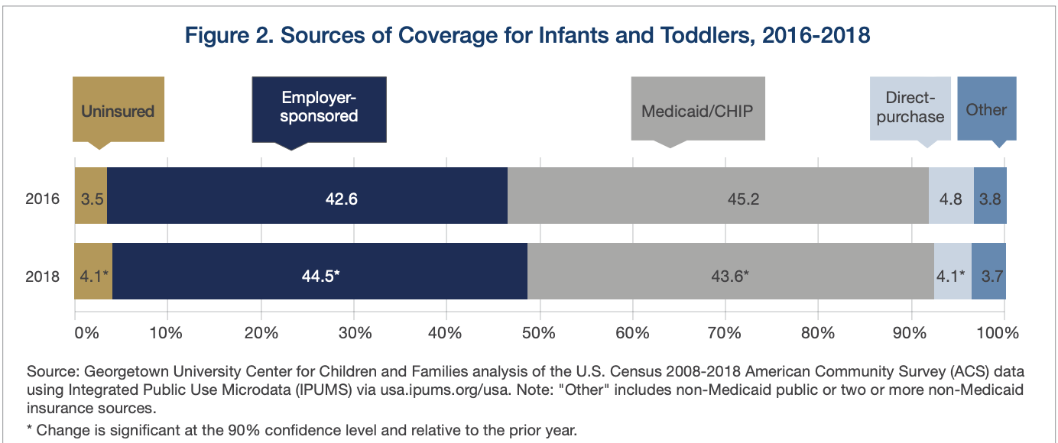
Medicaid Serves Nearly Half of All Children Under Age 3
Source: Georgetown CCF and ZERO TO THREE Think Babies (April 2020) https://ccf.georgetown.edu/2020/04/06/rate-of-uninsured-infants-and-toddlers-on-the-rise/

Slide 19
THE Pediatric Benefit in Medicaid:
Early Periodic Screening Diagnostic and Treatment (EPSDT)

Slide 20
More than two-thirds of states (33) report that Medicaid rates are not sufficient to cover the full costs of eligible Part C mental health services
Survey Findings
Half of states (26) have taken steps in the past five years to improve Medicaid rates OR coverage for Part C mental health services (e.g. MI, SC)

Slide 21
IECMH & EI Part C Medicaid Practice Opportunity
Medicaid and Part C/Early Intervention – Does State Use Administrative Data to Explore Overlap?
Less than one-third of states (16): AK, AZ, CO, IL, IN, IA, LA, MD, MA, MI, MO, NY, ND, OR, PA, SC

Slide 22
Perspectives of IECMH: Part C in North Carolina
Organizational Structure
Families and children served
Eligibility

Slide 23
Part C in North Carolina
State Systemic Improvement Plan
Evidence-based practices and treatments (Coaching and Pyramid Model)
Infrastructure
Assessment and Evaluation
Cross-sector initiatives focused on early childhood mental health

Slide 24
Part C in North Carolina
Education and awareness
People (staff, workgroups/teams, champions)
Buy in
Feasibility
Communications/support
Small steps

Slide 25
National IECMH and Part C workgroup
Monthly meetings and collaborative work between:
Alliance for the Advancement of Infant Mental Health
Early Childhood Technical Assistance Center
IDEA Infant Toddler Coordinators Association (ITCA)
Georgetown University – IECMH Consultation Center of Excellence
Georgetown University – Center for Child and Human Development
National Center for Child Poverty (NCCP)
National Center for Pyramid Model Innovation (NCPMI)
Zero To Three

Slide 26
Upcoming Products and Supports
Briefing Paper – Eligibility; Services & practices; Funding; Workforce, Implementation Strategies
Webinars
Webpage – webinars; links to resources
Technical Assistance – potential state team support
Other? – Looking forward to hearing from states…

Slide 27
Getting Started / Next Steps
Partnerships – IMH Association? State Children’s Mental Health Director?
IECMH Collaborative Initiative – Seat at the table? Bring (virtual) donuts!
Self-Assessment – Utilizing the National Survey; Review data already collected
Low hanging fruit – Training? Screening?
Planning - Tie to SPP? ICC strategic Plan / priority?

Slide 28
Resources
PRiSM: Promoting Research-informed State IECMH Policies and Scaled Initiatives
Using Medicaid to Ensure the Healthy Social and Emotional Development of Infants and Toddlers
More early childhood resources from the Center for Children and Families
The Part C survey report is now available on the NCCP website:
https://www.nccp.org/publication/part-c-report/

Slide 29
Thank you!
Contact us:
Dan Ferguson ferguson@nccp.org
Sheila Smith Sheila.smith@nccp.org
Elisabeth Burak Elisabeth.Burak@georgetown.edu
Andy Gomm andypgomm@gmail.com
Sharon Loza Sharon.Loza@dhhs.nc.gov

