Slide 1
Follow the Yellow Brick Road: Part C to part B 619
Road blocks & remedies for linking & using data
Mary Peters, DaSy, ECTA Center
Debbie Cate, ECTA Center

Slide 2
Objectives
Share Indicator C8 & B12 data processes, collection and, data sharing
Explore data transfer mechanisms
Discuss strengths and roadblocks
Review Part C and 619 state and local data use
Identify needed supports and resources

Slide 3
Part C, Indicator 8
A: Percent of IFSPs with transition steps and services in place
B: Percent of children potentially eligible for Part B services for whom notification was given to the Lead Education Agency (LEA)
C: Percent of children potentially eligible for Part B services for whom a transition conference was held
Notes:
The FFY 2011 reporting period ended in June 2012 and the new regulations were not required to be in effect until July 2012.
This analysis of Part C Indicator 8 is based on a review of FFY 2011 Annual Performance Reports (APRs) for 55 states and jurisdictions. One state’s data was determined not valid and reliable for this indicator. For the purpose of this report, all states and jurisdictions are referred to collectively as “states”.

Slide 4
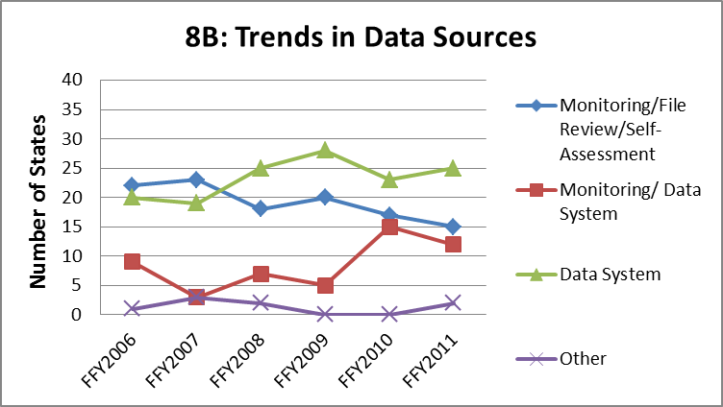
Part C, Indicator C8B, FFY 2011
Notes:
Data sources reported by states are categorized as monitoring (e.g. file review and self-assessment), data systems, or a combination of the two. 54 states provided this information for 8B Figure 2 show the trend for data sources across the reporting periods for sub-indicator C8B.

Slide 5
Notification to LEA (C8B) Number and Percent of States Reporting Census Approach
Yes | 36 (64%)
No | 16 (29%)
FFY 2011
Notes:
There is still variability among states regarding use of census vs. sampling methodologies for reporting on this indicator. A census approach is defined as reporting on all children for the entire reporting period or all children in a specific time frame (e.g. one quarter of the calendar year). Table 1 shows the number and percentage of states using a census approach across the three sub-indicators.

Slide 6
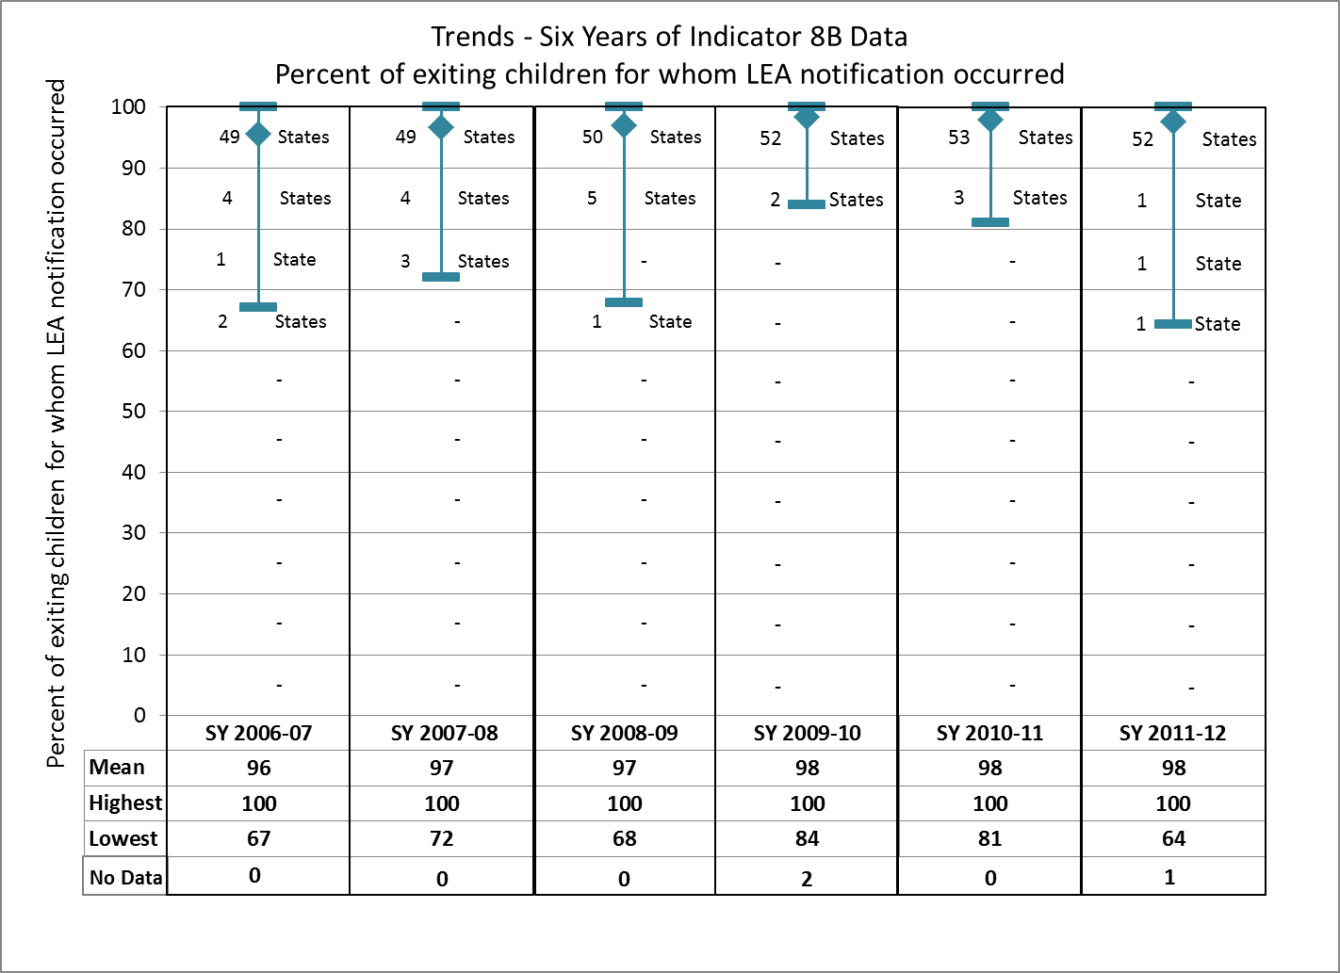

Slide 7
Part B, Indicator 12
Early Childhood Transition
Percent of children referred by Part C prior to age three and who are found eligible for Part B, and who have an IEP developed and implemented by their third birthday

Slide 8
Part B, Indicator 12 Data Sources Over Time
Data Collection Source | Number of States by Year
 | FFY 2006 | FFY 2007 | FFY 2008 | FFY 2009 | FFY 2010 | FFY 2011
State data system | 33 | 34 | 33 | 44 | 45 | 45
Monitoring, includes system-wide file review | 8 | 2 | 5 | 6 | 6 | 5
Other (LEA spreadsheets) | 7 | 13 | 15 | 2 | 3 | 4
Not reported or unclear | 7 | 4 | 2 | 4 | 2 | 2
Total | 56 | 56 | 55 | 56 | 56 | 56
Notes:
Currently, in most states, more than one data system or method of collecting data is necessary to provide the specific data needed to report on this indicator. Some states utilize spreadsheets detailing transition data elements, which are then compared or matched to state data system elements. In many states a comparative match of individual child level data supplied directly by Part C has been cross-referenced with Part B data, ensuring an accounting of each child, regardless of the data source used. Ten states have comprehensive or integrated data systems with the capability of seamlessly capturing C to B child level data for this indicator.
Table 1 provides a count of the number of states by the type of data collection source used for this indicator. Note that state data systems are often supplemented with additional data collection methods or systems. The total number of states varies across years due to missing data.

Slide 9
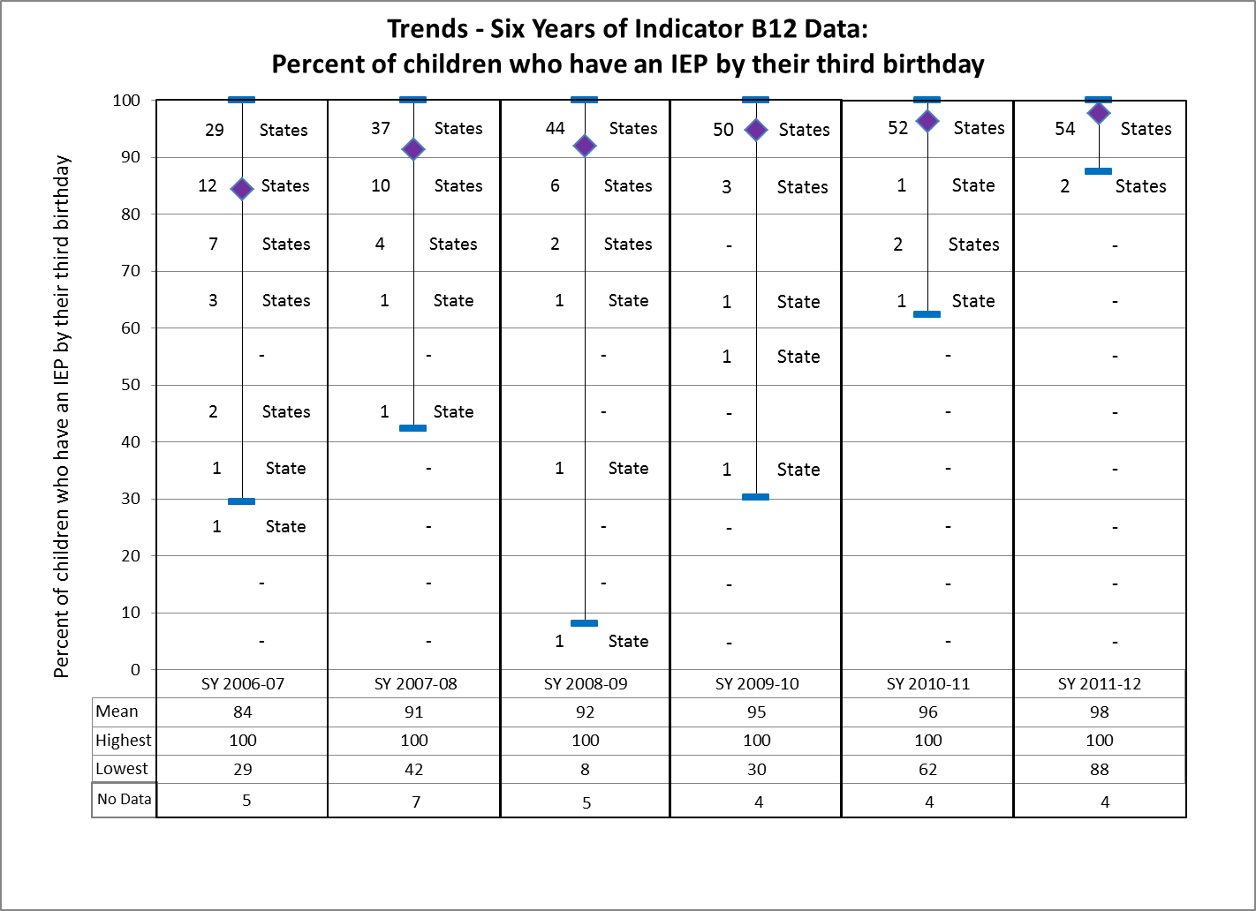
Notes:
Figure 1 illustrates current and trend data for timely transition services over the last six reporting years. For each reporting year, the number of states represented within each ten-percentage point range is shown in the chart, and the table below the chart shows the national mean, range, and number of states included. Of the 56 states reporting on this indicator, the mean percent of children referred by Part C, eligible for Part B, and who have an IEP developed and implemented by their third birthday was 97.7%. Ten states demonstrated 100% compliance.

Slide 10
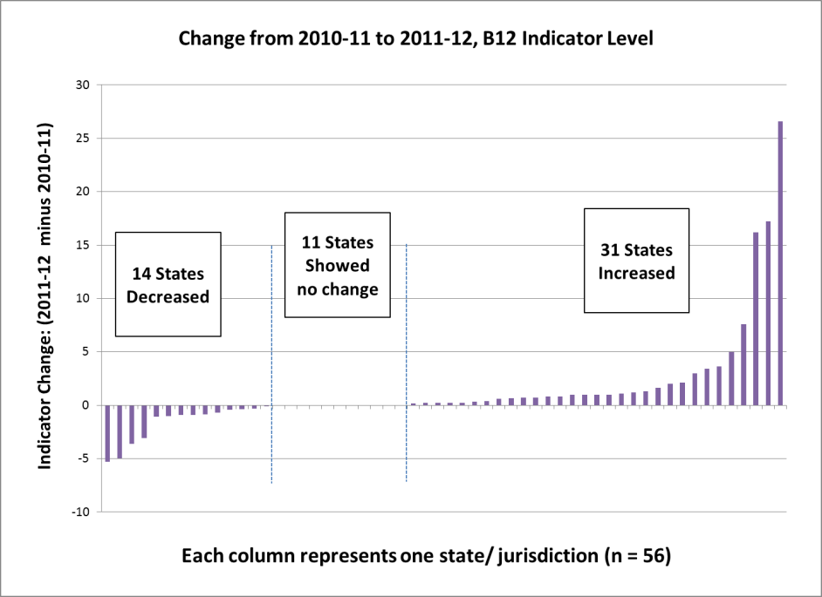

Slide 11
Transition C to B
Most states demonstrate high performance
Improvement due to institutional collaborative activities, strategies, policies, procedures and practices
Progress in building state-level data systems, particularly the ability to share Part C and Part B child-specific data
Notes:
Most states demonstrated significantly improved performance on this indicator over time. A wide range of collaborative activities has been the mechanism responsible for the considerable improvement states have attained on this indicator. Many high-performing states have institutionalized successful on-going transition strategies and activities, along with collaborative policies, procedures and practices, all designed to ensure the continuation of timely transitions. Overall, states have made progress in building state-level data systems to capture the information needed to report on this indicator, particularly in the ability to share Part C and Part B child-specific data.

Slide 12
Transition Process for Reporting
 | Part C | Part B
 | All Children | All Children
A | Child specific name or ID of each child | Child specific name or ID of each child
B | Census reporting, numbers | Census reporting, numbers
 | Some Children | Some Children
C | Reporting a portion of children through monitoring or other | Reporting a portion of children through monitoring or other
E | Other | Other

Slide 13
Transition Data Mechanisms
 | Part C | Part B
 | All Children | All Children
1 | Web-based Data System ALL Children by name or ID | Web-based State Education Data System ALL Children by name or ID
2 |  | Web-based Special Education Data System ALL Children by name or ID
3 |  | Web-based Data System Some information supplemented from other sources
4 | Excel Table or Web Report/Template ALL Children by name or ID | Excel Table or Web Report/Template ALL Children by name or ID
5 | Excel Table or Web Report/Template ALL children by aggregate numbers | Excel Table or Web Report/Template ALL children by aggregate numbers
 | Some Children | Some Children
6 | Reporting, Monitoring or File review A portion of all children | Reporting, Monitoring or File review A portion of all children
7 | Other | Other

Slide 14
Transition Data Sharing
 | Part C | Part B
 | All Children | All Children
Ruby Slippers | Web-based Data System, Fully Integrated System C and B Sharing data for ALL Children by name or ID
Flying Monkeys | Part C Web-based Data System, C to B Integrated Components - ALL Children by name or ID, sharing some child specific data into 619 system | Part B Web-based Data System, C and B Integrated Components - migrates some child specific data into 619 system
Tin Men | Table or Report/Template with Part C information - ALL Children by name or ID shared with State 619 | Table or Report/Template with Part C information merged or compared with 619 state data
Lions | Part C information ALL Children by name or ID shared with State 619 and local LEA | Part C information compared or merged at local level
Toto |  | No Comparison of Part C data at the child level
Notes:
§303.209 Transition to preschool and other programs.
Notification to the SEA and appropriate LEA
(1) The State lead agency must ensure that—
(i) Subject to paragraph (b)(2) of this section [opt out], not fewer than 90 days before the third birthday of the toddler with a disability if that toddler may be eligible for preschool services under Part B of the Act, the lead agency notifies the SEA and the LEA for the area in which the toddler resides that the toddler on his or her third birthday will reach the age of eligibility for services under Part B of the Act, as determined in accordance with State law;

Slide 15
Ruby Slippers
Part C | Part B
All Children | All Children
Web-based Data System Fully Integrated System C and B Sharing data for ALL Children by name or ID

Slide 16
Flying Monkeys
Part C | Part B
All Children | All Children
Part C Web-based Data System, C to B Integrated Components - ALL Children by name or ID, sharing some child specific data into 619 system | Part B Web-based Data System, C and B Integrated Components migrating some child specific data into 619 system

Slide 17
Tin Men
Part C | Part B
All Children | All Children
Table or Report/Template with Part C information - ALL Children by name or ID shared with State 619 | Table or Report/Template with Part C information merged or compared with 619 state data

Slide 18
Local Lions
Part C | Part B
All Children | All Children
Part C information ALL Children by name or ID shared with State 619 and compared at local level | Part C information compared or merged at local level

Slide 19
Toto
Part C child specific transition data is not being compared to Part B transition data at the child level

Slide 20
Data Sharing Specifics
Supports, such as written agreements
Communication and/or PD strategies
Collaborative data analysis (C and 619)
Data verification
Follow up, TA, or CAPs
State and local data use
Discussion Topics

Slide 21
Resources and Technical Assistance

Slide 22
Thank you for your participation
Mary and Debbie
Thank you for your participation
Mary and Debbie

