Slide 1
Spotlight on States: Using the High-Quality, Functional Outcome and Goal Training Package
September 16, 2013
Anne Lucas, ECTA/WRRC
Sherry Franklin, NC
Lynne Johnson, CT
Phoebe Rinkel, KS
Notes:
Megan
Welcome, introductions

Slide 2
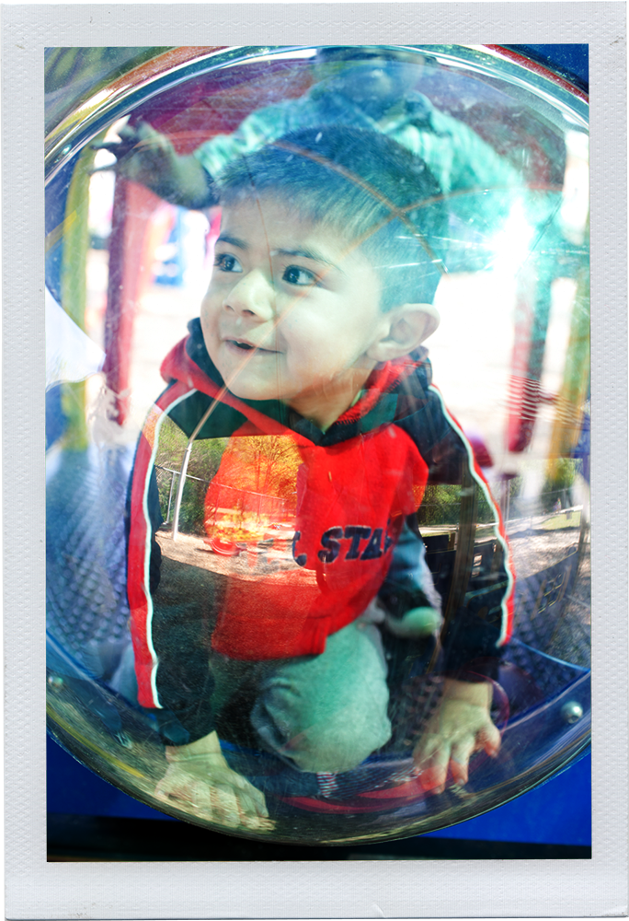
Session Agenda
Brief overview of the training package
State examples of how the training package was used
Questions/Discussion

Slide 3
Training Package Purposes
Assist professionals/parents in understanding:
  the evidence behind how children learn
  the fundamental components of functional assessment
  how to use this information to develop functional IFSP outcomes and IEP goals
Notes:
The training on Developing High-Quality, Functional IFSP Outcomes and IEP Goals was developed by NECTAC (which is now the ECTA Center), the Early Childhood Outcomes Center, and the Western Regional Resource Center in response to requests from state and local Part C early intervention (EI) and Part B, Section 619 early childhood special education (ECSE) staff related to:
the evidence behind how children learn,
the fundamental components of functional assessment, and
how to use this information to develop functional, high-quality IFSP outcomes and IEP goals.

Slide 4

Materials Available
Power Point
Trainer Script
Trainer Instructions
Handouts
Activities
http://ectacenter.org/knowledgepath/ifspoutcomes-iepgoals/ifspoutcomes-iepgoals.asp
Notes:
The Training package is located on the ECTA Center website at the link on this slide. The package includes Power Point presentations, handouts and other resources, as well as a trainer script. The trainer script helps the trainers prepare for and present the training – it includes suggestions for what to say with each slide, prompts for discussion, and guidance related to the use of each handout and how to conduct the various activities that are incorporated.
The training package also contains a full set of instructions for the use of the materials. The instructions include a description of the content of each section of the training, suggestions for adaptations by time, audience and content as well as resources, such as a sample participant agenda and references used in developing the training package.
Resource materials needed for several activities that engage the learner and apply the content to practice experiences are also included.

Slide 5


Slide 6
Power Point Presentation
Section 1: Setting the Context
Section 2: Functional Assessment
Section 3: Integrating Functional Assessment and Outcome Measurement with IFSP Outcomes/IEP Goals
Section 4: Functional, High-Quality IFSP Outcomes and IEP Goals
Section 5: IFSP Strategies to Meet Outcomes and IEP Objectives to Meet Goals
Section 6: Applying the Information: A Practical Learning Experience
Notes:
The full PPT presentation has six sections.
Section 1 of the PPT, “Setting the Context” contains information about how children learn and the roles of the adults in the child’s life, emphasizing natural learning opportunities and successful participation in every day activities. We create connections between how children learn with the overarching mission, goals, and principles of early intervention and early childhood special education and how these relate child and family outcomes measurement for accountability and program improvement.
Section 2 is all about functional assessment. The majority of this section outlines critical features of functional assessment, such as:
What functional assessment is and is not
Why functional assessment is fundamental to developing functional outcomes and goals
Who does it,
When, where and how it is done
Section 3 links using assessment information with developing high-quality, functional individualized outcomes and goals for children and families and to complete the child outcomes measurement process as well.
Section 4 delves into the detail behind developing high-quality, functional outcome and goal statements. The section begins with information about where to start with outcome and goal development and includes IFSP and IEP federal requirements related to outcomes and goals. Examples of high-quality, functional statements and those that are not are provided for both IFSP outcomes and IEP goals. The section also provides criteria for rating whether or not outcome or goal statements are of high quality.
Section 5 contains information to help the learner create IFSP strategies and IEP objectives to meet the outcomes and goals developed, and to begin the process of determining what services will be needed to help meet the goals and outcomes
Section 6 is an opportunity for the participants to apply the information from the training. Using a child example, participants are able to review information about a child, write an outcome or goal, and determine strategies or objectives. The Kim child example provided as part of the training package is available in a 17 month version, or a 35 month version, so that it will be appropriate for both Part C and preschool special education audiences participating in the training.

Slide 7
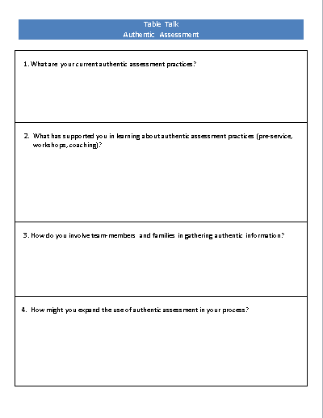
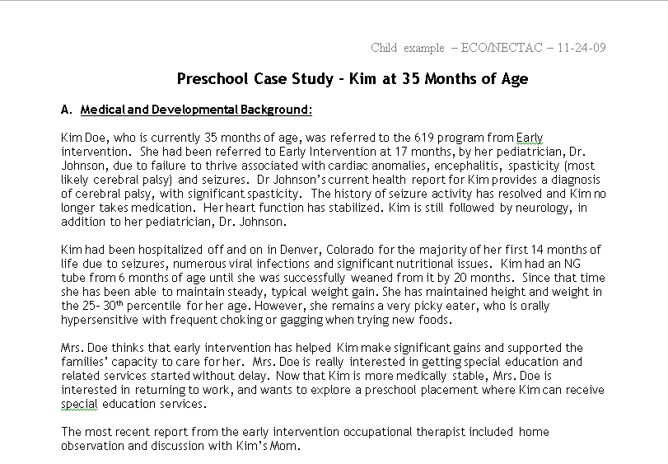
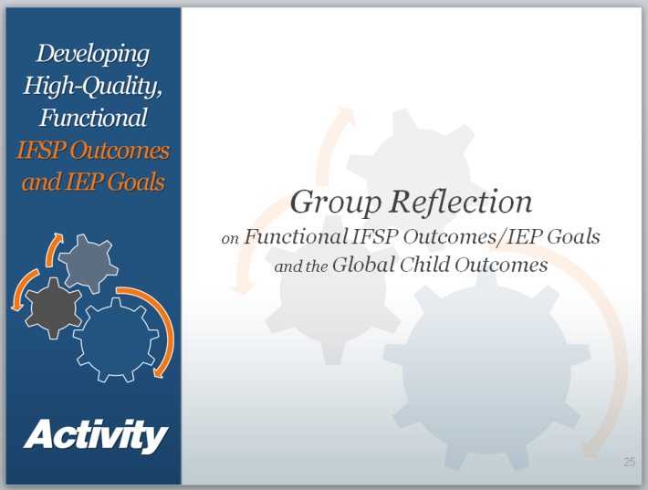
Activities
Discussions
Videos
Case examples
Notes:
The training package includes a number of activities that apply the information presented to everyday work with children and families.
Throughout the training, there are opportunities for participants to reflect upon and discuss the information that has been presented. Questions for the facilitators are included in the trainer script, and can be modified based on the needs of those in attendance.

Slide 8
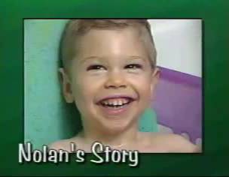
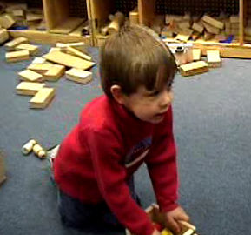
Nolan and Tim
Participants watch short videos, then answer questions such as:
  What did you observe about the child?
  What do you think might be an appropriate outcome/goal? Why?
  What skills did you observe related to Outcome 1 (positive social relationships)?
Notes:
We have also included two video examples in Section 3: Nolan, who is a child under the age of three, and Tim, who is a preschool age child. Both are brief video clips meant to represent what a portion of an observation might look like during a functional, authentic assessment. After viewing each video, participants are asked to respond to some reflective questions
Guidance is provided for the facilitator in the trainers’ notes to help guide the conversation and ensure that the participants pick up on salient points, including:
Listening to families talk about what’s going well in daily routines to help build intervention strategies (as observed in Lisa, the PT’s behavior in the Nolan video), and
The need for more observations OVER TIME in order to accurately develop a goal for Tim.
Access to the videos are included in the training package.

Slide 9
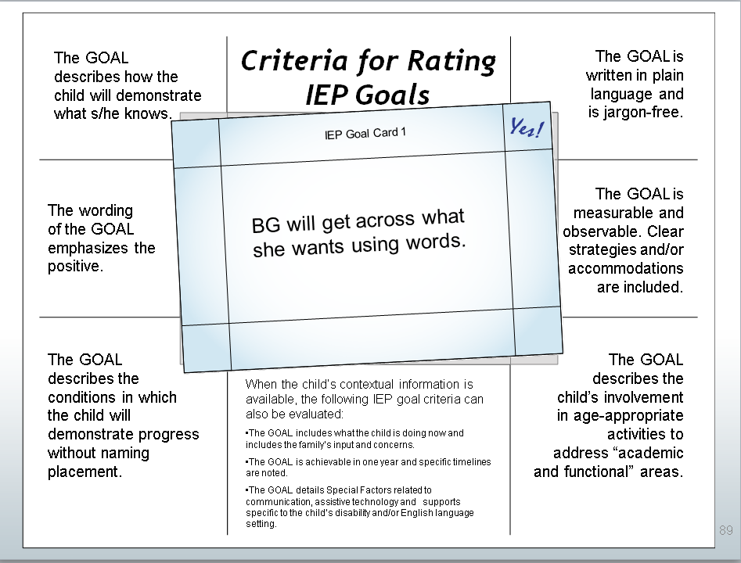
Rating IFSP Outcomes and IEP Goals
Participants read outcome statements on cards, and using the criteria, determine if the statements are high-quality and functional
Notes:
Another activity, “Enhancing Recognition of High-Quality, Functional IFSP Outcomes and IEP Goals,” provides a hands-on opportunity for participants to work in small groups to apply the criteria presented in the power point presentation to sample outcome and goal statements and rate whether or not the outcome and goal statements are high-quaiity or not.

Slide 10
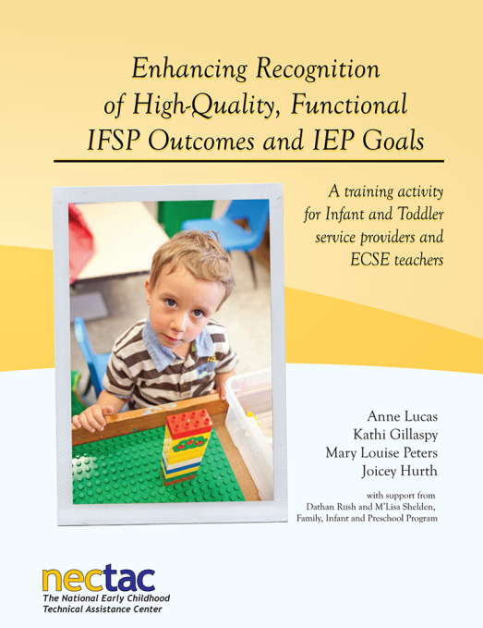
Enhancing Recognition of High-Quality, Functional IFSP Outcomes and IEP Goals
Available at: http://www.nectac.org/~pdfs/pubs/rating-ifsp-iep-training.pdf
Notes:
The “placemat” activity is available under the Publications link on the NECTAC website, or directly at the link on this slide.

Slide 11
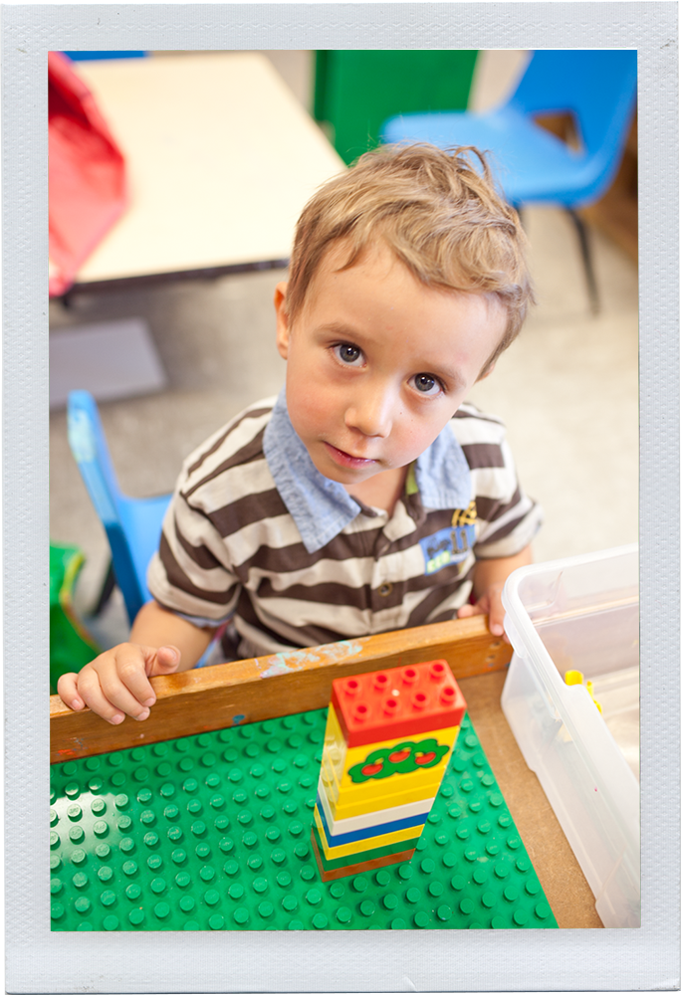
Uses
Adaptation by:
  Time
  Audience
  Content
Notes:
We’ve designed the training package to be highly adaptable so that it meets the needs of states. It can be a stand alone training or information, resources, and activities from the training can be adapted and embedded in existing state training materials. To that end, we’ve designed the PPT and the trainer notes to be editable, and we’ve provided suggestions about how the presentation material, activities and handouts may be used, depending on the time, audience or content.

Slide 12
State Use Survey
How have you used the training package?
Please describe the audiences and locations (for example, statewide or regional conferences, family events, individual programs) you’ve delivered the training.
How have you modified the training package?

Slide 13
State Use - Themes
Outcome/goal rating activity incorporated into existing training or in providing TA
Portions of training package used in developing training or in existing training
PowerPoints were used with online facilitated study group
Used Kim case study to create an IFSP exemplar
Developed a 2nd case study
Notes:
Some training is train-the trainer
Portions of the training package (e.g. child assessment and IFSP outcome development) have been used in state wide training (webinar, face to face, online facilitated, and online self-paced

Slide 14
State Use - Themes
Modified by embedding state requirements and terminology
Voiced over sections of the PowerPoint for independent use
Adapted material for specific groups
Adapted materials for conference session, webinar, face to face, online facilitated, and online self-paced work
Used to support integration of outcome measurement into IFSP and IEP process
Training package shared with IHE for course-work

Slide 15

North Carolina
Sherry Franklin
Part C Coordinator

Slide 16
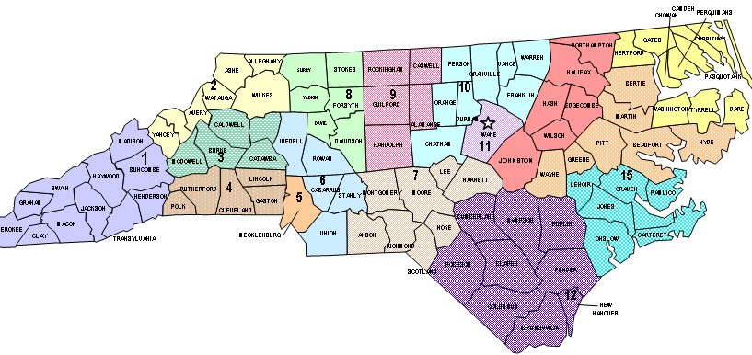

North Carolina Early Intervention Service System

Slide 17



Implementation Overview of NC ITP and IDEA Regulations
Bee Lines 2 Success

Slide 18

NC ITP Implementation
Phase 1:Be Right Procedural Safeguards
Phase 2:Be Ready Evaluation/Child and Family Assessments- Eligibility Determination
Phase 3:Be Practical IFSP Outcomes/Services/Supports - Transition - Definition of EI Services
Phase 4:Be Early Child Find – Referral – EI Records

Slide 19
Overview:
BE READY
NC ITP Webinar

Slide 20



Authors
Anne Lucas
NECTAC / WRRC
Kathi Gillaspy
NECTAC / ECO
Mary Peters
NECTAC
With contributions from Naomi Younggren, Department of Defense/Army Early Intervention;
Debbie Cate, NECTAC; Megan Vinh, WRRC; Joicey Hurth, NECTAC/NERRC;
Christina Kasprzak, NECTAC/ECO; and Grace Kelley, SERRC

Slide 21
Setting the Context
  How Children Learn
  Mission, Goals and
  Outcomes of Early
  Intervention

Slide 22
Mission of Early Intervention Services
Part C early intervention builds upon and provides supports and resources to assist family members and caregivers to enhance children’s learning and development through everyday learning opportunities.
Mission and Key Principles of Early Intervention Services http://www.nectac.org/~pdfs/topics/families/Finalmissionandprinciples3_11_08.pdf
Seven Key Principles Looks Like/Doesn’t Look Like http://www.nectac.org/~pdfs/topics/families/Principles_LooksLike_DoesntLookLike3_11_08.pdf

Slide 23
GOALS OF EARLY INTERVENTION AND EARLY CHILDHOOD SPECIAL EDUCATION
For children
  To enable young children to be active and successful participants during the early childhood years and in the future in a variety of settings – in their homes with their families, in child care, preschool or school programs, and in the community
For families
  To enable families to support the development of their child and have the resources they need to participate in their own desired family and community activities

Slide 24
EVIDENCED BASED PRACTICES
“Practices that are informed by research, in which the characteristics and consequences of environmental variables are empirically established and the relationship directly informs what a practitioner can do to produce a desired outcome.” (Dunst, Trivette, & Cutspec, 2002)
A National Effort : Much of the research and national guidance has been occurring for over 2 decades, but for the first time is becoming cohesive, with the research threads being woven into “evidence based” practice guidance
Professionals from many disciplines are reviewing and evaluating their own
practices in light of this research and guidance
IDEA 303.112 and 303.32 Scientifically based research/ peer reviewed research

Slide 25

Functional Assessment
Our Focus Shifts
From |  | To
Knows how to make eye contact, smile, and give a hug |  | Initiates affection toward caregivers and respond to others’ affection
Knows how to imitate a gesture when prompted by others |  | Watches what a peer says or does and incorporate it into his/her own play
Uses finger in pointing motion |  | Points to indicate needs or wants
Shows a skill in a specific situation |  | Uses a skill in actions across settings and situations to accomplish something meaningful to the child

Slide 26
Phase 2 Webinar &
Phase 2 Train the Trainer Goals
Understand how to:
    Gather information about the child’s functioning
    Differentiate evaluation & conventional vs. functional assessment
    Partner with families
Meaningful
IFSP Outcomes
3 Global Child Outcomes
Functional Assessment

Slide 27
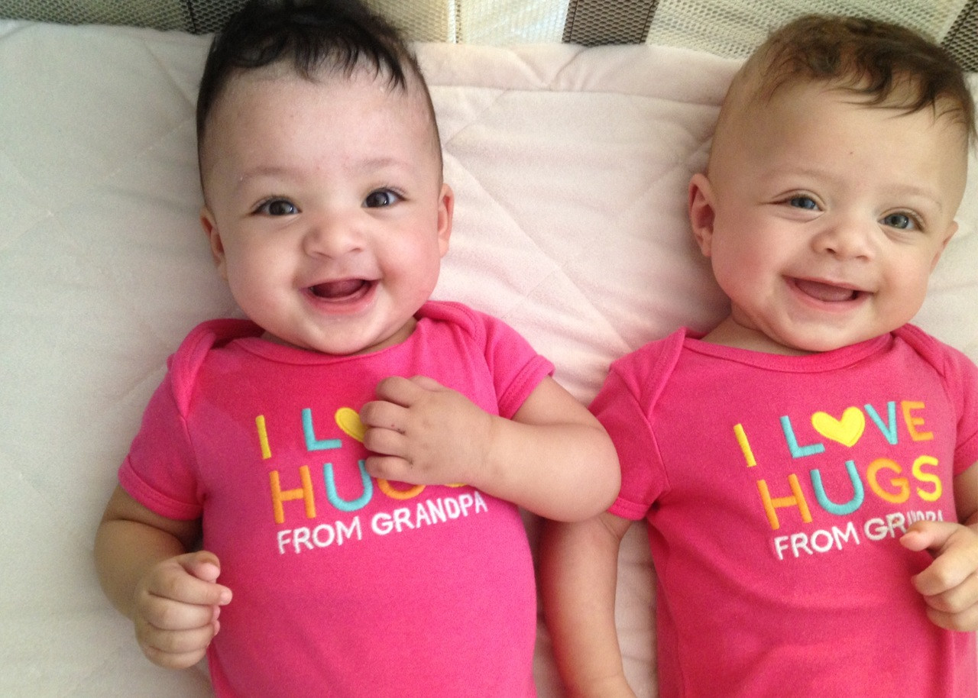

Slide 28

Family-Directed Assessment
Foundation for Outcome Development
Embedded in child’s routines and activities
Leads to Meaningful Service Decisions
Connected and integrated opportunities

Slide 29
Functional Child Assessments
Who?
How?

Slide 30


IDEA Implementation
Phase 3
Be Practical
Developing High Quality Functional IFSP Outcomes

Slide 31
Using Information within the IFSP Process
Info from IFSP process | Determine Eligibility | Develop Outcomes | Select Routines, Activities Settings | Develop Strategies | Determine People and Resources (Services) | Determine Frequency and Intensity | Determine Criteria to Measure Progress
Family hopes |  | √ | √
Family concerns priorities |  | √ |  |  |  | √ | √
Family resources |  |  | √ | √ | √ | √
Child needs | √ | √ | √ |  |  | √ | √
Child strengths |  | √ | √ | √
Child interests |  | √ | √ | √ | √
Behaviors in Settings |  | √ | √ | √ | √ |  | √
Desired activities | √ | √ | √ | √ | √ |  | √

Slide 32

Enhancing Recognition of High-Quality, Functional IFSP Outcomes
Developing
High-Quality,
Functional IFSP Outcomes
Instructions and materials for this activity may be found at:
http://www.nectac.org/~pdfs/pubs/rating-ifsp-iep-training.pdf

Slide 33

Placemat Activity:
Let’s Practice!
Is the Outcome “High Quality”?

Slide 34
High-Quality, Functional
IFSP Outcomes
Necessary and functional for child’s and family’s life
Reflect real-life contextualized settings
Discipline-free
Jargon-free, clear and simple
Emphasize the positive
Avoid use of passive words (e.g., tolerate, receive, improve, maintain)

Slide 35
The OUTCOME
is necessary
and functional
for the child’s
and family’s life.
Criteria for Rating
IFSP Outcomes
The wording of
the OUTCOME is
jargon-free,
clear and simple.
Ava will sleep through the night and take regular daytime naps.
The wording of
the OUTCOME
emphasizes the
positive.
The OUTCOME
is discipline-free.
Place Card Here
The OUTCOME
reflects real-life
contextualized
settings (e.g.,
not test items).
The OUTCOME
avoids the use
of passive words
(e.g., tolerate,
receive, improve,
maintain).
When the child’s contextual information is available, the following IFSP outcome criteria can also be evaluated:
The outcome is based on the family’s priorities and concerns.
The outcomes described both the child’s strengths and needs based on information from the initial evaluation or ongoing assessment.

Slide 36
The OUTCOME
is necessary
and functional
for the child’s
and family’s life.
Criteria for Rating
IFSP Outcomes
The wording of
the OUTCOME is
jargon-free,
clear and simple.
Ava will use a pincer grasp to pick up objects.
The wording of
the OUTCOME
emphasizes the
positive.
The OUTCOME
is discipline-free.
Place Card Here
The OUTCOME
reflects real-life
contextualized
settings (e.g.,
not test items).
The OUTCOME
avoids the use
of passive words
(e.g., tolerate,
receive, improve,
maintain).
When the child’s contextual information is available, the following IFSP outcome criteria can also be evaluated:
The outcome is based on the family’s priorities and concerns.
The outcomes described both the child’s strengths and needs based on information from the initial evaluation or ongoing assessment.

Slide 37
The OUTCOME
is necessary
and functional
for the child’s
and family’s life.
Criteria for Rating
IFSP Outcomes
The wording of
the OUTCOME is
jargon-free,
clear and simple.
IFSP Outcome Card 1
Nolan will play with toys with his sister during bath time.
The wording of
the OUTCOME
emphasizes the
positive.
The OUTCOME
is discipline-free.
The OUTCOME
reflects real-life
contextualized
settings (e.g.,
not test items).
The OUTCOME
avoids the use
of passive words
(e.g., tolerate,
receive, improve,
maintain).
When the child’s contextual information is available, the following IFSP outcome criteria can also be evaluated:
The outcome is based on the family’s priorities and concerns.
The outcomes described both the child’s strengths and needs based on information from the initial evaluation or ongoing assessment.

Slide 38
The OUTCOME
is necessary
and functional
for the child’s
and family’s life.
Criteria for Rating
IFSP Outcomes
The wording of
the OUTCOME is
jargon-free,
clear and simple.
Thomas will initiate eye contact and use gestures
The wording of
the OUTCOME
emphasizes the
positive.
The OUTCOME
is discipline-free.
Place Card Here
The OUTCOME
reflects real-life
contextualized
settings (e.g.,
not test items).
The OUTCOME
avoids the use
of passive words
(e.g., tolerate,
receive, improve,
maintain).
When the child’s contextual information is available, the following IFSP outcome criteria can also be evaluated:
The outcome is based on the family’s priorities and concerns.
The outcomes described both the child’s strengths and needs based on information from the initial evaluation or ongoing assessment.

Slide 39
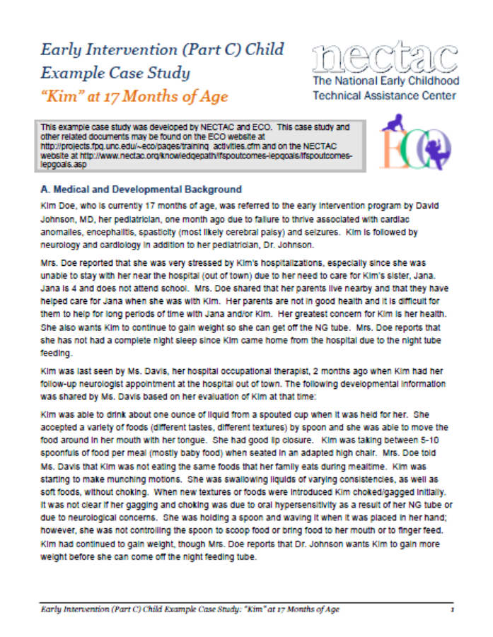

Slide 40
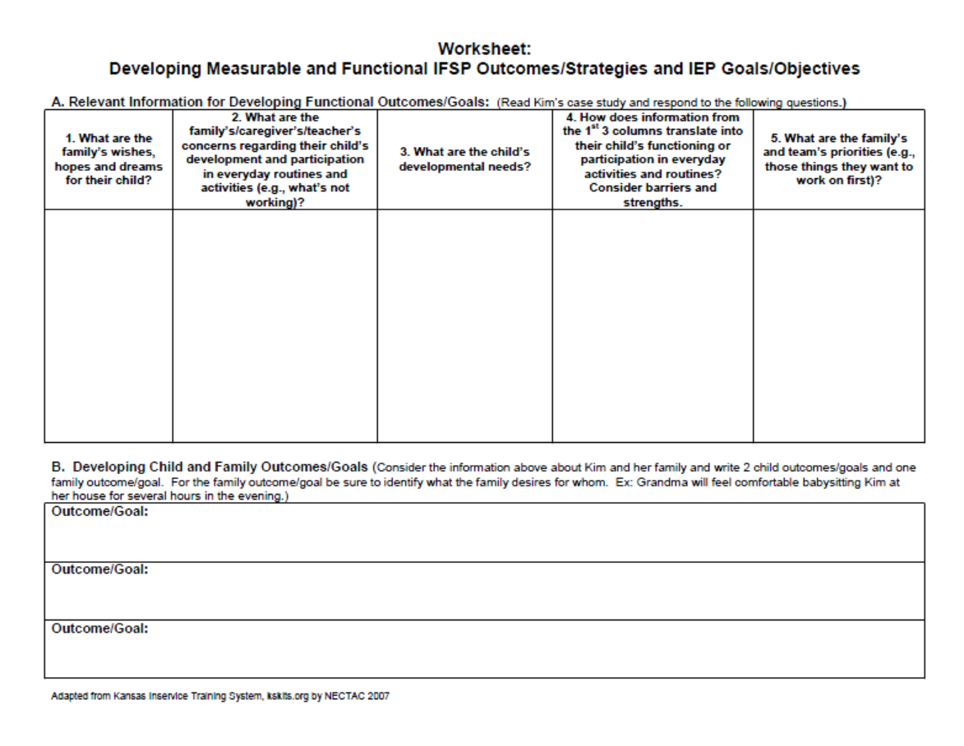

Slide 41

___________________________________________________________
IFSP Strategies to Meet Outcomes
IFSP Strategies
Supports and Services to Meet Outcomes

Slide 42
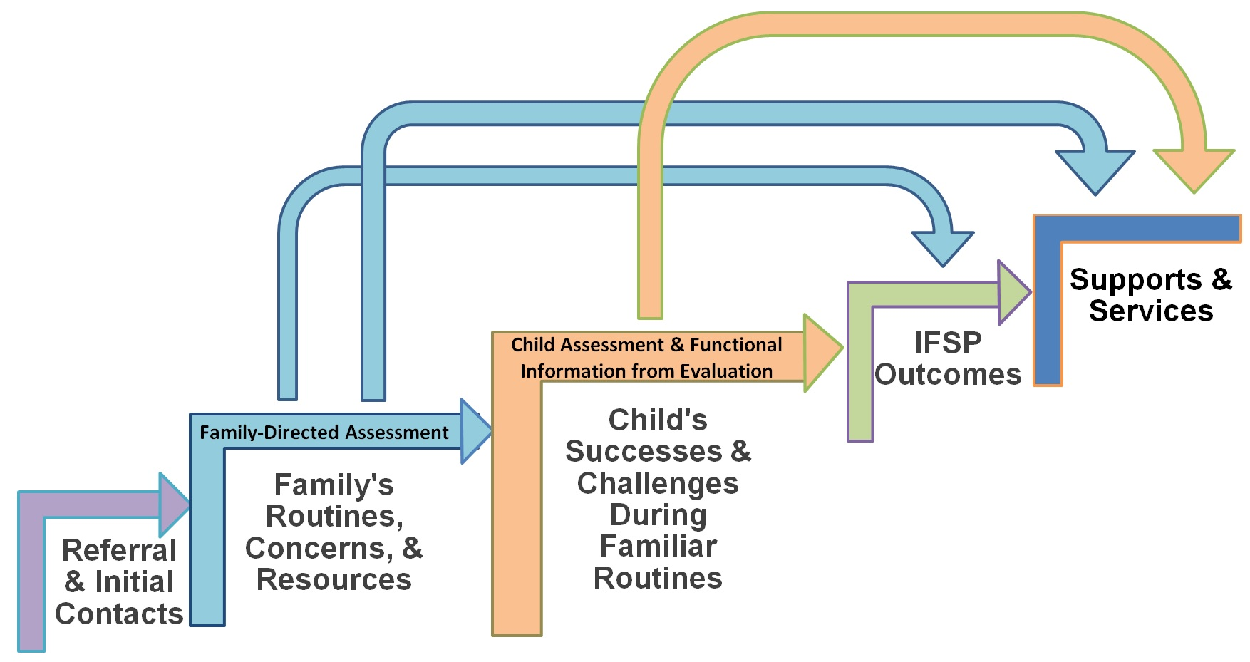
INTERRELATED STEPS

Slide 43
Guiding Questions for Developing Strategies
1. What resources and supports are already in place to help achieve this outcome?
2. Are there ways to help these existing supports be more effective in helping achieve the outcome?
3. What possible learning opportunities exist within current family/classroom routines or environments for helping meet the outcome?
4. What strategies will help achieve the outcome?

Slide 44
Additional Questions
5. Who else can help? What additional supports and services are needed to help achieve the outcome?
6. What are the appropriate roles for team members or others to play?
7. How will we know we are making progress, strategies are effective, or if modifications are needed?

Slide 45
Placemat Activity:
Let’s Practice!
strategies

Slide 46
Developing Strategies to Meet IFSP Outcomes
The strategy is functional for the child’s and family’s life
The strategy is discipline-free and helps achieve the outcome
The strategy reflects real-life contextualized settings for the child and family (e.g. not test items or developmental checklist items).
The wording of the strategy is jargon-free, clear and simple

Slide 47
Developing Strategies to Meet IFSP Outcomes
The strategy is developmentally appropriate for the child
The strategy includes parents and other caregivers in the child and family’s life who will help achieve the outcome
The strategy is based on how all children learn throughout the course of everyday life, at home, in early care and education settings, and in the community.

Slide 48
The strategy is
functional
for the child’s
and family’s life.
Criteria for Rating
IFSP Strategies
The wording of
the strategy is
jargon-free,
clear and simple.
Ava’s parents and other caregivers will keep a consistent nap and bedtime schedule for Ava, and work with the special instructor in trying different ways to support a regular sleep pattern for Ava.
The strategy
is discipline-free
and helps achieve
the outcome.
The strategy is developmentally appropriate for the child.
The strategy
reflects real-life contextualized
settings for the child and family (e.g.,
not test items or developmental checklist items).
The strategy
includes parents and other caregivers in the child and family’s life who will help achieve the outcome.
The strategy is based on how all children learn throughout the course of everyday life, at home, in early care and education settings, and in the community.

Slide 49
The strategy is
functional
for the child’s
and family’s life.
Criteria for Rating
IFSP Strategies
The wording of
the strategy is
jargon-free,
clear and simple.
Ava’s parents and other caregivers will be sure Ava has her favorite comfort things (pacifier, soft blanket, favorite toy) close by and talk to her as they move about the room/house to reassure her.
The strategy
is discipline-free
and helps achieve
the outcome.
The strategy is developmentally appropriate for the child.
The strategy
reflects real-life contextualized
settings for the child and family (e.g.,
not test items or developmental checklist items).
The strategy
includes parents and other caregivers in the child and family’s life who will help achieve the outcome.
The strategy is based on how all children learn throughout the course of everyday life, at home, in early care and education settings, and in the community.

Slide 50
Guiding Questions for Developing Strategies
1. What resources and supports are already in place to help achieve this outcome?
2. Are there ways to help these existing supports be more effective in helping achieve the outcome?
3. What possible learning opportunities exist within current family/classroom routines or environments for helping meet the outcome?
4. What strategies will help achieve the outcome?

Slide 51
Useful Competencies for Identifying Strategies
Ability to observe child participation in everyday activity settings and natural environments
Knowledge of typical child development
Knowledge of responsive parenting and teaching
Ability to perform task analysis and explore alternatives while interacting with the child in everyday routines and activities
Ability to be open to the possibilities of how families and care providers function best within everyday routines

Slide 52
Results
More to Come
Statewide Technical Assistance
Evaluation planning
Monitoring

Slide 53
Lessons Learned
Information specific to the State made the materials even more relevant for staff
Utilizing as many of the written materials within training helped staff contextualize the information
Lots of great information!! Have to select what is most relevant for your audience and for specific purposes

Slide 54

Connecticut
Lynn Skene Johnson
Assistant Director

Slide 55

    Connecticut Birth to Three System Overview
Approximately 4,500 children/daily, 9,500/Annually
Eligibility – Significant delay in development.

Slide 56
Connecticut Birth to Three System Overview
41 programs including specialty programs for children with autism or who are deaf or hard of hearing.
Service Coordination is provided by one of the primary providers on the IFSP.
Statewide IFSP & IEP Form.

Slide 57
    Reasons for Using the Materials from the Training Package
Parent complaints regarding number of service hours instead of outcomes attained.
Staff complaining that families demanded a medical model – direct therapy, limited family engagement.
System needed to change the focus of IFSP and specifically the outcomes to incorporate daily activities and routines and thereby drive the development of functional outcomes.

Slide 58
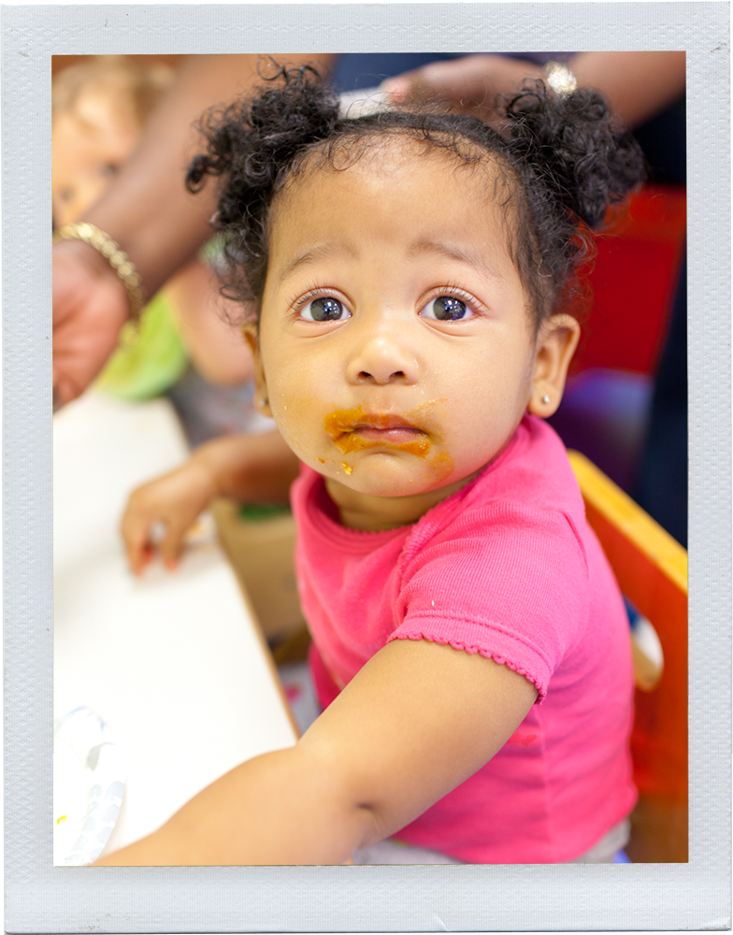
    Issues & Needs Addressed by the Training
Entry Level - New Service Coordinators Training
  4 days of training to understand the system and their role
  Focus on working with families to create functional IFSPs

Slide 59
Issues & Needs Addressed by the Training
Ongoing Training with Experienced Staff- Staff Meetings & Trainings
  Getting them to reflect on how the outcomes they are writing lead to parents wanting therapy driven services.
  Measuring outcomes-instead of measuring the attainment of pre-requisite and developmental skills, measurement is based on functional steps specific to the outcome which is now specific to child/family. This has led to ‘Aha moments’
  Now the pre-requisite skills become strategies not measurements
  Staff see that it is a dance with the parents to create a functional outcome-instead of parent saying “I want him to …” or staff saying “the next step is…” Its hard work!

Slide 60
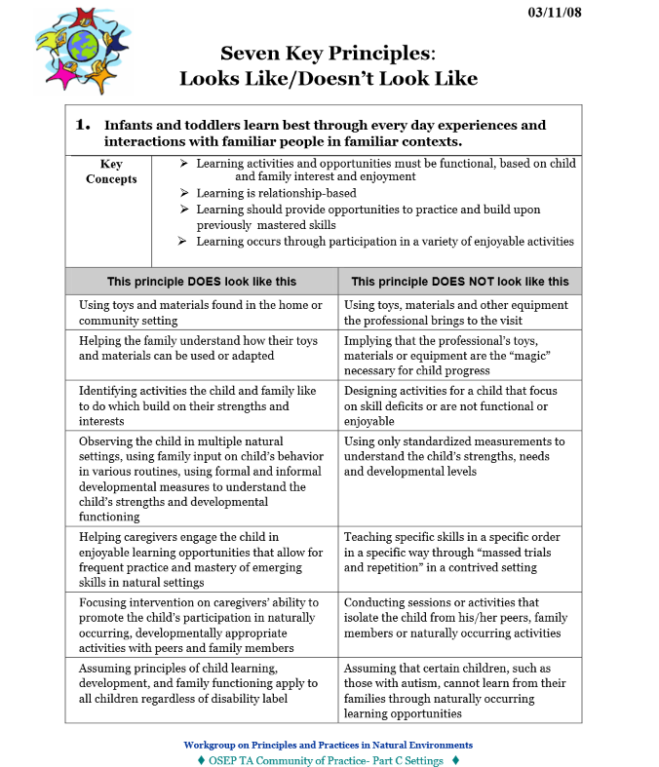
    Tools & Content Being Used from the Training Packet
PowerPoint has been incorporated with some adjustments
Seven Key Principles document

Slide 61
Tools & Content Being Used from the Training Packet
Placemat activity
  Used to increase awareness of the main outcome statement
    CT then breaks the outcome down into measurable steps and the strategies

Slide 62
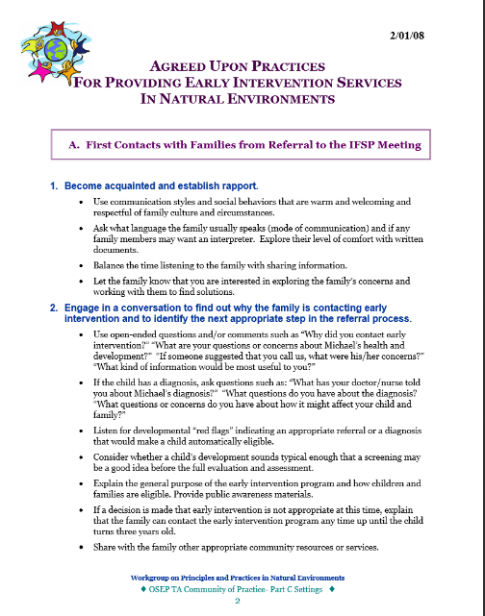
Tools & Content Being Used from the Training Packet
Self Assessment: Use of Agreed Upon EC Practices

Slide 63
    Results
Overall parents report feeling more ownership of the outcomes and IFSP in general,
Providers are reflecting on how they have been writing outcomes. “Looking at outcomes through a different lens”,
Working on developmental skills and milestones is not enough. Outcomes need to address functional skills in the context of the home. This leads to ‘aha moments’
Learning that pre-service training is not preparing EC staff for writing functional outcomes
Too soon to see if this is making a difference with outcomes or IFSP services

Slide 64
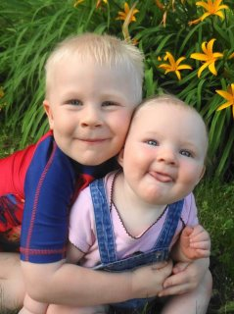

What are the Next Steps?
Revision of placemat activity to better reflect CT’s IFSP outcome format
A full day training is being developed for Spring 2014. Utilizing more of these materials

Slide 65
What are the Next Steps?
Outreach to more program staff via:
  Staff meetings
  Online training components
Targeting staff who say “Great, but this won’t work for children with… autism, hearing loss, etc.
Identify ways to measure impact of training.

Slide 66
    Lessons Learned
Greater buy-in when staff who are working with families and using the IFSP do the training
  Critiquing their own work
  Sharing their personal learning experiences
Look closer at the website for materials before reinventing the wheel
Can’t reach all the staff- but presenting to the the newer staff in SC training gets the attention of the rest of the program staff interested.
Expect some pushback from seasoned staff.

Slide 67
For More Information… www.birth23.org

Slide 68
Kansas
Phoebe Rinkel, M.S.
Technical Assistance Coordinator
TASN-Kansas Inservice Training System (KITS)

Slide 69

Kansas Landscape
Part C – Kansas Department of Health and Environment (KDHE) http://www.ksits.org/
Part B/619 – Kansas State Department of Education (KSDE) http://www.ksde.org/
Outcome Web System (OWS) – Birth to 6 http://kskits.org/OWS/index.html
Kansas Inservice Training System – Birth to 8
http://www.kskits.org/

Slide 70

Statewide IFSP for tiny k Programs
IFSP Guidance Document and form http://www.ksits.org/forms.htm
2012-2013 training series
http://www.kskits.org/training/trainingVideoClips.shtml

Slide 71
IEP Training for Kansas Schools
Early Childhood: Writing IEPs for Young Children
http://ksdetasn.org/cms/index.php/iep-training-coaching-resources
Kansas State Department of Education Technical Assistance System Network
2012 – 2013

Slide 72
ECO Process Quality Rating Checklists
For Administrators
http://kskits.org/ta/ECOOutcomes/AdminNdsKno/AdminQtyRatingChecklist1_31_12.doc
For Direct Service Providers
http://kskits.org/ta/ECOOutcomes/whatDirectService/DrctSrvcPvdrQtyRtgLst_6_27_12.doc

Slide 73





Implementation Timeline for Kansas ECO
2013-2014
Integrating ECO into the IFSP/IEP process to support improved practices, ongoing measurement, and positive outcomes for children and families
2013-
2014
2011-2012
Understanding and using ECO data for program improvement
2011-2012
2008-2010
Refining the process for measuring and reporting ECO
2008-2010
2006-2007
Developing guidance & training to support local teams in
-use of approved curriculum based assessment
-completing the Child Outcomes Summary Form
-entering COSF data into the Outcomes Web System
2006-
2007
2004-2005
Designing the process for measuring and reporting ECO to the Office of Special Education Programs (OSEP)
2004-2005

Slide 74
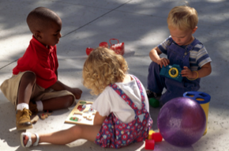

Integrating Early Childhood Outcomes (ECO): Improving Practices In tiny k and Part B/Preschool Programs
August 29, 2013
3:00 p.m.
August 30, 2013
11:30 a.m.
Presented by
Peggy Kemp, M.S., KITS
Phoebe Rinkel, M.S., TASN-KITS
Chelie Nelson, Ph.D., TASN-KITS
http://kskits.org/training/trainingVideoClips.shtml

Slide 75
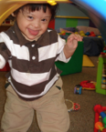
Integrating ECO: Session Objectives
Understand the connections among
  Using functional assessment
  Developing meaningful IFSP Outcomes
  and IEP Goals
  Measuring the 3 global child outcomes
Identify benefits and challenges of integrating ECO with IFSP/IEP process
Begin/Continue program self-assessment and planning for integration of ECO with IFSP/IEP process
Leave with resources to support your efforts to improve practices and outcomes for children

Slide 76
Developing
High-Quality,
Functional
IFSP Outcomes and IEP Goals http://www.nectac.org/knowledgepath/ifspoutcomes-iepgoals/ifspoutcomes-iepgoals.asp
presented in collaboration with
Notes:
.

Slide 77
Goal
Understand the connections among:
    Functional Assessment
    Developing meaningful IFSP Outcomes and IEP Goals
    Measuring the 3 global child outcomes
Meaningful
IFSP Outcomes
and IEP Goals
3 Global Child Outcomes
Functional Assessment

Slide 78
The Right People, the Right Situation, the Right Time
Why not complete the Child Outcome Summary (COS) rating while talking about the child’s functioning and development?
Providers who are integrating the outcomes work, suggest that the completing the COS rating at the IFSP or IEP meeting to summarize the assessment results is a natural and enriching conversation
Outcomes and goals become more functional – routine and activity based
For more information about integrating outcomes into the IFSP/IEP process, please visit the ECO website at www.the-eco-center.org.

Slide 79
Outcomes Process At-a-Glance
KS ECO Process Quick Reference
http://www.kskits.org/ta/ECOOutcomes/documents/KS_ECO_ProcessQuickRef_2_20_12Opt.pdf
KS ECO Data Quick Reference
http://www.kskits.org/ta/ECOOutcomes/documents/KS_ECO_DataQuickRef_2_20_12.pdf

Slide 80
SECTION 2
___________________________________________________________
Functional Assessment
Adapted from: Younggren, N. (May, 2011). Quality Practices in Early Intervention and Preschool Programs – Authentic Assessment. Power Point presentation presented at the Pacific TA Meeting, Honolulu, HI.
What is Functional Assessment?
Why is Functional Assessment Foundational?
Who does Functional Assessment?
Where is Functional Assessment done?
How is Functional Assessment done?

Slide 81

Involving Families
Questions for Eliciting Family Interests, Priorities, Concerns, and Everyday Routines and Activities (July 2012)

Slide 82
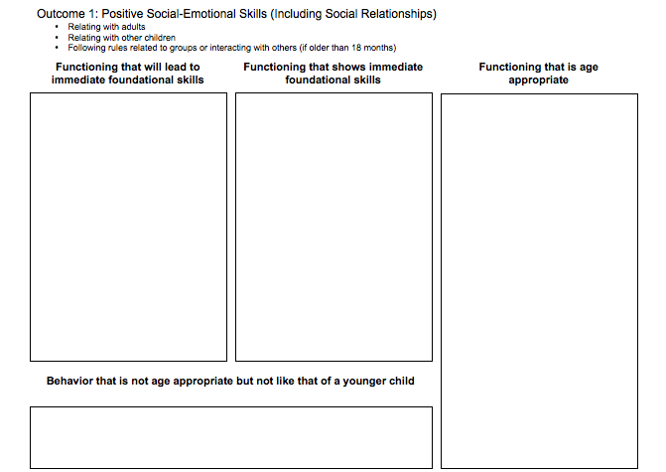
Using Information from the DBRF to Develop Child Story or PLAAFP
Skills/ behaviors
of much younger
child
Immediate foundational skills/
behaviors
(3-6 months delay)
Age- appropriate skills/
behaviors
Notes:
.

Slide 83
Goal
Understand the connections among:
    Functional Assessment
    Developing meaningful IFSP Outcomes and IEP Goals
    Measuring the 3 global child outcomes
Meaningful
IFSP Outcomes
and IEP Goals
3 Global Child Outcomes
Functional Assessment

Slide 84
SECTION 3
___________________________________________________________
Integrating Functional Assessment and Outcome Measurement with IFSP Outcomes / IEP Goals
Linking Assessment Information to IFSP Outcomes and IEP Goals
Integrating the Global Child Outcomes Measurement into the IFSP/IEP Process

Slide 85
Using Information within the IFSP/IEP Process
Info from IFSP/IEP process | Determine Eligibility | Develop Outcomes/Goals | Select Routines, Activities Settings | Develop Strategies/Objectives | Determine People and Resources (Services) | Determine Frequency and Intensity | Determine Criteria to Measure Progress
Family hopes |  | √ | √
Family concerns priorities |  | √ |  |  |  | √ | √
Family resources |  |  | √ | √ | √ | √
Child needs | √ | √ | √ |  |  | √ | √
Child strengths |  | √ | √ | √
Child interests |  | √ | √ | √ | √
Behaviors in Settings |  | √ | √ | √ | √ |  | √
Desired activities | √ | √ | √ | √ | √ |  | √

Slide 86
SECTION 6
___________________________________________________________
Applying the Information: Practical Learning Experience

Slide 87
Worksheet: Developing Measurable and Functional IFSP Outcomes/Strategies and IEP Goals/Objectives
What are the family’s wishes, hopes and dreams for their child?
What are the family’s/caregiver’s/teacher’s concerns regarding the child’s development and participation in everyday routines and activities?
What are the child’s developmental needs?
How does information from 1-3 translate into the child’s functioning or participation in everyday activities and routines? Consider barriers and strengths.
What are the family’s and team’s priorities (e.g., those things they want to work on first)?

Slide 88
Worksheet: Developing Measurable and Functional IFSP Outcomes/Strategies and IEP Goals/Objectives
What strengths, resources and supports are already in place?
Are changes needed to make these strengths more effective?
What possible opportunities exist within existing family/classroom routines or environments for meeting the outcome/goal?
What strategies will help achieve the changes we want?
Who can help? What roles can team members or others play?
What services/supports are needed to achieve the outcome/goal?
How will we know we have made progress, achieved the outcome/goal, or need to modify it?

Slide 89
SECTION 4
___________________________________________________________
Functional, High-Quality IFSP Outcomes and IEP Goals
IFSP Outcome Requirements
Developing Functional, High Quality IFSP Outcomes
IEP Goal Requirements
Developing Functional, High Quality IEP Goals
Rating Activity: IFSP Outcome and IEP Goal Statements

Slide 90
Develop Functional IFSP Outcomes
Step 1: Determine the functional area(s) to support participation based on identified needs. | Using words/signs to communicate choices to his mother during daily routine and activities
Step 2: What routine(s) or activity(ies) does this affect? | Meal time. Play time.
Step 3: Draft the context portion of the outcome. [routines or activities] | During meals, Davy will use the sign for “more” to indicate the need for more milk in order to communicate his needs to his mother
Step 4: Draft the measurement portion of the outcome and add the family’s chosen time frame | By his birthday, …when he wants more milk at mealtime
Adapted from McWilliam, R.A. (2006)

Slide 91
Develop Functional IEP Goals
Step 1: Determine the academic (preschool activities) and functional area(s) based on identified needs. | Following directions independently
Step 2: What routine(s) or activity(ies) does this affect? | Familiar multi-step routines at home and in the classroom
Step 3: Draft the condition and behavior portion of the goal [routines or activities] | Provided correspondence training and using verbal rehearsal, Johnny will follow 3 consecutive directions within familiar classroom routines
Step 4: Draft the criterion portion of the goal and add the time frame | Independent of adult prompts at least 2 out of 3 opportunities for 3 consecutive days by Dec. 20xx
Adapted from McWilliam, R.A. (2006)

Slide 92
Resources on IFSPs and IEPs
IFSP
IEP
Agreed Upon Practices For Providing Early Intervention Services In Natural Environments http://www.nectac.org/~pdfs/topics/families/AgreedUponPractices_FinalDraft2_01_08.pdf
Key Practices Underlying the IEP Process http://nectac.org/~pdfs/knowledgepath/ifspoutcomes-iepgoals/Key_Practices_IEP_Process.pdf

Slide 93
Outcomes/Goal
Understand the connections among:
    Functional Assessment
    Developing meaningful IEP Goals
    Measuring the 3 global child outcomes
Meaningful
IFSP Outcomes
and IEP Goals
3 Global Child Outcomes
Functional Assessment

Slide 94

Measuring ECOs
Functional IFSP outcomes/IEP goals, services and interventions provided during participation in daily activities and routines allows for ongoing assessment of early childhood outcomes for
  Progress monitoring
  Making decisions about
  intervention practices
  Rating outcomes at exit.

Slide 95

Why Use the Outcomes??
Socially validated – reflect what we are trying to achieve
Functional
They’re integrated – emphasize the whole child
Flexible – not wedded to one particular assessment, curriculum, or level of child functioning

Slide 96

Opportunities for Outcomes Measurement in IFSP/IEP Process
Part C to B Transition Meeting
Curriculum Based Assessment
Parent Input
IEP Development/Eligibility
Ongoing Intervention
IFSP/IEP Reviews

Slide 97
Next Steps In Integrating ECO with the Kansas IFSP/IEP Process
Share information about the 3 global outcomes and the ratings process with families during the evaluation and eligibility process.
Use information from the DBRF, Child Outcomes Summary narrative, and language (not numbers) from the COSF ratings to describe present levels (this means COSF would need to be completed as part of the evaluation/eligibility/IFSP/IEP process).
Refine process for determining the ratings as part of the IFSP/IEP process (initially and annually thereafter).
Continue to update curriculum based assessment information quarterly, or as recommended by publisher, for ongoing progress monitoring.
Continue to update family interview information at reviews and annually.

Slide 98
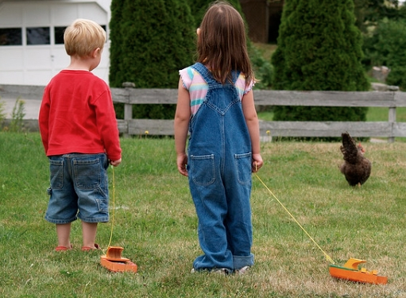
Potential Benefits and Challenges to Integrating ECO and IFSP/IEP Processes in Kansas

Slide 99
Lessons Learned
Benefits
Makes outcomes, IFSPs/IEPs and the assistance we provide more meaningful for families
More family involvement in the process to develop more functional outcomes and goals
Documentation more consistent; exit ratings more reliable
Use of existing data to identify present levels
No longer two disconnected processes
Help us write better outcomes/goals

Slide 100
Lessons Learned
Challenges
Time (most frequent response)
Getting whole team together
Overloading families during process
Team buy-in; seeing utility of process
Staff training
Notes:
We also have heard from some part B programs whose districts require IEP goals to be linked to standards that this is a barrier to integrating the outcomes with their process. We have aligned the three outcomes with our original state early learning standards and will do the same with our newly revised standards that are now aligned with our college and career ready state standards.

Slide 101
First Step: Assessing Your Program Principles and Practices
Part B/619
Integrating Child Outcomes Measurement with the Individualized Education Program (IEP) Process: Implementation Rating Scale (Revised July 2013)
  http://projects.fpg.unc.edu/~eco/assets/docs/selfassessment%20_Key_Practices_IEP_Process-July2013.docx
tiny k
Integrating Child Outcomes Measurement into an Effective IFSP Process (Revised March 2012)
    http://projects.fpg.unc.edu/~eco/assets/pdfs/SelfAssessment_IFSP_practices-updated%2012-2012.pdf

Slide 102



Messages From Our Sponsors
Contact me: prinkel@ku.edu

Slide 103

Questions?

Slide 104
Contact Information
Anne Lucas, ECTA/WRRC
anne.lucas@unc.edu
Sherry Franklin, NC Part C
Franklin, Sherry sherry.franklin@dhhs.nc.gov
Lynn Johnson, CT Part C
Lynn.S.Johnson@ct.gov
Phoebe Rinkel, KS KITS prinkel@ku.edu
Notes:
We are available to answer any questions that you have about the training package, either in your preparation or debriefing or answering questions after you use it. Here is our contact information; please let us know if we can help.
Thank you for participating in the webinar today. This concludes our call. Have a great afternoon!

