Slide 1



CESA 6
Improving the Quality of
Child Outcomes Data
Ruth Chvojicek – Statewide Part B Indicator 7
Child Outcomes Coordinator

Slide 2
Objectives
To discuss the significance of and strategies for improving child outcomes data quality
To look at state, CESA and District data patterns as one mechanism for checking data quality
2
Notes:
Introductions
Objectives
Agenda

Slide 3

Quality Assurance:
Looking for Quality Data
I know it is in here
somewhere

Slide 4
Ongoing checks for data quality
Before | Good training and assessment Efficient data systems Timely and accurate data entry
During | Ongoing supervision of implementation Feedback to implementers Refresher training
After | Review sample of completed COSFs Pattern checking analysis
Notes:
Training has evolved as we’ve learned and grown
Fit Indicator 7 into IEP process
Increased focus on assessment as a result of this indicator
Enhancements to data system in 2011 enables us to use data for analysis
Ensuring quality data is important throughout data collection process – so you have to build in strategies before, during and after data collection. You’re building a system for ensuring data quality.
BEFORE: The kinds of strategies you use beforehand are things like good training and establishing an efficient data system and thinking about training and procedures that will ensure timely and accurate data entry.
To ensure staff who are involved in the data collection and reporting process have the knowledge and skills they need to do a good job, you conduct trainings around topics such as good assessment practices, understanding the COSF process, child development and age expectations, family involvement, data entry procedures, etc.

Slide 5
Promoting Quality Data -
Through data systems and verification, such as
  Monthly data system error checks e.g. missing & inaccurate data
  Monthly email data reminders
  Indicator Training data reports
  Good data entry procedures
Notes:
You also promote quality data through your data system by setting up a system to capture the data, providing staff with information/procedures/TA on data entry, and also you can include things like built-in error checks (e.g. when the program won’t let you proceed if a field is blank, if a program tells you the information you entered is not possible, when the program reminds you when data are due).
Are you missing data selectively e.g. by local program, eligibility determination, type of exit, etc?
If data are missing, there are problems with interpreting and using the data. Your data are not “representative” of the chidlren served. Therefore, you do not want to draw conclusions and take action until your data are representative.

Slide 6

Looking at Data
6

Slide 7

Using data for program improvement = EIA
Evidence
Inference
Action
7

Slide 8

Evidence
Evidence refers to the numbers, such as
  “45% of children in category b”
The numbers are not debatable
8
Notes:
60% of children are in SS1
20% of children had an entry rating of 7
Just the facts

Slide 9
Inference
How do you interpret the #s?
What can you conclude from the #s?
Does evidence mean good news? Bad news? News we can’t interpret?
To reach an inference, sometimes we analyze data in other ways (ask for more evidence) “Drill Down”
9
Notes:
What’s critical is how we interpret the numbers --- putting meaning on the data.
What does the data tell you? What can you conclude?
Is it something you’re not sure what it means?

Slide 10

Inference
Inference is debatable -- even reasonable people can reach different conclusions
Stakeholders (district personal) can help with putting meaning on the numbers
Early on, the inference may be more a question of the quality of the data
10
Notes:
It’s important to realize that inference is debatable– different people can reach different conclusions. That’s why stakeholders (such as the program administrators, staff, beneficiaries) can help with putting meaning on the numbers.
You don’t want to start making conclusions or decisions about the quality of your program until you feel the data are accurate.

Slide 11
Action
Given the inference from the numbers, what should be done?
Recommendations or action steps
Action can be debatable – and often is
Another role for stakeholders
Again, early on the action might have to do with improving the quality of the data
11
Notes:
So, after you’ve decided what the data mean, you can think about what actions need to be taken. This too can be debatable and may be another place where stakeholders can help.
For example, last year a director, while conducting a data review, realized that there was missing data. It was just sitting on a person’s desk waiting to be entered into the web portal.
Many districts noticed missing data when they saw their districts data report at the Indicator Trainings.

Slide 12

Promoting quality data through data analysis
12
Notes:
12

Slide 13

The Three Outcomes
Percent of preschool children with IEPs who demonstrate improved:
Positive Social Emotional Skills
Acquisition & Use of Knowledge & Skills
Takes Appropriate Action to Meet Needs
Notes:
These next 2 slides are just reminders to help us as we look at data.
These are the 3 outcome areas– they are functional outcomes, across domains, how a child functions in everyday life and situations
Note – We’ve seen in trainings this year that it is good for people to practice identifying what skills and behaviors fit into each outcome area.
For Indicator 7 the state reports to the Office of Special Ed Programs (OSEP), the percent of children who are making progress in the three outcomes stated on this slide:
Positive Social Emotional Skills
Acquisition & Use of Knowledge Skills
Takes Appropriate Action to Meet Needs
The handout – The Three Outcomes – includes a complete list of skills and behaviors included in each outcome.

Slide 14









7-Point Rating Scale
Please refer to handout – “The Bucket List”
1
Child does not yet show functioning expected of a child his or her age in any situation.
6
Child’s functioning generally is considered appropriate for his or her age but there are some significant concerns about the child’s functioning in this outcome area. These concerns are substantial enough to suggest monitoring or possible additional support.
7
Child shows functioning expected for his or her age in all or almost all everyday situations that are part of the child’s life. Functioning is considered appropriate for his or her age.
2
3
4
5
No one has any concerns about the child’s functioning in this outcome area.
Although age-appropriate, the child’s functioning may border on not keeping pace with age expectations.
Child’s functioning does not yet include immediate foundational skills upon which to build age-appropriate functioning.
Child functioning reflects skills that developmentally come before immediate foundational skills.
Child’s functioning might be described as like that of a much younger child.
Child occasionally uses immediate foundational skills across settings and situation. More functioning reflects skills that are not immediate foundational than are immediate foundational.
Child does not yet show functioning expected for a child of his or her age in any situation.
Child uses immediate foundational skills, most or all of the time, skills upon which to build age-appropriate functioning.
Functioning might be described as like that of a younger child.
Child shows occasional age-appropriate functioning across settings and situations. More functioning is not age-appropriate than age-appropriate.
Child shows functioning expected for his or her age some of the time and/or in some settings and situations. Child’s functioning is a mix of age-appropriate and not age-appropriate behaviors and skills.
Childs functioning might be described as like that of a slightly younger child.
Notes:
This is the 7-point rating scale used in the Child Outcome Summary process. This slide is the same information that is found on the handout, “The Bucket List”.
In review, when a child is rated a 6 or 7 that is essentially saying that a child is functioning at an age-expected level in the specific outcome level. At the other end of the continuum, a rating of 1 is saying the child is functioning below both age-expected and immediate foundational levels.
A rating of 4 and 5 is saying that a child is functioning with a combination of age-expected and immediate foundational skills.
And, a rating of 2 and 3 is saying that a child is functioning with a combination of foundational and immediate foundational skills.
We will now look at a patterns of rating within Wisconsin. It will be helpful to keep The Bucket List handout in front of you to reference throughout this discussion.

Slide 15
Pattern Checking - Checking to see if ratings accurately reflect child status
We have expectations about how child outcomes data should look
  Compared to what we expect
  Compared to other data in the state
  Compared to similar states/regions/school districts
When the data are different than expected ask follow up questions
Notes:
When we talk about pattern checking, we’re talking about running the data in various ways and then looking at the patterns to see if the patterns make sense and therefore are accurately reflecting child status.
We do that by comparing the data in different ways – comparing the data to what we EXPECT; comparing the data to other state data; and comparing the data to other states/regions/school districts, etc.

Slide 16
Questions to ask
Do the data make sense?
  Am I surprised? Do I believe the data? Believe some of the data? All of the data?
If the data are reasonable (or when they become reasonable), what might they tell us?
Notes:
Can’t use data for program improvement until you believe them.
(The second bullet) This is when the data get exciting – when the data are reasonable and we are able to use it to understand how our program is performing. Where and how are we performing well? With which types of children? Which intervention strategies or teaching practices and curriculum are working well?

Slide 17
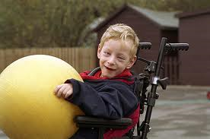
Patterns We will be Checking Today
Entry Rating Distribution
Entry Rating Distribution by Eligibility Determination
Comparison of Entry Ratings Across Outcomes
Entry/Exit Comparison by CESA
State Entry Rating Distribution by Race/Ethnicity
State Exit Rating Distribution
Progress Categories by State/CESA
Summary Statements by State/CESA
Notes:
Data available for pattern checking for today’s meeting included:
OSEP a-e Progress Categories (for C & 619)
Entry Data (1-7 ratings for 619)
Exit Data (1-7 ratings and yes/no progress question for 619)
Summary Statements data (for C & 619)
Given the volume of data, I had to choose some data as examples for today’s presentation. So, sometimes we will look at the same data charts for C as 619 (e.g. we will look at the a-e progress categories for both programs). But other times we will look at just a 619 example or just a Part C example.
The reason for choosing one example or another was not based on any reason except what was available and trying to choose a manageable amount of data to include.
Key to today’s discussion is the PROCESS of looking at data– evidence, inference, action. So, it’s my hope that you walk away with HOW to look at data (and not just learnings about the specific data we are looking at today).

Slide 18
Small Group Discussion Questions:
What do you notice about your local data?
What stands out as a possible ‘red flag’?
What might you infer about the data?
What additional questions does it raise?
What next steps might you take?

Slide 19
Predicted Pattern #1
Children will differ from one another in their entry scores in reasonable ways (e.g., fewer scores at the high and low ends of the distribution, more scores in the middle).
Rationale:
Evidence suggests EI and ECSE serve more mildly than severely impaired children (e.g., few ratings/scores at lowest end). Few children receiving services would be expected to be considered as functioning typically (few ratings/scores in the typical range).
Notes:
From the longer handout of patterns, we will investigate a few of the expected patterns today.

Slide 21
Predicted Pattern #2
Groups of children with more severe disabilities should have lower entry numbers than groups of children with less severe disabilities.
Notes:
From the longer handout of patterns, we will investigate a few of the expected patterns today.

Slide 22
State 11-12 Entry Rating Eligibility Percentages

Slide 23
Notes:
Slide shows statewide entry rating %’s by eligibility. Handout shows individual district entry rating %’s by eligibility.

Slide 24
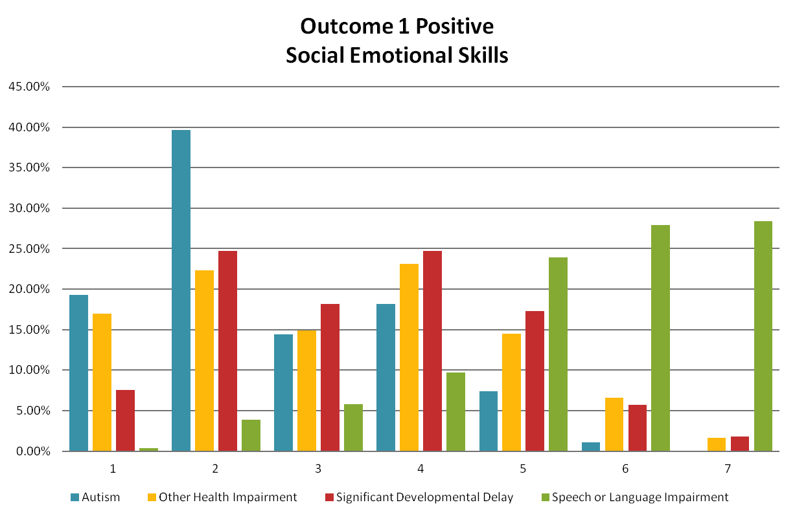

Slide 25
Notes:
Slide shows statewide entry rating %’s by eligibility. Handout shows individual district entry rating %’s by eligibility.

Slide 26
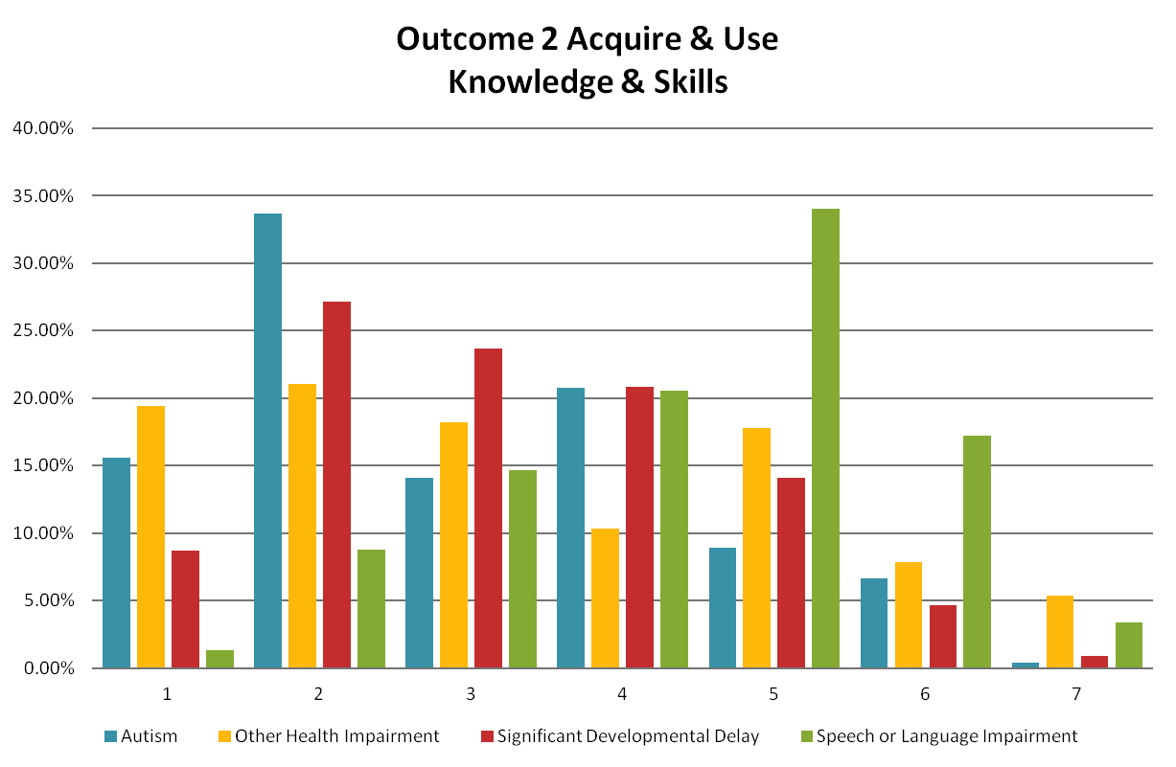

Slide 27
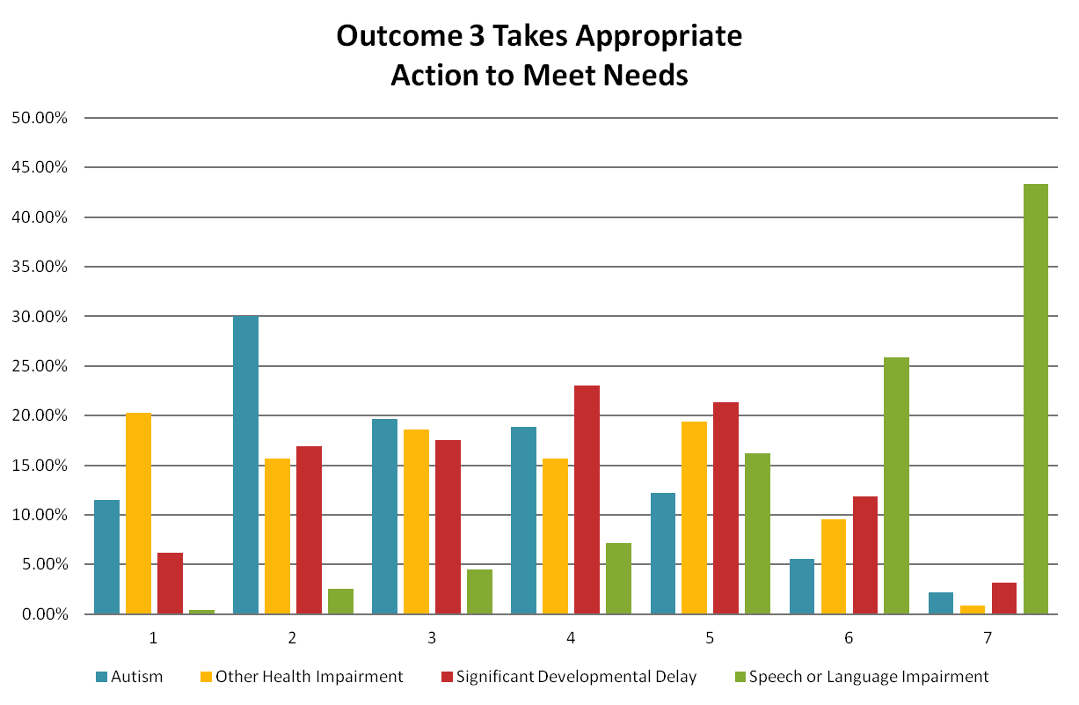

Slide 28
Notes:
Slide shows statewide entry rating %’s by eligibility. Handout shows individual district entry rating %’s by eligibility.

Slide 29
Predicted Pattern #3
Functioning at entry in one outcome is related to functioning at entry in the other outcomes.
For cross tabulations we should expect most cases to be in the diagonal and the other to be clustered on either side of the diagonal.
Notes:
From the longer handout of patterns, we will investigate a few of the expected patterns today.

Slide 33
Predicted Pattern #4
Large changes in status relative to same age peers between entry and exit from the program are possible but rare.
When looking at the Entry/Exit Rating comparison for individual children we would expect very few children to increase more than 3 points.
Notes:
From the longer handout of patterns, we will investigate a few of the expected patterns today.

Slide 34
 | Outcome 1 Exit
Outcome 1 Entry |  | 1 | 2 | 3 | 4 | 5 | 6 | 7
 | 1 | 1 | 2 | 1 | 1 | 1 |  | 1
 | 2 |  | 4 | 3 | 6 | 6 | 2 | 3
 | 3 | 1 | 1 | 1 | 4 | 6 | 2 | 3
 | 4 |  |  |  |  | 4 | 6 | 5
 | 5 |  |  | 1 | 2 | 4 | 11 | 20
 | 6 |  |  |  |  | 1 | 4 | 18
 | 7 |  |  |  |  |  | 2 | 19

Slide 35
 | Outcome 2 Exit
Outcome 2 Entry |  | 1 | 2 | 3 | 4 | 5 | 6 | 7
 | 1 | 2 | 1 | 1 |  | 1
 | 2 | 1 | 3 | 6 | 4 | 12 | 2 | 2
 | 3 |  |  | 1 | 4 | 5 | 9 | 10
 | 4 |  |  |  | 1 | 6 | 10 | 4
 | 5 |  |  |  |  | 10 | 10 | 15
 | 6 |  |  |  |  | 1 | 9 | 15
 | 7 |  |  |  |  |  | 1

Slide 36
 | Outcome 3 Exit
Outcome 3 Entry |  | 1 | 2 | 3 | 4 | 5 | 6 | 7
 | 1 | 3 | 3 | 1 | 1 | 1 | 1
 | 2 |  |  | 3 | 2 | 4 | 1 | 2
 | 3 |  | 1 |  | 2 | 3 | 5 | 6
 | 4 |  |  |  | 2 | 3 | 9 | 6
 | 5 |  |  |  | 1 | 5 | 7 | 13
 | 6 |  |  |  | 1 | 1 | 2 | 21
 | 7 |  |  |  |  |  | 4 | 32

Slide 37
Predicted Pattern #5
If children across race/ethnicity categories are expected to achieve similar outcomes, there should be no difference in distributions across race/ethnicity.
Note:
Wisconsin began gathering race/ethnicity data for Indicator 7 on July 1, 2011. This impacts the data on the graphs being reviewed today.
Notes:
From the longer handout of patterns, we will investigate a few of the expected patterns today.

Slide 41
Predicted Pattern #6
Children will differ from one another in their exit scores in reasonable ways. (At exit there will be a few children with very high or very low numbers.
Notes:
From the longer handout of patterns, we will investigate a few of the expected patterns today.

Slide 42
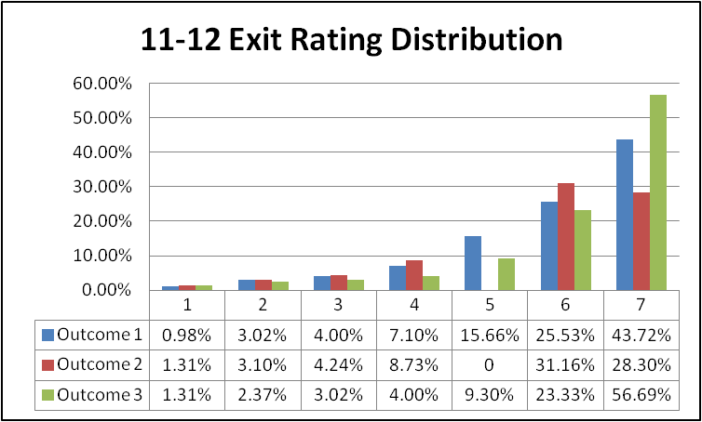
Notes:
What do you notice about the distribution?
Is it sensible?
Is there anything (red flags) that seem to not make sense given the children you serve?
(note – slide updated 1-7-13)

Slide 43
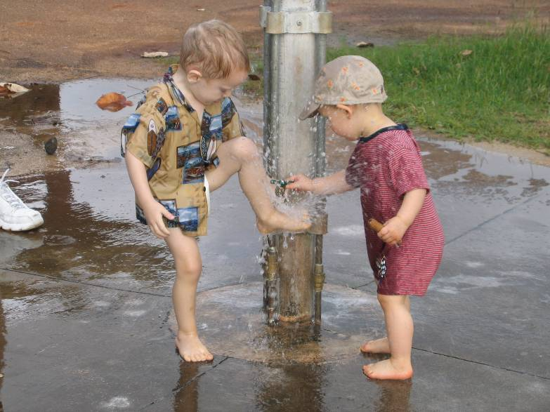
OSEP Progress Categories

Slide 44
Progress categories
Please refer to handout “Child Outcomes Data Conversion”
Percentage of children who:
a. Did not improve functioning
b. Improved functioning, but not sufficient to move nearer to functioning comparable to same-aged peers
c. Improved functioning to a level nearer to same-aged peers but did not reach it
d. Improved functioning to reach a level comparable to same-aged peers
e. Maintained functioning at a level comparable to same-aged peers
Notes:
C- ‘narrow the gap’
D- ‘close the gap’

Slide 45
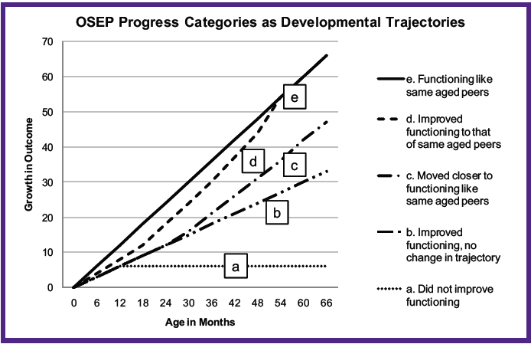

Slide 46
Predicted Pattern #7
Children will differ from one another in their OSEP progress categories in reasonable ways.
Note – A graph of this predicted pattern should have a similar distribution expected in entry & exit ratings (bell curve).
Notes:
From the longer handout of patterns, we will investigate a few of the expected patterns today.

Slide 47
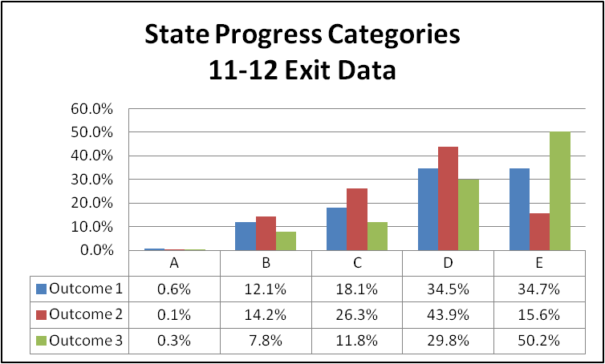
Notes:
What patterns do you notice?
Review your CESA wide / State distribution charts.

Slide 51
Summary Statement #1
Please see handout – “Summary Statements for Target Setting
Of those children who entered the program below age expectations in each Outcome, the percent who substantially increased their rate of growth by the time they exited the program.
c + d___
a + b + c + d
Notes:
For each of the 3 outcome areas, states must report on children who substantially increased their rate of growth. The numerator includes ‘c’ the children who narrowed the gap and ‘d’ the children who closed the gap. Notice the denominator does not include the ‘e’ category which are the children who came in functioning at age level in that outcome area.
Don’t forget, these outcome areas are measured and reported independently. So, a child may enter the program performing at age expectations in one or more of the areas.
The key concept here is ‘increased rate of growth’ (those children who narrowed the gap and those who closed the gap or caught all the way up)

Slide 52
Summary Statement #2
The percent of children who were functioning within age expectations in each Outcome by the time they exited the program.
d + e__
a + b + c + d + e
Notes:
For each outcome area, a state must report on the percent of children who were functioning within age expectations by the time they exited the program. The numerator includes ‘d’ the children who closed the gap and ‘e’ the children who entered the program at age expectation.
Some have likened this summary statement to the ‘readiness or ready to learn’ concept. These are the children leaving the program at age expectations.

Slide 53
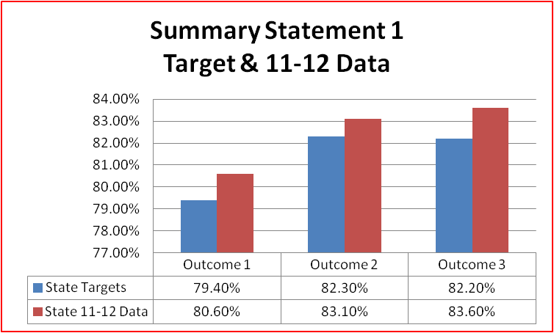

Slide 54
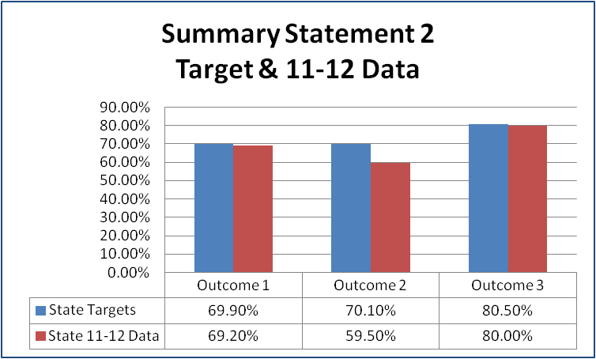

Slide 58
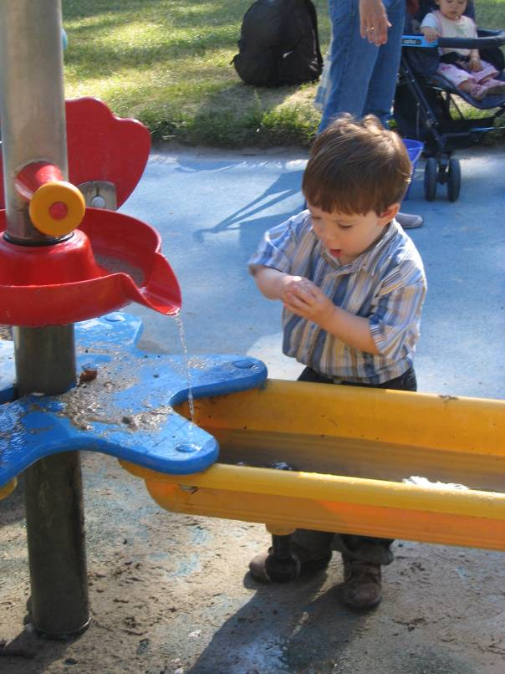
Wrap Up &
Next Steps
Notes:
Share some closing thoughts and think about some next steps.

Slide 59
Take Home Message
If you conclude the data are not (yet) valid, they cannot be used for program effectiveness, program improvement or anything else.
SO
What do you if the data are not as good as they should be?
Answer: Continue to improve data collection through ongoing quality assurance

Slide 60
Key to Good Data
Have a good outcome measurement
SYSTEM

Slide 61
Quality checks during data collection
During | Ongoing supervision of implementation Feedback to implementers Refresher training
Notes:
DURING the data collection process, there are strategies such as ongoing supervision, providing feedback to staff collecting and reporting the data, and providing refresher training.

Slide 62
Quality Review of COSF Team Discussion:
Team discussion
Parent input
Documentation of rating discussion
Multiple assessment sources
Child’s everyday functioning – Not test scores
Child’s full range of functioning (AE/IF/F)
Ongoing Supervision:
Feedback to teams critical
Refresher training
Beware of “auto pilot” and “drift”
Methods:
Observation
Videos
Notes:
We know that coaching and support is key to how staff really learn a new process. A supervisor might think of various strategies to support staff in ensuring the COSF process is high quality.
Quality Review of COSF Team Discussion
1. Do all team members participate in the discussion?
2. Is parent input considered in the rating? Give examples.
3. Is the team documenting the rating discussion? Give examples.
4. Does the team discuss multiple assessment sources? What are they?
5. Does the team describe the child’s functioning, rather than just test scores? Give examples.
6. Does the discussion include the child’s full range of functioning, including skills and behaviors that are age appropriate, immediate foundational, and leading to immediate foundational? Give examples.

Slide 63

Quality Review of Completed COSFs
Complete?
Adequate evidence?
Match the outcome area?
Based on functional behaviors?
Across settings and situations?
Ratings consistent with evidence?
Notes:
Quality Review of completed COSF
Is the COSF complete?
Is there adequate evidence for the basis for the rating?
Does the evidence match the appropriate outcome area?
Is the evidence based on functional behaviors?
Is there evidence that the child’s functioning across settings and situations considered?
Are the ratings consistent with the evidence?
Reviews might be:
Individuals conducting self-assessment
Teams conducting self-assessment
Colleagues conducting assessments of one another and providing feedback
Supervisors conducting assessments and providing feedback

Slide 64
Next Steps?
What steps might you take after today’s discussion?
What other data patterns would be interesting / helpful to look at and interpret?
What types of TA/support/follow up might be appropriate next steps?
Notes:
Next steps at the state and/or local level.

Slide 65
Thank You for Participating Today!
For more information:
www.collaboratingpartners.com
http://sped.dpi.wi.gov/sped_spp-preout
http://projects.fpg.unc.edu/~eco/index.cfm

