Slide 1

Christina Kasprzak
ECTA/ECO/DaSy
Lauren Barton
ECO/DaSy
Ruth Chvojicek
WI Statewide Part B Indicator 7 Child Outcomes Coordinator
September 16, 2013
Improving Data, Improving Outcomes Conference - Washington, DC
Where the Rubber Hits the Road:
Tools and Strategies for Using
Child Outcomes Data for
Program Improvement
Notes:
Query who is in the audience – discuss exactly what we want to know (may depend on size of group)
Roles C, 619, data or program side, state or local
Prior familiarity with pattern checking table, local contributing factors tool. Prior use?
Data analysis novice vs. moderate vs. expert

Slide 2
Purposes
To describe national resources for promoting data quality and supporting program improvement
To share Wisconsin 619 experience and strategies to promote data quality and program improvement
To discuss potential approaches for examining data quality and using data in your state
2

Slide 3

Quality Assurance:
Looking for Quality Data
I know it is in here
somewhere

Slide 4
Do Ratings Accurately Reflect Child Status?
Pattern Checking
We have expectations about how child outcomes data should look
  Compared to what we expect
  Compared to other data in the state
  Compared to similar states/regions/school districts
When the data are different than expected ask follow up questions
Notes:
When we talk about pattern checking, we’re talking about running the data in various ways and then looking at the patterns to see if the patterns make sense and therefore are accurately reflecting child status.
We do that by comparing the data in different ways – comparing the data to what we EXPECT; comparing the data to other state data; and comparing the data to other states/regions/school districts, etc.

Slide 5
Questions to Ask
Do the data make sense?
  Am I surprised? Do I believe the data? Believe some of the data? All of the data?
If the data are reasonable (or when they become reasonable), what might they tell us?
Notes:
Can’t use data for program improvement until you believe them.
(The second bullet) This is when the data get exciting – when the data are reasonable and we are able to use it to understand how our program is performing. Where and how are we performing well? With which types of children? Which intervention strategies or teaching practices and curriculum are working well?

Slide 6
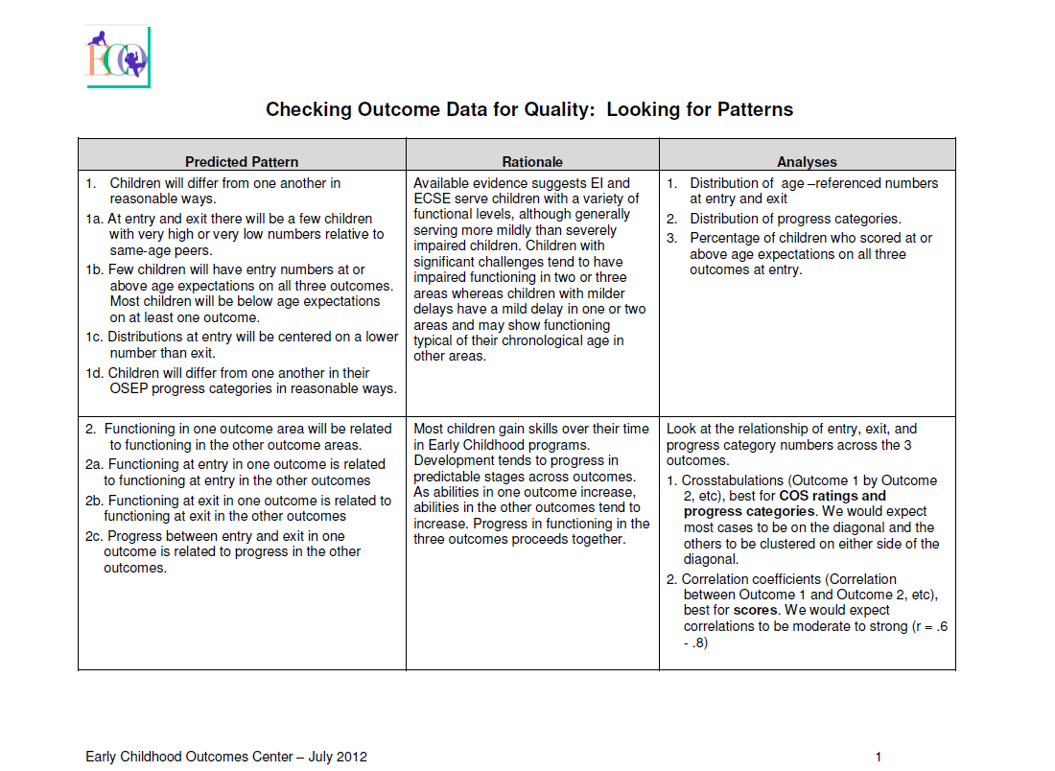
Pattern Checking for Data Quality
Strategies for using data analysis to improve the quality of state data by looking for patterns that indicate potential issues for further investigation.
http://ectacenter.org/~pdfs/eco/pattern_checking_table.pdf
Notes:
For those familiar with the tool…. Note has been updated about a year ago, including with a focus on summary statements (weren’t in the original).

Slide 7
Predicted Pattern
3b. Large changes in status relative to same age peers between entry and exit from the program are possible, but rare.
Notes:
(e.g. COS rating increases of 4 or more = large change – mentioned in later slide)

Slide 8
Rationale
Most children served in EI and ECSE will maintain or improve their rate of growth in the three child outcomes areas over time given participation in intervention activities that promote skill development.
Notes:
Helps explain why we expect to see the identified pattern. Others might agree or disagree with the rationale and choose to focus on the pattern or not. But many of the patterns included are based on rationales that most people agree with.

Slide 9
Analysis
1. Crosstabs between entry and exit ratings for each outcome, best for COS ratings.
2. Exit minus Entry numbers.
For COS ratings we would expect most
cases to increase by no more than 3 points.
Question: Is the distribution sensible?
Notes:
1. Crosstabs between entry and exit ratings
for each outcome, best for COS ratings.
We would expect most cases to be on the
diagonal or small positive changes.
2. Exit minus Entry numbers. For COS
ratings we would expect most cases to
increase by no more than 3 points. For
standard scores we would expect most
cases to increase by no more than 14
points.

Slide 10
Outcome 3: Crosstabs Between Entry and Exit Ratings
 | Entry
Exit | 1 | 2 | 3 | 4 | 5 | 6 | 7 | total
1 | 1 | 4 | 2 |  |  |  |  | 7
2 | 1 | 1 | 5 | 6 | 9 | 3 | 1 | 26
3 |  | 2 | 15 | 14 | 27 | 19 | 6 | 83
4 |  | 4 | 4 | 21 | 39 | 28 | 12 | 108
5 |  | 1 | 12 | 14 | 71 | 86 | 48 | 232
6 |  | 1 |  | 3 | 21 | 48 | 63 | 136
7 |  |  |  | 2 | 18 | 23 | 56 | 99
Review Total | 2 | 13 | 38 | 60 | 185 | 207 | 186 | 691
Notes:
10

Slide 11
Outcome 1: Children that increased by 4 or more points from entry to exit
Notes:
11
Looks a little too perfect, can we mix it up (either local numbers or the bars). Or just say that numbered programs after you rank ordered them.

Slide 12

Analyzing Child Outcomes Data for Program Improvement
Quick reference tool
Consider key issues, questions, and approaches for analyzing and interpreting child outcomes data.
http://www.ectacenter.org/~pdfs/eco/AnalyzingChildOutcomesData-GuidanceTable.pdf

Slide 13


Steps in Using Data for
Program Improvement
Defining Analysis Questions
Step 1. What are your crucial policy and programmatic questions?
Step 2. What is already known about the question?
Clarifying Expectations
Step 3. Describe expected relationships with child outcomes.
Step 4. What analysis will provide information about the relationships? Do you have the necessary data for that?
Step 5. Provide more detail about what you expect to see. With that analysis, how would data showing the expected relationships look?
Notes:
After feeling pretty good about data quality.
Describes an approach for looking at your data and using it for program improvement. See figure on page…
Key process repeated.
Question: Where is the idea of ‘what data do you have’ or ‘what is realistic given the data’?

Slide 14


Steps in Using Data for
Program Improvement
Analyzing Data
Step 6. Run the analysis and format the data for review.
Testing Inferences
Step 7. Describe the results. Begin to interpret the results. Stakeholders offer inferences based on the data.
Step 8. Conduct follow-up analysis. Format the data for review.
Step 9. Describe and interpret the new results as in step 7. Repeat cycle as needed.
Data-Based Program Improvement Planning
Step 10. Discuss/plan appropriate actions based on the inference(s).
Step 11. Implement and evaluate impact of the action plan. Revisit crucial questions in Step 1.
Notes:
After feeling pretty good about data quality.
Describes an approach for looking at your data and using it for program improvement. See figure on page…
Key process repeated.
Question: Where is the idea of ‘what data do you have’ or ‘what is realistic given the data’?

Slide 15
Defining Analysis Questions
What are your crucial policy and programmatic questions?
Example:
1. Does our program serve some children more effectively than others?
  Do children with different racial/ethnic backgrounds have similar outcomes?

Slide 16
Clarifying Expectations
What do you expect to see?
Do you expect children with racial/ethnic backgrounds will have similar outcomes? Why? Why not?

Slide 17
Analyzing Data
Compare outcomes for children in different subgroups:
    a. Different child ethnicities/races (e.g. for each outcome examine if there are higher summary statements, progress categories, entry and/or exit ratings for children of different racial/ethnic groups).

Slide 18
Outcome 1: Summary Statements by Child’s Race/Ethnicity
Notes:
What is the evidence? Is it what you expected?
What is the inference or interpretation?
What might be the action?

Slide 19
Outcome 1: Progress Categories by Child’s Race/Ethnicity
Notes:
What is the evidence? Is it what you expected?
What is the inference or interpretation?
What might be the action?

Slide 20
Describing and Interpreting Results
Is the evidence what you expected?
What is the inference or interpretation?
What might be the action?
Notes:
Provide more detail about some of the specific kinds of questions to get you started looking at these three.

Slide 21
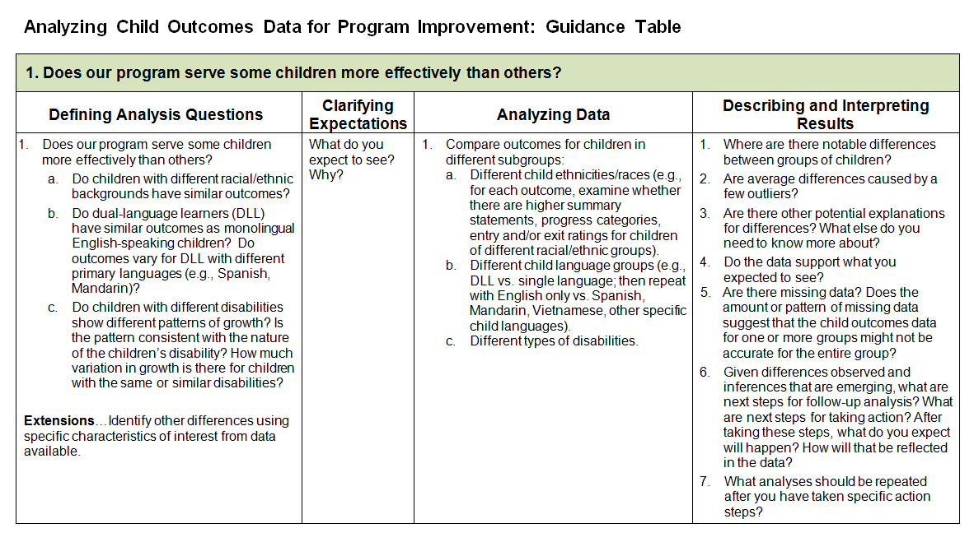
Guidance Table
Notes:
Analyzing Child Outcomes Data for Program Improvement: Guidance Table

Slide 22


Slide 23



Using Data for State &
Local Improvement
Wisconsin’s Part B
Ruth Chvojicek – WI Statewide Part B Indicator 7 Child Outcomes Coordinator

Slide 24
Key Points About Wisconsin’s System
Sampling strategy until July 1, 2011
Part B Child Outcomes Coordinator position funded through preschool discretionary funds – focus on training and data
Statewide T/TA system with district support through 12 Cooperative Educational Service Agency’s – Program Support Teachers

Slide 25
Notes:
Two years ago
Pattern Checking Table – Big red flag when looking at Outcomes 1 & 3 had to dig into data to see what was causing this.
Realized needed to work on data quality before could start using data to look at other trends

Slide 26
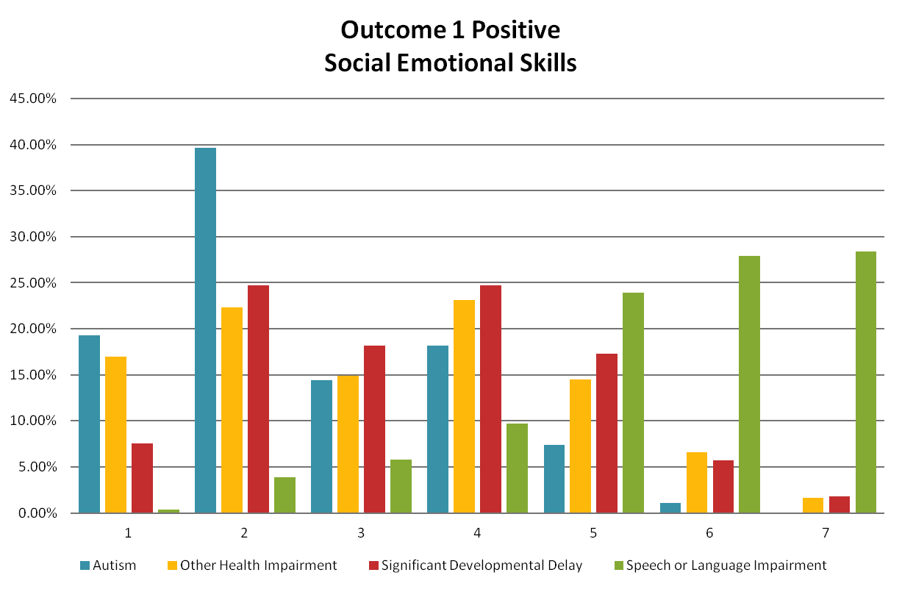
Notes:
When broke down data by disability area it was clear what was driving the data – Children identified as S/L. (Show all three outcome slides).
Did several things statewide to address this:
In annual ec indicator training heavy focus on accurate rating. Gave districts snapshot of their data. Showed this graph and explained it was how s/l children were being rated.
Conducted statewide webinar specifically for s/l. Showed this data, reviewed how to rate – used bucket list. Also discussed eligibility determination criteria for s/l. In WI have to justify impact of child’s s/l skills on ability to function successfully. To do this need to conduct observation/functional assessment which is useful for accurate rating and to determine eligibility accurately. This webinar and this point hit home for a lot of people. It was seeing the data the helped them to realize the need for better functional assessment and more accurate determination of eligibility.
Conducted data reviews throughout state to give individual districts opportunity to analyze data in their own district. (Will talk more about this after Germantown.) Purpose to enhance data quality but ultimately it opened the door to more conversations about:
Eligibility – primarily SDD vs S/L - also Autism and CD – discussions about having tough conversations with parents
Formative Assessment
Looking at functioning of the whole child in an integrated way.

Slide 27
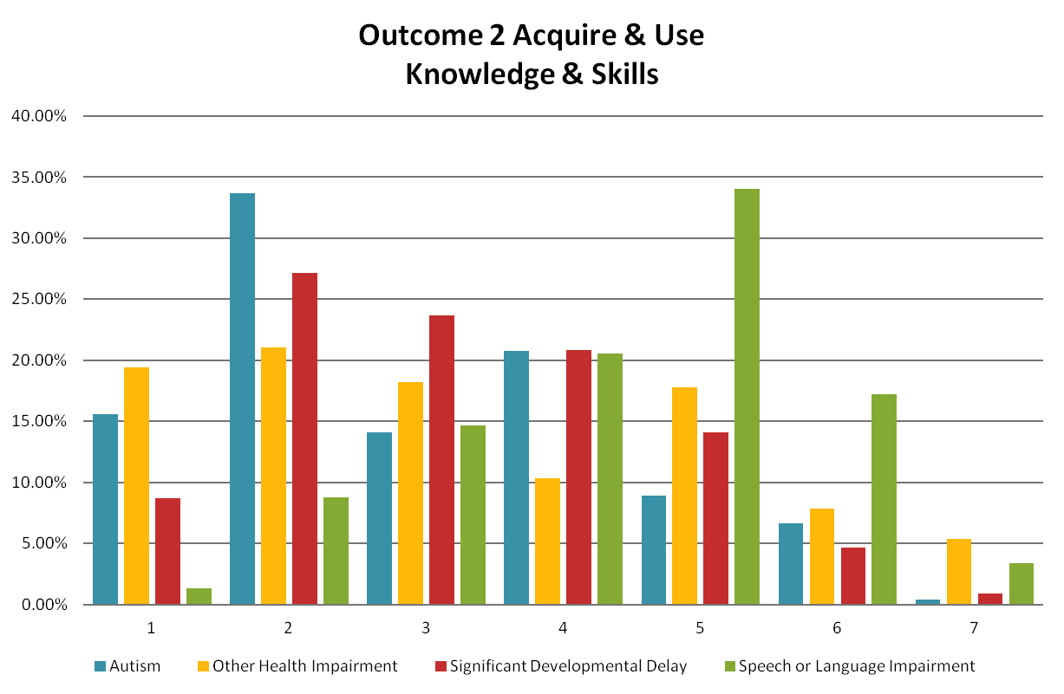

Slide 28
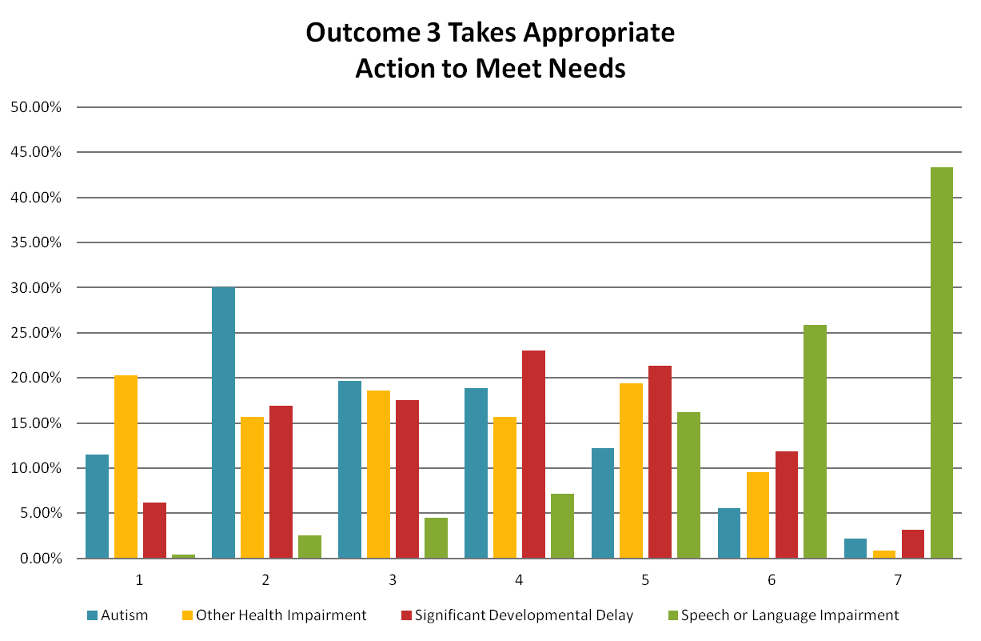

Slide 29


Germantown School District – Lesson’s Learned
Jenni Last – Speech Language Pathologist
Lisa Bartolone
School Pyschologist
Notes:
Attended Indicator Training – received Germantown Data Snapshot (entry rating distribution for 11-12 by eligibility determination) and realized had to do something
Pulled together all staff to discuss process for how they gathered information from parents and as a result:
Shifted staff so S/L staff had time to connect with parents
Created parent questionnaire to gather info from parents if couldn’t meet in person
Jenni’s comment, “Biggest thing this discussion did was that it changed how we looked at children. Staff now looking at children in a more functional, integrated way as opposed to the silos of looking at developmental domains.
Team participated in Data Review – Jenni’s comment, “This isn’t rocket science – we just have to understand the three outcome areas and be intentional about what we ask parents about their child’s development. It’s helped me develop more functional goals for children and think more holistically about my s/l children.”

Slide 30
Result of Germantown’s work in just 2 years

Slide 31
Germantown – Outcome Two

Slide 32
Germantown – Outcome Three

Slide 33
State Progress in Two Years – Outcome One

Slide 34
State Progress – Outcome Two

Slide 35
State Progress – Outcome Three

Slide 36
BUT … Outcome One Exit Rating

Slide 37
Outcome Three
Notes:
This tells us part of our work for 13-14 school year to work with districts on exit teams, e.g. Who is the team?; What data does the district have at exit?, etc.

Slide 38
Wisconsin Part B Data Reviews
11-12 – Piloted process individually with 20 districts
  Discovered differences in how districts were determining eligibility S/L and SDD
  Two districts who used criterion referenced tool consistently AND provided PD on using tool showed more appropriate pattern than other 18 districts
  Next steps identified by districts:
    Mentoring and pd for new staff
    More attention to formative assessment process
    Work on internal data tracking system

Slide 39
Wisconsin Part B 12-13 Data Review
Looked at 8 data patterns including:
  Entry Rating Distribution
  Entry Rating Distribution by Disability*
  Comparison Entry Ratings by Outcome
  Exit Rating Distribution
  Entry / Exit Comparison*
  Race/Ethnicity Comparison*
  State Progress Categories*
  Summary Statements*
Notes:
*Entry rating by distribution – districts realized they were not doing functional assessment of whole child for s/l children
*Entry/Exit Comparison – different teams rating children at exit and didn’t have as thorough training. More data on Outcome 2 at exit
*Race/Ethnicity – Saw difference statewide and had to drill down further
*State Progress Categories – When saw how WI compared to other states it “hit home” and realized it was a WI thing and we needed to do something different.

Slide 40
Looking at Race/Ethnicity

Slide 41
Notes:
Hypothesized this was coming from the Southeast part of the state where there is the most diversity (Milwaukee, etc)

Slide 42
Notes:
But, when we pulled out their data, our hypothesis wasn’t true.

Slide 44
Trying out the New Tool -
Do Children with Specific Types of Disabilities Show Different Patterns of Growth?

Slide 45
Do Children with Specific Types of Disabilities Show Different Patterns of Growth?
Notes:
Looking at Autism – when looking at the Outcome 1 % of 17.3% seemed very discouraging. Was this what we would expect?
But (next slide)

Slide 46
Do Children with Specific Types of Disabilities Show Different Patterns of Growth?
Notes:
If you look at the progress made we see that even though only 17% made substantial growth – overall – 53% (over half of the children) did make growth (Prog Cat C) and if you combine C, D, and E it tells us that 70.7% of children with Autism made growth. Of those children, 17.3 exited functioning at a level comparable to same age peers!

Slide 47
Do Children with Specific Types of Disabilities Show Different Patterns of Growth?

Slide 48
Do Children with Specific Types of Disabilities Show Different Patterns of Growth?

Slide 49
Wisconsin Next Steps
Looking at the data – does the type of setting impact the progress children make? (District level analysis)
As a state T&TA system, we’re operating as a PLC to guide the work and support the District
  What will the Districts want to focus on? E.g. settings, race/ethnicity, curriculum use

Slide 50
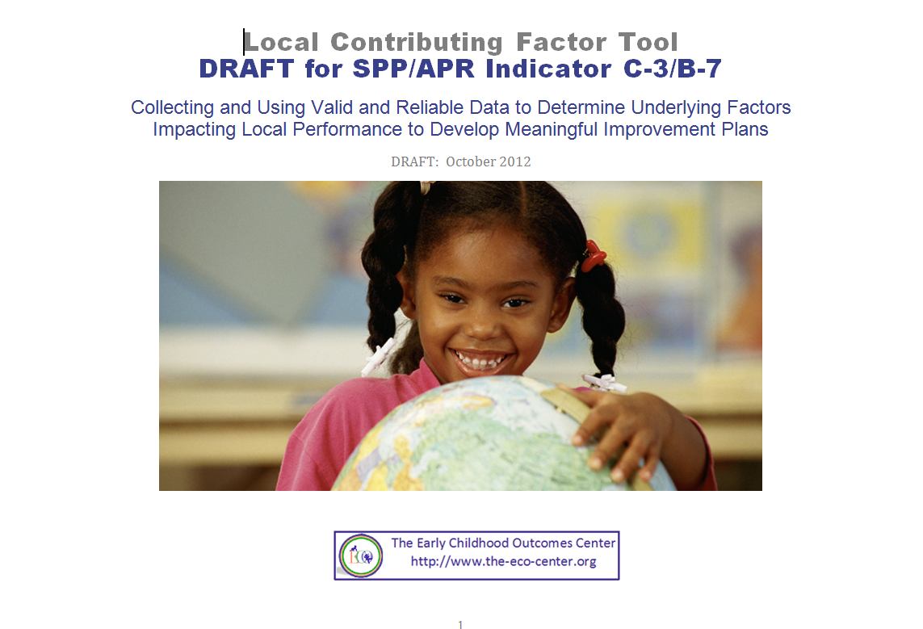
Local Contributing Factors Tool
Provides ideas for the types of questions a local team would consider in identifying factors impacting performance.
http://www.ectacenter.org/~meetings/outcomes2012/Uploads/ECO-C3-B7-LCFT_DRAFT-10-19-2012.docx

Slide 51
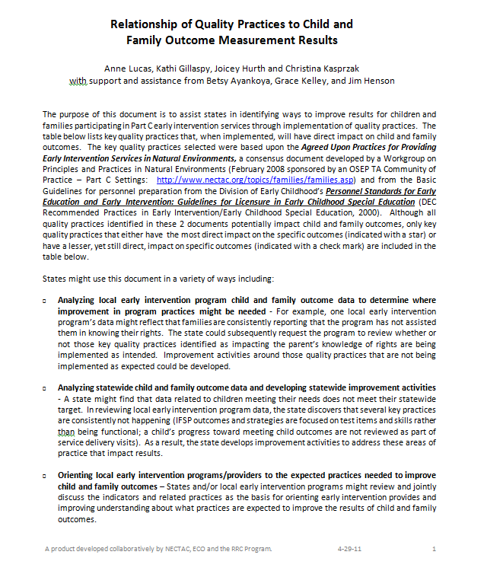
Relationship of Quality Practices to Child and Family Outcome Measurement Results
Designed to assist states in identifying ways to improve results for children and families through implementation of quality practices.
http://ectacenter.org/~docs/eco/QualityPracticesOutcomes_4-29-11-Final.doc
51

Slide 52
Next Steps?
Try out using these resources
Send feedback to ECO Center about the new Analysis tool
What are your ‘take aways’ and next steps related to analyzing your data for data quality and/or program improvement? (notes for State Team time)
52

Slide 53

Find more resources at: http://www. the-eco-center-org

