Slide 1
Perspectives from Implementation Science: Implications, Tools and Resources for Systems Change and Improving Services
Kathy Whaley & Joicey Hurth,
Early Childhood TA Center
Oscar Fleming & Melissa K. Van Dyke
National Implementation Research Network
Frank Porter Graham Child Development Institute
University of North Carolina, Chapel Hill
Improving Data, Improving Outcomes September 15 - 17, 2013

Slide 2
We Are A New Center!
NECTAC
Early Child Outcomes Center (ECO)
TACSEI
CELL
PACER

Slide 3
Integrated ECTA Initiatives
How can we best support states’ success in identifying, implementing, scaling up, and sustaining effective practices.
Implementation of Effective Practices
and
Positive Outcomes for Young Children with Disabilities and their Families
System Framework: Components and quality indicators of an effective system
DEC Recommended Practices: Effective practices for supporting children and families
Implementation Process: The science of implementation and sustainability
+
+
=

Slide 4
Charge to ECTA Center Implementation Process Team
Knowledge development
What does the field need that is not available?
2. Technical Assistance (TA)
Generalized (anyone and everyone)
Targeted (individual states or small groups)
Intensive (specific selected states over time)
3. Topics for TA (examples)
Implementation Process in general
OSEP Results-driven Accountability – State Systemic Improvement Plan (SSIP)
Notes:
Barbara

Slide 5
Back ground & Foundation for Implementation Informed TA
NECTAC Model of Long term System Change
NIRN & SISEP
TACSEI Implementation of Pyramid Model of Positive Social & Emotional Supports
Implementation Science Literature

Slide 6
Availability of fine work, tools, resources, web sites and publications serve as part of our work context!

Slide 7
Implementation Processes Build Capacity
Implementation of a practice necessitates building infrastructure capacity to support those practices.
Conversely, strengthening infrastructure components can support the adoption and spread of effective practices.
Implementation processes can guide both strengthening of systems components and adoption and spread of effective evidence-based practice.
Implementation work is intense and takes time. This investment puts structures and procedures in place that will be supportive of the next change – no longer are you implementing siloed changes.

Slide 8
System Framework
Standards
Finance
Implementation of Effective Practices
Monitoring & Accountability
Governance
Data
Personnel

Slide 9
Implementation Process Guidance
Developing Systems Capacity
Recommended Practice/ Evidence –Based Practice

Slide 10
Overview: Stages & Steps in the Implementation Process
Exploration
Installation
Initial Implementation
Implementation
Expand & Sustain

Slide 11
Exploration – Desired Outcomes
Stakeholder group established
Needs assessment & desired outcomes
Determine Fit of potential new practices/changes with mission, values and resources
Inform constituents of changes, and benefits
Analysis of current practices & infrastructure & necessary changes
Practices selected to addresses needs and likely to result in desired outcomes.
Necessary agency (and /or cross agency) leadership is committed
The decision to move ahead into implementation was made.

Slide 12
Installation – Desired Outcomes
A state leadership team is guiding the implementation process.
Mission and value statements and other concise descriptive materials are available to assure regular communication and support for the new initiative.
System capacity is strengthened - communication structures, T&TA, and data systems, etc.
A written Implementation, Scale-up and Sustainability Plan has been developed and is “in use” by the State Leadership Team.

Slide 13
Initial Implementation – Desired Outcomes
Local Implementation Teams provided oversight to activities at all sites.
Practices were implemented.
Training and coaching assured increasing level of fidelity.
Data were used to inform and improve all aspects of implementation.
Systemic changes and organizational supports were added to support the practices.
Implementation of new practices began to show expected results.

Slide 14
Full Implementation – Desired Outcomes
Practices successfully implemented with fidelity.
Outcomes show intended results.
Training TA and coaching procedures and materials are effective = fidelity
Systemic issues were resolved and the system has the capacity to support the practices.
Each site is sustaining fidelity of practice, and able to adjust for unintentional “shift”.
The State Leadership Team is ready to expand to new Implementation Sites.

Slide 15
Expansion: Scaling Up New Practices
Practices are expanded to new sites with necessary supports.
Expectations for performance are in job descriptions and supervision activities.
On-going training and coaching continues and are “institutionalized” in orientation activities, regular performance assessments, targeted TA and supervision practices.
Supportive organizational structures are in place (leadership, policies, procedures funding, data systems and continuous feedback loops for problem solving)
State-wide compliance and on-going monitoring provides checks on fidelity and achievement of desired outcomes.

Slide 16
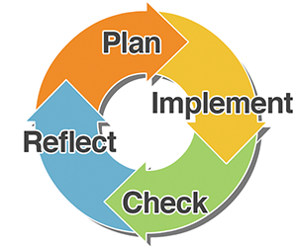
Continuous Improvement of Infrastructure Components

Slide 17
Additional Resources
ECTA- ECO module: Implementing an Integrated Child and Family Outcomes and IFSP/IEP Process
NECTAC module: Implementing and Sustaining an Effective Service Delivery Model
Stages and Steps in the Implementation Process (coming soon)
NIRN, SISEP, Hub Resources and Modules

Slide 18
Notes:
http://ectacenter.org/effectiveservicedelivery/splash.asp

Slide 19
Notes:
http://ectacenter.org/effectiveservicedelivery/stage1/intro.asp

Slide 20
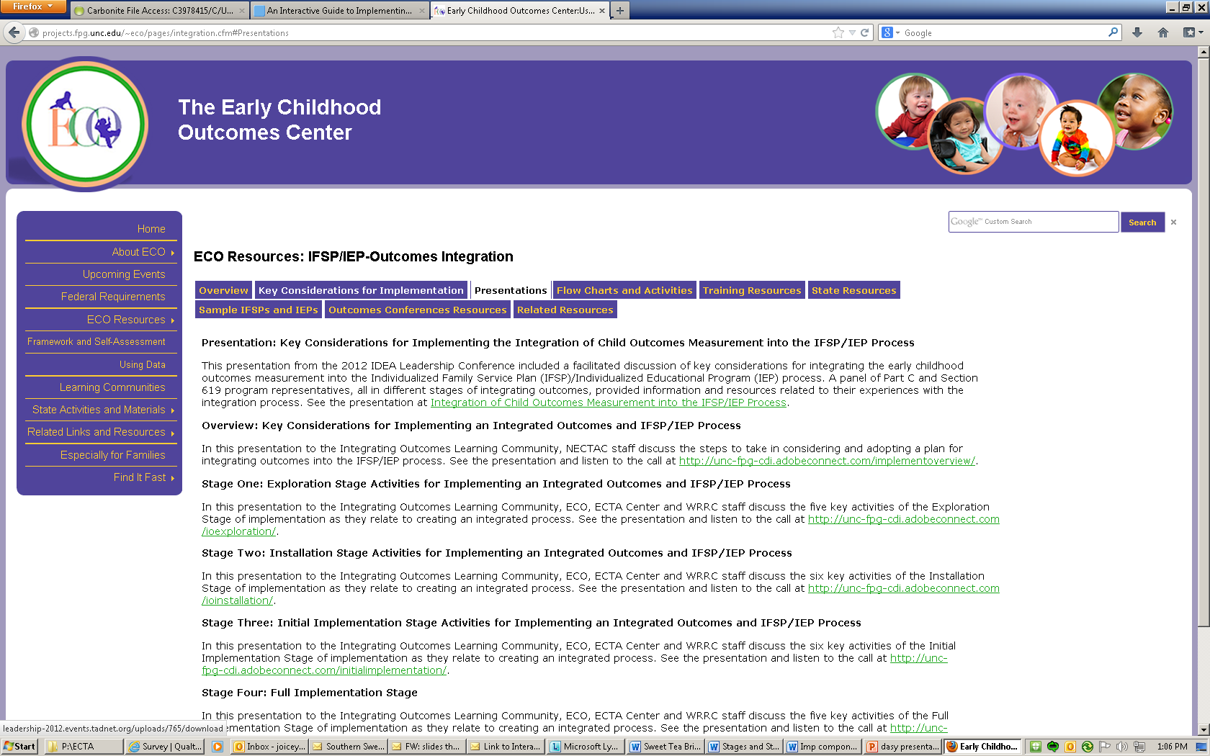
Notes:
http://projects.fpg.unc.edu/~eco/pages/integration.cfm#Presentations

Slide 21
Notes:
http://ectacenter.org/implementingintegrated/default.asp

Slide 23
Making It Happen
Key Implementation Lessons
What doesn’t work
What works
Active Implementation
Matching intensity of supports to complexity of intervention
Investing in scale-worthy interventions
Building capacity (Early Learning Challenge Race to the Top)
Resources

Slide 24
The Challenge
Active Implementation
Letting “innovation” happen. . .
Innovation occurs without intervention
Helping “innovation” happen. . .
Interested innovators figure it out on their own
Making “innovation” happen. . .
Active use of strategies to support the adoption of the innovation
Active installation of supports for the implementation of the innovation

Slide 25
Current Systems/Process
Vision of Future Systems/Process
Transition
Systems/Process
Use New, Effective Practices
Develop Implementation Infrastructure
Change System
The current system is designed “intentionally or unwittingly to achieve precisely the results it gets”*
* Quotation attributed to R. Spencer Darling
National Implementation Research Network, 2012

Slide 26
The Challenge
Assessing the Desired Outcome
Are new skill sets required?
Is practice change required at multiple levels?
Are changes in functional organizational supports required?
Is new thinking and acceptance of new ideas required?
Are changes in local infrastructure required to support practice change (training, coaching, performance assessment)?
Are policy changes required at multiple levels?
Is broad systems change required to achieve the desired outcomes?

Slide 27
Matching TA to Desired Outcomes
Matching TA to Desired Outcomes
Intensive TA
Blended Intensive and Basic TA
Basic TA
Systems Change
Capacity Building
Knowledge
Information
Attitudes
Blase, 2009

Slide 28
The Challenge
Is this intervention Scale-worthy?
Scale-worthy Interventions
WHAT interventions qualify for statewide support?
Criteria used by State Leaders to decide when to use the infrastructure for implementation to support widespread use of an evidence-based program or other worthy intervention
Fit with core goals and vision
Scope to impact early childhood outcomes
Research to demonstrate effectiveness
Implementation supports developed and demonstrated to be effective

Slide 29
Scale-worthy Interventions
Clear description of the program
Philosophy, values, principles (guidance)
Inclusion – exclusion criteria (beneficiaries)
Clear essential functions that define the program (core components)
Operational definitions of essential functions (practice profiles; do, say)
Practical performance assessment (highly correlated with outcomes)
Notes:
29
Fixsen, D., Blase, K., Metz, A., & Van Dyke, M. (2013). Statewide implementation of evidence-based programs. Exceptional Children (Special Issue), 79(2), 213-230.

Slide 30
Building State Capacity
Organized, Expert Assistance
State Leadership Team
State Implementation Team
Local/ Regional Leadership Team
Local/ Regional Leadership Team
Local/ Regional Leadership Team
Local/ Regional Leadership Team
Local/ Regional Implementation Team
Local/ Regional Implementation Team
Local/ Regional Implementation Team
Local/ Regional Implementation Team

Slide 31
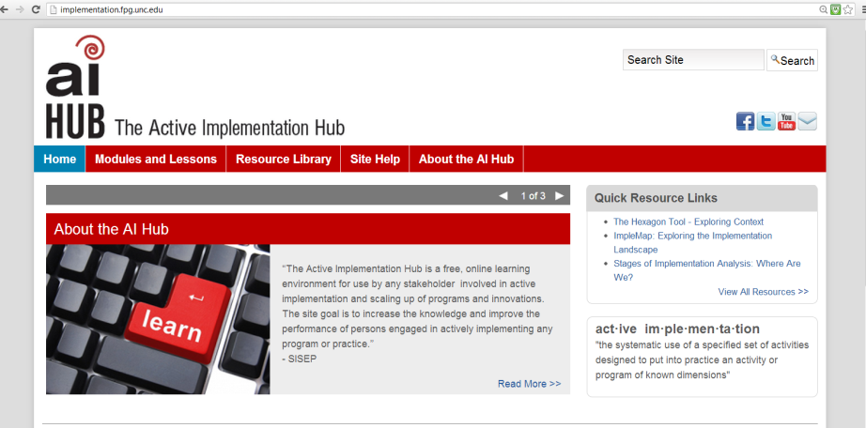
Resources
For more information, go to:
http://implementation.fpg.unc.edu/sites/implementation.fpg.unc.edu/files/resources/AIHub-Handout2-DevelopingPracticeProfileGuide.pdf
Notes:
31
Fixsen, D., Blase, K., Metz, A., & Van Dyke, M. (2013). Statewide implementation of evidence-based programs. Exceptional Children (Special Issue), 79(2), 213-230.

Slide 32
Goals for Today’s Session
Summary
Socially Significant Outcomes through the Active Use of Effective Implementation Strategies --
Scale-worthy interventions or approaches
A change process that embeds and sustains the effective, well-defined intervention in a real-world setting
“stage-matched” activities to guide the process
“implementation drivers” to build the infrastructure
Improvement processes that shape the context to support the effective intervention
Intentional development of in-state capacity; implementation teams to “make it happen”

Slide 33
Goals for Today’s Session
For More Information
Oscar Fleming
oscar.fleming@unc.edu
Melissa Van Dyke
melissa.vandyke@unc.edu
Frank Porter Graham Child Development Institute
University of North Carolina
Chapel Hill, NC
http://nirn.fpg.unc.edu/
www.scalingup.org
www.implementationconference.org

Slide 34
Implementation Science
Implementation Research:
A Synthesis of the Literature
Fixsen, D. L., Naoom, S. F., Blase, K. A., Friedman, R. M. & Wallace, F. (2005). Implementation Research: A Synthesis of the Literature. Tampa, FL: University of South Florida, Louis de la Parte Florida Mental Health Institute, The National Implementation Research Network (FMHI Publication #231).
HTTP://NIRN.FPG.UNC.EDU
Notes:
34

Slide 35
©Copyright Dean Fixsen and Karen Blase
This content is licensed under Creative Commons license CC BY-NC-ND, Attribution-NonCommercial-NoDerivs. You are free to share, copy, distribute and transmit the work under the following conditions: Attribution — You must attribute the work in the manner specified by the author or licensor (but not in any way that suggests that they endorse you or your use of the work); Noncommercial — You may not use this work for commercial purposes; No Derivative Works — You may not alter or transform this work. Any of the above conditions can be waived if you get permission from the copyright holder.
http://creativecommons.org/licenses/by-nc-nd/3.0

Slide 36
Thank You for Your Support
Annie E. Casey Foundation (EBPs and Cultural Competence)
William T. Grant Foundation (Implementation Literature Review)
Substance Abuse and Mental Health Services Administration (Implementation Strategies Grants; National Implementation Awards)
Centers for Disease Control & Prevention (Implementation Research)
National Institute of Mental Health (Research And Training Grants)
Juvenile Justice and Delinquency Prevention (Program Development And Evaluation Grants)
Office of Special Education Programs (Scaling up and Capacity Development Center)
Administration for Children and Families (Child Welfare Leadership; Capacity Development Center)
Duke Endowment (Child Welfare Reform)

Slide 37
Discussion: What do you Think About all This?
What stands out to you about the implementation process and resources that you’ve seen today?
What about this work is interesting or worrisome to you?
What are implications for your work back home?
Are any of you involved in system’s change process using a systematic implementation process? How is the work going?
What other resources, tools guidance would be helpful?
Notes:
Joicey
Prompts what does the field need
How can The ECTA work complement or enhance your work?

