Slide 1
Including IDEA Services and Programs into State TQRIS Systems ()
Andy Gomm, Part C Coordinator
New Mexico Family Infant Toddler (FIT) Program
State Department of Health/DDSD
Verna Thompson, Interim Director, Early Development and Learning Resources/ IDEA 619 Coordinator
Delaware Department of Education
Moderator: Shelley deFosset
ELC TA

Slide 2
Agenda
National Context and Overview of TQRIS
Perspectives from DE and NM
Panel Discussion
Questions and Discussion

Slide 3
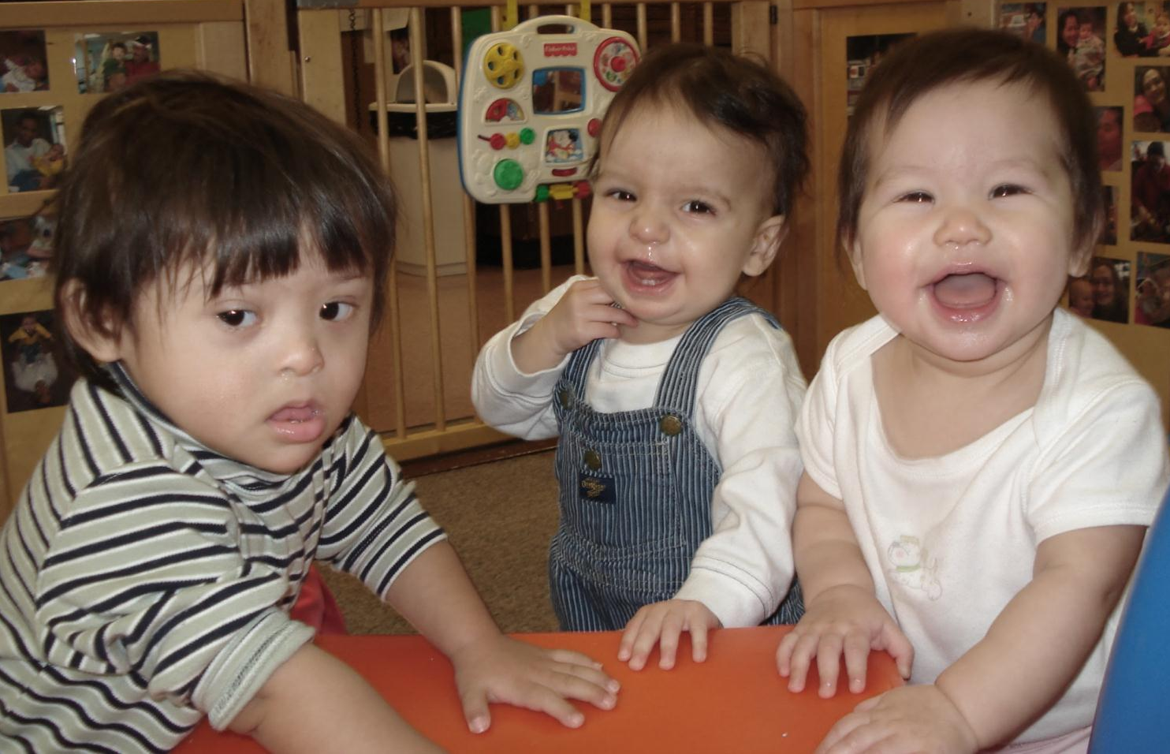
National Context Focus on High Needs Children

Slide 4
National Context Focus on Cross Sector Systems Building

Slide 5
National Context Accountability & Quality
Notes:
For whole or small group discussion.
Participants or presenters may wish to record responses on posters or dry erase boards.

Slide 6
Quality Movement = Multiple Quality Initiatives
Head Start Performance
Framework
OSEP Monitoring and
Accountability
licensing
QRIS
ELG
program standards
Accreditation Criteria
Personnel Standards

Slide 7
Two Different Initiatives
Quality Inclusion
QRIS
US DOE OSEP State Performance Plan Annual Report (SPP APR)
Notes:
States will be asked to provide status of QRIS using Benchmarks of Quality Improvements

Slide 8
What Is QRIS?
Varies from state to state with most states participating at some level
Common elements include
Quality standards
Process for assessing standards
Outreach and support to programs to raise quality
Financial incentives
Consumer awareness
8

Slide 9
What Is QRIS (cont.)?
A method to assess, improve, and communicate the level of quality in early and school-age care settings
May also be called a Tiered Quality Rating and Improvement System (TQRIS)

Slide 10
What Does QRIS Look Like?
Builds on foundation of licensing and adds multiple steps between licensing standards and higher quality standards
Offers supports/incentives for reaching higher levels
Provides easily recognized markers for higher levels

Slide 11
APR Indicator C2 State data on Infants and toddlers with disabilities collected and reported to congress.
Includes % of infants and toddlers with IFSPs who primarily receive early intervention services in the home or community-based settings
Documents the extent to which early intervention services are provided in “natural environments”. Natural environments are settings that are either home-based or community based.
States must identify targets for increases in % in natural environments, identify improvement activities and explain state progress.

Slide 12
APR Indicator B6 State data on children with disabilities and their families collected and reported to Congress
Includes % of preschool children with disabilities receiving services in regular early childhood programs (Least Restrictive Environment)
States must identify targets for increases in % in LRE, identify improvement activities, and explain state progress
Notes:
Verna - OSEP SPP APR does not indicators of quality.

Slide 13
Three Issues Related to an Inclusive Approach to Quality Within QRIS
Structures & incentives
Measurement
Professional development

Slide 14
States have been moving ahead with explicit references to including IDEA Program in their QRIS systems. Some examples include:
Indiana
Vermont
Pennsylvania

Slide 15
State Context re IDEA and QRIS Development in:
Delaware
New Mexico
FOCUS

Slide 16
Vexing Questions for Panelists

Slide 17
Questions and discussion

Slide 18
THANK
YOU

