Slide 1
Validity of the Child Outcomes Summary Process:
Updates from the ENHANCE Project
Lauren Barton, Cornelia Taylor,
Donna Spiker, Kathy Hebbler
September 15-17, 2013
Improving Data, Improving Outcomes Conference
Washington, DC
Notes:
Overview of ENHANCE: Research Underway on the Validity of the Child Outcomes Summary Form (COSF)
Are COSF data valid and reliable? This session will provide an overview of a research project underway to investigate the validity of the COSF. Plans for using information learned to provide better guidance about the COSF and implementing the COSF process will be shared. The group will discuss the kinds of validity information needed by States and specific content that might be important to investigate further in the studies
1

Slide 2

Today’s session
Brief overview of ENHANCE project
Update on status of each study and project-related resources
Describe some preliminary findings from the child assessments study
Discuss implications and potential state activities surrounding reliability and validity of COS process
Notes:
Progress of project efforts to investigate the validity of the Child Outcomes Summary process

Slide 3


Origin of ENHANCE
States identified need…
Notes:
July 1 2009

Slide 4

ENHANCE
Series of studies designed to find out:
  the conditions under which the Child Outcomes Summary (COS) Process produces meaningful and useful data for accountability and program improvement
  the positive and/or negative impact of the COS process on programs and staff
  what revisions to the form and/or the process are needed
Notes:
Project was funded by IES to meet the urgent need to know more about the valdity of the Child Outcomes Summary Process
Series of studies – focus on the child outcomes summary form
Conditions meaningful and useful COSF data
Impact of use on practice, pos or neg
Revisions or recommendations from that
For other audiences: ECO is a national center located at SRI that has been working with states – first to identify what outcomes to measure and then to support the development of effective systems to measure those outcomes so that data is available to guide decision-making at the state and national levels.

Slide 5

Four ENHANCE Studies
Comparison with Child Assessments
Team Decision-Making
Provider Survey
State Data Study
Notes:
5 studies, multiple years
So, let’s unpack this…. What does all this mean?
ENHANCE include 5 studies staggered across 3.5 years,
Studies use different methods to get at questions related to the COSF process.
Comparison COSF ratings with external child assessments
Video tape team decision making process where COSF ratings are decided
Online provider survey – opportunity, if interested, to share your input about the process you’ve observed and its impact on your work
ENHANCE staff come for on-site record reviews to relate COSF info to broader info in the file
Not at this program site, also analyze state COSF data to look for patterns
States if needed: IL, MN, ME, TX, NC, and one other Part C (probably NM)
IL, MN, ME, TX, and two others (NM, TN, VA, KS?)

Slide 6

Studies 1-3:
Project Data Collection Sites
Part C (Birth to 3)
Illinois
Maine
Minnesota
New Mexico
Texas
North Carolina
Virginia
Part B Preschool (3-5)
Illinois
Maine
Minnesota
New Mexico
Texas
South Carolina
Notes:
Data is being collected from 36 local programs or school districts in 7 states for the first 4 studies

Slide 7

Provider Survey
Get the Survey
http://enhance.sri.com/datacollection/data.html or
ECO website – last year’s conference handouts (ECO resources, presentations, 2012)
Related presentations posted on same web sites
Content
Training and knowledge of providers
How COS process is structured
Frequency of implementing recommended practices
Attitudes and implementation challenges
Perceived accuracy of the ratings
Impact of COS on practice
Notes:
Encourage to conduct own state surveys…

Slide 8

Provider Survey
Sample/Approach
All providers in the program who participate in the COS process are invited to participate in an online survey
Study Status
Data collected spring 2012
Initial analyses completed
856 providers, 19 EI and 15 ECSE programs in 8 states
Notes:
Impact on practice either positive or negative….

Slide 9
Selected Provider Survey Findings
Most receive COS training, variable length
Providers report understanding key concepts
¾ of providers complete most ratings in teams
Few think COS process has a negative impact on providers’ work
Providers receive limited monitoring, feedback, and support
Many providers don’t understand why data are collected and what happens with it
For 1/3 of providers, family input is not included in most COS ratings
Notes:
What we know is that any implementation effort has a lot of these characteristics…
How do others perceive this?
65% understood why COS data are
being collected
37% understood what happens with
the data
52% knew how to explain the need
for child outcomes data to others
Impact on practice neither positive or negative (68% neutral)….

Slide 10
Team Decision-Making Study
Approach
Videotape team meetings where COS completed
Code videos for quality indicators
Study Status
131 videos received from 13 EI and 9 ECSE sites in 7 states
Video coding is underway
Learning
About the implementation of the COS process, including how the team reaches a decision about a rating and what is discussed.
About team understanding of outcomes, rating criteria, and emphasis on describing child’s functioning
Gathering information for future guidance
Notes:
180 children each from Part C & Part B 619 ½ entry & ½ exit meetings
Self-appraisal or supervisors??

Slide 11

Useful Resources and Additional Information
http://enhance.sri.com/datacollection/data.html
  1 page overview of content being coded in Team Decision-Making videos
  Paper version of coding form in use
Codebook with specific information for coding – contact lauren.barton@sri.com

Slide 12
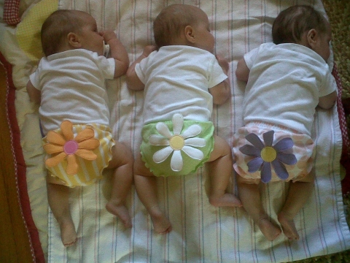
State Data Study
Approach
Analyze characteristics of COS data and relationships to other variables
Look for consistency in patterns across states
Examining data relative to first few claims shows some differences between EI and ECSE data.
Support found in both programs for relative stability in summary statements year to year.
Notes:
Patterns – in the distributions (see variability, expected amount of progress, etc), in the relationships with other variable, with state factors like % served, patterns in relationships of data between outcomes…

Slide 13


State Data Study
Sample and Status
All valid COS data within the state for a reporting year
9 Part B preschool and 6 Part C states have submitted their data or a series of analyses for comparison
Additional states sharing select analyses as they do them anyway for other purposes
Still accepting data from states. Participation involves sharing the data set used for APR analyses or a series of tables.
Notes:
Patterns – in the distributions (see variability, expected amount of progress, etc), in the relationships with other variable, with state factors like % served, patterns in relationships of data between outcomes…
Entire state level population on children birth-5 with disabilities served under IDEA

Slide 14

Comparison with Child Assessments
Instruments
  Abilities Index
  Child Outcomes Summary form
  BDI-2
  Vineland-II
Approach
  Compare COS ratings to BDI-2, Vineland-II scores
    Program Entry
    Program Exit
  Compare conclusions from COS and assessments

Slide 15



Looking Closely at the Study Design…

Slide 16
Might Expect to Compare COS to a “Gold Standard”

Slide 17
Key Differences from Other Concurrent Validity Study Mean…
No gold standard in this case…
Notes:
Showing one piece of the picture…
Ground this in challenge of concurrent validity… Is there a gold standard for the COS?? Is it appropriate to compare them? Best practices in assessment and multiple measures (combine and integrate across sources and settings, look at skills in a functional way). See child differently in accountability system with one or other tool. Neither one is perfect

Slide 18
Reasons COS and BDI-2 Would or Would Not Show Agreement
Would Agree
Overlapping content being assessed
Same child, similar time frame
Same family provides input in both approaches
Would Not Agree
Tools do not reflect the same content
BDI-2 uses domains; COS uses outcomes organization
Threshold variation for level of same-age peers and movement toward that level
Differences in emphasis on multiple settings and situations
Single score vs. multiple sources of information
Notes:
Some COS teams review results of BDI-2 as evidence
Methodological Differences From Other Validation Studies
Tools do not reflect the same content
BDI-2 and Vineland-II designed to measure domains, not outcomes
COS emphasis is on functional use of skills across settings
Tools not designed to identify progress categories Variation in algorithms for BDI-2/Vineland II conversion
Emphasis on validity of aggregate data for accountability decisions about programs rather than child-level

Slide 19

Expected Agreement Across Tools
How well do you think progress categories would map on to each other using different approaches (BDI-2 and COS)? Similar/different for…
  Children with various types of disabilities/patterns (e.g., younger children)
  Types of progress/ratings where expect more/less agreement (e.g., children close to typical developmental levels)
  Others?

Slide 20

Comparison with Child Assessments
Current Sample
  154 children (95 EI, 54 ECSE) Entry data
  51 children (31 EI, 16 ECSE) Entry-Exit data
Study Status
  Continue data collection through December
  See expected variability in sample (ages, disability types) and initial COS ratings/assessment scores
Today’s Focus
  Preliminary findings – longitudinal COS-BDI-2 data
  51 children (31 EI, 16 ECSE) Entry-Exit data

Slide 21
Sample Characteristics
Mean Age
Overall = 29 months (SD = 16.3, Range 3-63)
EI = 20 months (SD = 9.1, Range 3-34)
ECSE = 49.4 months (SD = 8..3, Range 36-63)

Slide 22
Sample Characteristics

Slide 23

Sample Characteristics
Notes:
(11 boys, 5 girls in ECSE)

Slide 24
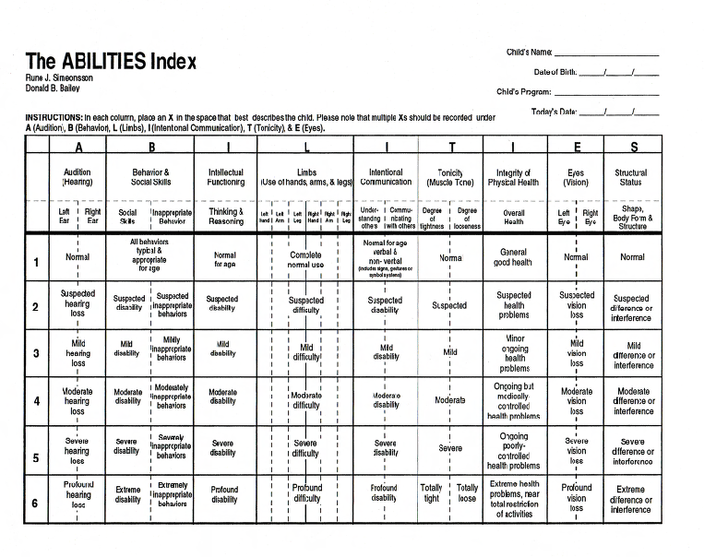
Notes:
9 areas of functional abilities and disabilities – describes..

Slide 25
Functioning at Entry - ABILITIES Index
Social/ Communication | BEHAVIOR & SOCIAL SKILLS Social skills Inappropriate behavior | INTENTIONAL COMMUNICATION Understanding Others Communicating with Others
Cognitive/ Communication | INTELLECTUAL FUNCTIONING Thinking and reasoning | INTENTIONAL COMMUNICATION Understanding others Communicating with others
Structural Integrity | LIMBS Use of each hand, arm, & leg STRUCTURAL STATUS Shape, body form, and structure | TONICITY Degree of tightness Degree of looseness
Integrity of Physical Health | OVERALL HEALTH
Sensory Capabilities | AUDITION Left and right ears | VISION Left and right eyes

Slide 26
Severity of Disability at Entry
Overall Sample (n = 51)
Overall Sample (n = 51) | Possible Min | Possible Max | Mean | SD | Median | Actual Minimum | Actual Maximum
Social/Communication | 4 | 24 | 9.3 | 4.2 | 9 | 4 | 21
Cognitive/Communication | 3 | 18 | 7.2 | 3.3 | 7 | 3 | 16
Structural Integrity | 8 | 48 | 12.8 | 5.8 | 11 | 9 | 36
Integrity of Physical Health | 1 | 6 | 1.4 | 1.0 | 1 | 1 | 5
Sensory Capabilities | 4 | 24 | 4.8 | 1.9 | 4 | 4 | 12
Total | 19 | 114 | 30.0 | 8.5 | 28 | 20 | 59

Slide 27
COS Rating Distributions – Entry (n=51)

Slide 28
COS Distributions – Exit (n=51)

Slide 29
COS Distributions – Entry Exit
Overall
Outcome 1: Positive Social Relationships
Crosstab showing numbers of children by rating at entry and exit
 | Exit
Entry | 1 | 2 | 3 | 4 | 5 | 6 | 7 | Grand Total
1 | 1 | 0 | 0 | 0 | 0 | 0 | 0 | 1
2 | 0 | 0 | 0 | 1 | 0 | 1 | 1 | 3
3 | 0 | 0 | 2 | 1 | 0 | 0 | 1 | 4
4 | 0 | 1 | 0 | 1 | 5 | 1 | 1 | 9
5 | 0 | 0 | 0 | 1 | 3 | 2 | 5 | 11
6 | 0 | 0 | 0 | 1 | 2 | 10 | 7 | 20
7 | 0 | 0 | 0 | 0 | 0 | 0 | 3 | 3
Grand Total | 1 | 1 | 2 | 5 | 10 | 14 | 18 | 51
Notes:
Look at the quality of the COS data…
Encourage states to do it.

Slide 30
COS Distributions – Entry Exit Overall
Outcome 2:
Crosstab showing numbers of children by rating at entry and exit
 | Exit
Entry | 1 | 2 | 3 | 4 | 5 | 6 | 7 | Grand Total
1 | 1 | 0 | 0 | 1 | 0 | 0 | 0 | 2
2 | 0 | 0 | 0 | 2 | 0 | 1 | 1 | 4
3 | 0 | 1 | 0 | 1 | 2 | 1 | 1 | 6
4 | 0 | 0 | 0 | 3 | 4 | 3 | 2 | 12
5 | 0 | 0 | 1 | 0 | 5 | 6 | 4 | 16
6 | 0 | 0 | 0 | 0 | 1 | 5 | 5 | 11
7 | 0 | 0 | 0 | 0 | 0 | 0 | 0 | 0
Grand Total | 1 | 1 | 1 | 7 | 12 | 16 | 13 | 51

Slide 31
COS Distributions – Entry Exit Overall
Outcome 3:
Crosstab showing numbers of children by rating at entry and exit
 | Exit
Entry | 1 | 2 | 3 | 4 | 5 | 6 | 7 | Grand Total
1 | 1 | 0 | 0 | 0 | 0 | 0 | 0 | 1
2 | 0 | 0 | 1 | 0 | 0 | 0 | 1 | 2
3 | 0 | 0 | 1 | 1 | 1 | 0 | 1 | 4
4 | 0 | 0 | 1 | 2 | 4 | 3 | 2 | 12
5 | 0 | 1 | 0 | 0 | 6 | 6 | 7 | 20
6 | 0 | 0 | 0 | 0 | 0 | 3 | 4 | 7
7 | 0 | 0 | 0 | 0 | 0 | 1 | 4 | 5
Grand Total | 1 | 1 | 3 | 3 | 11 | 13 | 19 | 51

Slide 32

Methods
BDI-2 subdomain mapping
  Positive social relationships: Personal Social
  Knowledge and skills: Communication & Cognitive
  Action to meet needs: Adaptive & Motor
Notes:
States that are using the BDI use different ways to calculate progress categories… This what we’re using. There are different ways we can categorize and this is what we did

Slide 33
Methods – Identifying Progress Categories on the BDI-2
 | Entry Standard Score | One or Both Subdomains | Exit Standard Score | One Both Subdomains | Change Standard Score | One or Both Subdomains | Raw Score Increase
e | > 84 | Both | > 84 | Both
d | < 84 | One | > 84 | Both | > 5 pts | One
c | < 84 | One | < 84 | Both | > 5 pts | One
b | < 84 | One | < 84 | Both | < 5 pts | Both | Yes
a | < 84 | One | < 84 | Both | < 5 pts | Both | No
Notes:
Progress categories not computed by BDI. Have to determine how to do that. Different states using it for accountability do it differently…

Slide 34

Positive Social Relationships
(n = 51)
$χ_{4 df}^{2}$ = 5.5
Instrument | SS1 | SS2
BDI-2 | 40% | 63%
COS | 63% | 64%
Difference | 23% (p>.05) | 1.3%(p>.05)
Notes:
Progress categories (not significant )
SS also not significant
Emphasis on aggregate because that is level use data in the accountability system

Slide 35

Knowledge and Skills
(n = 51)
$χ_{4 df}^{2}$ = 12.2*
Instrument | SS1 | SS2
BDI-2 | 57.5% | 33.3%
COS | 72.5% | 58.0%
Difference | 15% (p>.05) | 25% (p<.05)
Notes:
Progress category is significant
Not signif ss1, is signfi SS2
BDI less kids look typical on outcome 2 and fewer kids catching up…

Slide 36

Taking Action to Meet Needs (n = 51)
$χ_{3 df}^{2}$ = 8.74*
Instrument | SS1 | SS2
BDI-2 | 52.8% | 45.1%
COS | 75.0% | 66.7%
Difference | 22% (p<.05) | 22% (p<.05)
Notes:
Chi square 3 df because no kids in a

Slide 37


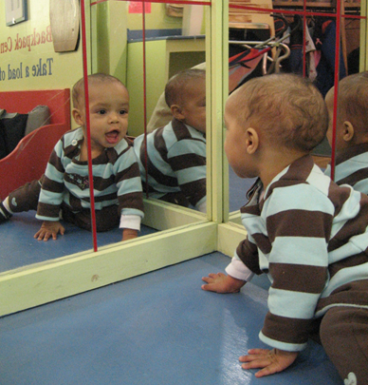
Child-Level Comparisons of Progress Categories
Notes:
Not the actual kids (or the actual names)..

Slide 38
Child-level comparison of progress categories
Knowledge and Skills – “Charlie B.”
 | a - BDI2 | b - BDI2 | c - BDI2 | d - BDI2 | e - BDI2 | COS - totals
a - COS | 0 | 0 | 0 | 0 | 0 | 0
b - COS | 1 | 4 | 3 | 0 | 3 | 11
c - COS | 1 | 3 | 4 | 0 | 2 | 10
d - COS | 0 | 4 | 7 | 4 | 4 | 19
e - COS | 0 | 3 | 3 | 2 | 2 | 10
I - COS |  | 1 |  |  |  | 1
BDI-Totals | 2 | 15 | 17 | 6 | 11 | 51

Slide 39
Charlie B.
Entry assessment completed at 22 months
Exit assessment completed 11 months later when Charlie was 33 months
Diagnosed with a developmental delay
On the COS Knowledge and Skills
  entry rating 5
  exit rating also a 5
Progress category on COS “b”
Progress category on BDI-2 “e”

Slide 40
“Charlie B.” Qualitative description
Exit, 33 months
Family is concerned because he rarely strings three words together and does not initiate using words.
Charlie B will answer yes and no questions.
Names colors and refers to himself by a pronoun.
He is beginning to follow two-step unrelated commands and identify more body parts.
He will attend to adult directed activities. He will attend to activities when spoken to by an adult.
He identifies matches and sorts colors and shapes. He will respond to size concepts of big and little.
He maintains focus on activities without becoming overly distracted.

Slide 41
Standard scores and COS ratings – “Charlie B.”
 | Entry | Exit
Communication | 84 | 88
Cognitive | 107 | 95
COS rating | 5 | 5
Notes:
BDI-2 e
COS b

Slide 42
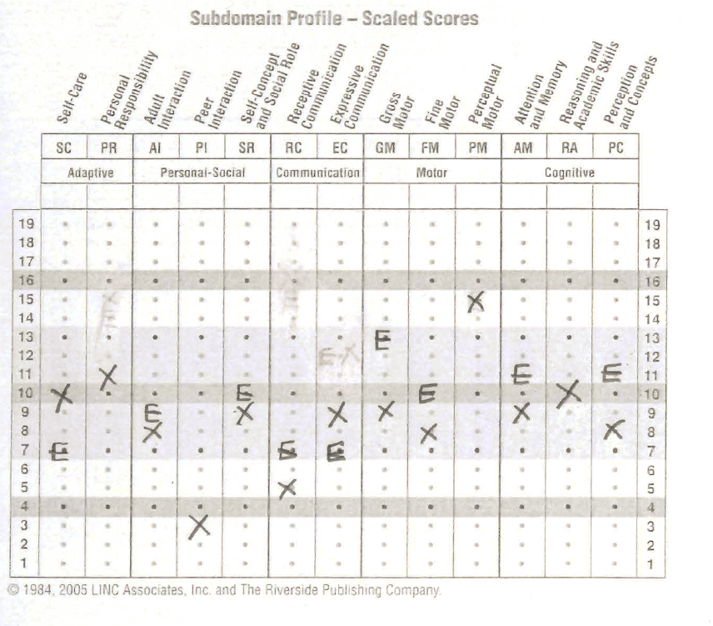
Entry
Exit
Only administered at exit
+2 SD
+1 SD
Mean
- 1 SD
- 2 SD

Slide 43

Reactions?

Slide 44
Child-level comparison of progress categories
Knowledge and Skills – Michael J.
 | a - BDI2 | b - BDI2 | c - BDI2 | d - BDI2 | e - BDI2 | COS - totals
a - COS | 0 | 0 | 0 | 0 | 0 | 0
b - COS | 1 | 4 | 3 | 0 | 3 | 11
c - COS | 1 | 3 | 4 | 0 | 2 | 10
d - COS | 0 | 4 | 7 | 4 | 4 | 19
e - COS | 0 | 3 | 3 | 2 | 2 | 10
I - COS |  | 1 |  |  |  | 1
BDI-Totals | 2 | 15 | 17 | 6 | 11 | 51

Slide 45
“Michael J.”
Entry assessment completed at 29 months
Exit assessment completed 8 months later when Michael was 37 months
Diagnosed with a developmental delay
On the COS Knowledge and Skills
  entry rating 4
  exit rating also a 5
Progress category on COS “c”
Progress category on BDI-2 “e”

Slide 46
Michael J. Qualitative description
Entry, 29 months
He responds to a variety of directions and knows his name.
He follows two-part directions.
He uses gestures and vocalizations to get his wants and needs met.
His speech is difficult to understand. His mother reports that others only understand him 10% of the time.

Slide 47
“Michael J.” Qualitative description Exit, 37 months
He is learning numbers, letter and colors.
He attempts to use words and phrases to communicate with others.
He has recently had a vocabulary explosion. He uses 1 – 7 word sentences.
His articulation errors make it difficult for others to understand him.
His mom estimates that she understands 80-85% of his speech when the context is readily available.

Slide 48
Standard scores and COS ratings – Michael J.
 | Entry | Exit
Communication | 100 | 102
Cognitive | 87 | 109
COS rating | 4 | 5

Slide 49
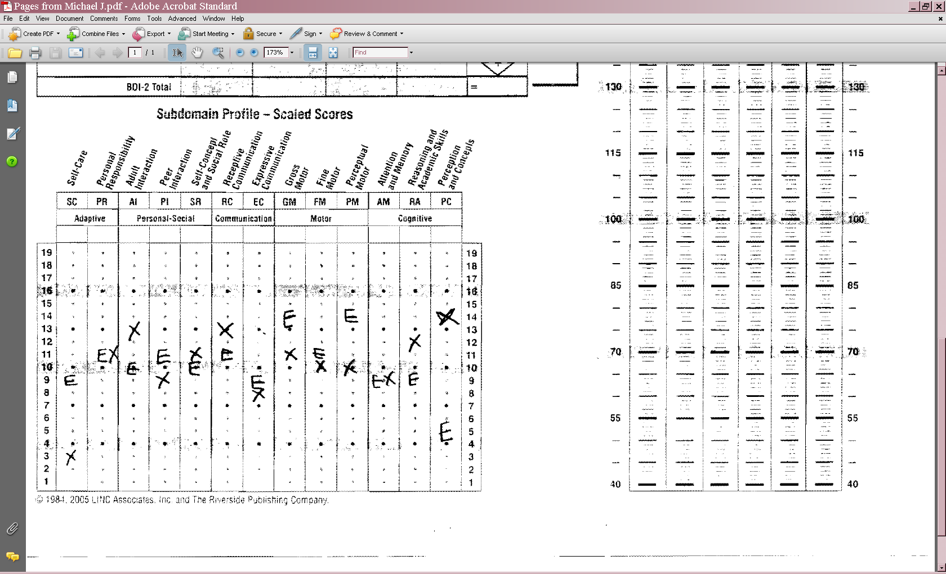
Entry
Exit

Slide 50
Reactions?

Slide 51
Child-level comparison of progress categories
Knowledge and Skills – Jenny A.
 | a - BDI2 | b - BDI2 | c - BDI2 | d - BDI2 | e - BDI2 | COS - totals
a - COS | 0 | 0 | 0 | 0 | 0 | 0
b - COS | 1 | 4 | 3 | 0 | 3 | 11
c - COS | 1 | 3 | 4 | 0 | 2 | 10
d - COS | 0 | 4 | 7 | 4 | 4 | 19
e - COS | 0 | 3 | 3 | 2 | 2 | 10
I - COS |  | 1 |  |  |  | 1
BDI-Totals | 2 | 15 | 17 | 6 | 11 | 51

Slide 52
“Jenny A.”
Entry assessment completed at 34 months
Exit assessment completed 10 months later when Jenny was 43 months
Diagnosed with a developmental delay
On the COS Knowledge and Skills
  entry rating 6
  exit rating a 7
Progress category on COS “e”
Progress category on BDI-2 “c”

Slide 53
“Jenny A.” Qualitative description
Entry, 34 months
She is moderately intelligible.
She attends to activities for a long time.
She is persistent in figuring things out and has good creative play.
Parents are not worried about her cognitive abilities but they are worried that she is harder to understand than her brothers were.

Slide 54
“Jenny A.” Qualitative description
Exit, 43 months
There are still concerns about her speech intelligibility.
Her mother said that she seems to be on task in her skills and that she is understanding more of her communication.
She is using language more with less frustration.
She is very interested in books and following a story.
She seeks out movement and deep pressure to help with self-regulation.

Slide 55
Standard scores and COS ratings – Jenny A.
 | Entry | Exit
Communication | 85 | 102
Cognitive | 77 | 82
COS rating | 6 | 7

Slide 56
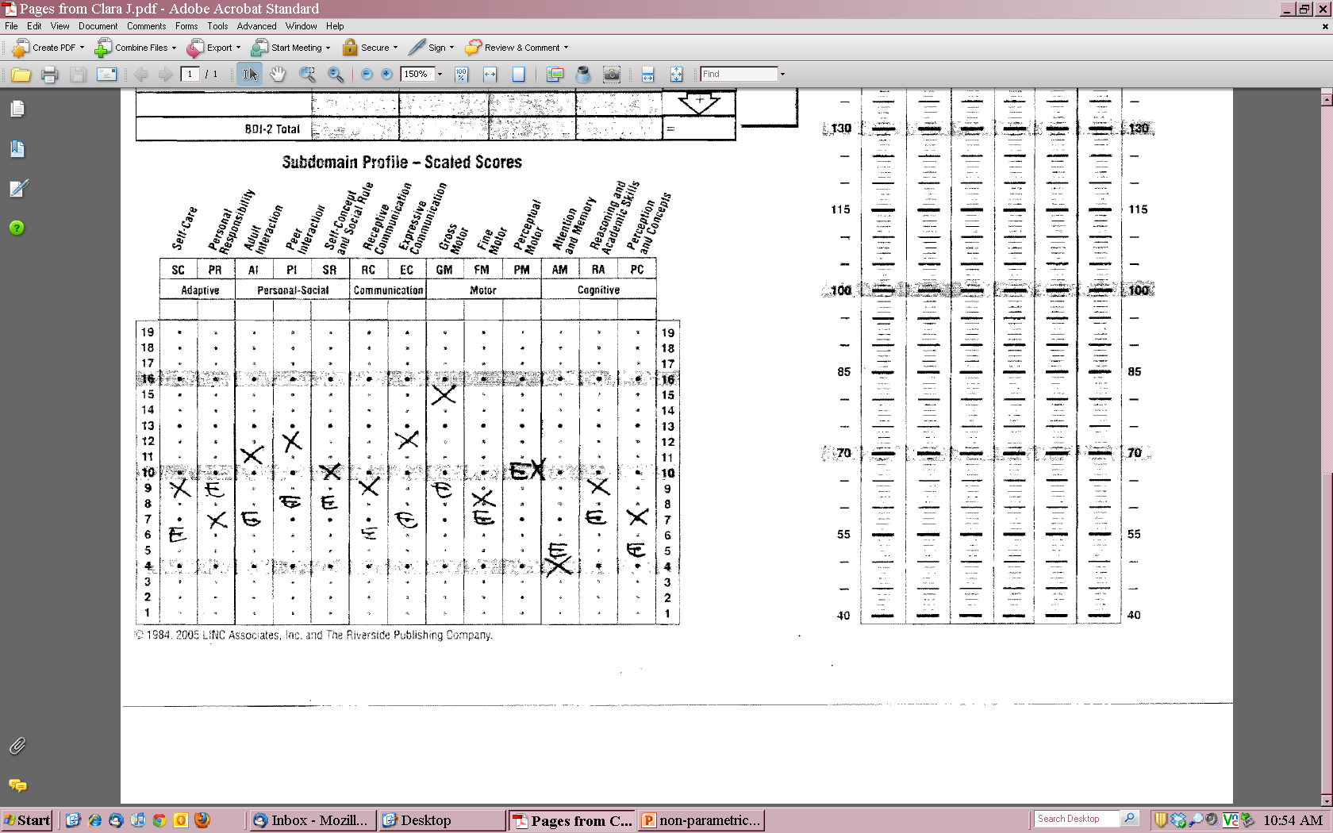
Entry
Exit

Slide 57
Reactions?

Slide 58
Summary
Preliminary data suggests some similarity, but many children would be classified differently using the 2 methods
Clinically complex. Different categories but a lot of similarities in the clinical picture.
Disagreement about what % and actions reflect typical functioning, breadth of sample observations to know functioning…
Continue to collect more data, investigate further.
Notes:
not seeing radical difference.
Validity implications.

Slide 59
Questions? Comments? Reactions?
Notes:
59

Slide 60

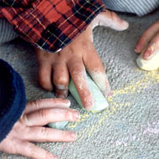

Find out more
ENHANCE Website
  http://ENHANCE.sri.com
ECO Center Website
  http://www.the-ECO-center.org
Contact ENHANCE staff
  E-mail: ENHANCE@sri.com
Notes:
Individual emails for Kathy Hebbeler, Donna Spiker, Lauren Barton, or Cornelia Taylor
60

