Slide 1
What did you say? Communicating with families about child and family outcomes
Darla Gundler (EIFA), Barb Jackson (ECO, MMI), Siobhan Colgan (ECO, DaSy)

Slide 2
Session Objectives
Share select resources related to talking with families about outcomes
ECO resources
State resources
Other national center resources
Digital Stories
Solicit feedback about priority resources needed in key areas

Slide 3
Background
TA providers expressed need in the field for resources
ECO leadership priority area
Assessing specific areas of need via:
Communities of practice calls
ECO staff input
Conference sessions

Slide 4
Overview of the Key Areas

Slide 5
Key principles: Program staff…
Define child and family outcomes with families.
Describe the multiple purposes of collecting outcomes data
Discuss how outcomes measurement is done in their state/program, including:
Timing of assessments
How information is gathered
What tools are used for assessment

Slide 6
Key principles: Program staff…
Invite family engagement through multiple options and formats
Use a strengths-based approach
Individualize their approach to gather information from families.
Obtain information about the child in his/her natural environments
Engage families an ongoing manner

Slide 7
Key principles: Program staff…
Review child-level data with families.
Describe child’s behaviors and skills in an understandable, sensitive way.
Communicate child’s skills in a meaningful way addressing strengths and concerns/needs.
Engage families in meaningful conversations about the findings.
Use child and family data to write IFSP/IEP outcomes & plan services.
Present data in multiple formats and with user-friendly language

Slide 8
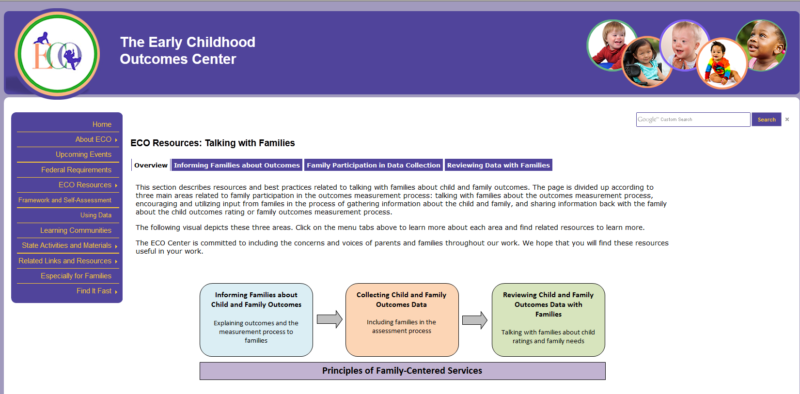
Take a Tour: Web Resources
New ECO web page:
http://projects.fpg.unc.edu/~eco/pages/talking.cfm

Slide 9
Darla gundler, early intervention family alliance

Slide 10
What are Digital Stories?
Three to five minute emotion based messaging tools which may include:
Photos
Clip Art
Music
Spoken voice

Slide 11
How is a digital story different than a family telling their story?
Impact
Seeing and hearing makes it come to life
Specific message instead of the whole story
Different perspectives from diverse families
Easily Reused
“Let’s view a digital story”

Slide 12
Crystal’s
Story

Slide 13
Digital Story Debrief This story is 2:45 and has a powerful message
Digital Stories - Guided Viewing Questions
What are your first thoughts or reactions to the digital story?
What words or images stood out to you?
After seeing the video; are there things that you will do differently in the future?
Either working with families or within your own family?
What resonates with you after viewing this digital story?
In closing: final thoughts or suggestions?

Slide 14
Child & Family Outcomes
http://eiplp.org/child_family_outcomes.html
Completing the Family Survey video
2 formats on website (YouTube & wmv)
http://www.youtube.com/watch?feature=player_embedded&v=Gd5nnKOrkI0
Child & Family Outcomes Posters & Photo Cubes

Slide 15
YouTube Video
You can track the number of views from YouTube easily

Slide 16
SMALL GROUP DISCUSSION [see handout]

Slide 17
Thanks!!

