Slide 1
Innovations in Training and Technical Assistance for the Child Outcomes Measurement (COS) Process
Improving Data, Improving Outcomes Conference
September 2013

Slide 2
Presenters
Shannon Dunstan, 619 Program, Idaho
Grace Kelley, TA specialist, SERRC
Pam Miller, Quality Assurance Specialist, Birth -5, Maryland
Lisa Wasacz, ECSE/619 Consultant and Nancy Surbrook, Training and TA Manager, Michigan
Notes:
Megan –
Include who is in the room:
Part C
619
Those providing TA
Others?

Slide 3
Focus of Today’s Session
Training partnership with families
Training focused on needs identified by the field: typical child development
Online training options
Notes:
Kathi

Slide 4
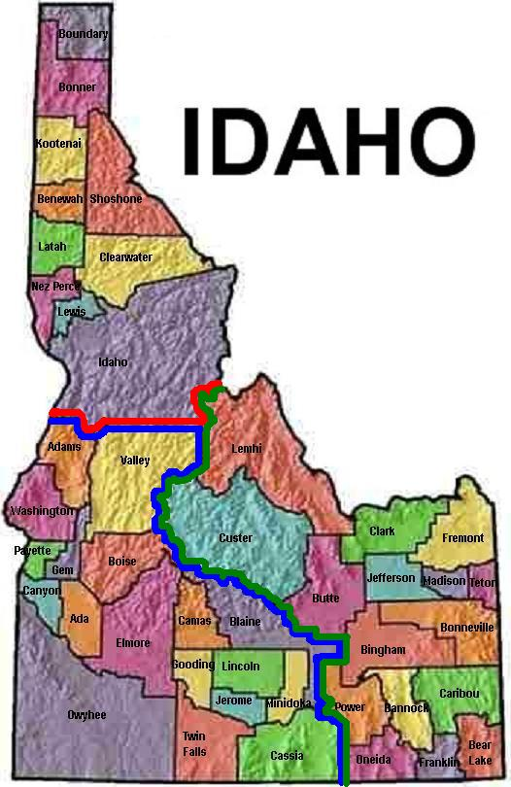
Notes:
Idaho has approximately 144 school district in 7 regions of the State, with approximately 170 EC teachers, serving an estimated 2800 students between the ages of 3-5.

Slide 5

Defining a High Quality
Early Childhood Program
Notes:
How do we define a high quality Early Childhood program? We first needed to look at what our State had to offer. Idaho accomplished this by doing a Statewide needs assessment.

Slide 6
ECO Data Analysis
COSF–R Validity and Reliability
Cross reference December 1 and ECO data
EC Teacher Interviews
Anchor Assessments
District ECO processes
Statewide Survey
Parent Participation
ECO Processes
Teacher qualification/training
Statewide Needs Assessment
Notes:
In conducting the needs assessment we looked at three main areas: ECO Data, district and teach practices, and used a statewide survey. What we found was very informative to our next steps.
Through an analysis of districts COSF-R forms we found that Parent involvement was documented less than 32%; Documented age appropriate, immediate, and foundational skills less than 26%; Student’s ECO rating matched information provided less than 10%; Overall minimal criteria for accurate reporting less than 3% of the time
The State was under-reporting approximately 1000 students. SLPs did not think they needed to do ECOs
Almost all districts had at least one of the 10 anchor assessments identified for completing the ECO ratings at entrance and exit. Most districts had no formalized process to complete the ECO process.
Statewide survey:
Parent Participation
Parents do not understand the need for ECO document, difficult for parents to answer the question what are my child’s strengths, hard for parents to articulate concerns, how much parent input do we need, parents don’t know how to make sense of their child in regard to education, parent is not a valuable member until parent teacher conferences, gathering information from parents is good but not actuate for goal outcome without extensive observations
ECO Process
Teachers expressed that it is not a true picture of child, progress with most challenging students is not reflective in ECO reporting, outcomes do not reflect minimal growth of severe students, data is more important for developing goals and intervention then reporting outcomes, easier to see growth in IEP but not on an anchor assessment, Redundant, takes time way from kids; paperwork, just another form, more work not related to services provided, just what the state says to do, not relevant, not a useful tool, more time, not enough time to process paper, ECO areas are very broad in comparison to IEP goals, team does not want to take the time so do it alone, not valued by the team, to subjective, program will not change if ECOs goes away, takes time away from teaching
Teacher qualifications/Training: 70% of Respondents were ECSE teachers; 55% of respondents had been working 10 or more years; 84% respondents ECOs was one of their primary responsibilities, 57% were initially trained by SDE; 33% received training by a college or not at all

Slide 7

Embedding the ECO Process into Early Childhood IEPs
Notes:
Based on all of this information the decision was made to move toward embedding the ECO process into an Early Childhood IEP’s

Slide 8
Across Systems ECO/IEP Implementation Strategy
Parents Engagement
Partnered with Idaho Parents Unlimited (IPUL)
Developed parent material
Teachers Engagement
Engaged 17 districts to pilot new ECO/IEP process
Hold statewide meetings to provide information on ECO/IEP process and seek input
Stakeholders Engagement
Draft new ECO/IEP Forms
Develop an implementation Plan
Co-facilitate statewide parent trainings
Develop webinar to archive for future reference
Developed series trainings
Hold statewide meetings provide information on ECO/IEP process and seek input
Notes:
We proceeded in a 3 pronged approach to the ECO/IEP implementation strategy. The statewide survey informed us that teachers did not feel that parent engagement was necessary or expressed that parents were too overwhelmed to understand the Early Childhood Process; Teachers did not value the ECO process; and through stakeholders involvement, Idaho needed to modify how ECO’s were being collected and reported to assure reliable and valid data.

Slide 9

Guess What???
Notes:
After holding meetings throughout the State, working with our parent partners, and providing Statewide training the responses have been surprising. Teachers that were nay sayers are excited, energized, exclaiming, “It finally makes sense.” SLP’s that expressed that ECO did not apply to “speech only student” left expressing how important it is to have communication skills represented in the 3 Outcome areas. It truly was awesome to see. The focus shifted from discrete skills to the impact of the child’s disability on functional activities. Putting the focus on routines within the family and how the child’s disability impacts their ability to fully participate. Where the 3 Outcomes felt overwhelming, now were specific to areas that the families identified as important.

Slide 10

Notes:
The next step is to assure that IEP teams are reaching out to their parent partners. We will be evaluating this process of the next several years, tweeking things as we go, but we feel we are on the right track.

Slide 11

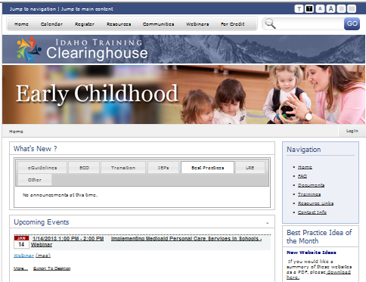
www.idahotc.com
Find the following on the ITC:
Online Learning Community
  Early Childhood
    eGuidelines
    Early Childhood Outcomes
    Transitions
    IEPs
    Best Practice
    Least Restrictive Environment
Housed at: Center on Disabilities and Human Development, University of Idaho

Slide 12
Contact Information:
Shannon Dunstan
Early Childhood & Interagency Coordinator
Idaho State Department of Education
Division of Student Achievement and School Improvement
Division of Special Education
(208) 332-6908
sdunstan@sde.idaho.gov

Slide 13

Understanding Child Development is Key to Quality Child Outcomes Measurement and to Planning Services

Slide 14
Why?
Important to have an understanding of typical child development
Its been a while since we worked with typical children or had a college course
ECO based on functional skills not isolated skills
What have you experienced?
Notes:
We know that to in order to have complete the ECO rating we have to understand that we are comparing a child with delays or disabilities to a child with typical development. Most of us have had a course in typical child development ~ but its been a while.
We had requests from staff to provide some material and training on typical development.

Slide 15
Results
Better understanding of importance of ECO
Increased reliability of ECO ratings
Common understanding of developmental skills
Shift thinking from domains to functional learning and skills
Remind us of functional

Slide 16

How to use these resources
Train the Trainer
Workshop
Webinar
Supervision
Guide for ECO

Slide 17
Outline
Intro, learning objectives, early childhood outcomes, early childhood rating scale
Brain Development
Child Development
0-1 Year, 1-2,2-3,3-4,4-5
  Powerpoint with Trainer Notes slides
    Developmental milestones (CDC)
    Developmental Health Watch
    Learning Activity
    Case Study
Touchpoints
Strengthening Families
Parent Involvement

Slide 18
Motor Area
Sensory area
Intellect, Logic, Reasoning
Taste
Speech
Language
Hearing
Vision
Balance
Emotional Regulation
Understanding the Brain
Notes:
This gives a visual idea of how brains are contstructed, all are affected by emotions and the environment around us.

Slide 19

Infants by the end of 3 months

Slide 20
Developmental Health Watch
3 months
Doesn’t respond to loud noises
Doesn’t follow moving objects with eyes at 2-3 months
Doesn’t smile at people by 3 months
Doesn’t support head well by 3 months
Doesn’t reach for and grasp objects by 4 months
Doesn’t push down with legs when feet are placed on a firm surface (4 months)
Doesn’t pay attention to new faces, or seems frightened by new faces
Experiences a dramatic loss of skills he or she once had
Notes:
This is what to watch for – possible delays. We know this by a specific disciplines, but need to look across the spectrum.

Slide 21
Functional Skills vs. Developmental Skills
Functional Skills
Things that are meaningful to the child in the context of everyday living
Example: The child uses index finger to point to pictures to request food items when he is hungry
Developmental Skills
A discreet behavior or action
Example: The child can point using index finger
Notes:
Talk about how dev skills are important but not helpful or useful unless described how it relates to a child’s functioning within that outcome.
Followed by and Activity 2 Which Outcome?

Slide 22
Functional Skills are INTEGRATED
Have Positive Social Relationships
Acquire & Use Knowledge & Skills
Take Appropriate Action to Meet Their Needs
NOT domain-specific

Slide 23
Resources
http://www.cdc.gov/ncbddd/actearly/milestones/index.html- Developmental Milestones
http://www.brazelton-institute.com/ - Touchpoints
http://www.preschoollearningcenter.org/images/upload/developmental_checklist.pdf - Syracuse Developmental Checklist

Slide 24


Innovative Online Resources
Maryland State Department of Education, Division of Special Education/Early Intervention Services

Slide 25
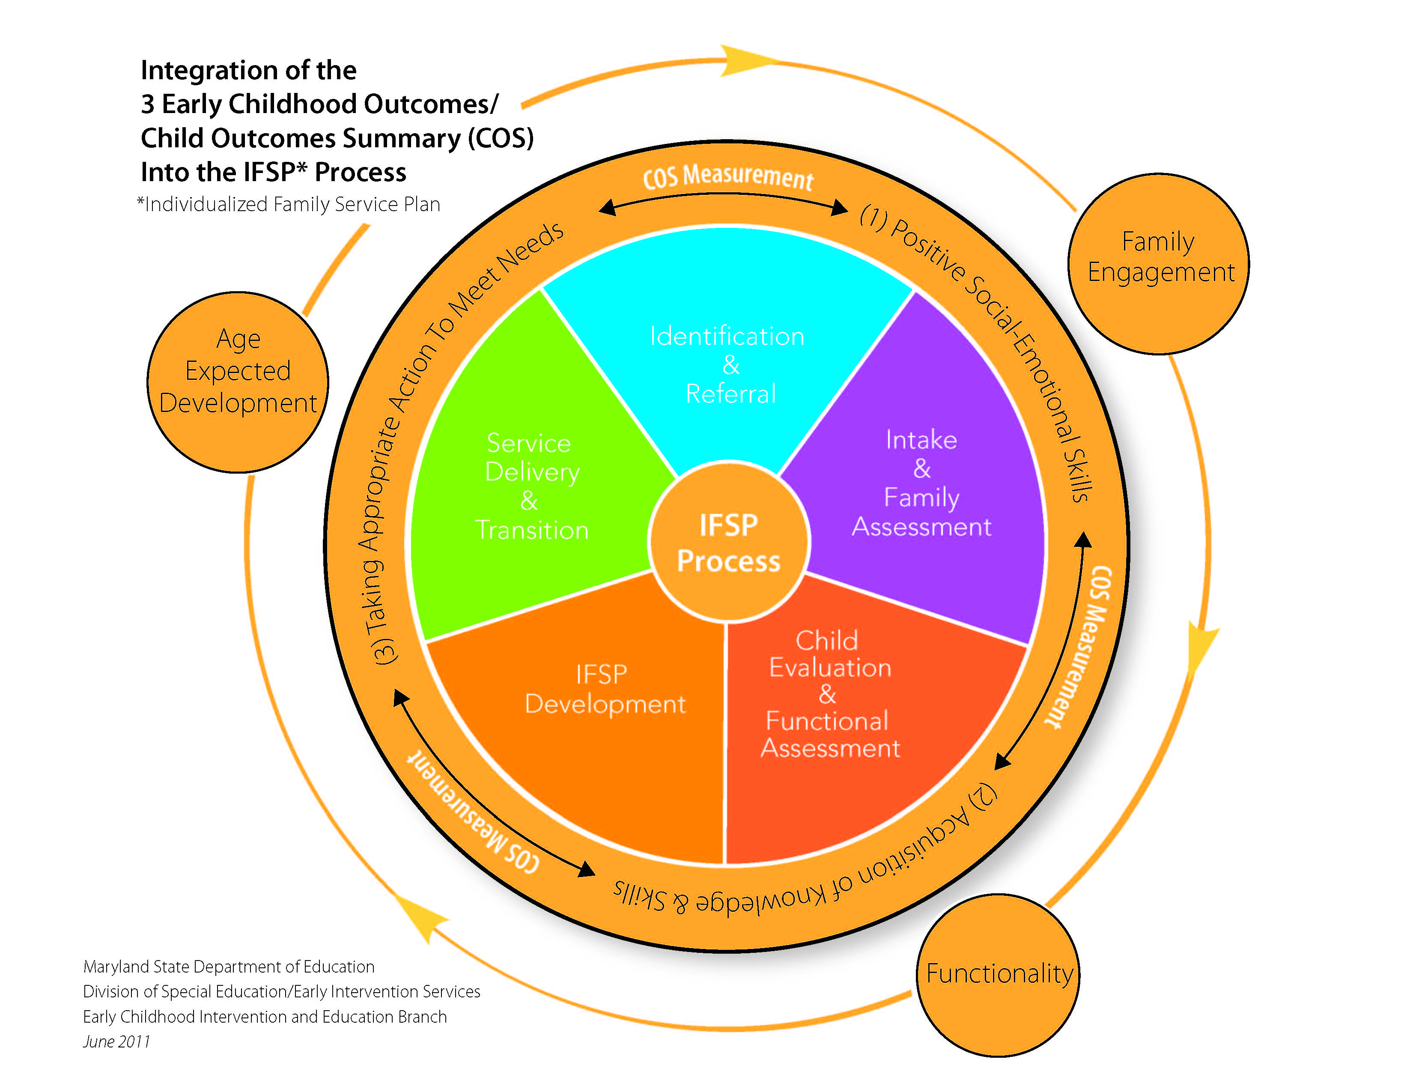
Maryland State Department of Education, Division of Special Education/Early Intervention Services

Slide 26

Child Outcomes Summary (COS) Tutorial
Maryland State Department of Education, Division of Special Education/Early Intervention Services

Slide 27
Purpose of the COS Tutorial
The COS tutorial was developed to assist early intervention professionals to understand and be successful with measuring early childhood outcome results. This online tutorial is to supplement direct face-to-face training and provide an ongoing resource for implementing the integration of COS into the IFSP process in Maryland.
http://olms.cte.jhu.edu/olms2/128970
Maryland State Department of Education, Division of Special Education/Early Intervention Services
Notes:
So now, let’s talk about the purpose of the COS tutorial.
The online tutorial was developed to assist early intervention professionals with understanding and being successful with measuring early childhood outcome results.
Please Note: This tutorial does not take the place of local Professional Development (PD) around the COS process.
Professional development on the COS process must be completed in every jurisdiction as a required component of the CSPD Plan (utilizing materials from the COS TOT Manual and COS Mini-Conference Manuals).
The intent of the online COS tutorial is to supplement direct face-to-face training and provide an ongoing resource as early intervention professionals implement the integration of COS into the IFSP process.
Let’s briefly walk thru the tutorial.

Slide 28
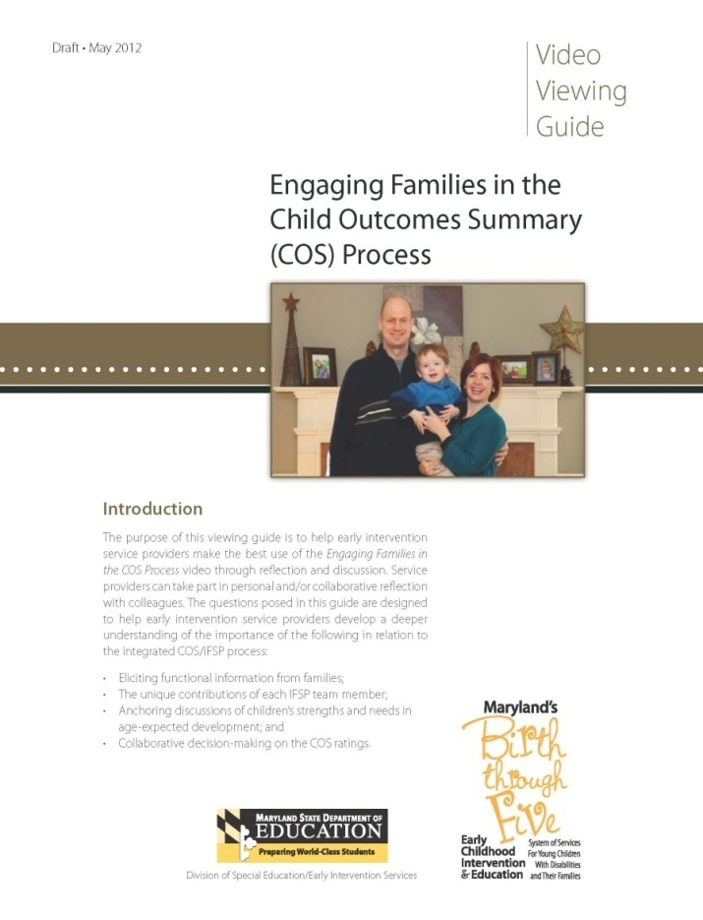
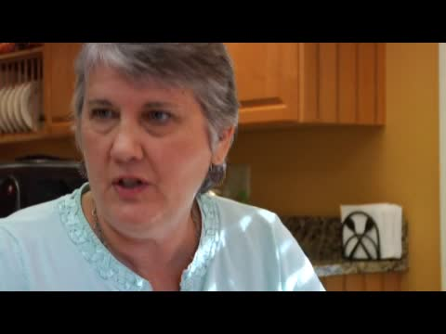
Engaging Families in the Child Outcomes Summary (COS) Process: Video Resource
http://marylandlearninglinks.org/11695
Maryland State Department of Education, Division of Special Education/Early Intervention Services
Notes:
Summarize the video:
This video is in 2 parts and is an actual IFSP team meeting to discuss Cade’s progress as he and his family begin the transition process. The video describes how the staff prepared for the meeting and how they assisted Cade’s mom (Cat) to be prepared for the meeting. The staff discuss how the family’s role is the most important because they know Cade the best and they want Cade’s mom to feel comfortable sharing . One staff person clearly explains each of the 3 early childhood outcomes and provides mom with the opportunity to talk about what she sees from Cade in the home environment. The emphasis is on functional skills and behaviors within daily settings and routines. The team reviews Cade’s current functioning with age-expected development and functioning to decide on a rating for each of the 3 indicators. The video concludes with a discussion around the importance of collaboration and how this integrated process really allows for a true picture of how Cade is functioning.

Slide 29

Embedded Learning Opportunities (ELO)
Maryland State Department of Education, Division of Special Education/Early Intervention Services
Notes:
How children learn best through the implementation of natural learning environment practices is the foundation of the Embedded Learning Opportunities website. This site is designed to assist IFSP teams with selecting learning experiences to integrate into families' daily routines in an effort to enhance children’s development of functional skills and behaviors across the three early childhood outcomes (i.e., developing positive social emotional skills, acquiring and using knowledge and skills, and taking appropriate action to meet needs).

Slide 30
Purpose of the ELO Resource
The Embedded Learning Opportunities (ELO) website is designed to assist IFSP teams with selecting learning experiences to integrate into families' daily routines in an effort to enhance children’s development of functional skills and behaviors across the three early childhood outcomes (i.e., developing positive social emotional skills, acquiring and using knowledge and skills, and taking appropriate action to meet needs).
http://olms.cte.jhu.edu/olms2/10634
Maryland State Department of Education, Division of Special Education/Early Intervention Services

Slide 31

Walkthrough of the ELO Resource
Maryland State Department of Education, Division of Special Education/Early Intervention Services

Slide 32
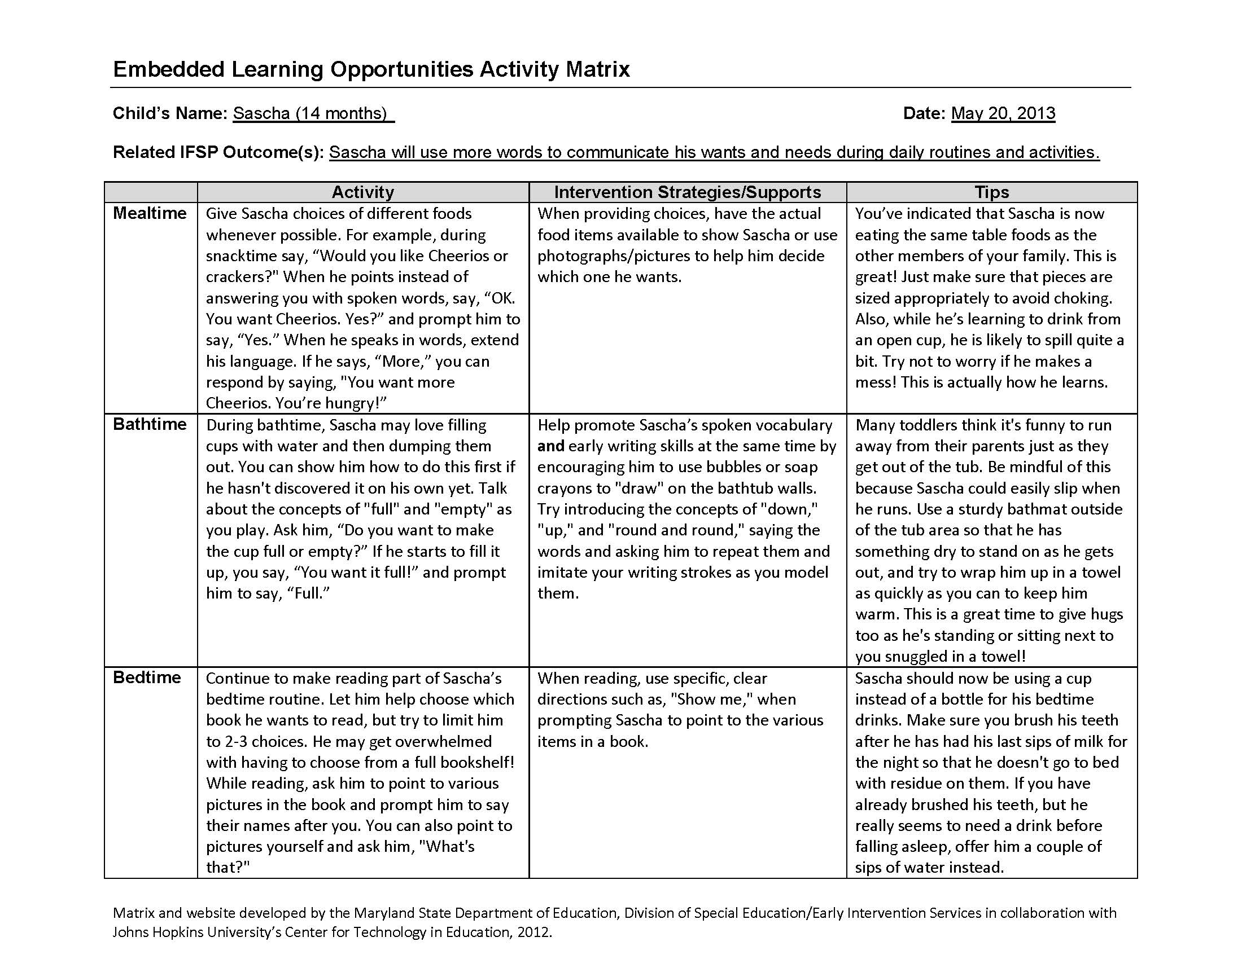
Maryland State Department of Education, Division of Special Education/Early Intervention Services

Slide 33

Nancy Surbrook, Training & TA Manager
Lisa Wasacz, ECSE Consultant for MDE

Slide 34
OGS System
Office of Great Start
Early On®
Part C
Head Start Collaboration
Early Childhood Special Education
619
Great Start Readiness Program
State Funded Preschool for At Risk
Great Parents, Great Start
Child Care: Subsidy & Quality
21st Century Community Learning Centers

Slide 35
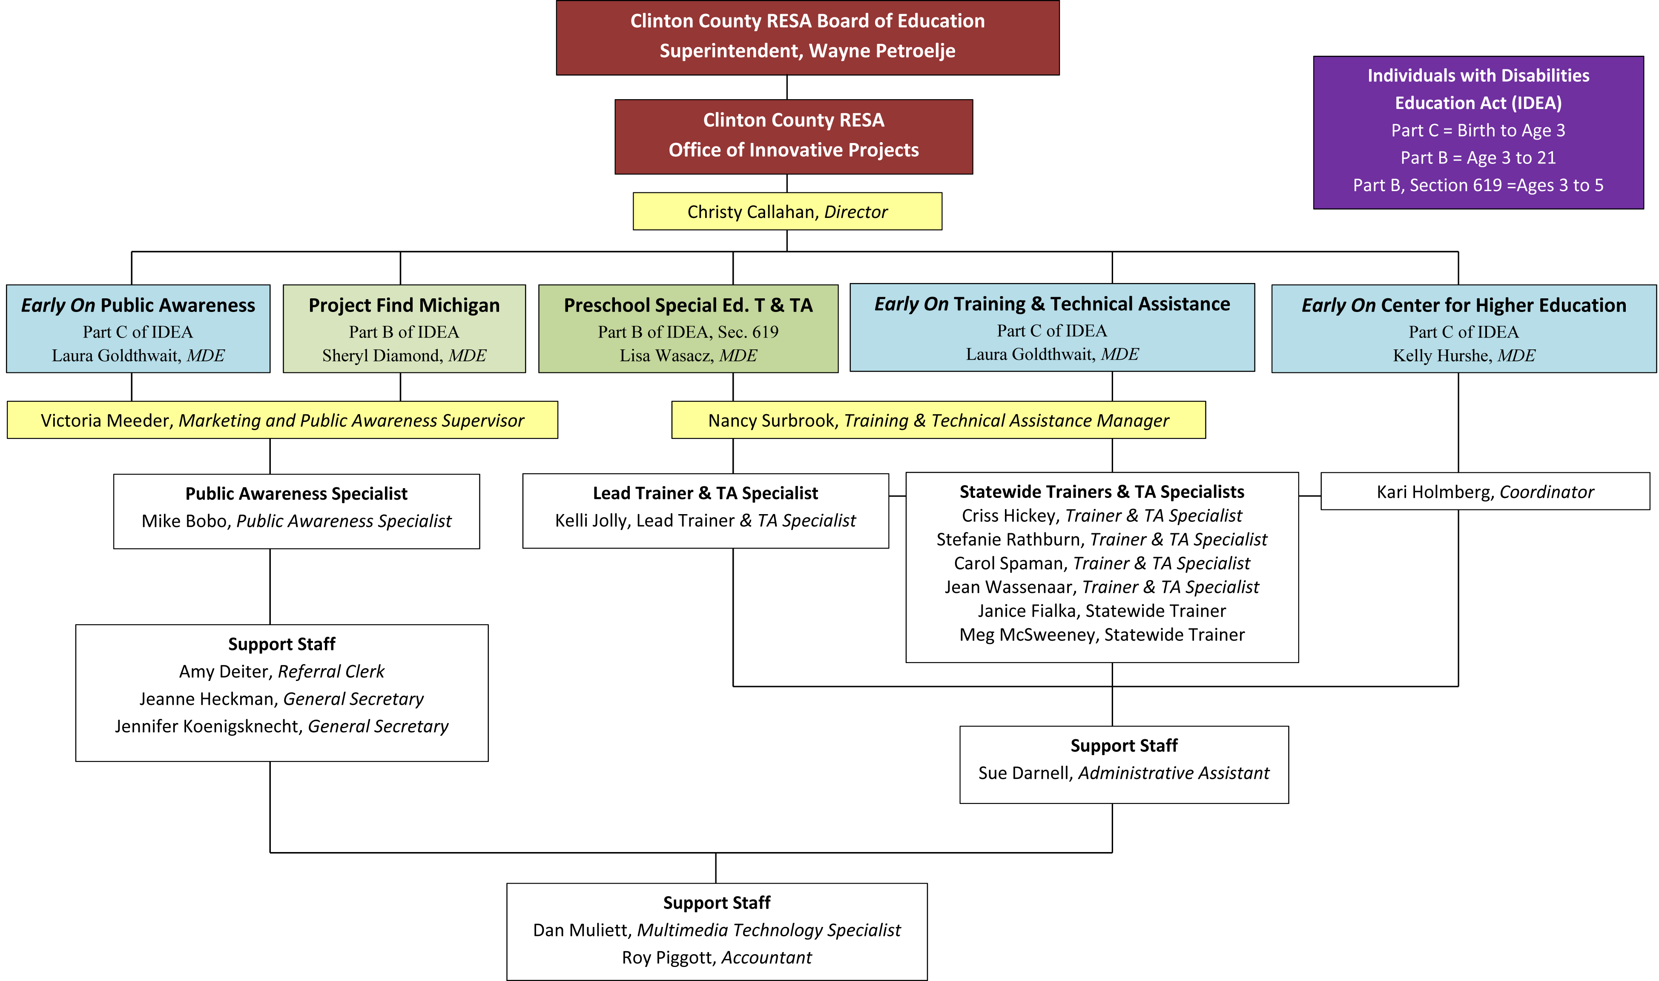

Slide 36
Similarities
20,000+ served
MDE is LEA
Local control state
57
Part C/619 same local staff – in many areas
Same child outcomes
Same TA Grantee
Early On®
Part C
Early Childhood Special Education
619

Slide 37
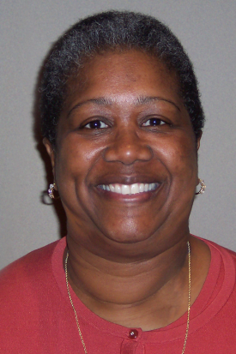
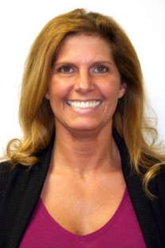
Differences
Vanessa Winborne
Part C, Early On®
MDE has 1 coordinator and
3 consultants
TA Grantee has 4 TA specialists
TA on all SPP indicators
57 service areas
Lisa Wasacz
ECSE/619
MDE has 1 consultant
TA Grantee has 1TA specialist
TA on SPP #6 & SPP #7
800+ locals

Slide 38
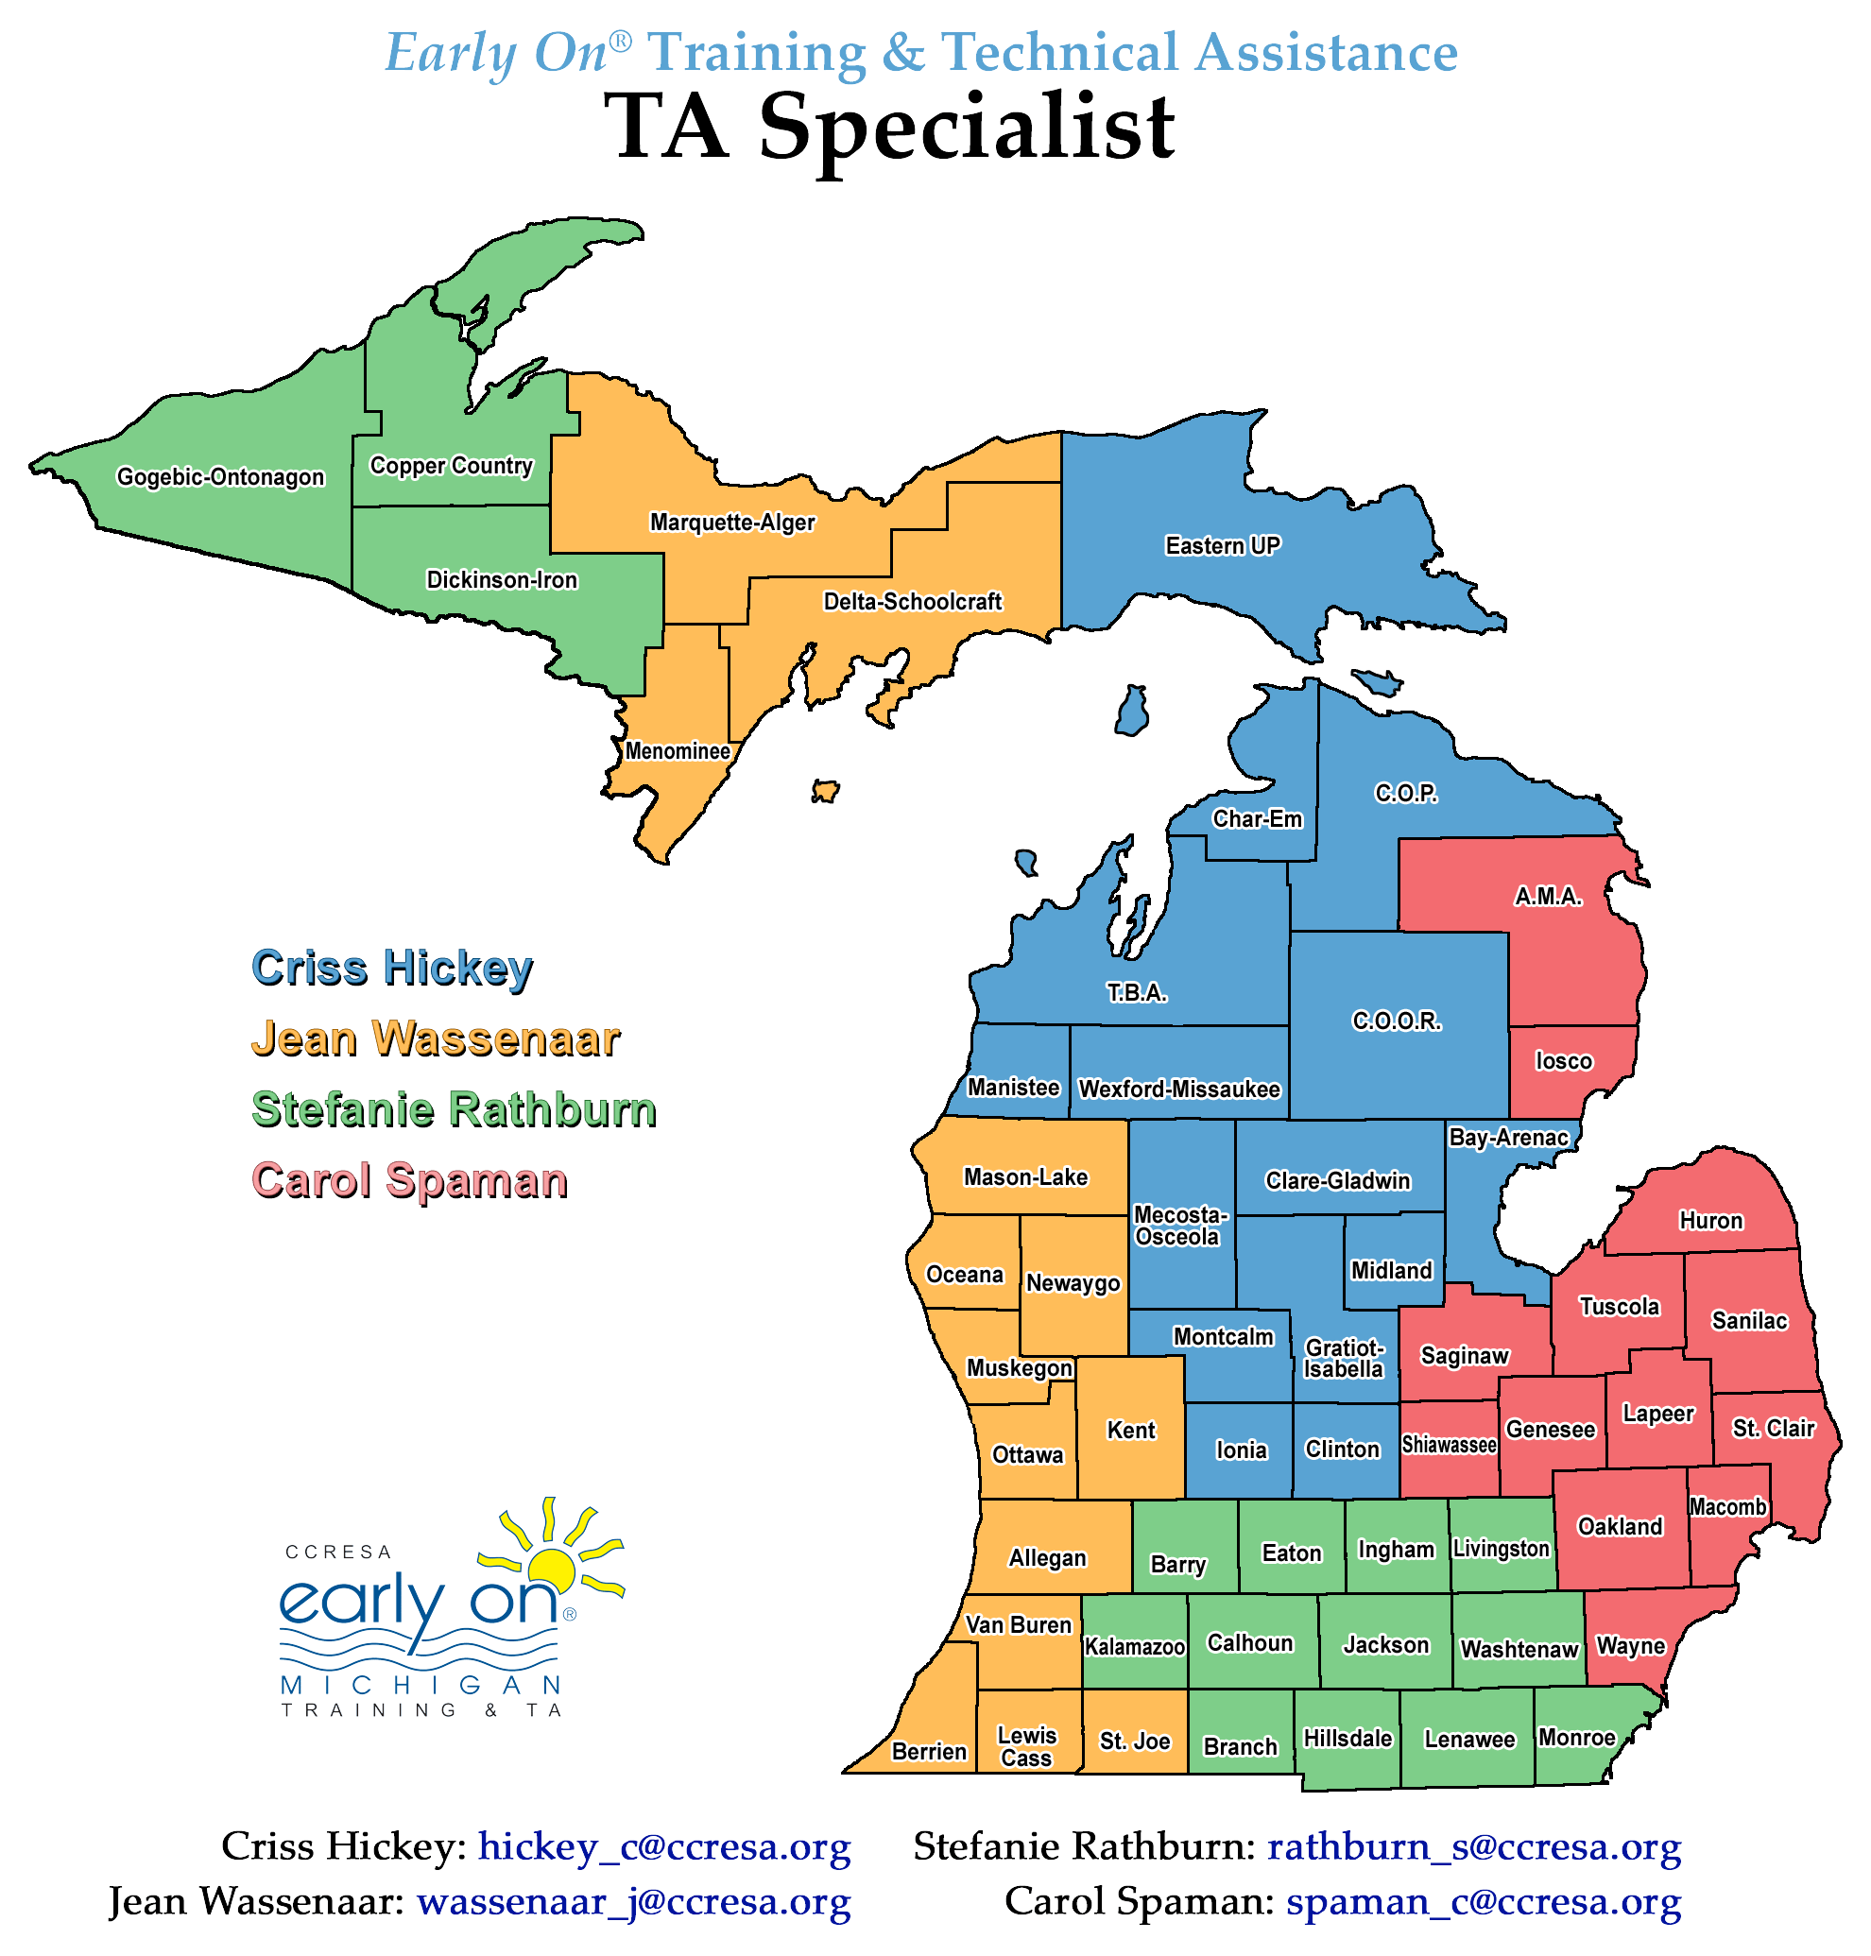

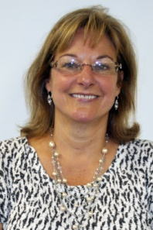
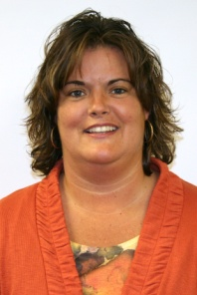
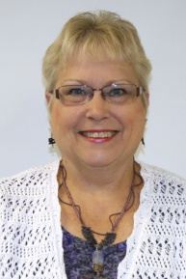
Part C TA Team
Criss Hickey
Jean Wassenaar
Stefanie Rathburn
Carol Spaman

Slide 39
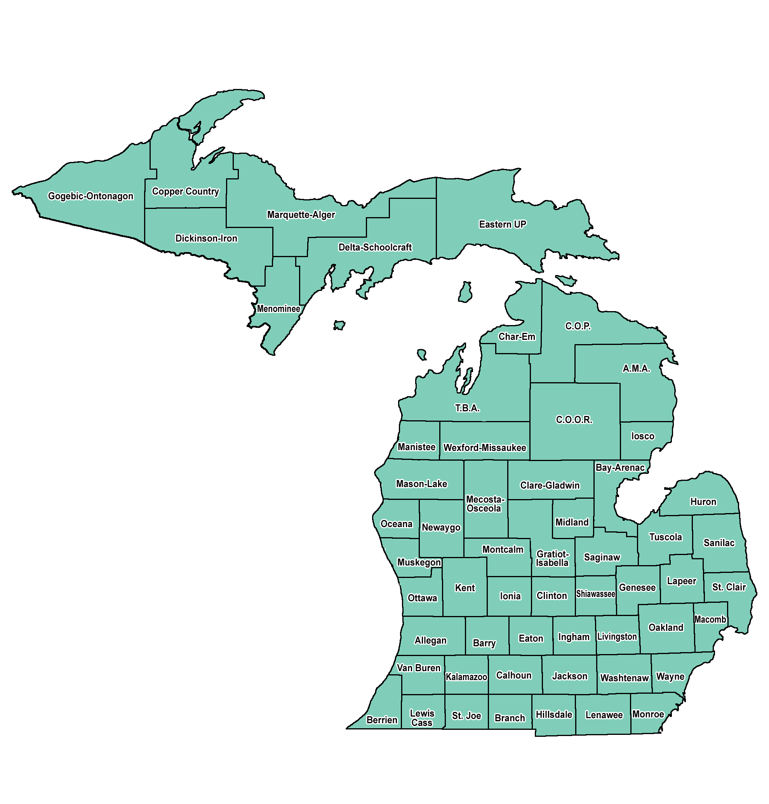
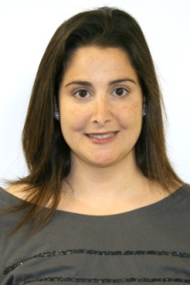
ECSE/619
TA Team
Kelli Jolly
Lisa Wasacz
MDE

Slide 40
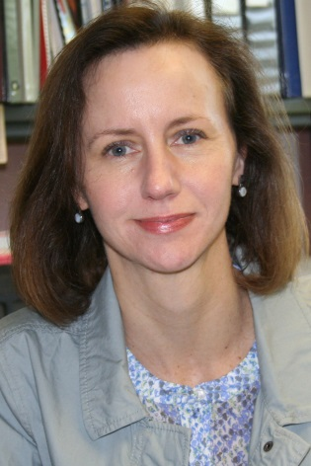
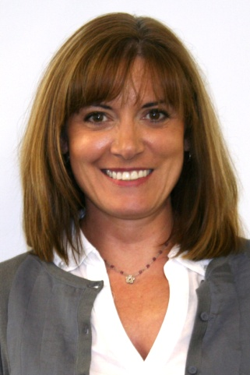
Management Team for
Training and Technical Assistance
Christy Callahan
Nancy Surbrook

Slide 41
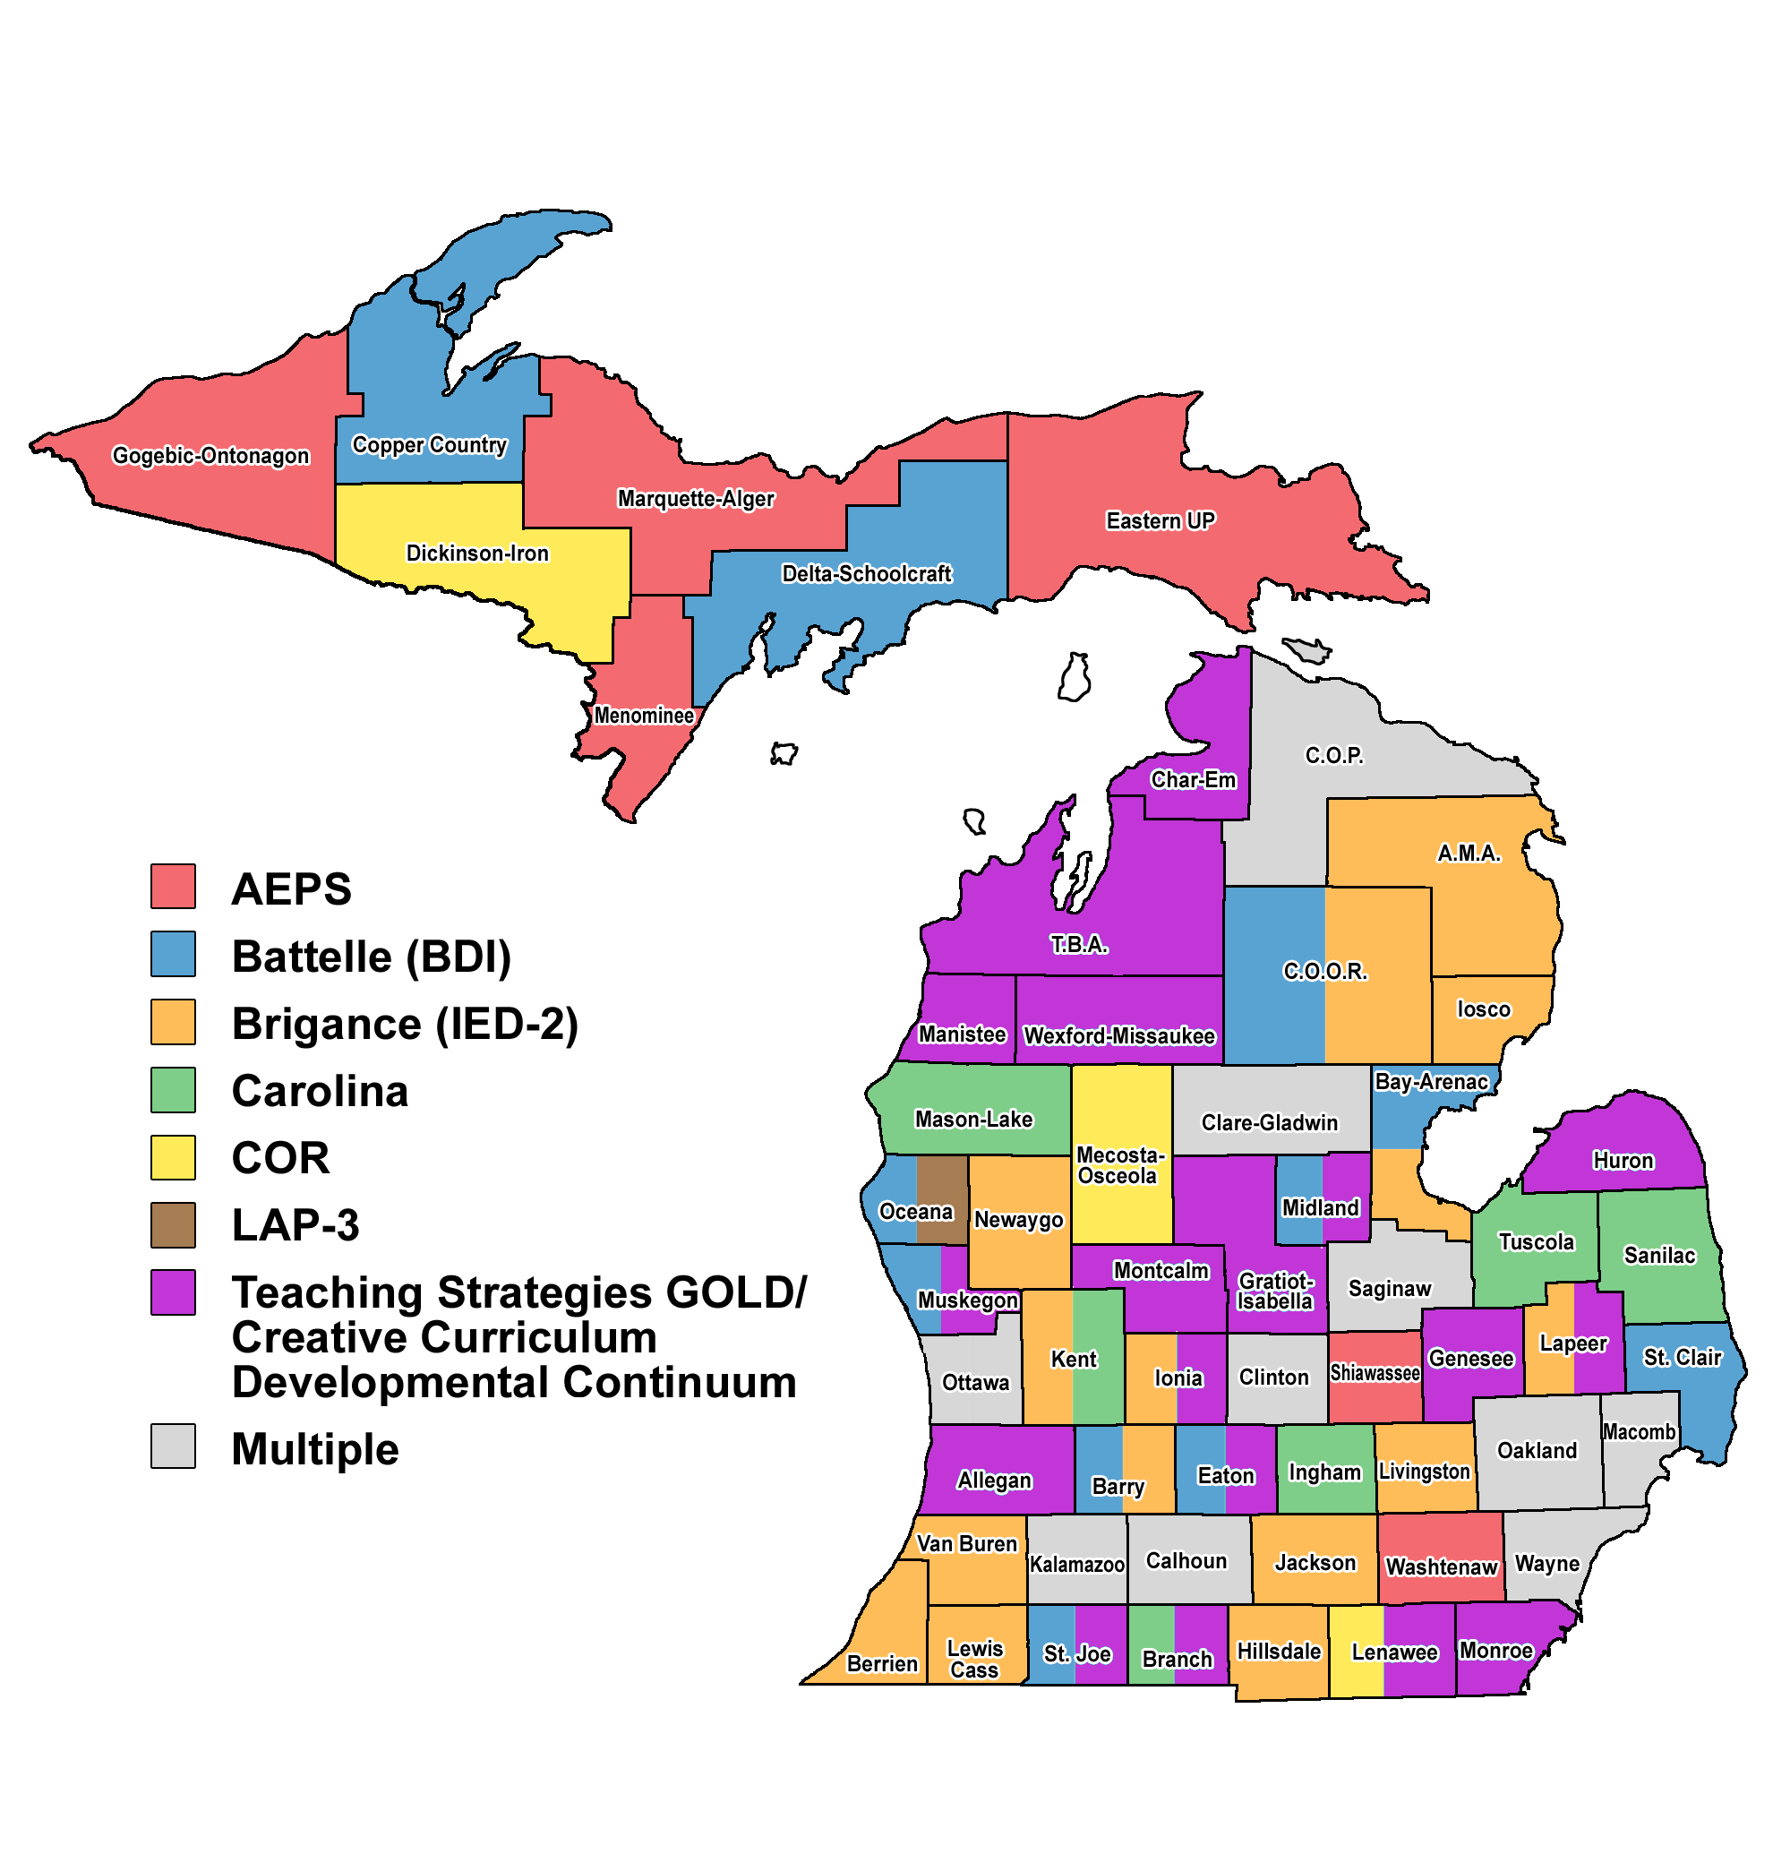
ECSE/619 Assessment

Slide 42
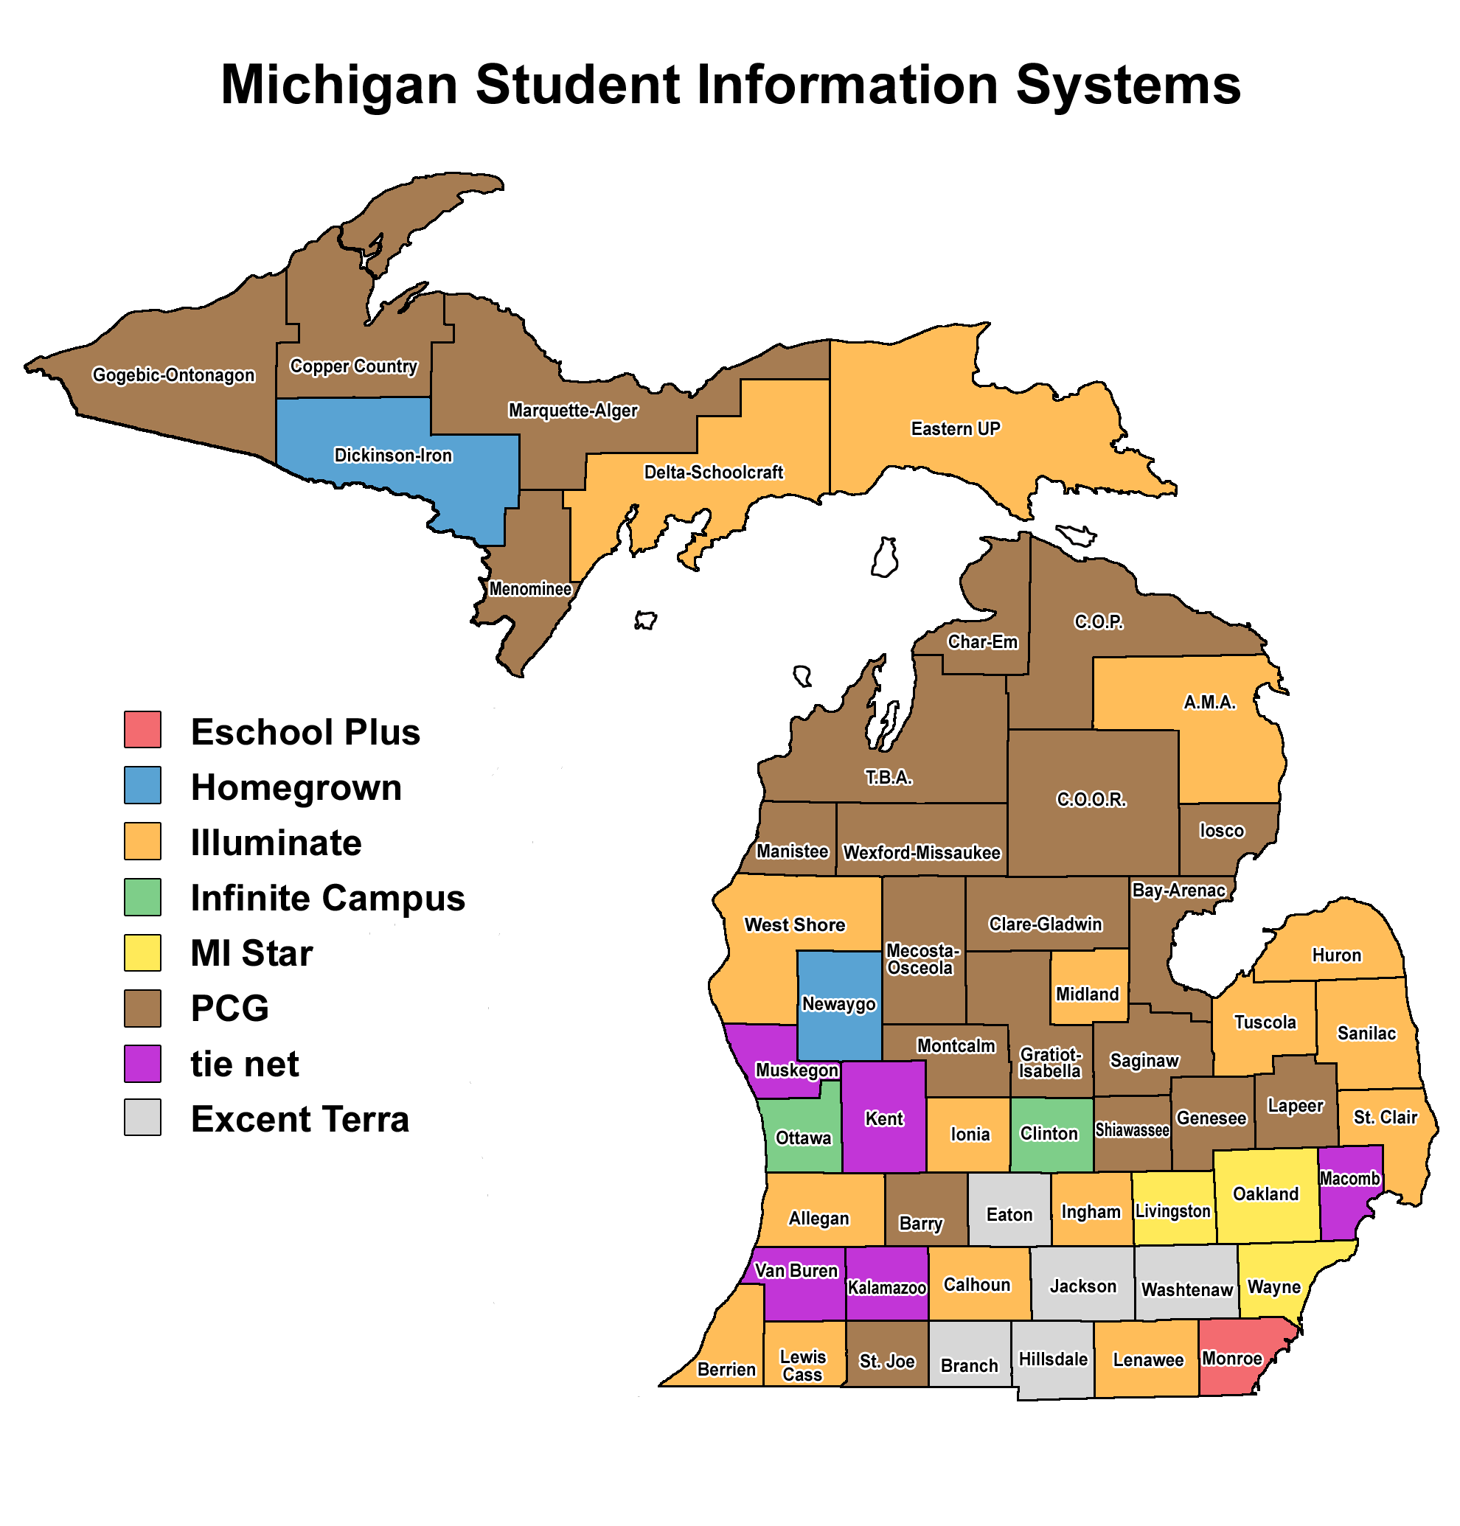
Data
Entry Systems

Slide 43
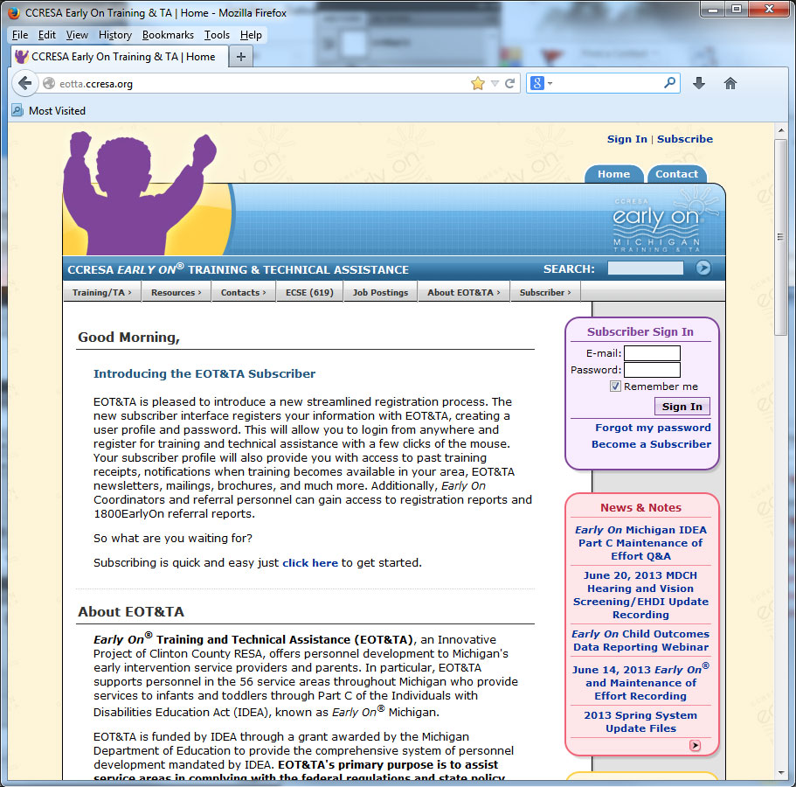
Training and TA
Home
Page

Slide 44
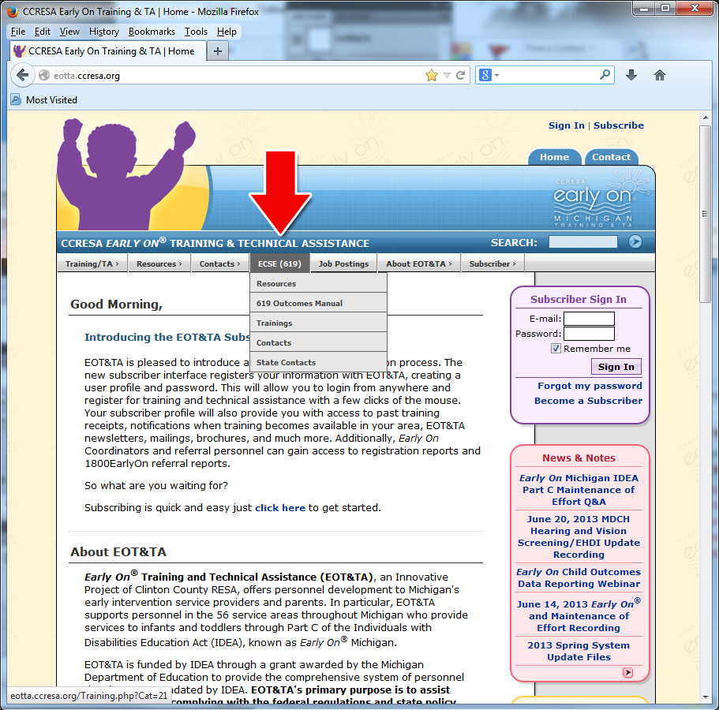
ECSE/619 Tab

Slide 45
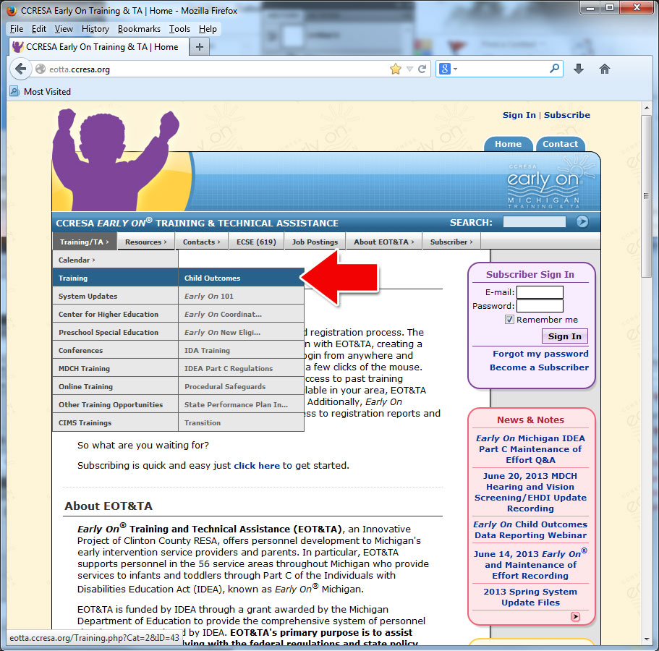
Available Trainings

Slide 46

Child Outcomes Training

Slide 47
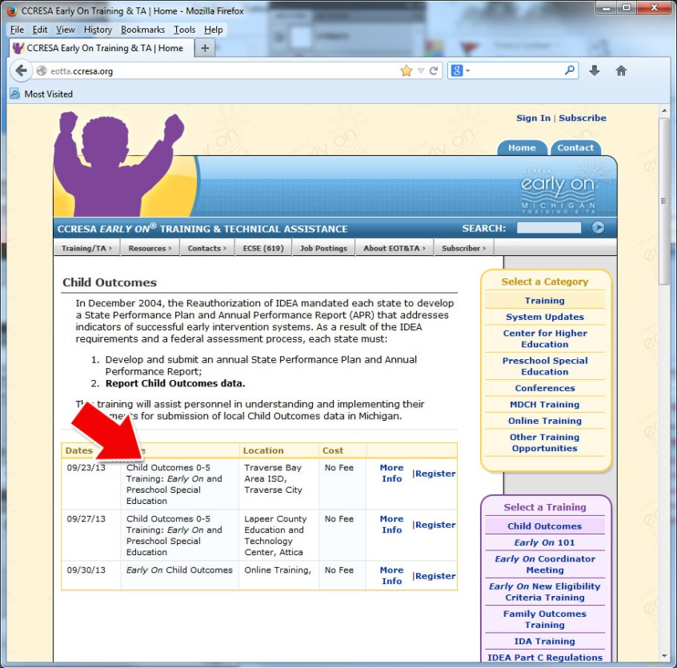
Child Outcomes0-5 Training

Slide 48
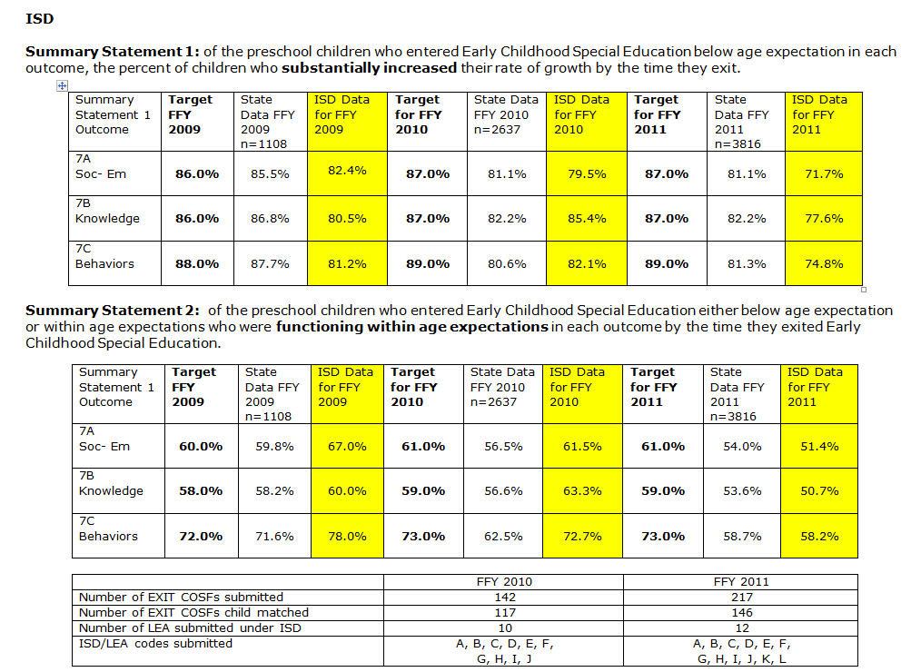

Slide 49
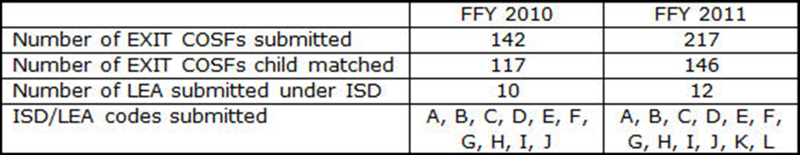
Trend Data and
Year to Year Comparisons

Slide 50
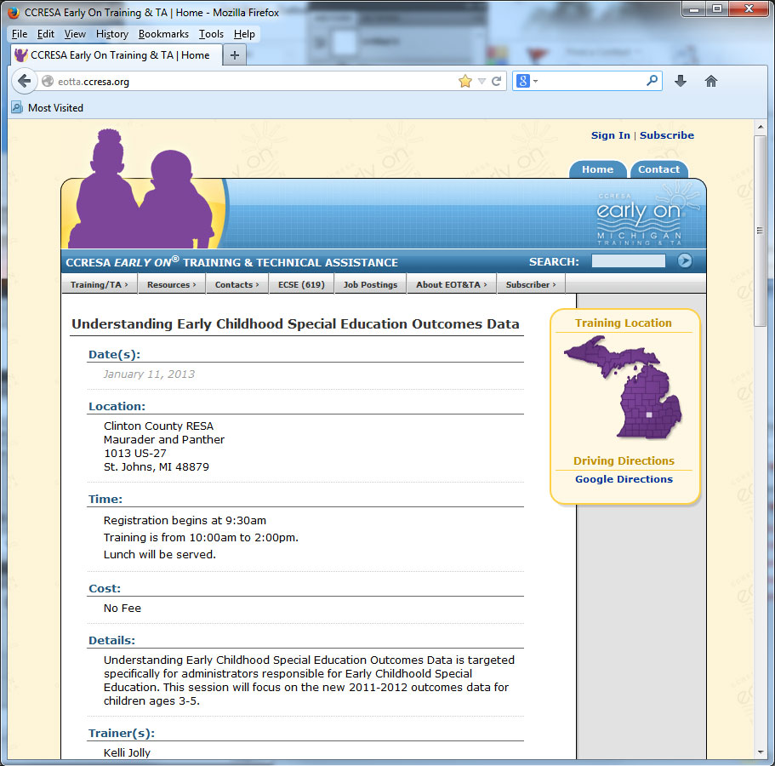
Understanding Early Childhood Special Education Outcomes Data Sessions

Slide 51

Understanding Data Webinar

Slide 52
What’s Next
Pilot Project – Data drill down specific to 1 ISD
  Beginning with SPP Indicator #7
  Moving into SPP Indicator #6 data drill down
SPP Indicator #6
  Pilot Project with Michigan’s Autism Council
  State level stakeholder group
  Local level Community of Practice
  Collaboration between state and local level

Slide 53
Contact Information
More information about Training and Technical Assistance
www.eotta.ccresa.org
Kelli Jolly Jolly_k@ccresa.org
Nancy Surbrook Surbrook_n@ccresa.org
Lisa Wasacz WasaczL@michigan.gov
Jean Wassenaar Wassenaar_j@ccresa.org

Slide 54
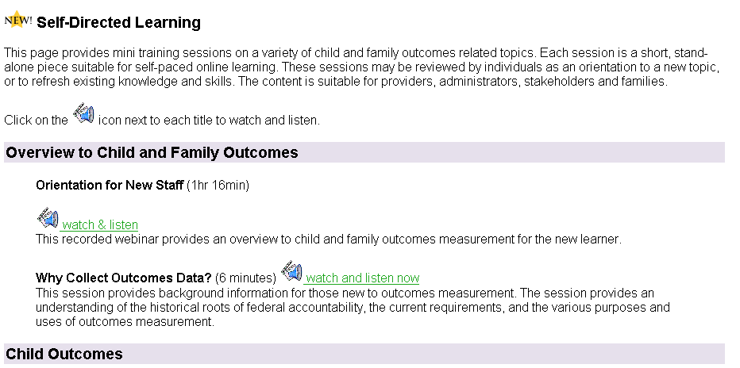
Self Directed Learning
http://projects.fpg.unc.edu/~eco/pages/selflearning.cfm
Notes:
Kathi
Overview to Child and Family Outcomes
Orientation for New Staff
Child Outcomes Understanding The Child Outcomes
Child Outcomes Step by Step Video
Assessing the Three Child Outcomes
Integration of Outcomes and IFSP/IEP Processes Introduction to IFSP/IEP integration
Child Development Understanding Young Children's Development
These three narrated modules were developed by training personnel in Illinois based on content developed by the University of Connecticut Center for Excellence in Developmental Disabilities.
Child Outcomes Summary Process and Form Developmental Trajectories: Getting to Progress Categories from COS Ratings (
Working with Data Analyzing and Interpreting Child Outcomes Data

Slide 55
New Training Activities
Age Anchoring – video activity
Kim case studies – 17 and 35 months
Who Wants to be a Millionaire? Activity
Updates to existing activities:
  Learning objectives
  Instructions for trainers
  http://projects.fpg.unc.edu/~eco/pages/training_activities.cfm

Slide 56

Interactive Guides
Interactive Guide to Implementing an Integrated Child & Family Outcomes and IFSP/IEP Process
http://www.ectacenter.org/implementingintegrated/splash.asp

Slide 57
Questions?
Notes:
Ask what other resources states have – we can share these if they are on the internet

Slide 58
Contact us:
Shannon: sdunston@sde.idaho.gov
Grace: gkelley3@cox.net
Pam: pmiller@msde.state.md.us
Kathi: kathi.gillaspy@unc.edu
Megan: Mvinh@uoregon.edu
Lisa: wasaczl@michigan.gov
Nancy: surbrook_n@ccresa.org

