Slide 1
The Role of Data in Improvement Planning
Anne Lucas, ECTA Center/WRRC
Penny Geiger, FLA
Catherine Goodwin, TN
Mark Sharp, OK
Bruce Bull, DaSy Consultant
Notes:
Welcome to the session

Slide 2

Session Agenda
Overview of Proposed SSIP
Proposed TA Resources to be developed
3 States’ efforts (TN, FLA, OK)
Discussion

Slide 3
Proposed Indicator C-11 (SSIP)
INDICATOR: The State’s SPP/APR includes a State Systemic Improvement Plan that meets the requirements set forth for this indicator.
MEASUREMENT: The State’s SPP/APR includes a comprehensive, multi-year State Systemic Improvement Plan, focused on improving results for infants and toddlers with disabilities and their families.
Notes:
The State’s proposed SPP that was released for public comment in Spring 2013 includes a State Systemic Improvement Plan (SSIP) that is a comprehensive, ambitious yet achievable plan for improving results for infants and toddlers with disabilities. The proposed SSIP must be a multi-year plan that the State develops. The basis for this plan is a detailed data and infrastructure analysis that will guide the development of the strategies to increase the State’s capacity to structure and lead meaningful change in early intervention service (EIS) programs and providers.

Slide 4
Proposed SSIP Activities by Phase
Year 1 - FFY 2013 Delivered by Feb 2015 | Year 2 - FFY 2014 Delivered by Feb 2016 | Years 3-6 FFY 2015-18 Feb 2017- Feb 2020
Phase I Analysis | Phase II Plan | Phase III Evaluation
Data Analysis; Identification of the Focus for Improvement; Infrastructure to Support Improvement and Build Capacity; Theory of Action | Infrastructure Development; Support for local educational agency (LEA) Implementation of Evidence-Based Practices; Evaluation Plan | Results of Ongoing Evaluation Extent of Progress Revisions to the SPP
Notes:
The proposed SSIP is to be developed in 2 phases and then implemented in a third phase that occur over the new APR reporting period of 2015-2020
Phase 1—February, 2015
Phase 2—February, 2016
Phase 3—February, 2017 through February, 2020
Data Analyses: In order to improve results, States must assess the capacity of their current infrastructure systems and their ability to enhance this infrastructure to increase the capacity of EIS programs and providers to implement, scale up, and sustain evidence-based practices that will result in improved outcomes for infants and toddlers with disabilities and their families. The data and infrastructure analysis should use multiple data sources, including SPP/APR indicators and 618 State-reported data, to identify systemic approaches that will lead to improved results for infants and toddlers with disabilities and their families across key measures: early childhood outcomes and family involvement.
Identification of the Focus for Improvement: A description of improvement strategies on which the State will focus that will lead to a measurable child-based result. The State must include in the description how the data analysis led to the identification of the area on which the State will focus. The State must demonstrate how addressing this area of focus for improvement will build the capacity of EIS programs and providers and supports to improve the identified result for infants and toddlers and their families with disabilities. (For example, the State might be working to improve the validity and representativeness of their data on early childhood outcomes and family involvement.)
Infrastructure to Support Improvement and Build Capacity: A description of how the State analyzed the capacity of its current system to support improvement and build capacity in EIS programs and providers to implement, scale up, and sustain evidence-based practices to improve results for infants and toddlers with disabilities and their families, and the results of this analysis. State system components include: governance, fiscal, quality standards, professional development, data, technical assistance, and accountability.
The description must include:
strengths of system
how components of system are coordinated
areas for improvement within and across components of the system
an analysis of initiatives in State, including initiatives in general education and other areas beyond special education, which can have an impact on children and youth with disabilities
how decisions are made within State system and representatives (e.g., agencies, positions, individuals) that must be involved in planning for systematic improvements in the State system
Theory of Action: Based on the data analysis and infrastructure analysis, the State must describe the general improvement strategies that will need to be carried out and the outcomes that will need to be met to achieve the State-identified, measurable improvement in results for infants and toddlers and their families with disabilities. The State must include in the description the changes in the State system, and EIS program and provider practices, that must occur to achieve the State-identified, measurable improvement in results for infants and toddlers with disabilities and their families. States should consider developing a logic model that shows the relationship between the activities and the outcomes that the State expects to achieve over a multi-year period.
Evaluation Plan: A description of how the State will evaluate the implementation of its SSIP. The plan must include the methods that will be used to collect and analyze data related to specific activities and outcomes of the SSIP. The description must also include how the State will use the results of the evaluation to examine the effectiveness of the implementation of the plan and the progress toward achieving intended outcomes, and make modifications to the SSIP as necessary.

Slide 5

Proposed RRCP Priority Area
TA Resources
SSIP Talking Points for use with stakeholders
Proposed Timeline for SSIP Activities
SSIP Process Framework
Guiding Questions
Web-based Support (slide decks, short lessons)

Slide 6

Proposed RRCP Priority Area
TA Resources
Quantitative Data Resources:
  Compiling data analysis currently available
  Developing SSIP decision flow chart
  Developing a how-to guide for planning data analysis (companion to flow chart)
Notes:
Quantitative Data Team: Developing a repertoire of data analysis tools that are currently available. In addition, the team is developing a SSIP decision flowchart with a companion document and a how-to guidance for planning data analysis project that will accompany the flowchart along with other available resources such as EdFacts Data Quality Assessment rubric

Slide 7
Proposed RRCP Priority Area TA Resources
Qualitative Data Analysis
  Developing White paper on analysis of qualitative data
  Providing Case Studies
Theory of Action
  Describing uniform process for working with stakeholders to develop Theory of Action
  Adapting general frameworks to reflect SSIP
  Providing options for displaying Theory of Action
  Developing checklist to ensure achieves desired results
  Developing an Evaluability Assessment
Notes:
Qualitative Data Team: Developing knowledge/strategies/tools regarding the analysis of qualitative data. This work will result in a white paper describing the value of qualitative data, a description of qualitative data collection methods and approaches to analysis and a case study applying qualitative data collection and analysis principles.
Theory of Action Team: Building on general frameworks and processes for developing theories of action, we are refining these to reflect language of SSIP. We will offer a few options for how to display the theory of action, but describe a uniform general process for working with stakeholders to develop it. We are also pulling together a "checklist" to help state's assess whether the theory of action they develop is specific, relevant, and useful to achieving the results they want. Finally, the materials developed around the Theory of Action will include an Evaluability Assessments for States to utilize as they begin to develop an evaluation plan for the SSIP.

Slide 8


Potential Other TA Resources
Reference Guide Concerning Data Collection, Review and Analysis (MSRRC)
ECTA Systems Framework

Slide 9

OKLAHOMA
INDICATOR 11
BUILDING OUR ROAD MAP

Slide 10

WHAT I HEARD

Slide 11

CONSIDER ALL DATA

Slide 12

WALLOW IN THE DATA

Slide 13
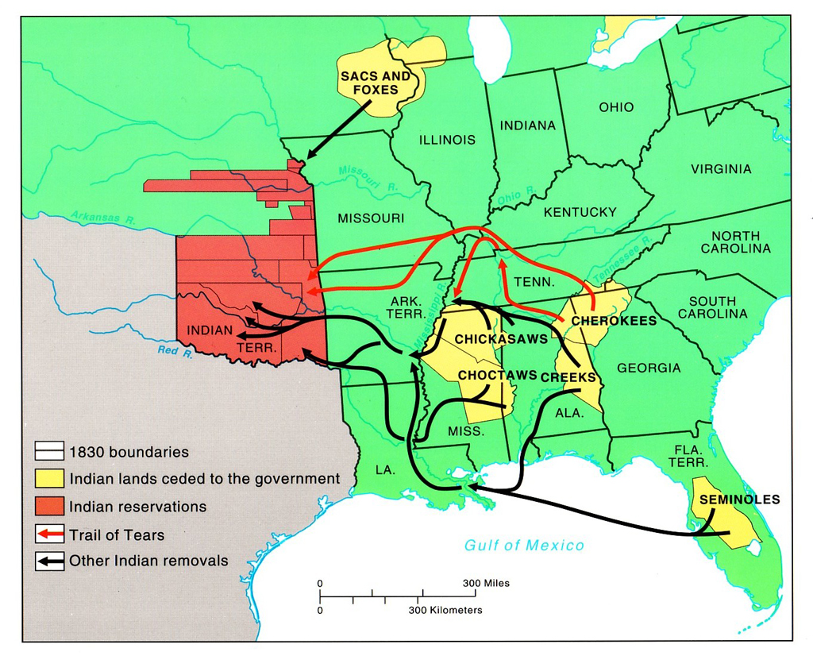
DEVELOP YOUR MAP

Slide 14
Oklahoma’s Process
Step 1: Stop the drama and start looking at our map with the destination driving our actions.

Slide 15

Our Destination Our Mission
Oklahoma’s SoonerStart Early Intervention program builds upon and provides supports and resources to assist family members and caregivers to enhance children’s learning and development through everyday learning opportunities.
  Now we know our destination – how do we measure it?
  We choose to measure the 8 key principles that build upon our mission statement.

Slide 16
Key Principle #1
Early Intervention services for children and families are most effective when agencies and organizations work together to provide services based on families needs.
  Interagency Agreement
  Interagency Contract for services
  Agency(s) participation in ICC meetings
  SoonerStart Family Survey
  Child Find data
  Service delivery by each agency by region
  Timely services
  45 day timeline

Slide 17
Key Principle #2
Infants and toddlers learn best through everyday experiences and interactions with familiar people in familiar context.
  EI Database – Services provided in natural environments.
  SoonerStart Parent Survey - Caregiver involvement satisfaction
  Early Childhood Outcomes Data
  Data on where children spend their days
  Settings data

Slide 18
Key Principle #3
All families with the necessary supports and resources, can enhance their children’s and family’s learning and development.
  SoonerStart Parent Survey - Caregiver involvement satisfaction
  Early Childhood Outcome results
  IFSP Review of supports and services outside of SoonerStart - eg: CSHCN, food stamps, medicaid etc
  Number of local staff trained on the Routine Based Interview (RBI) and usage rate with families
  IFSP content – Resources provided to families

Slide 19
Key Principle #4
The primary role of the service provider in early intervention is to work with and support family members and caregivers in children’s lives.
  SoonerStart Parent Survey - Caregiver involvement satisfaction
  SoonerStart service delivery approach
  Documentation in progress notes
  Promised services in relation to services provided
  Number of local staff trained on the Routine Based Interview (RBI) and usage rate with families
  Family goals written on the IFSP
  Provider caseload

Slide 20
Key Principle #5
The early intervention process, from initial contacts through transition, must be dynamic and individualized to reflect the child’s and family’s preferences, learning styles and cultural beliefs.
  Team use of the RBI
  SoonerStart Parent Survey
  Review of family concerns and priorities
  Compare against services that are provided on IFSP
  Number of local staff trained on the Routine Based Interview (RBI) and usage rate with families
  Complaint and Due Process Hearing data

Slide 21
Key Principle #6
IFSP outcomes must be functional and based on children’s and family’s needs and family identified priorities.
  SoonerStart Parent Survey - Caregiver involvement satisfaction
  Number of local staff trained on the Routine Based Interview (RBI) and usage rate with families
  Review of IFSP using tool to assess such as Missouri IFSP review tool
  IFSP goals reflect child and family identified needs
  Early Childhood Outcome Data
  Complaint and Due Process Hearing Data

Slide 22
Key Principle #7
The family’s priorities, needs, and interests are addressed most appropriately by a primary provider who represents and receives team and community support.
  Review of local team composition (staff and contract)
  Community collaboration – Early Head Start / Head Start Interagency Agreements
  Documentation of team input on IFSP and other documents
  Number of local staff trained on the Routine Based Interview (RBI) and usage rate with families
  SoonerStart Parent Survey

Slide 23
Key Principle #8
Interventions with young children and family members must be based on explicit principles, validated practices, best available research, and relevant laws and regulations.
  IFSP Promised services compared to IFSP services delivered.
  Monitoring and compliance data
  Complaint and Due Process Hearing Data
  Professional development provided for staff on various services delivery issues, review of higher education curriculum and inclusion of EI principles

Slide 24
Next Steps
Collect and analyze data
Involve stakeholders
  ICC
  Partner Agencies
  Oklahoma State Department of Education
Use data to determine Area of Focus

Slide 25

Tennessee
C-11 (SSIP)
Catherine Goodwin
Part C Monitoring Coordinator
Tennessee Department of Education

Slide 26

Pre Improvement Plan Planning
Mystery Presenter
Initial meetings and conversations
Internal conversations and planning

Slide 27
Results-Based Monitoring for Improvement is an opportunity to update and align TEIS work and efforts to the broader work of the TDOE to increase performance of all students. RBMI takes advantage of TEIS location within TDOE to coordinate with both 619 and Part B.

Slide 28
Results-Based
Monitoring for
Improvement
DRAFT

Slide 29
1. TEIS Topic Selection
2. Point of Entry (POE) Selection
3. Administer Improvement Strategy Tool with POE(s)
4. Develop POE Improvement Plan
5. Implement the Improvement Plan
► TEIS Technical Assistance Efforts
► POE Efforts
► Local Provider Efforts
6. Ongoing Measurement Until Criteria

Slide 30
Topic selection is supported by recently updated content in the Revised TN Early Learning Developmental Standards (TN ELDS) Birth-48 Months. These pre-academic concepts align with the broader work and focus of IDEA Part B SSIP and TDOE’s efforts to improve all student performance through consolidated and results focused ESEA/IDEA/fiscal monitoring.

Slide 31
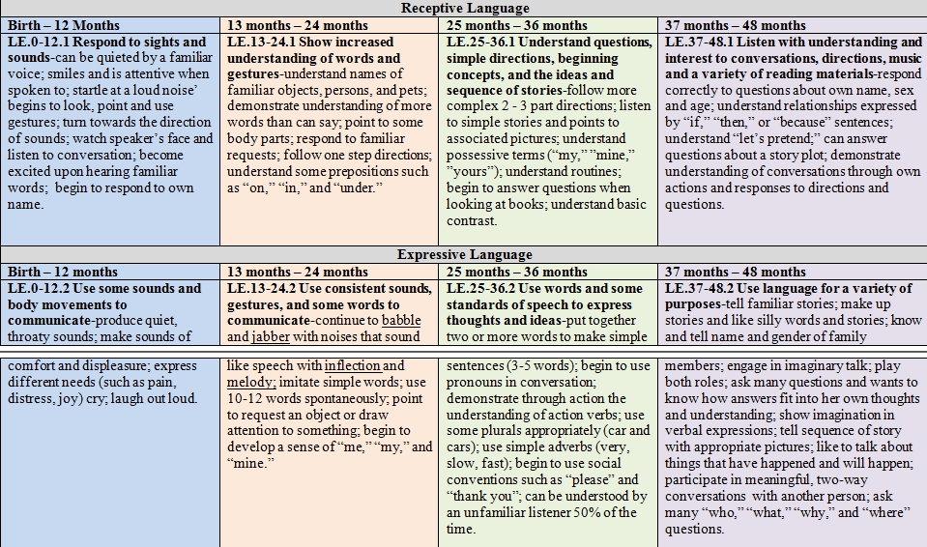
Revised Tennessee Early Learning Developmental Standards: Birth – 48 Months

Slide 32

Florida
Florida Department of Health
Children’s Medical Services
Early Steps
Penny Geiger, Bureau Chief

Slide 33


We are what we do repeatedly. Excellence, therefore is not an act but a habit.
Aristotle

Slide 34

SSIP Beginning Steps
Spring 2012
Closer look at disaggregated data
Move from data reporting to possible improvement strategies

Slide 35

Family Outcome Data
Family Survey - NSCEAM
  Local Early Steps Programs interested in their results (15 regional local lead agencies)
    What did scores mean
    Relationship between three outcome areas measured
  Each program identifies priority items from survey based on results
  Process for family survey optimized

Slide 36

Child Outcome Data
Tool - Battelle Developmental Inventory, 2
First look at data:
  Children enter typical, exit not typical
  Social/Emotional data

Slide 37

Child Outcome Data
Hypothesis
Positive social, consistent relationships are base from which developmental potential is possible
Social/Emotional skills not sufficiently addressed unless deficit area
Providers have limited knowledge/strategies to address social/emotional needs of child/caregiver dyad
Conclusion
Social/Emotional development identified as area of focus

Slide 38
Additional Data
Analyzed disposition data
  Increased number of “Lost to Follow Up”
Hypothesized
Compliance requirements may have unintended consequence – close instead of engaging family
Family engagement from referral to exit is critical to get positive results from early intervention
Conclusion
Family engagement is identified as area of statewide focus.

Slide 39

Next Steps
Engage broad stakeholder group to analyze the data and review focus areas to develop plans for improvement

Slide 40

Questions
?

Slide 41
Discussion
What data do you have to analyze for your SSIP?
What concerns, if any, do you have with those data?
What might be done to reduce concerns? (E.g., address validity concerns.)
How might data improvement be addressed pre SSIP, during SSIP development, and after SSIP is in place?
If you were sitting on top of the PDH (perfect data heap) what data would you analyze? What would that analysis look like? What might it take to get there . . . or part way there?

Slide 42
Discussion
Which proposed resources do you think would be most helpful? Why?
Least helpful? Why?
What additional SSIP resources would you suggest be considered for development?

Slide 43
Discussion
What types of SSIP evaluation activities might be considered?
Who would be involved in the evaluation?
What stakeholders might you consider bringing into the SSIP fold?
What roles would stakeholders be expected to have in SSIP development?
In the ongoing SSIP?

Slide 44
Contact Us
Catherine Goodwin, TN
Catherine.Goodwin@tn.gov
Penny Geiger, FL
penny_geiger@doh.state.fl.us
Mark Sharp, OK Mark.Sharp@sde.ok.gov
Bruce Bull, DaSy Consultant
bruce.bull@spedsis.com
Anne Lucas, ECTA/WRRC
Anne.Lucas@unc.edu

