Slide 1

Planful Changes: Using Self-Assessments to Improve Child and Family Outcome Measurement Systems
Lauren Barton, ECO at SRI, DaSy
Melissa Raspa, ECO at RTI
Improving Data, Improving Outcomes Conference
Washington, DC Sept. 15-17, 2013
Notes:
1
Quick check… who is in the audience…
Coordinators, data managers, state TA providers, national TA providers, higher ed., others?
How many in your current positions when your state first started to collect child outcomes data?
Working in this position, < 1 year, < 2 years, < 5 years, < 8 years, < 10 years

Slide 2
Today’s Session
Need for and where child and family outcome measurement systems fit in the “big picture”
Provide background on the COMS and FOEMS self-assessment tools
How states are using these tools
Simulate how stakeholder teams might use the self-assessment tools and learn about the content on the tool
Begin to plan how to use the tools in your state
Notes:
Work with the tools and consider how to use them in your state….

Slide 3

Why Child and Family Outcomes?
Notes:
Growing realization need not just to document that a program is being delivered, but that it is producing the outcomes that we value for our children. Message is being communicated in lots of ways, as bills are being written, as funders establish requirements, and in messages all the way from the top…. For example Arne Duncan recently said….

Slide 4
Why Child and Family Outcomes?
"Yet, ultimately, teachers, parents, and policymakers also need to know if young children are healthy, that they are developing essential social and emotional skills such as self-regulation and cooperative play, and that their emerging academic skills are developing appropriately. At the end of the day, early learning and development programs must begin to shift to evaluating the basic outcomes we seek and prize for our children.“
Secretary of Education Arne Duncan's Remarks at the National Association for the Education of Young Children Annual Conference November 18, 2009
Notes:
Read quote…
As with the saying we treasure what we measure… the emphasis on outcomes helps us ensure that programs are producing the results we care about for children and families.

Slide 5
System for Producing Good Child and Family Outcomes
Professional Development
Preservice
Inservice
Evidence Based Practice
High quality services and supports for children 0-5 and their families
Good outcomes for children and families
Good Federal policies and programs
Good State policies and programs
Good Local policies and programs
Strong Leadership
Adequate funding
Information infrastructure
Notes:
Outcomes don’t just appear out of nowhere. There are lots of aspects within the bigger system that must be in place to produce good outcomes for children and families.
Part of the intentionality we need to building our systems is the availability and use of good information about the direct service component and the other components in the systems. It’s shown here as the “information infrastructure”. Without good information, we are operating in a “pay and pray” mode. Without good data, we don’t know what we are buying with our money. And we don’t have the tools to identify program weaknesses and begin to address them.

Slide 6
A good information infrastructure is an essential tool to providing high quality services and supports.
Notes:
(You cannot have data based-decision making without good data.)
This really is about children and families.

Slide 7
Early Childhood Information Infrastructure:
Data Needed for Program Improvement
WHO
SERVICES
OUTCOMES
PERSONNEL
COST
Notes:
Think about the kinds of information/data need to know to improve programs, understand whether the system is accomplishing what you want…these are some of the big categories….
Who –
Ages
Disabilities
Race/ethnicity
Services – what, how much, how long – part c and 619 – many different services; not so much with state operated preschool
Give examples of key questions in each area….need good data

Slide 8
Where is your state (or program) now?
WHO
SERVICES
OUTCOMES
Early Childhood Outcomes Center
8
Notes:
8
Do they answer the questions you want them to answer…

Slide 9
Where is your state (or program) now?
WHO
SERVICES
OUTCOMES
What do you have?
How much is linked?
Early Childhood Outcomes Center
9
Notes:
9
Do they answer the questions you want them to answer…

Slide 10
Have You Been Wondering…
In our state, how well do we measure
  Child outcomes
  The experiences of and outcomes for families
What else do we need to do with our data?
How do we know if we are heading in the right direction?
How can we prioritize improvements to our outcomes measurement systems?
Notes:
Could use at program level too, though mostly geared for state level.
Purpose: Developed tools for state and local Part C/619 programs
to identify components of a high-quality system
to evaluate their existing COMS
to encourage decision making that supports

Slide 11


Notes:
These 2 tools allow you to look at your infrastructure of your system….see the pieces in place and understand how well that system can support your understanding and improvement of the system… so that we can continue to make it better for children and families we serve.
2 parallel versions for your benefit/use
Sometimes one or the other is the primary focus.
Sometimes different stakeholders use each one and synthesize ideas.

Slide 12
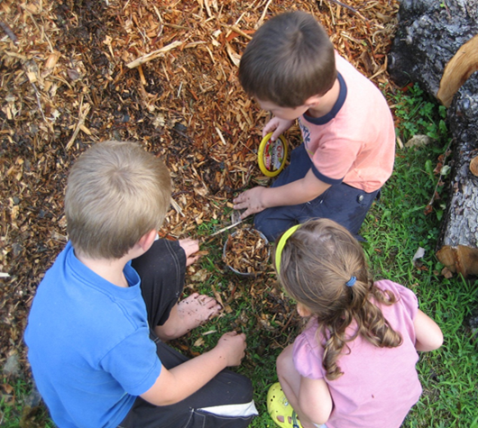
Development Process
Extensive stakeholder input about key steps in development
ECO workgroup
Iterative discussion/feedback with partner states (7 - child; 4 - family)
Feedback from Part C and 619 coordinators, national advisors, and others
Continue to listen to feedback to clarify and improve the tool
Notes:
Family: CT, IL, TX, and MN
Child: CA, MN, DE, NY, CO, ME, OH

Slide 13
Clarifying Terms
Framework
Set of components and quality indicators
Provides the structure for the self-assessment
Notes:
In each case, there are 2 core aspects…

Slide 14
The Two Frameworks…
Provide a common language
Identify key components of effective measurement systems
Provide an organizing structure for categorizing resources and state examples related to implementation or improvements to the measurement system.
Serve as the foundation for the self- assessment
Notes:
Provide a common language for ECO/other TA providers/states to use in discussing child outcomes measurement system/family outcomes and experiences measurement systems with states.
Identify key components of a system for measuring family experiences and child outcomes.
Provide an organizing structure for categorizing resources and state examples related to implementation or improvements to the measurement system.
Serve as the foundation for the self- assessment

Slide 15
Clarifying Terms
Framework
Set of components and quality indicators
Provides the structure for the self-assessment
Self-assessment
Scale that provides criteria for levels of implementation within each quality indicator
Ratings are assigned based on level of implementation within each quality indicator
Notes:
In each case, there are 2 core aspects…

Slide 16
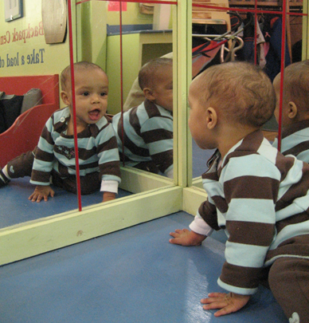
The Self-Assessments…
Provide guidance to states on what constitutes a high quality system
Evaluate strengths and weaknesses in one’s current system
Assist states in setting priorities for improvements in their measurement system
Supports efforts of state staff to advocate for resources for systems development by identifying expected capabilities of effective systems
Notes:
Provide guidance to states on what constitutes a high quality system for measurement of child outcomes or family experiences and outcomes.
Evaluate one’s current family experiences and outcomes system
Assist states in setting priorities for improvements in their measurement system
Supports efforts of state staff to advocate for resources for systems development… It identifies expected capabilities of effective systems and shows where the state’s system has deficits… some states have used this as added support for why resources should be targeted for those changes.

Slide 17
Structure
Measures progress of each measurement system toward full implementation
7 components (colored bands)
Specific quality indicators (numbered)
  15 in family outcomes and experiences
  18 in child outcomes self-assessment
Series of elements for each indicator (lettered)
  For each, decide: not yet, in process, fully implemented,
  or don’t know

Slide 18

Organization
Framework Component
1. Quality Indicator
a. Element
b. Element
2. Quality Indicator
a. Element
b. Element
c. Element

Slide 19
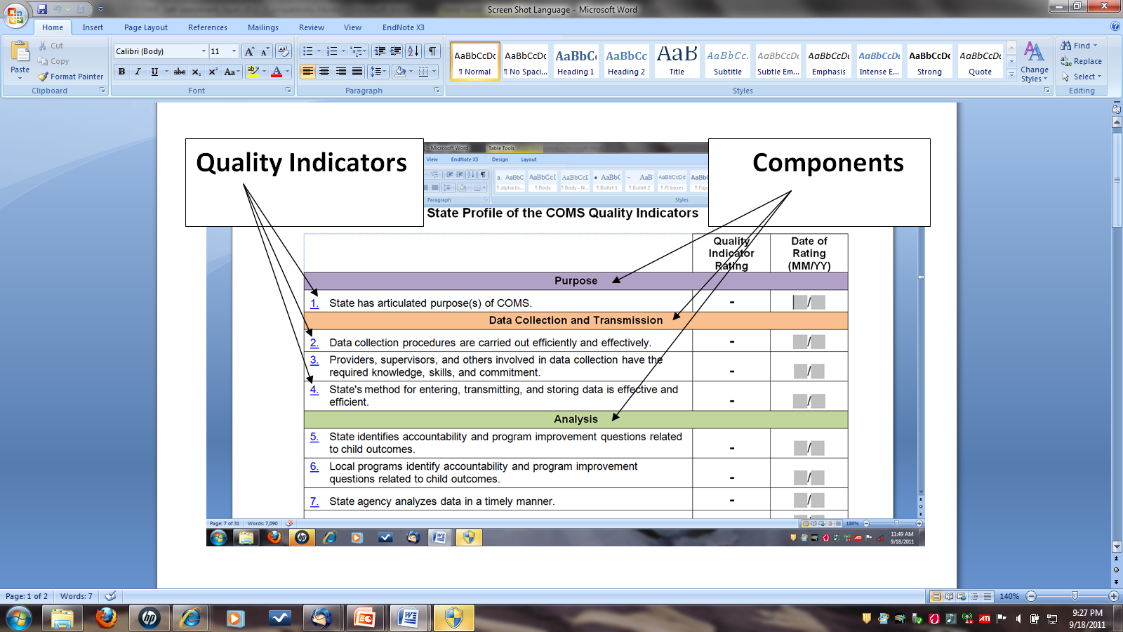
Notes:
Summary sheet
Family looks similar…
Identification of components and quality indicators (content structure on first page)…viewed as framework

Slide 20
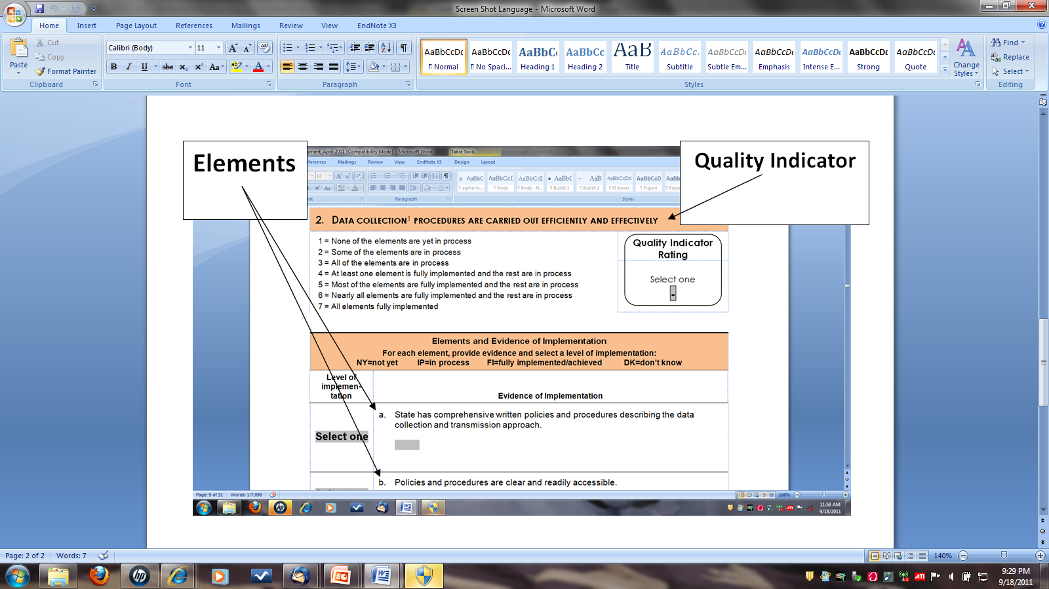
Notes:
Element details, approach for rating elements and scoring quality indicators is what makes it a self-assessment.
Note place to write in evidence of actions associated with each element and select NY, IP, FI, or DK for each element and then look across elements to generate 1-7 rating on the quality indicator. Fill in quality indicator rating and it autofills rating for summary sheet…

Slide 21
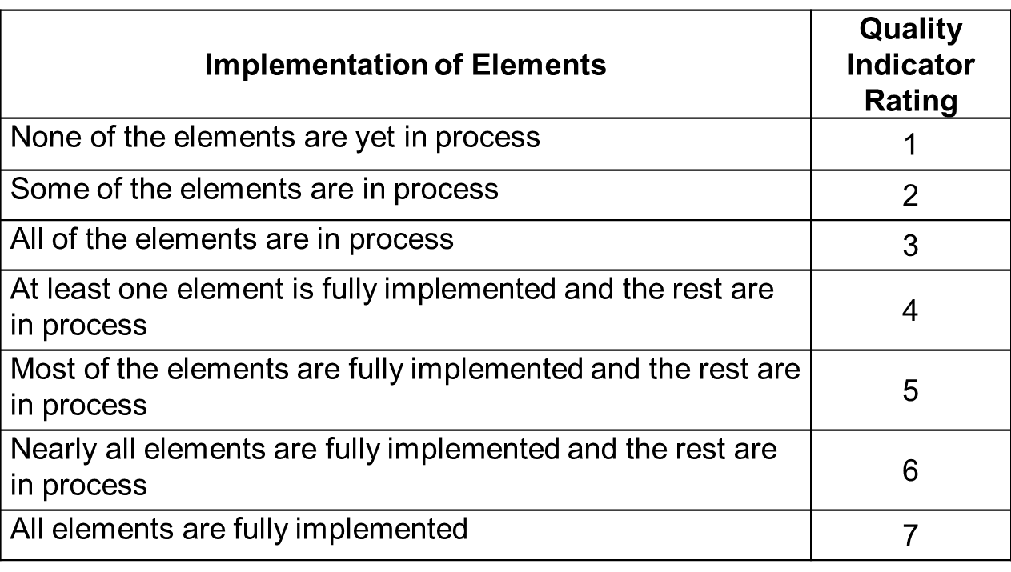
Quality Indicator Ratings
Notes:
Same for both family and child self-assessment

Slide 22
Features
Online interactive version is on the web http://www.fpg.unc.edu/~eco/pages/frame_dev.cfm
State profile page compiles overall scores
Space for evidence/notes about status on each element
Future plans to link elements to resources, state examples, and any clarifying information or definitions
Notes:
In the future watch for back-up – click on element with additional resources about state examples and information about the element
Check links for both…

Slide 23
Use
States should determine the best use and process
Flexible
Notes:
States should determine the best use and process.
There is no right or wrong way to complete it. We have recommendations and suggestions around scoring, focus is on using the content to improve your systems… variety of ways you can do that.

Slide 24

Suggested Use
Group of knowledgeable stakeholders
Part of an ongoing strategic planning process
Reassess periodically
May be completed in total or in sections
Notes:
See actual notes on bottom of next slide

Slide 25
State Uses and Approaches
WHO is involved
Convene stakeholders – composition depends on content
Small state team that seeks input/uses surveys as needed
Individual/dyad – organize thinking, guide planning
Combination
Notes:
WHO
Totally new- useful overview to organize pieces, identify need to gather information
If by yourself – small state team
If small state team – expand stakeholders
If stakeholders – more systematic build into ongoing meeting cycles and activities (sustainability)

Slide 26
State Uses and Approaches
WHO is involved
HOW process occurs
In person or via conference call
All at once or in chunks (specific groups or specific sections, gather more info over time)
One time or revisit on recurring schedule (sustainability benefits)
Sometimes include TA provider/facilitator in process or initial plan
Notes:
HOW Identify which areas are most important/need attention not all sections at once… Within section, assess where you are, what next step to take (needs, priorities)
ANOTHER – is to use as evidence of need for action (e.g., if barriers and need support to move forward)
OHIO/CO example
Approaches
Stakeholder groups: Describe OH process… how translated stakeholder input into action steps…
Smaller state team review content and reflect on their own system, ask more info if needed (survey if not know some aspect or look for more info).
Both states had individual conversations about it first (with or without ECO).

Slide 27

Results
Collect information/create report about status of different aspects of the system
List of ideas and strategies for changes discussed
Prioritize system changes to focus on
Update specific guidance documents to reflect information discussed throughout this process
Notes:
Linkages with other frameworks
ECTA
SLDS
DaSy
Links with other ECO resource documents
Local contributing factor tool
Analysis guidance documents:
Pattern checking table
Program improvement analysis guidance table
Family analysis guidance document
Reporting supports
Graphing templates
Data visualization resources

Slide 28

Questions??

Slide 29
Small Group Activity 1
Individually, read over quality indicators under your group’s component.
As a group, select one of those quality indicators
Each individual reviews an assigned element & considers how his/her state is doing, with examples
As a group, each person is to describe how they see their state on their assigned element with others at the table acting as stakeholders.
Based on the discussion, think about how you might have selected a rating and record the evidence for each element.

Slide 30
Activity 1 Reflection and Sharing
What did you think of the process of reviewing each element?
Did the process make sense? What was difficult?
Are these elements for which you would want stakeholder involvement? For which you would need multiple perspectives?
Notes:
In discussions did you find all stakeholders in the state would make the same appraisal ? What kinds of dialogue might occur within the state when thinking about this element?

Slide 31
Small Group Activity 2
How do you think the self-assessments might be useful in your state? With what process?
Timing – child/family self-assessments separately or together?
Who might you involve at different steps with the self-assessment?
Identify resources that would be helpful to benefit the most from the self-assessment process.
How would you begin to move from findings on the self-assessment to deciding on specific actions to improve your outcomes measurement system?

Slide 32

Getting Started
Jump in!
Use the self-assessment to help you improve your child outcomes measurement system!
Use the ECO Center as a resource for support
staff@the-eco-center.org

