Slide 1
Why are we here and a few more things… Kathy Hebbeler DaSy@SRI International ECO@SRI International ECTA@SRI International
Improving Data, Improving Outcomes
Washington, DC September 2013
Notes:
How many of you have never been to an outcomes meeting or a data managers meeting?
I am going to give you an overall sense of what we have planned for you with this meeting and share some other new and information

Slide 2
What’s up with all these
TA Centers?

Slide 3
DaSy
Center for IDEA Early Childhood Data Systems
New OSEP Center (as of December 2013)
TA to Pt. C and Part B Preschool agencies states around data systems
Notes:
If you are not familiar with DaSy, there are some flyers describing the Center at the registration des

Slide 4
Early Childhood Technical Assistance Center
New OSEP Center (as of December 2013)
TA to Pt. C and Pt. B preschool agencies to improve systems, practices, and outcomes
Notes:
Flyers at the registration desk if you are not familiar with ECTA.

Slide 5
Early Childhood Outcomes Center
Old OSEP Center
TA to Pt. C and Pt. B preschool agencies around building child and family outcomes measurement system.

Slide 6
ECO
As of November 1, 2013, the work of ECO becomes part of ECTA.
The same TA providers will be working on outcomes.
The contents of the ECO web site are moving to the ECTA website.
Links will be redirected.
The ECO Center will no longer exist as a separate Center but…
…the work will continue under ECTA

Slide 7
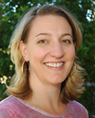
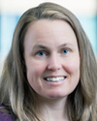
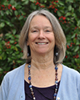
The
ECTA/ECO BuncH
Notes:
In addition to DaSy, ECTA, and ECO, you will see staff from several other TA Centers here including OSEP’s new ECPC, the RRCs, and other Department of Education Centers such as PTAC, SLDS, and ELCTA. There is a cheat sheet in your agenda booklet to help with the acronyms but the big question is…

Slide 8
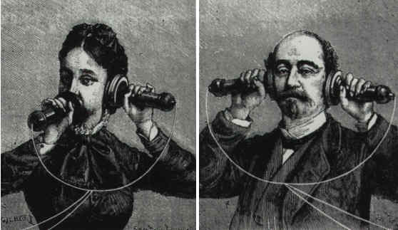
Who do I call?
Answer: It doesn’t matter

Slide 9
The Conference
Notes:
We have some rather detailed intended outcomes for the conference. I am going to summarize them for you briefly because it is really important to us to get feedback on how well those outcomes were achieved. Let’s talk about why you are here.

Slide 10
Better IDEA data
Identify and answer important questions
Improved plans
Knowledge of data systems
Knowledge of what other states are doing
Awareness of national resources
“Sense of the possible”
State sharing of resources
Improved outcomes for children and families
Improved Programs and Services
Knowledge about EC integrated data systems
Need/Value
Components
Approach
State staff can advocate, participate, develop an ECIDS
Intended Meeting Outcomes
Notes:
Increased knowledge of how enhanced data systems can improve the quality of IDEA data and how improved data systems can inform the development of improvement plans based on the data;
Increased knowledge of how data systems development is occurring in other states to provide state agency staff with information about what is possible as well as what is likely to be problematic and so states can use other states as resources;
Increased awareness of the need for a fully functional EC data system¹ (which will translate into a commitment on the part of attendees [Part C and Part B Preschool coordinators and their data managers ] to advocate for enhancing their current state data system);
Increased knowledge of what constitutes a high quality approach to building a fully functional EC data (so state staff can be knowledgeable advocates for high quality processes as they work to improve their state data system);
Increased knowledge of the necessary components of a fully functional data system (so state staff can participate meaningfully in data systems enhancement conversations within their state and advocate for a high level of data system functionality);
Increased state capacity to identify and answer critical policy and programmatic questions related to services and outcomes for children and families receiving Part C and Part B Preschool Programs;
Increased knowledge of national resources to support state data system enhancement efforts.

Slide 11
Your options
Formats
Plenaries
Workshops
Concurrent sessions
Discussions
State team time
Content
Data/Data systems
Measuring outcomes
Data use
Practices
State system
Building capacity
Notes:
Each time slot was designed to have something to appeal to different attendees. If you do not think of yourself as a data person, this is an opportunity to stretch yourself a bit. None of the sessions are designed to be highly technical. If you want to learn how to build a data system, you are going to be disappointed. We figure you can hire people with those skills. The more challenging issue is what do program staff and others need to think about as they set about improving their state data system or working to link their data system with another program’s data system.

Slide 12
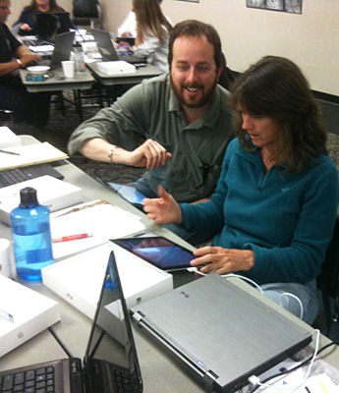
Workshops – 3 hours
Data analysis to guide improvement
Common Education Data Standards (CEDS)
Linking family and child outcomes data
Do you prefer workshops embedded in the meeting or at the beginning and end?
Notes:
CEDS – we know many of you already know about CEDS but not many of you are using the online tools to support its use. CEDS also applies to Part C. Important to data linkage. If data systems use the same data standards, it is much easier for them to talk to one another. We are going to be promoting the use of CEDS in lots of ways.
Where should we put work shops? Please let us know on the evaluation. I would like to make this sound like we are doing this as an experiment but, honestly, we could not get the hotel for longer. Nevertheless, we do want your feedback on where to put workshops.

Slide 13
Early Bird Discussions
Interactive sessions
Monday – 8 to 8:45
6 different topics for discussion
Tuesday – 8 to 8:45 in
Input to the next round of CEDS

Slide 14
Concurrent Sessions
38 with 6-7 in each time slot
Mix of data and practice sessions in each time slot
Come early
Be flexible and have a second choice

Slide 15
Second Plenary
Michael Yudin
Acting Assistant Secretary for the Office of Special Education and Rehabilitative Services
Libby Doggett
Deputy Assistant Secretary for Policy and Early Learning
Christina Kasprzak
Co-Director of ECTA
Notes:
We have a very exciting closing plenary.
Michael Yudin and Libby Doggett will be here to address the group. Libby just started in her new position on at the end of August. It is a tribute to the importance of the work you do and the hard work you have done, particularly around building your outcomes measurement systems, that both of them will be here to speak with you. Many of you have heard Michael Yudin speak before and if you heard him speak at the Leadership Conference, you know the Department is talking about the outo
comes data that Part C and Part B preschool have produced. It is unique across federal early childhood programs and it is valued. And speaking of child outcomes data, Christina will be sharing with you the latest national data on child outcomes. Can you believe it? We now have 4 years of child outcomes from states. By the way, in 2 weeks, on October 1, it will be 10 years since OSEP first funded the ECO Center. It was ten years ago that those of us on the ECO Center met with many of you in this room to ask what should we be measuring for children and families. We have come a long way since those initial meetings. The states have done phenomenal work in this area. We know there is more work to be done, but all of you have a lot to be really proud of.
But wait there is more.

Slide 16
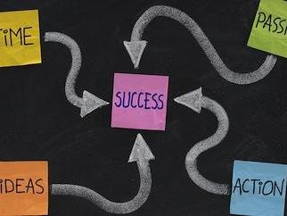
State Next Steps: Take it Back, Make a Difference (Tuesday 11:00 to 1:00)
State teams meet for a facilitated discussion
TA provider assigned to state team
Find where your state will meet in the agenda booklet
Your state facilitator will try to find you during the meeting.

Slide 17
State Next Steps: Take it Back, Make a Difference: Purpose and Outcome
Purpose for states:
Reflect on concepts/content/highlights of conference
Identify realistic ways to what was learned;
Purpose for TA Centers:
Provide ideas for TA materials, webinars, and topical meetings; and
Identify which states want/need a follow up call or TA
Outcome: Written worksheet of possible/desirable next steps in your state
Notes:
For this meeting to have value to children and families, you have to learn something but you also have to do something with what you learn. The state team sessions are meant to give state staff a time to reflect on the concepts, the content, and the highlights of the conference, and then to identify realistic ways to apply that learning. We know it is a little crazy that we bring you all the way to Washington so you can talk to people from your own State. However, we expect you will be full of ideas and this time is about harnessing the ideas that you pick up through out the meeting having some time to reflect with your colleagues as to what these ideas might mean for your state.
For the TA Centers, these sessions provide us with an opportunity to hear what resonated with you, what you want to hear more of, to give us ideas for what kind of TA we need to be providing. Your facilitator will be helping you develop a set of next steps that you can take home from the meeting.

Slide 18
Notes:
In your agenda booklet, you will find a form that looks like this. There are more copies at the registration desk. This form is to help you prepare throughout the conference for the Next Steps reflection time with your state team. We want to see lots of you pulling it out when you are sitting in sessions and making some quick notes. Do not lose those inspirations. As you sit in sessions, ask yourself “what does this mean for my state?” “What can I do with this information that will improve data and ultimately programs.” When you are thinking about next steps, think grand or think small – whatever you can do in your state. We are early childhood people. We know lots of important things come from taking baby steps. The state team time will be an opportunity for you to reflect and document with your state colleagues on what some your next steps might be. We also will be asking you if you want TA with any of those steps so it will be an opportunity for you to indicate a TA request to us.

Slide 19
We need your feedback
Please complete your evaluation form
Did the meeting achieve its intended outcomes?
How can we improve?
We will be asking ourselves is a national meeting the best use of resources?
Notes:
We apologize again for starting on Sunday, especially bordering on a Jewish holiday. As a new project trying to find hotel space late in the game, we were lucky to be able to do this at all, but we recognize these are not the most convenient days for you.
Before I continue with my remarks, I want to pause here and thank our conference planning team who have done a phenomenal job of pulling this meeting together.
And a special thank you to the staff from Frank Porter Graham for handling the logistics.
And finally a very big thank you to Martha Deifendorf, our hero, who has remained completely unflappable as she worked her miracles on a daily basis.

Slide 20
A big thank you to Martha Diefendorf and our wonderful conference team!!!

Slide 21
Maps are coming
Notes:
Remember in the needs assessment, we asked you to give permission for your data to be shared on an interactive map? Well, we confused a lot of you with how we asked that question and we apologize for that. I want to take a few minutes to explain what we will be doing because we want everyone to understand. I am going to show you an email where you can send questions if you don’t.

Slide 22
Notes:
Many of you have seen those maps that show state status with regard to something. We are developing maps for the DaSy web site right now that will show where states are on 10 different facets related to state data systems. These facets will be shown across the top of the map on the web site and you will be able to click on one and see where each state is. To simplify not having to do a completely separate set of maps for C and Part B preschool, we combined the information from each state on the two programs. When you look at a map for a facet, you will see whether it is a yes for C and B meaning they both have it, a yes for one and a no for the other, a no for both, or we are do not have information for one of the programs. This could be because the state did not complete the survey or did not give permission to share the information. By the way, this is not real data. This is a mockup for our web designers.

Slide 24
The contents of the map can be changed
If….
You see an error for your state…
Information for your state is missing…
Your state did not give permission and now that you see the map, you would like to give permission…
Your state gave permission and you want to withdraw permission…
Send an email to dasycenter@sri.com
Notes:
If you look at the map and realize, you answered a question incorrectly, no problem – get in touch with us. If you didn’t complete the survey or didn’t provide information for an item, get in touch with us. If you were sure about this permission thing and now that you see it on the web site, you realize it is something you would like to be a part of, get in touch with us. All you have to do is get in touch with us.

Slide 25
Please send us the links to your state’s materials on data systems issues, especially early childhood data systems.

Slide 26
Staying Connected

Slide 27
Join the conversation about Improving Data, Improving Outcomes using Social Media
Notes:
How many of you are on Facebook?
Do you tweet—How many of you are on Twitter?
You’re not alone—the DaSy Center is also on Twitter and Facebook.
We want to invite you to be our FRIEND on Facebook and FOLLOW US on Twitter @DaSyCenter.
We are inviting your interaction during the conference and beyond. You can expect DaSy to continue to share news, events, and activities.

Slide 28
Twitter, Tweet, Retweet!
Follow us on Twitter @DaSyCenter
Retweet or Reply to our tweets.
Tweet what you’re hearing; tweet your questions.
During the Conference use the hashtag #ImprovingDataOutcomes
Notes:
Do you want to stay up-to-date with what’s happening at the conference?
Follow us @DaSyCenter. During the conference, Tweet about what you’re hearing.
Tweets are small bits of information – 140 characters – that connect you and others to cutting-edge information.
Say you’re in a session, and you hear a strategy that’s new to you: Tweet about it @DaSy Center and use the hashtag #ImprovingDataOutcomes. (this information is also on your agenda!)

Slide 29
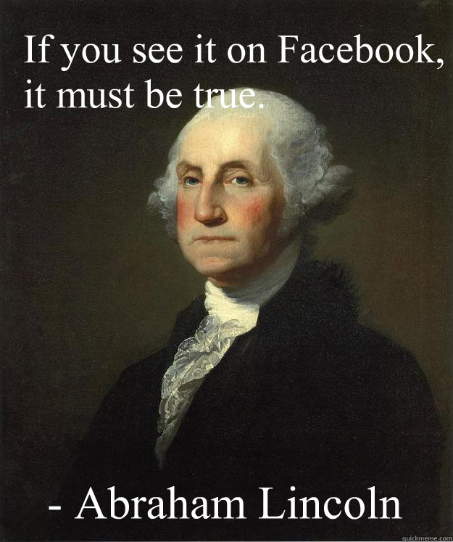
Friend Us, Like Us, and Post!
Like us on Facebook on the Dasy Center page.
Let your status show that you’re at the Improving Data, Improving Outcomes Conference.
Share what you’re hearing!
Notes:
You can rely on the DaSy Center to provide a newsfeed to the data issues of Part C/619.
We’ll keep you connected with the DaSy partners through Facebook, too. You can ‘friend’ us, ‘like us’ and post to our Dasy Center page on Facebook.
For example, the ECTA Center also has a Twitter presence (@ECTACenter) and Facebook page (ECTA Center)
Join the conversation about Improving Data, Improving Outcomes on Twitter and Facebook as we build the network together.

Slide 30
@DaSyCenter #ImprovingDataOutcomes Dasy Center
Notes:
Maybe your goal is simply to see what the DaSy Center is sharing. That’s a great way to use social media, too.
We will have our finger on the ‘pulse’ of your interests and concerns as you interact with us on social media.
It is on the first page of your agenda
Let’s see where social media takes us in creating a kind of real time ‘community’.
Join the conversation about Improving Data, Improving Outcomes on Twitter and Facebook as we build the network together.

Slide 31
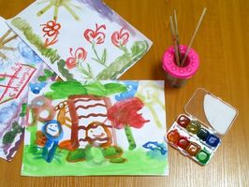
Moving forward
Notes:
Why the emphasis on data? This is about building capacity – but this is a pretty complicated capacity.
Requires technology, requires procedures (data collection, data verification), well defined data elements
Human capacity to collect and use the data. Data can be a powerful tool but having it and using it does not come easy. So we have an entire center focused on helping you build your data tool box.
I want to thank all of you for what you do. You are truly an inspiration to those of us who do technical assistance and we want to do whatever we can to support you. Each of us plays a small part in the systems that provide young children and their families with the service and supports they need to address whatever developmental challenges those children are facing. I started my career by teaching preschool but decided that making a difference for 15 kids in the morning and 15 kids in the afternoon was not enough for me. So I became a researcher and worked in a large school system where presumably I could make a difference for 1000s of kids – but the problem as you move away from kids is that you can’t really see your impact anymore (and you end up with a job that has your mother always saying “tell me again what it is that you do everyday.”
You too might not be able to describe what you do or see all the difference that you are making. You work in a complex system that is every bit as real as the chair you are sitting on – but it is a whole lot harder to see or move. We hope you agree that good data can play an important role in changing systems and improving services. We hope that in our next two days together you will hear many things that inform you and inspire you. So let’s all go learn together and have some wonderful ideas.

