Slide 1
Data Workshop:
Analyzing and Interpreting Data
Cornelia Taylor, DaSy/ECO at SRI
Lynne Kahn, DaSy/ECTA/ECO at FPG
Taletha Derrington, DaSy at SRI
Presented at the Improving Data Improving Outcomes
Washington, DC, September 2013

Slide 2
1. Using Data

Slide 3
Using data for program improvement = EIA
Evidence
Inference
Action

Slide 4
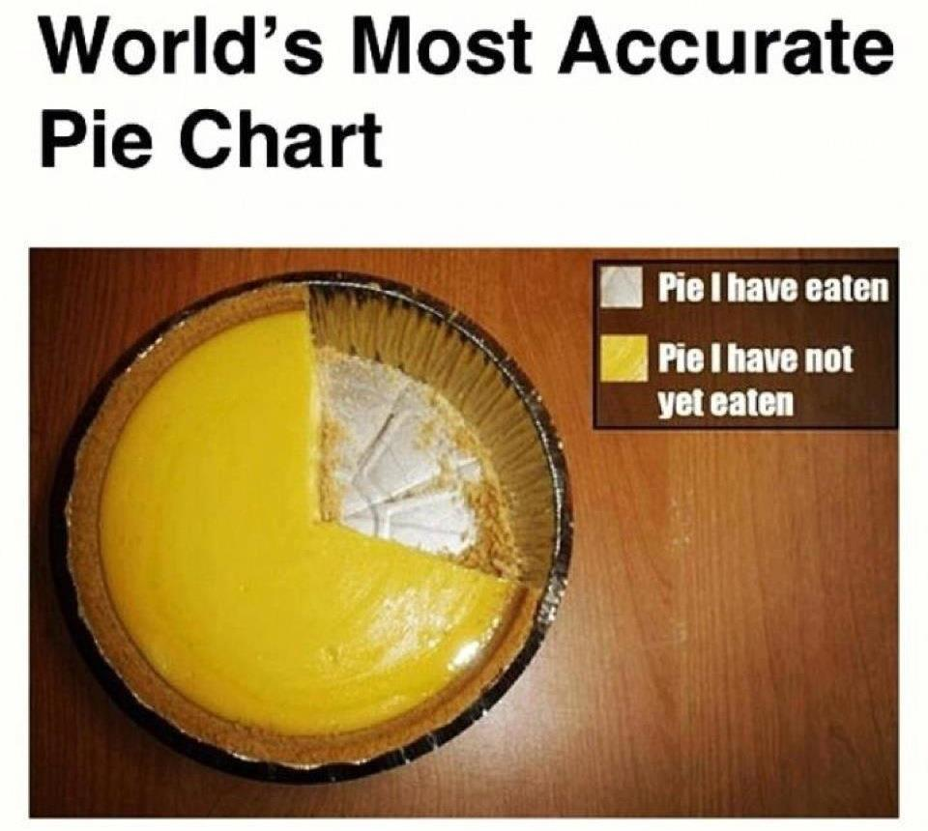
Evidence
Evidence refers to the numbers, such as
  “45% of children in category b”
The numbers are not debatable

Slide 5
Inference
How do you interpret the #s?
What can you conclude from the #s?
Does evidence mean good news? Bad news? News we can’t interpret?
To reach an inference, sometimes we analyze data in other ways (ask for more evidence)

Slide 6

Inference
Inference is debatable -- even reasonable people can reach different conclusions
Stakeholders can help with putting meaning on the numbers
Early on, the inference may be more a question of the quality of the data

Slide 7
Action
Given the inference from the numbers, what should be done?
Recommendations or action steps
Action can be debatable – and often is
Another role for stakeholders
Again, early on the action might have to do with improving the quality of the data
Notes:
Action steps = training and TA, for example – first to improve the quality of the data, then to improve programs when the inference is that improvement is needed

Slide 8
Good Data??
 |  | Programs
 |  | Bad/Weak | Good/Strong
Data | Bad/Weak | ?? | ??
 | Good/Strong | Program Improvement Questionable → Good | Program Improvement Good → Better

Slide 9
Good Data??
 |  | Programs
 |  | Bad/Weak | Good/Strong
Data | Bad/Weak | ?? | ??
 | Good/Strong | Program Improvement Questionable → Good | Program Improvement Good → Better

Slide 10
Good Data??
 |  | Programs
 |  | Bad/Weak | Good/Strong
Data | Bad/Weak | ?? | ??
 | Good/Strong | Program Improvement Questionable → Good | Program Improvement Good → Better

Slide 11
Crucial questions and hypotheses

Slide 12
Characteristics of Crucial Questions
Important to programs, families and other stakeholders
Well defined
Clear expectations for what you will find
Matched to the elements in your data system
Linked to actions

Slide 13
Asking Important Questions
Is the question related to important efforts in your system?
Does this question come up across groups stakeholders?
Is this question linked to existing accountability efforts?

Slide 14
Well Defined Questions
Crafting clear crucial questions allows for easier interpretation down the line.
First step – frame a what question as simply as possible
  e.g. What do programs with the best child outcomes do better?
Second step– get more specific
  e.g. Do programs with the best child outcomes participate in the CELL initiative.
Adapted from: Kekahio, W., & Baker, M. (2013). Five steps for structuring data-informed conversations and action in education (REL 2013–001). Washington, DC: U.S. Department of Education, Institute of Education Sciences, National Center for Education Evaluation and Regional Assistance, Regional Educational Laboratory Pacific. Retrieved from http://ies.ed.gov/ncee/ edlabs

Slide 15
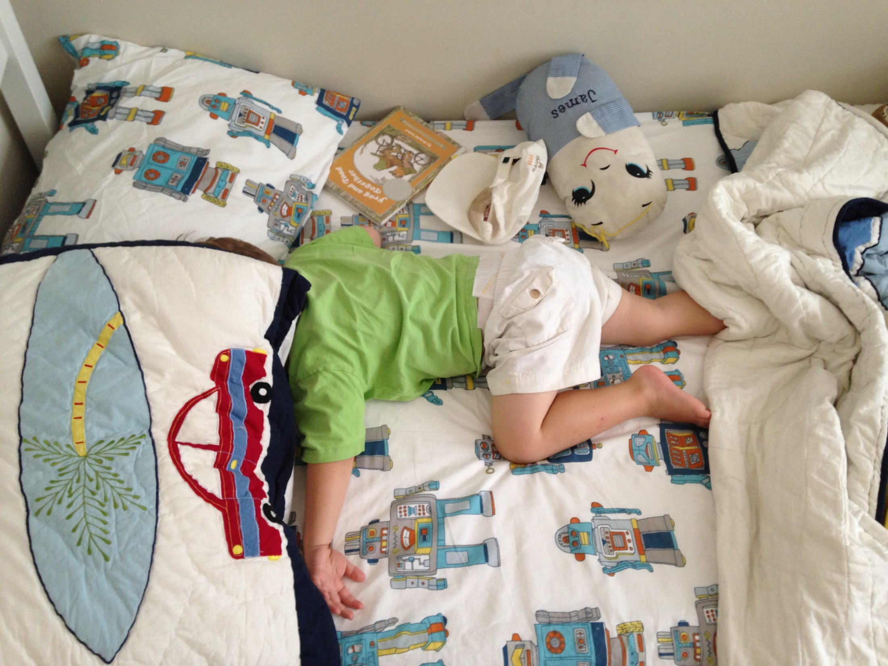

Slide 16
Clear expectations (if-then)
If CELL improves children’s language and literacy skills then programs that participate in the initiative will have a higher percentage of children exiting at age expectations in their acquisition of knowledge and skills compared to matched programs that did not participate.

Slide 17
Matched to the elements in your data system
Break down you crucial question into data components
Do you have all of the data components in your system?
If not, is there another way to ask the questions with the elements that are in your system?

Slide 18
Some inferences are more actionable than others
  Not Actionable
  Infants and toddlers with older siblings are more likely to exit at age expectations in positive social emotional skills than those without older siblings
  Actionable
  Children that participate in community playgroups are more likely to exit at age expectations than those that do not.

Slide 19
Exciting new tool!
ANALYZING CHILD OUTCOMES DATA FOR PROGRAM IMPROVEMENT: A GUIDANCE TABLE
Available on the ECO website
http://www.ectacenter.org/~pdfs/eco/AnalyzingChildOutcomesData-GuidanceTable.pdf

Slide 20
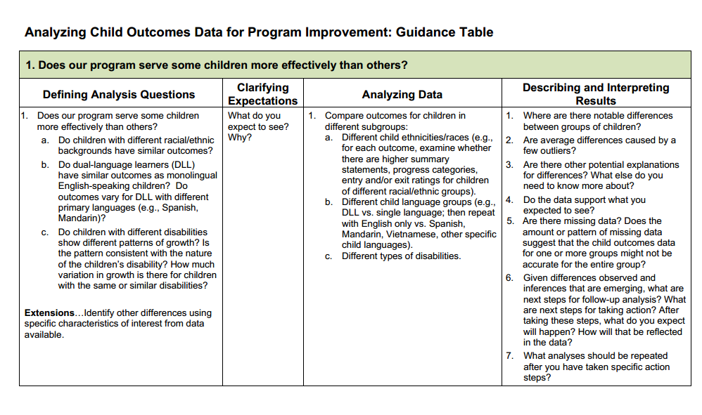

Slide 21



Find more resources at: www. the-eco-center-org
Thank you!!

