Slide 1
OSEP New Data Manager Overview

Slide 2
Objectives
Briefly review the IDEA data collections
Outline OSEP’s data quality review process and associated documents
Introduce OMB Max
Demo the Max main page, Part B and Part C pages, and individual state pages
Provide information on account setup, uploading and downloading documents, and posting comments

Slide 3
IDEA Data Collections
Part C
Part B
Child Count and Settings
Exiting
Dispute Resolution
Child Count and Ed Environments
Exiting
Personnel
Discipline
Dispute Resolution
Assessment
MOE/CEIS

Slide 4
OSEP Review
Timeliness
  Are the data in by the due date?
Completeness
  Are all file specifications submitted?
  Are all category sets, subtotals, and totals submitted?
  Do data match our metadata sources?
Accuracy
  Do data meet our edit checks?

Slide 5
The Data Review Process
System closes on the due date for a “snapshot” of the data; snapshot is used for OSEP’s review
OSEP reviews the snapshot data for timeliness, completeness, and accuracy
Once review is complete, OSEP posts a Data Quality Review Report to each State’s individual OMB Max webpage
State reviews report and begins preparing for reopen period
States may resubmit or provide a data note during reopen period (approx. 1 month)
OSEP reviews data notes and/or resubmissions

Slide 6
Tentative Timelines For Data
Note: Current year only
2013-2014 Exiting (B&C), Dispute Resolution (B&C), Personnel (B), Discipline (B)
  Due Date: November 5, 2014
  Reopen Period: May 11, 2015 - June 5, 2015
2013-2014 Assessment Collection
  Due Date: December 17, 2014
  Reopen Period: February 23, 2015 - March 6, 2015 (Matches CSPR)
2014-2015 Child Count/Settings (C); Child Count/Ed Environments (B)
  Due Date: April 1, 2015
  Reopen Period: June 8, 2015 - July 3, 2015
FFY 2013 / 2013-2014 MOE & CEIS (B)
  Due Date: May 6, 2015
  Reopen Period: August 3, 2015 – August 28, 2015

Slide 7
Tentative Timelines For
Metadata (Note: Current year only)
State Supplemental Survey (SSS) – IDEA
  Metadata for SY 2013-14
    Initial open – January 8, 2014 – January 28, 2014**
    (ALREADY OCCURRED)
    Reopen period – December 1, 2014 – December 12, 2014
  Metadata for SY 2014-15
    January 2015 (TENTATIVE)
EMAPS Assessment Metadata Survey
  Metadata for SY 2012-13
    Initial Open – July 15, 2014 – August 8, 2014 **
    (ALREADY OCCURRED)
    Reopen Periods
      September 2, 2014 – September 12, 2014
      December 1, 2014 – December 18, 2014
      February 23, 2015 – March 5, 2015
      April 13, 2015 – April 15, 2015

Slide 8
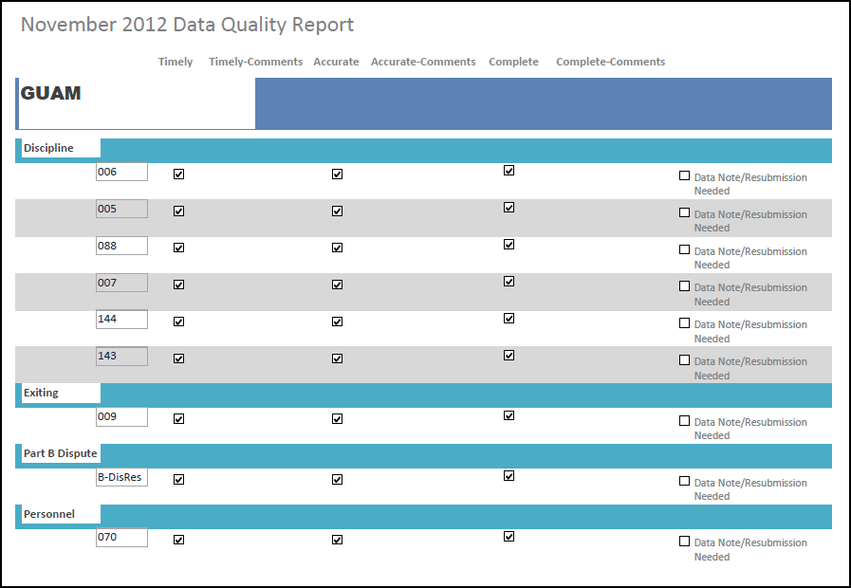
Documents: Data Quality Report – Part B

Slide 9
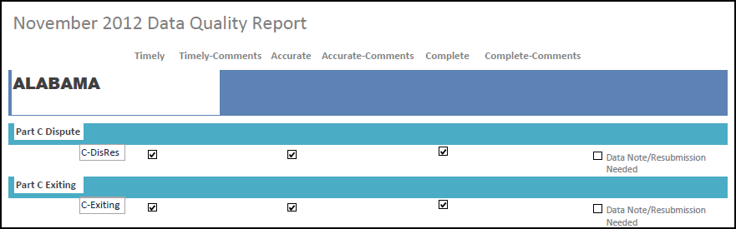
Documents: Data Quality Report – Part C

Slide 10
Examples of Common Error Comments
Part B
Part C
“Did not submit N/X ###”
“Data does not match information specified in State Supplemental Survey IDEA”
“Data missing for multiple disability categories and exiting reasons”
“Category Set A and Subtotal 2 do not match Subtotal 1 and Grand Total”
“Sum of columns 5B, 5C, and 5D is greater than the sum of columns 1A, 2, 3A, 3B, 4A, and 4B for multiple disability categories”
“Value must be a positive integer or 0”
“Missing is not a valid selection when a value has been provided”
“1.1b +1.1c > 1.1”
“Q1 Race/ethnicity total <> Q1 Gender total”
“Child Count date does not fall within proper range”

Slide 11
Year to Year Changes
Goal is to highlight large changes in counts between years
  Helps to identify possible data errors
  Data notes on the changes can help users better understand the data
Utilized a 20/20 rule for subtotals
  Change from the 10/10 rule previously used
Based on a percent change calculation for two most recent years
*We realize you might not know why a year to year change occurred. This is okay, but we still want to know you at least looked at it.

Slide 12
Year to Year Reports

Slide 13
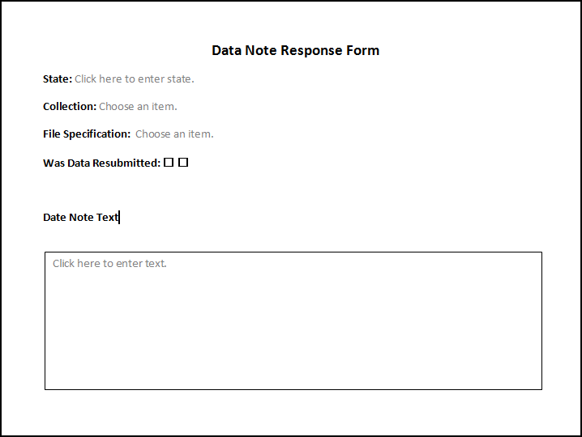
Documents: Data Note Response Form
Note: The form is still in production. This is a preliminary draft view.
Notes:
We will send this to you.

Slide 14
Data Quality Tools and Resources
Part B
Part C
EDFacts OSEP pre-fill reports
  SEA-level
  LEA-level
EDFacts Error Submission Reports (for data submitted to ESS)
Warnings or Errors in EMAPS submissions
Review and Submit Forms in EMAPS
HTML reports
Year-to-Year-Change Reports
OSEP comments on OMB MAX

Slide 15
Data Managers, Meet Max
Max, Meet the Data Managers

Slide 16
Why Max?
Online communication tool has been previously utilized
We want to maintain an online, up-to-date, communication tool that is:
    Private and secure
    Self-contained and able to store files and communications
    Accessible to State staff
    OSEP managed
    -FREE-
Max allows us to offer user-group type communication tool.

Slide 17
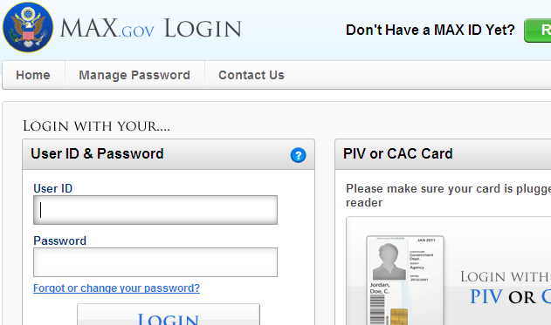
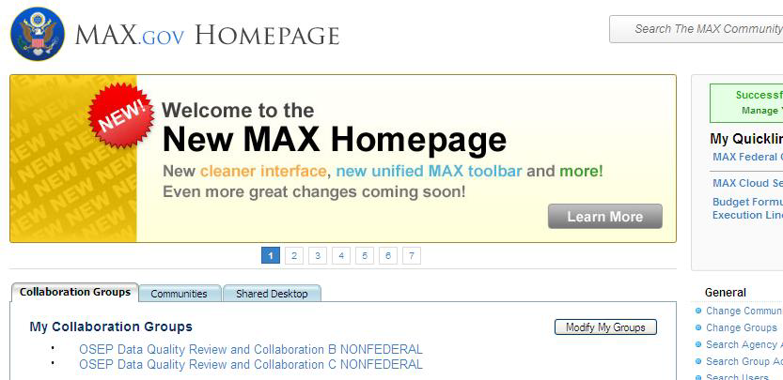
Getting Started: Max
Setting up an account
  You will be getting an email from max@omb.eop.gov with an invitation and instructions to set up your Max account
  We have also prepared a step-by-step document to guide you through the process
Once you have an account
  Login at www.max.gov or http://login.max.gov to go directly to the login page

Slide 18
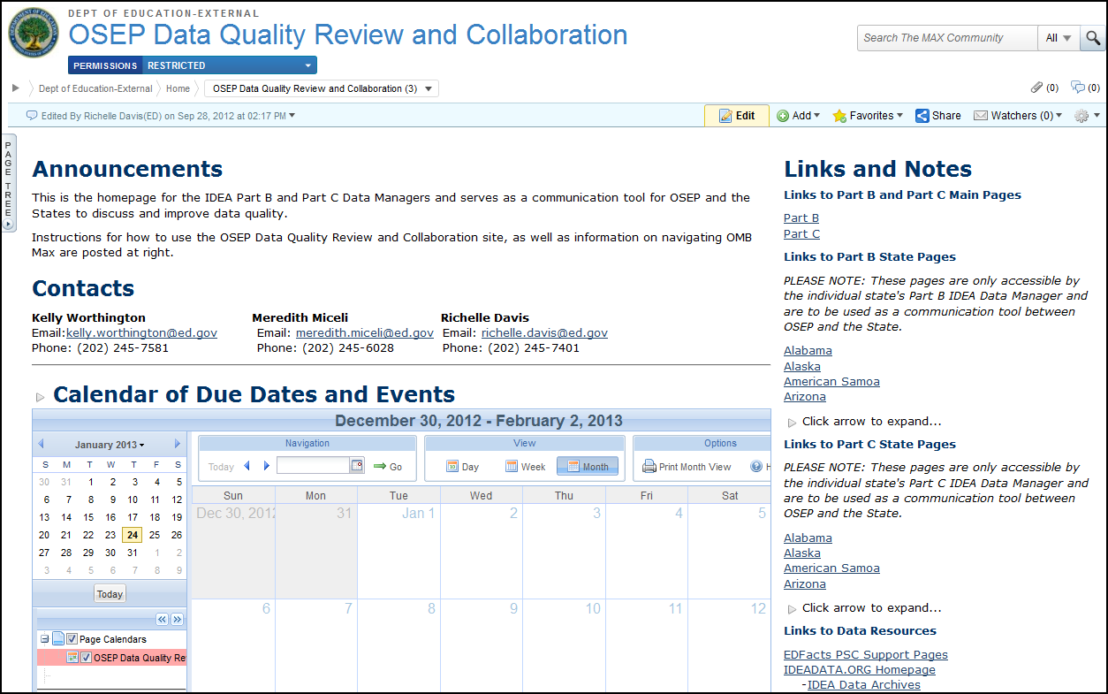
Main Page

Slide 19
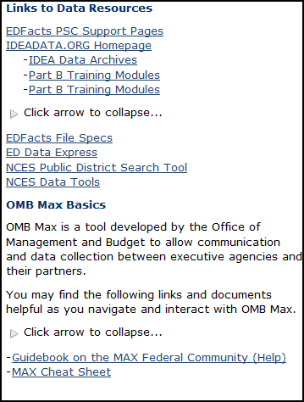
Main Page continued

Slide 20
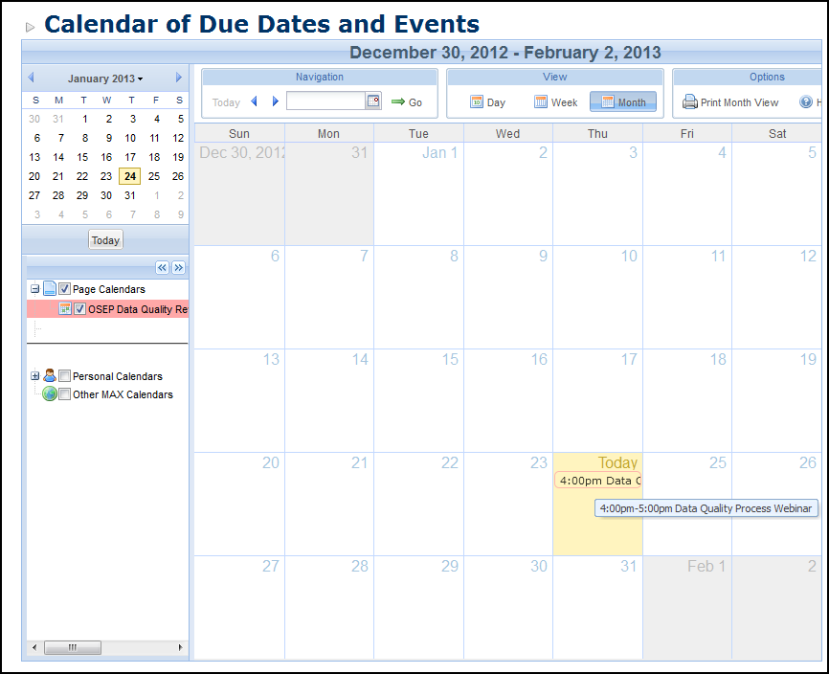
Main Page: Calendar
Calendar is MS Outlook based
Hover over an event to read the description
Let us know if Data Managers have dates they would like included

Slide 21
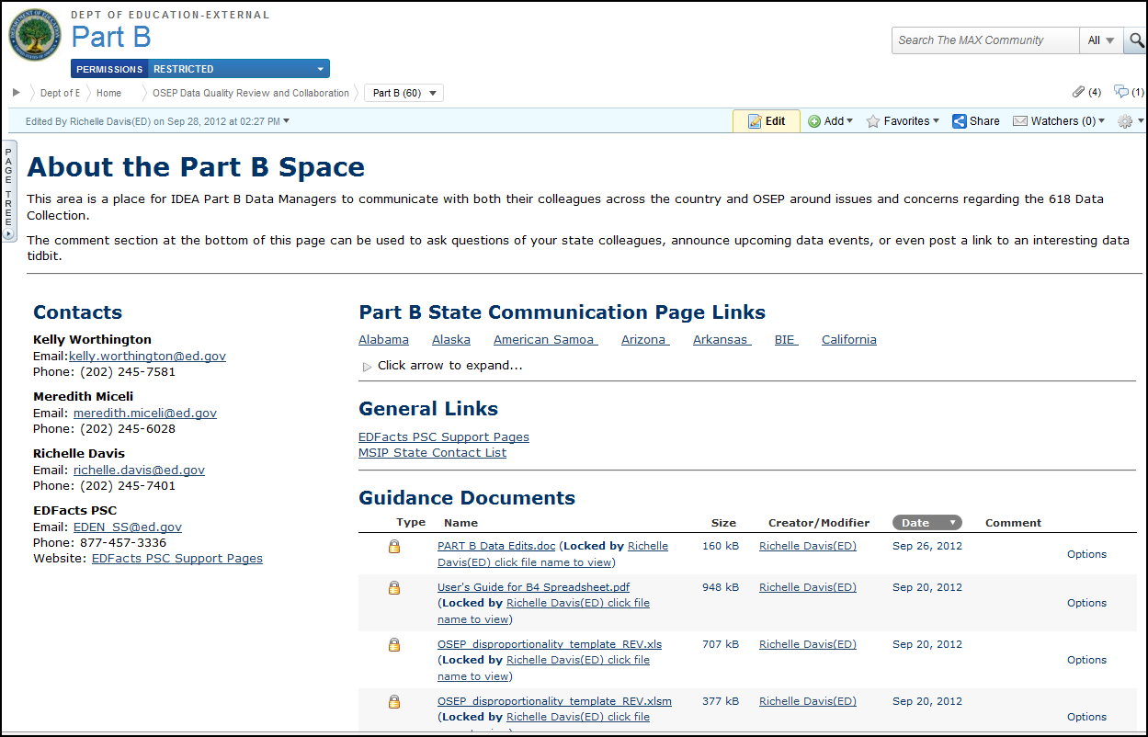
Part B Collaboration Page

Slide 22
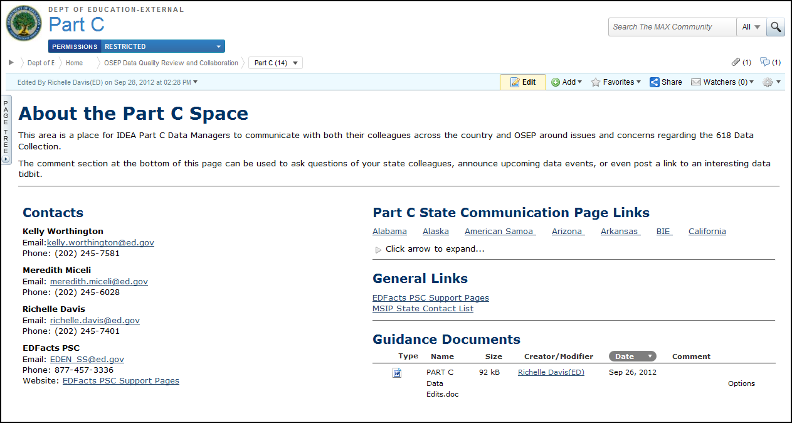
Part C Collaboration Page

Slide 23
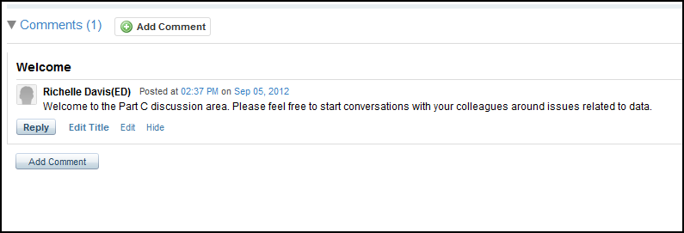
Part B & C Comment Sections
Located at the very bottom of the Part B & C Collaboration Pages
Can only be seen by fellow Part B or fellow Part C data managers and OSEP
Keep it clean and friendly, please ☺
Notes:
Former listserv

Slide 24
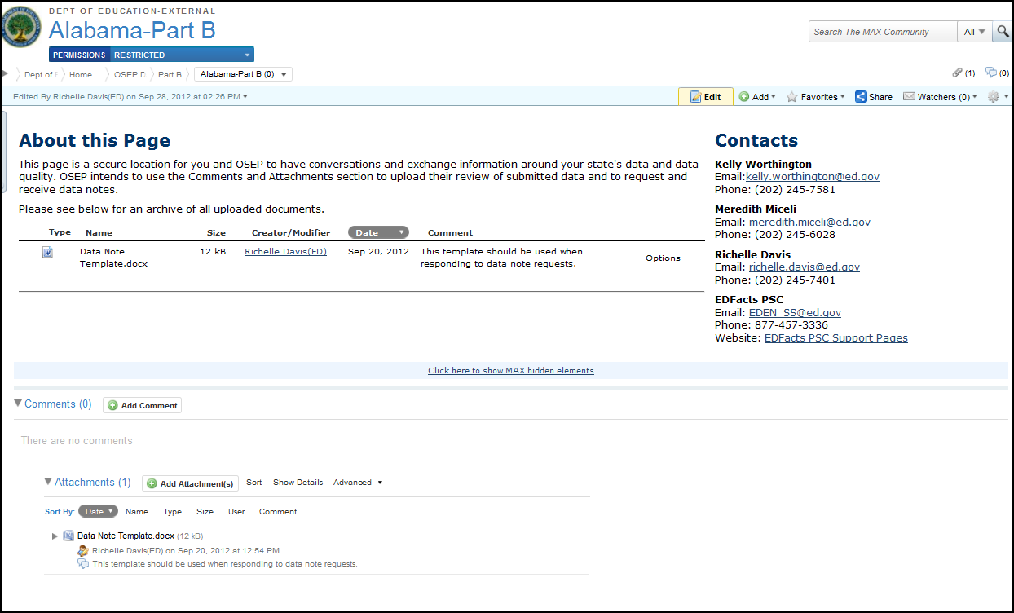
State Communication Pages
You can download an attachment by just clicking on it
Use “Add Comment” on your State Page to privately communicate with OSEP about issues with MAX
Just click “Add Attachment” to upload your data notes

Slide 25
Next Steps
Email PSC and Richelle @ richelle.davis@ed.gov if you do not have an account
Once you set up your account, please log in and familiarize yourself with the site
  You may not be able to see your state page immediately. Please allow a day or two for security settings to take hold
Max is OSEP’s data communication vehicle. Please check it frequently or set up Max to “watch” the page
  Directions for “watching” included on “Max Cheat Sheet” to be sent out with account set up instruction following webinar
  **This method of communicating data quality issue is a change from the former process of sending individual emails**
Remember: All questions related to 618 submission should still go through PSC
  They are able to track comments and then escalate them

Slide 26

EDFacts Partner Support Center (PSC)
Hours of Operation: 8:00 a.m.−6:00 p.m.
Eastern Standard Time (EST) -- Monday-Friday.
Contact information
Telephone: 877-457-3336 (877-HLP-EDEN)
Fax: 888-329-3336 (888-FAX-EDEN)
TTY/TDD: 888-403-3336 (888-403-EDEN)
E-mail: EDEN_SS@ed.gov

Slide 27
PSC Communication
PSC Support Update - Distributed once a week. Sent to EDFacts Coordinators and IDEA Part B Data Managers. Contains information on upcoming collections, webinar announcements, updated guidance and a file due date reminder. PSC’s main vehicle for distributing news to states
Broadcasts- The main form of communication on IDEA Part C collections. PSC sends broadcasts to IDEA Part B and IDEA Part C Data Managers. Broadcasts often contain reminders of collection openings and due dates as well as webinar invitations.
Outreach - PSC also periodically conducts state specific outreach to address data issues in ESS.
State Specific Emails- PSC may reach out to your state to address specific data issues or to facilitate a conference call with OSEP

Slide 28
EMAPS automated emails
Possible notifications during original submission period:
  When the system is open
  When data has been submitted
  When there has been no account activity two week prior to due date.
  When data has been entered, but not submitted three days prior to due date
  If there are data errors in the submissions three days prior to due date
Possible notifications during resubmission period:
  Resubmission is required
  The system has been reopened
  Corrected data has not been submitted one week prior to close of the reopen period
  One week prior to the close of the reopen period

Slide 29
Helpful links
EdFacts Files Specs
  http://www2.ed.gov/about/inits/ed/edfacts/file-specifications.html
EMAPS User Guides
  http://www2.ed.gov/about/inits/ed/edfacts/index.html
IDEA Part C Documentation
  http://www2.ed.gov/about/inits/ed/edfacts/index.html
IDEA Part B Section 618 Data Quality Webinar
  http://www.mediafire.com/?d5xr2kz3skx2dz3
IDEA Part C Section 618 Data Quality Webinar
  Part C Webinar for Aug 20th.ppt

Slide 30
Thank you. Questions?

