Slide 1
State Panel on the Benefits of CEDS: Finding Out if Your Data Actually Meets Your Needs
Alice Ridgway, Connecticut Part C
Vera Stroup-Rentier, Kansas Part B 619
Tony Ruggiero, DaSy, IDC
2014 Improving Data, Improving Outcomes Conference
September 9, 2014

Slide 3
DaSy CEDS Team
Tony Ruggiero, AEM
Haidee Bernstein, Westat
Missy Cochenour, AEM
Abby Winer, SRI
Nancy Copa, AEM
Notes:
Estimated Time: 1 minute

Slide 4
Knowledge and Use of CEDS
Survey (2013) conducted by DaSy found that:
About two-thirds of Part C (69%) and 619 staff (67%) know about CEDS.
Very few Part C staff use the CEDS tools (6%) and only about one-fourth of Part B 619 staff use them (23%)
Derrington, T., Spiker, D., Hebbeler, K., & Diefendorf, M. (2013). IDEA Part C and Part B 619 state data systems: Current status and future priorities. Menlo Park, CA: SRI International.

Slide 5
Session Description
Provide an overview of the CEDS
Illustrate how CEDS can support state agencies responsible for early intervention and preschool education program data
Discuss benefits of using common data elements, definitions, and the align tool
Feature Connecticut and Kansas who are incorporating CEDS

Slide 6
CEDS Overview
What are the Common Education Data Standards?
How have they been developed?
Who developed CEDS, specifically in early learning?
Why is CEDS an initiative worth caring about?

Slide 7
Does CEDS relate to Head Start?
Common Education Data Standards
Education - Sounds like it doesn’t include Head Start, Child Care, and Part C non-Education lead agencies
Standards - Sounds like it refers to federal requirements, benchmarks, or criteria that data would have to meet
Common (mis) Conclusions:
CEDS does not include or relate to Head Start.
OR
If CEDS does include Head Start , it means more requirements coming down from U.S. Department of Education.

Slide 8
What is CEDS?
A vocabulary including standard definitions, option sets, and technical specifications to streamline sharing and comparing information
A national collaborative effort to develop voluntary, common data standards for a key set of education data elements
Voluntary Common Vocabulary

Slide 9
Why
CEDS in EC?

Slide 10
Imagine...
A child from
Early Head Start also enrolls in Early Intervention Part C services that use a different education data standard.

Slide 11
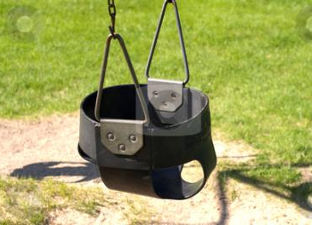
Here’s a
child:
Matthe
SmithIII
Race = Guamanian
Gender = M
Did you mean:
Matthew ?
Smith ?
Suffix = III ?
Race = NHOPI ?
Sex = M ?
Early Head Start
Early Intervention

Slide 12
Development

Slide 13
How do we get it done?
Assemble stakeholders representing the field
Use existing sources of data standards
Check alignment with the field
Review ideas with the public (ongoing)
Model elements
Place in tools
Release
Notes:
CEDS has stakeholder groups for EL, K12, Postsecondary, Adult Education/Workforce, P20W, and Technical.

Slide 14
CEDS V5 Stakeholders (1 of 2)
State Agencies
State Education Agencies
State Higher Education Agencies
Social Services Agencies
Local Education Agencies
K12
Head Start
Social Services
Institutions of Higher Education
Public
Private
Community Colleges

Slide 15
CEDS V5 Stakeholders (2 of 2)
U.S. Department of Education
NCES (SLDS, IPEDS)
EDFacts
U.S. Health and Human Services (including OHS)
U.S. Department of Labor
Interoperability Standard Organizations
Education Associations
Foundations

Slide 16
CEDS Anatomy: The Basics

Slide 17
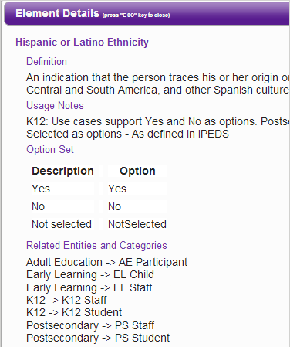
Standard Information: The Basics
Element
Definition
Hispanic
or Latino
Ethnicity
Option set
Yes
No
NotSelected
Domain
Entity
Early Learning
EL Child

Slide 18
Previous EL Workgroups
Eligibility
Assessment
Program Quality
Staff/Workforce (including education, employment, and professional development)

Slide 19
EL Workgroups for V5
Finance
Home visiting
Workforce
Connections

Slide 20
State Example: Data Elements
Many states are:
Building new data system
OR
Expanding or revising existing data system
CEDS provides a “jump start”

Slide 21
CEDS Tools

Slide 22
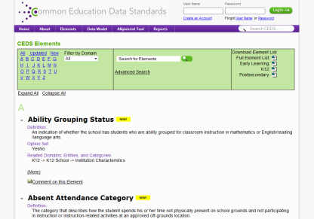
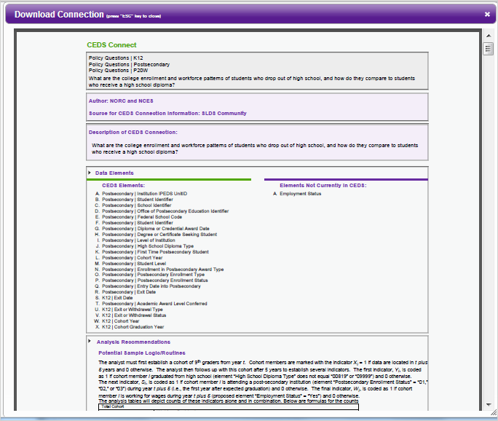
CEDS Tools
A Robust & Expanding Common, Voluntary Vocabulary drawn from existing sources
Powerful Stakeholder Tools & Models
Align
Logical Data Model
Connect
myConnect

Slide 23
Using Align

Slide 24
Align
Web-based tool that allows users to
Import or input their data dictionaries
Align their current data to CEDS
Compare their data dictionaries
Analyze their data in relation to various other CEDS-aligned efforts

Slide 25
Aligning to CEDS

Slide 26
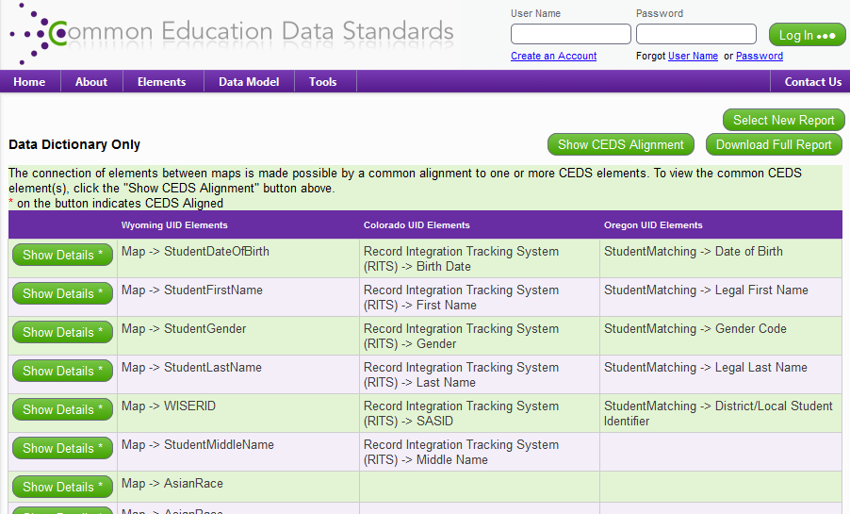
Aligning to Others

Slide 27
Using CONNECT

Slide 28
Connect
Stakeholders from various types of educational organizations can use the tool to
Answer program and policy questions
Calculate metrics and indicators
Address reporting requirements

Slide 29
Using CEDS to Answer Program & Policy Questions
Possible Head Start question: How do children that participated in Head Start do when they enter K-12?
To answer such a program question, you need
Data, possibly from multiple data systems
Data elements and their definitions
A plan to analyze the data . . .
You need the CEDS Connect tool.

Slide 30
myConnect

Slide 31
Reminder: CEDS Publications

Slide 32
Connecticut and Kansas
Reasons for incorporating CEDS
How is CEDS supporting our work?
Process for working with DaSy to align elements

Slide 33
Connecticut and Kansas
Benefits of CEDS and Align
Provides a location to store dictionaries for multiple programs across agencies and domains (e.g. EL to K12)
Helping states to identify data elements
People know we have data
Don’t know what we have or what it means

Slide 34
Connecticut and Kansas
Helping states organize early childhood data
Can align data elements across programs, offices, departments, and domains (e.g. EL to K12)
Provide assistance to start conversations with P-20, various agencies, and own technical department

Slide 35
Connecticut and Kansas
Allows us to address gaps in our data collection
Create conversations about bridging data files and elements across different departments and offices to answer questions
Receive technical assistance to work with CEDS
Bring departments and offices together for a common cause – make sure children are ready for school!

Slide 36
Next Steps for Connecticut and Kansas
myConnect
Connect
Linking to other data sources
Participate in CEDS V5 Public Comment to begin late September or early October

Slide 37
Participant discussion
How can DaSy support your data efforts using CEDS?
What challenges would CEDS address in your state?

Slide 38
Participant discussion
If interested in learning more about CEDS reach out to the DaSy Center at dasycenter@sri.com

Slide 39
Q & A

Slide 40
Engage with CEDS
http://ceds.ed.gov
Notes:
Public comment period for CEDS Version 5 will begin in late September or early October.

Slide 41
CONTACTS:
Beth Young
bethyoung@qipartners.com
Missy Cochenour
missy.cochenour@aemcorp.com

