Slide 1
Validity of the Child Outcomes Summary Process:
Updates from the ENHANCE Project
Lauren Barton, Donna Spiker, Kathy Hebbeler
September 8-10, 2014
Improving Data, Improving Outcomes Conference
New Orleans, LA
Notes:
1

Slide 2

Today’s session
Brief overview of ENHANCE project
Update on status of each study and project-related resources
Describe some findings from the team decision-making study
Discuss implications and potential state activities surrounding reliability and validity of COS process

Slide 3


Origin of ENHANCE
States identified need…

Slide 4

ENHANCE
Series of studies designed to find out:
  the conditions under which the Child Outcomes Summary (COS) Process produces meaningful and useful data for accountability and program improvement
  the positive and/or negative impact of the COS process on programs and staff
  what revisions to the form and/or the process are needed

Slide 5
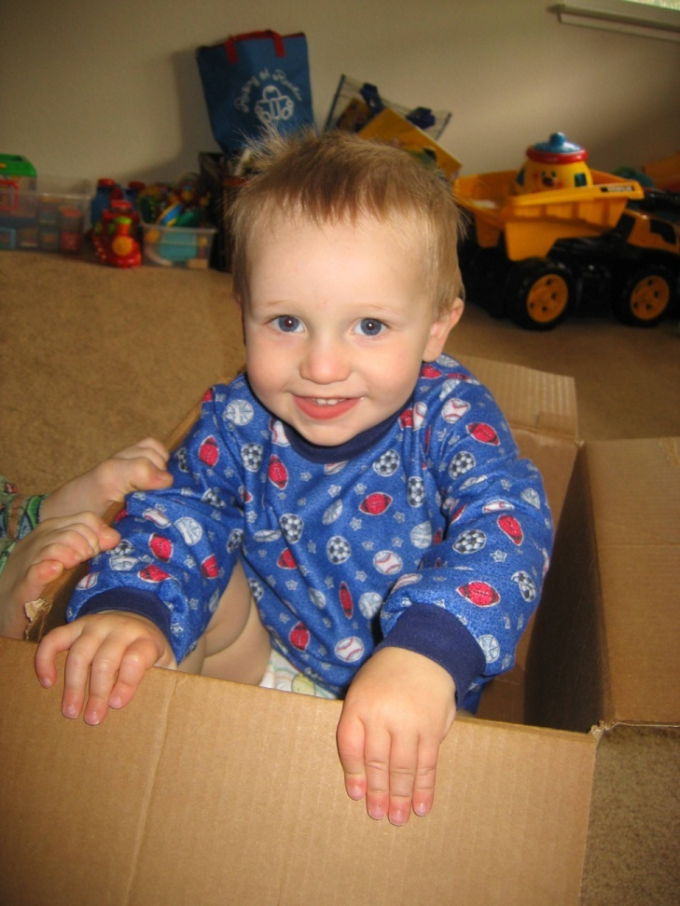
Four ENHANCE Studies
State Data Study
Provider Survey
Comparison with Child Assessments
Team Decision-Making

Slide 6
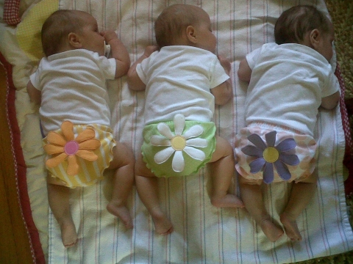
State Data Study
Question
Are patterns in statewide data consistent with what we would expect from valid data?
Method
Analyze characteristics of COS data and relationships to other variables
Look for consistency in patterns across states
Support found in both EI and ECSE for relative stability in summary statements year to year.

Slide 7


State Data Study
Sample
All valid COS data within the state for a reporting year
9 Part B preschool and 9 Part C states have submitted their data for comparison

Slide 8

Studies 2-4:
Project Data Collection Sites
Part C (Birth to 3)
Illinois
Maine
Minnesota
New Mexico
Texas
North Carolina
Virginia
Part B Preschool (3-5)
Illinois
Maine
Minnesota
New Mexico
Texas
South Carolina

Slide 9

Provider Survey
Question
What do providers tell us about their
training about, experiences with, and the
perceived validity of the COS process?
Get the Survey
http://enhance.sri.com/datacollection/data.html or
2012 Outcomes conference and DEC Conference presentations on ENHANCE website
Content
Training and knowledge of providers
How COS process is structured
Frequency of implementing recommended practices
Attitudes and implementation challenges
Perceived accuracy of the ratings
Impact of COS on practice

Slide 10

Provider Survey
Method
All providers in the program who participate in the COS process were invited to participate in an online survey
Sample
Data collected spring 2012
856 providers, 19 EI and 15 ECSE programs in 8 states

Slide 11
Selected Provider Survey Findings
Most receive COS training, variable length
Providers report understanding key concepts
¾ of providers complete most ratings in teams
Few think COS process has a negative impact on providers’ work
Providers receive limited monitoring, feedback, and support
Many providers don’t understand why data are collected and what happens with it
For 1/3 of providers, family input is not included in most COS ratings

Slide 12
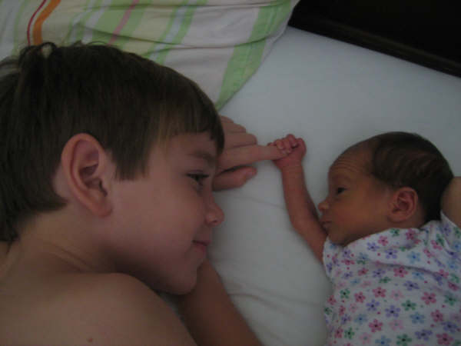
Comparison with Child Assessments
Question
How do team-based status ratings and progress categories on the COS relate to other assessments of child functioning at entry and exit?
Method
Compare COS ratings to BDI-2, Vineland-II scores
  Program Entry
  Program Exit
Compare conclusions from COS and assessments
Instruments: Abilities Index, Child Outcomes Summary form, BDI-2, Vineland-II
Sample
153 at entry, 72 with entry & exit information

Slide 13
Team Decision-Making Study
Question
How is the COS process being implemented?
How are indicators of a quality COS process related to appropriate application of the COS rating criteria?
How much agreement is there between team ratings and coder ratings?
Method
Video team meetings where COS completed
Code videos for quality indicators

Slide 14
Team Decision-Making Videos
Anyone in states observing COS meetings or reviewing videos and sharing feedback?
Methods
Identified indicators to code in videos
Codebook to support consistent coding
Reliability checks on coder

Slide 15

Useful Resources and Additional Information
http://enhance.sri.com/datacollection/data.html
  1 page overview of content being coded in Team Decision-Making videos
  Paper version of coding form in use
For codebook with specific information for coding – contact lauren.barton@sri.com

Slide 16

Team Decision Making Study Sample
Initially:
Teams & observe decision-making
Analysis
Videos:
64 EI
50 ECSE
From:
21 programs in 8 states
64% Entry
36% Exit
114
131

Slide 17
Team Decision Making Study Sample
Meetings in videos:
  Most = stand-alone meetings COS only, at the end of an IFSP/IEP meeting, or at the end of a meeting to review evaluation results (mostly if entry video).
  Only 5-7% were fully embedded into IFSP/IEP.
Teams:
  About half had parent(s) on the team
  Average 4 people present + or – 2; range = 2-12
  Usually 1 more person at each entry meeting than exit meeting
  87% of meetings had a service coordinator present
114

Slide 18
Team Decision Making Study Provider Training and Experience
Experienced in service delivery
Most had some COS training, but < full day.
12% of all providers had > 9 hrs of training and completed more than 30 COS ratings,
37% of teams had one or more of these experienced providers on it
Nearly all felt they understood outcomes, rating criteria, and what is age appropriate well or very well (95-97%)

Slide 19
Team Decision Making Study Sample of Videos
Ratings:
  All 7 ratings points used
Child Characteristics:
  Variation in ages, types of disabilities, and severity of disability as measured by the ABILIITES Index.
Notes:
.

Slide 20

Learning about implementation of COS process
C
S
O

Slide 21

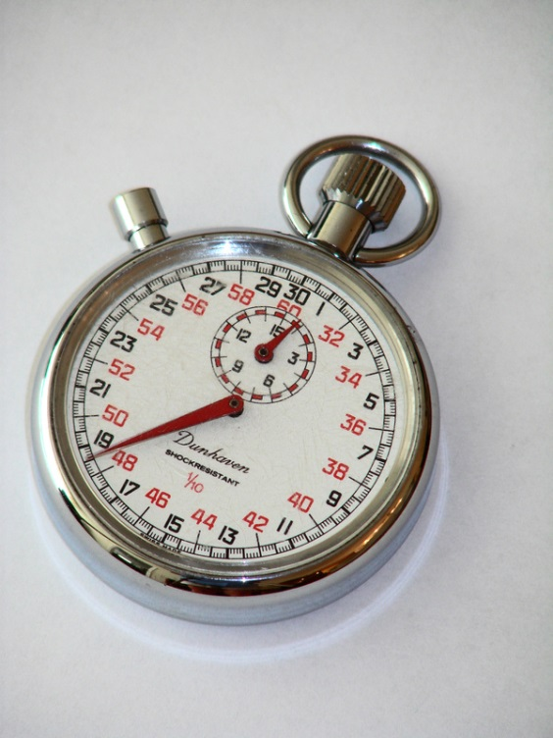
Implementation of COS Process
How long does the COS process usually take?
  1-4 minutes
  5-9 minutes
  10-17 min
  18-30 min
  > 30 min

Slide 22
Meeting Length

Slide 23
Meeting Length
Longer meeting related to:
More discussion of multiple settings
Referencing assessment tools, age levels, or skills
Higher overall quality of general team process
Higher overall COS quality rating on each outcome
People in more roles present
Not having parent present
Unrelated to:
Specific rating provided

Slide 24

Consensus or Not?
True or False:
Reaching consensus is a significant problem for some teams. A small fair number of teams will not reach consensus.
False:
In these videos no teams had any unresolved disagreement.

Slide 25

Explicit Discussion About Assessment Tools?
How many teams reference specific assessment tool(s) in their discussions? In their documentation?
None, a few, some, many, nearly all

Slide 26
Meetings Including Parents
Shorter meetings when a parent was present
  mean 8.7 (6.6) min vs. 11.9 (8.1) min
  74% of meetings 1-4 min included a parent
Lower quality of team process when parent present
  Mean 3.3 (1.2) rating vs. 3.8 (1.1) rating
Explanations:
  71% did not explain why data were collected
  49% explained the meaning of each outcome during the meting
  49% mentioned what skills are expect of a child that age
  14% mentioned sequences in development
19% parents said agree or nodded head only, 72% parent spontaneously spoke up
Same average number of settings discussed as on teams without a parent
Less likely to consider more than one rating

Slide 27



Reactions?

Slide 28

Coder Rating: Quality of Overall Team Process
Mean:
Entry 3.6 (1.1)
Exit 3.4 (1.3)

Slide 29
Coder Rating of Quality of the COS Process for each Outcome Area
Somewhat higher ratings of COS quality for outcomes 2 and 3, than for 1.
COS quality related to overall team process quality ratings. Correlations: .46 O1,
.56 O2,
.58 O3.

Slide 30
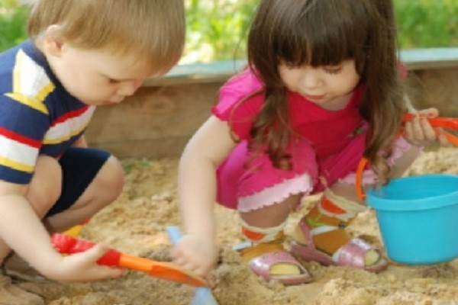
Validity Approach
Assumptions:
COS validity is inherently tied to implementation
Validity is not a characteristic of the COS
Validity is a characteristic of the data produced by the COS process and how those data are used
Effective and consistent implementation is central to valid data.
Approach:
Across studies, investigating a series of claims to see if base of evidence is consistent with valid/reliable data….
Accumulate evidence to suggest that COS process can produce data that are valid for inended purpose

Slide 31
Validity Evidence
Integrity of the data
< 10% explicit intent to alter rating | Supported.
 | 5 videos (4%, from 4 programs) had evidence of intent to alter ratings on one outcome.
Associate skills with the right outcomes
>=85% associate skills with the right outcomes | Supported.
 | 94% outcome 1, 94% outcome 2, 95% outcome 3 associated skills with the appropriate outcome area.

Slide 32

Validity Evidence
Application of rating criteria
>=85% of teams will apply rating criteria appropriately
Types of misunderstanding/misapplication of rating criteria:
base rating on progress instead of distance from age-expected
over emphasize one aspect too much (e.g., EVER)
apply criteria wrong way
explain criteria appropriately, but then apply it wrong

Slide 33
Validity Evidence
Understanding Age-Appropriate Functioning
< 15% of videos will show major mistakes related to age-appropriate functioning | Supported
 | Only 9 videos (8%, from 6 programs) showed major inappropriate age-anchoring 13 video (11%) showed any level (major or minor) of inappropriate age anchoring
Match between Coder and Team Ratings
>= 85% of the team’s ratings are within 1 point of the coder’s ratings. | Supported in videos where there was enough evidence for coder to make a judgment.
 | 88-97% of the single point ratings were a match. 85-97% of the ratings involving 2 point ranges were a match.

Slide 34
Match Between Team and Coder Ratings
Coder’s rating about extent to which team ratings were consistent with coder’s ratings | Positive Social Relationships |  |  | Knowledge and Skills |  |  | Take Appropriate Action to Meet Needs
 | n | Percentage |  | n | Percentage |  | n | Percentage
 |  |  |  |  | of all | With infor-mation |  | of all | With infor-mation
 |  | of all | With infor-mation
Match | 72 | 63 | 89 | 81 | 71 | 94 | 84 | 74 | 94
Not match | 9 | 8 | 11 | 5 | 4 | 6 | 5 | 4 | 6
Can’t tell/Excluded (coder could not provide rating or a specific range of 2 points or less) | 33 | 29 |  | 28 | 25 |  | 25 | 22
Match if:
Coder single point rating and team rating was within 1 point
Coder 2 point range and team rating fell within that

Slide 35
Predictive Relationships of Coder Ratings of COS Quality
Coder ratings of COS quality for each outcome predicted by:
  depth of discussion,
  Coder rating of quality of team process,
  team gave a rationale for their rating,
  avoiding misapplications of rating criteria
Coder rating of COS Quality on each outcome were strongly related to match of coder-team ratings

Slide 36

Predictive Relationships for Match Between Coder and Team Ratings
Matching between coder and team ratings:
  Less likely when:
    specific assessment tools were identified and
    when parent was on team
  More likely when:
    rationale for rating was provided,
    higher coder rating of quality general team process,
    more providers with different roles participated,
    coder rated as high COS quality

Slide 37

Limitations
Not a nationally representative sample of videos
Too small a sample to disaggregate by multiple predictor variables.
Videos may not reflect all the knowledge people consider. Teams who work together may speak in shorthand about information everyone knows
Unknown effects of people knowing that they were being videotaped

Slide 38
Summary
Wide variation in implementation. Seems especially true when parents are on the team
Small group of COS meetings involve quick affirmation of rating with parent, documenting an assessment, and with little discussion/rationale
Meetings vary considerably in length and depth of discussion/description of child’s skills
Evidence that meetings where more information was available, COS can be a valid process
Positive team process appears to support quality COS process
Misapplications of rating criteria often base rating on progress rather than distance from age-expected or over emphasize one aspect too much

Slide 39
Questions? Comments? Reactions?
Notes:
39

Slide 40

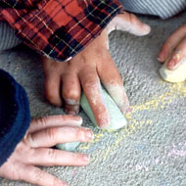

Find out more
ENHANCE Website
  http://ENHANCE.sri.com
ECTA Center Website
  http://www.ectacenter.org go to topics: child outcomes
Contact ENHANCE staff
  E-mail: ENHANCE@sri.com
Notes:
Or email Lauren.Barton@sri.com, Donna.Spiker@sri.com, Kathleen.Hebbeler@sri.com, or Cornelia.Taylor@sri.com
40

Slide 41

Thanks to our funder
Contents were developed with funding from grant R324A090171 from the U.S. Department of Education.
Presentation does not necessarily represent the policy of the Department of Education, or endorsement by the Federal Government.

