Slide 1
Family Outcomes and SSIP
State of North Carolina
Infant Toddler Program
Gary Harmon, PhD
Part C Data Manager

Slide 2
Overview of Presentation
Briefly describe the SSIP data analysis process for looking at Family Outcomes (Indicator 4)
Examine issues of data quality
Review Family Outcomes Data
Next Steps/Discussion of Two Paths to Continue to Examine Family Outcomes

Slide 3
SSIP – Data Analysis
Comprehensive analysis of NC Child and Family Outcomes Data
Family Outcomes Analysis
Data quality
Results over time
Compared to other states
Compared to targets
By subgroup (Race, Gender, Language, Condition)

Slide 4
SSIP Questions – Family Outcomes
Data quality vs. True Measurement of Outcomes?
How do we separate data quality from performance on outcomes?

Slide 5
Family Outcomes Process
North Carolina uses The NCSEAM Family Survey – Early Intervention
Designed to yield reliable, valid and useful measures of families’ perceptions and involvement in early intervention.
Survey results are summarized into:
Percent of families participating in Part C who report that early intervention services have helped the family:
A. Know their rights;
B. Effectively communicate their children's needs;
C. Help their children develop and learn.

Slide 6
Family Outcomes Process (cont.)
Survey mailed to families with option of paper (postage paid envelope) or internet response (online survey program)
Postcards sent prior to mailing to inform parents about survey
Follow-up survey and reminder sent two weeks after initial survey

Slide 7
Family Outcomes – Data quality

Slide 8
Family Outcomes Response Rates

Slide 9
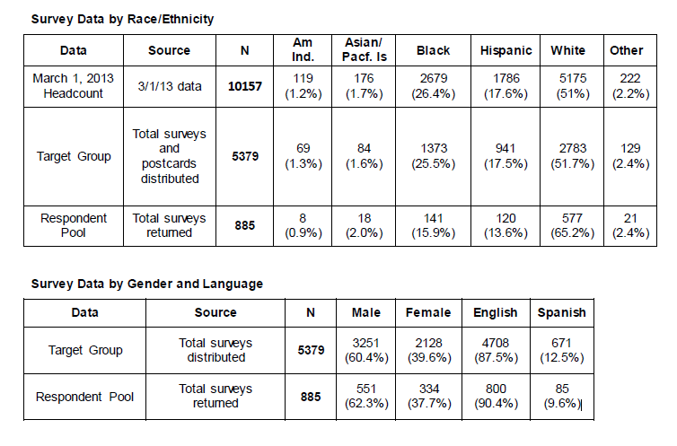
Family Outcomes Respondents 2012/2013

Slide 10
Family Outcomes – Longitudinal Data

Slide 11
Family Outcomes Know Your Rights

Slide 12
Family Outcomes Effectively Communicate

Slide 13
Family Outcomes Develop and Learn

Slide 14
Family Outcomes Sites Meeting Survey Targets 2012
RANGE
Family Outcome | Target | Number (%) of Sites At or Above Target | Number (%) of Sites Below Target | Low | High
Know Their Rights | 90% | 2 (12.5%) | 14 (87.5%) | 61% | 93%
Effectively Communicate | 86% | 1 (6.25%) | 15 (93.75%) | 52% | 89%
Develop and Learn | 91% | 2 (12.5%) | 14 (87.5%) | 71% | 96%

Slide 15
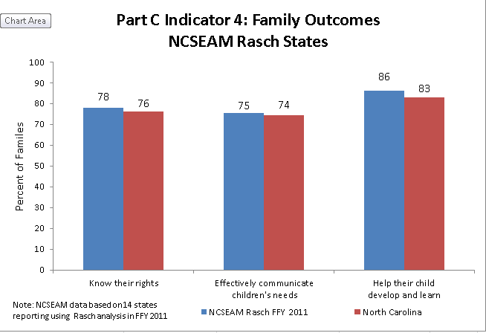
How is NC Performing Compared to Other States?

Slide 16
NEXT STEPS

Slide 17
Two Separate Paths
Data Quality
Administration of survey
Survey instrument
SSIP
Infrastructure analysis to examine work with families
Current initiatives focused on family involvement

Slide 18
Acknowledgements
Deborah Carroll, PhD – Early Intervention Branch Head
Sherry Franklin – Part C Coordinator
Infant Toddler Program Data Team (Brian Deese and Barbara Simpson)
Interagency Coordinating Council

