Slide 1
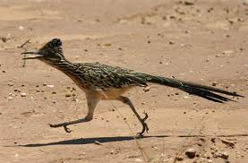
New Mexico Family Infant Toddler (FIT) Program
First, a little background…
The FIT Program is the lead agency for early intervention services under the Individuals with Disabilities Education Act (IDEA) Part C.
The FIT Program contracts with 34 provider agencies across the state that serve one or multiple counties.
We serve over 13,000 children birth to age 3 and their a families.
And.. The Roadrunner is our state bird! In case you were wondering…

Slide 2
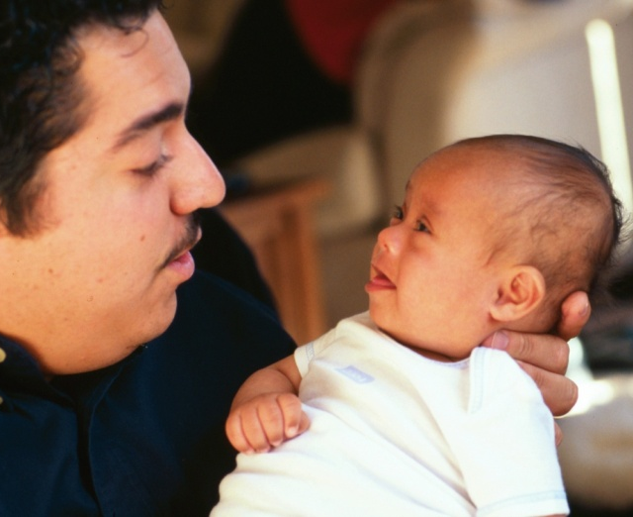
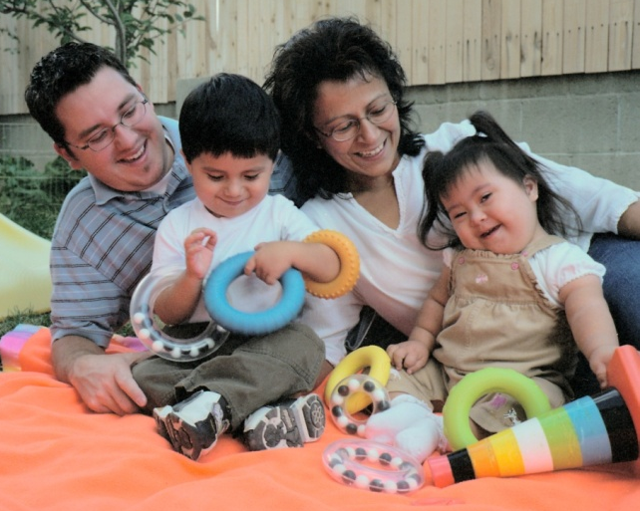
Background: Current Monitoring
Community Based Assessment – 2 day site visit looking at compliance issues
Annual Performance Report – FIT Providers collect and analyze their data 9 indicators and develop an improvement plan as part of a local APR
Focused monitoring – 1-2 day onsite review of a specific compliance area that has been determined through complaint, CBA or other mechanism to need attention.

Slide 3
Race To the Top – Early Learning Challenge grant and TQRIS
Race To the Top – Early Learning Challenge grant application said NM will apply a TQRIS to:
Child care
Pre-K
Head Start & Early Head Start
Home Visiting
Preschool Special Education
Early Intervention – FIT Program

Slide 4
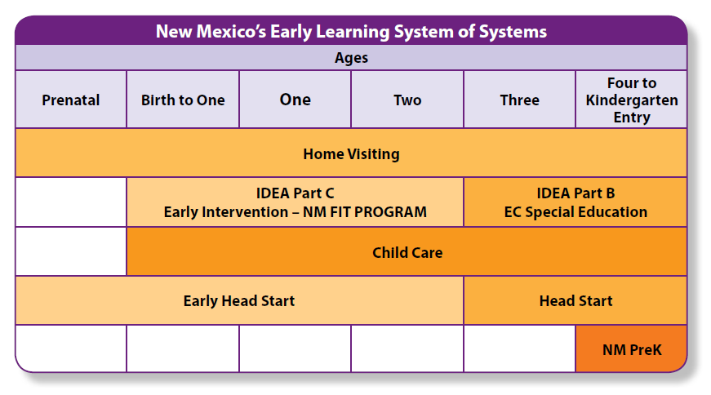
Early Learning New Mexico
TQRIS will be developed for each of the following:

Slide 5
FIT Program and TQRIS
My first reaction was – what this got to do with the FIT Program?
This is for classroom
based programs…
This is for programs just
starting out looking at
quality…
This has to do with
reimbursing providers at different rates…

Slide 6
FOCUS on young children’s learning
TQRIS criteria developed for center based settings building on a previous “Reach for the Stars” TQRIS system for child care

Slide 7
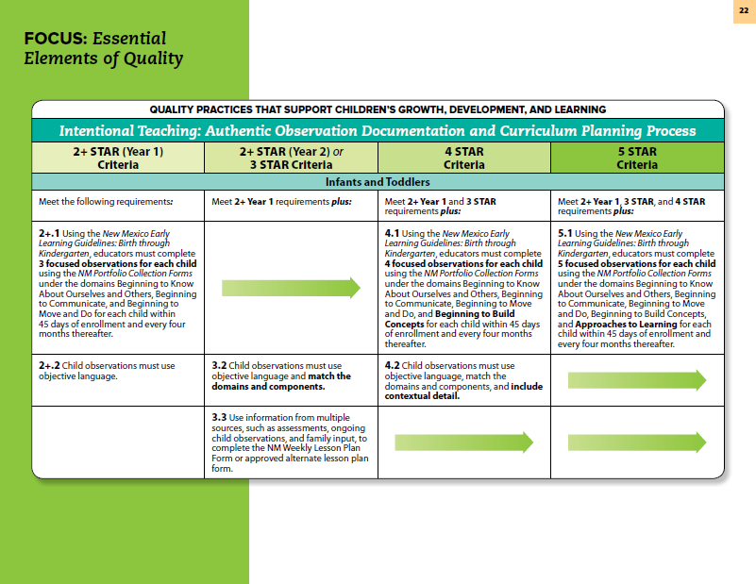
FOCUS on young children’s learning
TQRIS criteria for center based settings:
Essential elements
of quality will be used
as a framework
Criteria will be
developed specific to
Part C early
intervention

Slide 8
FIT and TQRIS – a paradigm shift
A opportunity to shift:
From just measuring compliance to measuring quality practices
From state external monitoring to verification
From corrective action plans (from that external monitoring) to a Continuous Quality Improvement
From universal training and TA to targeted coaching and consultation to help agencies increase their quality
…So we have moved from skeptic to champions

Slide 9
What is TQRIS?
Tiered – Incentives and expectations provided based upon designation of providers at various levels of quality
Quality – Evidence based practices to be measured that will promote child development and support families.
Rating - determined though the use of a number of tools
Improvement – Improvement activities to improve performance
System – to be applied to all early childhood program with common framework, but criteria and tools specific to each early learning program

Slide 10
Developing TQRIS criteria for the FIT Program
Stakeholder group will help develop TQRIS criteria based on:
DEC recommended practices,
NECTAC Key Principles and Practices
Literature review
Professional wisdom
Stakeholders will:
Help determine a set of guiding principles for the TQRIS development, and
Make recommendations regarding criteria selection

Slide 11
Developing TQRIS criteria
Potential FIT TQRIS criteria (examples only):
Quality IFSPs
Evaluation and Assessment practices
Quality Early Intervention Practices (observational tool)
Transdisciplinary Team Practices
Inclusion Practices
Reflective Practices / reflective supervision
Practices for working with specific disabilities
Cultural and language (incl. Support for dual language learners)
Staff Qualifications & Professional Development

Slide 12
FIT TQRIS - example
Early Intervention Quality Practices:
Provider agency receives training and coaching in the use of an “observational tool” to assess implementation of quality practices by staff
Provider agency utilizes video or direct observation of early intervention session to form basis for reflection with staff on their implementation of quality practices
Provider agency utilizes results of tool to address staff’s need for professional development (mentorship, training etc.)
FIT Program verifies provider agencies use of tool with fidelity and that they addressed staff’s support needs.

Slide 13
FIT TQRIS - example
Quality EI Practices (example only):
3 Star | 4 Star | 5 Star
Agency conducts observation tool with staff irregularly | Agency conducts observation tool with staff at least once a year | Agency conducts observation tool with staff at least twice a year
Agency conducts observational tool with poor level of fidelity | Agency conducts observational tool with some fidelity | Agency conducts observational tool with a high level fidelity
Agency conducts inconsistent professional development with staff identified as needing improvement | Agency conducts good professional development with staff identified as needing improvement | Agency conducts strong professional development with staff identified as needing improvement

Slide 14
NM Early Learning Guidelines
Need to determine how we will incorporate the NM Early Learning Guidelines into our TQRIS.

Slide 15
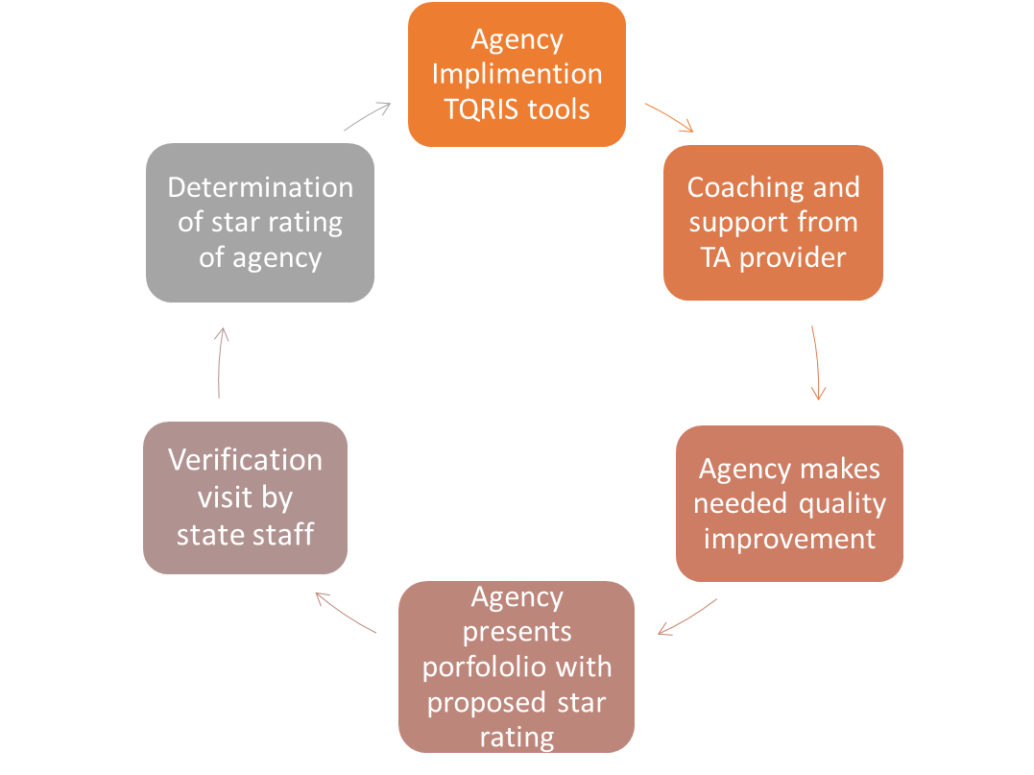
Potential TQRIS process

Slide 16
Status of our TQRIS work
Hired a FOCUS TQRIS lead for the FIT Program
Contract established with University of NM to:
Help develop and validate quality assessment tools
Provide training and coaching in use of tool(s) and how to improve quality.
Foundational training in use of video & reflective supervision
Work with ICC Quality Committee and expanded stakeholder group to develop quality criteria
Work closely with other early learning programs to promote alignment.

Slide 17
Plan to develop TQRIS
Now – Summer 2015
Develop quality criteria and tools
Establish video technology demonstration projects (through Dec 2016)
Summer 2015 - Summer 2016
Pilot TQRIS criteria and tools with 4-5 providers
Verify agency’s quality rating star level.
Validate tools and change as needed.
Validate overall TQRIS star rating rubric
Establish statewide standards and policies and procedures, including incentives and timelines
Role out TQRIS statewide over 1-2 years.

Slide 19
Questions?

