Slide 1
Determining the Quality of Your Finance System: Using the ECTA System Framework to Inform Current Status and Areas for Improvement
Improving Data, Improving Outcomes Conference
New Orleans, LA
September 2014

Slide 2
System Framework: Purpose and Audience
Purpose: to guide states in evaluating their current Part C/619 system, identifying areas for improvement, and providing direction on how to develop a more effective, efficient Part C and Section 619 system that requires, supports, and encourages implementation of effective practices.
Audience: the key audience is state Part C and state Section 619 coordinators and staff, with acknowledgement that other key staff and leadership in a state will need to be involved.

Slide 3
System Framework: Process and Partners
Iterative validation process: the framework has been developed through an iterative process among national and state experts in the field.
Partner states: the framework is being developed iteratively with 6 states (DE, ID, MN, NJ, PA, WV), so that it reflects (and is applicable to) the diversity of state systems (e.g. Lead Agency, eligibility criteria).
Technical Work Group (TWG): the Center has a technical work group (TWG) with experts in the field to advise the Center by providing early input on the elements, and later review and give input on drafts, as well as contribute resources available to support states on various elements.
Notes:
Generally speaking, we will be engaging in an iterative validation process that will include state partners as well as this technical work group. This means that we will work collaboratively with the state folks and with this group to draft ideas, review and edit those ideas (over and over so that each iteration is an improvement on the last), and then (when ready) we will share more refined ideas in a broader sense to more folks in the field for additional refinement.
We recently identified our 6 partner states – DE, ID, MN, NJ, PA & WV. They applied to be a partner states, so these are the final six selected and they represent some diversity across demographics (like size of state, and region of the country) as well as diversity in some state systems aspects (such as Lead Agency for Part C and eligibility criteria).
Our Technical Work Group – you all – are a second key group that we’ll be working with throughout the iterative process. You were selected because of your expertise in knowing the Part C and Section 619 programs and/or your general expertise around quality systems and systems building. So we have some diversity within this group –some folks having more research experience, some more TA and consulting; we have diversity with some folks who know Part C and/or Section 619 particularly well, others who understand the general early childhood and systems building.

Slide 4
System Framework: Assumptions/Parameters
The framework and corresponding self-assessment are designed to be:
Evidence based
Useful to Part C and Section 619 programs, including resources and exemplars
Responsive to the variation that exists across states; designed in a way that recognizes that states can reach quality in different ways
Related to critical areas of Part C and Section 619
Consistent with IDEA requirements
Consistent with recommended early childhood practices (e.g., DEC, DAP)
Consistent with best practices from implementation science
Inclusive of resources and exemplars to illustrate ways state can meet quality

Slide 5
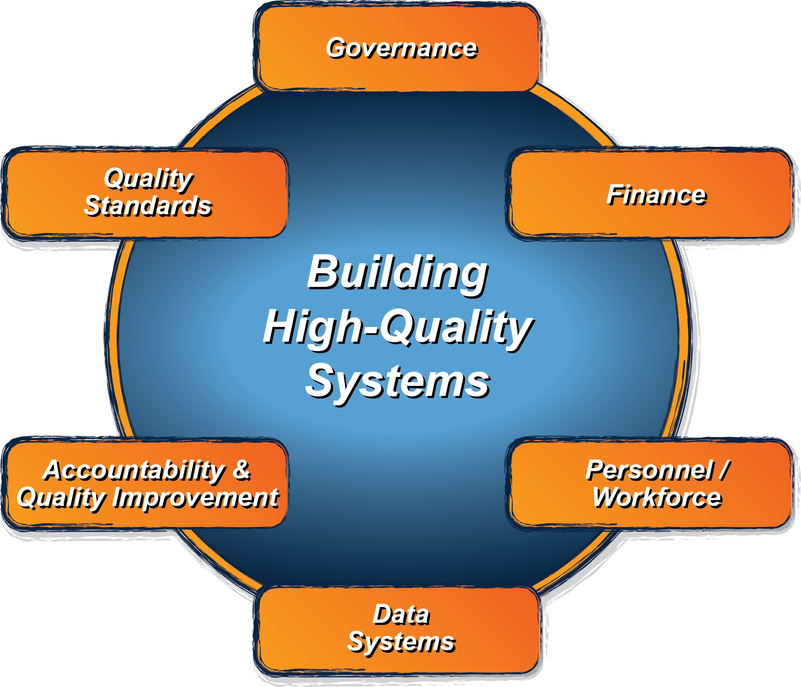
ECTA System Framework
What does a state need to put into place in order to encourage, support, require local implementation of effective practices?
ectacenter.org/sysframe

Slide 6
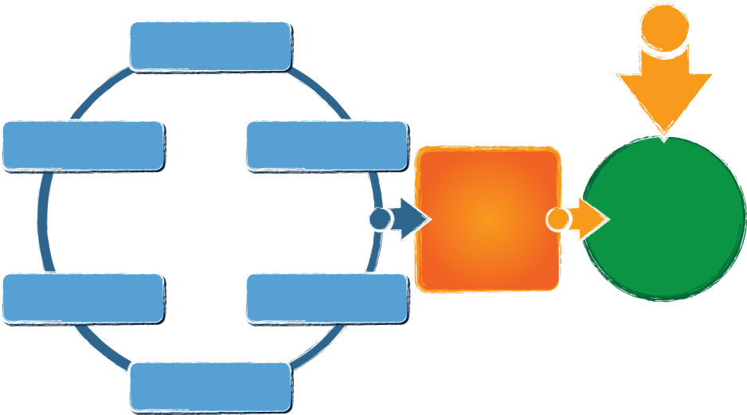
ECTA Center System Framework
What does a state need to put into place in order to encourage, support, require local implementation of effective practices?
Governance
Finance
Personnel / Workforce
Data Systems
Accountability & Quality Improvement
Quality Standards
Result:
Implementation of effective practices
Good outcomes for children with disabilities and their families
Available from: http://ectacenter.org/sysframe
Notes:
What does a state need to put into place in order to encourage, support, require local implementation of effective practices?
Governance
Quality Standards
Finance
Accountability & Quality Improvement
Personnel/Workforce
Data Systems
(leading to)
Implementation of effective practices
(leading to)
Result: Good Outcomes for children with disabilities and their families

Slide 7
Cross Cutting Themes
Engaging stakeholders, including families
Establishing/revising policies
Promoting collaboration
Using data for improvement
Communicating effectively
Family Leadership & Support
Coordinating/Integrating across early childhood

Slide 8
System Framework
Products:
components and subcomponents of an effective service delivery system (e.g. governance, finance, personnel)
quality indicators scaled to measure the extent to which a component is in place and of high quality
corresponding self-assessment for states to self-assess (and plan for improvement)
with resources and examples related to the components of the system framework
Notes:
Glossary of terms
Self-assessment
Resources and Examples:
Specific as possible to make it useful
Providing the best resources examples (focus on quality, not quantity)
State examples when possible
We will likely identify places where resources and examples are needed
Coordinating with other TA Centers and partners in the field on these aspects as well as components:
DaSy
Early Childhood Personnel Center
Early Childhood Systems Work Group

Slide 9
Summary/Timelines
Governance, Finance, and Accountability & Quality now posted
Data Systems (completed by DaSy) posted
Quality Standards being revised based on state input
Personnel/Workforce under development with ECPC

Slide 10
Self-Assessment - Purpose
Provides states a current status ‘snap shot’ to help them prioritize improvement efforts
Quantitative self-assessment score provides states ability to measure progress over multiple points in time.
Encourages state participants engage in rich conversations about the system.
Shared purpose and structure with DaSy framework (data system component)
Notes:
Wanting to keep it simple and doable.

Slide 11
Look for updates via the web site: http://ectacenter.org/sysframe

Slide 13
Finance Sub-Components:
1: Finance Planning Process/Forecasting
2: Fiscal Data
3: Procurement
4: Resource Allocation, Use of Funds and Disbursement
5: Monitoring and Accountability of Funds and Resources
Notes:
Review sub-components and quality indicators (10).

Slide 14
Part C Fiscal Initiatives
ECTA Finance Framework
ITCA Fiscal Initiative:
Partnership with ECTA Center and the RRCs
Topical Webinars
Intensive Fiscal TA
Cohort of 10 states: Alaska, Arizona, Colorado, Georgia, Illinois, Montana, North Dakota, Ohio, Utah, Wisconsin
DaSy Center:
Understanding and Using Fiscal Data: A Guide for Part C State Staff

Slide 15
A Strategic Planning Process for Developing and Sustaining a Part C Finance System
Agreements for Use of Resources
Demographic Information
V
I
S
I
O
N
System Monitoring
Design a Finance System
Infrastructure
Fiscal Resources
Policies and Procedures
Guidance and Support
Political and Economic Context

Slide 16
Key Phases of Strategic Plan Development
Phase I
Demographics
Fiscal Resources
Phase II
Design a System Based on Information and Priorities Identified in Phase I
Phase III
Agreements for Use of Resources
Phase IV
System Monitoring
Political and Economic Context
Infrastructure
Policies and Procedures
Guidance and Support

Slide 17
Finance Framework Subcomponents | Fiscal Initiative Strategic Planning Process | Fiscal Data Guide
Finance Planning Process / Forecasting | Mapping of Fiscal Resources Political & Economic Context
Fiscal Data | Demographics | Child & Family Demographics Service Data Program Data SLA Data
Procurement | Policies and Procedures
Resource Allocation, Use of Funds and Disbursement | Agreements for Use of Resources Allocation Methodologies
Monitoring & Accountability of Funds & Resources | Ongoing System Monitoring

Slide 18
Where Do I Start?
Finance Framework
Strategic Plan
Sub-component 1: Finance Planning Process/Forecasting
Sub-component 2: Fiscal Data
Mapping Fiscal Resources
Child/Family Demographics

Slide 19
Implications for 619
Quality Indicator FN6: Part C and Section 619 state staff coordinate and align resources and funding streams with other state agencies, programs and initiatives in order to improve system effectiveness, implement evidence-based practices and ensure efficient use of resources.
Elements of Quality
b. Specific mechanisms (e.g., policy, IAs, MOUs, Medicaid state plan amendments, waivers, and guidance) clearly articulate service, programmatic and funding responsibilities.
Delaware is updating MOUs between school districts for providing special education services to children in district where child care is located.
d. Regional and /or local entitites are encouraged to pursue partnerships across systems (e.g., early childhood, health, education) to leverage resources.
Delaware school districts have partnerships with Head Start to share resources to serve young children with disabilities in least restrictive environment (braided funding - transportation, meals, staff, training)

Slide 20
Implications for 619
Quality Indicator FN8: State and regional and/or local entities use funds and resources efficiently and effectively to implement high quality programs for meeting the needs of children and families.
Elements of Quality
c. State and regional and/or local funds and resources are prioritized to facilitate active implementation of evidence-based practices (e.g., inclusion, coaching, teaming).
Delaware 619, RTTT ELCG, and local funding supports implementation of QRIS quality standards in inclusive school district classrooms
Delaware Part C, 619, ELL, Head Start and local funding supports training and technical assistance for WIDA Early Learning Standard implementation for ELL children and families

Slide 21
Small Group Discussion by Sub-Component Area
Within your sub-component area, reflect on the extent to which each quality indicator is fully in place or implemented in your state.
Not Yet
In Process
In Place
In your small group, share where you think your state would rate on each quality indicator and why.
Notes:
Prior to session, have sections of the room designated in areas 1-5. have printed handouts by sub-component area for participants to review.
Have participants count off, 1-5.
Small groups have 20 minutes to discuss. We hope you’ll get through at lest one quality indicator. This is just a quick scan, to get you comfortable with the content. More of your gut reaction to where you are with this, not all the details.
Facilitator to meet with each group:
1-Grace(?)
2-Maureen
3-Verna
4-Katy
5-Anne(?)

Slide 22
Highlights from your conversations:
What stood out to you?
Did anything prompt you to think about actions you could take within your state?
What questions do you still have about the finance component and/or how it could be used?
Notes:
10 min

