Slide 1


Leadership and DEC Recommended Practices: Influencing People to Achieve Great Things
Betsy Ayankoya, ECTA Center
Cindy Brown, ME Dept of Education
Phyllis Mondak, VA Dept of Education
Kathy Whaley, ECTA Center
September 2014
Improving Data, Improving Outcomes Early Childhood National Conference

Slide 2
Session Goals
Awareness of DEC Recommended Practices on leadership
Opportunity to apply these practices to your agency and consider priorities for future work
Share highlights regarding leadership experiences from Maine and Virginia
Have an opportunity to share ideas with colleagues

Slide 3
Who is here?
  Part C
  Section 619
  ICC
  Part B School Age
  Professional Development and TA
  Higher Education
  Research and Evaluation
  Family Member

Slide 4
Leadership and RP Considerations
Leaders establish the essential conditions for successful implementation of the practices
Leadership in EI and ECSE is present and can be demonstrated in a variety of roles (administrators, practitioners, family members, students, faculty, and others)
These practices address the responsibilities of those in position of program authority at the state, regional and local level
Leaders are often affected by policies and procedures outside their span of responsibility which can present challenges
Leaders have a professional responsibility to use all mechanisms within their control to create conditions needed to support practitioners

Slide 5
Applying the Recommended Practices to your work

Slide 6
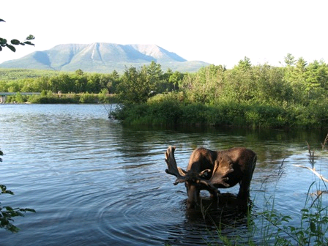

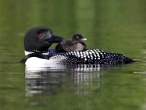
UPTA CAMP In MAINE!

Slide 7
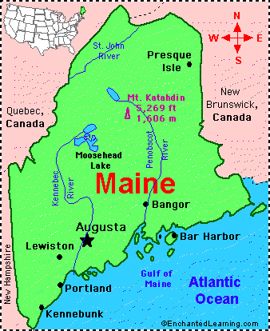
MAINE-VACATIONLAND

Slide 8
Where did I begin?
It was a very steep hill to climb ! There has been a very strong independent history of how EI and ECSPED were operated in Maine. You know – the LOCAL CONTROL thing…
FOR me as the new leader of the new system
L1 WAS THE STARTING PLACE: LEADERS CREATE A CULTURE AND A CLIMATE IN WHICH PRACTITIONERS FEEL A SENSE OF BELONGING AND WANT TO SUPPORT THE ORGANIZATION’S MISSION AND GOALS.

Slide 9

How does one create a culture and a climate?
Stop playing defense- it does not gain you any ground.
If only we had more money, we could do xxxx!
The data must be wrong! I know we do a better job than what it says!
Saying you follow the rules when you know there are issues.
Acknowledge the issues and figure out what you are going to do next!
Stop seeing yourselves as victims-dig deep to find out the issues.
We really do a good job, nobody gives us any credit!
Why are we always getting targeted as being the “bad guys”?
Why are we always the ones in “trouble”

Slide 10


Creating the culture and climate
Hone your listening skills- people have to be heard!
Be Kind, Polite, and Patient- it will take you far!

Slide 11
Culture & Climate
Agree to meet with stakeholders- friends and not-yet-friends, especially not-yet-friends ;-)
Meet, meet, meet and meet some more! ( IF YOU AREN’T AT THE TABLE, YOU ARE PROBABLY ON THE MENU!

Slide 12

Climate & Culture
Never let them see you sweat- LOL- but really!
Or Cry, or lose your temper…sometimes that’s really hard!
Stay on message- that’s hard!
WHAT IS THE MESSAGE????

Slide 13
STAYING ON MESSAGE
In Maine the message became: “WE ARE ONE EARLY INTERVENTION AND EARLY CHILDHOOD SPECIAL EDUCATION SYSTEM THAT COVERS THE ENTIRE STATE”.
“ALL FOR ONE AND ONE FOR ALL”- HAS BECOME MY MANTRA!
THERE NEEDED TO BE A CATYLST THAT CREATED THE MESSAGE:
The Commissioner of Education put forth legislation that created only 1 State Intermediate Education Unit- instead of 10 independent IEUs, with locally controlled sites that had governing boards
The Legislature approved this major change in the infrastructure of the system in Maine, effective July 1, 2012.

Slide 14
What next?
L.6: Leaders establish partnerships across levels(state to local) and with their counterparts in other systems and agencies to create coordinated and inclusive systems of services and supports.
Logical partners: Headstart, DOE Early Childhood Consultant, Public 4 year old programs, Health and Human Services: CDC/Newborn Screening programs, state medicaid program, child care program
SAIEL: State Agency Interdepartmental Early Learning Team http://www.maine.gov/earlylearning/saiel/index.html

Slide 15
L.6 Partnerships!
Developmental Systems Integration Project: a SAIEL sub-committee
http://www.mainequalitycounts.org/page/2-923/dsi-saiel

Slide 16
Last but not Least!
L.8 Leaders work across levels and sectors to secure fiscal and human resources and maximize the use of these resources to successfully implement DEC Recommended practices.
State Personnel Development Grant: Early Intervention Support!
Concerted effort by CDS State Team to insure compliance with regional budgets, state budget, contracts with private providers: Produced big results!

Slide 17


MOST IMPORTANT!

Slide 18
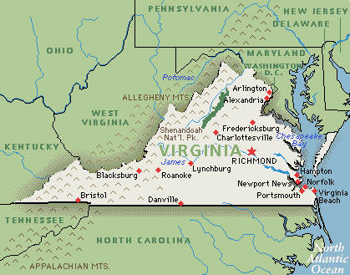
Virginia, Old Dominion!

Slide 19
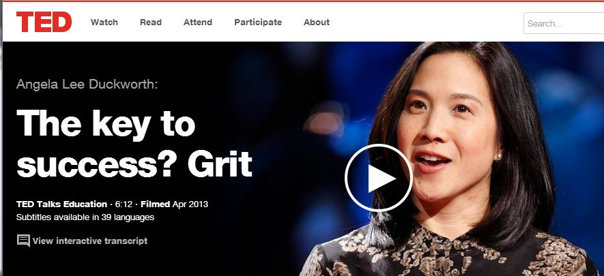
https://www.ted.com/talks/angela_lee_duckworth_the_key_to_success_grit
GRIT score
https://sasupenn.qualtrics.com/SE/?SID=SV_06f6QSOS2pZW9qR

Slide 20
L2. Leaders promote adherence to and model the DEC Code of Ethics, DEC Position Statements and Papers, and the DEC Recommended Practices.

Slide 21
Shape the Path
(Switch by Chip and Dan Heath)
  Tweak the environment
  (Implementation)
  Build habits
  (Implementation)
  Rally the herd

Slide 22



Slide 23
L9. Leaders develop and implement an evidence-based professional development system or approach that provides practitioners a variety of supports to ensure they have the knowledge and skills needed to implement the DEC Recommended Practices.

Slide 24
Governor’s working group task force
2 Gov (6-7 yrs)
Phase I 2002- 2009
Grant writing and implementation team
NPDCI
Special Quest
State PK leadership team
Office of Early Childhood Development (DOE/DSS)
Leadership and Governor change
NPDCI
Special Quest

Slide 25
Keep PD task force work going
Phase 2 – 2006-Present
Form Virginia Cross Sector Professional Development Group
Use information from NPDCI surveys
Expand group
Landscape of PD in Virginia
Vision of statewide coordinated system
VCPD.org
State Coordinator (multiple funding sources)
Regional consortia
Monthly meetings, quarterly face-to-face
Partnership agreement
Commission on Youth, Children’s Cabinet
Applying for Preschool Development Expansion Grant – hope VCPD has major PD role for grant
Partnership agreement signed by all involved agencies and parties
Local consortia – coordinate local PD, share resources, stop duplication, know who they have in area to do PD

Slide 26
L10. Leaders ensure practitioners know and follow professional standards and all applicable laws and regulations governing service provision.

Slide 27

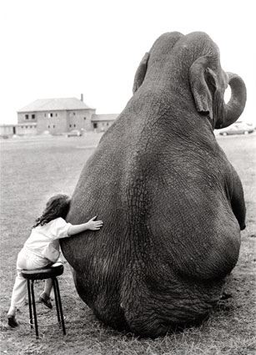
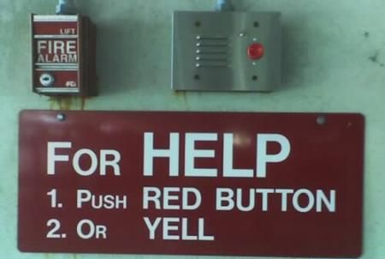
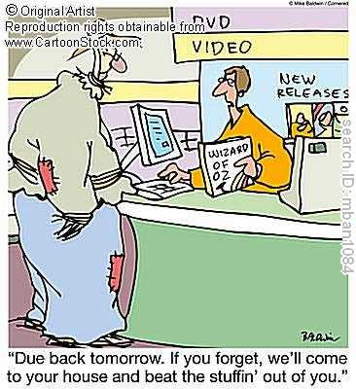


Slide 28
L11. Leaders collaborate with higher education, state licensing and certification agencies, practitioners, professional associations, and other stakeholders to develop or revise state competencies that align with DEC, Council for Exceptional Children (CEC), and other national professional standards.

Slide 29
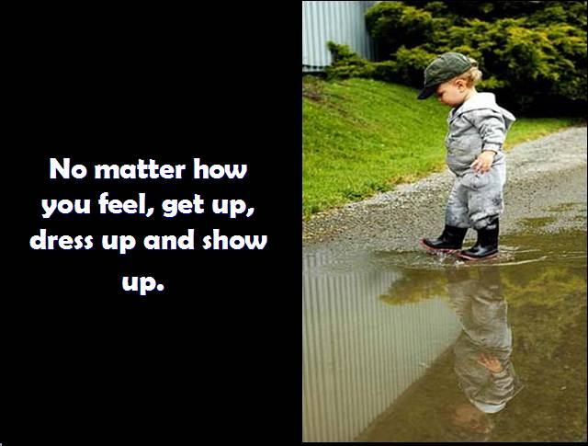

Slide 30

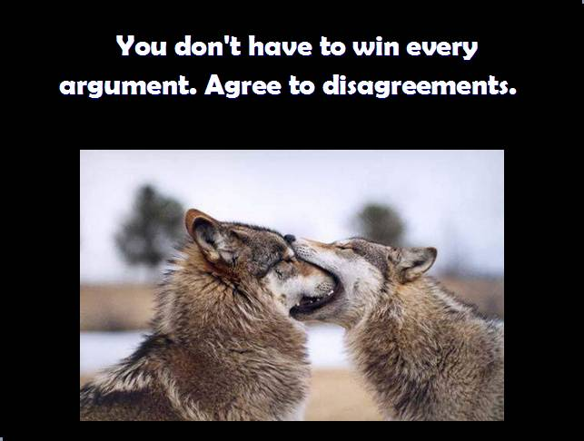

WAIT

Slide 31
Let’s talk about this
  What resonates or appeals to you about the leadership practices?
  Are there practices that concern you and might be challenging to implement?
  Are there practices here that you feel like you can work on right now?
  What might be a priority for you when you get home?
  What kinds of supports do you feel you need to implement any of these?

