Slide 1




Ready for Phase II? Developing an Effective Systemic Improvement Plan
Anne Lucas, ECTA/WRRC
Grace Kelley, SERRC
Taletha Derrington, DaSy
Christina Kasprzak, ECTA/DaSy
Improving Data, Improving Outcomes
New Orleans, LA September 9, 2014

Slide 2

Session Outline
Overview of Phase II
Developing a good improvement plan
Implementation Science
Evaluation
Discussion

Slide 3

Overview of phase ii

Slide 4
Proposed SSIP Activities by Phase
Year 1 - FFY 2013 Delivered by Apr 2015 | Year 2 - FFY 2014 Delivered by Feb 2016 | Years 3-6 FFY 2015-18 Feb 2017- Feb 2020
Phase I Analysis | Phase II Development | Phase III Evaluation and Implementation
Data Analysis; Description of Infrastructure to Support Improvement and Build Capacity; State-identified Measureable Result; Selection of Coherent Improvement Strategies Theory of Action | Multi-year plan addressing: Infrastructure Development; Support EIS Program/LEA in Implementing Evidence-Based Practices; Evaluation Plan | Reporting on Progress including: Results of Ongoing Evaluation Extent of Progress Revisions to the SPP

Slide 5
  Evaluation
  Evaluation of progress annually
  Adjust plan as needed
  Analyzing and Focusing
  Identify starting point
  Initiate broad Data Analysis
  Conduct broad Infrastructure Analysis
  Identify primary concern (potential SiMR)
How well is the solution working?
What is the problem?
SSIP Phase III
SSIP Phase I
SSIP
What shall we do about it?
Why is it happening?
SSIP Phase I and II
SSIP Phase I
  Planning and Doing
  Identify coherent
  improvement strategies (Exploration Phase)
  Develop action steps (address barriers/use leverage points)
  Develop Theory of Action
  Develop Plan for improvement (Implementation Framework)
  Investigating
  Conduct root cause analysis (including infrastructure) to identify contributing factors
  For each contributing factor, identify both barriers and leverage points for improvement
  Narrow and refine the SiMR

Slide 6
Phase II - Improvement Plan: Infrastructure Development
Infrastructure development includes:
Improvements to infrastructure to better support EIS programs/LEAs to scale up evidence-based practices to improve SiMR
  Who will implement infrastructure changes
  Resources needed
  Expected outcomes
  Timelines

Slide 7

Phase II - Improvement Plan: Infrastructure Development
Infrastructure development includes (cont’d):
Identify steps to further align/leverage current improvement plans/initiatives
How to involve other LA/SEA offices and other agencies

Slide 8
Phase II - Improvement Plan: Evidence-based Practices
Support for implementing evidence-based practices includes:
Activities supporting implementation of strategies including:
  Communication strategies and stakeholder involvement
  How identified barriers will be addressed
  Who will be in charge of implementing
  How activities will be implemented with fidelity

Slide 9
Phase II - Improvement Plan: Evidence-based Practices
Activities include (cont’d):
  Resources that will be used
  How expected outcomes of strategies will be measured
  Timelines
How multiple offices/other state agencies will be involved to support LEAs/EIS programs in scaling up and sustaining evidence-based practices implemented with fidelity

Slide 10

Phase II - Improvement Plan: Evaluation
The plan to evaluate implementation includes:
  Short-term and long-term objectives to measure implementation and impact on results
  Long-term objectives for children exiting Part C
Plan must be aligned with:
  Theory of Action
  Other components of SSIP

Slide 11
Phase II - Improvement Plan: Evaluation
Plan must include:
  How stakeholders will be involved
  Methods to collect and analyze data on activities and outcomes
  How State will use evaluation results to:
    Examine effectiveness of implementation plan
    Measure progress toward achieving intended outcomes
    Make modifications to plan
    How results of evaluation will be disseminated

Slide 12

SSIP Components
The SSIP components are not linear
Information from one component feeds other components and it is often necessary to “loop back” to a previous component

Slide 13

Developing a Good Improvement Plan
Planning is something you do so when you do something it is not all messed up
Christopher Robin to Winnie the Pooh

Slide 14
What is Planning ?
Planning is an organizational management activity that is used to:
  Set priorities
  Focus energy and resources
  Ensure that employees and other stakeholders are working toward common goals
  Establish agreement around intended outcomes/results

Slide 15
Why an SSIP Plan?
Your plan will define how you will achieve measureable results for infants and toddlers by strengthening your infrastructure, and implementing evidenced based practices.
  Based on stakeholder input
  Builds on all of the information gathered during Phase 1

Slide 16
Why an SSIP Plan?
Your plan will define how you will implement SSIP, including:
Identification of the improvement strategies, mechanisms and resources for implementing the improvement activities
The timelines for beginning and completing the improvement strategies
Strategies Activities with timelines

Slide 17
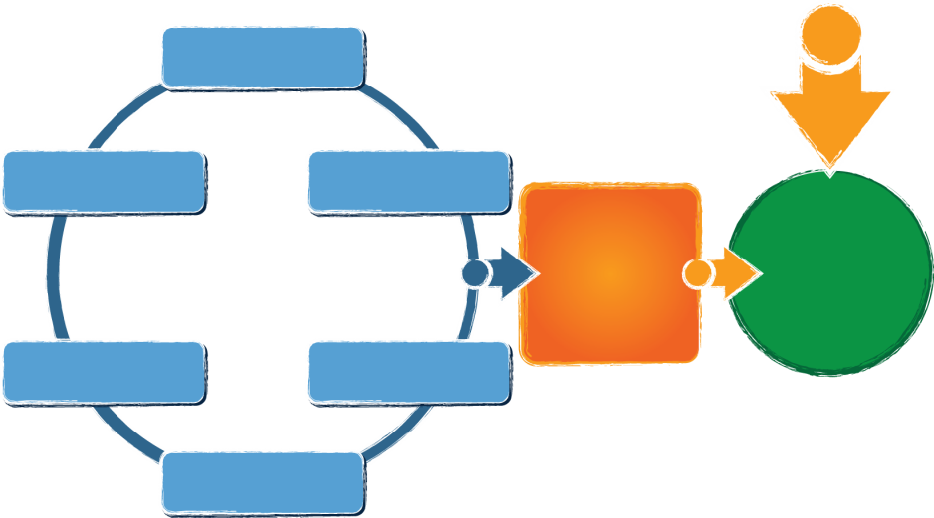
What Results will Your Plan Achieve?
Governance
Finance
Personnel / Workforce
Data Systems
Accountability & Quality Improvement
Quality Standards
Result:
Implementation of effective practices
Good outcomes for children with disabilities and their families

Slide 18
Begin with the End in Mind
What are the desired results or outcomes for children and/or families ?
Achieve the SiMR

Slide 19
How do We Prepare Staff and Sustain System/Practice Change?
What activities will be implemented to ensure practitioners have relevant knowledge and implement aligned practices?
Professional Development/Leadership

Slide 20
How do we support systems/practice change on a day to day basis
What activities will be implemented to ensure effective training, TA, coaching and other supports related to desired practices ?
Support for Practice

Slide 21
Local Support of Systems/Practice Change
What activities will be implemented to ensure local systems support practitioners?
Local supports

Slide 22
State Support of System/Practice Change
What activities will be implemented to ensure state system supports local systems and implementation of desired practices?
        State Support

Slide 23
What Activities Support the Strategies and Implement the Theory of Action?
What activities will be implemented to ensure state system supports local systems and implementation of desired practices? State Supports | What activities will be implemented to ensure local systems support practitioners? Local supports | What activities will be implemented to ensure effective training, TA, coaching and other supports related to desired practices ? Support for Practice | What activities will be implemented to ensure practitioners have relevant knowledge and implement aligned practices? Professional Development | What are the desired results or outcomes for children and/or families ? Achieve the SIMR

Slide 24
Short and Long Term Strategies/ Objectives
Objectives are the defined steps that help achieve the goal:
Short Term Objectives – incremental steps with shorter timeframes that move an organization toward their goals usually accomplished in 1-3 years
Long Term Objectives- Performance measures to be achieved over a period of five years or more

Slide 25
Set Targets
Targets ~ specific numbers you intend to meet in order to achieve the goals over the time period of the SSIP
They can be incremental increases or maintain progress

Slide 26
Clear Strategies/Actions to be Implemented
  Should address issues at all levels of the system
  Address aspects of the infrastructure that must be improved including resources needed and timelines
  Address how they will be aligned with initiatives and current improvement plans
  Activities must be connected and reflect the root causes impacting the SiMR
  Identify communication strategies (to facilitate buy in) and stakeholder involvement

Slide 27
Develop Improvement Activities:
Improvement Activities are the specific actions that lead to the measurable results of your program.
Activities are SMART:
      Specific
      Measurable
      Attainable
      Realistic
      Timed

Slide 28
Resources
http://ctb.ku.edu/en/table-of-contents/structure/strategic-planning/create-objectives/main
http://www.hfrp.org/publications-resources/browse-our-publications/strategic-planning-process-steps-in-developing-strategic-plans

Slide 29

Implementation science

Slide 30
Implementation Science
Active Implementation Frameworks
WHO
WHEN
WHAT
Teams
Stages
HOW
HOW
Usable
Interventions
Drivers
Cycles
http://sisep.fpg.unc.edu/
http://implementation.fpg.unc.edu/

Slide 31

Consider Implementation Science:
Implementation Drivers
Performance Assessment
(Fidelity)
Coaching
Systems
Intervention
Training
Facilitative
Administration
Competency Drivers
Organization Drivers
Decision Support
Data System
Selection
Leadership
© Fixsen & Blase, 2008
Technical
Adaptive
Notes:
31

Slide 32
Consider Implementation Science:
Implementation Drivers
Resource
Implementation Drivers: Assessing Best Practice
http://implementation.fpg.unc.edu/sites/implementation.fpg.unc.edu/files/resources/NIRN-Education-ImplementationDriversAssessingBestPractices.pdf

Slide 33

The Hexagon Tool
The Hexagon
An EBP Exploration Tool
Need in local programs, state
Academic & socially significant Issues
Parent & community perceptions of need
Data indicating need
The “Hexagon” can be used as a planning tool to evaluate evidence-based programs and practices during the Exploration Stage of Implementation.
Download available at:
www.scalingup.org/tools-and-resources
Capacity to Implement
Staff meet minimum qualifications
Able to sustain Imp Drivers
  Financially
  Structurally
Buy-in process operationalized
  Practitioners
  Families
NEED
Fit with current Initiatives
Local program, state priorities
Organizational structures Community values
CAPACITY
FIT
EBP:
5 Point Rating Scale: High = 5; Medium = 3; Low = 1. Midpoints can be used and scored as a 2 or 4.
 |  | High | Med | Low
Need
Fit
Resource Availability
Evidence
Readiness for Replication
Capacity to Implement
Total Score
READINESS
RESOURCES
Readiness for Replication
Qualified purveyor
Expert or TA available
Mature sites to observe
Several replications
How well is it operationalized?
Are Imp Drivers operationalized?
Resources and supports for:
Curricula & Classroom
Technology supports (IT dept.)
Staffing
Training
Data Systems
Coaching & Supervision
Administration & system
EVIDENCE
Evidence
Outcomes – Is it worth it?
Fidelity data
Cost – effectiveness data
Number of studies
Population similarities
Diverse cultural groups
Efficacy or Effectiveness
© National Implementation Research Network 2009-2012
Adapted from work by Laurel J. Kiser, Michelle Zabel, Albert A. Zachik, and Joan Smith at the University of Maryland

Slide 34
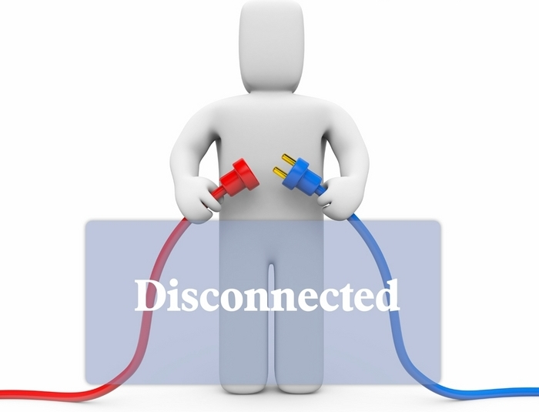
Some Ideas to Consider
The SSIP cannot thrive in a vacuum - EIS/special education state agencies will not be successful if the SSIP is disconnected from the agency’s focus and work.

Slide 35

Some Ideas to Consider
The SSIP should be aligned to and integrated with other initiatives in the state.
  Supports leveraging of resources - greater influence
  Prevents duplication of efforts
  Builds momentum and capacity
  Improves results

Slide 36

Evaluation

Slide 37
Evaluating the Implementation
Built into the plan from the beginning
Based on your theory of action
Based on data that informed the plan development
Formative data and summative data
Evidence to show progress

Slide 38
Evidence of Progress
Activities occurred and intended outcomes of each activity accomplished
Changes are occurring at the system, practice, and child/family level

Slide 39
For Each Activity...
Did the activity occur?
  If yes, what are evidences that it occurred?
  If not, why not?
  What do we need to do next?
Did it accomplish it’s intended outcomes?
  If yes, what are evidences that it accomplished intended outcomes?
  If not, why not?
  What else do we need to do before we move to the next activity?

Slide 40
If the Activity is an Output/Product e.g. Guidance Document
How will we know if the activity occurs?
  Evidences, e.g.
    guidance document developed and disseminated to the field
    what else?
How will we know if the activity accomplishes the intended outcomes?
  Evidences, e.g.
    feedback from the field about whether the guidance document is clear, readily available, helpful, etc.
    what else?

Slide 41
If the Activity is a Process e.g. Training for Practitioners
How will we know if the activity occurs?
  Evidences, e.g.
    training agenda, materials, activities
    participation records
    what else?
How will we know if the activity accomplishes the intended outcomes?
  Evidences, e.g.
    participant evaluations
    measure of competencies
    what else?

Slide 42
Evaluation at All Levels
Governance
Finance
Personnel / Workforce
Data Systems
Accountability & Quality Improvement
Quality Standards
Result:
Implementation of effective practices
Good outcomes for children with disabilities and their families

Slide 43
For Each Level...
What are the guiding evaluation questions?
What will be our performance measure to know we’ve been successful?
What are the data sources for the performance measure?

Slide 44
Measuring Results
Results question, e.g.:
  Have child outcomes improved?
Performance measure, e.g.:
  % of children exiting at age expectations in social emotional functioning
Data source, e.g.:
  Current state approach to C3/B7 measure of child outcomes

Slide 45
Measuring Practices
Practice-level questions, e.g.:
  Have practices improved? Are more practitioners implementing the desired practice(s)?
Performance measure, e.g.:
  % of practitioners implementing the desired practice
  % of programs with 80% or more practitioners implementing the practice
Data sources, e.g.
  Pre/Post measures of practices such as:
    Fidelity check lists
    Supervisory observation of practices
    Monitoring data on practice implementation
    Self-assessment data on practices
    IFSP/IEP data
What else?

Slide 46
Measuring Local Capacity
Local system-level questions, e.g.:
  How has the local infrastructure been improved to support implementation of the practices?
Performance measure, e.g.:
  Changes to local systems (governance, finance, personnel—TA and PD, data systems, accountability and quality improvement, quality standards).
Data sources, e.g.:
  A local leadership team is established to support the new initiative
  A local strategic plan is developed to align with state priority and strategic plan
  Mentoring and supervisory system set up for supporting the practice
  New supervisory checklist developed for observing and supporting practitioners’ implementation of the practice
What else?

Slide 47
Measuring State Capacity
State system-level questions, e.g.:
  How has the state infrastructure been improved to support implementation of the practices?
Performance measure, e.g.:
  Changes to state systems (governance, finance, personnel—TA and PD, data systems, accountability and quality improvement, quality standards).
Data sources, e.g.:
  Statewide communication plan created to inform all relevant stakeholders about new state priorities and strategic plan
  Revised fiscal policy to reduce barriers to implementation of the practice
  New monitoring process established to gather data on the practice
What else?

Slide 48
Questions
What do you see as your biggest challenge(s) related to evaluating your SSIP?
What resources or supports will you need related to evaluating your SSIP?

Slide 49
Moving From Phase I to Phase II
What are your needs in moving from Phase I to Phase II? This includes linking coherent improvement strategies, TOA with the plan)
What are your needs for planning the development of the improvement plan?
What are your needs related to the content of the plan specific to Infrastructure Development?
What are your needs related to the content of the plan specific to supporting LEAs/EIS Programs implementation of evidence-based practices?

Slide 50
Thank you!
Anne Lucas, anne.lucas@unc.edu
Grace Kelley, gkelley3@cox.net
Taletha Derrington, taletha.derrington@sri.com
Christina Kasprzak, christina.kasprzak@unc.edu

