Slide 1




Finishing Phase I: Improving Results through Systemic Improvement Planning
Stacy Kong, Hawaii Part C
Ruth Littlefield, New Hampshire 619
Anne Lucas, ECTA/WRRC
Brenda Sharp, Louisiana Part C
Notes:
Planning Team: Taletha Derrington, Megan Vinh, Christina Kasprzak, Grace Kelly

Slide 2

Session Goals
Understand SSIP requirements related to coherent improvement strategies
Gain ideas about how data and infrastructure analysis lead to identifying improvement strategies

Slide 3

Session Outline
Introduction
Sharing from 3 states
  Hawaii Part C
  Louisiana Part C
  New Hampshire 619
Discussion

Slide 4
SSIP Activities by Phase
Year 1 - FFY 2013 Delivered by Apr 2015 | Year 2 - FFY 2014 Delivered by Feb 2016 | Years 3-6 FFY 2015-18 Feb 2017- Feb 2020
Phase I Analysis | Phase II Development | Phase III Evaluation and Implementation
Data Analysis; State-identified Measureable Result; Description of Infrastructure to Support Improvement and Build Capacity; Selection of Coherent Improvement Strategies Theory of Action | Multi-year plan addressing: Infrastructure Development; Support EIS Program/LEA in Implementing Evidence-Based Practices; Evaluation Plan | Reporting on Progress including: Results of Ongoing Evaluation Extent of Progress Revisions to the SPP

Slide 5
Where Are You in Completing Phase I?
Data analysis
  Broad analysis
  In-depth and Root Cause Analysis
Infrastructure analysis
State Identified Measurable Result(s) (SiMR) for Children with Disabilities
Identification of Improvement Strategies

Slide 6
Phase I Components
Coherent Improvement Strategies
Theory of Action
What will be do about it?
In-depth
Data Analysis
In-depth
Infrastructure Analysis
Why is it happening?
State Identified Measurable Result(s)
Broad
Data Analysis
Broad
Infrastructure Analysis
What is the problem?

Slide 7

Coherent Improvement Strategies
Must provide explanation of:
  How improvement strategies were selected
  Why they are sound, logical and aligned
  How they will lead to measurable improvement in SiMR

Slide 8
Coherent Improvement Strategies
Includes strategies, identified through Data and State Infrastructure Analyses, that are needed to:
  Improve State infrastructure
  To support EIS program and/or EIS provider implementation of evidence-based practices to improve SiMR

Slide 9
Coherent Improvement Strategies
Describe how implementation of improvement strategies will:
  Address identified root causes for low performance
  Ultimately build EIS program and/or EIS provider capacity to achieve the SiMR

Slide 10
Suggested Process
Use information from data and infrastructure analyses to identify:
  Root causes (practices and infrastructure)
  Barriers as to why root causes have not previously been addressed
  Leverage points (things that are working well, existing initiatives and state improvement plans, things that will turn the curve)
Review evidence for potential solutions

Slide 11

Potential Selection Criteria
Select strategies that:
  Address root causes and barriers
  Build on leverage points
  Are appropriate and fit well
  Are doable within resources available
  Are aligned with each other
  Build capacity of LEAs/EIS programs
  Are evidence-based
  Will make a difference in results (SiMR)

Slide 12
Suggested Considerations
Use DEC Recommended Practices and the Agreed Upon Practices as resources for identifying key practices
Incorporate active implementation frameworks (from implementation science) as improvement strategies are designed to evaluate appropriateness and fit
Evaluate effectiveness and impact of improvement strategies

Slide 13
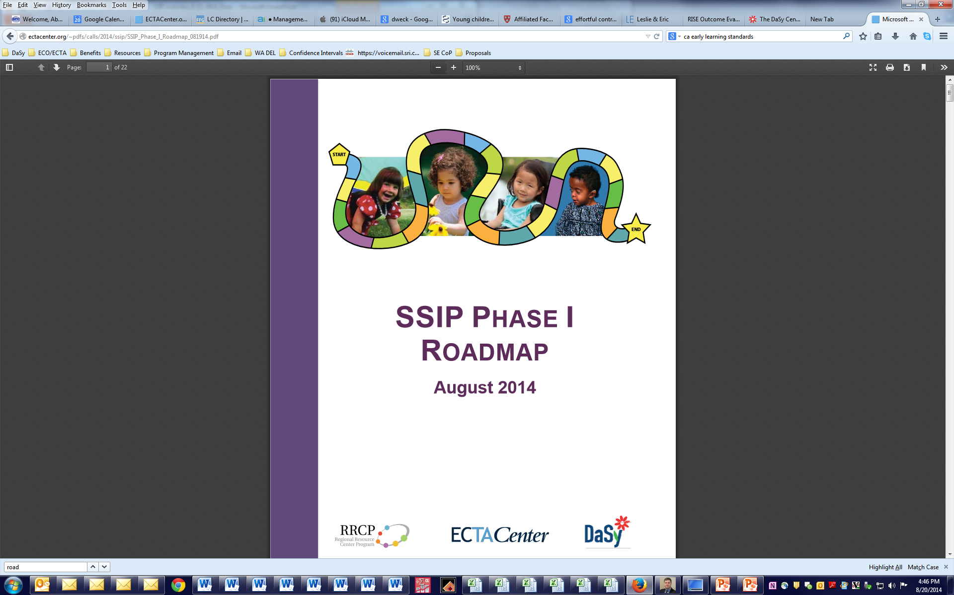
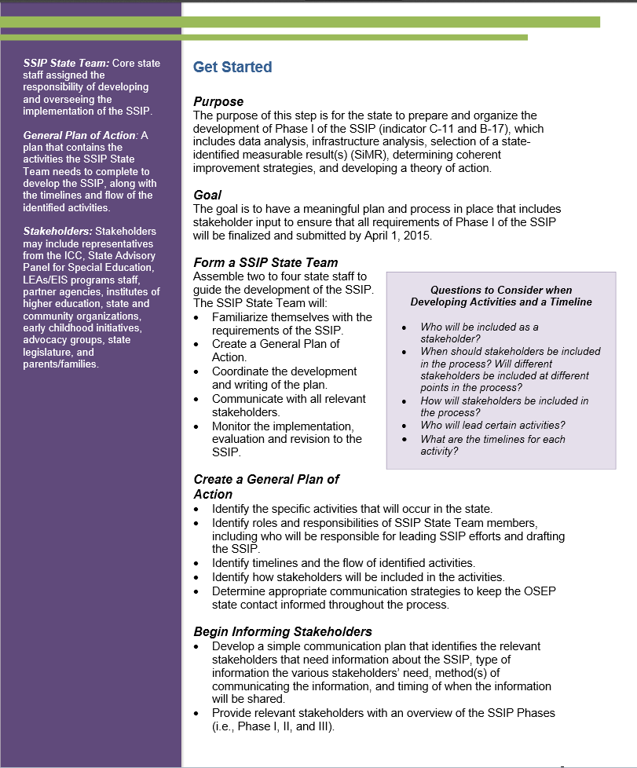
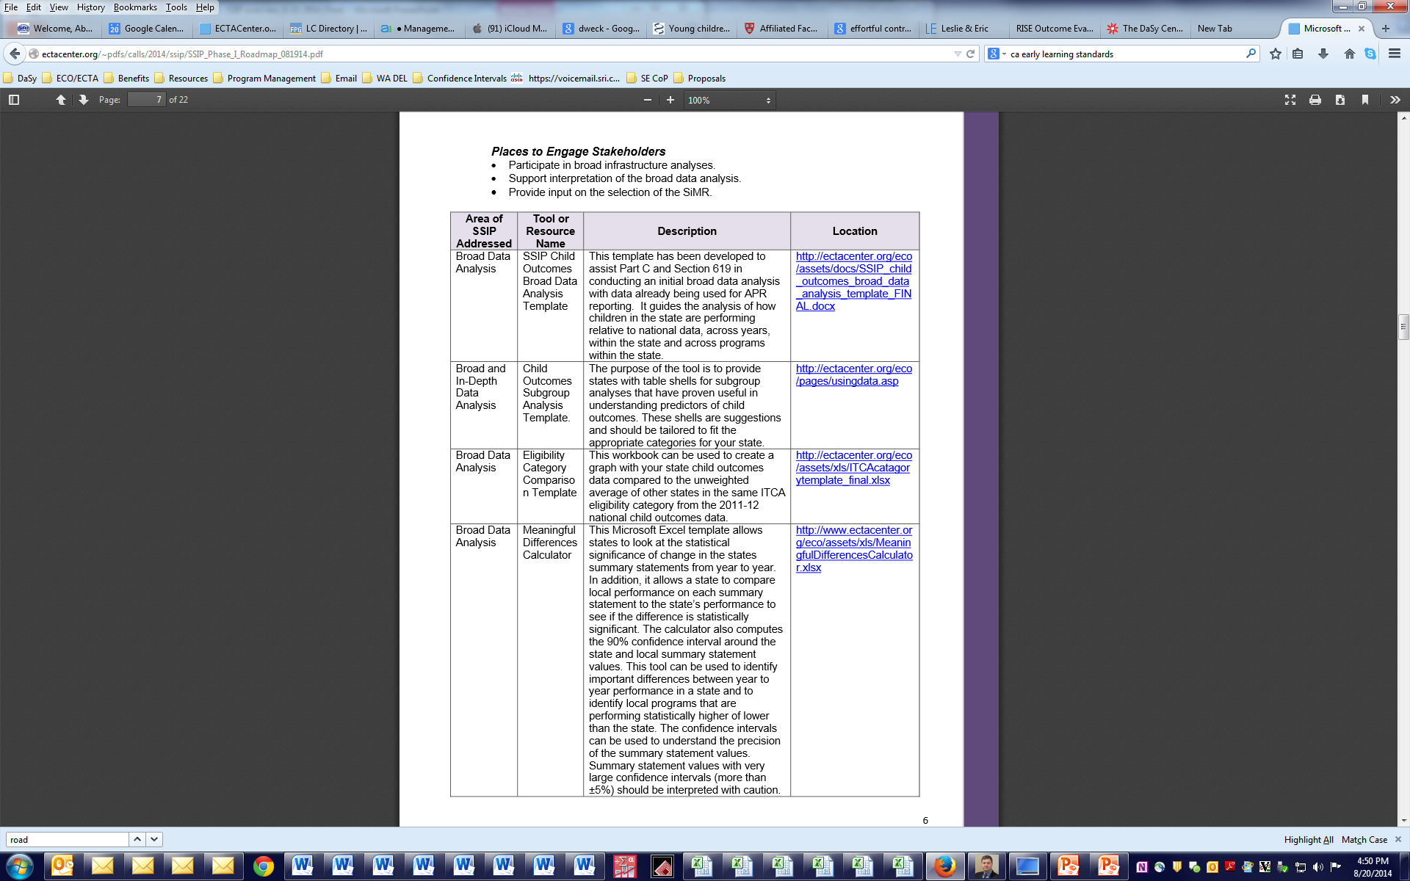
SSIP Webinar Series: http://ectacenter.org/~calls/2014/ssip/ssip.asp
SSIP Phase I Roadmap: http://ectacenter.org/~pdfs/calls/2014/ssip/SSIP_Phase_I_Roadmap_082214.pdf

Slide 14

State Sharing
HI-C, LA-C, NH 619:
  Used different approaches to completing data and infrastructure analysis and selection of SiMR
  Have not yet identified improvement strategies but are in process and working toward identification and selection

Slide 15

State Systemic Improvement Plan (SSIP)
Hawaii Part C

Slide 16

SSIP Involvement
State Team
Leadership Team
Stakeholders

Slide 17

Phase I – Data Analysis
Child Outcomes Data
  Local Programs
  State
  National
618 Child Count Data
Anecdotal Information

Slide 20
Meaningful difference from previous year

Slide 21
Meaningful difference from previous year

Slide 22

Focus Area
“Social Emotional Skills”
Broad Data Analysis
Hot topic
  Interest
  Information/resources available
Alignment with State Initiative
Mental health services are costly
Critical for overall development
Notes:
.

Slide 23

Phase I – Infrastructure Analysis
Gallery Walk
  Generated lots of discussion
  Lots of information to sort through
  Keep it focused on topic area
Compiled Information
Identify key points
TA
Prof. Dev.
Fiscal
Data
Quality
Accountability
Governance

Slide 24
Infrastructure Analysis – Key Points
Governance:
  Guided by IDEA and Hawaii Administrative Rules
  Part C Procedural Guidelines in place
  State bureaucracy that may hinder timely recruitment, establishing policies and procedures, MOAs, etc.
  HEICC established; need to explore how utilize their services to enhance EI system
Monitoring and Accountability:
  Compliance monitoring and data validation in place with one tool being used statewide
  Feedback regarding compliance and quality improvement shared
Technical Assistance/Professional Development:
  TA available statewide
  Lost six QA positions that provided on-site technical assistance
  Programs feel guidance inconsistent at times
  Not enough money for trainings, professional development, etc.
  Different qualifications for Private vs. State Programs (i.e., Social Workers)

Slide 25
Infrastructure Analysis – Key Points
Data:
  A lot of data in an outdated data system
  Question regarding if staff collect Child Outcomes data differently, is the data valid?
  Need to integrate multiple data systems
  Need data analyst
Quality Standards
  Inconsistent implementation of transdisciplinary and coaching model
  Need for consistent and on-going training/support of the BDI-2
  Hawaii Early Learning Developmental Standards (HELDS) established and EI trainers identified
  Consistently use evidence –based practices
Fiscal
  Funding deficit based
  Need to work with Medicaid and Tricare to explore reimbursement options for services for children with Autism
  Fiscal monitoring process in place
  Lack of resources continues to be an issue

Slide 26

Phase I – Focus Area
State-identified Measurable Result for Infants and Toddlers with Special Needs
“What identified area, which when implemented or resolved, has the potential to generate the highest leverage for improving outcomes/results for children with disabilities?”

Slide 27

Phase I – Root Cause Analysis
Small group discussion with stakeholders
Compiled information
Identified additional data that must be analyzed.

Slide 28

SSIP Status
Activities completed
  Informed broad stakeholder group about SSIP
  Broad data analysis
  Identified focus area
  Broad infrastructure analysis
  Broad root cause analysis

Slide 29
Next Steps
Identify SIMR
Identify root causes including barriers and leverage points to address root causes
  Create hypotheses of potential root causes
  Develop questions to confirm/reject hypotheses
  Interview high/low performing programs
  Determine root causes
Develop evidence-based improvement strategies
Create Theory of Action

Slide 30


Slide 31
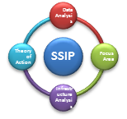



Louisiana:
SICC
Strategic Plan and State System Improvement Process (SSIP)
State Interagency Coordinating Council

Slide 32


Stakeholder involvement in EarlySteps
Louisiana SICC+
Lead Agency +
Stakeholders=
Louisiana Part C

Slide 33

EarlySteps Strategic Plan:
3 Strategic Directions:
      Improving the System
      Enhancing Services and Accountability
      Improving Efficiency and Access

Slide 34


Where to Start?
Beginning the new APR and SSIP discussion
Review the Proposed SSIP with initial release
Discussions with SERRC
July 2013 presentation to SICC on proposed APR/SSIP
SICC voted to host a retreat to begin planning for the SSIP—held September, 2013
Smaller workgroup planning in December, 2013 February and March 2014
Regular calls with SERRC
Full Workgroup meetings at April
and July, 2014 SICC meetings

Slide 35





SSIP Planning: SICC Members and Stakeholders gather to discuss Indicator C-11/update Strategic Plan
Review Data
Review Available Data: APR, Early Childhood Redesign, Strategic Plan and OCDD Transformation Plan
Align State Initiatives
Look at other state early childhood initiatives align/overlap
Create Workgroups
What do we need to gather that we don’t have? Look for trends and areas for improvement.
Assemble
SICC/Lead Agency SSIP Planning Retreat

Slide 36

Data Analysis
 | 2004-05 Baseline | 2005-06 | 2006-07 | 2007-08 | 2008-09 | 2009-10 | 2010-11 | 2011-12 | 2012-13
Target | 100% | 100% | 100% | 100% | 100% | 100% | 100% | 100% | 100%
Actual | 75.55% | 50% | 85% | 86% | 87.6% | 90.7% | 93.8% | 91.2** | 91%**
Raw Data |  | 116 meet timeline 234 reviewed | 195 meet timeline 229 reviewed | 144 meet timeline 167 reviewed | 355 meet timeline 405 reviewed | 361 meet timeline 398 reviewed | 530 meet timeline 565 reviewed | 588 645 reviewed **calculation with delays for family reasons 550 645=85.3% | 230 253 Reviewed **calculation with delays for family reasons 210 253=83%

Slide 37

Trend View

Slide 38


Slide 39


Slide 40
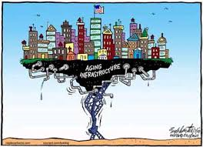
Infrastructure Analysis
SSIP Components ECTA System Framework Components Implementation Driver | Essential Functions | Will this component be involved in addressing the SIMR?
1.Governance Organization Drivers Leadership Drivers | Part C housed in DHH, OCDD – Lead agency for Part C Program ICC , Governor’s office of Community Programs – advises and assists the lead agency – staff person Lead Agency-SICC have shared Strategic Plan which includes shared vision and strategic directions. Regional ICC’s – do not directly mirror state ICC- local/regional input , communication loop between state and regional SICC Stakeholder Structure—committees, workgroups Families (COSs) involved in decision making, training, etc. Provide information on regional resources, address system concerns/issues, training/TA Administrative structure: independent vendor model for services delivery State Statute 28:461-470 Federal Statute Part C IDEA Bylaws of SICC- revised July 2010 Policies and Procedures Practice Manual Guidance documents | Yes

Slide 41

Next Steps:
Finalizing the Measureable Result
Use identified areas of improvement from Strategic Plan
Improve Child Outcome indicator measurement process
Align with Louisiana’s Early Care and Education Initiative
Address fragmentation of service delivery

Slide 42

New Hampshire:
On the road to Improving Outcomes for Children with Disabilities
Presented By Ruth Littlefield
NH Department of Education
619 Coordinator

Slide 43
  Phase III:
  Evaluate progress annually
  Adjust plan as needed
  Phase I:
  Initiate Data analysis
  Conduct Infrastructure analysis (Implementation Framework)
  Identify focus area
How well is the solution working?
What is the problem?
Phase III
SSIP
Phase I
What shall we do about it?
Why is it happening?
Phase and I II
  Phase I and II:
  Search/evaluate evidence-
  based solutions (Exploration Phase)
  Develop Theory of Action
  Develop and implement plan for improvement (Implementation Framework)
  Phase I:
  Conduct root cause analysis to identify contributing factor(s)
  Identify systemic barriers for improvement for contributing factors
Source: Western Regional Resource Center

Slide 44
Notes from calls with OSEP State Contact
  Data Analysis
  Describe how analyze key data and root causes that contribute to the results
  Multiple Data Sources
  Describe how disaggregate across multiple variables
  Identify any data quality issues
  More than 618/619 Data
  Infrastructure Analysis
  What is the structure in the State to do something about this? What programs can be leveraged for support? More than special education.
  SiMR
  Absolutely does not have to be all districts. Can look at a subset of districts for SiMR
  Stakeholder involvement: embedded through out

Slide 45
Stakeholder Input
NH State Advisory Committee on the Education of Students/Children with Disabilities (State Advisory Panel)
Interagency Coordinating Council for Part C (ICC) (align C-B)
Statewide Network for Preschool Special Education
NH Association of Special Education Administrators
Parent Information Center (PTI)
SSIP Stakeholder Input group
Formal and Informal
Ongoing
Surveys and environmental scans (not necessarily done for SPP)

Slide 46

Data Analysis
SPP/APR Data (all)
NH Data Display (OSEP)
Enrollment and Eligibility Figures
SAMSA grant: Safe Schools, Healthy Schools
Race to the Top data (not in vain)
Governor’s Guide to Early Literacy
Head Start Disability Data
Other State Data (Gen Ed and Early Childhood)

Slide 47

Infrastructure
Analysis
Active Secondary Transition CoP
NH Connections School and Family Partnerships
Next Steps NH: College, Career and Life Readiness (NH SPDG)
NHDOE Accountably and Assessment and Integrated Programs
NHDOE Innovations (Gen ED)
State Advisory Council for Early Childhood (Spark-NH)
NH Early Comprehensive Strategic Plan for Early Childhood

Slide 48

Data Analysis
Begin in-depth analysis of child Outcome Data
  Compare to National Results
  Compare tool to tool
  Review Cell Size(of 174 districts, 88 have fewer than 5 exiting, 34 have 6-10 exiting and only 7 have more than 25)
  District Enrollment for PSE
  Compare over time (targets, SS1 and SS2 by Outcome area)
  LRE data, Parent Survey, Kindergarten Entry, Exit Part C, Referral Source
  Identify data challenges/limitations

Slide 49

Data Drill Down
Can get messy

Slide 50
Data
Pairing Indicator 6 with Indicator 7 (by district)
Considering factors such as:
  Race/ethnicity
  Poverty
  Regional differences
  Rural vs urban (District Size)
  Referral source (Part C and other)

Slide 51

Infrastructure Analysis
Infrastructure Drill down
  Spark NH (EC Advisory Council)
  Family Centered Early Supports and Services (Part C)
  Title 1
  Preschool Special Education Special Projects (networks, TA systems)
    SEE-Change
  TQRIS &Early Learning Standards
  NH Association of School Principals and Coos Coalition for Young Children and Families
  Infant Mental Health Association
  Institutes of Higher Education

Slide 52
Student Identified Measurable Result
(SiMR)
Improved Outcome(s) for Preschool Special Education
  One or more of the Indicator 7 Outcomes (or subset of this)
  May be a subset of districts that are identified to start
  Scale-up and Sustainability
  Based on Data and Infrastructure
  Stakeholder input
  Implementation Science and DEC RP
  Still asking: what does a SiMR need to look like?

Slide 53
Improvement Activities and Theory of Action
Need more
  Drill-down of data and root cause analysis
  Exploration of infrastructure (strengths and weaknesses)
  Stakeholder input
To Be Determined…..

Slide 54
Small Group Discussion
At your table decide if you will discuss:
  data analysis
  infrastructure analysis
Discuss the following:
  What is working well
  How you designed your process for conducting analysis of this component to help you identify improvement strategies
  Lessons Learned
Decide what 1 item to share back with the full group from each

Slide 55
Large Group Discussion
What are your thoughts about your SiMR?
What might it look like?

Slide 56
Contact Information
Stacy Kong
stacy.kong@doh.hawaii.gov
Littlefield, Ruth Ruth.Littlefield@doe.nh.gov
Brenda Sharp
Brenda.Sharp@LA.gov
Anne Lucas
Anne.Lucas@unc.edu

