Slide 1
Collecting and Reporting Accurate Data
Three States Discuss Their Strategies for Advancing Data Quality

Slide 2
Do you know who I am?
I am a Person
I have a student profile
I have a SIS File
I have a Special Education file

Slide 3
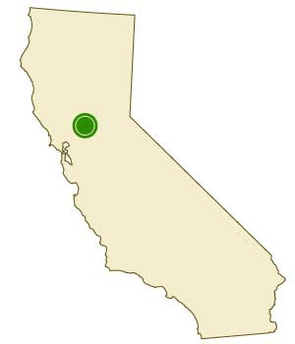
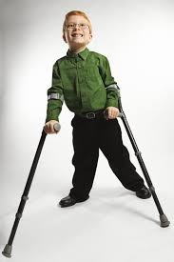
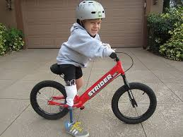
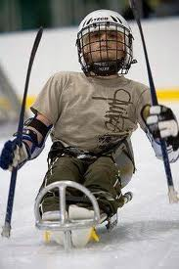
The data is me
Thank you for being my voice and ensuring others see the real me

Slide 4
Who are we?
Bonnie Dye
Georgia
Nick Easter
Kentucky
Shiyloh Duncan-Becerril
California

Slide 5
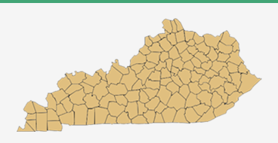
Kentucky
97,500 Students
173 LEAs
2 State Schools

Slide 6
Data Collection System
Kentucky is Local Control---However, it was mandated that all LEAs use the same vendor for their Student Information System (SIS).

Slide 7
Student Information System
Authoritative Source
for
Student Demographics
Attendance
Behavior
Health
Grades, GPA, & Graduates
Teacher Identifiers
Courses
Class Rosters linking students to teachers
School/District
Superintendents & Principals
Program Participation
-Gifted & Talented
-Title I
-LEP
-Free/Red. Lunch
-Preschool
-Migrant
-K-Readiness
-Prior Setting
17958 Data Elements
315 SpEd Data Elements

Slide 8
Data Quality and Validation
Guidance
Onsite Regional Trainings
Data Standards
Technical Assistance
District Edition support
State Edition Support
Data Validation Pre-Submission
Online Trainings
Phone Support
Validation via secure viewing of data to be publicly reporting on State School Report Card
Dada Validation Post-Submission
System Validation Checks
Data Stewards
SEA TA for validation
Reporting Validation Checks

Slide 9
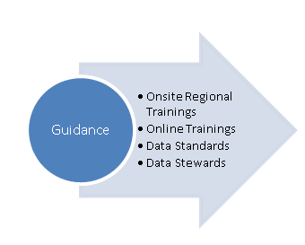
Guidance: Training
Regional Trainings via 9 Special Education Cooperatives
Online Trainings
Data Steward Trainings

Slide 10
Data Standards
Data Standardization is the process of making all data of the same type or class conform to an established convention or procedure to ensure consistency and comparability across different databases.
Data Standards are linked to website and to SIS.
Promote the use of procedures, guidelines for consistency for new initiatives and to improve data quality.

Slide 11
Data Stewards
Data Steward: owner of a data element or data field responsible for hands-on work related to data at KDE.
That person and office should (a) be the expert of what that particular data element means/does, (b) is the person/office that answers detailed questions/issues about that data element and (c) lastly regularly inspects (you get what you inspect versus expect) the level of quality to ensure it meets not only their office needs but all the others that depend on it.
The data steward for each key data element arrives each day knowing they have the responsibility for the accuracy of each data element that they have been assigned for not only their office but others outside their office that count on it.

Slide 12
Data Stewards
Recognize the Authoritative Source of the Data
Utilize Authoritative Source Systems
Systems should communicate
Avoid duplicate collections of data.
Validate and update data within authoritative source sytem.
Data stewards need to know and understand data.
Should know how data is used agency wide.
Verify reasonability
Follow-up on issues to improve data quality.
Promote the use of procedures, guidelines for consistency for new initiatives and to improve data quality.
Historically – Legislatively Required
NOW – best practices
Verify/Validate - completeness
Notes:
First we need to stop anything that KDE does that allows/encourages/requires a district or KDE staff making changes the separate excel spreadsheets/Filemaker pro apps versus within the authoritative source (i.e. district IC edition, MUNIS district edition, IC state edition). We also need districts to take the same approach internally (e.g. cafeteria system being updates with a new student home but IC not being updated). This results in the data not being consistent between multiple systems (e.g. Center for School Safety Report and P-20 data, Free and reduced Lunch, KEES, etc, etc)….which of course leads to embarrassing revelations
Second. We need the identified data stewards in KDE to get very serious/focused on inspecting the quality of the every data element that they are responsible for versus waiting for some report to be produced that points out the problem with that data element. They need to look at it from the perspective of every major stakeholder that counts on that data element. What we are finding is a good number of them have never closely looked at it or inspected it or compared it with other states. For every major data element that KIDS in responsible for we frequently compare it with other states to see if we are close to other states to ensure we don’t have some really wrong stuff. However it appears a good number of the data stewards don’t have any feel for if the totals they see in IC are in the ball park or way out of line.

Slide 13
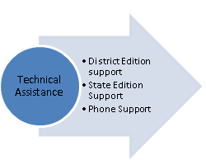
Student Information System
Technical Assistance
District Edition
Districts enter data into LEA SIS
Weekly Snapshot
Sync Weekly
Real
Time
Sync
State Edition
SEA SIS links to all LEA SIS
Sync Weekly

Slide 14
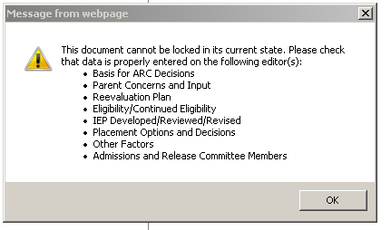
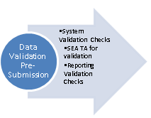
Data Validation Pre-Submission

Slide 15
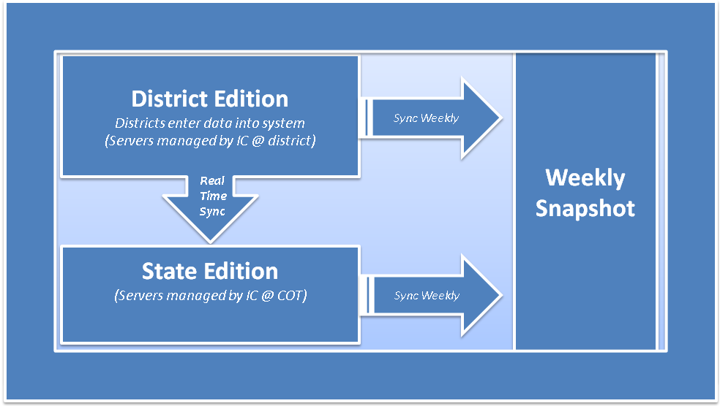
SEA Validation
Real
Time
Sync

Slide 16
Data Validation Pre-Submission

Slide 17
Report Validation

Slide 18
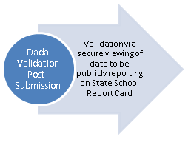
Data Validation via Public Reporting
Kentucky’s School Report Card
http://applications.education.ky.gov/SRC/
Each year, School and District Report Cards are posted on the Kentucky Department of Education’s (KDE's) website and provide information about each school and district, including test performance, teacher qualifications, student safety, awards, parent involvement and much more.’
LEAs have a data verification window to check data and make corrections either via the SRC data collector or by correcting the SIS and resubmitting the report.

Slide 19
California
705,000 Special Education Students
1700 Districts (LEAs)
139 SELPAs

Slide 20
Data Collection System
California Special Education Management Information System (CASEMIS)
2 data collections per year from LEAs
California is Local Control---Each LEA contracts with a vendor for a Student Information System (SIS) and an electronic IEP system
Two separate systems at both the LEA and the state level

Slide 21
How does the data get to us?

Slide 22
All Other Student Data
Special Education Data
SELPAS

Slide 23
Current Data Submission Structure
Data
State and Federal Reporting
Extraction
Certification
Data
Data
LEAs
SELPAs
CDE

Slide 24
Data Validity Concerns
Is data being entered correctly?
Does everyone who enters the data have the same understanding?
Are all SWD being reported?
Are all events being reported?
Are there explanations for anomalous data?
Where are discrepancies?

Slide 25
Data Concerns
Accuracy
Alignment to other data
Consistency in reporting fields
Training for field colleagues on needs and expectations
Lack of Data Culture

Slide 26
The Data Validation Process
Phase I
Phase III
Technical Assistance Guides
CASEMIS Training
CASEMIS Help Team
Software based Validation
Anomaly Review
Warning Review
On-time Submission
Cross-Validation
Other Analysis
Data Validation Review
Pre-Validation Stage
Phase IV
Phase II

Slide 27
Example in Practice
Pre-Validation
CASEMIS Technical Assistance Guide
Published twice per year
Regularly updated
CASEMIS Help Team
In-Person Trainings (CASEMIS Roadshow)
Webinars

Slide 28
Example in Practice
Cross-Validation of Data
Discipline data collected in two separate systems
Did not match up
Engaged with our stakeholders to develop solutions

Slide 29
Working with LEAs and SELPAs

Slide 30
At First it was…

Slide 31
Making SELPA and LEAs Partners
Work collaboratively
Build Trust
Be Consistent but Flexible
Be Open to Their Concerns
Lead by Example
Hold Accountable
Find the WIIFM

Slide 32
Working with General Education
Open Lines of Communication
Be the teacher
Show up to every invite
Use your voice at meetings
Get executive buy-in
Find common ground
Be appreciative

Slide 33
Now….
We are engaging in a process in which everyone has a voice
We are creating a culture of data
We can tell the story more accurately

Slide 34
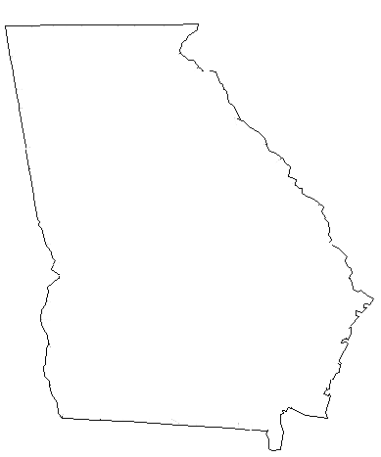
1100
Business
Rules
21,147
SpEd Teachers/
Related Service Providers
2263 Schools
198 LEAS
6 SpeED
Data Applications
1,723,439 Students
26,000
Helpdesk
Calls
12 Month Collection Period
21 Data
Collections
190,587 Students with Disabilities
700+
Data Elements

Slide 35
Georgia
Data Collections Division
Special Education Data Applications
EDFacts
Reporting
SPP/APR
All Files
618 Data
State Reporting
Preschool Outcomes (Indictor 7)
Transition Planning (Indicator 13)
Postsecondary Outcomes (Indicator 14)
CEIS (Table 8)
Overview of Georgia’s Data Reporting

Slide 36
Strategies for Advancing Data Quality
Written Guidance
Business Rules
Errors and Warning
Data Reports

Slide 37
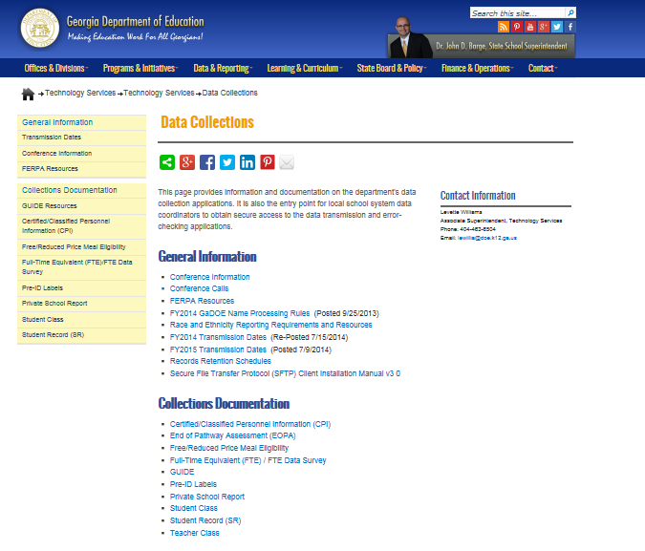

Slide 38
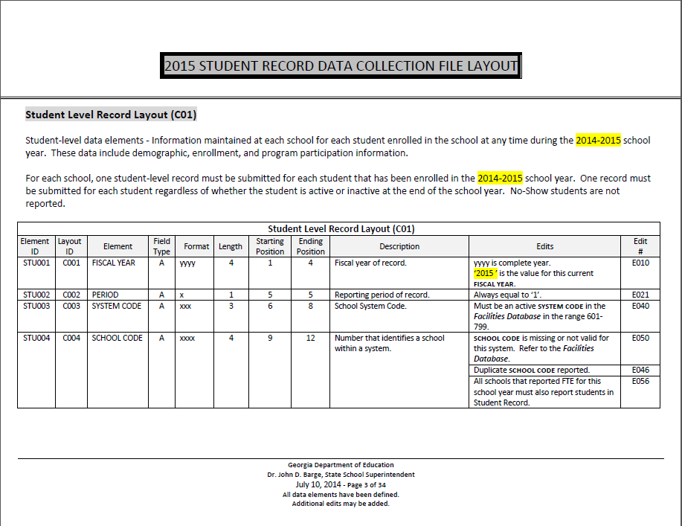

Slide 39
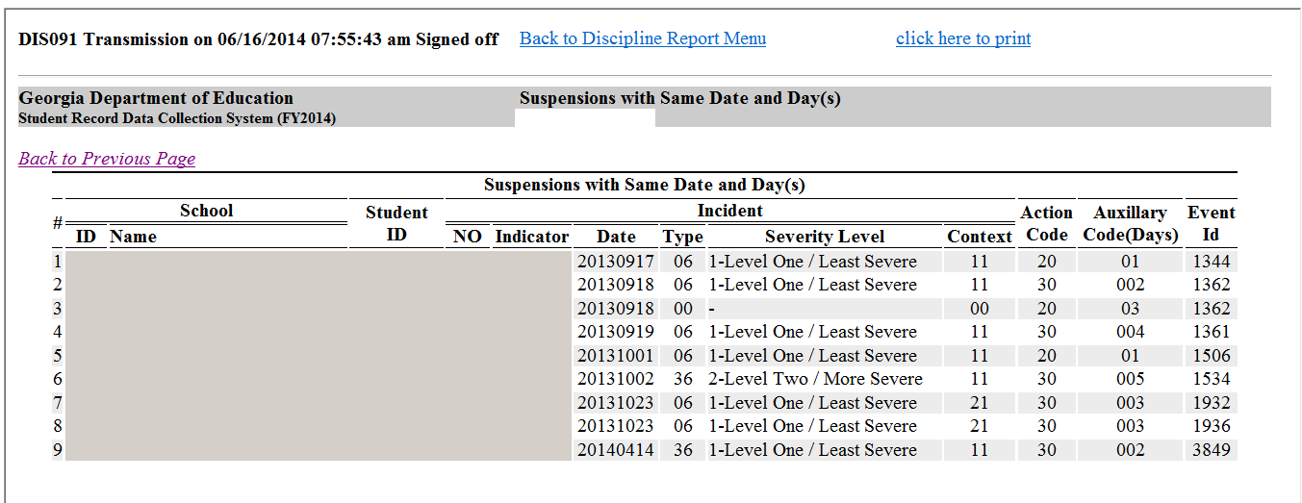
Drilldown on Student ID to View Student Level Data
Was this a continuation of the same action?

Slide 40
Ongoing Technical Assistance
Phone Calls
Preschool Outcomes Collection Tool
Data Conference
Age 3-5 Environment Calculator
Age 6 -21 Environment Calculator
Help desk
Monthly TA Calls
Warnings/Errors
Help Desk
Data Collection Worksheets
Special Education Leadership Conference
Data Reports
Special Education Leadership Academy
Emails
GOIEP
GLRS/
District Liaison Training
Year to Year Change Reports
Friday Blast

Slide 41
Georgia EDFacts Database
Category Sets
Reports for Program Office Review
SEA
Total Records by: Category Set
Subtotal
Total
SEA, LEA, School
Cell by Cell Analysis
Submission Reports
Submission Logs
Specialty Reports
Prior Year Comparison Reports
175,178,185,188,146 & 004 Summary
Assessment Results by Disability Area
SEA, LEA, School
Nsize and % Change
Cell by Cell Analysis

Slide 42
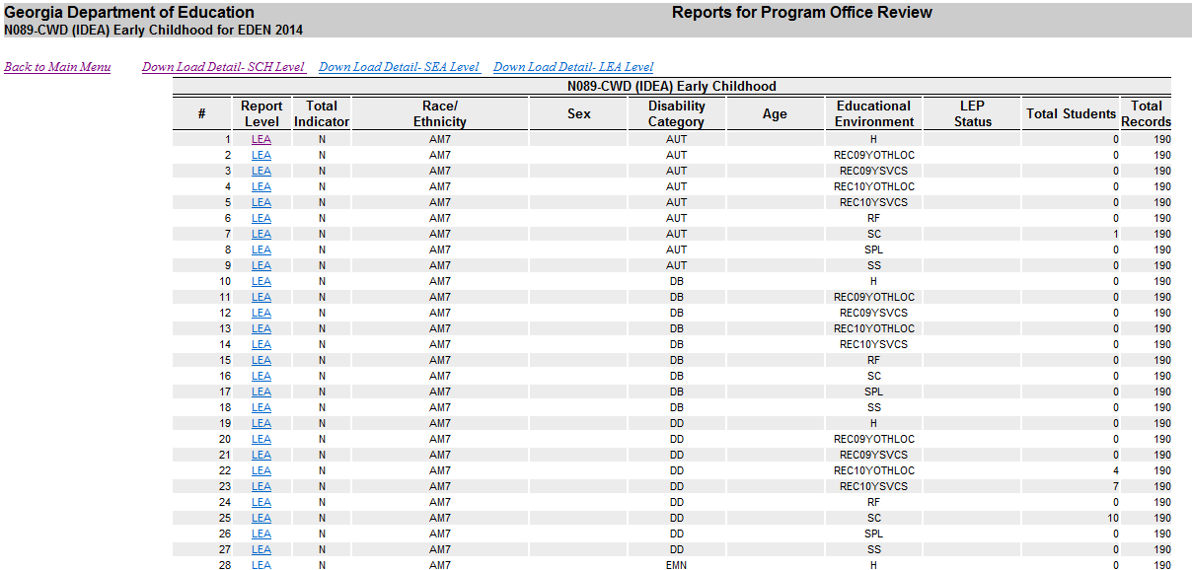
SEA
LEA
School

Slide 43
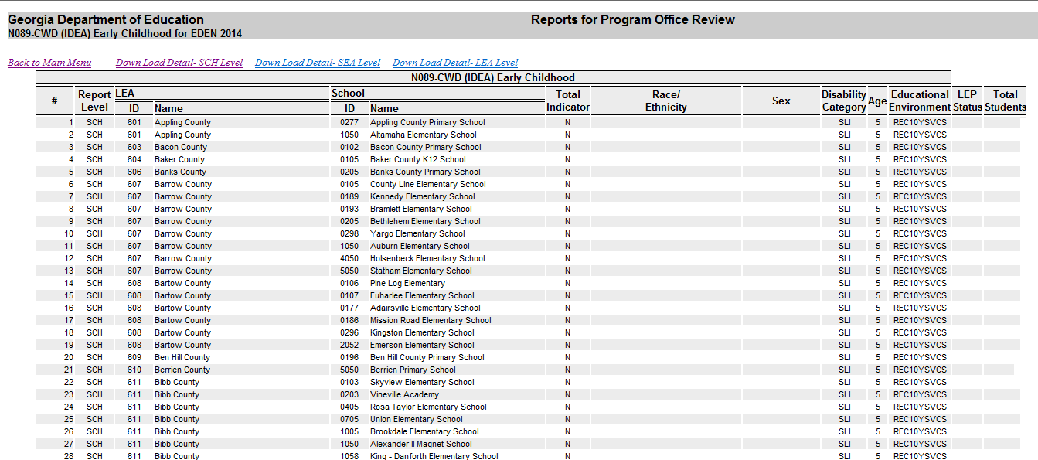
LEA
Disability
School Level
School
Age
Student Count
Environment

Slide 44
Current Year
Prior Year
Count Difference
% Difference

Slide 45
SEA
Student Count
Age
(3, 4, 5)
Race/
Ethnicity

Slide 46
Non-Part 60
Minus Medical
15,390
Performance 15,870
Total Enrollment
15,931
Assessment Congruency Report

Slide 47
Assessment Congruency Report
All Assessments
ALT/ALT Participation
1,254
Total Performance 1,264
Difference = 0
Performance By Level
Total Proficient

Slide 48
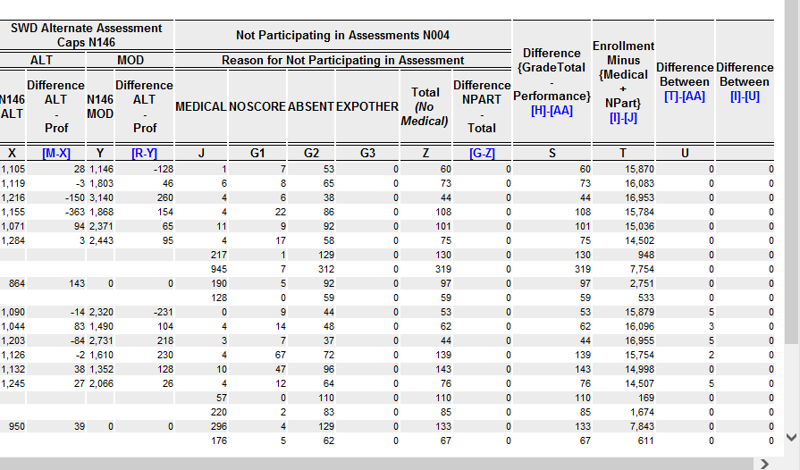
Calculates Caps Based on Count Proficient to Enrollment
Reports Count Over/Under Cap
Congruency Check Between Non-Part in N185 and N188 Compared to
Reasons for Non-Part in N004
Congruency Check Between
N185 and N188 Compared to
N175 and N178

