Slide 1
Building High Quality Personnel Systems
Improving Data, Improving Data Conference
September 9, 2014
Notes:
Carolee’s slide

Slide 2
Contributors and Presenters
Pennsylvania
James E. Coyle, Director, Pennsylvania Bureau of Early Intervention Services
Mary Anketell, Program Manager, Early Intervention Technical Assistance
Emily Hackleman, Chief, Division of Standards and Professional Development Pennsylvania Bureau of Early Intervention Services
Early Childhood Personnel Center (ECPC)
Jeffri Brookfield, Coordinator
Mary Beth Bruder, Director
Early Childhood Technical Assistance Center (ECTA Center)
Kathy Whaley, Technical Assistance Specialist

Slide 3
Goals and Session Organization
Provide an overview of the ECTA Center System Framework for Part C and Section 619 Systems
Provide an overview of the Personnel/Workforce Component of the System Framework that constitutes a Comprehensive System of Personnel Development (CSPD)
Share information on the subcomponents and quality indicators for CSPD

Slide 4
Goals and Session Organization
Provide an overview of the purpose and activities of the Early Childhood Personnel Center (ECPC).
Provide an overview of the ECPC outputs and strategic planning process.
Share strategies and processes from Pennsylvania’s experience in designing and implementing a high quality personnel system.

Slide 5
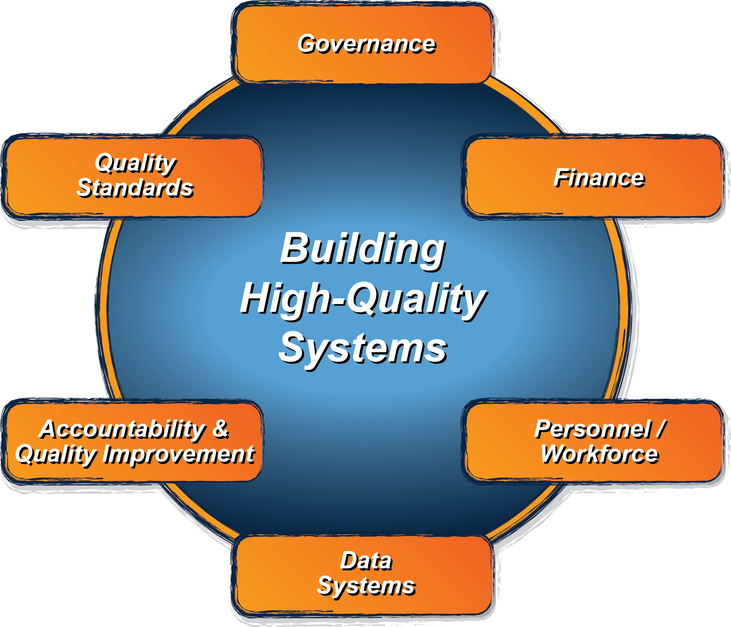
ECTA System Framework
What does a state need to put into place in order to encourage, support, require local implementation of effective practices?
ectacenter.org/sysframe

Slide 6
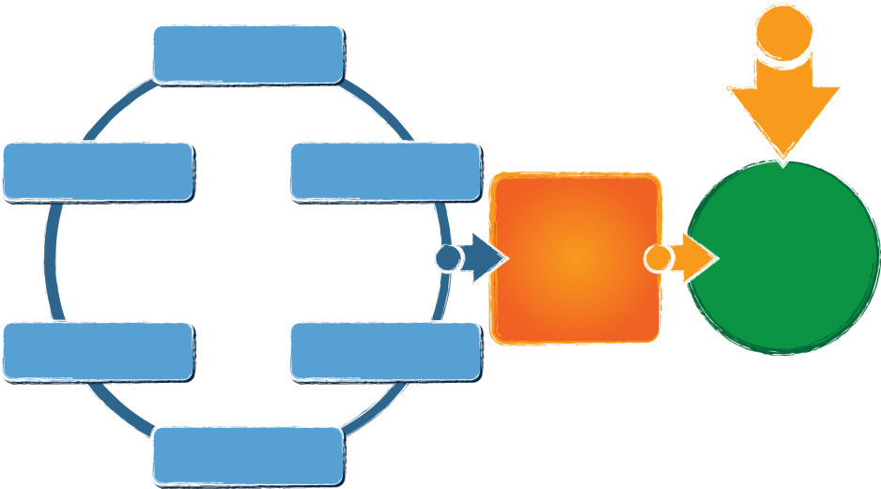
ECTA Center System Framework
What does a state need to put into place in order to encourage, support, require local implementation of effective practices?
Governance
Finance
Personnel / Workforce
Data Systems
Accountability & Quality Improvement
Quality Standards
Result:
Implementation of effective practices
Good outcomes for children with disabilities and their families
Available from: http://ectacenter.org/sysframe
Notes:
What does a state need to put into place in order to encourage, support, require local implementation of effective practices?
Governance
Quality Standards
Finance
Accountability & Quality Improvement
Personnel/Workforce
Data Systems
(leading to)
Implementation of effective practices
(leading to)
Result: Good Outcomes for children with disabilities and their families

Slide 7
Cross cutting themes
Engaging stakeholders, including families
Establishing/revising policies
Promoting collaboration
Using data for improvement
Communicating effectively
Family Leadership & Support
Coordinating/Integrating across early childhood

Slide 8
Governance:
Vision, Mission, Purpose
Legal Foundations
Administrative Structures
Leadership and Performance Management
Finance:
Finance Planning Process/ Forecasting
Fiscal Data
Procurement
Resource Allocation, Use of Funds and Disbursement
Monitoring and Accountability of Funds and Resources
Personnel/ Workforce:
Leadership, Coordination & Sustainability Structures
Personnel Standards
Preservice & Inservice Personnel Development
Recruitment and Retention
Evaluation
Data System:
Purpose & Vision
Data Governance & Management
Stakeholder Engagement
System Design/Development
Data Use
Sustainability
Accountability & Quality Improvement:
Planning for Accountability & Improvement
Collecting & Analyzing Performance Data
Using Results for Continuous Improvement
Quality Standards:
Child Level Standards
Program Standards

Slide 9
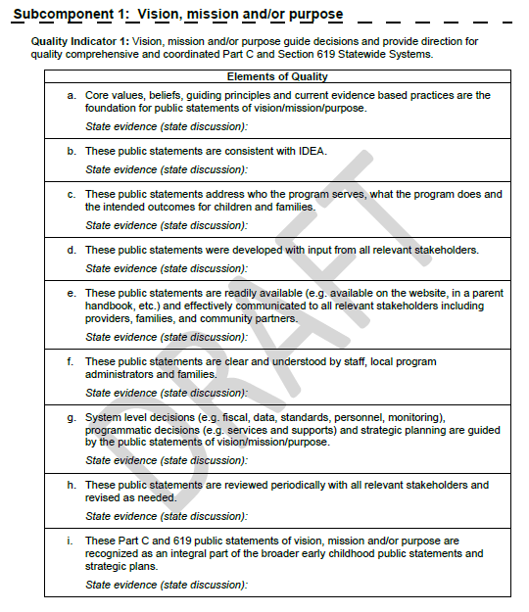
Framework Structure
Framework
Subcomponents
Quality Indicators
Elements of Quality
Self-assessment (coming soon!):
Scale for assessing quality indicators
Place for state evidence

Slide 10
Look for updates about the System Framework via the ECTA web site: http://ectacenter.org/sysframe

Slide 11
Personnel / Workforce
Comprehensive
Leadership
Personnel Standards
Inservice
TA
Evaluation
Retention
Recruitment
Preservice
Development
System
Personnel

Slide 12
Subcomponents and Quality Indicators
Subcomponent 1: Leadership, Coordination, and Sustainability
Quality Indicator 1: A cross sector leadership team is in place that can set priorities and make policy, governance, and financial decisions.
Quality Indicator 2: There is a written plan in place to address all sub-components of the CSPD.
Subcomponent 2: State Personnel Standards
Quality Indicator 3: State personnel standards across disciplines are aligned to national professional organization personnel standards.
Quality Indicator 4: The criteria for state certification, licensure, credentialing and/or endorsement are aligned to state personnel standards and national professional organization personnel standards across disciplines.

Slide 13
Subcomponents and Quality Indicators
Subcomponent 3: Preservice Personnel Development
Quality Indicator 5: Institution of higher education (IHE) programs and curricula across disciplines are aligned with both national professional organization personnel standards and state personnel standards.
Quality Indicator 6: Institution of higher education programs and curricula address early childhood development and discipline specific pedagogy.
Subcomponent 4: Inservice Personnel Development
Quality Indicator 7: A statewide system for inservice personnel development and technical assistance is in place for personnel across disciplines
Quality Indicator 8: A statewide system for inservice personnel development and technical assistance is aligned and coordinated with higher education program and curricula across disciplines.

Slide 14
Subcomponents and Quality Indicators
Subcomponent 5: Recruitment and Retention
Quality Indicator 9: A comprehensive recruitment and retention plan is developed based on multiple data sources, and revised as necessary.
Quality Indicator 10: Comprehensive recruitment and retention plan strategies are being implemented across disciplines.
Subcomponent 6: Evaluation
Quality Indicator 11: The evaluation plan for the CSPD includes processes and mechanisms to collect, store, and analyze data across all subcomponents.
Quality Indicator 12: The evaluation plan is implemented, continuously monitored, and revised as necessary based on multiple data sources.

Slide 15
HOW DO WE GET THERE?
Comprehensive System of Personal Development
(P.L. 94-142)

Slide 16
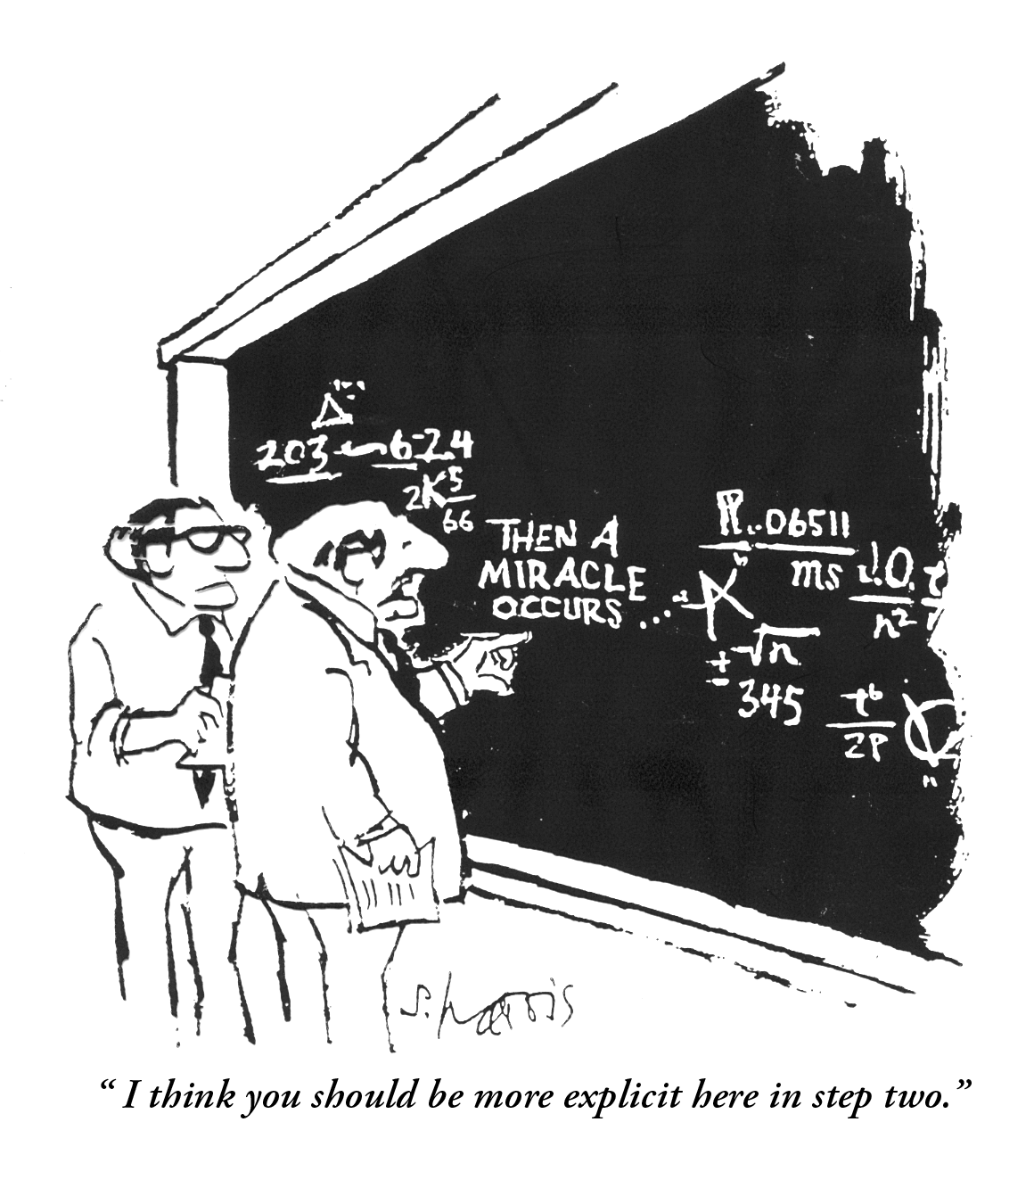

Slide 17
LOGIC: If we want improved outcomes for infants and young children with disabilities and their families, THEN…………
ECPC’s focus
More EC leaders and practitioners have the requisite knowledge and skills.
Improved effectiveness of EI, ECSE, and EC services and supports
Improved outcomes for children and families
States have high quality CSPD
How improved CSPD
leads to
improved outcomes

Slide 18
A Comprehensive System of
Personal Development
for the early childhood workforce who serve infants, toddlers and preschool children with disabilities and their families
is a necessary and integral
quality indicator of
an early childhood service system

Slide 19
Comprehensive System of Personnel Development
Personnel Standards
Recruitment and Retention
Preservice Training
Inservice Training
Leadership, Coordination & Sustainability
Evaluation

Slide 20
Early Childhood Personnel Center
to facilitate the implementation of integrated and comprehensive early childhood systems of personnel development (CSPD) for all disciplines serving infants and young children with disabilities

Slide 21
ECPC Framework
Evaluation
Leadership and Collaboration
Technical Assistance and Dissemination
Knowledge Generation
Personnel Standards
Outcomes and Accountability
Evidenced Based Practice
Model CSPD Development
Scaling Up CSPD Elements
Technology
State Agency and Certification Personnel
IHE Faculty
And Other PD Staff
Admin-
istrators
And EC Service
Providers
Families
Graduate
Students

Slide 22
Outputs of the Center
Knowledge Development
Technical Assistance
Leadership and Coordination

Slide 23
Knowledge Development
National Data Base of Personnel Standards
National Data Base of CSPD Components
Research Syntheses on Personnel Issues
National Initiative on Cross Disciplinary Standards

Slide 24
Technical Assistance
General: Across audiences, regions, and states
Targeted: Within audiences, regions, states and specific CSPD components
Intensive: CSPD within 9 states, fidelity to implementation framework

Slide 25
TA Outcomes:
Phase I
Developing Model CSPD
Intensive TA:
Delaware, Iowa, Kansas, Oregon
Targeted TA:
Florida, Hawaii, Massachusetts, Rhode Island, Utah

Slide 26
Comprehensive System of Personnel Development
Personnel Standards
Recruitment and Retention
Preservice Training
Inservice Training
Leadership, Coordination & Sustainability
Evaluation

Slide 27
Strategic Planning for a CSPD
Process by which CSPD:
Sets its direction
States its intent
Establishes parameters for implementation
CSPD should include:
Clear statement of the problem the strategic plan intends to address
Broad goal statement of what to be accomplished
Outcome-oriented objectives which move toward that accomplishment
Strategies and actions which will enable the accomplishment of objectives
Operational guidelines for implementation

Slide 28
The Strategic Planning Process: Key Characteristics
Focused and Decision Related
Future Oriented
Fact-Based
Avoids Over-Generalization
Explores Alternative Solutions
Reassesses Decisions Over Time
Politically Realistic

Slide 29
TA Outcomes:
Phase I
Developing Model CSPD
Intensive TA:
Delaware, Iowa, Kansas, Oregon
Targeted TA:
Florida, Hawaii, Massachusetts, Rhode Island, Utah

Slide 30
Phase II: Model Replication
We Will
Scale Up Effective Practices for Comprehensive and Integrated Early Childhood Systems of Personnel Development
AND EFFECT SUSTAINABLECHANGE

Slide 31
VISION via Outcome
MISSION of the Group
CAPACITY of the State
OBJECTIVES AND ACTION PLAN
EVALUATION

Slide 32
WHEN WE…….
Demonstrate a Reliable Relationship Between and Among Variables
Replicate across……..
Evaluate Fidelity and Outcomes
Isolate Model Components that are Effective Across Multiple Exemplars

Slide 33
Scaling UP a CSPD with Fidelity
Accuracy of Procedures
Consistency Across Users

Slide 34
Leadership and Coordination
Leadership Institute with Part C and 619 Coordinators
Working Collaboratively with other OSEP Early Childhood TA Centers: DaSy; ECTA; IRIS
Working Collaboratively with Other Education and HHS TA Centers

Slide 35
The Conclusion:
Personnel Can Have a
Powerful Impact....
or NOT

Slide 36
Pennsylvania’s Professional Development System for Early Intervention
Improving Data, Improving Outcomes Conference
September 8 – 10, 2014

Slide 37
Structure of PA Early Intervention
Pennsylvania Department of Education
Pennsylvania Department of Public Welfare
Finance, Administration & Planning
Office of Child Development and Early Learning (OCDEL)
Bureau of Early Intervention Services
Bureau of Certification
Bureau of Subsidized Child Care Services
Bureau of Early Learning Services

Slide 38
Structure of the Bureau of Early Intervention Services
Office of Child Development and Early Learning (OCDEL)
Bureau of Early Intervention Services
Early Intervention Technical Assistance
Division of Standards & Professional Development
Division of Operations & Monitoring - East
Division of Operations & Monitoring - West

Slide 39
Structure for the Provision of EI Services
Bureau of Early Intervention Services
Infant Toddler Early Intervention Services (County Based Oversight)
Preschool Early Intervention Services (Grantee Structure)
Contracted Early Intervention Service Agencies

Slide 40
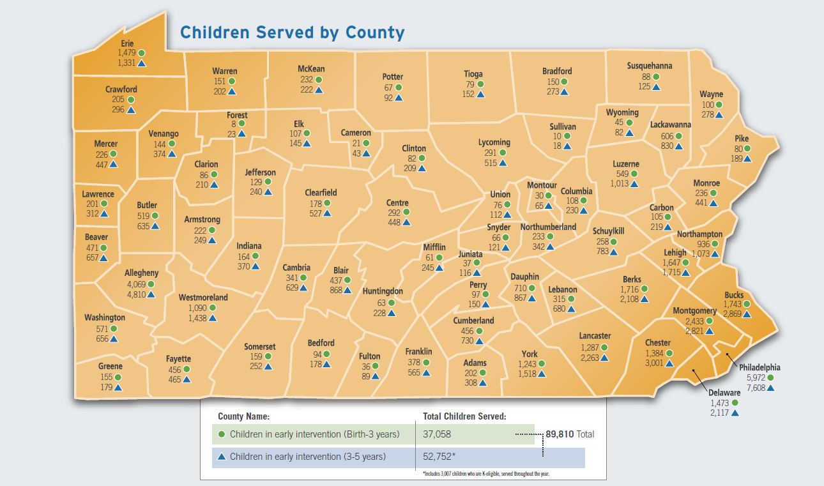

Slide 41
Percent of Children Served
Percentage of Infants, Toddlers, and Preschoolers in Pennsylvania’s EI System

Slide 42
Early Intervention Professionals

Slide 43
Early Intervention Technical Assistance
Professional Development System for Pennsylvania’s Infant, Toddler and Preschool Early Intervention System

Slide 44
EITA Model
Verification
Support
Policy
Support
EI Core Competency
Support
Support for Evidence Based Practices
Support the BEIS in their management of the EI Program
High Quality EI Services
Ensure skilled, highly qualified EI staff

Slide 45
EITA Core Functions
&
Strategies
Partnerships with state & local EI leadership
Responsive
solutions
Family support & leadership
Verification
Support
Policy
Support
EI Core Competency
Support
Support for Evidence Based Practices
Effective Project Management
Data Informed Technical Assistance
Outcomes based project evaluation
Implementation Science Focus
Learning
Technologies
Cross-system TA Partnerships

Slide 46
EI Core Competency
Support
Support for Evidence Based Practices
Policy
Support
Verification
Support
EI Core Competency Support
Providing professional development to ensure that all EI staff have the basic competencies needed to provide high quality EI services to children and families.
Statewide and local workshops for knowledge and skill development
Online learning modules & webinars
Materials development & dissemination

Slide 47
Policy Support
Providing assistance to the BEIS in development of policies to ensure high quality EI services. Assisting local programs in translating EI policies into practice.
Assistance in developing BEIS policy documents & reports
Development of statewide leadership activities
Policy related research & materials development.
Training and technical assistance to move policy to practice.
EI Core Competency
Support
Support for Evidence Based Practices
Policy
Support
Verification
Support

Slide 48
EI Core Competency
Support
Support for Evidence Based Practices
Policy
Support
Verification
Support
Support for
Evidence Based Practices
Providing professional development activities to EI staff based on innovative evidence based practices. Designed to enhance existing high quality EI services.
Select-team based approaches to professional development
Coaching support
Online learning modules & webinars
Sustainability activities
Fidelity measures

Slide 49
Verification Support
Providing support to the BEIS’s verification process to ensure high quality EI services.
Ongoing
Participation in infant toddler and preschool EI verification teams
Training and technical assistance support to local programs based on verification needs/improvement plan
Targeted
Targeted, intensive support to select programs based on the results of the verification process or program management data analysis
EI Core Competency
Support
Support for Evidence Based Practices
Policy
Support
Verification
Support

Slide 50
Highlights of EITA Infrastructure
BEIS Leadership Support for PD
PELICAN Data to Link Evaluation
Coordination with EC Training System (PA Key)
Birth to 5 Coordinated PD System
Highly Qualified PD Consultants
PD Linked to Program Monitoring
Multiple Funding Streams
High Quality EI Services

Slide 51
EITA Resources
EITA Online Learning Portal
http://www.eita-pa.org/
Additional Resources
http://padlet.com/manketell/outcomesconf

