Slide 1
Professional Development for the Child Outcomes Summary Process: Updates and Innovations
Shannon Dunstan, ID 619
Sheila Ammons, WA Part C
Naomi Younggren, EDIS Program
Amy Nicholas, JHU/CTE, DaSy
Kathi Gillaspy, ECTA, DaSy
September 9, 2014
Improving Data, Improving Outcomes Conference
New Orleans

Slide 2
Idaho Integrated Early Childhood Outcome Individual Education Plan
ECO/IEP

Slide 3
ECO/IEP – Indicator 7 Revision Implementation Plan
Statewide on-site needs assessment
Summary analysis of the accuracy and reliability of the current ECO reporting process based on submission of ECO data during Child Count Verification process of 2010 and 2011.
Statewide ECO/IEP Process and new Forms Survey
Pilot New ECO/IEP forms and process February 2012-June 2012 in 17 school districts statewide
IEP Goals with Early Childhood Outcomes approved and adopted for use (utilized input from pilot and rollout one day trainings)
Modify the SPP to reflect change in ECO process and data collection (include instruction for SDE ECO data collection)
Develop Idaho ECO Quality Assurance Checklist to be used during Spring 2013 Child Count Verification
Training and Resource Development

Slide 4
Comments from field Spring 2012
I am not excited about this form at all
It is too difficult and overwhelming for the family to be involved
I need to have the child for awhile before I can give them a rating
This will require more assessment which will take longer
Observing in variety of settings is not possible for an initial IEP
Therapists (OT, SLP) will not be pleased with this
Decision tree and identifying AA, IF and F skills is too confusing
Need to know specifically what is expected to be compliant
Formal training and samples are needed on how to embed ECO into IEP process

Slide 5
Professional Development
Introduction to ECO/IEP Webinar (August, 2012)
Results of statewide survey on current ECO reporting
Upcoming changes
Introduction of proposed new ECO/IEP form
Presentations at state conferences: CEC, Early Years (Fall, 2012)
One day trainings: 7 locations (Oct. – Nov. 2012) - Awareness Focus
Idaho Integrated Outcome-IEP Process (Flowchart)
Planning Worksheet – Now & Future
New ECO/IEP form & guidance document
Full implementation required Fall, 2013

Slide 6
Professional Development
Two day Summer Institutes: 7 locations (Summer, 2013) – Implementation Focus
Integrated ECO-IEP Process – How to and resources per step of process
NECTAC training materials – Setting stage, functional assessment, IEP goals
Collecting ECO data from variety of sources (parent, anchor, observations, etc.) and building knowledge of age expected skills related to outcomes
AA, IF, F identification and rating practice
ECO embedded IEP development
LRE and other considerations
ECO Exit ratings
Multiple sample child files (referral, eligibility, IEP)
Continuous Improvement Monitoring System
One day Follow-up Trainings: 7 locations (Fall, 2013)
Practice, practice, practice – Completing new ECO-IEP using data
“I do, We do, You do”
Support & feedback

Slide 7
General Supervision/File Review Quality Assurance and Validation Process
56 of Idaho’s 150 LEA’s the deliver early intervention provided 87 student files for verification 2013-2014:
Current eligibility report,
Current IEP, and if not implemented into IEP
Child Outcome Summary Form Revised

Slide 8
Resource Development
Updated Parent Brochure, Definitions of the Child Outcomes Summary Form Ratings Brochure, Parent Material
Edited Decision Tree
eGuideline/Common Core and ECO alignment
Embedded ECO/IEP Form Guidance & samples
Utilize ECTA High Quality Functional IEP Goal material

Slide 9
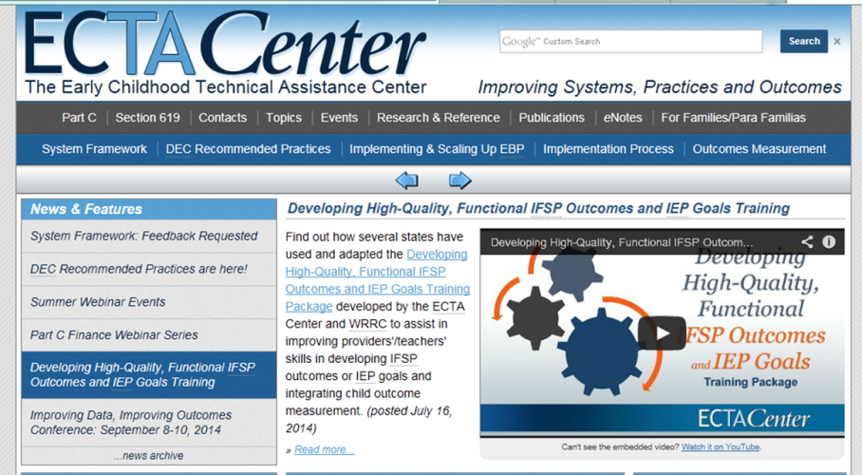
Resource Adaptation

Slide 10
Resource Adaptation

Slide 11
Summer Institute
Training in 7 locations Statewide
Attendance represented approximately 300: Special Education Directors, Speech Language Pathologist, Early Childhood Special Education Teachers, Occupational Therapist, Physical Therapist, and Head Start Teachers

Slide 12
Agenda
Day 1
1. Introductions
Purpose & Agenda
IDEA & Federal Requirements
Idaho Integrated Outcomes/IEP Process (adapted NECTAC form)
Setting the Context (adapted ECTAC PowerPoint and Key Practices document dated 10/12)
Engaging Families (used with permission from Maryland State MSDE)
Special Education Process
2. Child Find and Identification
Transition, Screening & Referral
3. Evaluation and Eligibility
Comprehensive evaluations
CLD/ELL Evaluations
ECO Anchor Assessments
Functional Assessments (adapted ECTAC PowerPoint and activities)
Determining Developmental Skills (adapted ECTAC PowerPoint and activities)
Eligibility

Slide 13
Agenda
Day 2
4. IEP Development
Integrating assessment and the IEP (adapted ECTAC PowerPoint and activities)
IEP Requirements
Writing Functional Goals (adapted ECTAC PowerPoint and activities)
New IEP/ECO Process: Entry Rating (ECTAC activity)
Idaho eGuidelines (Idaho’s Early Childhood Standards)
5. IEP Services & Considerations
IEP Requirements
LRE
6. IEP Implementation & Review
Progress Monitoring & Data Collection
Amendments & Annual Review
ECO Exit Rating
Kindergarten transition

Slide 14
Credit to other States and Organizations
Maryland State Department of Education
Ventura County Special Education Local Plan Area
Idaho School Districts that shared materials
Wicomico County Board Of Education, Salisbury, MD
Baltimore County
Rhode Island Early Intervention
North Dakota Department of Special Education
Tennessee Early Intervention
RA McWilliams (forms adapted)
Head Start

Slide 15
Comments from the field Fall 2013
I feel that we get better information from parents
I get more functional assessment information
I have improved my knowledge of child development
I feel much better about ECO!!!!
I learned so much and do not feel so overwhelmed
Loved ideas of how other districts are implementing ECOs
I value time to discuss concerns, successes and ask questions. Love ALL the resources!
Hands-on application with real files was valuable
Connecting AA, IF, F with Decision Tree and into IEP

Slide 16
Comments from the field Cont.
Follow-up training is so helpful because it is so hard to take in all changes and know if you are doing it right
Valuable to use our own files for practice and discussion
Having heard this more than once, I now feel ready to make necessary tweaks to be in compliance
Want more opportunity for peer review
Concerned with disagreement between participants on classifying AA, IF and F
Helped me realize I was on right track and clarified what we have been doing
Liked being able to take information, use it and bring it back to work out the bugs

Slide 17
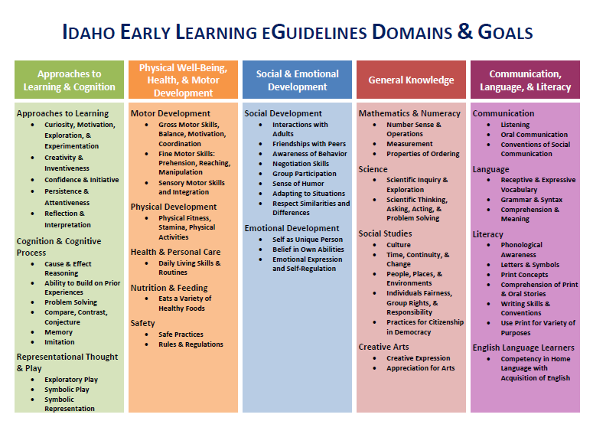

Slide 18
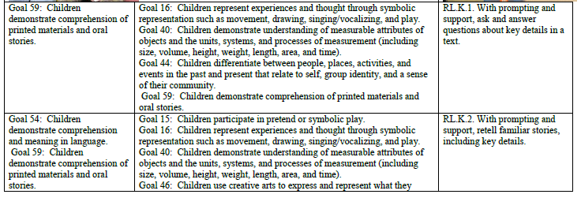
Idaho Core Standards and Idaho’s eGuidelines

Slide 19
Idaho Integrated ECO Journey
What to Anticipate
Change is hard and teachers are overworked
Complaints
Teachers are already doing the work
Need multiple compliant examples
Helps to get administrative support

Slide 20
Idaho Integrated ECO Journey
What we might have done differently
Utilize pilot teachers as member of PD team for regional trainings
Regional teacher coaches to help mentor

Slide 21
Idaho Integrated ECO Journey
What next?
Post all training materials on ITC
Create training sections into mini webinars for new teachers and refreshers
Next round of training focus on transition to kindergarten
Monitor the process of implementation through General File Review

Slide 22
Child Outcome Summary (COS) Training Modules
Sheila Ammons
Improving Data, Improving Outcomes Conference
September 9, 2014
New Orleans, LA
Every day, we are honored to take action that inspires the world to discover, love and nurture the greatness in all children.
Notes:
22

Slide 23
Objectives
Context
Journey in creating COS training modules
State Systemic Improvement Plan (SSIP)
Tour of the modules

Slide 24
Context
Washington State
Status of COS training
Embedded Summary of Functional Performance (SFP) into the IFSP
Present Levels of Development and SFP sections

Slide 25
Related Topics
High quality assessment practices
Effective teaming structures
Understanding of COS process
Families as full participants in IFSP process
Use of Evidence-Based Practices
Training on data analysis
Kids' Potential, Our Purpose
Notes:
25

Slide 26
Journey: What did we want to create?
Online, self-directed learning resource accessible to early intervention providers at no cost
Voiced Power Point with knowledge checks
Comprehensive content to meet the needs of both new and veteran service providers
Method for administrators to evaluate COS implementation in local programs
Support improvement efforts at the local level
Kids' Potential, Our Purpose
Notes:
26

Slide 27
Journey: What Did We Do?
Contacted NECTAC (now ECTA)
Participated in a series of phone calls with ECO and DaSy staff to review existing materials
Identified primary training needs in Washington State
Modified materials and customized content to Washington State
Separated into six topical areas
Took about two years (fitting into existing work)

Slide 28
Throughout the process…
Engaged in ongoing team discussions about the gap between current practices and implementation of a high quality COS process
Challenged assumptions with data
Negotiated a balance between ideal practices and realistic expectations
Kids' Potential, Our Purpose
Notes:
28

Slide 29
Timeline to completion
Modules 1-4 are recorded, modules 5-6 are being finalized and will be recorded soon
Roll out webinar to introduce all six modules this winter (November or December)
Integrate follow-up training into Local Lead
Agency meetings, site visits, and annual self
assessment process
Kids' Potential, Our Purpose
Notes:
29

Slide 30
Connection to State Systemic Improvement Plan (SSIP)
Washington’s State identified Measurable Result (SiMR) area of focus has been identified by stakeholders as improving social-emotional skills
COS Training Modules will support data quality improvement efforts for each global child outcome area
Ultimately assist in improving child outcomes
Kids' Potential, Our Purpose
Notes:
30

Slide 31
Brief Tour of COS Training Modules
Kids' Potential, Our Purpose
Notes:
31

Slide 32
Topics of the Six Training Modules
Module 1: Setting the Stage--Global Child Outcomes and the Summary of Functional Performance (SFP)
Module 2: Learning More About the SFP and COS Rating
Module 3: Essential Knowledge for Completing SFP and COS Rating
Module 4: Guidance for Completing the SFP and COS COS Rating Within the Team Process
Kids' Potential, Our Purpose
Notes:
32

Slide 33
Topics of the Six Training Modules (con’t.)
Module 5: Understanding Age-expected Child Development, Developmental Trajectories, and Progress
Module 6: Using COS Data to Inform Program Improvement at all Levels
Each training module is 40-50 minutes in length
Kids' Potential, Our Purpose
Notes:
33

Slide 34
Selected Slide from Modules
Examples of kinds of questions data can help you answer…
Does our program serve some children and families more effectively than others?
Do child outcomes differ across local programs or service areas?
Do child outcomes differ across programs with different intervention approaches or service features?
Are trends over time showing gradual increases in rates of progress and child achievement?
Notes:
34

Slide 35
Selected Slide from Modules
Expectations around using SFP data
Professionals should know how the SFP relates to COS data and why it matters.
Reviewing evidence, making inferences, and identifying actions should be an ongoing part of the program’s continuous improvement cycle and part of ongoing activities with community stakeholders, funders, and staff.
Data should be incorporated into reports and improvement plans should be based on data whenever providing information for accountability.
Kids' Potential, Our Purpose
Notes:
35

Slide 36
Selected Slide from Modules
Reflection
What do you most want to know about the outcomes for children you serve?
How would you find it helpful to use your data?
What supports do you need to be able to use your data more effectively? Who can you talk with to access that support?
Kids' Potential, Our Purpose
Notes:
36

Slide 37
Questions?
Sheila Ammons, Program Consultant
Early Support program for Infants and Toddlers (ESIT)
Sheila.ammons@del.wa.gov
COS Training Modules will be available at: http://www.del.wa.gov/development/esit/training.aspx
Kids' Potential, Our Purpose
Notes:
37

Slide 38
Child Outcomes Summary Process: Collecting and Using Child Outcomes Data for Program Improvement
An Online Professional Development Module
Notes:
Kathi

Slide 39
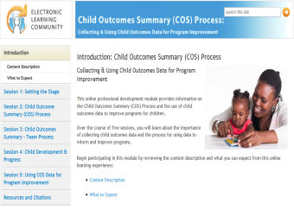
Module Outcomes
Understand foundation information about the Child Outcomes Summary process
Learn effective use and practice of the process
Address COS relative to team discussions, decisions, and documentation
Examine how COS is used to understand children's development and improve programs
Notes:
Kathi
Please note: JHU CTE has proposed five sessions based on our preliminary review of the content. If this changes or is incorrect, the slide will need to be revised.

Slide 40
JHU CTE PDQuest Cycle of Instruction
Notes:
Amy
This module is designed with JHU CTE’s PDQuest model of online professional development.
Individual activities in each session are organized around a cycle of instruction that follows a consistent format and sequence:
Set-Up: Establishes the purpose of the session and provides a Challenge Question to guide learning
Presentation: Presents the essential concepts, ideas, and skills of the session content
Just for Me: Provides an opportunity for individual reflection, application of content, and resource gathering
Assessment: Checks for understanding of the essential concepts, ideas, and skills
Wrap-Up: Concludes the session with your response to the Challenge Question

Slide 41
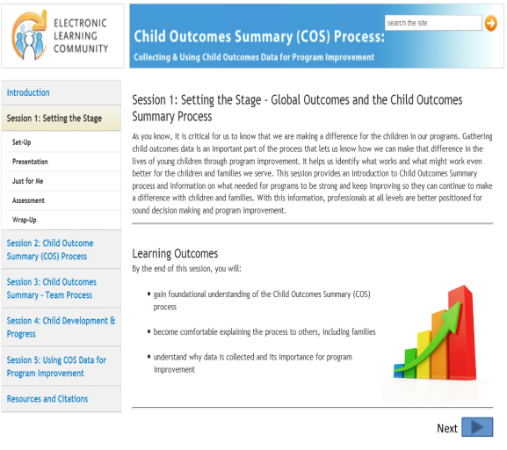
Module Feedback: Session One Review
Notes:
Kathi
This slide has a screenshot of the module. At this point, you can login and show the first session using this demo login:
http://olms.cte.jhu.edu/olms2
Username: pduser1
Password: welcome
Suggested questions for review would be around how providers and administrators might use this, content needs for the remaining sessions, practical resources to include for providers, etc.

Slide 42
Next Steps
Revise first session based on feedback provided
Develop remaining sessions of the module
Launch module for public access through DaSy and ECTA websites
Notes:
Kathi

Slide 43
Child Outcomes Summary-Competency Check COS-CC
Why was it developed?
How does it work?
Where will it be available?
What is the purpose?
When will it be ready?
How it was developed?
Notes:
Naomi

Slide 44
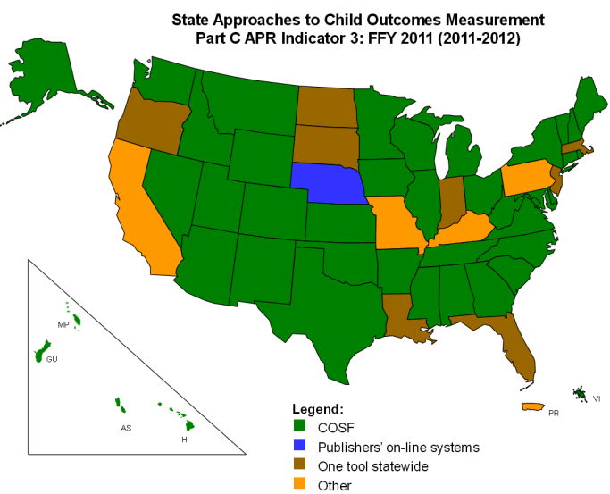
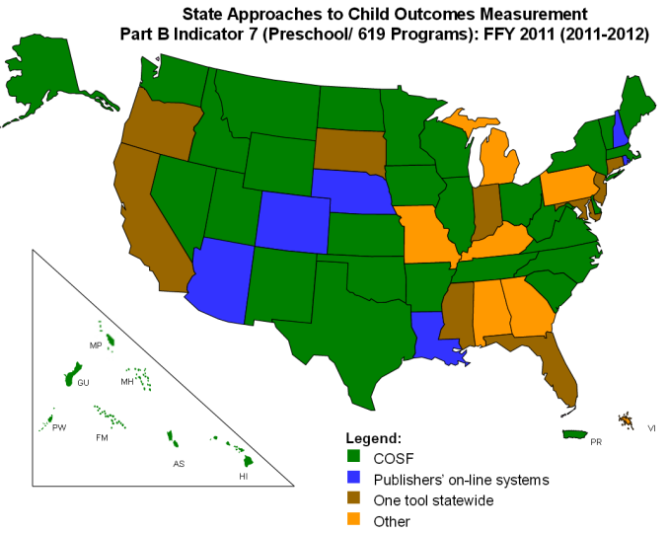
WHY was it developed?
Most states are ‘green’
Training varies
COS users have to know
Why we measure
Functionality
Content of the 3 outcomes
A-E development
COS rating 7-point scale
Need a means to determine if providers understand the key components of the COS process
Notes:
Naomi
Most states are using the COS Process to measure child outcomes
ENHANCE study: Results also show that COS teams who are trained can effectively apply this knowledge. Trained teams apply knowledge about which skills map on to specific outcomes and identify ratings that are consistent with the specific rating criteria provided. Ratings by independent coders have consistency with team rating scores. Taken together, trained teams who implement the COS process using resources and ideas from training are able to implement the COS in ways that produce meaningful data.
Everyone gets training – recognize there is variation in the way it’s implemented. Training is tailored to meet the needs of the program.
What we don’t have is a universal mechanism to check people’s foundational competence with the COS process after they have received training.

Slide 45
What’s the purpose?
To provide states a shared way to check COS competencies
To identify professional development needs
To tailor individualize staff support
Notes:
Naomi
A set of materials to assess staff understanding of the essential knowledge and skills needed to contribute to the COS process.
It’s a competency check – not a certification. It’s a means to check provider’s understanding of the key components of the COS process
Passing the COS-CC doesn’t make you an expert – it only verifies that you have the basic competencies needed to contribute to the COS discussions.
Results will help states determine which areas of professional development and training support providers’ understanding, and which might need expansion or strengthening to support providers.

Slide 46
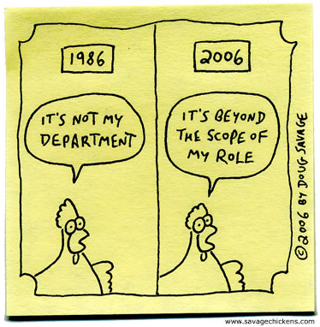
WHAT it’s not.
http://hansdeleenheer.com/2013/07/
Not everything needed
Not a training tool
Does not include
Observation skills
Collaborative teaming
Notes:
Naomi
It is expected that staff using the COS-CC would have attended training on the basic competencies prior to using the assessments.
Does not include:
Observation of children’s skills and behaviors
Collaborative teaming
These are essential to the COS process, but are difficult to assess.

Slide 47
HOW does it work?
State / Program Training & Practical Experience
COS-CC
Level I Questions
COS-CC
Level II
Case Studies
Notes:
Naomi
Two levels of information (Levels 1 & 2)
Banks of questions and answers (both levels)
Case studies and videos (level 2)
Level 1 must be passed before moving on to Level 2.
Instructions will be included, with options for customizing the materials for your state.

Slide 48
COS-CC
Level I Questions
> 100 questions
Why we measure outcomes
Functionality
Content of the 3 outcomes
Age-expected development
COS rating 7-point scale
Answer key
Notes:
Naomi

Slide 49
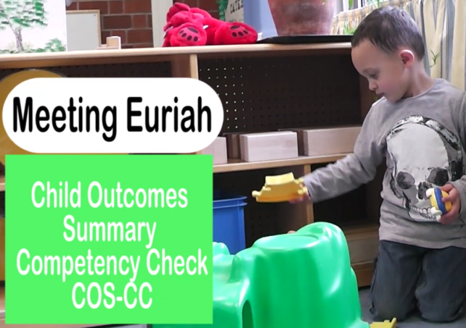
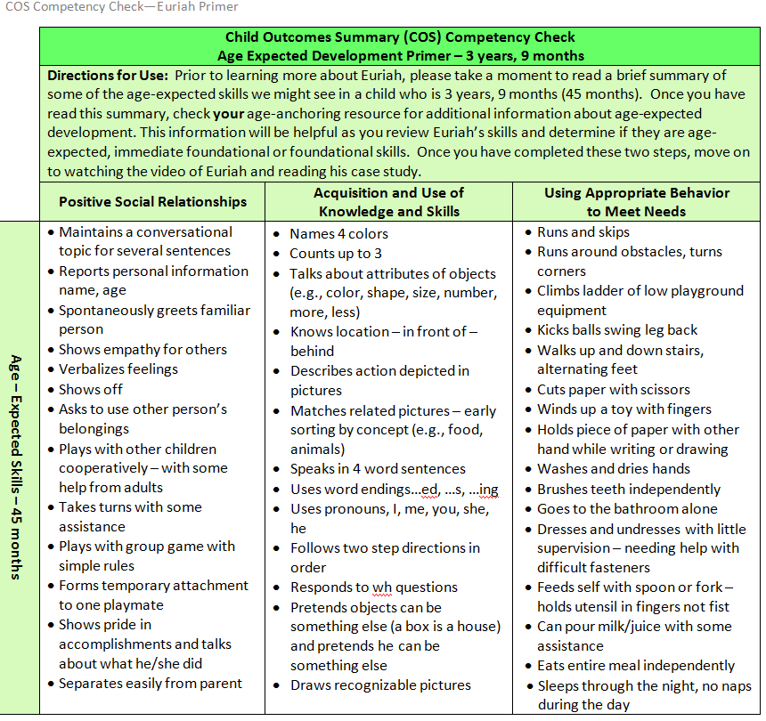
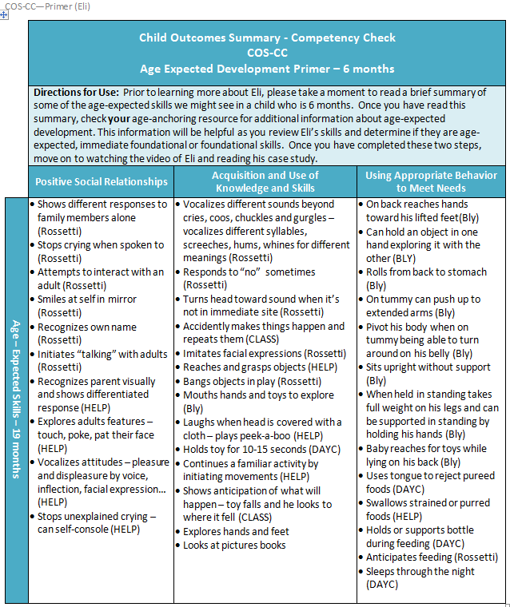
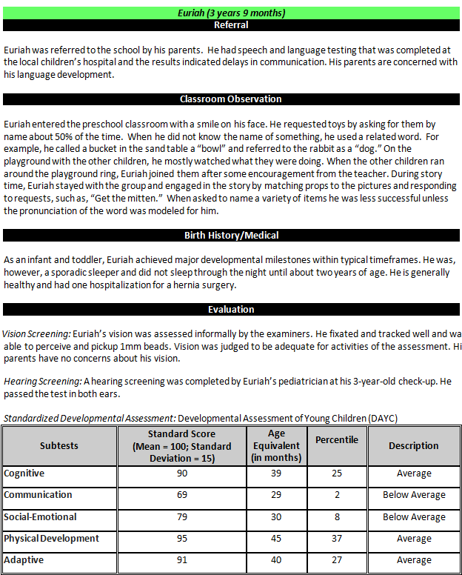
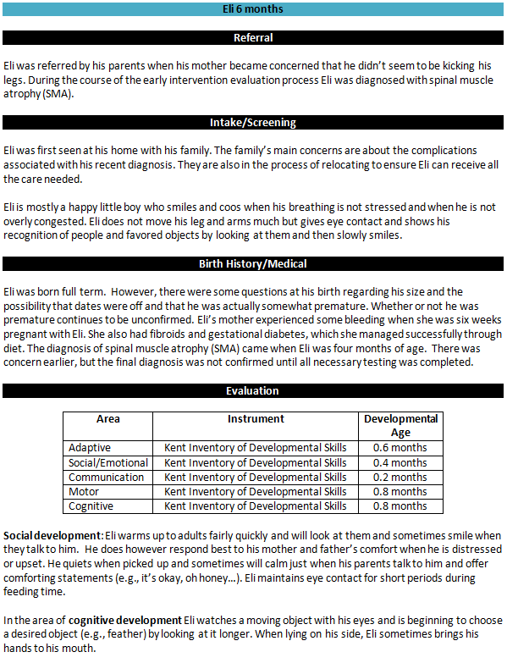
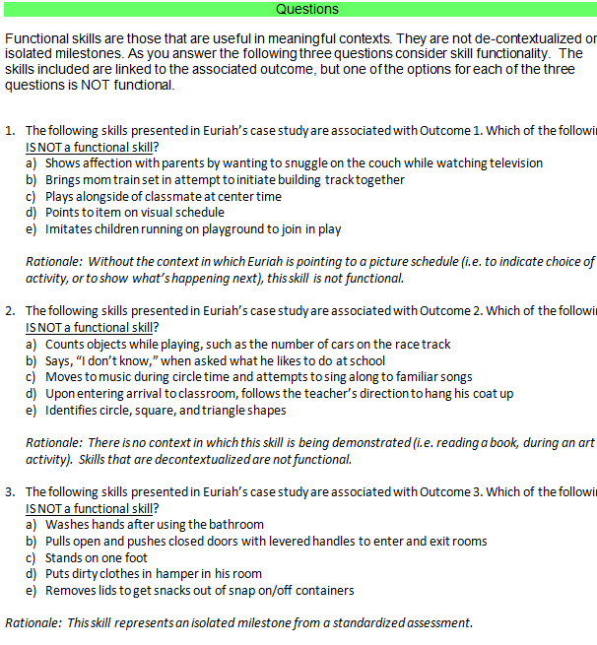
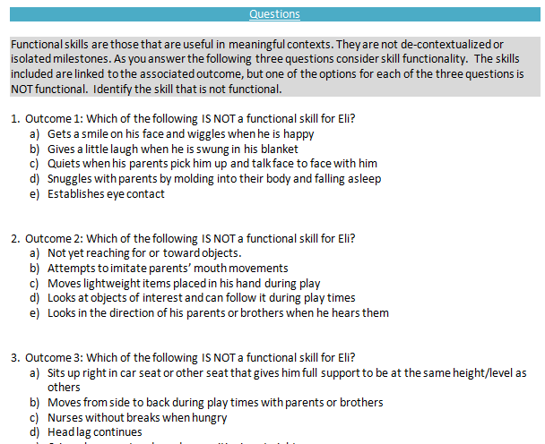
COS-CC
Level II
Case Studies
Notes:
Naomi
Video clips
AE development primers
Write-ups
Competency questions
Answer Keys

Slide 50
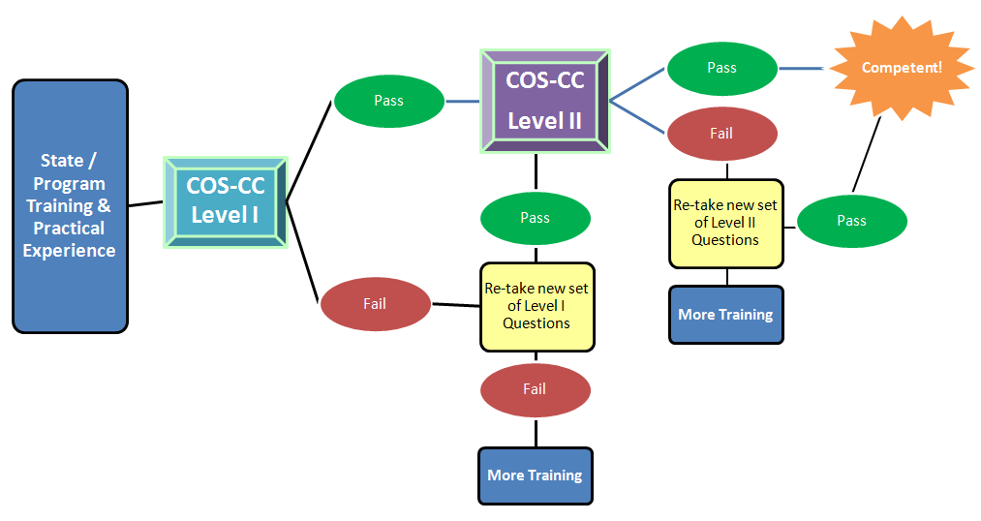
Notes:
Naomi

Slide 51
HOW was it developed?
Content developed by work team
Face validity with content experts
Field testing
Round 1 completed
Round 2 getting started
IRB exemption completed
Notes:
Naomi
IRB exemption obtained
Inviting more states
Identifying 5 programs each
Providers taking Level 1 then Level 2
Analyzing results
Developed;
Content validity analysis to make sure questions asked what we wanted
100 questions reviewed by experts and given feedback on whether actually measured what we wanted to measure
Field tested case studies:
Results…
Variations in C and 619 (functionality – was better for Part C; age anchoring was better for 619)
Item analysis: those that did better on functionality and age anchoring did better with the ratings
Field testing was with small sample and because of variation decided to do another round of field testing – to widen sample and administer as intended and analyze that data.

Slide 52
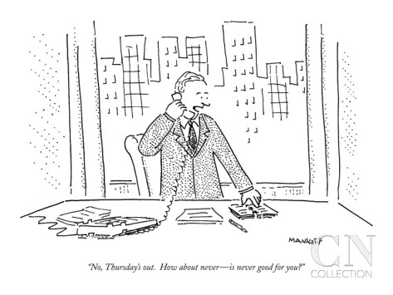
WHEN will it be ready?
COS-CC on schedule for 2015!
Notes:
Naomi

Slide 53
WHERE will it be?
Available from ECTA
Adaptable for your state
Multiple versions
Notes:
Naomi

Slide 54
The Child Outcomes Summary Competency Check (COS-CC)
An Online Assessment Tool
Notes:
Amy until the end

Slide 55
What is it?
COS-CC is a set of materials to assess provider understanding of the essential knowledge and skills needed to contribute to the COS process
DaSy, in partnership with JHU CTE, developed requirements for building this assessment in an online format

Slide 56
What will the online version include?
Online delivery of COS-CC self-assessment
Part 1: Assessment of Essential Knowledge and Skills
Part 2: Assessment of Application of Essential Knowledge and Skills
Links to professional development resources

Slide 57
Who will use it?
Supervisors (state administrators, agency leaders)
Providers
Families
Notes:
Families are not targeted users, but it will be available for them.

Slide 58
What are the planned features of the online assessment?
Access
State administrator or agency leaders
Providers participating in the COS process
Self-Assessment
Providers must pass Part 1 and Part 2
Passing criteria is 80% questions answered correctly across both
Providers must pass 17 of 20 questions in Part 1 before moving to Part 2
Providers must pass 10 of 13 questions in Part 2

Slide 59
What are the planned features of the online assessment?
Retake Option
If providers do not pass Part I, they may not move to Part 2
Providers will be presented with resources to help them understand items not passed
Providers should review resources
Providers may return to retake the assessment after a period of time
Verifying Results
Providers who pass will be presented with a certificate of successful completion
Providers may print and save
System notifies supervisor of provider passing

Slide 60
Relationship: COS Modules and COS-CC
The modules will be available as one option for staff to use as training prior to the COS-CC
Both will be accessible through the ECTA and DaSy websites

Slide 61
QUESTIONS?
?
?
?
?
?
?
Notes:
Kathi/Siobhan

Slide 62
Contact Information
Shannon Dunstan:
sdunstan@sde.idaho.gov
Sheila Ammons: sheila.ammons@del.wa.gov
Naomi Younggren: naomi.younggren@googlemail.com
Amy Nicholas: anicholas@jhu.ed
Kathi Gillaspy: kathi.gillaspy@unc.edu
Notes:
Kathi

