Slide 1


What it Takes: Scaling up the Implementation of Recommended Practices for Improving Child Outcomes
Lise Fox, University of South Florida
Barbara J. Smith, University of Colorado – Denver
Lisa Backer, Minnesota Department of Education
Michelle Dockter, Minnesota Department of Education

Slide 2
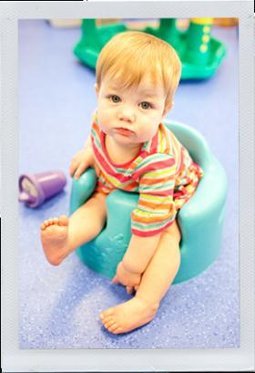
Intensive TA
Build the capacity of programs and practitioners to use DEC Recommended Practices to promote child engagement in learning opportunities
Build the capacity of the professional development system to provide ongoing training and support to programs to implement DEC Recommended Practices with fidelity.

Slide 3
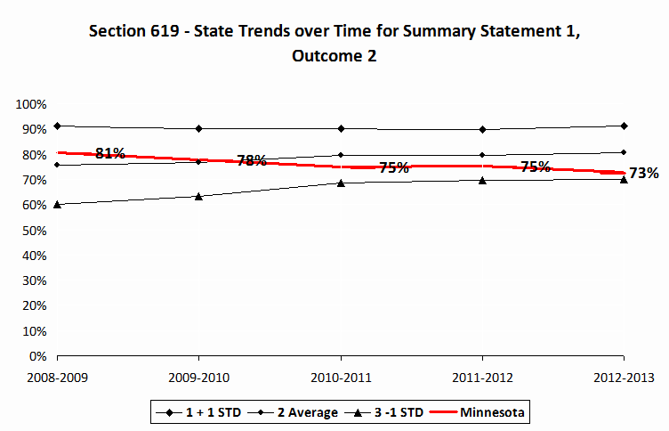
Minnesota’s Goals for the Partnership:
Start with Why

Slide 4
Minnesota’s Goals for the Partnership:
Start with Why
Why: Increase slope of developmental trajectories
How: Do it right! Do it Well!
What: Components of Quality

Slide 5

Systems Model for Early Childhood
Professional Development
Incorporates best practice from:
  Systems Thinking
  Implementation Science
  Cross-Agency Collaborative Planning

Slide 6
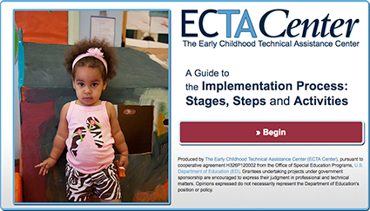
Implementation Process Interactive Guide
http://ectacenter.org/implementprocess/interactive/

Slide 7
RP²: Reaching Potentials through Recommended Practices
Quality Program
Program uses implementation science to ensure the implementation of effective teaching practices
Effective Practices
Using Recommended Practices to Promote Child Engagement
Child Outcomes
Notes:
2 min logic model

Slide 8
Making It Happen
Active Implementation Frameworks
USABLE INTERVENTIONS
  To experience the benefits of the intervention, what exactly are practitioners saying and doing?
IMPLEMENTATION STAGES
  What steps lead to successful implementation?
IMPLEMENTATION DRIVERS
  What critical program and organizational supports are needed to implement this change?
IMPLEMENTATION TEAMS
  Who helps guide the change process?
IMPROVEMENT CYCLES
  How can we efficiently solve problems and get better?
Interventions
Stages
Drivers
Teams
Cycles
©Copyright Dean Fixsen and Karen Blase

Slide 9
Inspire Action Framework
Finding Quality: Supporting the Selection Driver during Exploration Stage

Slide 10
Framework Attributes: Twelve Core Components
Definition
Rationale for inclusion as a core component grounded in research or regulation or both.
Related APR Indicators
Self-Assessment based on evidence
  Evidence of Quality or Potential Concern
  Sources of evidence
    Document review
    Existing data
    Observation, interview, reflection
  Component score of <0 to 5

Slide 11
Phase I (Exploration):
Staged Matched Activities
INSPIRE ACTION will help the Minnesota Department of Education to:
Determine which aspects of program quality correlate strongly with outcomes achieved by children and benefit perceived by families.
Better understand what is needed for change at many levels.
Develop and provide meaningful supports.
Build foundational quality needed to support the implementation of evidence-based practices
Inform the development of the Theory of Action required by Phase 1 of the State Systemic Improvement Plan (SSIP)

Slide 12
Intensive TA Model for Installing, Sustaining and Scaling up Recommended Practices
State Leadership Team to plan and implement a sustainable, cross-agency, state infrastructure
A Master Cadre of External Coaches that support high fidelity use of Recommended Practices
Implementation Sites with Leadership Teams to demonstrate effectiveness and to model for others
Data/Evaluation and data feed-back systems for: data-based decision making at all levels for PD, ensuring fidelity, demonstrating effectiveness, and making system recommendations

Slide 13
http://ectacenter.org/implement_ebp/implement_ebp.asp

Slide 14
Visibility
Political
Support
Funding
Policy
State Leadership Team
Active Coordination
Training
Coaching
Content
Expertise
Evaluation
Local Implementation Programs
Sugai et al., www.pbis.org

Slide 15
1. State Leadership Team
Is a committed, cross-agency group about 15
Makes multi-year commitment
Meets monthly; uses effective meeting strategies
Establishes Demo sites, Master Cadre, data systems
Secures resources
Provides infrastructure
Builds political investment
Ensures systems integration
Works to sustain initial effort and to scale up statewide

Slide 16
Minnesota State Leadership Team
Vision (WHY)
We share responsibility to ensure that all children in Minnesota have the great start they need to succeed in school and life.
Scope of our work (WHO)
We support PD efforts that are targeted towards young children, infants through age 5, who are found within ALL sectors of our local community.

Slide 17
MN State Leadership Team Members
Voting Members include representatives from:
The Minnesota Department of Health
Children’s Mental Health at the Minnesota Department of Human Services
Child Care Aware (Child Care Resource and Referral System)
Center for Inclusive Child Care
Advocacy/parent organization (PACER)
ECSE Higher Education Consortium
Members from The Minnesota Department of Education
  Special Education (Part B)
  Early Childhood Special Education (C/619)
  Head Start
  We have standing work groups that include others as necessary

Slide 18
Minnesota State Leadership Team
Member
specific resource
Member
specific innovation
Member specific invitation
STATE LEADERSHIP TEAM
Member specific:
Innovation
Resource
Invitation
Member selected opportunity/share
Member selected work- leadership
Member selected commitment participation
Cross sector work for young children (Infants to age 5)
Member selected:
-Work/leadership
-Opportunities/share
-Commitment and participation

Slide 19
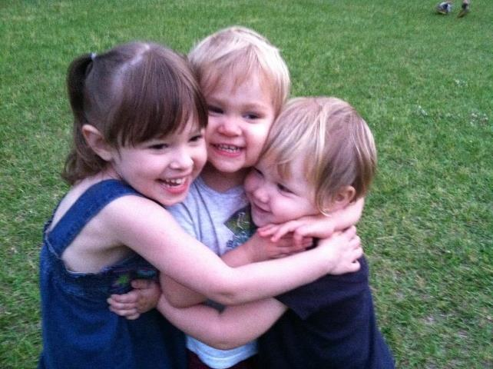
2. Master Cadre: Professional Development and
Technical Assistance
Master T/TA Cadre
  Carefully selected initial team of T/TA providers
  Application process
  Regionally located
  Expertise in 0-5, center services and family coaching
  Mentored by ECTA faculty partners in training, external coaching, and data systems

Slide 20
Mentoring a Master Cadre of External Coaches
We support you to guide implementation programs
You support programs to implement with fidelity
You assist your state with scale-up by training and coaching new external coaches, trainers, and implementation programs
Programs improve child and family outcomes

Slide 21
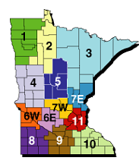
Master Cadre of External Coaches
Centers of Excellence for Young Children
with Disabilities
Minnesota’s System of Regional Professional Development
Idea sparked through Camille Catlett and NPDCI
Launched with ARRA funds
Sustained with Part C & B/619
Created 11 regional centers
Staffed by 10.0 FTE of Regional Professional Development Facilitators
Support Local leaders with PD efforts
Use Implementation Science in provision of support

Slide 22
RP²: Reaching Potentials through Recommended Practices
Professional Development Facilitator within region assigned to a local program who has committed to this work.
Will act as an External Coach-
  Meet with local Leadership team
  Support the local internal coach
  Provide additional training and content support to local professionals (using implementation science)
  Help Local leadership team collect, disaggregate and act up data for quality program implementation.

Slide 23
3. Program-Wide Demonstrations of High Fidelity Implementation
1. High fidelity demonstrations that exemplify the value of the implementation of the Recommended Practices (RPs)
2. Demonstration programs help build the political will needed to scale-up and sustain the RPs
3. Demonstration programs provide a model for other programs and professionals, “seeing is believing”
4. Demonstration programs “ground” the work of the State Team in the realities and experiences of programs and professionals

Slide 24

Leadership Team
Family Engagement
Program-Wide Implementation
Supports for Practice Implementation
Systems to Identify and Respond to Individual Child Needs
Continuous Professional Development
Data Decision-Making: Examining Implementation and Outcomes
Child Engagement in Learning

Slide 25
Program-Wide Supports
Establish leadership team
Recruit and promote staff buy-in
Ensure family engagement
Develop program-wide action plan
Implement strategies for promoting program-wide implementation
Support Recommended Practice implementation
Identify and respond to individual children’s support needs
Offer continuous professional development and staff support
Monitor implementation and outcomes

Slide 26
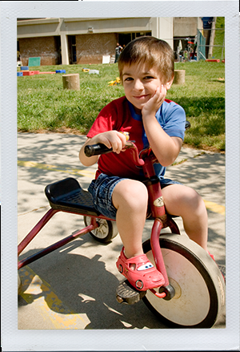
Using Implementation Science
What are we implementing?
When does implementation occur?
Who implements?
How do we make implementation happen?
How do engage in continuous improvement toward fidelity?

Slide 27
Why Program-Wide?
Classroom by Classroom | Program-Wide – All Classrooms
Focus on individual teacher and establishing practices | Across classroom focus in addition to within
Coaching support for implementation fidelity; Reliance on expert coaching | Coaching support as a part of program-wide systemic professional development; Multiple modes of coaching delivery
Fidelity data to drive coaching effort | Fidelity data for making decisions about individual teaching intervention and programmatic professional development
Children receive individualized supports when problems are identified and children “fail” to be engaged | Procedures across classrooms ensure efficient and effective individualized supports
Teachers make connections and establish partnerships with families | Programmatic effort to ensure all parents are connected to the program

Slide 28

Recommended Practices
Developed to help practitioners and families improve learning and developmental outcomes for children birth thru age 5
Bridging the gap between research and practice
To support children’s participation and access to inclusive settings in their natural environments
Include key leadership responsibilities to implement practices
Based on empirical evidence, values, and experience
8 key topic areas

Slide 29
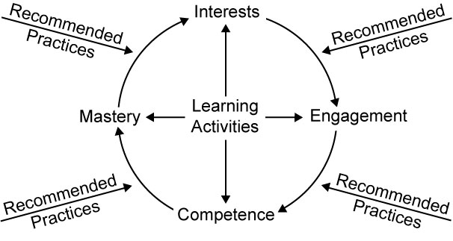
Child Learning Cycle
Notes:
We have selected the RP that most influence a child’s learning for our focus. Practices are from the Family, Environment, Interaction, and Instruction Strands

Slide 30
RP Topic Areas
Leadership
Assessment
Environment
Family
Instruction
Interaction
Teaming and Collaboration
Transition

Slide 31
Minnesota Home-Based
Implementation Sites
Early Childhood Special Education Programs
Mankato (small city in South central MN)
Moorhead (small city in Western MN)
Richfield (inner city suburb)
Zumbro Education District (group of small school districts in Southeast MN)
Early Head Start
Tri-Valley Head Start (Cross agency collaboration – Northwest MN)
Sites were selected based on a proven state of readiness and ability to implement other innovations.
Sites represent various regions of the state as well as district size

Slide 32
Minnesota Classroom-Based Implementation Sites
Early Childhood Special Education
Deer River (small district Northern MN)
Elk River (large district/outer ring suburb
Rochester (Southeast MN city)
St. Francis (mid-sized outer ring suburb) Also just beginning to implement the Pyramid model
Representative of:
Programs who have strong community partnerships (space, financial and relationships)
Programs who are beginning more than one innovation, learn how we can blend DEC recommended practices within innovations
Various leadership structures- building principals, ECSE coordinators

Slide 33
4. A Data Decision-Making Approach
Outcomes are identified
Fidelity and outcomes are measured
Data are summarized and used to:
  Identify training needs
  Deliver professional development
  Make programmatic changes
  Problem solve around specific children or issues
  Ensure child learning and success
Data collection AND ANALYSIS is an ongoing process

Slide 34
State Leadership Team Uses Data
To plan: determine fit with RP² , select Team members; to build awareness and support
To implement & install: select MC, selection of implementation/demonstration sites; evaluate and improve MC (their services, their supports), Sites (fidelity, child outcomes, BoQ) and State Team (BoQ, meeting evaluations, action plans, meeting notes)
To scale up: whom, where, when, how
To sustain: sustain only what data indicate is successful for children, families and programs; use data to build support over time

Slide 35
Programs Use Data
Leadership team uses data to ensure implementation fidelity and the achievement of intended outcomes
  Implementation Fidelity for Program-Wide elements
  Intervention Fidelity of Recommended Practices
  Family Engagement
  Child Engagement

Slide 36
Importance of Data within Minnesota
“Decision Support Data System”
Data are:
  Reliable (standardized protocols, trained data gatherers)
  Reported frequently (e.g. weekly, quarterly)
  Built into practice routines
  Collected at and available to actionable units (e.g. classrooms, practitioners, parents)
  Widely shared with organization personnel
  Shared with family members and community stakeholders
  Used to make decisions (e.g. curricula, training needed, coaching improvements)

Slide 37
Data as Part of Plan-Do-Study-Act
Plan
Decide what to do
Do
Do it (be sure)
Study
Look at the results
Act
Make Adjustments

Slide 38
Reciprocity of Accountability
Accountability must be a reciprocal process.
  For every increment of performance I demand from you, I have an equal responsibility to provide you with the capacity to meet that expectation.
Richard Elmore, 2000
Professor of Educational Leadership, Harvard University

Slide 39
Sphere of Influence- PD work and the Centers of Excellence
MDE (State Content Experts)
Regional Centers of Excellence
(3)
Professional
Development
Facilitators
(PDF)
Supporting LOCAL Programs
Early Childhood
LEADERSHIP
Local
Professional
Staff
Improved Child and Family outcomes
Use of evidence based/informed practices
Delivered through Active Implementation frameworks

Slide 40
Innovations supported through the CoE
USABLE INTERVENTIONS
To experience the benefits of the intervention, what exactly are practitioners saying and doing?
Pyramid Model (TACSEI)
  Pyramid response to social emotional learning
  Plan to expand to early literacy
Classroom Engagement Model (Formally RBII)
  Evidence based strategies for preschool providers

Slide 41
Innovations Supported Through the CoE
  Family Guided Routines Based Interventions
  Evidence informed strategies for birth to 3 providers
  Locally Defined Innovation
  Local leadership will be supported with Active Implementation frameworks

Slide 42
What is Next?
All ECSE programs will complete their own INSPIRE ACTION self assessment.
SOME ECSE programs will choose to begin to work on a selected:
  Foundational skill
  Innovation
  District selected innovation
  CoE staff will work with Local programs to determine appropriate Stage matched activities.
Stages

Slide 43
Local ECSE Leadership will Lead the Way!
This fall we will focus on helping local programs create teams
  To create pathways for their work
  Collect data
  Use of data and make/inform appropriate plans
PDF will assume a role of external coach
  help local programs use the drivers to ensure that professionals are equipped to implement selected work
Teams
Drivers

Slide 44
Making It Happen
Active Implementation Frameworks
USABLE INTERVENTIONS
  To experience the benefits of the intervention, what exactly are practitioners saying and doing?
IMPLEMENTATION STAGES
  What steps lead to successful implementation?
IMPLEMENTATION DRIVERS
  What critical program and organizational supports are needed to implement this change?
IMPLEMENTATION TEAMS
  Who helps guide the change process?
IMPROVEMENT CYCLES
  How can we efficiently solve problems and get better?
Interventions
Stages
Drivers
Teams
Cycles
©Copyright Dean Fixsen and Karen Blase

