Slide 1

Developing Collaborative Screening Systems:
The Good, the Bad, and the Ugly

Slide 2
Presenters
Camille Smith, CDC
  Birth to Five: Watch Me Thrive!
Ruth Gallucci & Holly Ayotte, RI Dept. of Ed.
  EXCEED RI’s Early Childhood Commitment
Lenita Hartman, CO Part C
  Assuring Better Child Health & Development
Laurie Thomas, AK Part C
  Promoting Universal Screening as a Child Find Effort

Slide 3


Birth to Five: Watch Me Thrive!
Developmental and Behavioral Screening and Support
Camille Smith, M.S.,Ed.S.,CPD
“Learn the Signs. Act Early”
Centers for Disease Control and Prevention
September 9th, 2014

Slide 4

The Issue
1 in 4 children, age 0-5 years, are at moderate or high risk for developmental, behavioral, or social delay
AAP recommends screening of all children
for developmental, behavioral, and
social delays at 9, 18, and 24 or 30 months
Less than 50% of pediatricians use valid
and reliable screening tools
Children who have developmental delays are at greater risk for later emotional and behavioral problems and poor educational achievement
Notes:
Have made progress over the years….Yet, an AAP Periodic Survey from 2009 showed that 47.7% use valid and reliable, standardized screening tools. Further, NOT ALL KIDS ARE SCREENED.
When kids are not screened systematically, opportunities for early identification, intervention, and treatment are delayed.
Children who have developmental delays are at greater risk for later emotional and behavioral problems and poor educational achievement.
According to CDC, about 1 in 6 children, age 3-17, has a parent-reported diagnosis of developmental delay or disability. This includes autism, intellectual disability, cerebral palsy, ADHD, hearing or vision impairment, or other developmental delay. “Trends in the Prevalence of Developmental Disabilities in U.S. Children, 1997–2008."

Slide 5






Notes:
Pediatric community cannot do it alone. We must think about all individuals who touch the lives of kids in all settings in which children receive services. We must think about a common language and common messaging across these settings to better educate families and the providers who support them.
Primary care
Child care
Head start
Mental health
Child welfare
Early Intervention
Home visitors
families

Slide 6
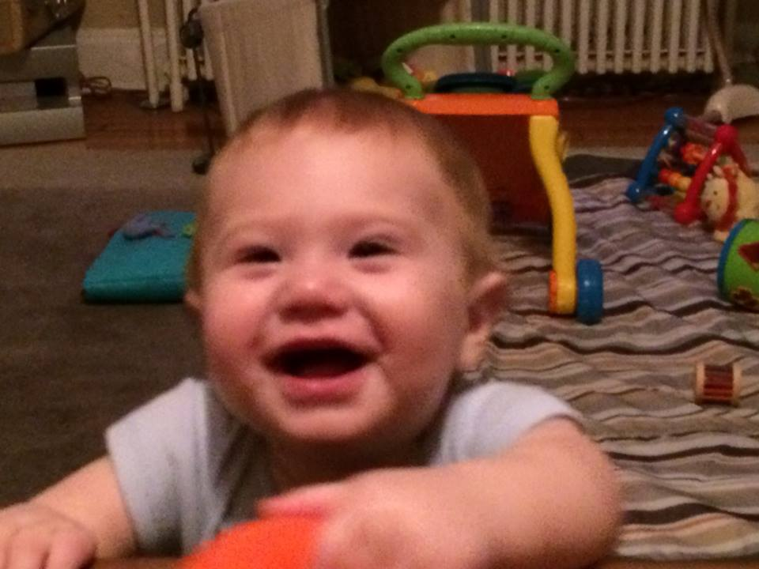
Making sure all of our youngest children are screened and given support early are important priorities for the U.S. Departments of Health and Human Services and Education.
Public awareness of child development and the importance of families is critical in this effort.

Slide 7
The Partners
Administration for Children and Families
Administration for Community Living
Centers for Disease Control and Prevention
Centers for Medicare and Medicaid Services
Health Resources and Services Administration
Eunice Kennedy Shriver National Institute for Child Health and Human Development
Substance Abuse and Mental Health Services Administration
Office of Special Education Programs, Department of Education
Notes:
So we all got together and developed a plan

Slide 8

Birth to Five: Watch Me Thrive!
Coordinated campaign to promote awareness of child development and developmental and behavioral screening, referral, and follow-up.
  Celebrating developmental milestones
  Promoting universal developmental and behavioral screening
  Improving early detection
  Enhancing developmental supports
Notes:
Celebrate milestones. Every family looks forward to seeing a child’s first smile, first step, and first words. Regular screenings help raise awareness of a child’s development, making it easier to expect and celebrate developmental milestones.
Promote universal screening. Just like hearing and vision screenings assure that children can hear and see clearly, developmental and behavioral screenings track a child’s progress in areas such as language, social, or motor development.
Identify possible delays and concerns early. With regular screenings, families, teachers, and other professionals can assure that young children get the services and supports they need, as early as possible to help them thrive alongside their peers.
Enhance developmental supports. Combining the love and knowledge families have of their children with tools, guidance, and tips recommended by experts can make the most of the developmental support children receive.

Slide 9
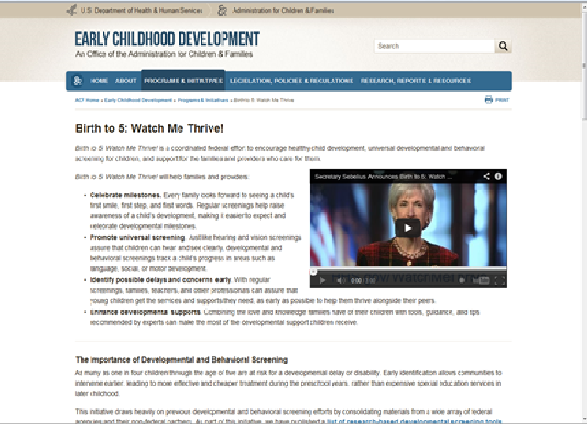
Birth to Five: Watch Me Thrive! Toolkit
  A compendium that reviews implementation, reliability and validity characteristics of screening instruments
  User guides, designed for providers from multiple sectors and the communities in which they live
  Collection of resources to bring awareness to parents and providers about healthy child development
Notes:
Two of the user guides are now offered in Spanish: The Home Visitor’s Guide and the Early Care and Education Guide

Slide 10

Birth to Five: Watch Me Thrive! Compendium
  First line screening instruments for children, birth to 5 years
  Pertinent information includes cost, administration time, quality level, training required, and age range covered
  Reference for early care and education providers, pediatricians, home visitors, child welfare case workers, mental health professionals, early intervention specialists, and various others
Notes:
Inclusion criteria:
Designed for the purpose of screening (not child assessment).
Appropriate for use with children between birth and age five.
Cover multiple developmental domains (i.e. physical/motor, cognitive, linguistic) and, particularly, social and emotional development.
Available for use by early childhood professionals
Include family input.
Have a sensitivity and specificity of 0.7 or greater

Slide 11









Birth to Five: Watch Me Thrive! User Guides
Early Care and Education Providers
Early Intervention Service and Early Childhood Special Education Providers
Families
Primary Care Providers
Communities
Child Welfare
Home Visitors
Behavioral Health Providers
Housing and Homeless Shelter Providers
Notes:
Common message all the sectors that touch kids and families.
Companion guides, designed for providers from multiple sectors as well as the communities in which they live (e.g. early care and education providers; pediatricians; social workers; mental health providers; Part B/C coordinators), to assist in selecting screening instruments;
Developmental milestones
Screening, monitoring and surveillance
How to engage families in the process
How and where to refer if concerns are detected
How to choose the appropriate tool to fit the need
Two of the User Guides are offered in Spanish: Home Visitors and Early Care and Education

Slide 12
Birth to 5: Watch Me Thrive!
Community Guide
Broad Community Goals and Strategies for Successful Developmental and Behavioral Screening Initiatives and Community Examples
  Raise public awareness about the importance of celebrating developmental milestones with children and families, universal developmental screening, risks for developmental delay and supports for those at risk.
  Engage community leaders.
  Discover common stakeholder interests and goals.
  Provide cross-disciplinary training to relevant providers who interact with young children in the administration of standardized, reliable screening tools.
Notes:
Effective promotion and support of healthy child development and wellness is best achieved early in a child’s life with well-coordinated, multi-sector services and resources as well as ongoing partnership with families. Public awareness of typical child development and risks for delay, developmental and behavioral screening, early identification of delays as well as linkages to referral and follow up services can be delivered anywhere young children and families spend time--in the home and in communities through a range of programs and services such as child care, Head Start, mental health, early intervention and special education programs, primary health care, child welfare, and home visiting.
Use this guide to aid in implementing a collaborative, community-led universal screening effort. Establishing a streamlined, coordinated system of screening, referral, feedback, and follow up is a complex undertaking, but lessons and examples of communities that are working toward realizing this vision are provided here.

Slide 13
Birth to 5: Watch Me Thrive!
Community Guide
  Build systems, communication, privacy assurances, and infrastructures
  Support expanded screening across early childhood programs and providers while minimizing the risk of duplicate screenings, and
  Ensure that referrals are successful, feedback loops are utilized, follow up and monitoring occurs, and action plans are shared with all who support young families and their children.
  Improve communication processes across early care and education and primary care.
  Destroy myths that may act as barriers to action.
  Take advantage of medical/health home, health information exchange, and health care reform initiatives.
Notes:
Medicaid/EPSDT…CHIP…Regardless of health insurance type, all children and families have access to preventative care without a copayment or coinsurance, even if the yearly deductible has not been met. Children’s preventative health coverage includes services like vision, hearing, developmental, behavioral, and autism screenings.
Another example…Under the ACA, Section 1945 Health Home State Plan Option provides 90% federal matching funds for States to provide health home options to coordinate care for Medicaid enrollees with chronic health conditions that include mental health, substance abuse, asthma, diabetes, heart disease, and being overweight. Services provided by health homes include comprehensive care management, care coordination, health promotion, comprehensive transitional care/follow up, patient and family support and referrals to community social support services, and use of health information technology. With Centers for Medicare and Medicaid approval, your state may be able to use the health home option in Medicaid to target individuals with developmental and behavioral health needs.

Slide 14

Birth to Five: Watch Me Thrive! Resources
      Information on developmental milestones
      Every day tips for caregivers to promote healthy development
      Fact sheets on specific developmental disabilities or delays
      Milestone checklists and tracking tools
      Learning modules for providers
      Screening passport for families
      Guidance for finding help locally

Slide 15

"Learn the Signs. Act Early"
To improve early identification of autism and other developmental disabilities so children and their families can get the services and support they need
Notes:
I want to highlight one of the resources that is contained in the resource toolkit – the LTSAE materials and messages

Slide 16

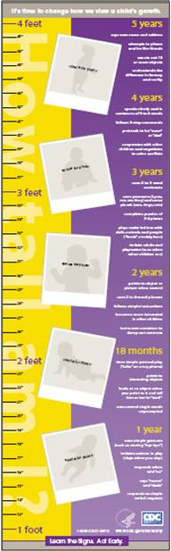
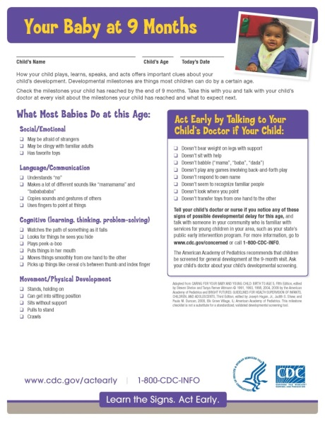
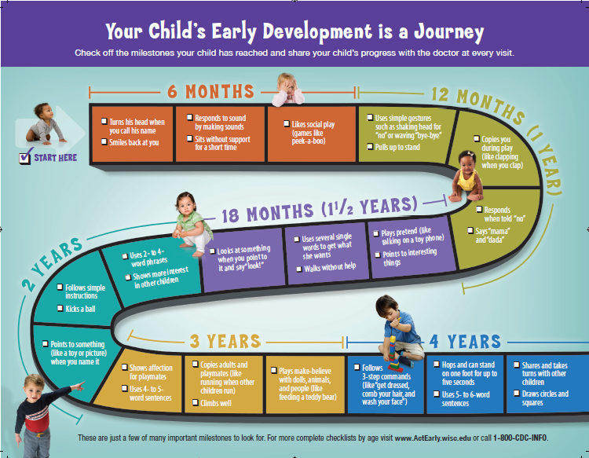

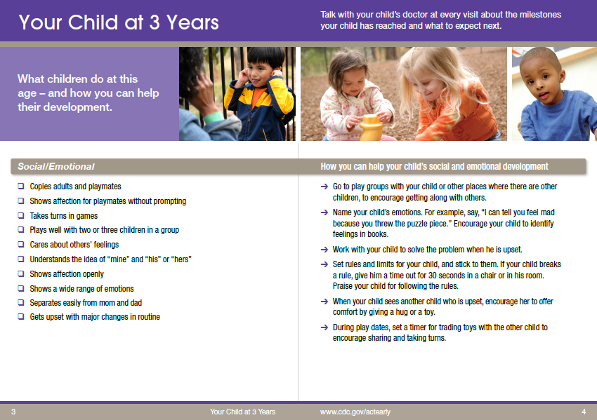
Notes:
Here’s a quick peek at just a sampling of our most popular materials including a milestone checklist, the Milestones brochure, the Milestone Moments booklet, and growth chart. They are being used around in the country by health care practitioners, in head start centers , child care, home visiting programs, child welfare, WIC clinics, child find activities, prenatal clinics as well as museums and libraries as a means of helping families celebrate their child’s milestones and as an observation and monitoring tool to identify those children who may need services and supports as soon as possible.

Slide 17
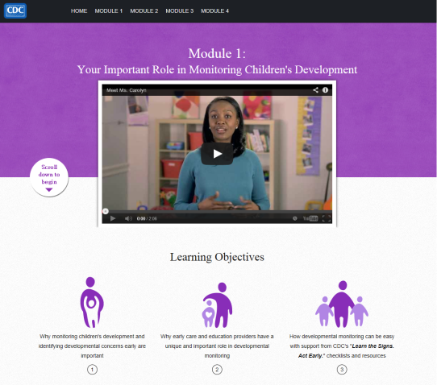
Watch Me! Celebrating Milestones and Sharing Concerns
Free, one hour on-line training
Four modules:
  Your Important Role in Monitoring Children’s Development
  Understanding Children’s Developmental Milestones
  Objective and Engaged Developmental Monitoring
  How to Talk with Parents about their Child’s Development
Continuing Education Credits Available (also free)
Interactive and engaging
Notes:
We are very excited about our new online training called Watch Me: Celebrating Milestones and Sharing Concerns! We have heard from early care and education providers around the country that they need more information on child development, monitoring child development and talking with families both about typical development but also when they have concerns about a child’s development. The training is very interacitve and engaging and CEU’s will be available. This was developed in collaboration with a variety of child development experts and organizations.

Slide 18
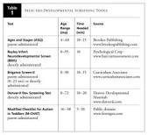


Using Electronic Health Records (EHRs) to Improve and Monitor Early Identification of Developmental Delays in Pediatric Practice
Learn the Signs. Act Early. Team
Policy Functional Group

Slide 19

Vision
Using electronic information to improve early identification of children with developmental delays, linkage to services, and tracking progress and outcomes.
Relation to “Benchmarks” for early identification: developmental monitoring, screening, linkage to services, and monitoring outcomes.
  EHRs may help
    Improve clinical services
    Improve referrals
    Provide data for tracking progress and outcomes

Slide 20
Summary of Early Identification EHR Projects
Project | Type | Partner
AAP EHR Coordination | National coordination Starting in October 2014 – environmental scan of EHRs and developmental screening and assemble workgroup for plan forward | American Academy of Pediatrics (AAP) and others
HL7 Interoperability Standard for Developmental Screening | International standards data transfer so EHRs can talk the same language and share information across systems | HL7 Child Health Workgroup

Slide 21



Slide 22
RI EI/ECSE Comprehensive Assessment System
EI/ECSE Comprehensive Assessment System
Birth -5
Developmental Screening
Evaluation and Eligibility
Child Outcomes Measurement System
Formative Assessment

Slide 23

Child Outreach
Every Child - Every Year
EI/ECSE Comprehensive Assessment System
Birth -5
Developmental Screening

Slide 24
Child Outreach Screening Initiatives
Ensuring reliability & avoiding drift
Collaboration with HEALTH
  pediatrician notification, referral
  referral to community-based services
DLL process, procedure & development of regional screening teams
New CO Policies & Procedures
Public Awareness Campaign
EI/ECSE Comprehensive Assessment System
Birth -5
Developmental Screening

Slide 25
Screening Challenges
Separate data collection systems/limited monitoring capacity
Lack of improvement in screening percentages
Inconsistent referral & eligibility decisions
Inconsistent DLL screening process & procedures
Lack of collaboration with pediatricians
Duplication of screens
EI/ECSE Comprehensive Assessment System
Birth -5
Developmental Screening

Slide 26
Child Outreach Screening Goals
Statewide Child Outreach data system
Ability to analyze Child Outreach screening data to inform policy decisions
Ability to find all children 3-5
System for monitoring referrals and eligibility
System for monitoring DLL screening process
System for sharing screening and health information within the community
EI/ECSE Comprehensive Assessment System
Birth -5
Developmental Screening

Slide 27

The development of a new Child Outreach system within KIDSNET (Rhode Island's confidential computerized child health information system) would mitigate the risks inherent in using a paper-based process.
Integration into KIDSNET would allow school districts to accurately locate, screen, and monitor RI children, resulting in the ability to most effectively and efficiently provide the necessary supports and interventions.

Slide 28



August 2013

Slide 29
Child Outreach-KIDSNET Project Team
Core Team
RIDE
HEALTH
HLN
Early Learning Council
Sub-Committee
RTT ELC Coordinating and Data Team
RIDE/Health Legal
Department of Children, Youth and Families
RIDE Early Childhood Team
Child Outreach Coordinators

Slide 30
Core Team
RIDE
HEALTH
HLN
scope of work
detailed requirements
desired workflow
future functionality
business rules
screen mockups
required data elements
associated edit rules

Slide 31
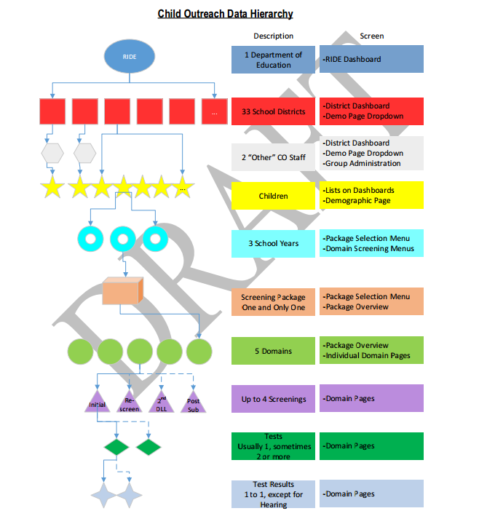

Slide 32
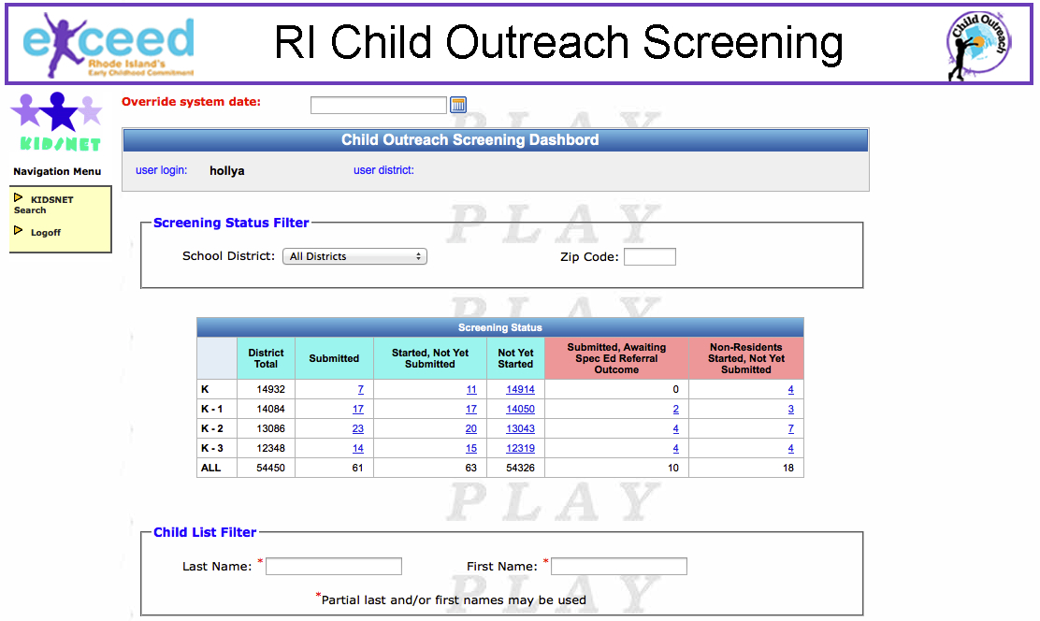

Slide 33
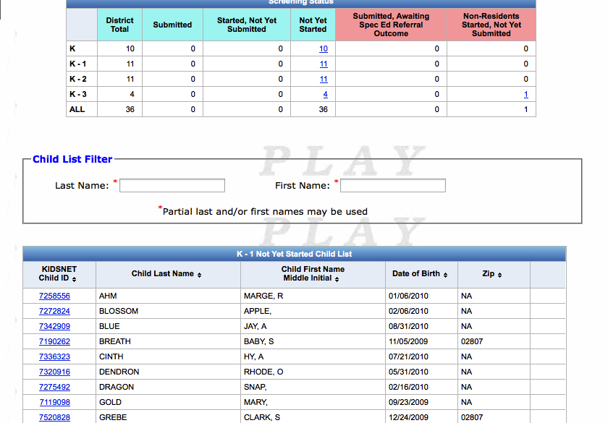
Finding Children Who Need Screening

Slide 34
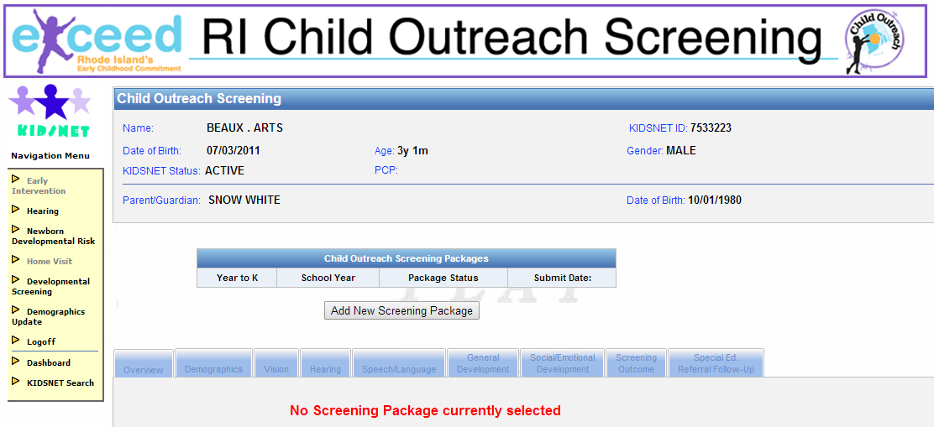

Slide 35
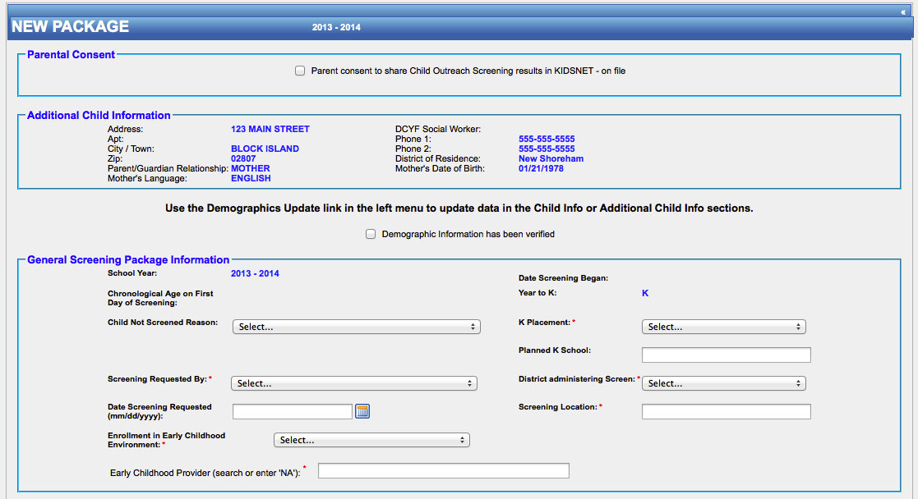

Slide 36
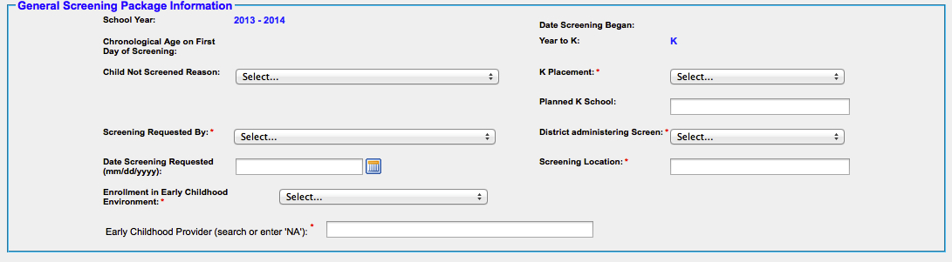
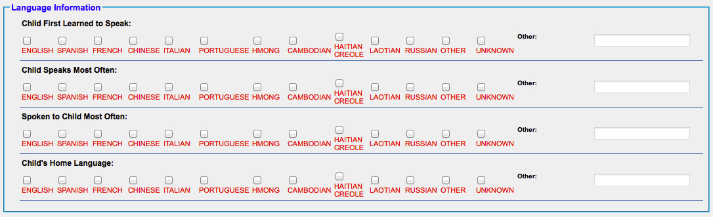
Demographic Data

Slide 37
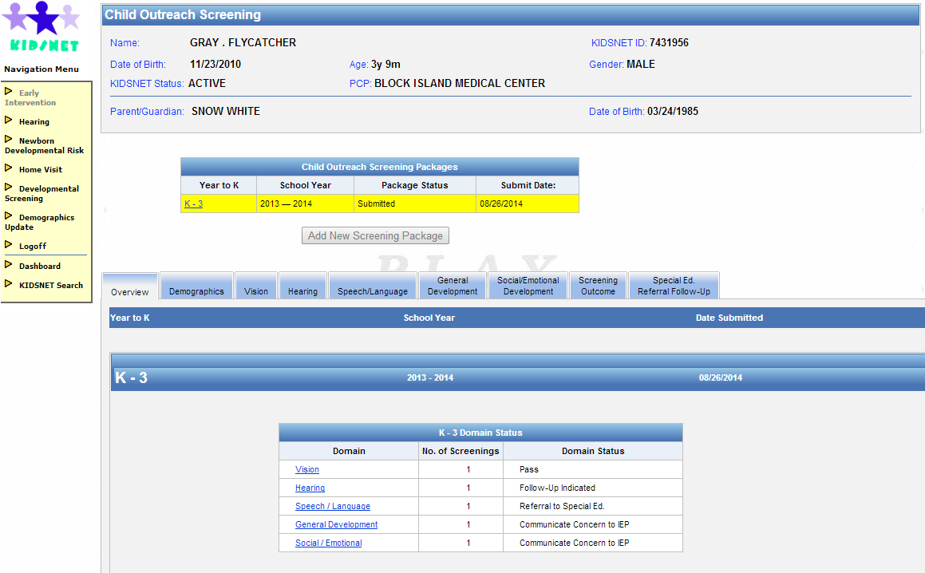

Slide 38
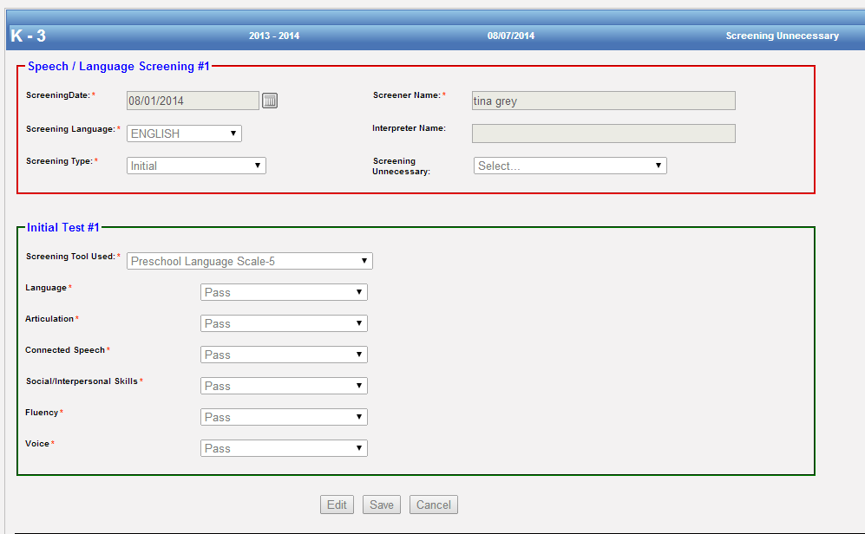
Speech/Language Screening Results

Slide 39
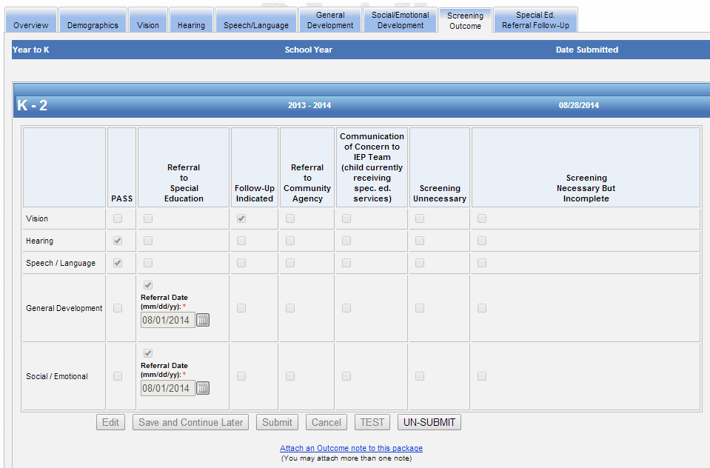
Notes:
Referral to sp ed

Slide 40
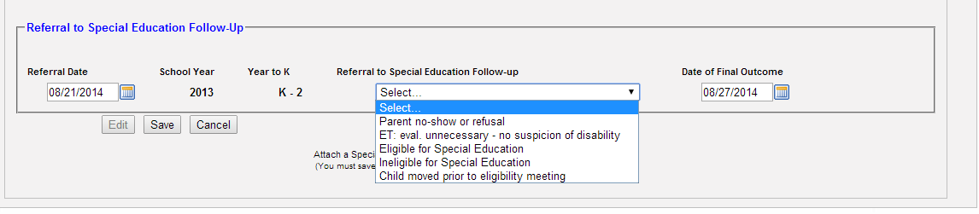
Referral to Special Education Follow-Up
Notes:
Apex report
End with performance report

Slide 41
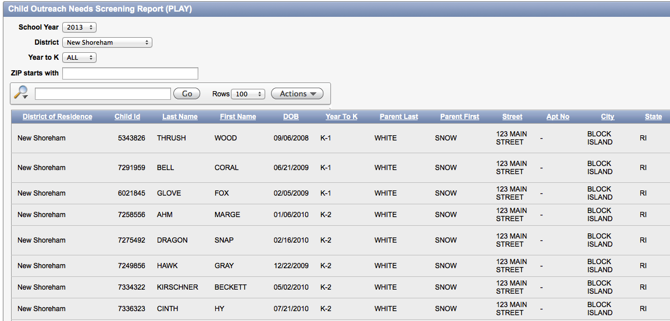

Slide 42
Every Child - Every Year

Slide 43



Building Upon Successes: Assuring Better Child Health & Development (ABCD) In Colorado
Improving Data, Improving Outcomes Conference
New Orleans, LA
September 8 & 9, 2014
Lenita Hartman, MA

Slide 44

ABOUT ABCD
The ABCD program was initially designed to assist states in improving the delivery of early childhood development services for low-income children and their families by strengthening the systems that support healthy child development of children birth to 3
http://www.coloradoabcd.org/
Notes:
Historical perspective: 2005

Slide 45
Initial ABCD Activities
In 2005, only 40% of pediatricians in Colorado were routinely conducting developmental screening
In response, ABCD began collecting data on screening practices in the state and targeted specific communities to improve physician referral rates
Notes:
In looking at available data in our state it was found that

Slide 46
Collaborative Data Sharing
Early Intervention Colorado and ABCD began working together to determine how the EI data could be utilized and shared to increase screening and referral
Quickly realized the data EI was collecting was too broad: could not track which hospital or physician was referring
Adjusted the database to respond to the needs of ABCD

Slide 47
Collaborative Data Sharing cont.
The EI database includes every health care practice statewide
When a local early intervention program (Community Centered Board, CCB) receives a referral from Dr. X , there is a drop down menu to select that physician
Notes:
If the physician is not in the database, a request is made to the EI team and the practice is added.

Slide 48
Collaborative Data Sharing cont.
EI shares a report quarterly with ABCD that includes:
  # of referrals by CCB
  Where the referral came from
  Which physician/practice
  By county
ABCD can target physician practices that need support to increase referrals
If the data is showing many children dropping out prior to eligibility, ABCD can follow up with outreach
Notes:
If the physician is not in the database, a request is made to the EI team and the practice is added.
System collects multiple referral sources so if it is a CAPTA referral ABCD can drill down to see if already referred by a physician.

Slide 49
ABCD Data Analysis
ABCD uses data to:
Determine how well referral systems are working in communities ABCD supports
Target additional referral sources and to ensure current referral sources are making appropriate referrals
Identify additional communities in the state who might benefit from technical assistance

Slide 50
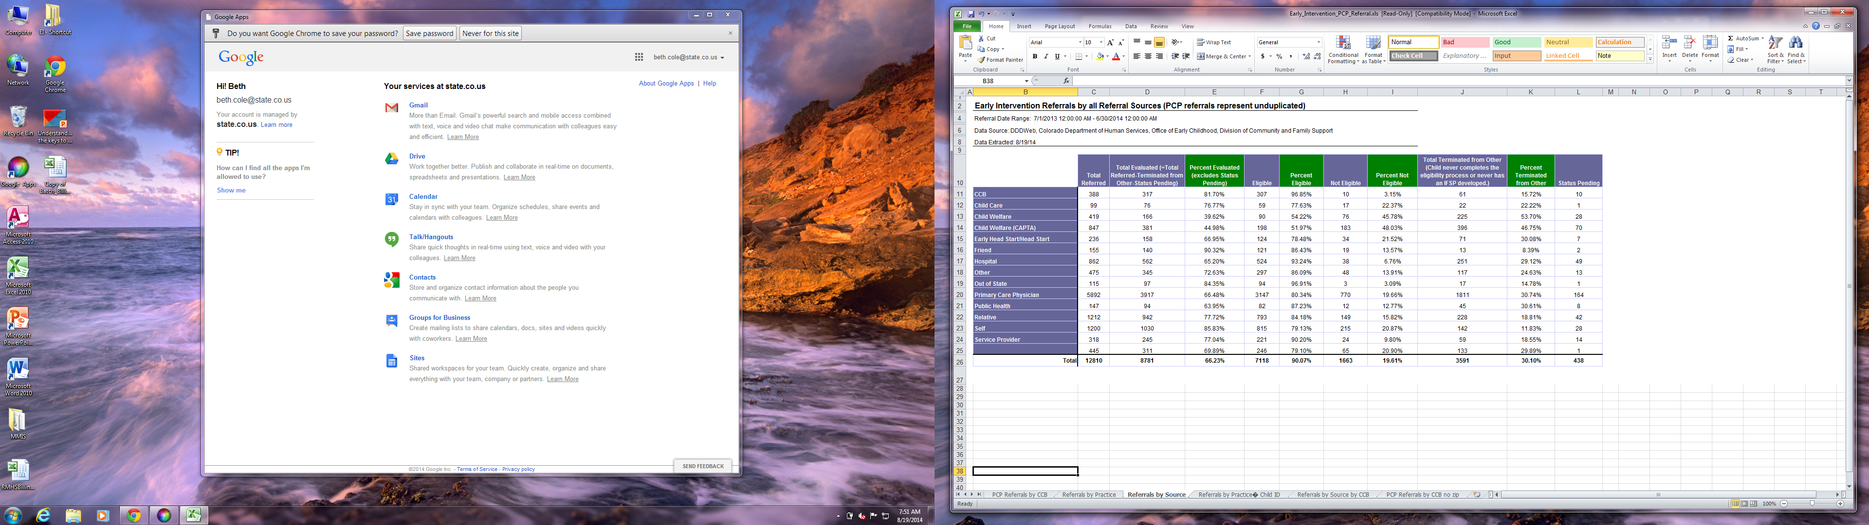

Slide 51
Ongoing Efforts
In 2012, ABCD expanded their scope and began working with 12 communities to identify all potential referral sources in order to streamline the process so children are not screened multiple times
80% of “ABCD” practices facilitated referrals to Early Intervention Colorado and an additional 17% said they would after receiving additional technical assistance
Notes:
Roadmapping

Slide 52
Using the Data to Determine Effectiveness
Data collected in 2013 revealed: 92% of pediatricians in Colorado are routinely conducting developmental screening using a standardized tool
Currently 45% of all practices that see children (which includes family practices) are now using a standardized developmental screening tool (baseline was less than 5%)

Slide 53
ABCD Moving Forward
Funded Through Race to the Top, currently ABCD:
Is committed to educating and engaging all community partners to ensure that they are working together as effectively and efficiently as possible on behalf of families and young children
Provides facilitation, training and technical assistance to local communities across Colorado in order to solidify a coordinated and quality system in which all children birth to five are screened for developmental delay, referred early when concerns exist, evaluated and connected to services when appropriate
Notes:
ABCD is moving away from just focusing on pediatrician referral to more community referral awareness: Who should be doing surveillance? The different roles of community partners, and how we can support families in making it all the way through the early intervention process, not just to referral.

Slide 54
ABCD Moving Forward cont.
Assists physicians in understanding how to identify and care for children with developmental delays
Incorporates research and evidence based best practices into the work and tries to ensure that community partners embed these research/evidence based best practices into the development of their local approach
Notes:
ABCD is moving away from just focusing on pediatrician referral to more community referral awareness: Who should be doing surveillance? The different roles of community partners, and how we can support families in making it all the way through the early intervention process, not just to referral.

Slide 55
Building on Successes
ABCD is in the process of working with Colorado Department of Human Services (CDHS), Colorado Department of Public Health (CDPHE), and the Colorado Department of Education (CDE) as part of the Race to the Top grant to develop a Model Community Framework (MCF) loosely based on the SERIES: “An Integrated Approach to Supporting Child Development” article that was published by Children’s Hospital of Philadelphia (summer, 2012)

Slide 56
Model Community Framework
ABCD has based its MCF on the idea that screening must happen as part of a spectrum of activities that includes the following essential roles:
  Monitoring & Surveillance
  Standardized Developmental Screening
  Referral
  Evaluation
  Parent Education
  Resources & Support
  The MCF Components consist of quality standards, roles/responsibilities, protocols and technical assistance

Slide 57
Model Community Framework cont.
The MCF will be offered to 10 additional communities within the state based on a competitive RFP
This work will provide new TA opportunities to communities in order to solidify a coordinated and quality system in which all children birth to five are screened for developmental delay, referred early when concerns exist, evaluated and connected to services when appropriate

Slide 58

QUESTIONS
Contact Information: Lenita Hartman, Community Coordinator, Early Intervention Colorado, p: 303-866-5419, email: Lenita.hartman@state.co.us

Slide 59
Promoting universal screening as a child find effort
Laurie Thomas, M.Ed.
Alaska
Defining the Path
Taking First Steps
Learning to Walk
Overcoming Roadblocks
Enjoying the View

Slide 60
Defining the Path: Desired Outcomes
More children are screened
Resulting in identification of children with developmental delays
More children receive needed services
Increased awareness of importance of developmental screening
Notes:
We are “in the weeds” with a lot of details but we really try to keep in mind the overall goals of what we are trying to accomplish. It’s not just technology for technology’s sake for improved access to screening.

Slide 61
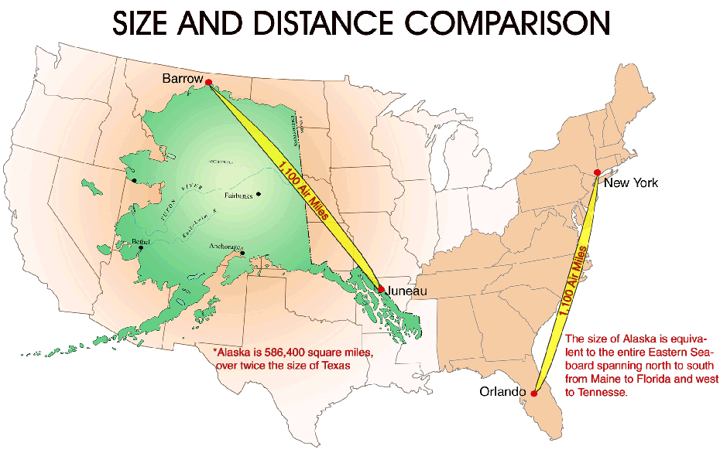
ALASKA

Slide 62
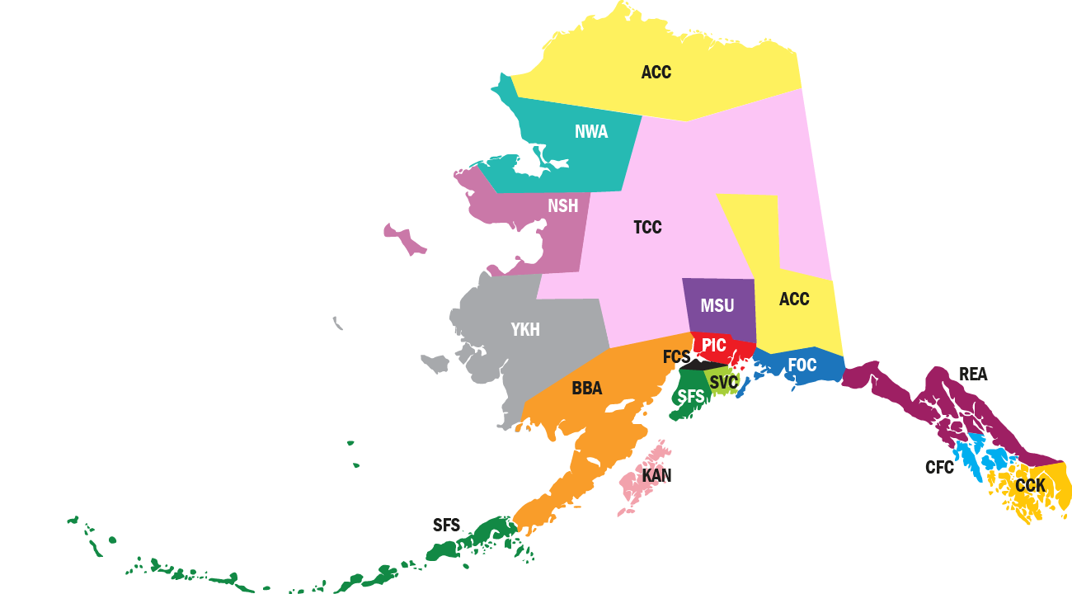
Alaska
EI/ILP
Providers

Slide 63
Defining the Path
The Individuals with Disabilities Education Act (IDEA) comprehensive child find system with referral mechanism for early intervention services.
Identification Outcomes
      13% - children 0-3 experiencing delays or disabilities (Rosenburg, S., Zhang, D. & Robinson, C., 2008)
      6% - Alaska children 0-3 served annually Part C
Notes:
IDEA reauthorized in 2004. Required rewriting state regulations and policies related to improving system implementation. The federal regulations stipulate entitlement to evaluation, not screening. Our belief that screening should happen where children are: primary referral sources such as: Medical home, head start, home visiting programs, child care.

Slide 64
Taking First Steps
Understanding Alaska screening
    What standardized tools were being used?
    What other initiatives ongoing?
Reviewed time, effort and cost data
    Purchased online ASQ licenses for each
    regional agency
      option to expand usage to primary referral sources.
Notes:
What our time, effort and cost data showed us was that according to the grant proposals, we were spending a lot of time and effort screening children. Over % of EI/ILP staff statewide are Master’s prepared or % of licensure/certification? Screening by an OT is certainly less expensive than evaluating, but still very expensive relatively. The idea here was to support child find effort possibilities where children showed with regularity: doctors offices, child care programs, head start, home visiting programs. Etc. Win- win. Decreased expense for Part C increased access for children, resource allocation for staff.

Slide 65
Learning to Walk
Building partnerships
    Early Childhood Comprehensive Systems
    Early Periodic Screening Diagnosis Treatment (EPSDT) work group recommended the use of the ASQ
    Head Start
    Parents as Teachers
    Alaska Pediatric Partnership

Slide 66

Overcoming Roadblocks
Bringing agendas together
Medical providers and HIPAA
Electronic Medical
Record/Data integration

Slide 67
Total Number of Programs by Program Type (June 9, 2014)
N = 51
Enjoying the view

Slide 68
Defining the Path: Alaska’s Vision
PIC
REACH
Sprout
FOCUS
MSU
BBA
FCS
SeaView
ACC
YKH
KAN
NWA
TCC
CFC
NSH
CCK
Alaska Part C Hub
Programs
Notes:
Establish the State of Alaska Part C Office as the “Hub”
Establish the 16 Early Intervention grantees as “Enterprise” accounts
Early Intervention grantees add “Programs” such as medical providers and early care and learning programs

Slide 69
Defining the Path:
Learning the Language
Hub (State of AK)
Sprout
(Early Intervention Grantee)
Kachemak Kids
Office of Children’s Services
KANA
(Early Intervention Grantee)
KANA ILP
Hub
Enterprise
Program
Notes:
There are particular terms used in the ASQ Online so it might help to identify those.

Slide 70
first steps
Establish Enterprise Accounts
Learn the ASQ Online system
Identify Training Needs and Schedule
Add Family Access
                Continue Support (teleconferences, problem solving, technical assistance)
Notes:
Asked for ILPs to volunteer to participate in first cohort
Some were reluctant due to limited staff and too many projects. We had to learn the language of ASQ Online, figure out a plan of approach
Takes some time to learn the ASQ Online system
Resistance to change

Slide 71
Learning to walk: Family access
Family Access added to each Enterprise
Families complete screening online
Increased access to screening
Health or early care provider can complete ASQ online
Eliminates duplication of data entry

Slide 72
Data Entry — Manual vs. Family Access
Family Access Entries:
2012 13%
2013 28%
2014 39%
(as of 6/9/14)
Learning to Walk: Family Access

Slide 73
Hub – State Part C
Enterprise - PIC
Programs
Programs for Infants and Children (PIC)
Alaska Center for Pediatrics
Kids Corps Head Start/Early Head Start
Providence Hospital Child Development Program
Parents as Teachers
Finding Our Stride:
Adding Programs
Notes:
Example: Programs for Infants and Children (Enterprise) in Anchorage invites programs to join their ASQ Enterprise system. ACP and Providence are examples of their individual outreach and HS/EHS and PAT are examples of statewide outreach

Slide 74
Screen Usage by Type: Comparison Over Time
Finding our Stride:
Increasing Usage

Slide 75
Overcoming roadblocks
Duplicate Data Entry (Application Program Interface)
Security / Confidentiality Issues (Brookes documents)
Technology Insecurities (Ongoing training)

Slide 76
Enjoying the view
Shared Screening Effort
Increased Role for Parents
Increased Number of Children Screened
Increased Data Tracking
Strengthened Partnerships

Slide 77
SPROUT - Homer Alaska
VISIT 10 INDIVIDUAL COMMUNITIES ONCE A YEAR
  Cost
    Staff day rate + 2 hours prep for travel: $4,000
    Travel (plane tickets or gas reimbursement): $1,214
    Loss of staff client services? (not calculated)
    Total cost of 10 days: $5,214
  Outcomes of past efforts
    52 ASQ/SE complete, 12 Infant Learning Service referrals
Local Part C Program
Past Childfind Efforts
Notes:
Our past efforts were costly, inefficient and did not yield the results that we wanted.
Cost per child: $100
Cost per referred Child: $435
% of children screened in region: .06%
We didn’t have good results, staff were spending their time screening instead of serving children.
If Sprout is hoping to interact with %100 of all children in the region to promote healthy development, we are a long way from our target.

Slide 78
Finding our stride
Enterprise
Sprout
Kachemak Kids Early Learning Center
Office of Children's Services
Child Protection
Sand Point Medical Clinic
Part C Office-Hub
PIC
REACH
Sprout
FOCUS
MAT-SU
BBAHC
Frontier
SeaView
ACCA
YKHC
KANA
NW Arctic
TCC
Sitka
NSHC
Ketchikan
Notes:
After we got our internal screening set up, Sprout was ready to add partners. Our goal is to have diverse partners in our region so that there is limited possibility that a child would be missed. So far we have partnered with our internal Parents as Teachers Program, Office of Children Services CPS, Medical Clinics and an Early Learning Center.
Each partner has completely different reason for joining our program and different needs for training.
Our staff created a general training session for interested partners. We have provided technical assistance with our OCS office through offering to enter in their screens until they have capacity to do it themselves. In Sand Point, we have helped their clinic director create new procedures to provide screenings at all well-baby exams.
Sprout’s goal is to reach out to our community partners that make referral
Each partner has completely different reason for joining our program and different needs for training.

Slide 79
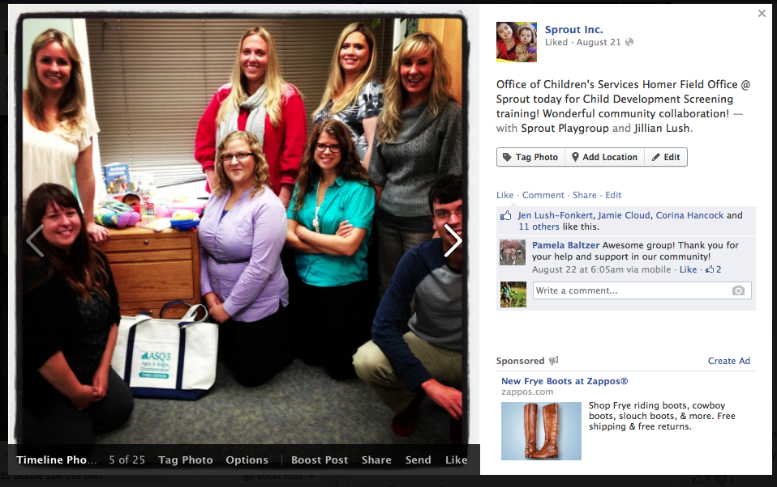
SPROUT AND CHILD PROTECTION SERVICES
OCS success story
Notes:
Called for Child Development Education for staff and we were able to offer them an immediate understanding of child development through the training and use of this tool.
Came to a 3 hour training on use of tool, complete with video demonstrations, Q & A and a plan that Sprout could continue to support them in screening each of their children. They weren’t ready for the step of adding the information into the database, so they are turning their paper reports into us to enter in. We will transition them to learn the database next year after they have seen the benefit of screening their kids.
We have now had the opportunity to train:
3 medical clinics
1 Child Care Center
Regional Child Protective Services

Slide 80

Overcoming roadblocks
Parents
Staff
Partners
SPROUT
Notes:
Parents – Internet access – no app for phone yet,
-- Teach parents to incorporate child development screening into the general health of their child, empower community to have environmental shift to look at development, technology shift
Staff – Training (one more thing to do!) paradigm shift of control to partners/parents –
-- now can spend more time with intervention and less time screening out ineligible children
Partners – Hard for their capacity, taken a lot of technical assistance support
-- Developed stronger partnerships, seen as a resource, know appropriate referral

Slide 81

Enjoying the view
Parents – Increased parental screenings
Staff – More staff time for assessment and intervention
Partners - Child Find is an on-going community-wide effort
Notes:
What Child Find looked like this year so far:
Providers spent time teaching parents/partners how to screen their children
Data looks promising for more children screened – not just a once per year effort.
Child Find efforts will be spent in technical assistance for partner programs & continued environmental shift of screening for all children on Southern Kenai Peninsula

Slide 82
Thank you!
Prepared for the Northwest Center for Public Health Practice
University of Washington Maternal and Child Public Health
Webinar Series June 27, 2014
Feel free to contact us with questions!
Laurie Thomas, M.Ed.
Alaska Part C Coordinator
Phone: (907) 269-3423
Email: laurie.thomas2@alaska.gov

Slide 83

Discussion

