Slide 1
Transition and Shared Data: 619 State Systems Use of Part C Data to Ensure All Children are Transitioned by Age Three
Danielle McCarthy, Montana Office of Public Instruction
Anne Rainey, Montana Office of Public Instruction
Wendy Studt, Montana Department of Public Health and Human Services
Debbie Cate, ECTA Center & IDC
Kathy T. Whaley, ECTA Center
Improving Data, Improving Outcomes Conference
New Orleans, LA
September 8th, 2014
Session S94

Slide 2
Objectives
Share APR C8 & B12 transition indicator trend data
Share information about Indicator C8 & B12 data collection and sharing processes
Provide a state highlight for using Part C notification data by an SEA
Discuss strengths, challenges and identify potential supports and resources

Slide 3
Transition Notification (Referral)
Prior to a toddler exiting the Part C early intervention program, if that toddler is potentially eligible for services under Part B of the IDEA, the lead agency must notify the SEA and the LEA where the toddler resides that the toddler on his or her third birthday will reach the age of eligibility for services under Part B. (§303.209(b)(1))

Slide 4
SEA/LEA Notification and Opt-out
SEA/LEA notification must be consistent with any opt-out policy the State has adopted. (§303.209(b)(2))
States can adopt opt-out policy that permits a parent to object to the disclosure of the child find personally identifiable information (PII). (§303.209(b)(2) & 303.401(e))
Opt-out policy includes notifying parent of the limited disclosure of PII for child find purposes and allowing a specified period of time for the parent to object. (§303.209(b)(2) and 303.401(e))

Slide 5
Transition Notification and Potentially Eligible
Lead Agency defines potentially eligible policy.
In many states all children receiving Part C services are considered potentially eligible.
Characteristics of PE policies include
eligible children with IFSPs
age of two
Not attaining IFSP outcomes
Served under established condition or developmental delay categories

Slide 6
Transition Notification (Referral)
Content of the SEA and LEA notification must include information to assist Part B child find responsibilities
Must include:
Child’s name
Child’s date of birth
Parent contact information
May additionally include:
Service Coordinator name & contact information
Language(s) spoken by the child and family

Slide 7
Previous Indicator Requirement for C8B
Sub-indicator (B) Notification to LEA, if child potentially eligible for Part B:
Part C regulations specify that the Lead Agency will "Notify the local education agency for the area in which the child resides that the child will shortly reach the age of eligibility for preschool services under Part B"

Slide 8
Procedural Changes for Part B
SEA has to have a mechanism in place to receive and use the Part C notification data
LEA/LEAs need to have a way to use, share and coordinate these data
SEA/LEAs need to understand potentially eligible and opt-out requirements/policies
School districts (LEAs) were responsible for establishing policies and procedures for acting upon referral.

Slide 9
Part C Revised Regulations and APR Requirements
New APR Monitoring Priority: Notified (consistent with any opt-out policy adopted by the State) the SEA and the LEA where the toddler resides at least 90 days prior to the toddler’s third birthday for toddlers potentially eligible for Part B preschool services;
New Measurement:
Percent = [(# of toddlers with disabilities exiting Part C where notification (consistent with any opt-out policy adopted by the State) to the SEA and LEA occurred at least 90 days prior to their third birthday for toddlers potentially eligible for Part B preschool services) divided by the (# of toddlers with disabilities exiting Part C who were potentially eligible for Part B)] times 100.

Slide 10
Revisions to APR Requirements
States not required to report using revised Indicator 8B in 2012 APR, (FFY Reporting Period 2010-11), prior regulations in effect
APR February 2013 (FFY Reporting Period 2011-12), states had flexibility in reporting
APR February 2014 (FFY Reporting Period 2012-13), revised indicator was required.

Slide 11
Indicator Results – Indicator C8
(a) IFSP transition steps & services
(b) Notification to SEA & LEA
(c) Transition conference
96%
91%
95%

Slide 12
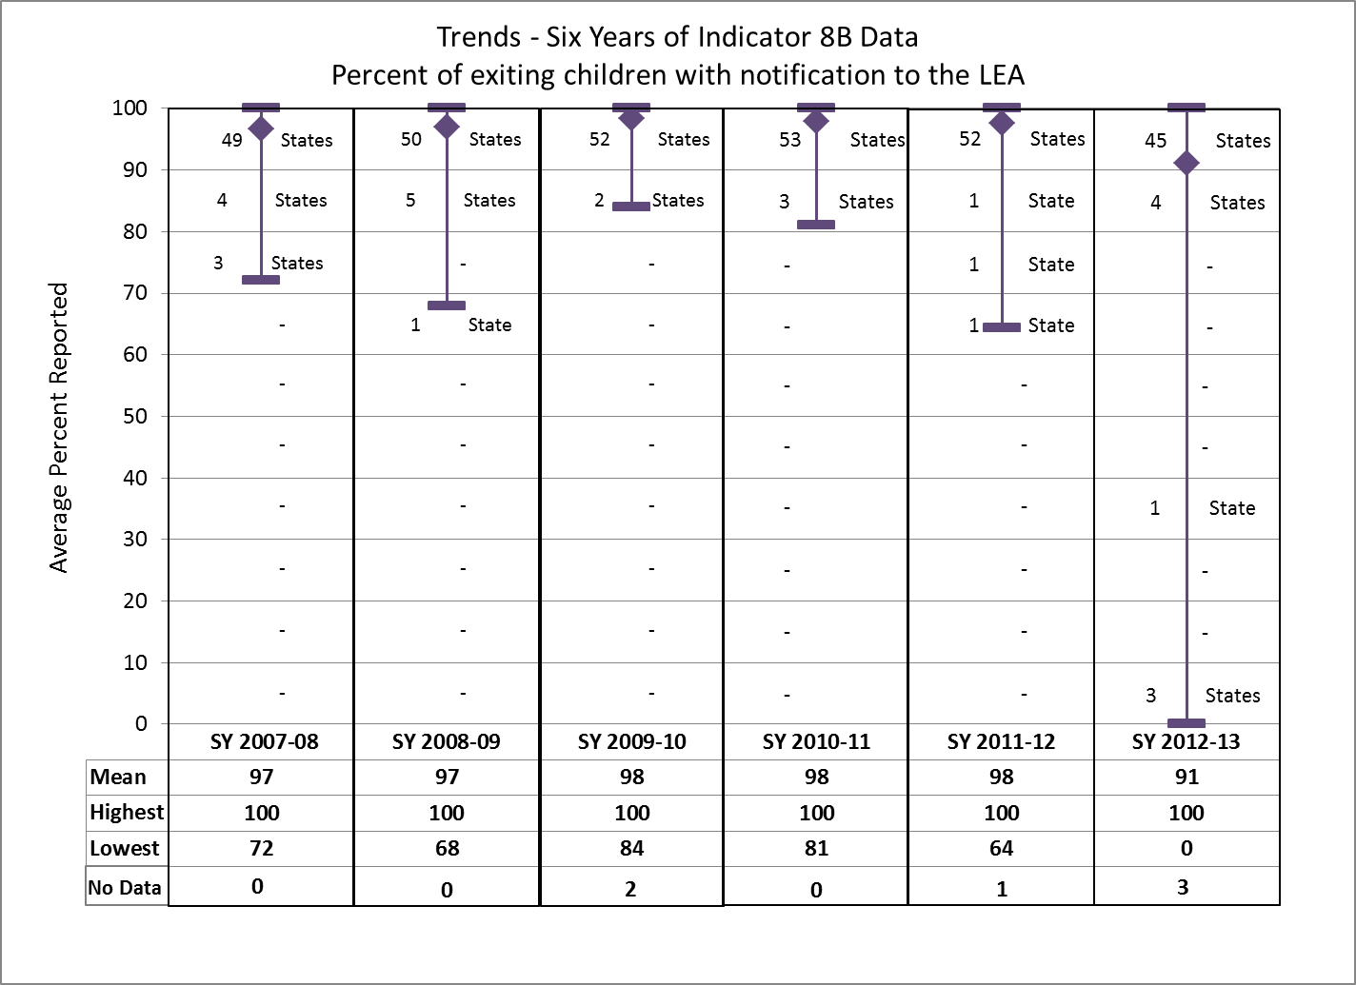

Slide 13
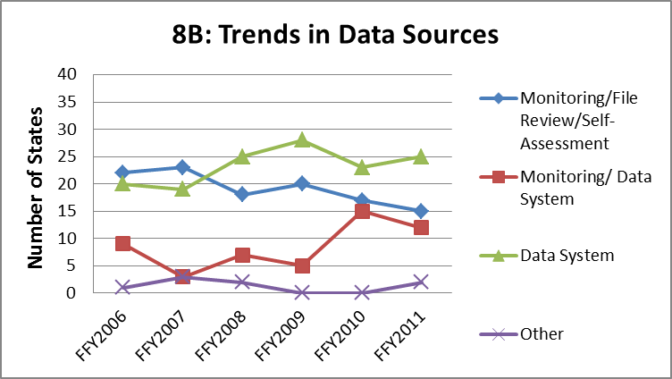
Part C, Indicator C8B, FFY 2011

Slide 14
Notification to LEA (C8B) Number and Percent of States Reporting Census Approach
Yes | 36 (64%)
No | 16 (29%)
Not Given/Unclear | 4 (7%)

Slide 15
Part C Exit Data | 2010 | 2011
Completion of IFSP prior to max age | 16% | 14%
Part B eligible | 40% | 39%
Not eligible Part B - exit to other program | 8% | 7%
Not eligible Part B - exit with no referrals | 4% | 4%
Part B eligibility not determined | 11% | 11%
Withdrawal by parent | 12% | 11%
Note: chart does not contain all exit categories

Slide 16
Using Part C Data
What mechanism does your state use to share data from Part C to Part B?
Does your state provide electronic reminders of key transition dates for individual children?
What definition of ‘potentially eligible’ is your state using?
What processes are in your transition agreements?

Slide 17
Part B, Indicator 12
Early Childhood Transition
Percent of children referred
by Part C prior to age three
and who are found eligible
for Part B, and who have an
IEP developed & implemented
by their third birthday.

Slide 18
Indicator Results, 2012-13
Early Childhood Transition

Slide 19
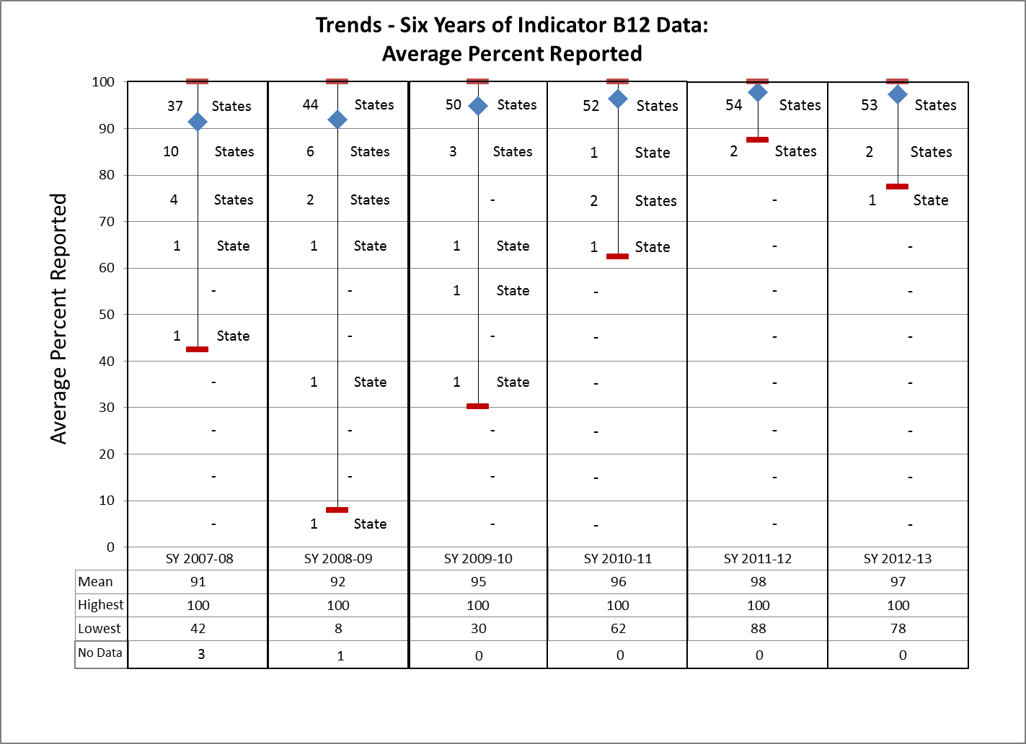

Slide 20
Additional transition information SY 2012-13
 | Average | Low | High
Percent of children not eligible | 13% | 0% | 35%
Percent of parent refusal to provide consent | 8% | 0% | 41%
Percent of late referral to Part C | 3% | 0% | 13%

Slide 21
Part B, Indicator 12 Data Sources Over Time
Data Collection Source | Number of States by Year
 | FFY 2006 | FFY 2007 | FFY 2008 | FFY 2009 | FFY 2010 | FFY 2011
State data system | 33 | 34 | 33 | 44 | 45 | 45
Monitoring, includes system-wide file review | 8 | 2 | 5 | 6 | 6 | 5
Other (LEA spreadsheets) | 7 | 13 | 15 | 2 | 3 | 4
Not reported or unclear | 7 | 4 | 2 | 4 | 2 | 2
Total | 56 | 56 | 55 | 56 | 56 | 56

Slide 22
Child Specific Data Strategies
 | Part C | Part B
 | Web-based Data System, Fully Integrated System C and B Access data for ALL Children by name or ID in one system
 | Part C Web-based Data System, C and B Integrated Components - ALL Children by name or ID, sharing some child specific data into 619 system | Part B Web-based Data System, C and B Integrated Components - some child specific data migrated into SEA system, or between C and SEA
 | Table or Report/Template with Part C information - ALL Children by name or ID shared with SEA | Table or Report/Template with Part C information merged or compared with SEA data
 | Part C information ALL Children by name or ID shared w/ SEA and LEA | Part C information compared or merged at local level
 | Part C information ALL Children by name or ID shared w/ SEA and LEA | No Comparison of Part C data at the child level

Slide 23
Montana Part C to Part B Transition
C8 Indicator:
B12 Indicator:
 | FY 2007 | FY 2008 | FY 2009 | FY 2010 | FY 2011 | FY 2012
C8 % | 100% | 100% | 100% | 100% | 100% | 100%
 | SY 2007-08 | SY 2008-09 | SY 2009-10 | SY 2010-11 | SY 2011-12 | SY 2012-13
B12 %’s | 71.5% | 70.5% | 82.3% | 93.1% | 94.1% | 96.7%

Slide 24
Discussion Topics
Data Sharing Specifics
Supports, such as written agreements
Communication and/or PD strategies
Collaborative data analysis (C and 619)
Use of exit data
Data verification
Follow up, TA, or CAPs
State and local data use

Slide 25
Resources and Technical Assistance

