Slide 2
Indicator B6: Using the Data,
Telling the Story
Vivian James, NC 619 Coordinator
Mary Peters, DaSy, IDC, ECTA
Debbie Cate, IDC, ECTA
Early Childhood Conference:
Improving Data, Improving Outcomes
September 10-11, 2014 New Orleans, LA

Slide 3
Session Objectives
Highlight new IDC materials
B6 Data Reporting Tools
B6 Decision Tree App
Provide an overview of Indicator 6 data
Share state reporting
Early Childhood Conference: Improving Data, Improving Outcomes
September 10-11, 2014 New Orleans, LA

Slide 4
B6 Data Reporting Tools
Excerpts from the Technical Guide –
Children with Disabilities (IDEA)
Early Childhood File Specifications
Source: EDFacts, File CO89
Early Childhood Conference: Improving Data, Improving Outcomes
September 10-11, 2014 New Orleans, LA

Slide 5
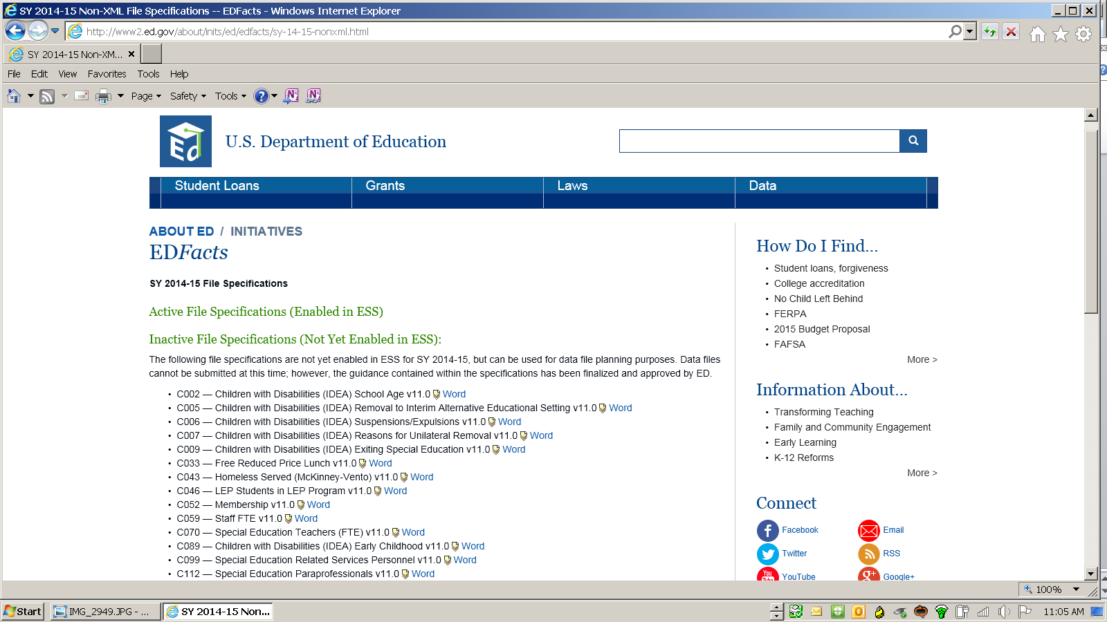
SELECT: CO89
Children with Disabilities
(IDEA) Early Childhood
Early Childhood Conference: Improving Data, Improving Outcomes
September 10-11, 2014 New Orleans, LA

Slide 6
Key Instructions
Child Count – Oct 1 to Dec 1
Unduplicated count children 3-5
Consider time in regular early childhood program
Consider where services are delivered
Guide contains Q and A
Early Childhood Conference: Improving Data, Improving Outcomes
September 10-11, 2014 New Orleans, LA

Slide 7
Definitions
Regular early childhood program RECP
50% or more typically developing children
Head Start, public and private preschool, kindergarten, child care
Separate special education classroom, separate school, residential facility
Less than 50% typically developing
Home
Service provider location
Early Childhood Conference: Improving Data, Improving Outcomes
September 10-11, 2014 New Orleans, LA

Slide 8
B6 Data Reporting Tools
Decision Tree
and Measurement Table
Early Childhood Conference: Improving Data, Improving Outcomes
September 10-11, 2014 New Orleans, LA

Slide 9
Think about these tools….
1. How might they be useful?
2. What support might you need?
Early Childhood Conference: Improving Data, Improving Outcomes
September 10-11, 2014 New Orleans, LA

Slide 10
SPP APR Indicator 6 Measurement:
Percent of children aged 3 - 5 with IEPs attending a regular early childhood program and receiving the majority of special education and related services in the regular early childhood program.
Percent of children aged 3 - 5 with IEPs attending a separate special education class, separate school or residential facility.
Early Childhood Conference: Improving Data, Improving Outcomes
September 10-11, 2014 New Orleans, LA

Slide 11
Indicator Results 2012-2013
Data reported for IDEA 2012 Educational Environments

Slide 12
2012-13: Percent of Children Attending:
Regular EC Program
Special
Education
42%
26%
And receiving the majority of special education in the program
Special education class,
separate school, or residential facility

Slide 13
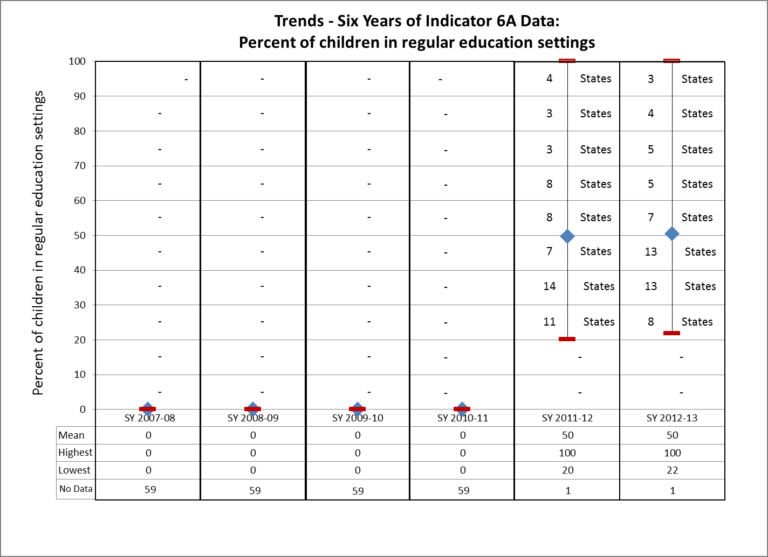
2012-13 SPP/APR Analyses, OSEP

Slide 14
6A: Percent of children with IEPs attending a regular early childhood program (RECP) and receiving the majority of services in the program
Each diamond represents a state or territory, SPP/APR SY 2012-2013

Slide 15
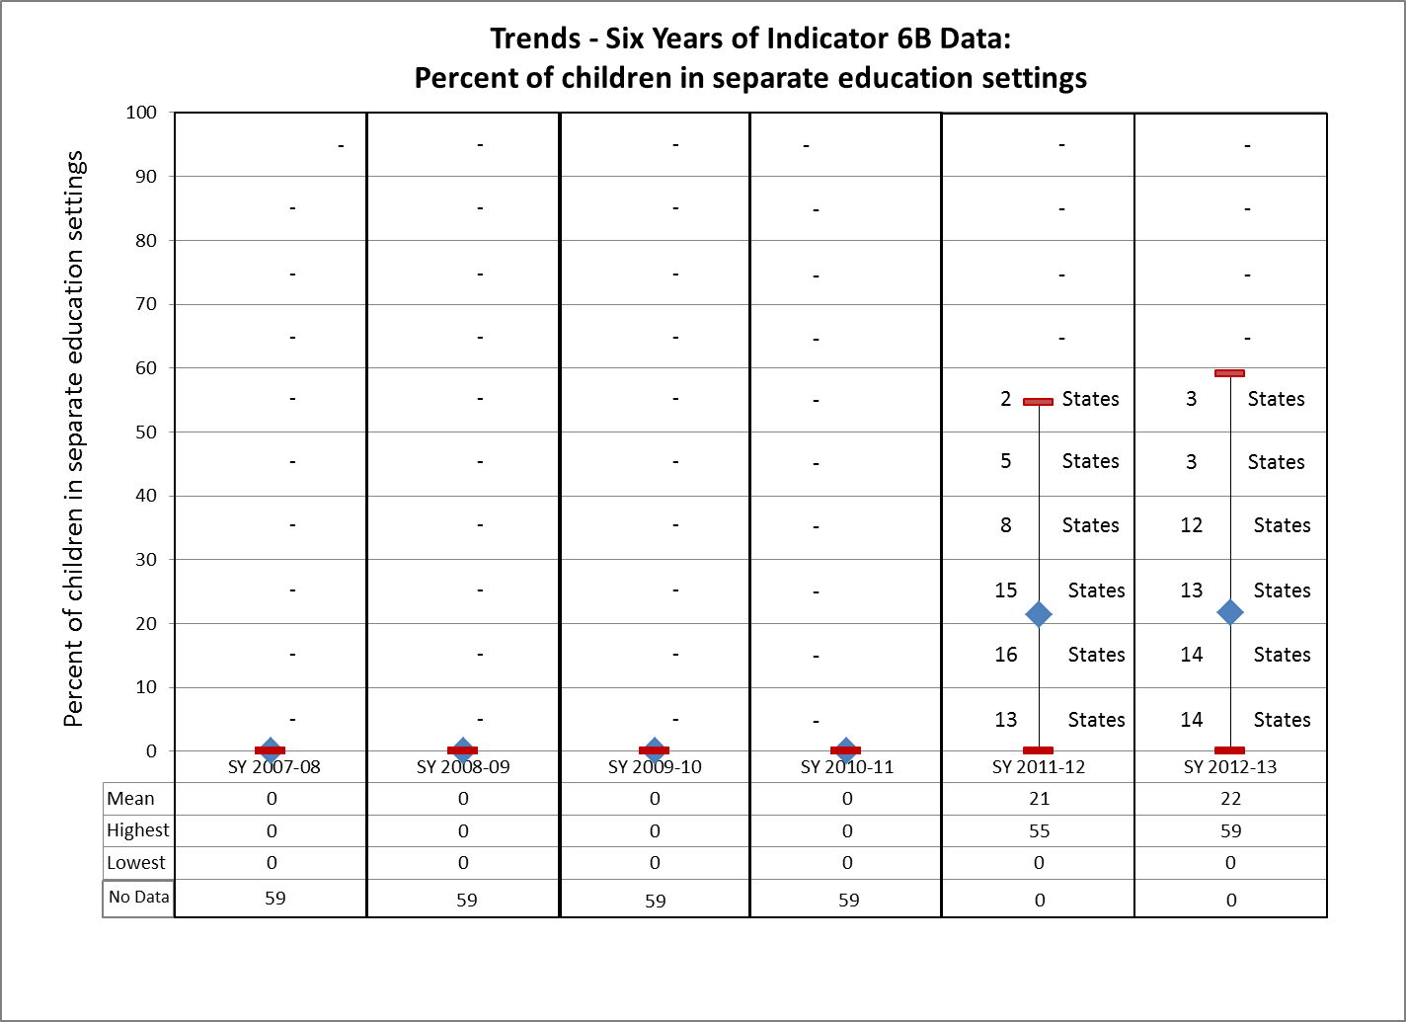
2012-13 SPP/APR Analyses, OSEP

Slide 16
Indicator 6B: Percent of children with IEPs attending a special education program
Each diamond represents a state or territory, SPP/APR SY 2012-2013

Slide 17
Reactions to what you have heard?
Early Childhood Conference: Improving Data, Improving Outcomes
September 10-11, 2014 New Orleans, LA

Slide 18
State Tables and Charts
Early Childhood Conference: Improving Data, Improving Outcomes
September 10-11, 2014 New Orleans, LA

Slide 19
Iowa
Iowa, Part B Indicator 6A
Early Childhood Conference: Improving Data, Improving Outcomes
September 10-11, 2014 New Orleans, LA

Slide 20
Iowa, Local Reporting Part B Indicator 6A
Early Childhood Conference: Improving Data, Improving Outcomes
September 10-11, 2014 New Orleans, LA

Slide 21
Iowa, Part B Indicator 6B
Early Childhood Conference: Improving Data, Improving Outcomes
September 10-11, 2014 New Orleans, LA

Slide 22
Iowa, Local Reporting Part B Indicator 6B
Early Childhood Conference: Improving Data, Improving Outcomes
September 10-11, 2014 New Orleans, LA

Slide 23
Missouri, Indicator 6, with 5 yr. olds in Kindergarten
Early Childhood Conference: Improving Data, Improving Outcomes
September 10-11, 2014 New Orleans, LA

Slide 24
Missouri, Indicator 6, Pre-K Only
Early Childhood Conference: Improving Data, Improving Outcomes
September 10-11, 2014 New Orleans, LA

Slide 25
New York, Local Reporting, Indicator 6A
Early Childhood Conference: Improving Data, Improving Outcomes
September 10-11, 2014 New Orleans, LA

Slide 26
New York, Local Reporting Indicator 6B
Early Childhood Conference: Improving Data, Improving Outcomes
September 10-11, 2014 New Orleans, LA

Slide 27
North Carolina
Early Childhood Conference: Improving Data, Improving Outcomes
September 10-11, 2014 New Orleans, LA

Slide 28
Reporting Indicator 6
Summary Statements | Actual FFY 2011 Total Headcount N= 18,787 (% and # of children) | Actual FFY 2012 Total Headcount N= 18, 665 (% and # of children) | Target FFY 2012
6A. Regular early childhood program and receiving the majority of special education and related services in the regular early childhood program | 51.0 % (N=9,576) | 49.9% (N=9.322) | 51.5%
6B. Separate special education class, separate school or residential facility | 21.0% (N=3,979) | 21.2%(N=3,962) | 20.5%
Early Childhood Conference: Improving Data, Improving Outcomes
September 10-11, 2014 New Orleans, LA

Slide 29
Reporting Indicator 6A
6A. Regular early childhood program and receiving the majority of special education and related services in the regular early childhood program
Performance (%) | Number of LEAs
75% to 90.2% | 15
51.5% to 74.9% | 52
25.1% to 51.4% | 44
16% to 25% | 4
Data for all 115 LEAs indicated the following:
Sixty-seven (67) of the LEAs met or exceeded the state target for the percentage
of children receiving the majority of their special education and related services in the
regular early childhood program. Forty-eight (48) LEAs did not meet the target.
Early Childhood Conference: Improving Data, Improving Outcomes
September 10-11, 2014 New Orleans, LA

Slide 30
Reporting Indicator 6A - Based on LEA Size
Tier I: LEAs with total student population of 48,001 to 120,000 – one (1) out of five (5) met the state target (20%).
Tier II: LEAs with total student population f 15,001 to 48,000 –
six (6) out of twenty (20) met the state target (30%).
Tier III: LEAs with total student populations of 5,000 to 15,000 – twenty-five (25) out of forty-one (41) met the state target (61%).
Tier IV: LEAs with a total student population of 645 to 5,000 – twenty-nine (29) out of forty-nine (49) met the state target (60%).
Early Childhood Conference: Improving Data, Improving Outcomes
September 10-11, 2014 New Orleans, LA

Slide 31
Reporting Indicator 6B
6B . Separate Special Education Class, Separate School, Residential Facility
Performance (%) | # LEAs
0% to 6.9 % | 43
7% to 20.5% | 30
20.6% to 36.9% | 27
37% to 76.0% | 15
Seventy-three (73) of the LEAs met or exceeded the state target for percentage of
children receiving the majority of their special education and related services in
a separate special education class, separate school or residential facility. Forty-two (42)
of the LEAs did not meet the state target.
Early Childhood Conference: Improving Data, Improving Outcomes
September 10-11, 2014 New Orleans, LA

Slide 32
Reporting Indicator 6B - Based on LEA Size
Tier I: LEAs with total student population of 48,001 to 120,000 – two (2) out of five (5) met or exceeded the state target (40%).
Tier II: LEAs with total student population f 15,001 to 48,000 – eleven (11) out of twenty (20) met the state target (55%).
Tier III: LEAs with total student populations of 5,000 to 15,000 – twenty-four (24) out of forty-one (41) met the state target (59%).
Tier IV: LEAs with a total student population of 645 to 5,000 – twenty-eight (28) out of forty-nine (49) met the state target (57%).
Early Childhood Conference: Improving Data, Improving Outcomes
September 10-11, 2014 New Orleans, LA

Slide 33
Reporting Indicator 6 PreK and Kindergarten Cohorts
Summary Statements | Actual FFY 2012 Total Head Count = 18,665 (% and # of children in each category)
6A. Regular early childhood program and receiving the majority of special education and related services in the regular early childhood program
PreK 3, 4, 5 year olds | 37.8% (N= 4,702) Total PreK N = 12,424
5 year olds in Kindergarten | 74% (N=4,620) Total Ktg N=6,241
6B . Separate Special Education Class, Separate School, Residential Facility
PreK 3, 4, 5 year olds | 23% (N= 2,902) Total PreK N = 12,424
5 year olds in Kindergarten | 19% (N=1,159) Total Ktg N=6,241
Early Childhood Conference: Improving Data, Improving Outcomes
September 10-11, 2014 New Orleans, LA

Slide 34
M
T
S
S
in
N
C
Intensive Support
Inclusion Initiative
PreK IEP Training (TOT),
Early Learning & Development
Standard Training (TOT),
NC SEFEL Initiative
Supplemental Support
Preschool Coordinator Orientation, Regional Meetings and/or Webinars, Representatives/Mentors , Annual Institute, National Inclusion Institute, Listserv, Guiding Practice Documents, Questions & Answer Document
Differentiated Core
Early Childhood Conference: Improving Data, Improving Outcomes
September 10-11, 2014 New Orleans, LA

Slide 35
Early Childhood Conference: Improving Data, Improving Outcomes
September 10-11, 2014 New Orleans, LA

Slide 36
Early Childhood Conference: Improving Data, Improving Outcomes
September 10-11, 2014 New Orleans, LA

Slide 37
Early Childhood Conference: Improving Data, Improving Outcomes
September 10-11, 2014 New Orleans, LA

Slide 38
Indicator 6 questions
In general…
What do you notice about the data?
Are there patterns? Trends?
Did your data show improvement from the previous year?
What kinds of questions do you have about these data?
What are the data telling you?
What is the ‘story’ behind the data?
Early Childhood Conference: Improving Data, Improving Outcomes
September 10-11, 2014 New Orleans, LA

Slide 39
Indicator 6 questions
Specifically…
Did the State meet targets for Indicator 6?
Did your LEA meet targets for Indicator 6?
What is the difference in LRE for PreK and Kindergarten?
If your LEA did not meet the state targets, what should be the plan for improvement?
If you are performing above the state target, have you set improvement targets for your LEA?
Early Childhood Conference: Improving Data, Improving Outcomes
September 10-11, 2014 New Orleans, LA

Slide 40
Results-Driven Accountability
When selecting LEAs for intensive support, we considered:
LRE data
Impact the size of the district had on the state data and the number of children it serves
The LEA’s buy-in
Early Childhood Conference: Improving Data, Improving Outcomes
September 10-11, 2014 New Orleans, LA

Slide 41
Inclusion Initiative - Intensive Support
SEA and LEA
Agreement
(Assurances)
Early Childhood Conference: Improving Data, Improving Outcomes
September 10-11, 2014 New Orleans, LA

Slide 42
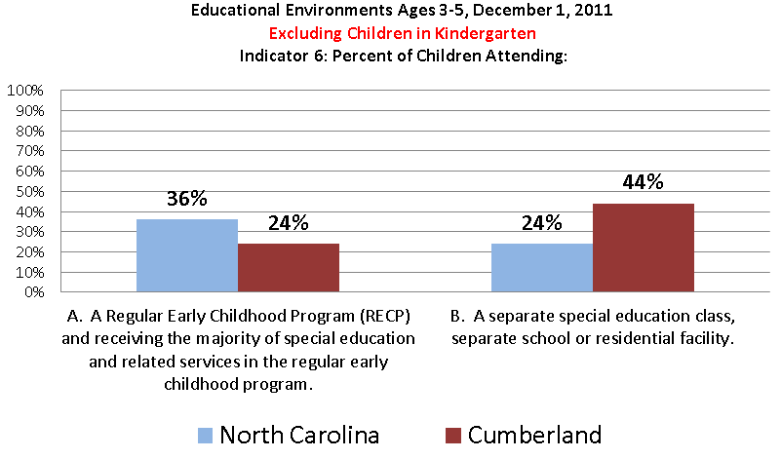
Early Childhood Conference: Improving Data, Improving Outcomes
September 10-11, 2014 New Orleans, LA

Slide 43
Early Childhood Conference: Improving Data, Improving Outcomes
September 10-11, 2014 New Orleans, LA

Slide 44
Early Childhood Conference: Improving Data, Improving Outcomes
September 10-11, 2014 New Orleans, LA

Slide 45
D
R
A
F
T
Early Childhood Conference: Improving Data, Improving Outcomes
September 10-11, 2014 New Orleans, LA

Slide 46
Comments
or
Questions?
Early Childhood Conference: Improving Data, Improving Outcomes
September 10-11, 2014 New Orleans, LA

Slide 47
Data Chat
Share in small group your reactions to what you have heard in this session?
How have you successfully shared Indicator 6 data?
How might your state use these tools and information?
Early Childhood Conference: Improving Data, Improving Outcomes
September 10-11, 2014 New Orleans, LA

Slide 48
What unanswered questions do you have?
What additional supports might be helpful?
Early Childhood Conference: Improving Data, Improving Outcomes
September 10-11, 2014 New Orleans, LA

Slide 49
Thank you for your participation
Vivian James
NC 619 Coordinator
Mary Peters
ECTA, DaSy, IDC
Debbie Cate
ECTA, IDC
Early Childhood Conference: Improving Data, Improving Outcomes
September 10-11, 2014 New Orleans, LA

Slide 50
The contents of this presentation were developed under grants from the U.S. Department of Education. However, the contents do not necessarily represent the policy of the Department of Education, and you should not assume endorsement by the Federal Government.

