Slide 1
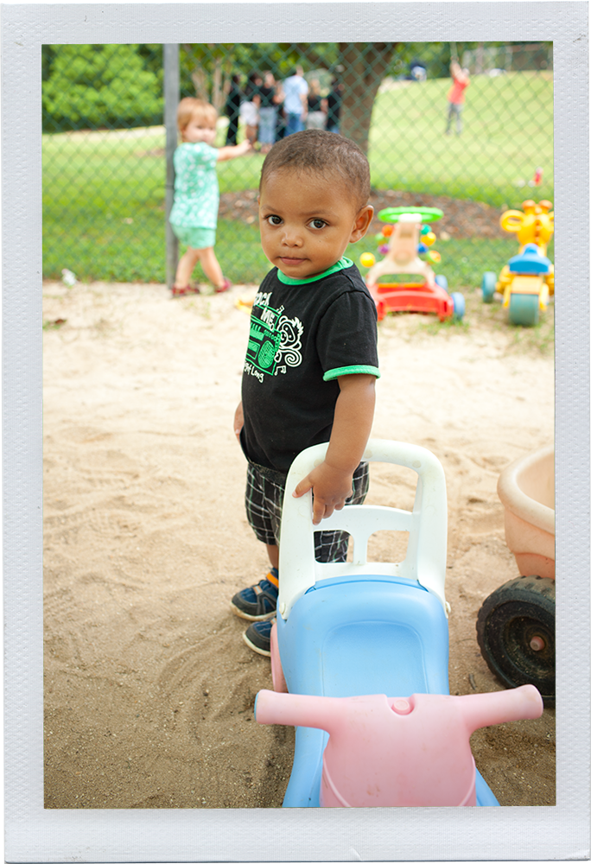
Welcome & Updates
from
The Early Childhood Technical Assistance Center
Christina Kasprzak
ECTA, DaSy
October 2014

Slide 2
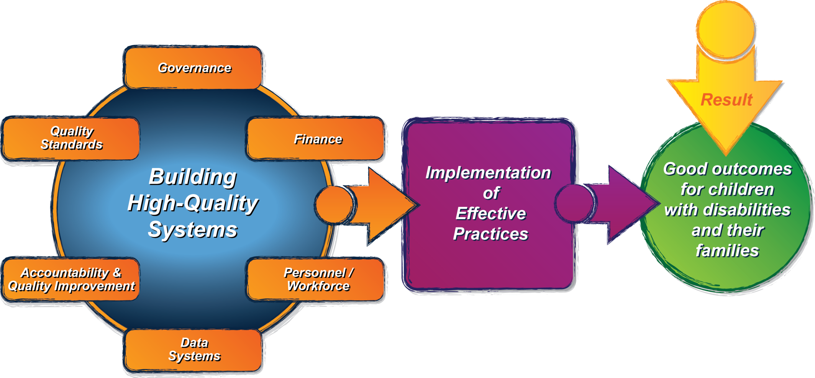
Update: ECTA Center Activities
Notes:
What does a state need to put into place in order to encourage, support, require local implementation of effective practices?
Governance
Quality Standards
Finance
Accountability & Quality Improvement
Personnel/Workforce
Data Systems
(leading to)
Implementation of effective practices
(leading to)
Result: Good Outcomes for children with disabilities and their families

Slide 3
TA Activities

Slide 4
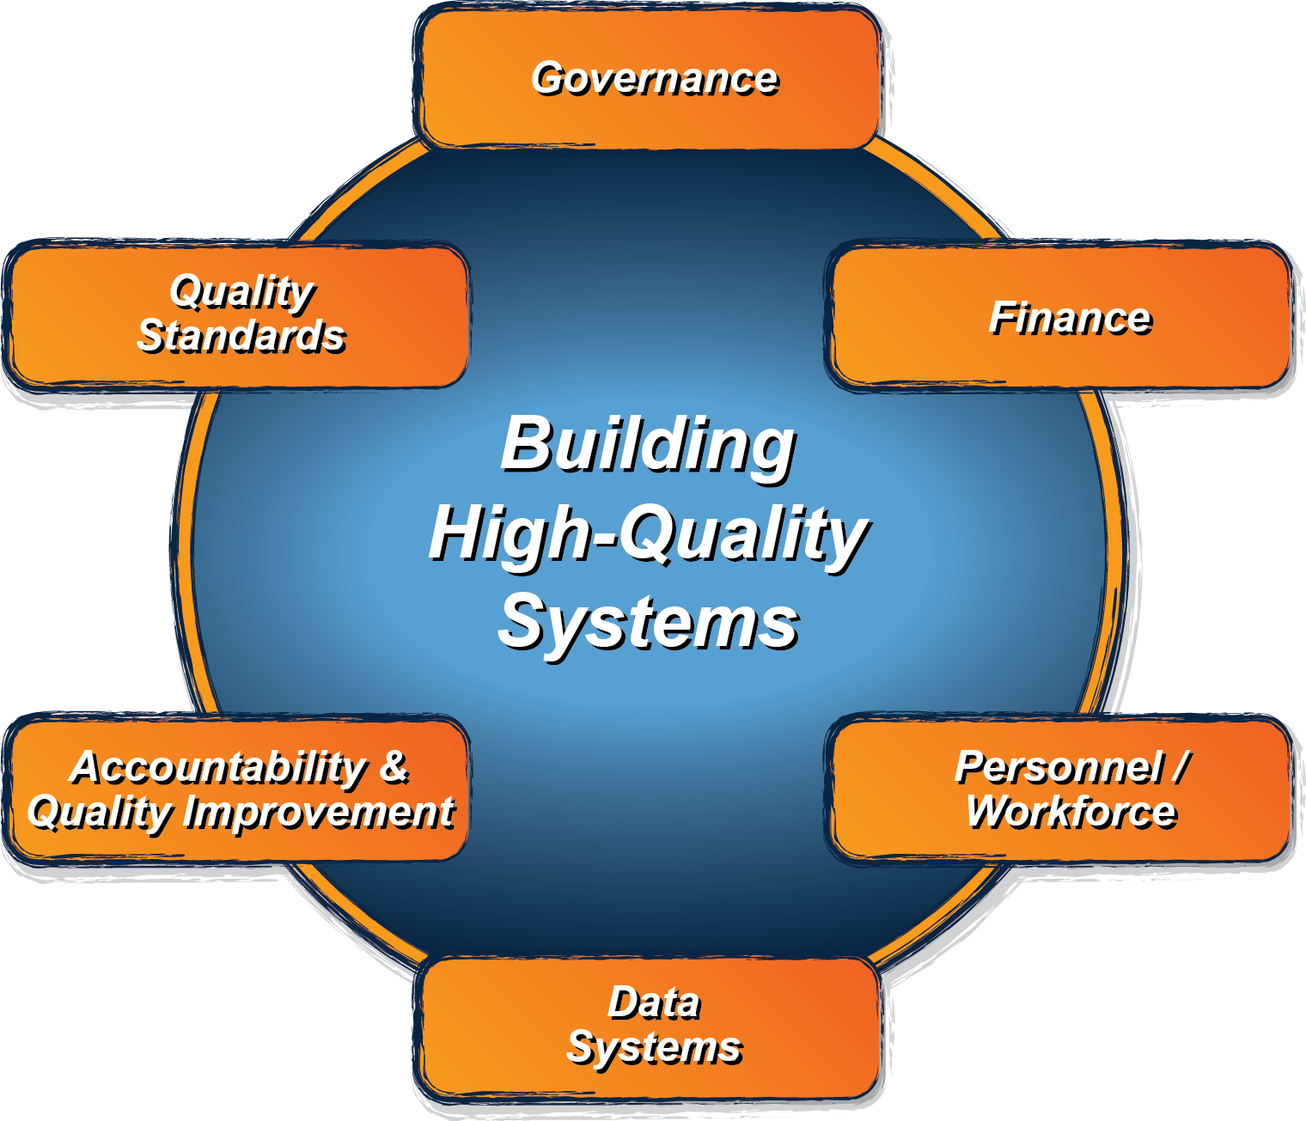
System Framework
What does a state need to put into place in order to encourage, support, require local implementation of effective practices?
http://ectacenter.org/sysframe

Slide 5
System Framework: Purpose and Audience
Purpose: to guide states in evaluating their current Part C/619 system, identifying areas for improvement, and providing direction on how to develop a more effective, efficient Part C and Section 619 system that requires, supports, and encourages implementation of effective practices.
Audience: the key audience is state Part C and state Section 619 coordinators and staff, with acknowledgement that other key staff and leadership in a state will need to be involved.

Slide 6
System Framework: Process and Partners
Iterative validation process: the framework is being developed through an iterative process among national and state experts in the field.
Partner states: the framework is being developed iteratively with 6 states (DE, ID, MN, NJ, PA, WV), so that it reflects (and is applicable to) the diversity of state systems (e.g. Lead Agency, eligibility criteria).
Technical Work Group (TWG): the Center has a technical work group (TWG) with experts in the field to advise the Center by providing early input on the elements, and later review and give input on drafts, as well as contribute resources available to support states on various elements.
Notes:
Generally speaking, we will be engaging in an iterative validation process that will include state partners as well as this technical work group. This means that we will work collaboratively with the state folks and with this group to draft ideas, review and edit those ideas (over and over so that each iteration is an improvement on the last), and then (when ready) we will share more refined ideas in a broader sense to more folks in the field for additional refinement.
We recently identified our 6 partner states – DE, ID, MN, NJ, PA & WV. They applied to be a partner states, so these are the final six selected and they represent some diversity across demographics (like size of state, and region of the country) as well as diversity in some state systems aspects (such as Lead Agency for Part C and eligibility criteria).
Our Technical Work Group – you all – are a second key group that we’ll be working with throughout the iterative process. You were selected because of your expertise in knowing the Part C and Section 619 programs and/or your general expertise around quality systems and systems building. So we have some diversity within this group –some folks having more research experience, some more TA and consulting; we have diversity with some folks who know Part C and/or Section 619 particularly well, others who understand the general early childhood and systems building.

Slide 7
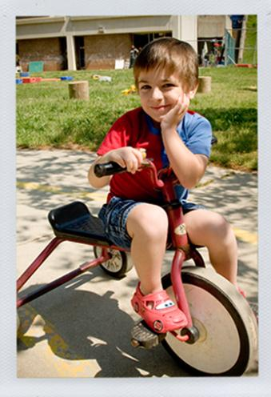
Cross cutting themes
Engaging stakeholders, including families
Establishing/revising policies
Promoting collaboration
Using data for improvement
Communicating effectively
Family Leadership & Support
Coordinating/Integrating across early childhood

Slide 8
Framework Next Steps
All components drafted and posted online by September 2014
Glossary and self-assessment are under development
Corresponding resources will be added over the next year and ongoing
Framework content is part of ongoing ECTA TA services and we will be available to support states with self-assessment and improvement planning

Slide 9
Sessions
Tools States Can Use for Building Effective Early Intervention and Preschool Special Education Systems
Building High Quality Personnel Systems
Determining the Quality of Your Finance System: Using the ECTA System Framework to Inform Current Status and Areas for Improvement
Using Child and Program Standards to Improve Child Outcomes
Building Better Systems, Implementing Recommended Practices (workshop)

Slide 10
Thank you and enjoy the conference!
Online at http://ectacenter.org

